Slide 1
Network Applications: Email; DNS;
Qiao Xiang
https://qiaoxiang.me/courses/cnns-xmuf22/index.shtml
09/26/2022
This deck of slides are heavily based on CPSC 433/533 at Yale University, by courtesy of Dr. Y. Richard Yang.

Slide 2
Outline
Admin. and recap
Email
How to handle spam
DNS
High-level design
Details
Extensions/alternatives

Slide 3
Admin
Assignment One due on Sep. 29
List of suggested projects to be posted on Sep. 29

Slide 4
Recap: Client-Server Paradigm
application
transport
network
data link
physical
The basic paradigm of network applications is the client-server (C-S) paradigm
Some key design questions to ask about a C-S application:
extensibility
scalability
robustness
security
request
reply
application
transport
network
data link
physical

Slide 5
Recap: Email App
Some key design features of Email
Separate protocols for different functions
email access (e.g., POP3, IMAP)
email transport (SMTP)
Separation of envelop and message body (end-to-end arguments)
envelop: simple/basic requests to implement transport control;
message body: fine-grain control through ASCII header and message body
MIME type as self-describing data type
Status code in response makes message easy to parse
user
agent
mail
server
user
agent
SMTP
mail
server
user
agent
SMTP
SMTP
mail
server
user
agent
POP3 or
IMAP SMTP
user
agent
user
agent

Slide 6
Evaluation of SMTP/POP/IMAP
user
agent
mail
server
user
agent
Key questions to ask about a C-S application
- extensible?
- scalable?
- robust?
- security?
SMTP
mail
server
user
agent
SMTP
SMTP
mail
server
user
agent
POP3 or
IMAP SMTP
user
agent
user
agent

Slide 7
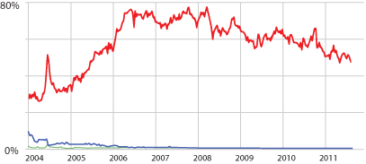
Email Security: Spam
Spam (Google)
Notes:
https://support.google.com/mail/answer/1366858?hl=en
http://www.securelist.com/en/analysis/204792282/Spam_in_January_2013
https://www.trustwave.com/support/labs/spam_statistics.asp
http://en.wikipedia.org/wiki/Bayesian_spam_filtering
http://www.pcworld.com/article/252206/google_explains_gmails_spam_filtering_process.html

Slide 8
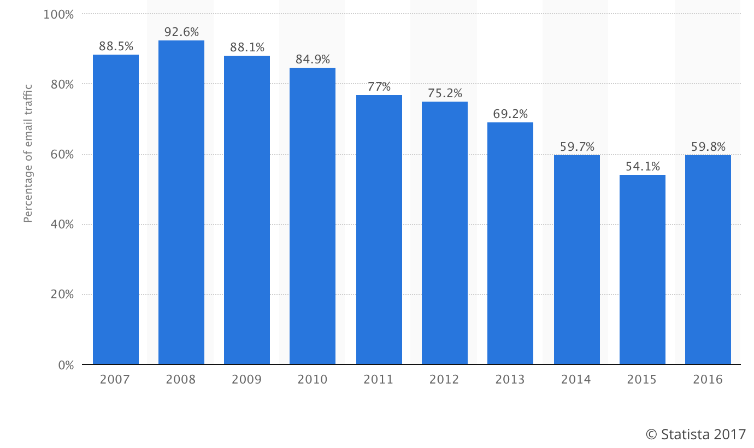
Email Security Issue: Spam
Source: https://www.statista.com/statistics/420400/spam-email-traffic-share-annual/

Slide 9
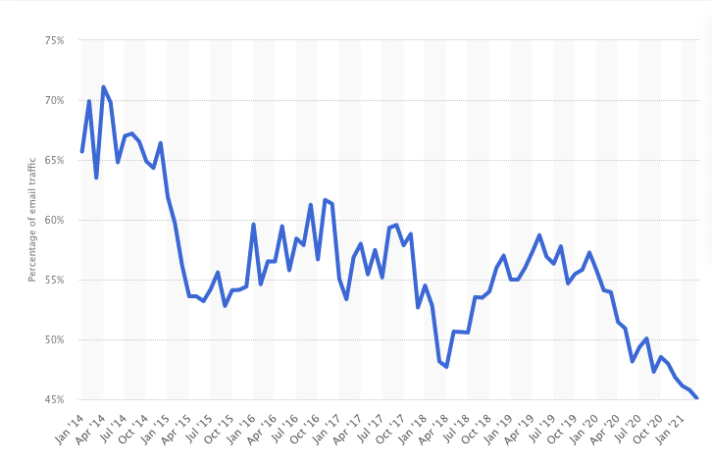
Email Security Issue: Spam
Source: https://www.statista.com/statistics/420391/spam-email-traffic-share/

Slide 10
Discussion: How May One Handle Email Spams?
Notes:
https://support.google.com/mail/answer/1366858?hl=en
http://support.simpledns.com/KB/a62/configuring-dns-records-for-domainkeys-dkim.aspx
http://www.slideshare.net/kka7/what-you-need-to-know-about-email-authentication

Slide 11
Detection Methods Used by GMail
Known phishing scams
Message from unconfirmed sender identity
Message you sent to Spam/similarity to suspicious messages
Administrator-set policies
https://support.google.com/mail/answer/1366858?hl=en
Notes:
https://support.google.com/mail/answer/1366858?hl=en
http://support.simpledns.com/KB/a62/configuring-dns-records-for-domainkeys-dkim.aspx

Slide 12
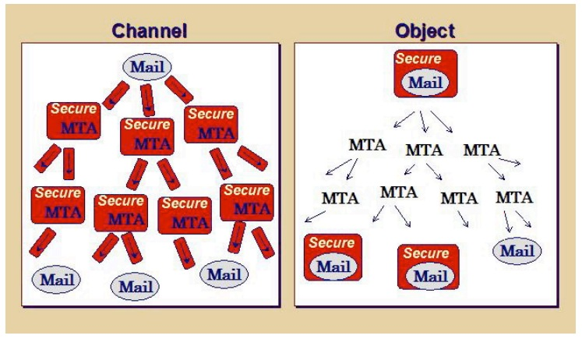
Email Authentication Approaches
Sender Policy Frame (SPF)
DomainKeys Identified Mail (DKIM) Authenticated Results Chain (ARC)
Notes:
https://support.google.com/mail/answer/1366858?hl=en
http://support.simpledns.com/KB/a62/configuring-dns-records-for-domainkeys-dkim.aspx
https://dmarc.org/presentations/ARC-Overview-2016Q3-v01.pdf

Slide 13
Sender Policy Framework (SPF RFC7208)
https://tools.ietf.org/html/rfc7208
MUA
smtp/submission
Is my neighbor m a permitted sender for the domain?
MTA
smtp
Border Outbound MTA m
smtp
Border Inbound MTA
neighbor MTA
pop/imap
validating MTA
MUA
Notes:
https://support.google.com/mail/answer/1366858?hl=en
http://support.simpledns.com/KB/a62/configuring-dns-records-for-domainkeys-dkim.aspx

Slide 14
Key Question for SPF?
How does SPF know if its neighbor MTA is a permitted sender of the domain?
Notes:
http://support.simpledns.com/KB/a62/configuring-dns-records-for-domainkeys-dkim.aspx
<selector>._domainkey.example.com
dig txt <selector>._domainkey.<domain> +short

Slide 15
DomainKeys Identified Mail (DKIM; RFC 5585)
A domain-level digital signature authentication framework for email, using public key crypto
E.g., mail.sina.com signs that the message is sent by mail.sina server
Basic idea of public key signature
Owner has both public and private keys
Owner uses private key to sign a message to generate a signature
Others with public key can verify signature
Assumption: difficult to get private key even w/ public key distributed
Notes:
mailing lists or account forwarding
https://blog.returnpath.com/how-to-explain-authenticated-received-chain-arc-in-plain-english-2/
https://support.google.com/mail/answer/1366858?hl=en
http://support.simpledns.com/KB/a62/configuring-dns-records-for-domainkeys-dkim.aspx

Slide 16
DomainKeys Identified Mail (DKIM)
MUA
smtp/submission
Is the message signed by the private key of the signing domain?
Signing MTA
smtp
MTA
smtp
VerifyingMTA
pop/imap
MUA
Notes:
https://support.google.com/mail/answer/1366858?hl=en
http://support.simpledns.com/KB/a62/configuring-dns-records-for-domainkeys-dkim.aspx

Slide 17
Example: RSA
1. Choose two large prime numbers p, q.
(e.g., 1024 bits each)
2. Compute n = pq, z = (p-1)(q-1)
3. Choose e (with e < n) that has no common factors
with z. (e, z are “relatively prime”).
4. Choose d such that ed-1 is exactly divisible by z.
(in other words: ed mod z = 1 ).
5. Public key is (n,e). Private key is (n,d).

Slide 18
RSA: Signing/Verification
0. Given (n,e) and (n,d) as computed above
1. To sign message, m, compute h = hash(m), then sign with private key
d
d
s = h mod n
(i.e., remainder when h is divided by n)
2. To verify signature s, compute
e
e
h’ = s mod n
(i.e., remainder when s is divided by n)
Magic
happens!
d
e
h = (h mod n)
mod n
The magic is a simple application of Euler’s generalization of
Fermat’s little theorem

Slide 19
Key Question about DKIM?
How does DKIM retrieve the public key of the author domain?
Notes:
http://support.simpledns.com/KB/a62/configuring-dns-records-for-domainkeys-dkim.aspx
<selector>._domainkey.example.com
dig txt <selector>._domainkey.<domain> +short

Slide 20
Summary: Some Key Remaining Issues about Email
Basic: How to find the email server of a domain?
Scalability/robustness: how to find multiple servers for the email domain?
Security
SPF: How does SPF know if its neighbor MTA is a permitted sender of the domain?
DKIM: How does DKIM retrieve the public key of the author domain?

Slide 21
Scalability/Robustness
Both scalability and robustness require that multiple email servers serve the same email address
need an email server’s IP address
client
mapping
sina.com
sina.com
sina.com
mail
server
mail
server
mail
server
130.132.50.7
130.132.50.8
130.132.50.9

Slide 22
Mapping Functions Design Alternatives
name (e.g., sina.com)
name (e.g., sina.com)
mapping
mapping
1 IP
multiple IPs
mapping
multiple IPs

Slide 23

Mapping Functions Design Alternatives
name (e.g., sina.com)
name (e.g., sina.com)
mapping
mapping
1 IP
load balancer (routing)
1 IP
1 IP
switch

Slide 24
Outline
Admin. and recap
Layered network architecture
Application layer overview
Network applications
Email
DNS

Slide 25
DNS: Domain Name System
Function
map between (domain name, service) to value, e.g.,
(xmu.edu.cn, addr) -> 210.34.0.35
(xmu.edu.cn, email) -> cmsn1.xmu.edu.cn
clients
DNS
Hostname, Service
Address
routers
servers
Notes:
Why name: easy to remember, one-level of indirection

Slide 26
DNS Records
http://www.iana.org/assignments/dns-parameters/dns-parameters.xhtml
DNS: stores resource records (RR)
RR format: (name, type, value, ttl)
Type=A
name is hostname
value is IP address
Type=CNAME
name is an alias of a “canonical” (real) name
value is canonical name
Type=NS
name is domain (e.g. xmu.edu.cn)
value is the name of the authoritative name server for this domain
Type=MX
value is hostname of mail server associated with name
Type=SRV
general extension for services
Type=TXT
general txt
Type=PTR
a pointer to another name

Slide 27
Discussion
Can DNS handle multiple values for the same (name, service)?

Slide 28
Try DNS: Examples
dig <name> <type>
Try xmu.edu.cn / others and various types
dig <domain> txt to retrieve spf
http://www.zytrax.com/books/dns/ch9/spf.html
Notes:
xmu.edu.cn
taobao.edu.cn
harvard.edu
xmu.edu.cn txt
hotmail.com txt

Slide 29
Observations
MX can return multiple servers
DNS may rotate the servers in answer
Address can also return multiple addresses
SPF is encoded as the txt type

Slide 30
Outline
Admin. and recap
DNS
High-level design
Details

Slide 31
DKIM Example
Send email from hotmail and check message
S: +OK sina pop3 server ready
C: user xmucnns
S: +OK welcome to sina mail
C: pass 334f5605df1504f9
S: +OK 4 messages (32377 octets)
Notes:
https://support.google.com/mail/answer/1366858?hl=en
http://support.simpledns.com/KB/a62/configuring-dns-records-for-domainkeys-dkim.aspx
Try TXT record for gmail.com dig txt gmail.com

Slide 32
DKIM Example
DKIM / ARC: Msg: ARC-Message-Signature: i=1; a=rsa-sha256; c=relaxed/relaxed; d=microsoft.com; s=arcselector9901; h=From:Date:Subject:Message-ID:Content-Type:MIME-Version; bh=bO91TxHI+4MjgAusrfg0EWGiDmvQ5hZRZ/aqb1MKLY8=; …
DKIM-Signature: v=1; a=rsa-sha256; c=relaxed/relaxed;
d=hotmail.com; s=selector1; h=From:Date:Subject:Message-
ID:Content-Type:MIME-Version:X-MS-Exchange-
SenderADCheck;…
Query: dig arcselector9901._domainkey.microsoft.com txt
DKIM introduces a session key to allow multiple public keys
<session>._domainkey.<domain>

Slide 33

DNS Design: Dummy Design
DNS itself can be considered as a client-server system as well
How about a dummy design: introducing one super Internet DNS server?
THE DNS server of the Internet
IP address
resolve <name>
register <name>
OK/used already

Slide 34
Problems of a Single DNS Server
Scalability and robustness bottleneck
Administrative bottleneck

Slide 35
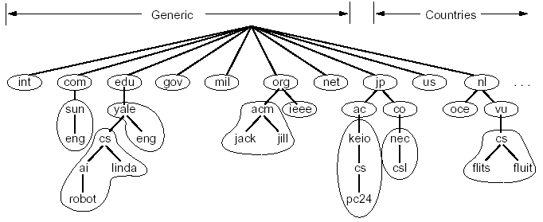
DNS: Distributed Management of the Domain Name Space
A distributed database managed by authoritative name servers
divided into zones, where each zone is a sub-tree of the global tree
each zone has its own authoritative name servers
an authoritative name server of a zone may delegate a subset (i.e. a sub-tree) of its zone to another name server
cn
pku
xmu
mail
cwc
called a zone

Slide 36
Email Architecture + DNS
user
agent
mail
server
user
agent
SMTP
mail
server
user
agent
SMTP
SMTP
mail
server
user
agent
POP3 or
IMAP SMTP
DNS
user
agent
user
agent

Slide 37
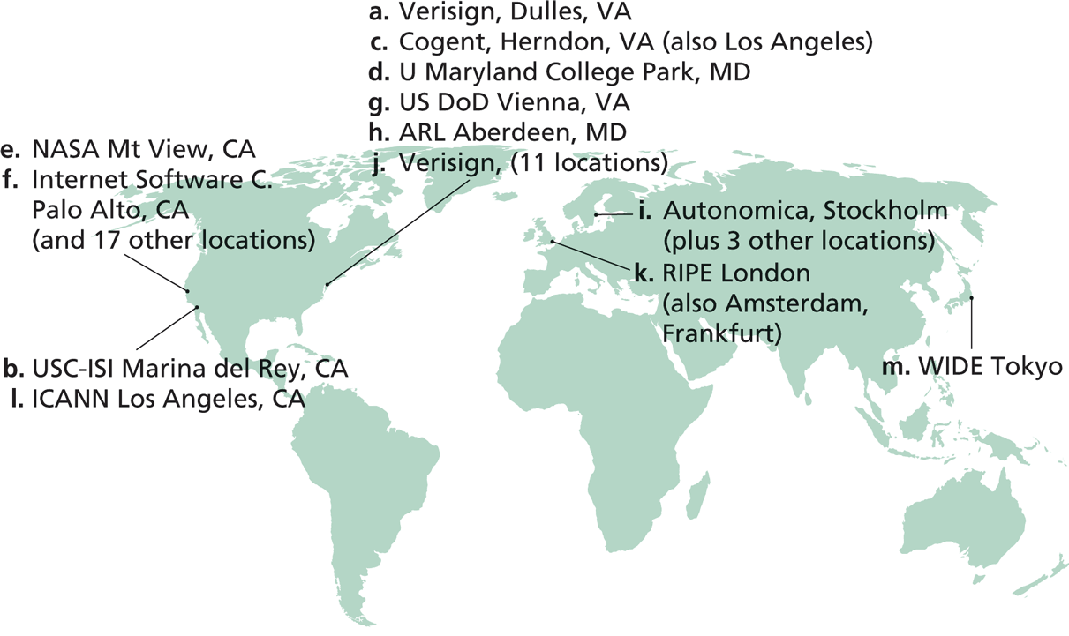
Root Zone and Root Servers
The root zone is managed by the root name servers
13 root name servers worldwide
See http://root-servers.org/ for more details

Slide 38
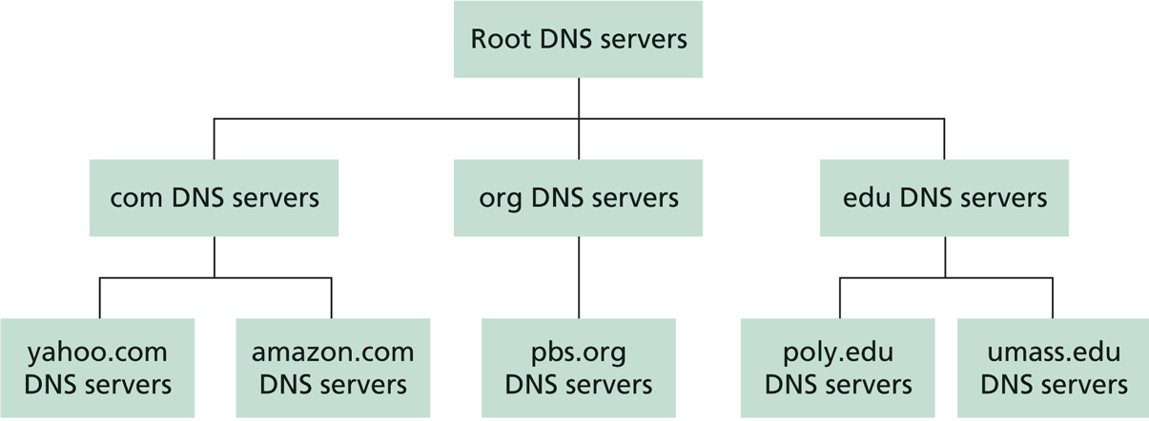
Linking the Name Servers
Each name server knows the addresses of the root servers
Each name server knows the addresses of its immediate children (i.e., those it delegates)
Top level domain (TLD)
Q: how to query a hierarchy?

Slide 39
DNS Message Flow: Two Types of Queries
Recursive query:
The contacted name server resolves the name completely
Iterated query:
Contacted server replies with name of server to contact
“I don’t know this name, but ask this server”

Slide 40

Two Extreme DNS Message Flows
root name server
root name server
Iterative query
Recursive query
1
1
2
2
6
client
TLD name server
client
5
TLD name server
3
4
5
4
3
6
A: ALL the load has to go through the root server!
Q: Issues of the two approaches?
authoritative name server
authoritative name server
informatics.xmu.edu.cn
informatics.xmu.edu.cn

Slide 41
Typical DNS Message Flow: The Hybrid Case
root name server
Host knows only local name server
Local name server is learned from DHCP, or configured, e.g. /etc/resolv.conf
Local DNS server helps clients resolve DNS names
2
iterated query
3
4
7
local name server
130.132.1.9
TLD name server
6
5
1
8
authoritative name server
dns.cs.umass.edu
requesting host
cyndra.cs.yale.edu
gaia.cs.umass.edu

Slide 42
Typical DNS Message Flow: The Hybrid Case
root name server
Host knows only local name server
Local name server is learned from DHCP, or configured, e.g. /etc/resolv.conf
Local DNS server helps clients resolve DNS names
Benefits of local name servers (often called resolvers)
simplifies client
caches/reuses results
2
iterated query
3
4
7
local name server
TLD name server
6
5
1
8
authoritative name server
dns.cs.umass.edu
requesting host
harvard.edu
gaia.cs.umass.edu

Slide 43
Outline
Admin. and recap
DNS
High-level design
Details

Slide 44
DNS Message Format?
Basic encoding decisions: UDP/TCP, how to encode domain name, how to encode answers…
DNS
DNS
TCP
UDP
TCP
UDP
IP
IP
Ethernet
Wireless
Cable/DSL
Ethernet
Wireless
Cable/DSL
44
Notes:
Basic questions: how to encode domain name; how to do compression…

Slide 45
Observing DNS Messages
Capture the messages
DNS server is at port 53
Display and clear DNS cache
MacOS: https://support.apple.com/en-us/HT202516 sudo killall -HUP mDNSResponder
Ubuntu:
sudo systemd-resolve --flush-caches
sudo systemd-resolve --statistics
Try to load the dns-capture file from class Schedule page, if you do not want live capture

Slide 46
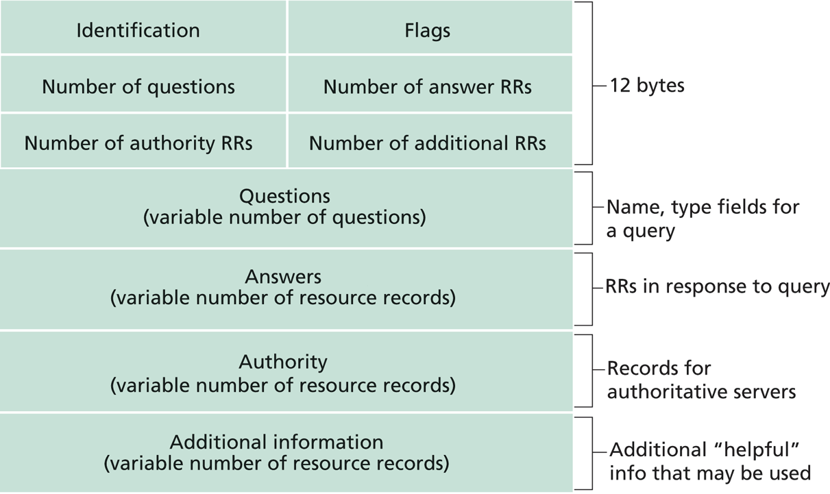
DNS Protocol, Messages
https://www.ietf.org/rfc/rfc1035.txt
DNS protocol : typically over UDP (can use TCP); query and reply messages, both with the same message format

Slide 47
DNS Details
Header (Sec. 4.1.1 of https://www.ietf.org/rfc/rfc1035.txt)
Encoding of questions (Sec. 4.1.2):
[Label-length label-chars]
Encoding of answers (Sec. 4.1.3)
Pointer format (http://www.iana.org/assignments/dns-parameters/dns-parameters.xhtml)
See example DNS packets

Slide 48
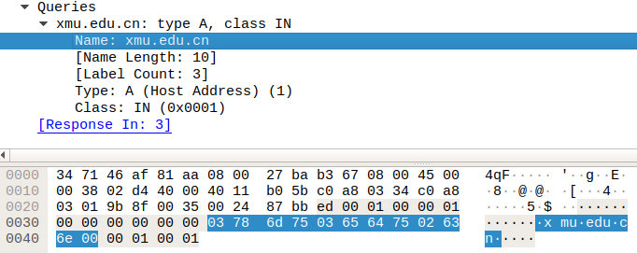
Name Encoding
cn
xmu
edu
length

Slide 49
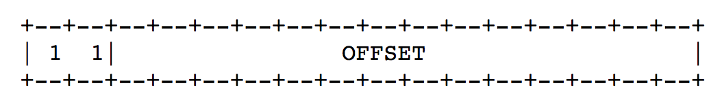
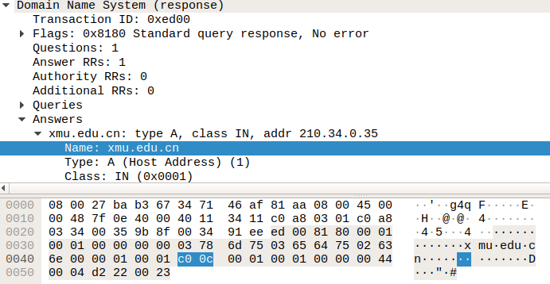
Message Compression (Label Pointer)
question
DNS start
Answer: offset 12

Slide 50
Recap: DNS Protocol, Messages
https://www.ietf.org/rfc/rfc1035.txt
Many features: typically over UDP (can use TCP); query and reply messages with the same message format; length/content encoding of names; simple compression; additional info as server push

Slide 51
What DNS did Right?
Hierarchical delegation avoids central control, improving manageability and scalability
Redundant servers improve robustness
see http://www.internetnews.com/dev-news/article.php/1486981 for DDoS attack on root servers in Oct. 2002 (9 of the 13 root servers were crippled, but only slowed the network)
Caching reduces workload and improves robustness
Proactive answers reduce # queries on server and latency on client

Slide 52
Problems of DNS
Simple query model, relatively static resource values and types make it harder to implement generic service discovery
e.g., service discovery of all printers
Although theoretically you can update the values of the records, it is rarely enabled
Early binding (separation of DNS query from application query) does not work well in mobile, dynamic environments
e.g., load balancing, locate the nearest printer
Each local domain needs servers, but an ad hoc domain may not have a DNS server

Slide 53
Outline
Admin. and recap
DNS
High-level design
Details
Extensions/alternatives

Slide 54
Discussions
What extension(s) to standard DNS operations do we need to allow service discovery, say to implement Bonjour (discover all local printers)?
each printer needs to provide the following info: host, port, printer info (e.g., support postscript)

Slide 55


DNS-Service Discovery
Leverage DNS message format, but each node can announce its own services
169.254.1.219
Printer
Network
169.254.10.29
169.254.4.51

Slide 56
Realizing DNS-SD without Central DNS Server: mDNS
Multicast in a small world
no central address server
each node is a responder
link-local addressing
send to multicast address: 224.0.0.251
169.254.1.219
Printer
Network
169.254.10.29
169.254.4.51

Slide 57
Example
Use the avahi-publish-service command on Ubuntu as example
Advertise (register) an LPR printer on port 515 avahi-publish-service test _printer._tcp . 515 pdl=application/postscript
port
Name of instance providing the service
<type_service>. <transport>
Txt for additional data
57

Slide 58
Example
Use the dns-sd command on Mac as example
Advertise (register) an LPR printer on port 515 dns-sd -R "test" _printer._tcp . 515 pdl=application/postscript
port
Name of instance providing the service
domain (. means default, which is local
<type_service>. <transport>
Txt for additional data
58

Slide 59
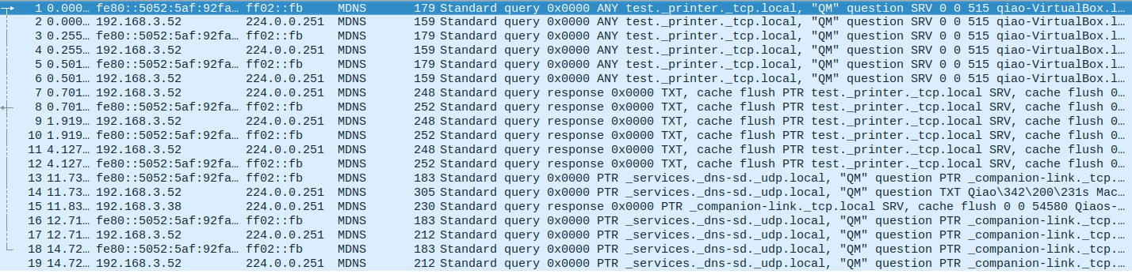

Slide 60
Offline Exercise
Use the dns-sd /avahi-publish-service command as example
Advertise (register) a web page on local machine dns-sd -R "My Test" _http._tcp . 80 path=/path-to-page.html
60

Slide 61
Issue: How to Query
Query needs a back pointer, PTR records
Exercise: Use the dns-sd / avahi-service-publish command as example
Browse web pages on local machines dns-sd -B _http._tcp
avahi-browse –rt _http._tcp

Slide 62
Network Service Discovery in Android
Based on DNS-SD/mDNS
Foundation for peer-to-peer/Wi-Fi Direct in Android
See https://developer.android.com/training/connect-devices-wirelessly/nsd.html for programming using nsd

Slide 63
Backup Slides (General Service/Naming Discovery)

Slide 64
General Service/Naming Discovery Paradigm: Linda
“Distributed workspace” by David Gelernter in the 80’s at Yale
Very influential in naming and resource discovery
Key issues
How to name services/resources
How to resolve names

Slide 65
The Linda Paradigm
Naming scheme:
arbitrary tuples (heterogeneous-type vectors)
Name resolution:
Nodes write into shared memory
Nodes read matching tuples from shared memory
exact matching is required for extraction

Slide 66
Linda: Core API
out(): writes tuples to shared space
example: out("abc", 1.5, 12).
result: insert (“abc”, 1.5, 12) into space
read(): retrieves tuple copy matching arg list (blocking)
example: read(“abc”, ? A, ? B)
result: finds (“abc”, 1.5, 12) and sets local variables A = 1.5, B = 12. Tuple (“abc”, 1.5, 12) is still resident in space.
in(): retrieves and deletes matching tuple from space (blocking)
example: same as above except (“abc”, 1.5, 12) is deleted
eval(expression): similar to out except that the tuple argument to eval is evaluated
example: eval("ab",-6,abs(-6)) creates tuple (“ab”, -6, 6)
Notes:
eval()
evaluates a tuple on the server

Slide 67
Linda Extension: JavaSpaces
Industry took Linda principles and made modifications
add transactions, leases, events
store Java objects instead of tuples
a very comprehensive service discovery system
Definitive book, “JavaSpaces Principles, Patterns, and Practice”

