Slide 1
Network Transport Layer: TCP/Reno Analysis, TCP Cubic, TCP/Vegas
Qiao Xiang
https://qiaoxiang.me/courses/cnns-xmuf22/index.shtml
11/03/2022
This deck of slides are heavily based on CPSC 433/533 at Yale University, by courtesy of Dr. Y. Richard Yang.

Slide 2
Admin.
Lab assignment 5 posted, due on Dec. 31
Final exam date: 2-4pm, Jan. 5

Slide 3
Recap: Transport Design
Basic structure/reliability: sliding window protocols
Determine the “right” parameters
Timeout
mean + variation
Sliding window size
Related w/ congestion control or more generally resource allocation
Bad congestion control can lead to congestion collapse (e.g., zombie packets)
Goals: distributed algorithm to achieve fairness and efficiency

Slide 4
Three Way Handshake (TWH) [Tomlinson 1975]
Host A
Host B
SYN(seq=x)
notify initial seq#. Accept?
ACK(seq=x), SYN(seq=y)
think of y as a challenge
ACK(seq=y)
accept data only after
verified y is bounced back
x is the init. seq
DATA(seq=x+1)
SYN: indicates connection setup
Notes:
Syn(seq=x) could be duplicate or malicious

Slide 5
Time_Wait Design Options
Design 1 (initiator time wait)
Design 2 (receiver time wait)
Host A
Host B
Host A
Host B
close
FIN
close
FIN
Time = n x timeout
Time to retry FIN after each timeout
Close after receive FIN
All states removed
ACK
Time to retransmit ACK
Close after first ACK
All states removed
ACK
All states removed
All states removed

Slide 6
TCP Four Way Teardown (For Bi-Directional Transport)
Host A
Host B
propose close A->B
close
FIN
A->B closed
ACK
close
propose close B->A
A->B closed
FIN
ACK
can retransmit the ACKif its ACK is lost
timed wait
closed
all states removed
closed
all states removed

Slide 7
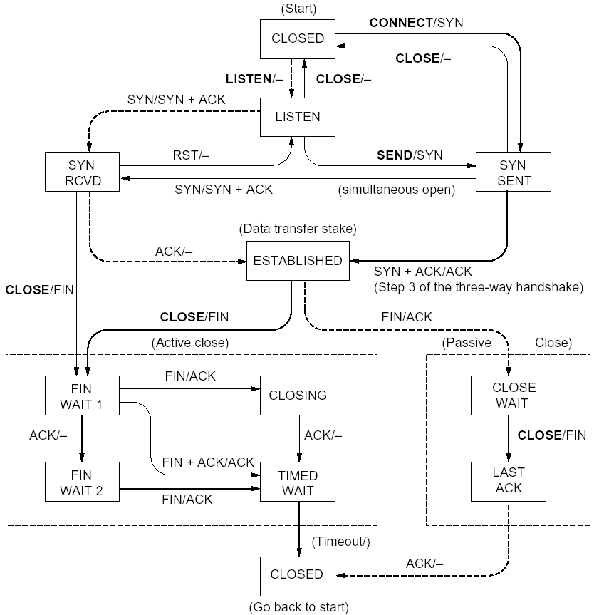
%netstat -t -a
CLOSED
SYN SENT
CLOSED
SYN
LISTEN
SYN RCVD
SYN/ACK
ESTABLSIHED
ACK
ESTABLSIHED
ESTABLSIHED
ESTABLSIHED
FIN WAIT 1
FIN
CLOSE WAIT
ACK
LAST ACK
FIN WAIT 2
FIN
TIME WAIT
ACK

Slide 8
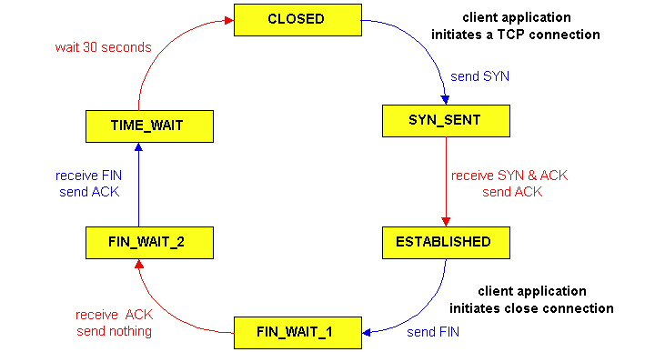
TCP Connection Management
CLOSED
SYN SENT
CLOSED
TCP lifecycle: init SYN/FIN
SYN
SYN RCVD
SYN/ACK
ESTABLSIHED
ACK
ESTABLSIHED
ESTABLSIHED
FIN WAIT 1
FIN
CLOSE WAIT
ACK
LAST ACK
FIN WAIT 2
FIN
TIME WAIT
ACK
http://dsd.lbl.gov/TCP-tuning/ip-sysctl-2.6.txt

Slide 9
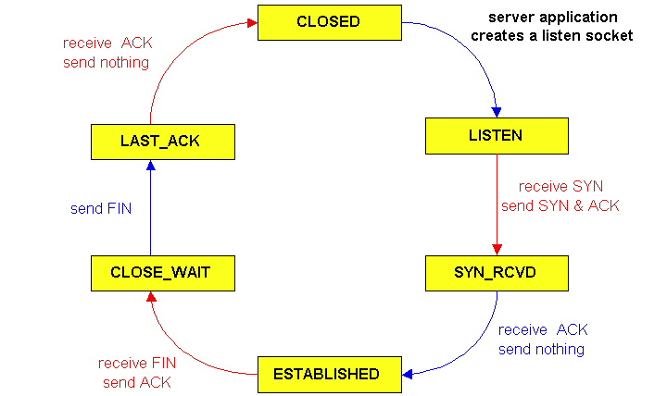
TCP Connection Management
CLOSED
SYN SENT
CLOSED
SYN
TCP lifecycle: wait for SYN/FIN
SYN RCVD
SYN/ACK
ESTABLSIHED
ACK
ESTABLSIHED
ESTABLSIHED
FIN WAIT 1
FIN
CLOSE WAIT
ACK
LAST ACK
FIN WAIT 2
FIN
TIME WAIT
ACK

Slide 10
A Summary of Questions
Basic structure: sliding window protocols
How to determine the “right” parameters?
timeout: mean + variation
sliding window size?

Slide 11
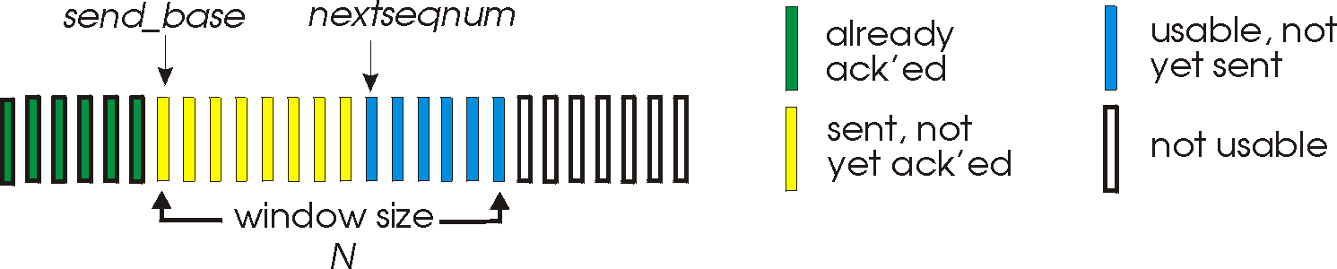
Sliding Window Size Function: Rate Control
Transmission rate determined by congestion window size, cwnd, over segments:
cwnd
cwnd segments, each with MSS bytes sent in one RTT:
cwnd * MSS
Rate =
Bytes/sec
RTT
Assume W is small enough. Ignore small details. MSS: Minimum Segment Size

Slide 12
Some General Questions
Big picture question:
How to determine a flow’s sending rate?
For better understanding, we need to look at a few basic questions:
What is congestion (cost of congestion)?
Why are desired properties of congestion control?

Slide 13
Roadmap
What is congestion
The basic CC alg
TCP/reno CC
TCP/Vegas
A unifying view of TCP/Reno and TCP/Vegas
Network wide resource allocation
Framework
Axiom derivation of network-wide objective function
Derive distributed algorithm

Slide 14
Outline
Admin and recap
TCP Reliability
Transport congestion control
what is congestion (cost of congestion)

Slide 15
Cause/Cost of Congestion: Single Bottleneck
flow 1
20 Mbps
5 Mbps
10 Mbps
flow 2 (5 Mbps)
20 Mbps
20 Mbps
router 1
router 2
- Flow 2 has a fixed sending rate of 5 Mbps
- We vary the sending rate of flow 1 from 0 to 20 Mbps
- Assume
no retransmission; link from router 1 to router 2 has infinite buffer
throughput: e2e packets delivered in unit time
Delay?
throughput of flow 1 & 2 (Mbps)
delay at central link
delay due to
randomness
10
sending rate by flow 1 (Mbps)
sending rate by flow 1 (Mbps)
5
0
5
5
0

Slide 16
Cause/Cost of Congestion: Single Bottleneck
router 3
router 5
flow 1
20 Mbps
5 Mbps
10 Mbps
flow 2 (5 Mbps)
20 Mbps
20 Mbps
router 1
router 2
router 4
router 6
Assume
no retransmission
the link from router 1 to router 2 has finite buffer
throughput: e2e packets delivered in unit time
Zombie packet: a packet dropped at the link from router 2 to router 5; the upstream transmission from router 1 to router 2 used for that packet was wasted!
throughput of flow 1 & 2 (Mbps)
10
sending rate by flow 1 (Mbps)
5
x
0
5

Slide 17
Summary: The Cost of Congestion
When sources sending rate too high for the network to handle”:
Packet loss =>
wasted upstream bandwidth when a pkt is discarded at downstream
wasted bandwidth due to retransmission (a pkt goes through a link multiple times)
High delay
packet
loss
knee
cliff
Throughput
congestion
collapse
Load
Delay
Load

Slide 18
Outline
Admin and recap
TCP Reliability
Transport congestion control
what is congestion (cost of congestion)
basic congestion control alg.

Slide 19
Rate-based vs. Window-based
Rate-based:
Congestion control by explicitly controlling the sending rate of a flow, e.g., set sending rate to 128Kbps
Example: ATM
Window-based:
Congestion control by controlling the window size of a sliding window, e.g., set window size to 64KBytes
Example: TCP
Discussion: rate-based vs. window-based

Slide 20
Sliding Window Size Function: Rate Control
Transmission rate determined by congestion window size, cwnd, over segments:
cwnd
cwnd segments, each with MSS bytes sent in one RTT:
cwnd * MSS
Rate =
Bytes/sec
RTT
Assume W is small enough. Ignore small details. MSS: Maximum Segment Size

Slide 21
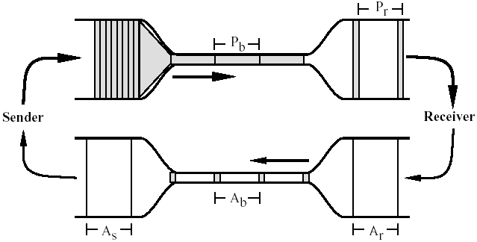
Window-based Congestion Control
Window-based congestion control is self-clocking: considers flow conservation, and adjusts to RTT variation automatically.
Hence, for better safety, more designs use window-based design.

Slide 22
The Desired Properties of a Congestion Control Scheme
Efficiency: close to full utilization but low delay
fast convergence after disturbance
Fairness (resource sharing)
Distributedness (no central knowledge for scalability)

Slide 23
Derive CC: A Simple Model
User 1
x₁
d = sum x_{i} > X_{goal}?
sum xi
User 2
x₂
x_{n}
User n
Flows observe congestion signal d, and locally take actions to adjust rates.

Slide 24
Linear Control
Proposed by Chiu and Jain (1988)
The simplest control strategy
Discussion: values of the parameters?

Slide 25
State Space of Two Flows
fairness line: x1=x2
x₂
x(0)
overload
efficiency line: x1+x2=C
underload
x₁

Slide 26
congestion
x₀
x₀
a=0
b=1
efficiency
efficiency: distributed linear rule
a=0
b=1
x₀
x₀
fairness
intersection

Slide 27
Implication: Congestion (overload) Case
In order to get closer to efficiency and fairness after each update, decreasing of rate must be multiplicative decrease (MD)
a_{D} = 0
b_{D} < 1

Slide 28
no-congestion
x₀
x₀
efficiency
efficiency: distributed linear rule
x₀
x₀
fairness
convergence

Slide 29
Implication: No Congestion Case
In order to get closer to efficiency and fairness after each update, additive and multiplicative increasing (AMI), i.e.,
a_{I} > 0, b_{I} > 1
Simply additive increase gives better improvement in fairness (i.e., getting closer to the fairness line)
Multiplicative increase may grow faster

Slide 30
Intuition: State Trace Analysis of Four Special Cases
 | Additive Decrease | Multiplicative Decrease
Additive Increase | AIAD (b_{I}=b_{D}=1) | AIMD (b_{I}=1, a_{D}=0)
Multiplicative Increase | MIAD (a_{I}=0, b_{I}>1, b_{D}=1) | MIMD (a_{I}=a_{D}=0)
Discussion: state transition trace.

Slide 31
AIMD: State Transition Trace
x₂
fairness line: x1=x2
overload
x₀
efficiency line: x1+x2=C
underload
x₁

Slide 32
Intuition: Another Look
Consider the difference or ratio of the rates of two flows
AIAD
difference does not change
MIMD
ratio does not change
MIAD
difference becomes bigger
AIMD
difference does not change
Notes:
AIAD: difference does not change
MIMD: ratio does not change
MIAD: difference becomes bigger
AIMD: difference does not change

Slide 33
Outline
Admin and recap
TCP Reliability
Transport congestion control
what is congestion (cost of congestion)
basic congestion control alg.
TCP/reno congestion control

Slide 34
TCP Congestion Control
Closed-loop, end-to-end, window-based congestion control
Designed by Van Jacobson in late 1980s, based on the AIMD alg. of Dah-Ming Chu and Raj Jain
Worked in a large range of bandwidth values: the bandwidth of the Internet has increased by more than 200,000 times
Many versions
TCP/Tahoe: this is a less optimized version
TCP/Reno: many OSs today implement Reno type congestion control
TCP/Vegas: not currently used
For more details: see TCP/IP illustrated; or read http://lxr.linux.no/source/net/ipv4/tcp_input.c for linux implementation

Slide 35
Mapping A(M)I-MD to Protocol
Basic questions to look at:
How to obtain d(t)--the congestion signal?
What values do we choose for the formula?
How to map formula to code?
Notes:
Implement d(t): loss/delay
Adjust window size
b_D: exponential backoff timeout after window size is 1

Slide 36
Obtain d(t) Approach 1: End Hosts Consider Loss as Congestion
Packets
1
2
3
4
5
6
7
Acknowledgements (waiting seq#)
2
3
4
4
4
4
Pros and Cons of endhosts using loss as congestion?
Assume loss => cong

