Slide 1
Monthly Sales Report
Jan 2026 · DEMO-CENTRAL
Figures computed from the sales database. Commentary drafted by a language model and checked against the source data.

Slide 2
Contents
01
Overview
02
Monthly trend
This month's revenue, units and orders, split by tier and category
How the last four months moved, and by how much
03
Product structure
04
Channels
Category mix, the premium range, best sellers, brands
Local walk-in and trade versus export parcels
05
Concentration
06
Operating context
How much of revenue a handful of SKUs carries
Foot traffic, enquiries and this month's campaigns

Slide 3
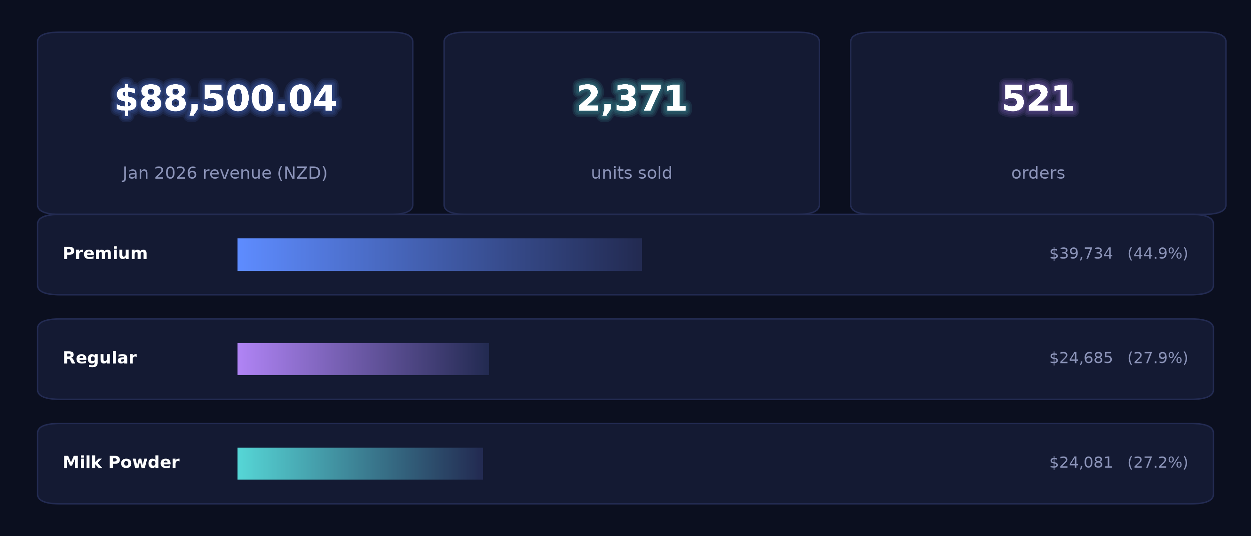
01 · Overview
Jan 2026: NZ$88,500.04 across 521 orders, average order NZ$169.87
Average order value $170

Slide 4
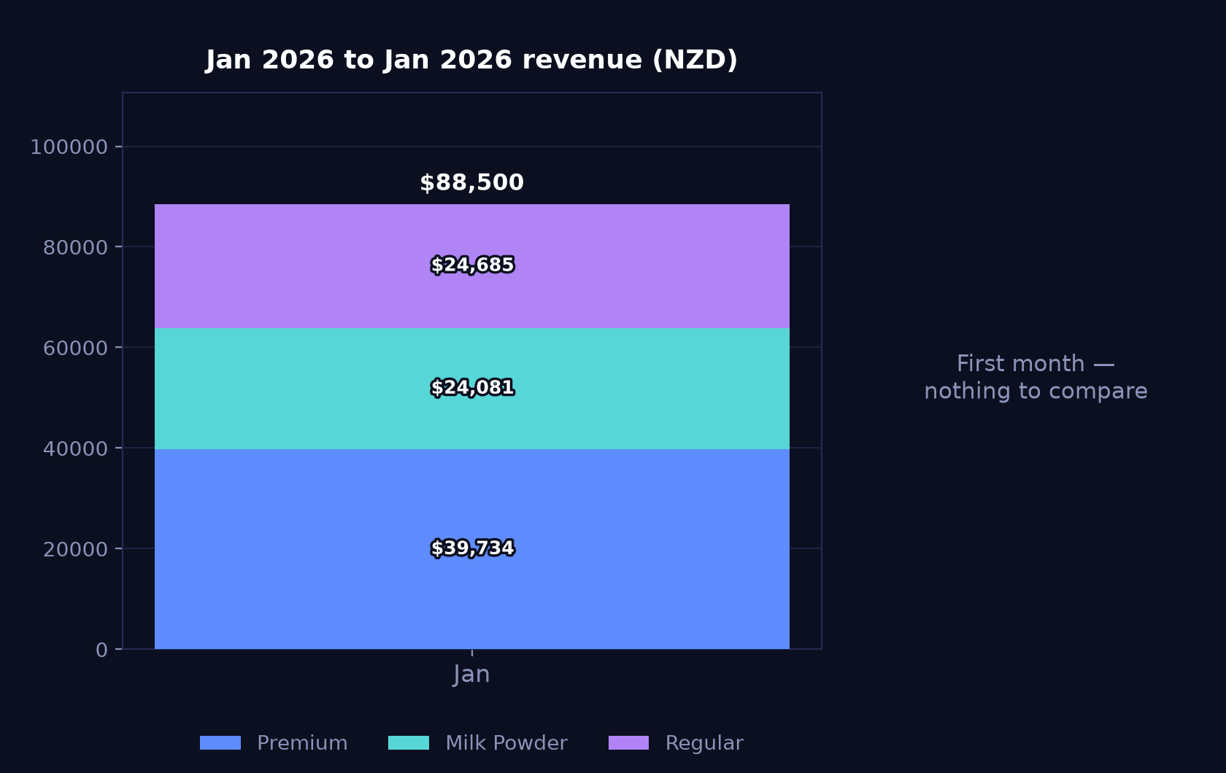
02 · Monthly trend
January stands alone in the trend at NZ$88,500.04 on 2,371 units
Jan 2026 – Jan 2026 · premium / milk powder / regular, stacked (NZD)

Slide 5
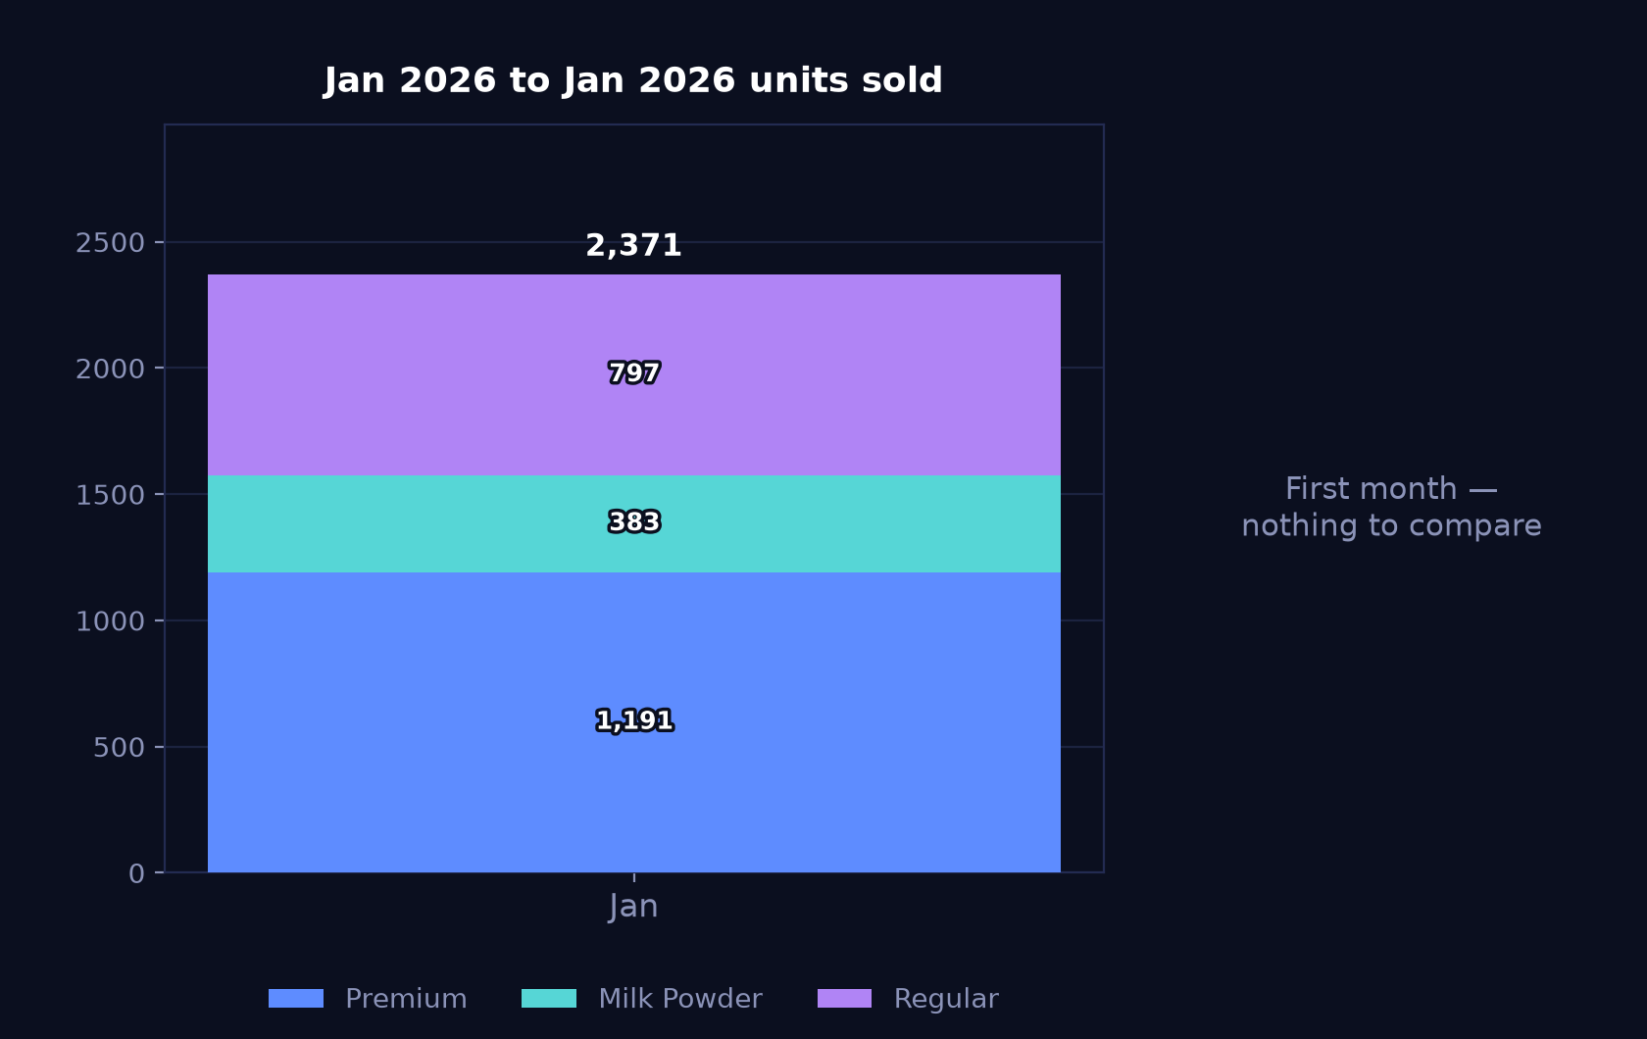
02 · Monthly trend
Premium accounts for 1,191 of the 2,371 units sold in January
Same three groups by units, so volume can be read separately from value

Slide 6
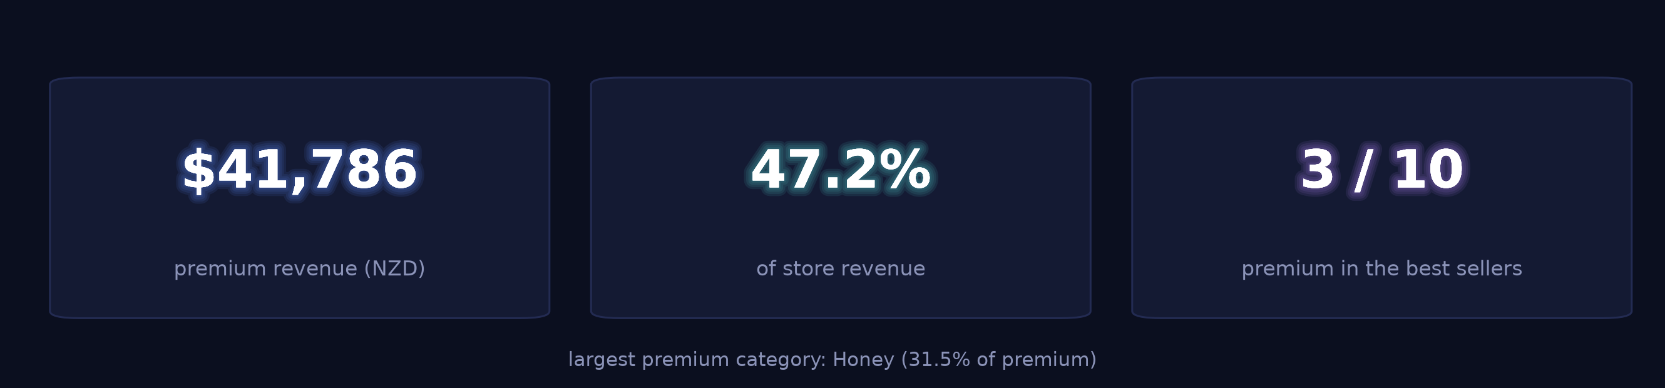
03 · Product structure
Premium range at NZ$41,785.60, or 47.2% of store revenue
The range the store is putting in front of customers, before the detail

Slide 7
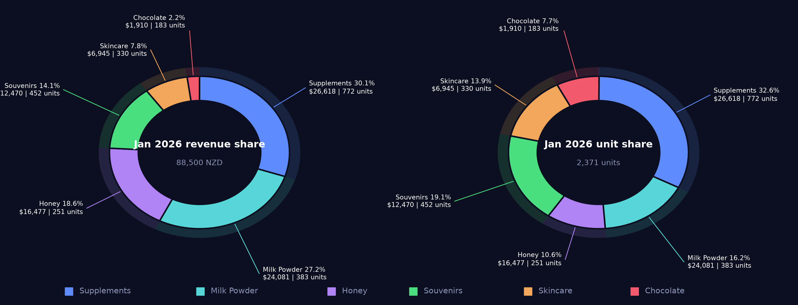
03 · Product structure
Supplements lead on both revenue (30.1%) and units (32.6%)
Revenue share and unit share side by side — the gap between the two is the unit-price effect

Slide 8
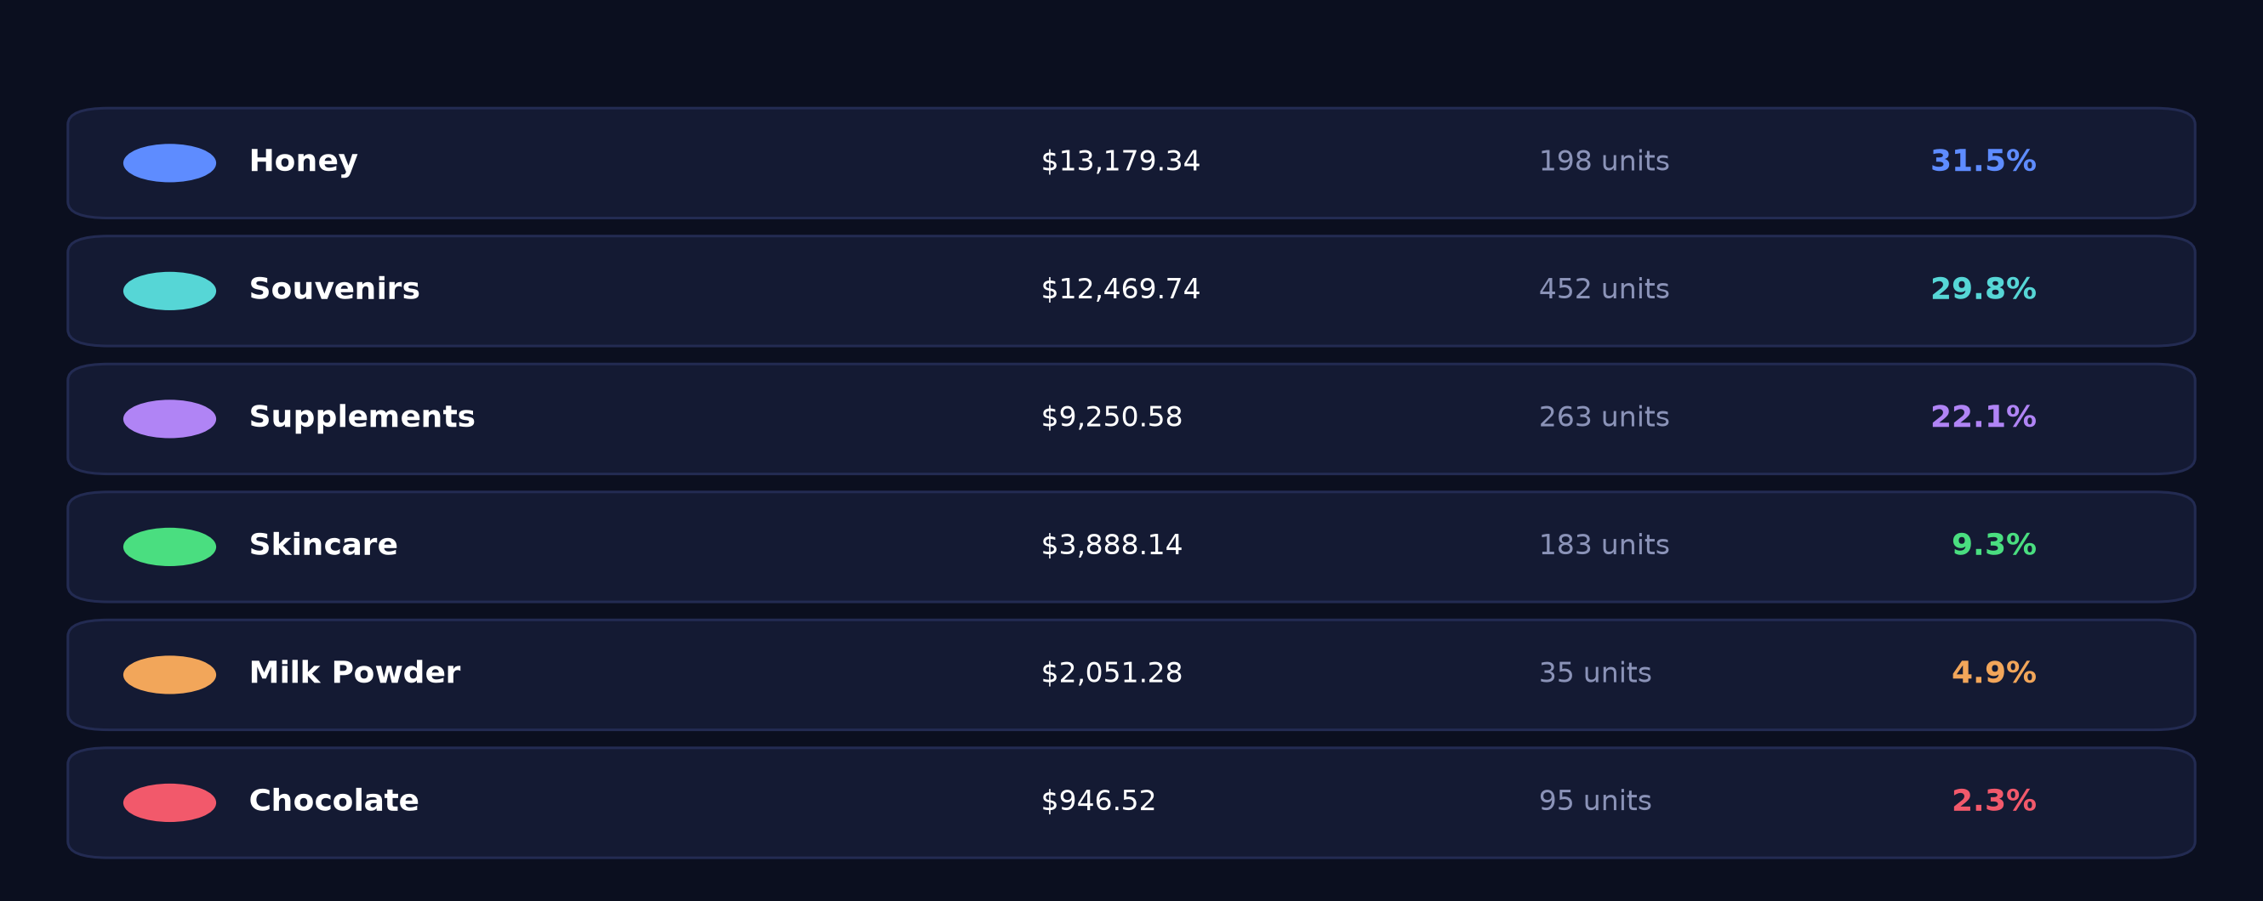
03 · Product structure
Honey at 31.5% of premium revenue from 16.2% of premium units
Shares are within premium, not of the store — a different denominator from the previous slide

Slide 9
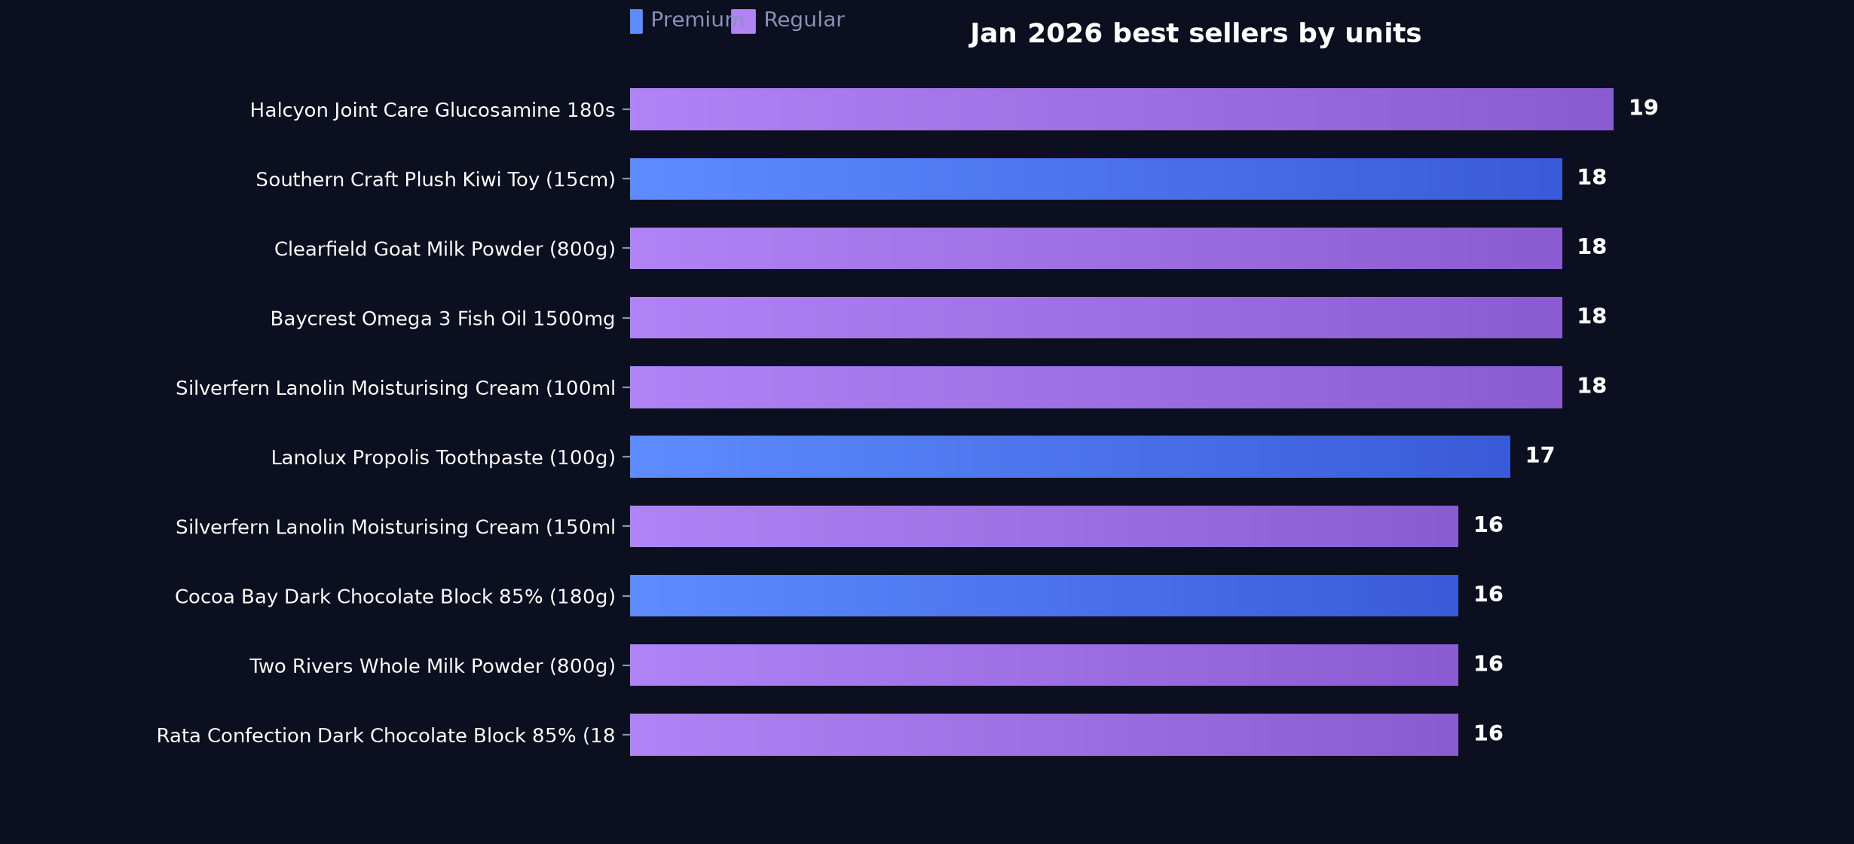
03 · Product structure
Three premium lines in the top 10 SKUs by units
Ranked by units sold

Slide 10
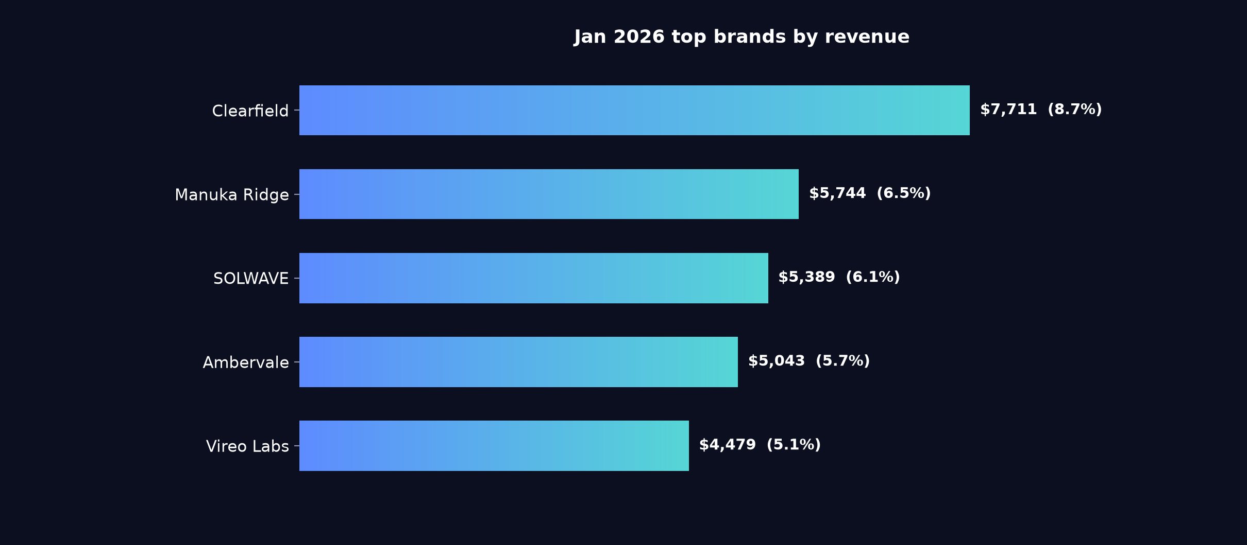
03 · Product structure
Clearfield leads the store brand table at 8.7% of revenue
Percentages are share of total store revenue

Slide 11
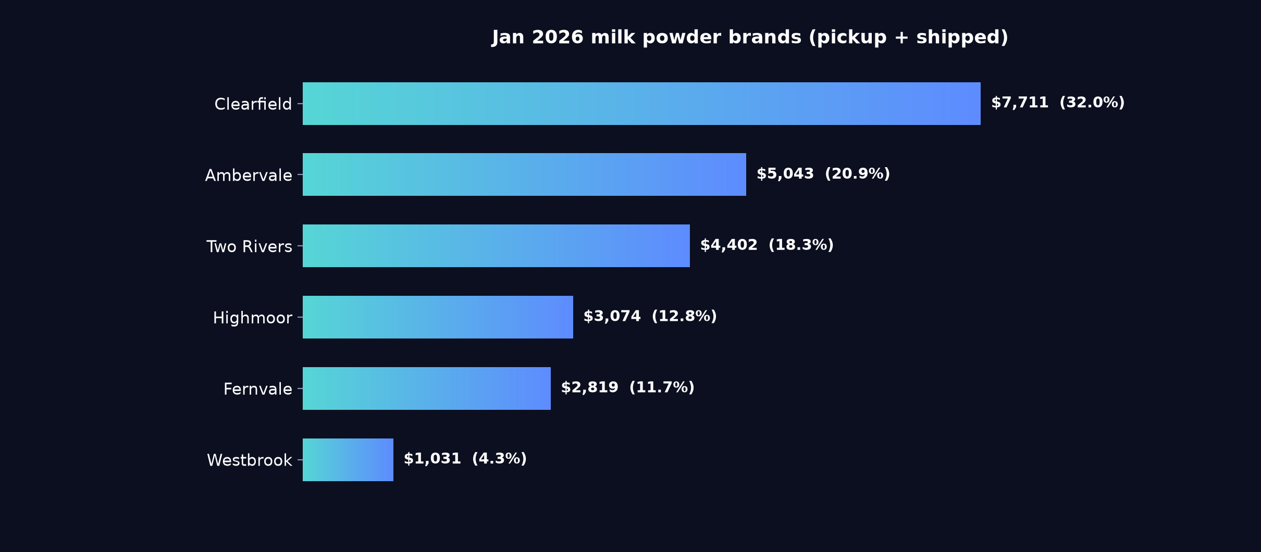
03 · Product structure
Clearfield holds 32.0% of milk powder against Ambervale at 20.9%
Pickup and shipped combined · percentages are share of the milk powder category, not of the store
Notes
Clearfield at 32.0% and Ambervale at 20.9% together cover just over half the category, with Westbrook at 4.3% the smallest of the six listed. Facings for the two leaders should reflect that gap when the shelf is reset.

Slide 12
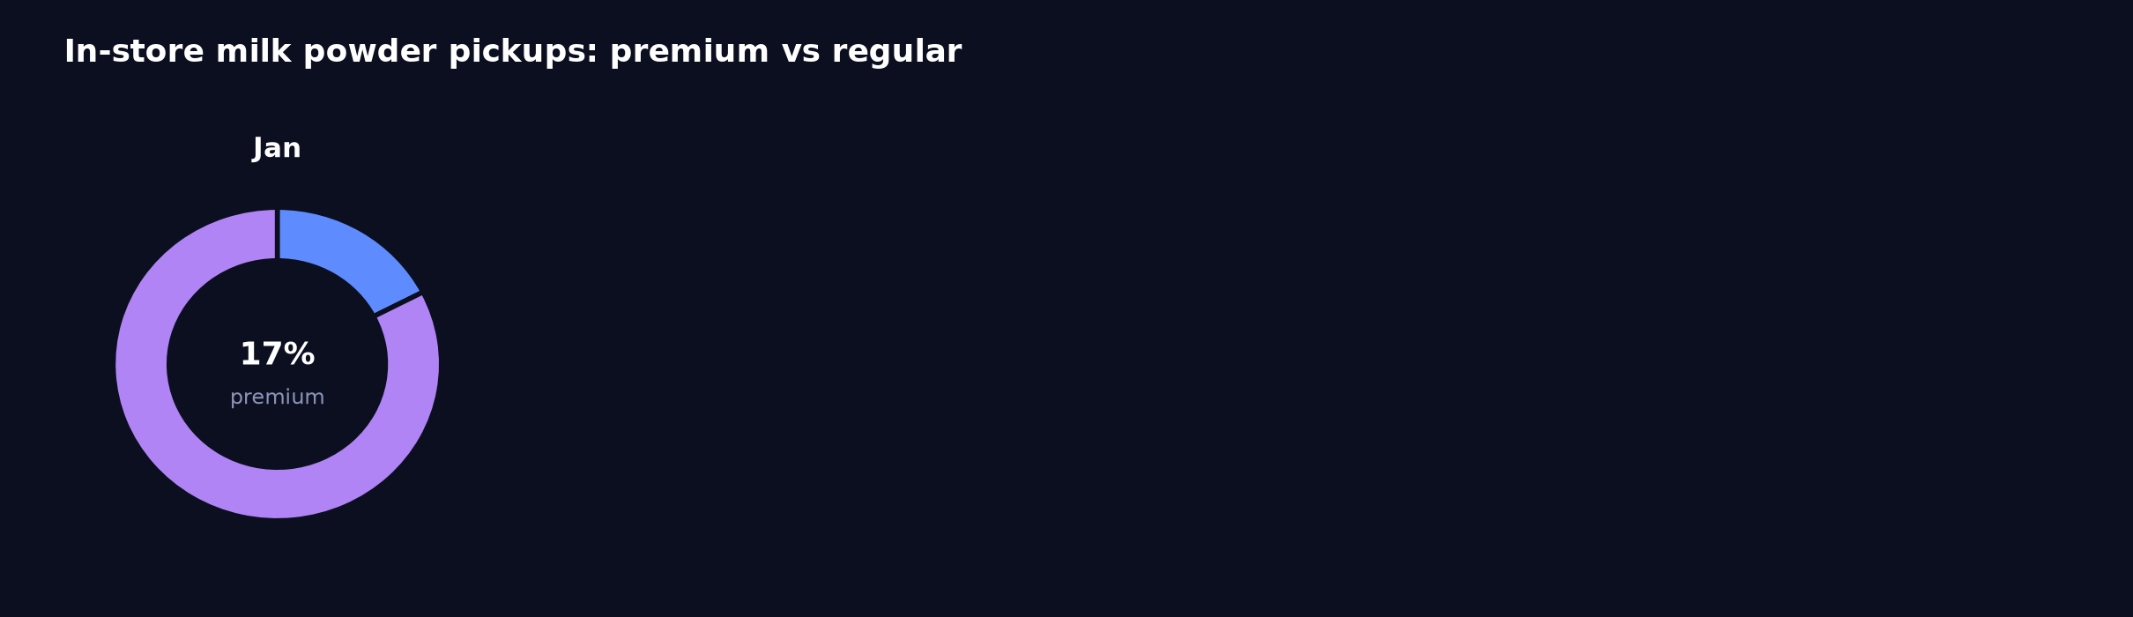
03 · Product structure
Pickup skews regular: NZ$9,737.10 against NZ$2,051.28 premium
Premium marks the range the store is putting in front of customers — it is not a price band
Reading
Pickup orders carried 161 regular units and 35 premium units in January. Placing a small premium display at the collection point would put that range in front of customers who are already in store.

Slide 13
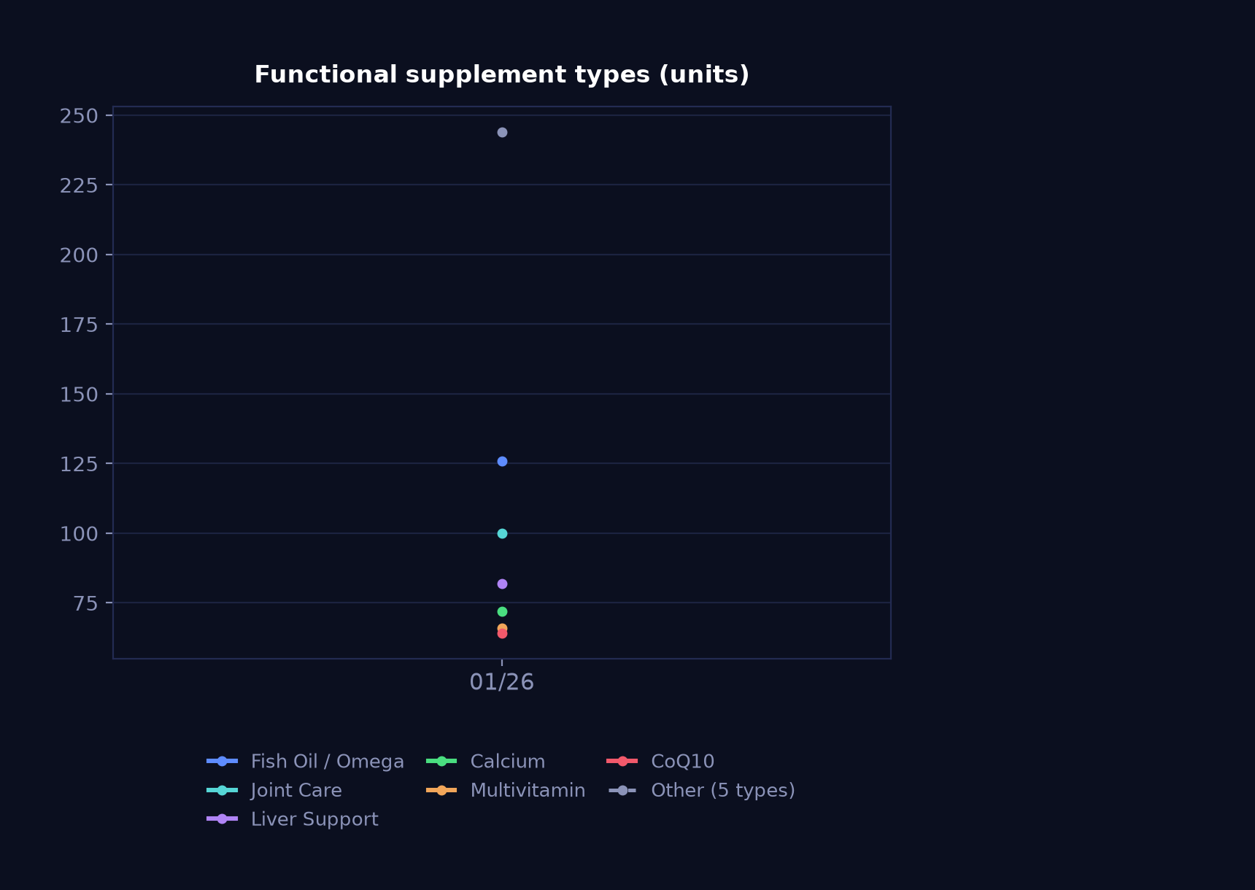
03 · Product structure
Fish oil tops functional lines at NZ$4,194.93 on 126 units
Units sold · a read on what customers are buying supplements for
Notes
Fish oil (126 units) and joint care (100 units) are the two largest functional lines, while eye care and magnesium sit at 38 units each. Shelf space at eye level could follow that order.

Slide 14
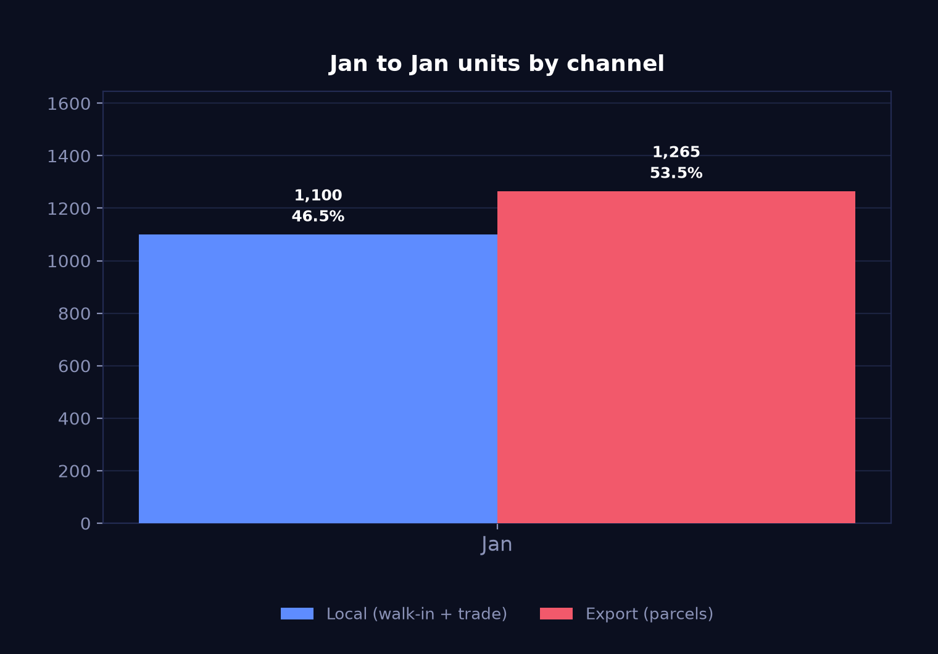
04 · Channels
Export 1,265 units to local 1,100 in January
Units · grouped rather than stacked, because the two channels move independently
n/a
Export units
parcels
n/a
Local units
walk-in + trade
Reading
Export took 53.5% of units and NZ$54,322.26 of revenue, against NZ$34,990.18 local. The New Year holidays at the start of the month typically leave walk-in trade quiet, which may sit behind the local figure.

Slide 15
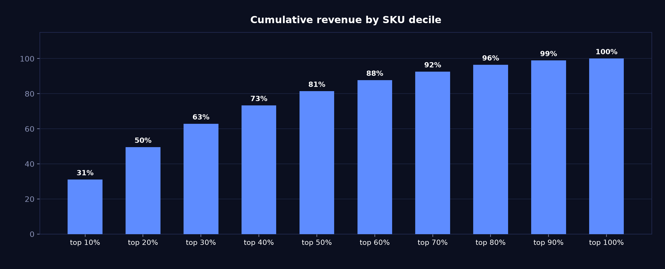
05 · Concentration
Top three SKU deciles carry 62.8% of revenue
Cumulative share of revenue as SKUs are added worst-to-best

Slide 16
06 · Operating context
268 visits and 94 mini-programme leads at a 61.0% completion rate
Entered by hand each month — these figures are not in the POS
268
94
61%
foot traffic
app enquiries
enquiry completion
Tour groups
No tour groups this month.

Slide 17
06 · Operating context
Summer bundle running on premium supplements
Taken from the note entered in monthly_context.csv
Key points
Premium supplements: 3 for 10% off summer bundle

Slide 18
Questions on any figure trace back to source
DEMO-CENTRAL · Jan 2026
Generated 2026-08-13 from report_data.json — every number on every slide comes from that one file.

