Slide 1
Monthly Sales Report
Feb 2026 · DEMO-CENTRAL
Figures computed from the sales database. Commentary drafted by a language model and checked against the source data.

Slide 2
Contents
01
Overview
02
Monthly trend
This month's revenue, units and orders, split by tier and category
How the last four months moved, and by how much
03
Product structure
04
Channels
Category mix, the premium range, best sellers, brands
Local walk-in and trade versus export parcels
05
Concentration
06
Operating context
How much of revenue a handful of SKUs carries
Foot traffic, enquiries and this month's campaigns

Slide 3
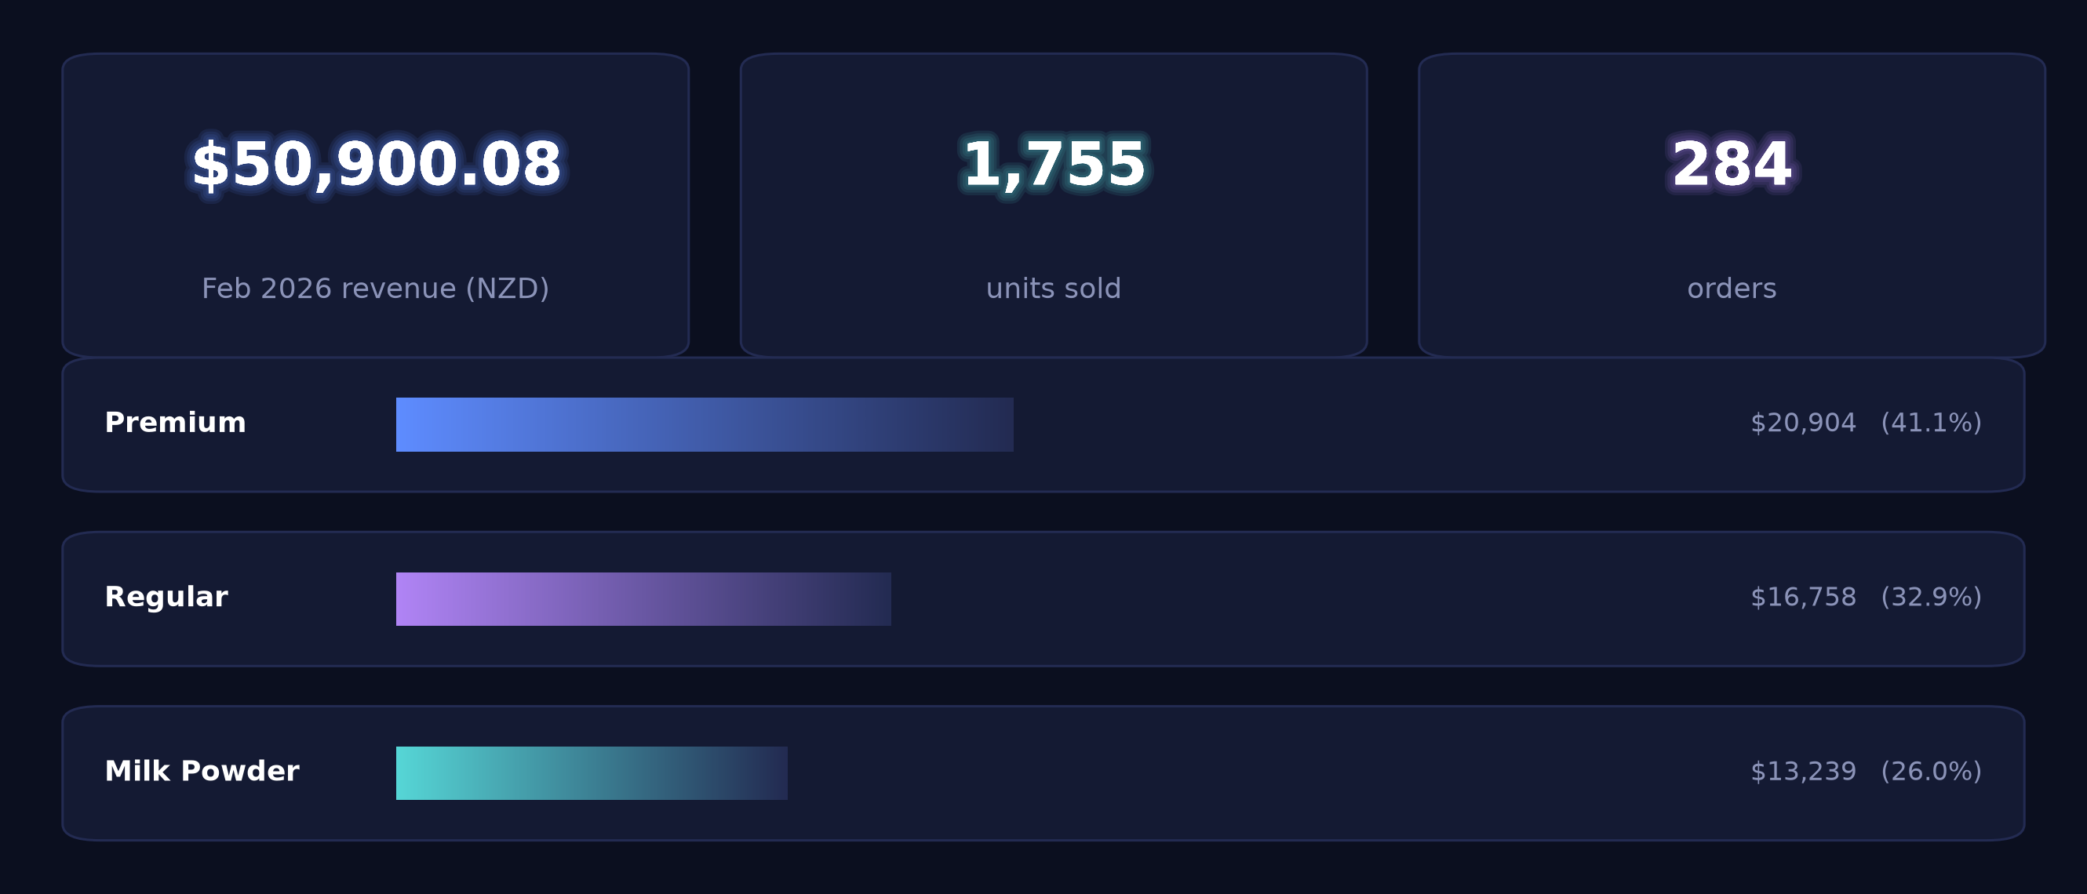
01 · Overview
Feb 2026 revenue NZ$50,900 across 284 orders, down 42.5% on January
Average order value $179

Slide 4
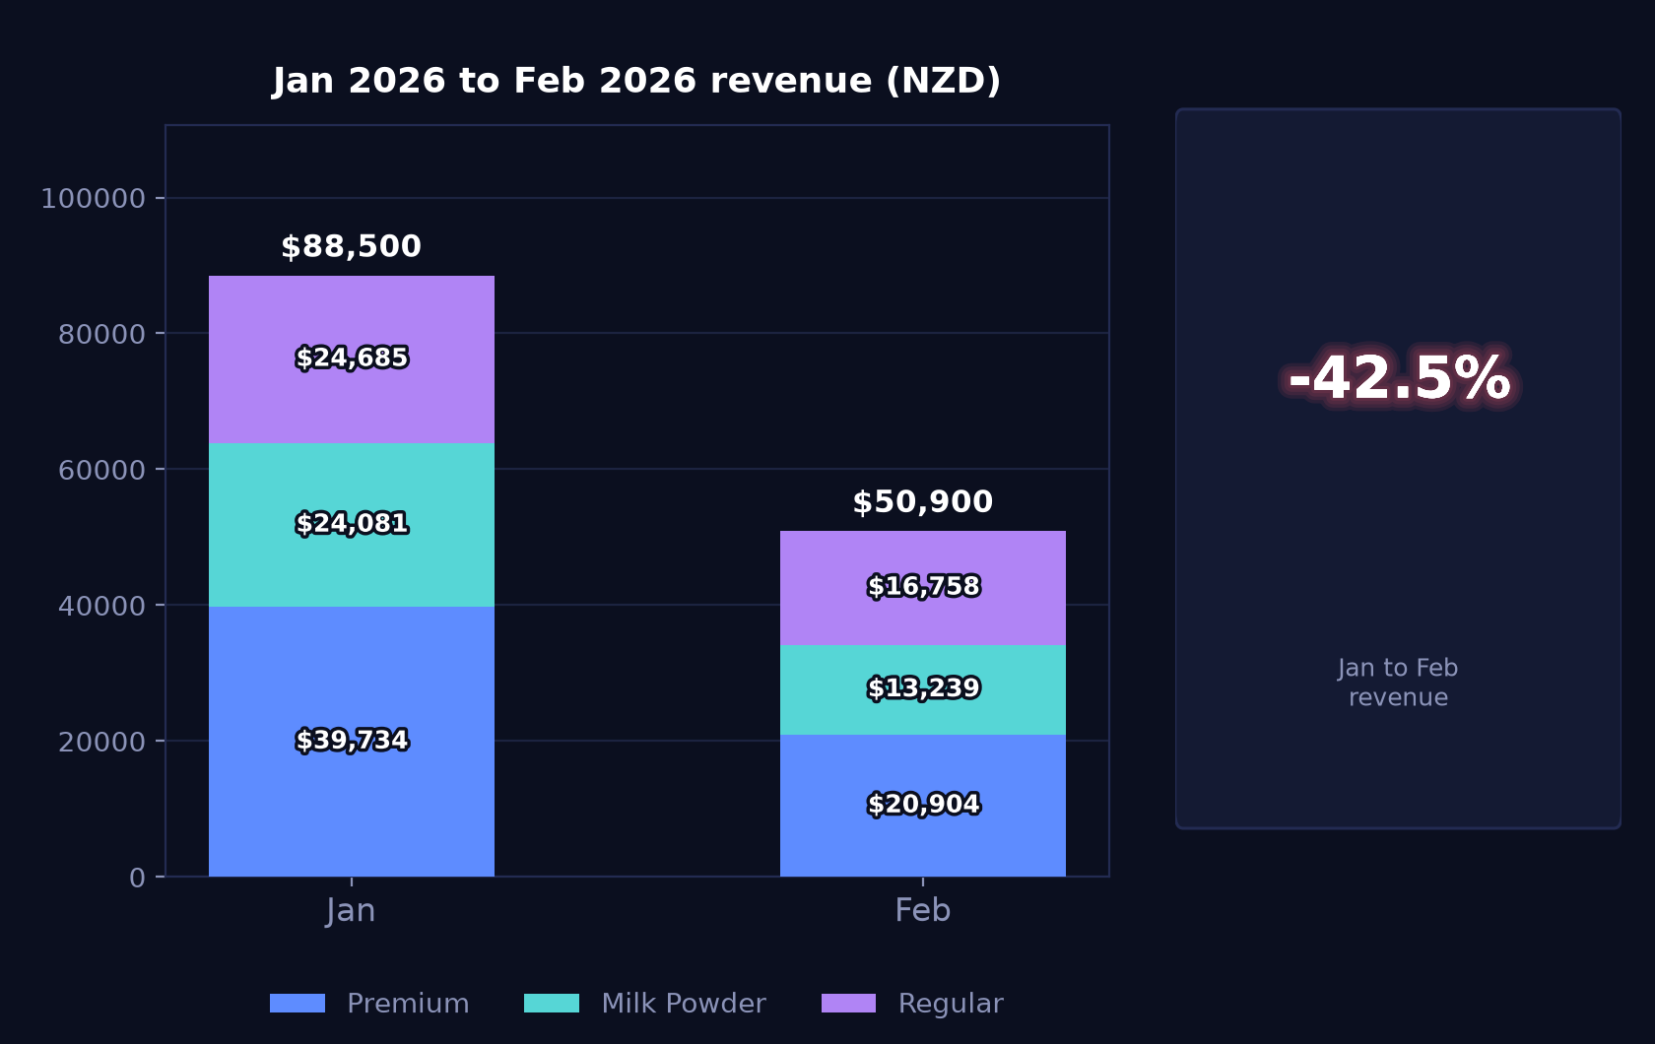
02 · Monthly trend
Revenue falls 42.5% month on month, with Chinese New Year spanning nine days of February
Jan 2026 – Feb 2026 · premium / milk powder / regular, stacked (NZD)

Slide 5
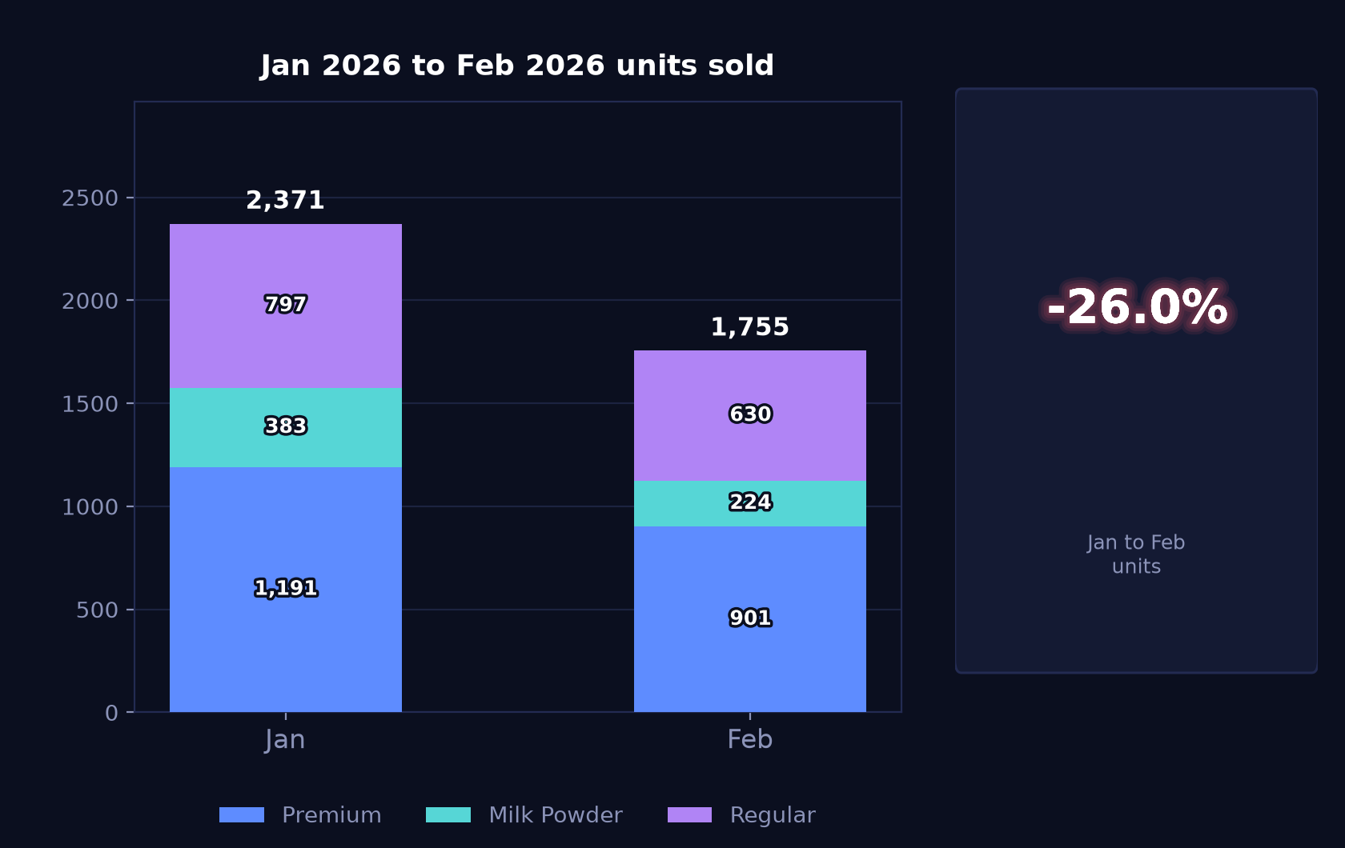
02 · Monthly trend
Units down 26.0% to 1,755, a shallower fall than the revenue decline
Same three groups by units, so volume can be read separately from value

Slide 6
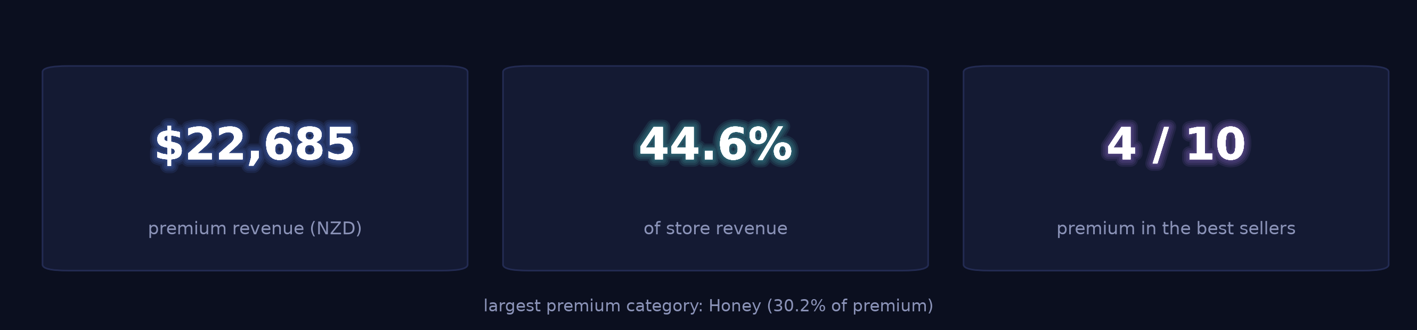
03 · Product structure
Premium lines account for 44.6% of store revenue and 4 of the top 10 products
The range the store is putting in front of customers, before the detail

Slide 7
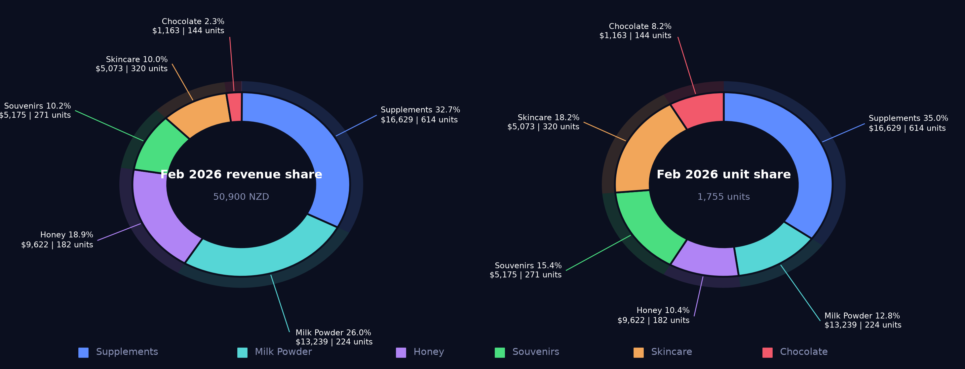
03 · Product structure
Supplements lead at 32.7% of revenue from 35.0% of units; milk powder 26.0% from 12.8%
Revenue share and unit share side by side — the gap between the two is the unit-price effect

Slide 8
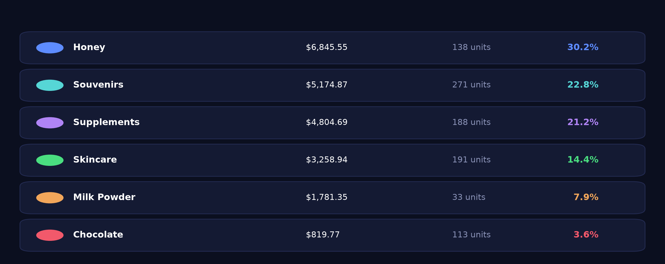
03 · Product structure
Honey holds 30.2% of premium revenue, souvenirs 22.8% from 29.0% of premium units
Shares are within premium, not of the store — a different denominator from the previous slide

Slide 9
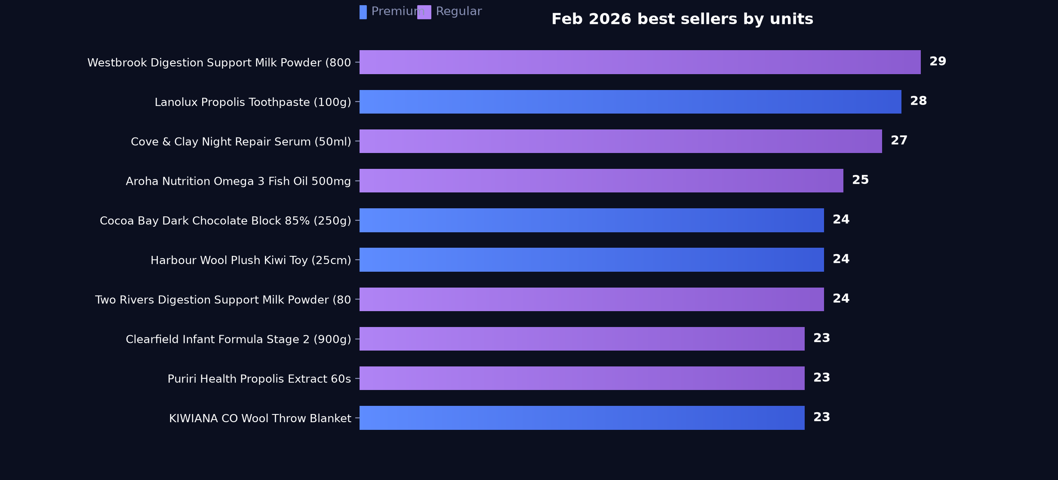
03 · Product structure
Westbrook Digestion Support Milk Powder tops the table at NZ$2,100.81 from 29 units
Ranked by units sold

Slide 10
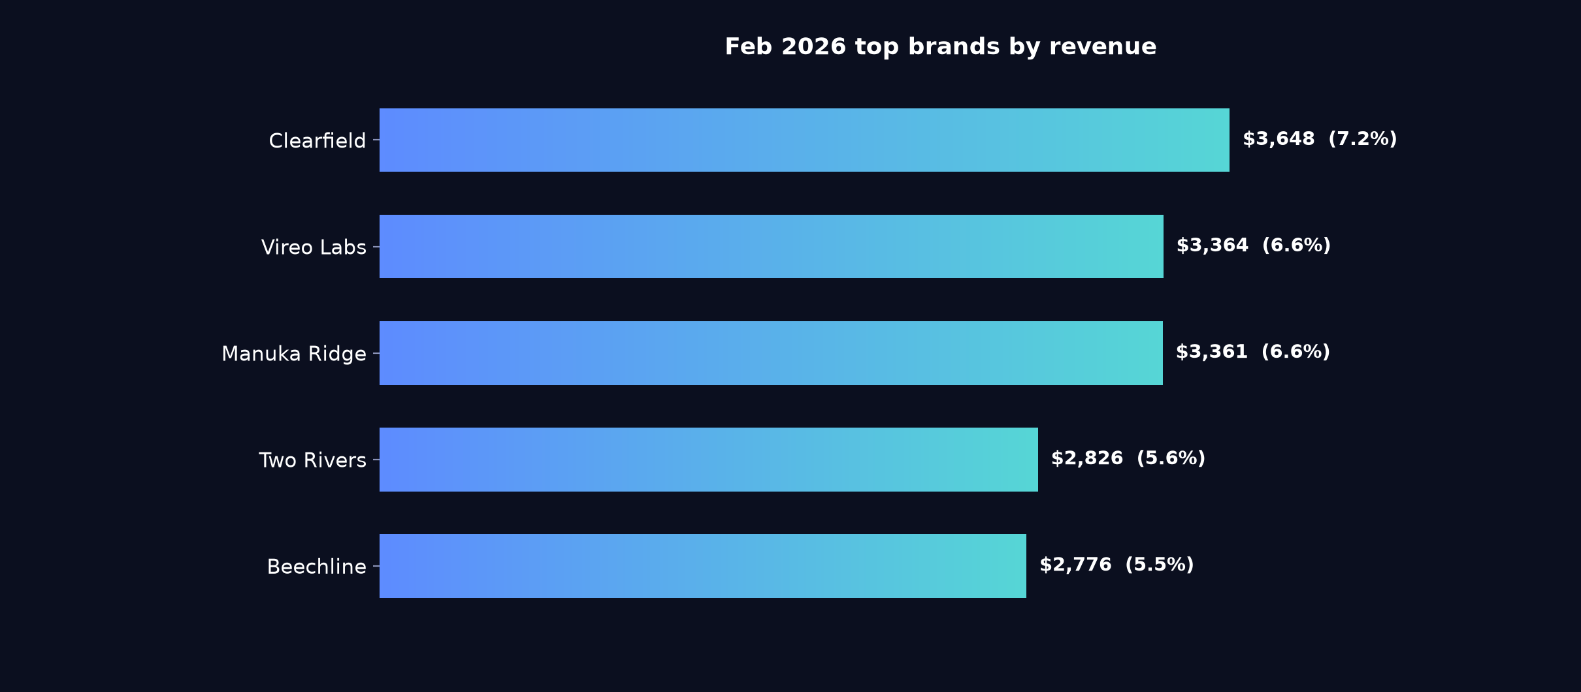
03 · Product structure
Clearfield at 7.2% of store revenue heads a spread where no brand passes 8%
Percentages are share of total store revenue

Slide 11
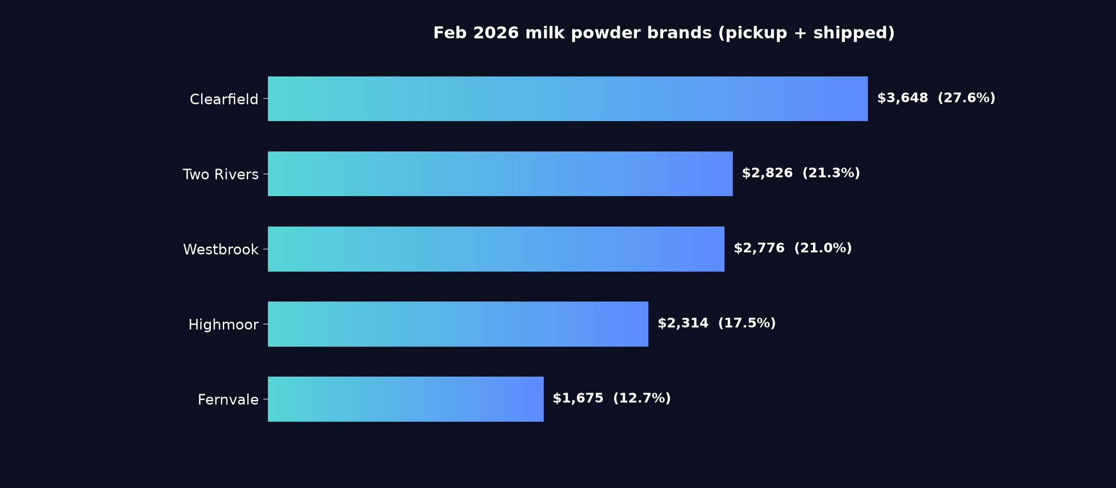
03 · Product structure
Clearfield leads milk powder on 27.6%, with Two Rivers and Westbrook close behind
Pickup and shipped combined · percentages are share of the milk powder category, not of the store
Notes
Clearfield (27.6%), Two Rivers (21.3%) and Westbrook (21.0%) together carry most of the category, with Fernvale last of the five at 12.7%. Shelf positioning decisions in this category will move a large share of it.

Slide 12
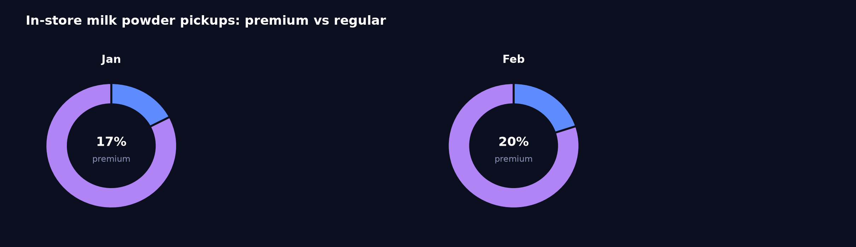
03 · Product structure
Pickup revenue splits NZ$7,153.60 regular against NZ$1,781.35 premium
Premium marks the range the store is putting in front of customers — it is not a price band
Reading
Premium pickup revenue moved from NZ$2,051.28 in January to NZ$1,781.35 in February on 33 units. Adding a premium item to the pickup counter display would put the range in front of collecting customers.

Slide 13
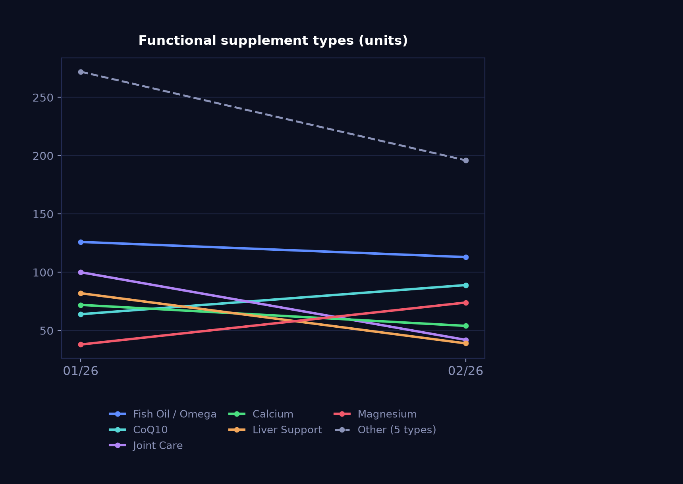
03 · Product structure
CoQ10 and magnesium rise against falls in joint care and lecithin
Units sold · a read on what customers are buying supplements for
Notes
CoQ10 grew from NZ$2,183.12 to NZ$2,446.27 and magnesium from NZ$1,470.08 to NZ$2,044.54, while joint care fell from NZ$3,725.81 to NZ$1,099.82 and lecithin from NZ$2,214.55 to NZ$629.43. Fish oil remains the largest at NZ$3,382.65.

Slide 14
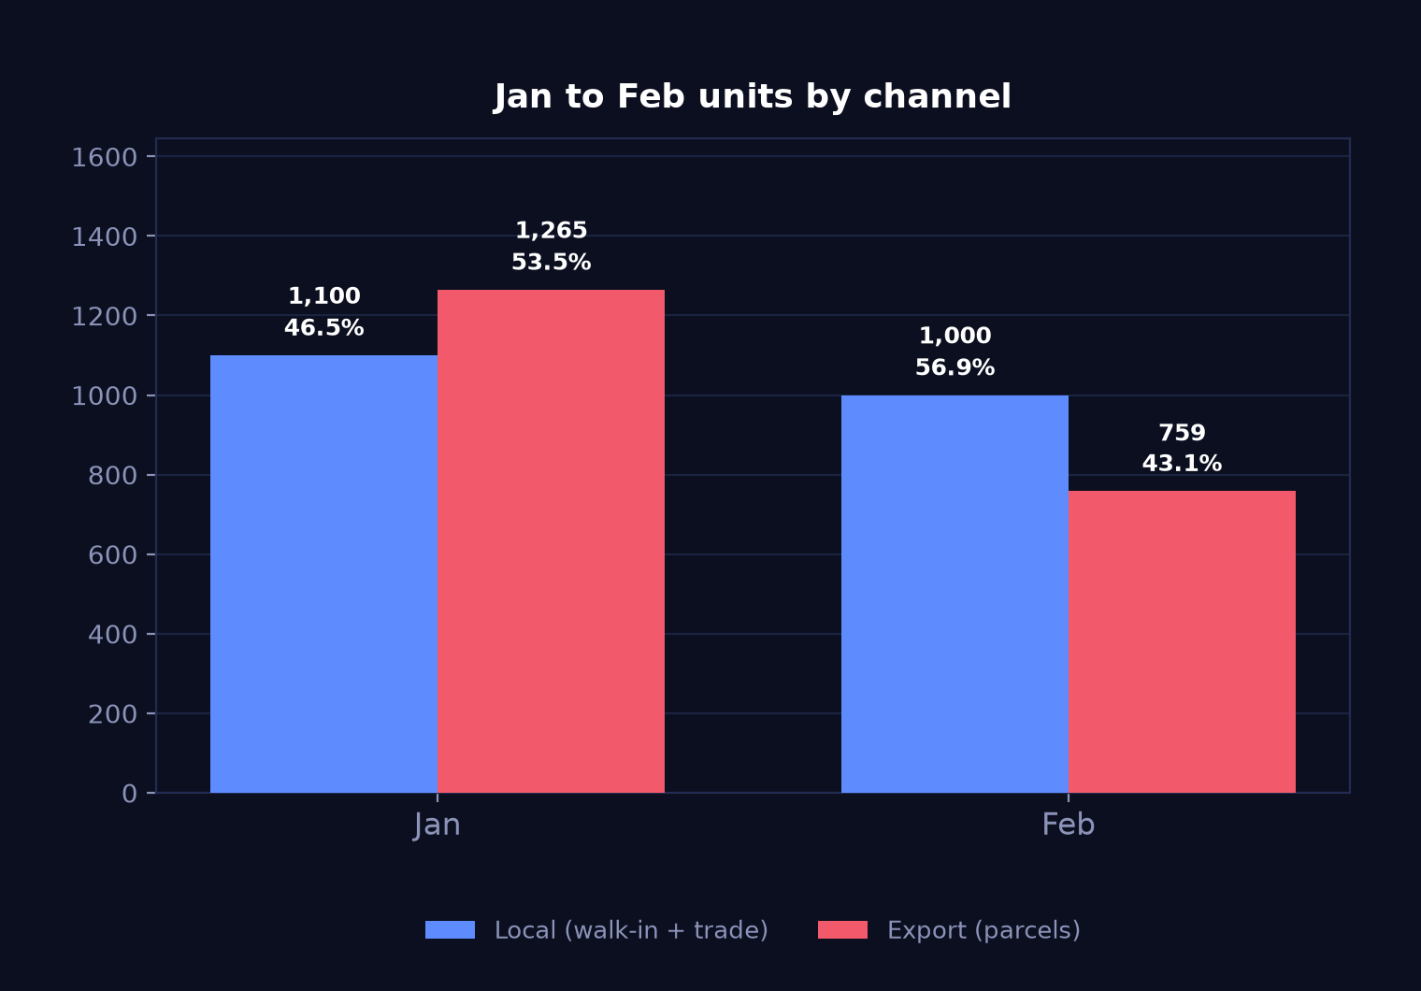
04 · Channels
Export units down 40.0%, local down 9.09%, shifting the split to 56.9% local
Units · grouped rather than stacked, because the two channels move independently
-40.0%
Export units
parcels
-9.1%
Local units
walk-in + trade
Reading
Export fell from 1,265 to 759 units while local held closer at 1,000, a pattern likely related to the nine-day Chinese New Year holiday and the freight suspension around it. Local trade at 56.9% of units is the higher share for the first time in the period shown.

Slide 15
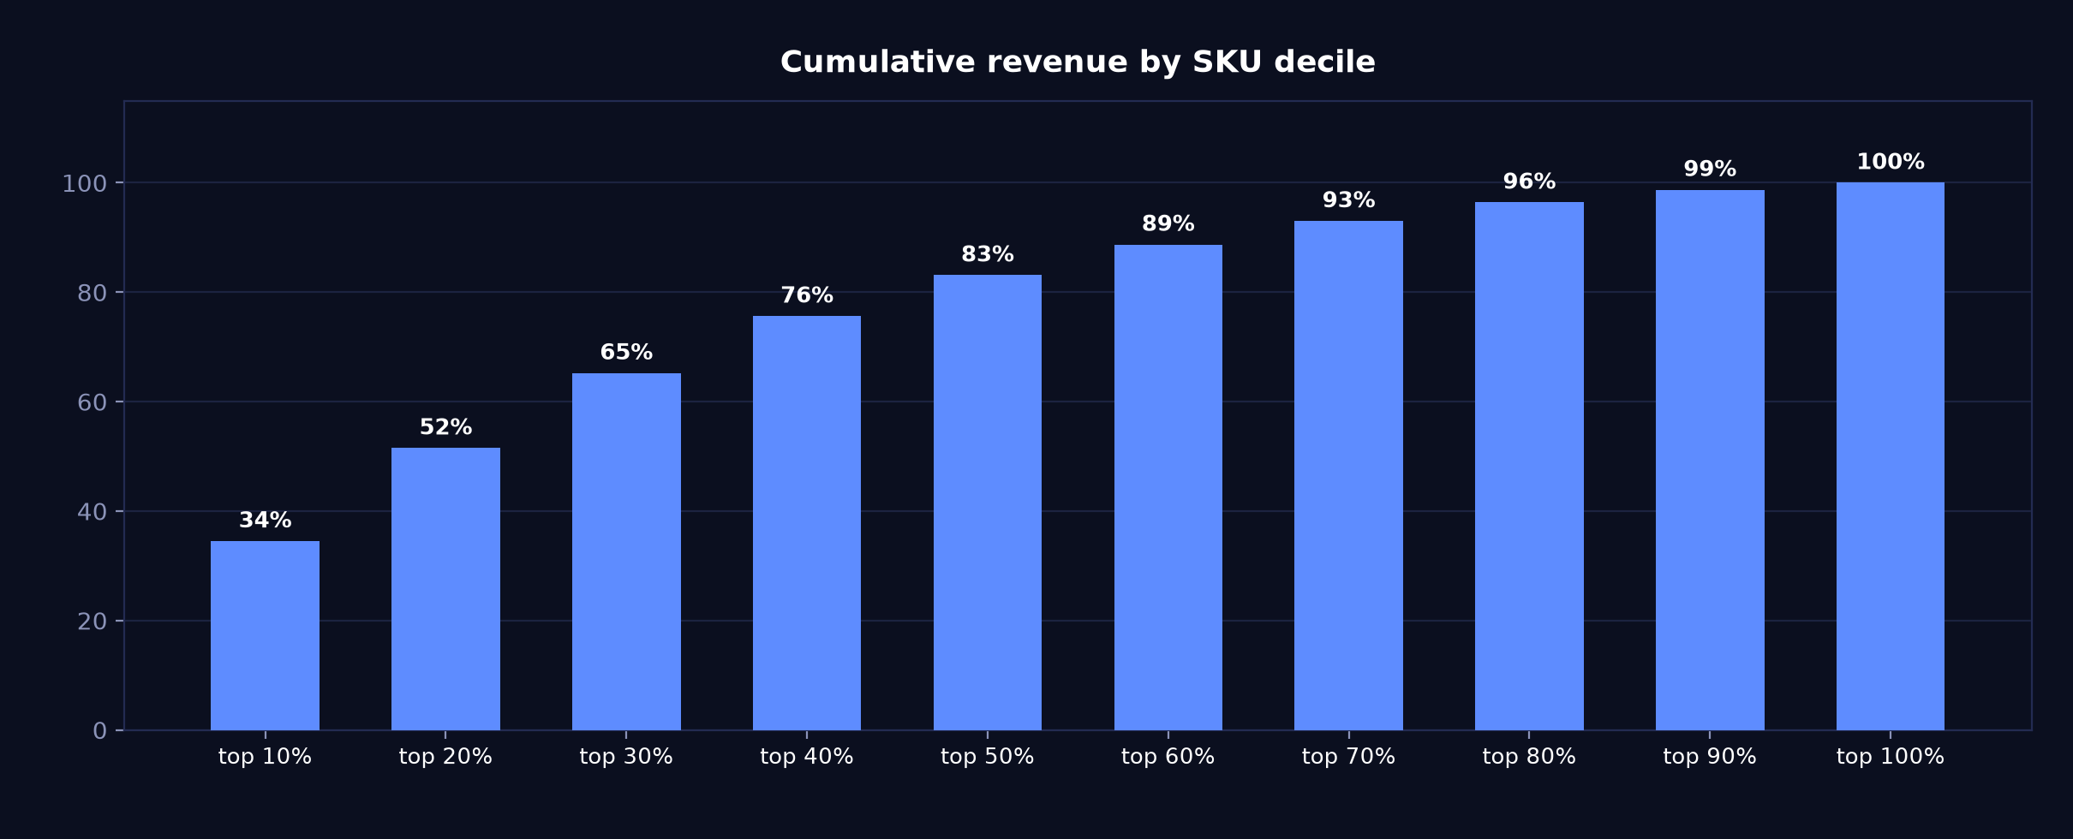
05 · Concentration
Top decile of SKUs carries 34.5% of revenue; half comes from the top two deciles
Cumulative share of revenue as SKUs are added worst-to-best

Slide 16
06 · Operating context
176 visits and 51 mini-programme leads at a 47.0% completion rate
Entered by hand each month — these figures are not in the POS
176
51
47%
foot traffic
app enquiries
enquiry completion
Tour groups
No tour groups this month.

Slide 17
06 · Operating context
Chinese New Year gift packs, in-store only
Taken from the note entered in monthly_context.csv
Key points
In-store customers: Chinese New Year gift packs, available in store only

Slide 18
Questions on any figure trace back to source
DEMO-CENTRAL · Feb 2026
Generated 2026-08-13 from report_data.json — every number on every slide comes from that one file.

