Slide 1
Monthly Sales Report
Mar 2026 · DEMO-CENTRAL
Figures computed from the sales database. Commentary drafted by a language model and checked against the source data.

Slide 2
Contents
01
Overview
02
Monthly trend
This month's revenue, units and orders, split by tier and category
How the last four months moved, and by how much
03
Product structure
04
Channels
Category mix, the premium range, best sellers, brands
Local walk-in and trade versus export parcels
05
Concentration
06
Operating context
How much of revenue a handful of SKUs carries
Foot traffic, enquiries and this month's campaigns

Slide 3
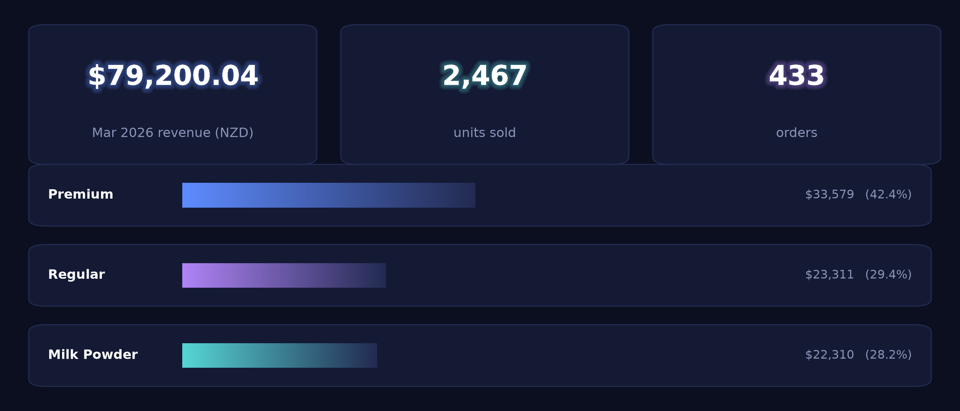
01 · Overview
Mar 2026: NZ$79,200 revenue on 433 orders, average order value NZ$182.91
Average order value $183

Slide 4
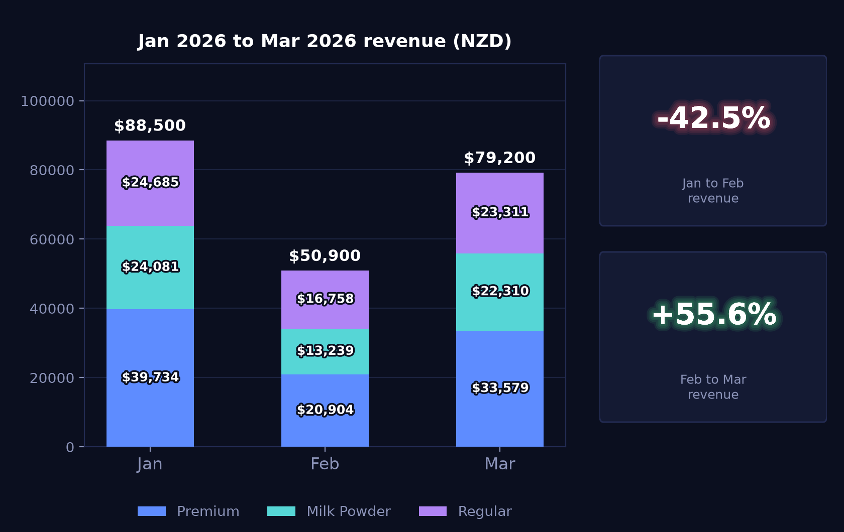
02 · Monthly trend
Revenue up 55.6% on February after the 42.5% February fall
Jan 2026 – Mar 2026 · premium / milk powder / regular, stacked (NZD)

Slide 5
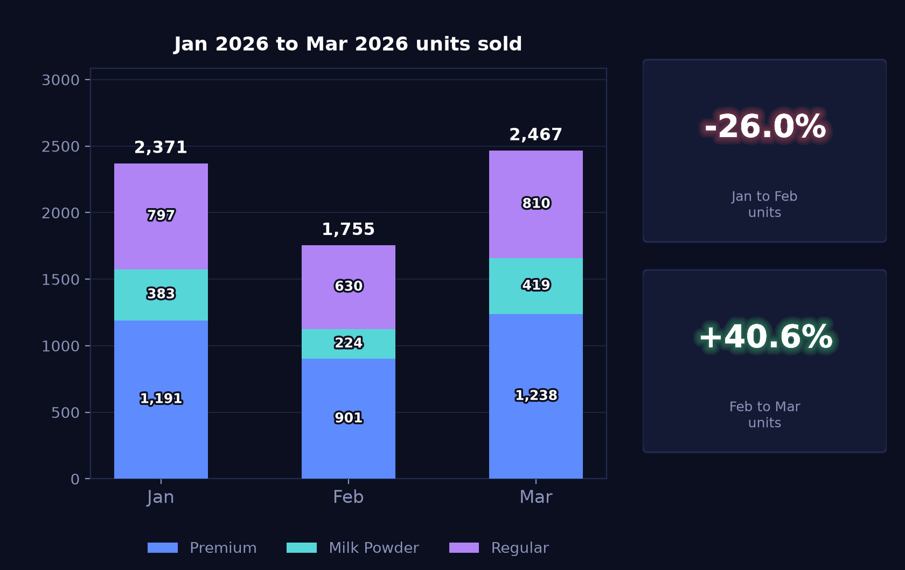
02 · Monthly trend
Units up 40.57% to 2,467 after February's 25.98% decline
Same three groups by units, so volume can be read separately from value

Slide 6
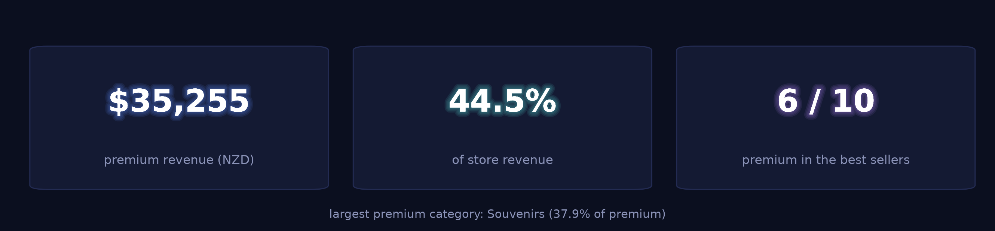
03 · Product structure
Premium lines account for NZ$35,255, or 44.5% of store revenue
The range the store is putting in front of customers, before the detail

Slide 7
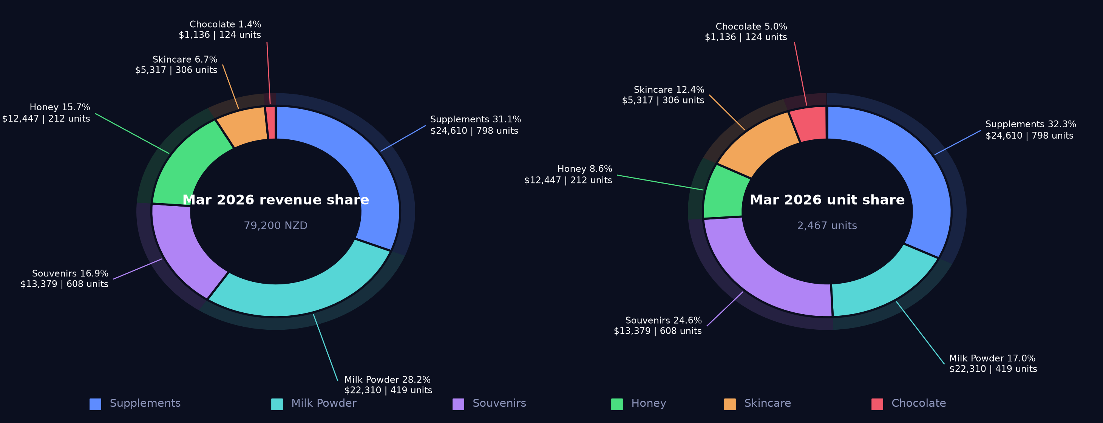
03 · Product structure
Supplements lead on revenue at 31.1%; souvenirs 16.9% of revenue on 24.6% of units
Revenue share and unit share side by side — the gap between the two is the unit-price effect

Slide 8
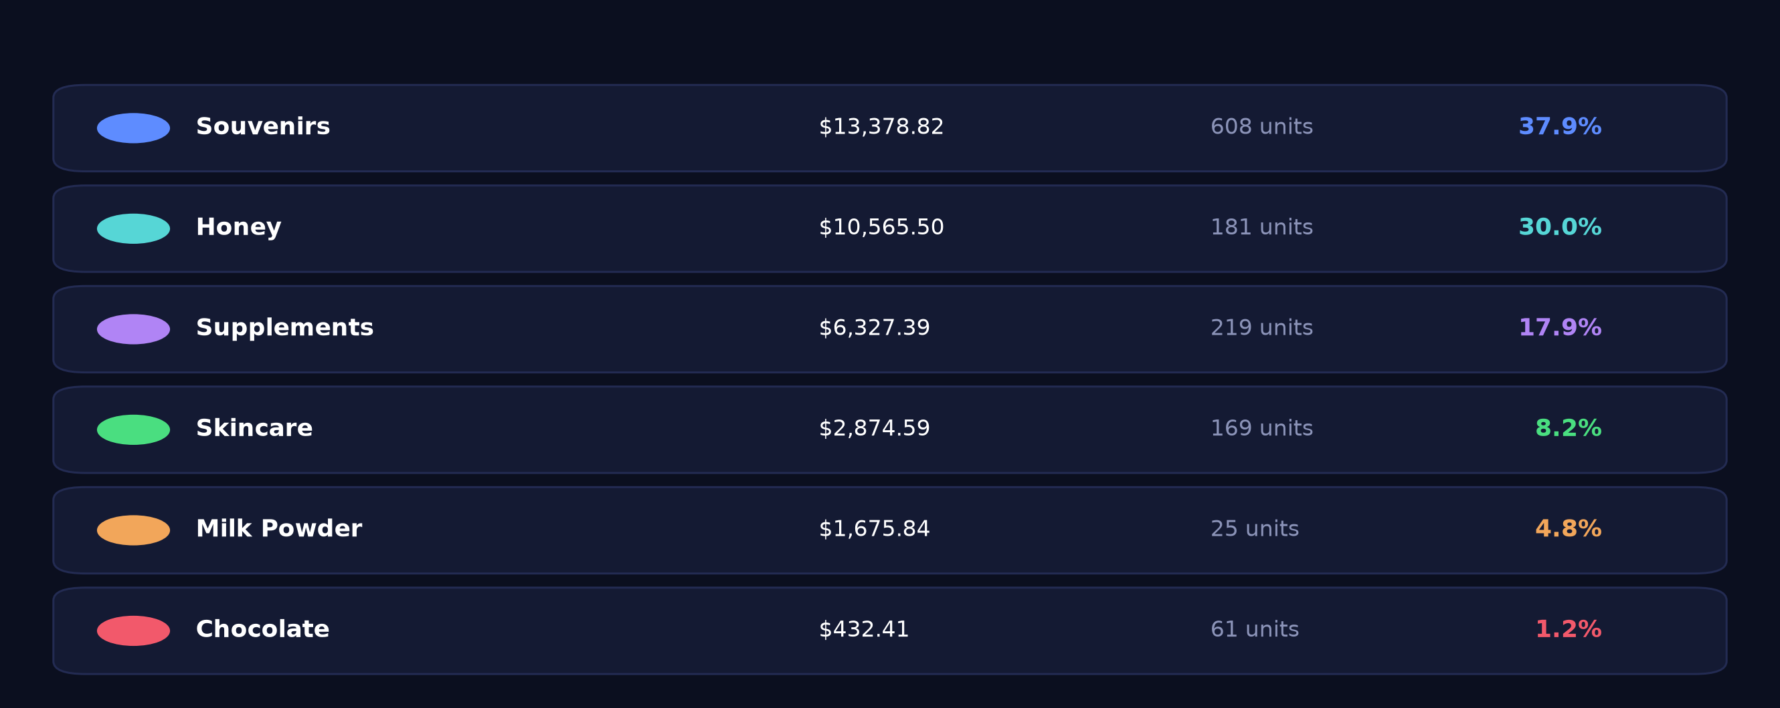
03 · Product structure
Souvenirs 37.9% and honey 30.0% of premium revenue; milk powder 4.8%
Shares are within premium, not of the store — a different denominator from the previous slide

Slide 9
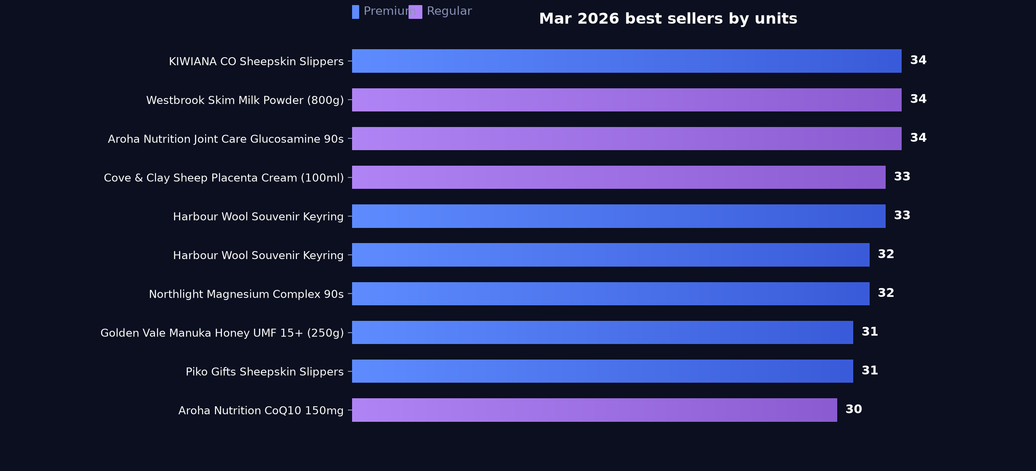
03 · Product structure
Six of the top ten SKUs are premium, led by souvenirs and supplements
Ranked by units sold

Slide 10
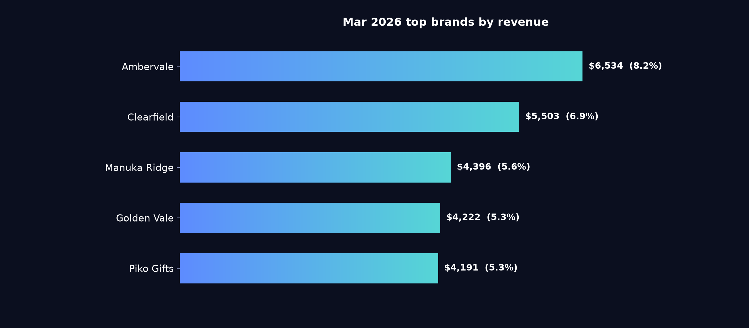
03 · Product structure
Ambervale at 8.2% of store revenue heads the top five
Percentages are share of total store revenue

Slide 11
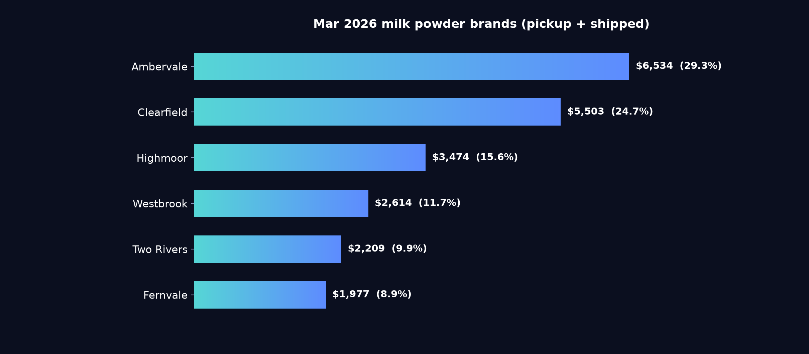
03 · Product structure
Ambervale and Clearfield together hold over half of milk powder revenue
Pickup and shipped combined · percentages are share of the milk powder category, not of the store
Notes
Ambervale takes 29.3% of milk powder revenue and Clearfield 24.7%, with Fernvale lowest of the six listed at 8.9%. The gap between the top two and Highmoor at 15.6% shows where the category's volume sits.

Slide 12
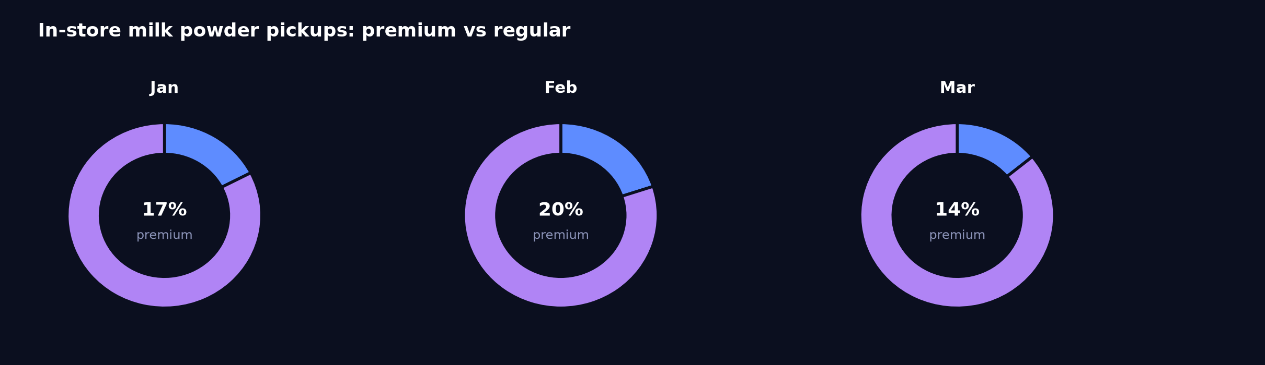
03 · Product structure
Pickup regular revenue NZ$10,231 in March against premium NZ$1,676
Premium marks the range the store is putting in front of customers — it is not a price band
Reading
Regular pickup revenue rose to NZ$10,231.29 from NZ$7,153.60 in February, while premium pickup fell across both February and March to NZ$1,675.84 on 25 units. Premium lines could be given counter space at the pickup point so collection customers see them at the moment of handover.

Slide 13
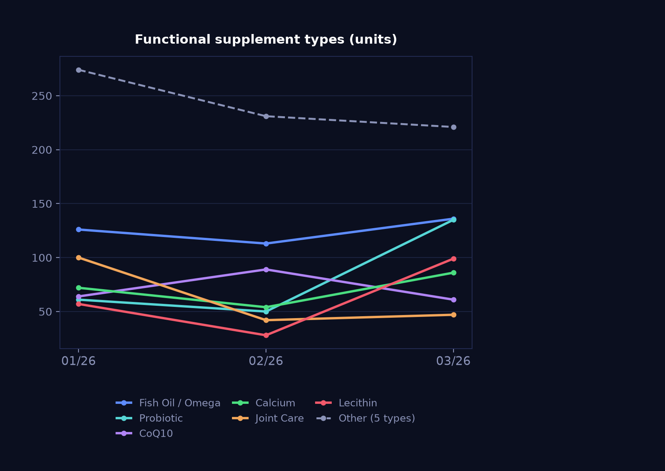
03 · Product structure
Probiotic and lecithin lead March functional revenue; propolis at NZ$466
Units sold · a read on what customers are buying supplements for
Notes
Probiotic reached NZ$3,733.39 in March from NZ$1,051.38 in February, and lecithin NZ$2,713.44 from NZ$629.43, while propolis fell in both February and March to NZ$465.89. Fish oil held the largest single line at NZ$4,270.25.

Slide 14
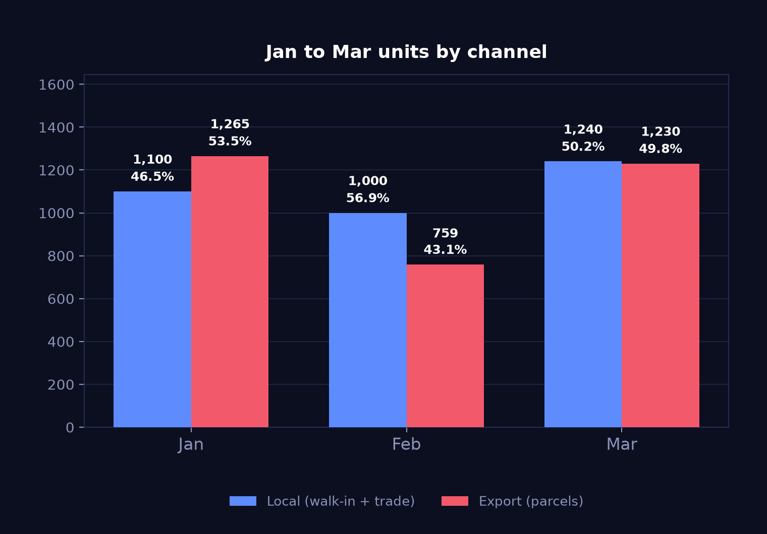
04 · Channels
Export units back to 1,230 in March, close to local at 1,240
Units · grouped rather than stacked, because the two channels move independently
+62.1%
Export units
parcels
+24.0%
Local units
walk-in + trade
Reading
Export units fell 40.0% in February and rose 62.06% in March, a pattern typically affected by Chinese New Year, when cross-border freight and clearance are suspended. Local units rose 24.0% to 1,240, leaving the split at 50.2% local to 49.8% export.

Slide 15
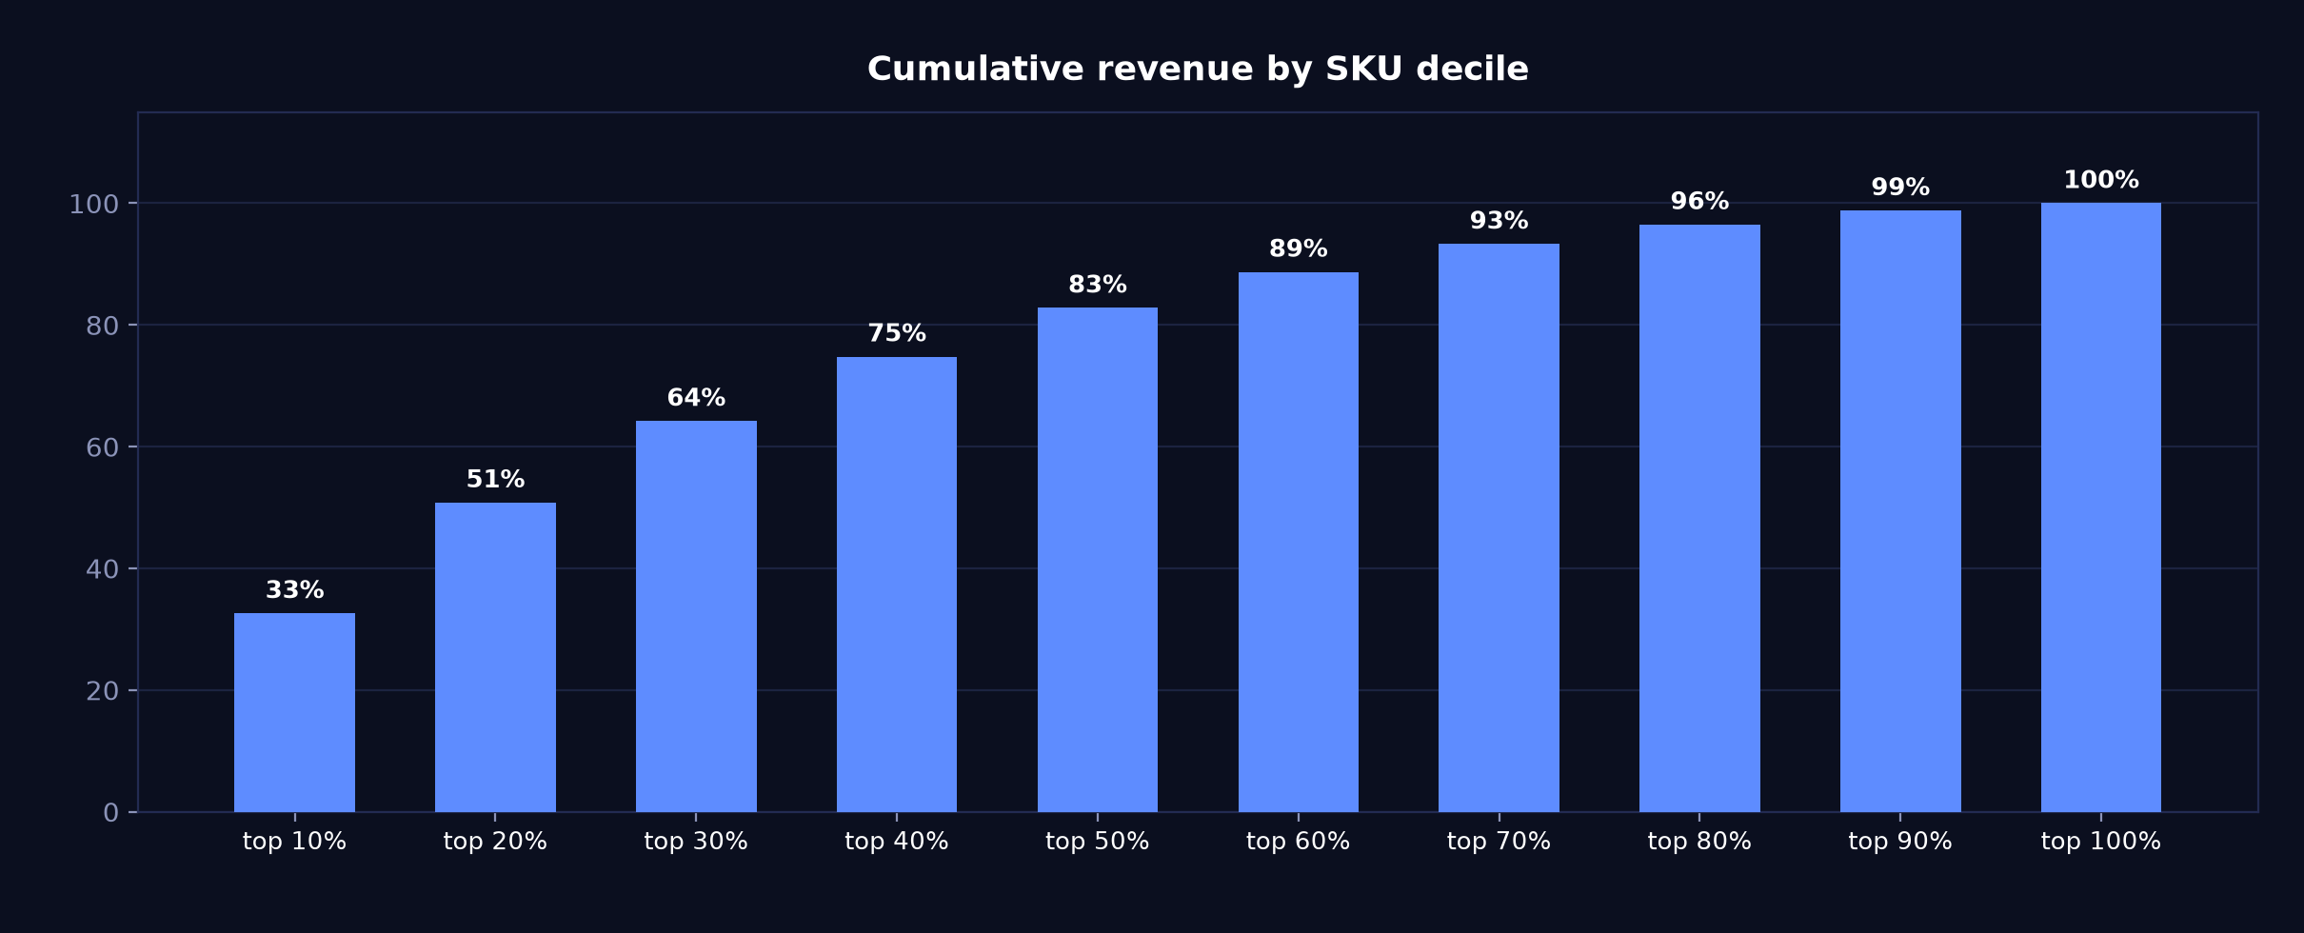
05 · Concentration
Top SKU decile carries 32.6% of revenue; half the range covers 82.8%
Cumulative share of revenue as SKUs are added worst-to-best

Slide 16
06 · Operating context
231 visits and 88 mini-programme leads at a 59.0% completion rate
Entered by hand each month — these figures are not in the POS
231
88
59%
foot traffic
app enquiries
enquiry completion
Tour groups
No tour groups this month.

Slide 17
06 · Operating context
March activity centred on premium supplements
Taken from the note entered in monthly_context.csv
Key points
Premium supplements: 3 for 10% off, or buy 5 get 1 free
All orders: free shipping

Slide 18
Questions on any figure trace back to source
DEMO-CENTRAL · Mar 2026
Generated 2026-08-13 from report_data.json — every number on every slide comes from that one file.

