Slide 1
Monthly Sales Report
Apr 2026 · DEMO-CENTRAL
Figures computed from the sales database. Commentary drafted by a language model and checked against the source data.

Slide 2
Contents
01
Overview
02
Monthly trend
This month's revenue, units and orders, split by tier and category
How the last four months moved, and by how much
03
Product structure
04
Channels
Category mix, the premium range, best sellers, brands
Local walk-in and trade versus export parcels
05
Concentration
06
Operating context
How much of revenue a handful of SKUs carries
Foot traffic, enquiries and this month's campaigns

Slide 3
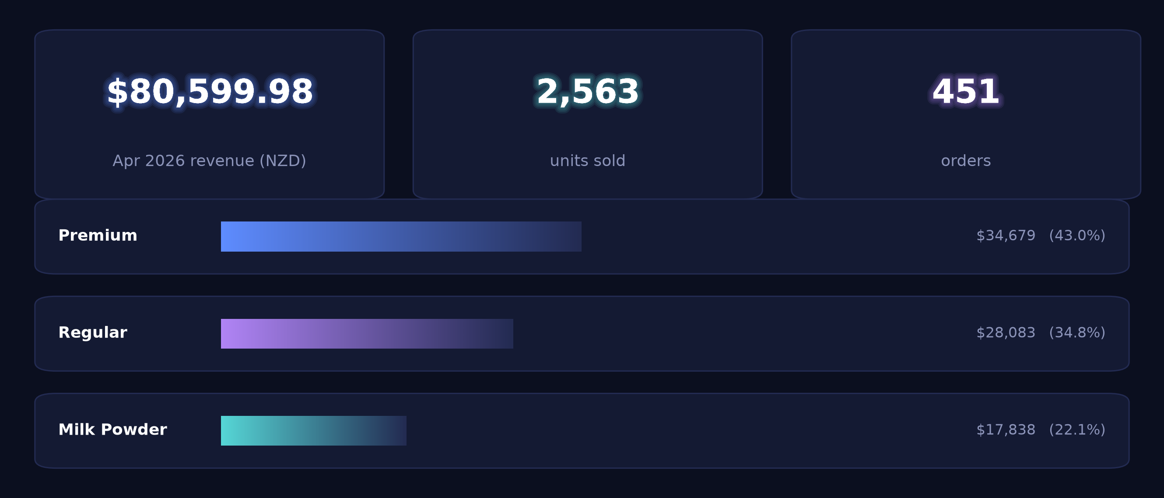
01 · Overview
April revenue NZ$80,599.98 across 451 orders, up 1.77% on March
Average order value $179

Slide 4
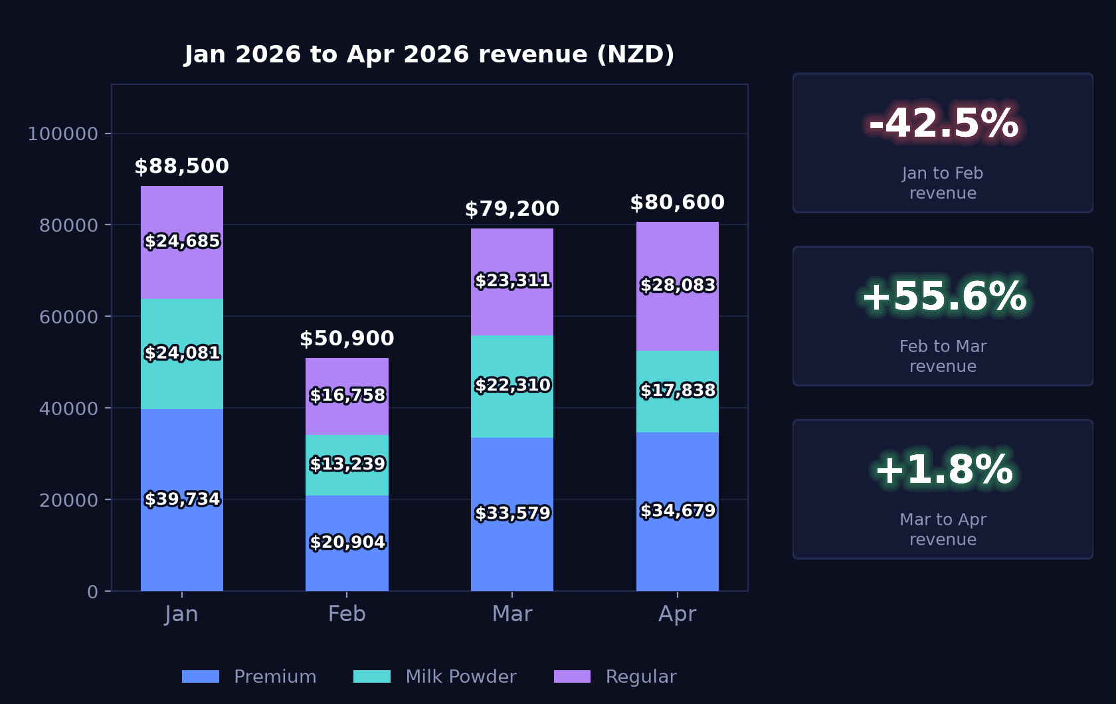
02 · Monthly trend
Revenue steady after the February dip, up 1.77% month on month
Jan 2026 – Apr 2026 · premium / milk powder / regular, stacked (NZD)

Slide 5
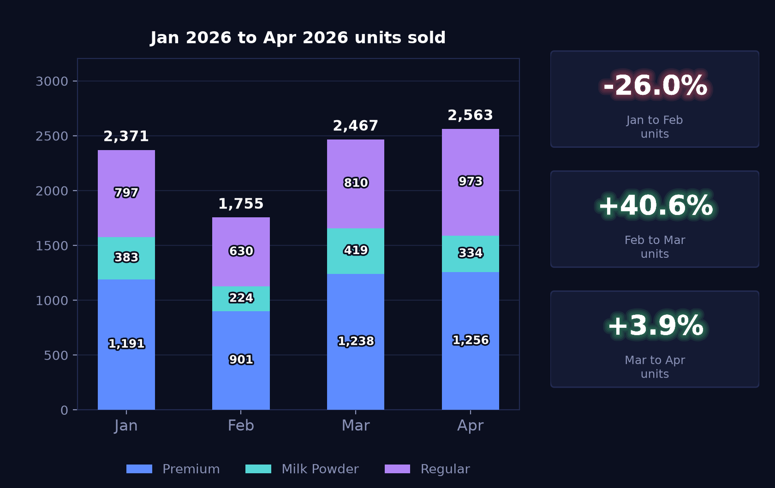
02 · Monthly trend
Units reach 2,563, up 3.89% on March and above the January level
Same three groups by units, so volume can be read separately from value

Slide 6
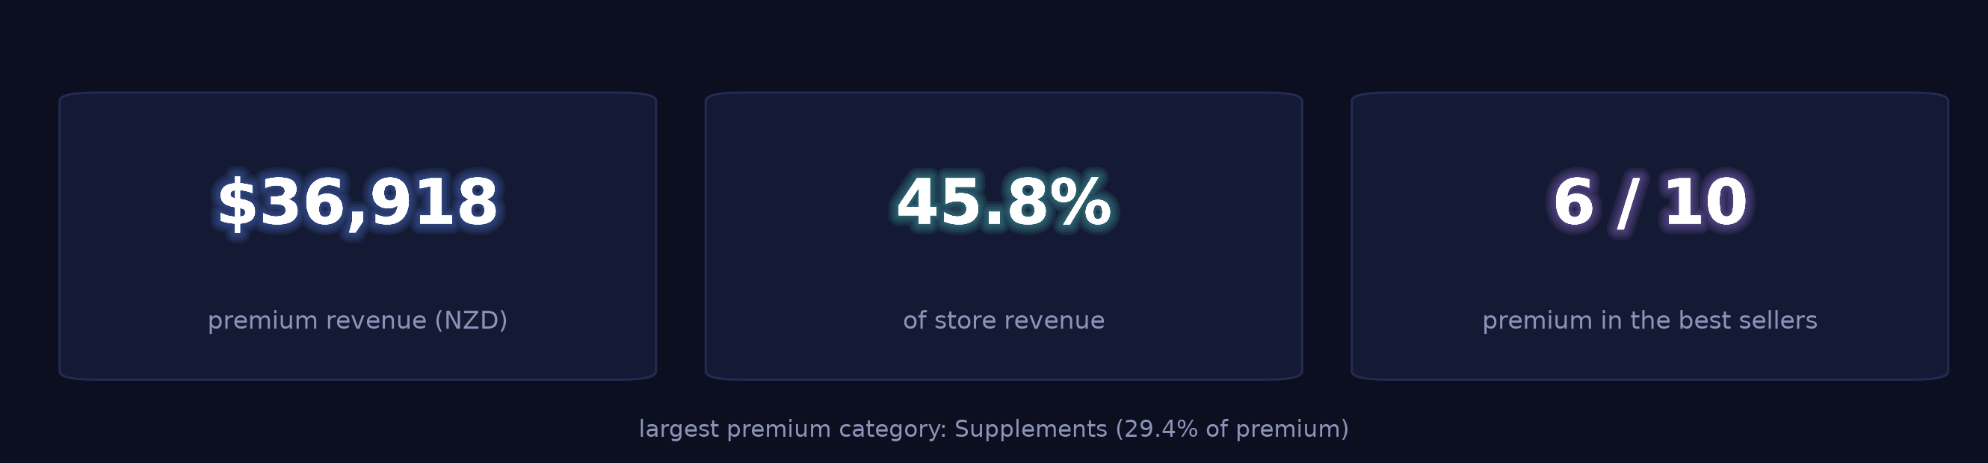
03 · Product structure
Premium lines account for NZ$36,917.92, 45.8% of store revenue
The range the store is putting in front of customers, before the detail

Slide 7
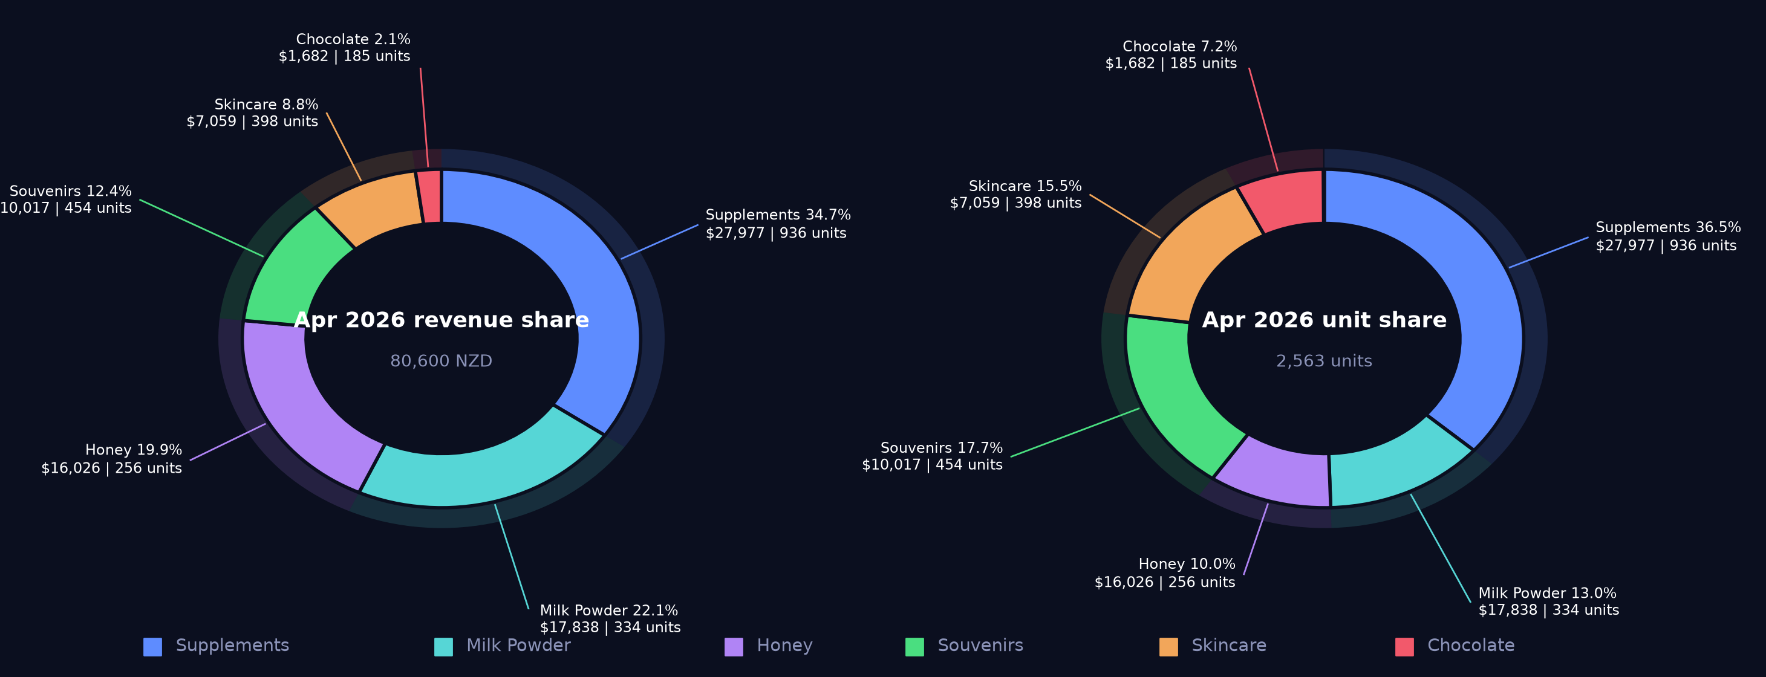
03 · Product structure
Supplement leads at 34.7% of revenue; souvenir takes 17.7% of units on 12.4% of value
Revenue share and unit share side by side — the gap between the two is the unit-price effect

Slide 8
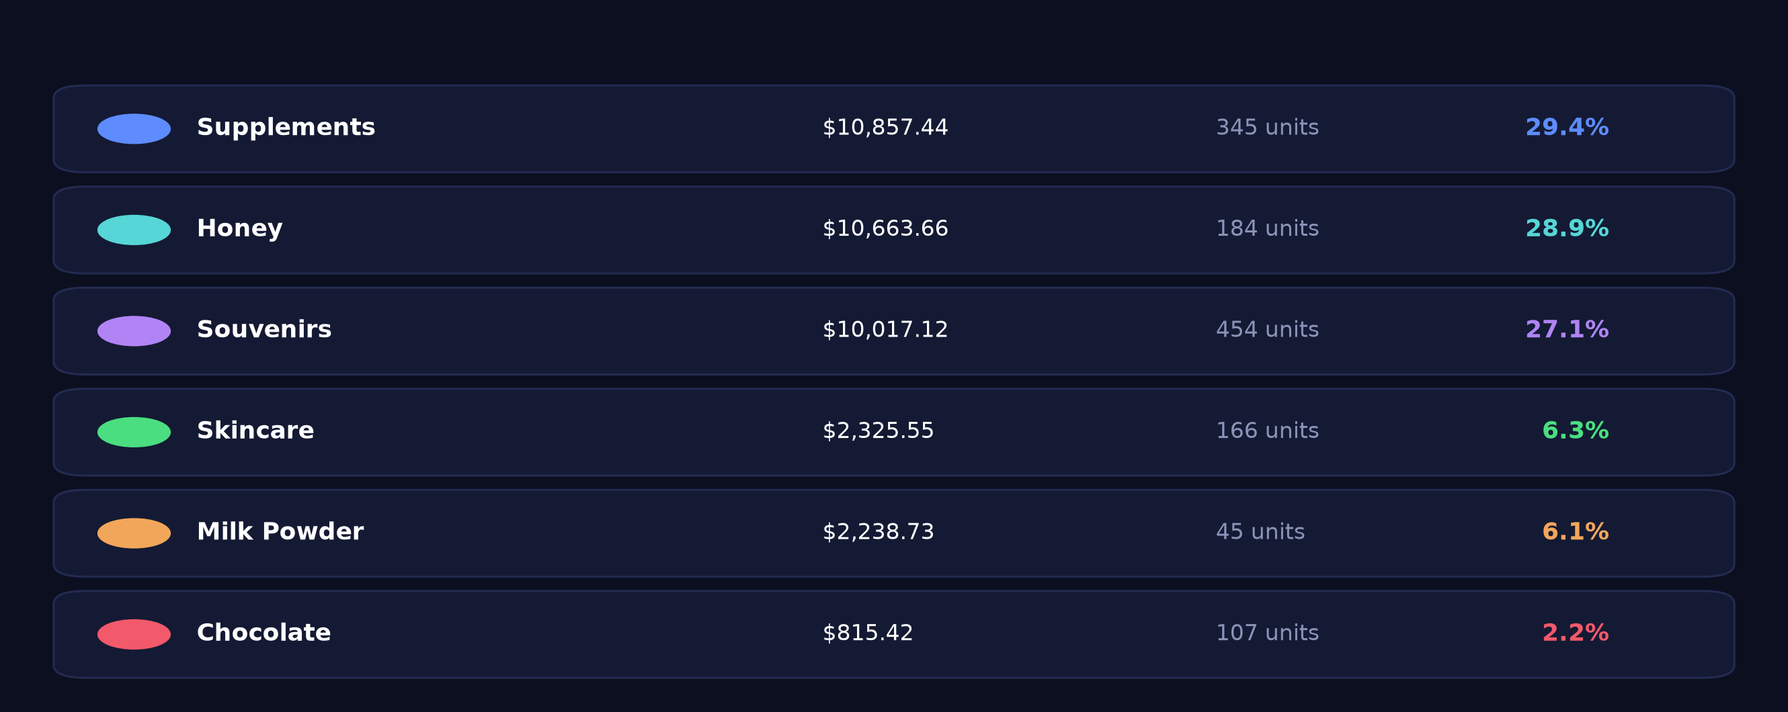
03 · Product structure
Supplement, honey and souvenir each hold roughly a quarter of premium revenue
Shares are within premium, not of the store — a different denominator from the previous slide

Slide 9
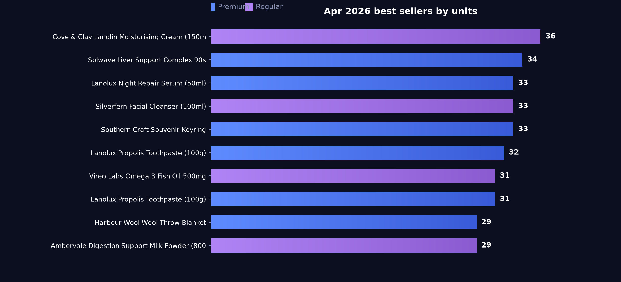
03 · Product structure
Six of the top 10 SKUs are premium, led by Solwave Liver Support Complex
Ranked by units sold

Slide 10
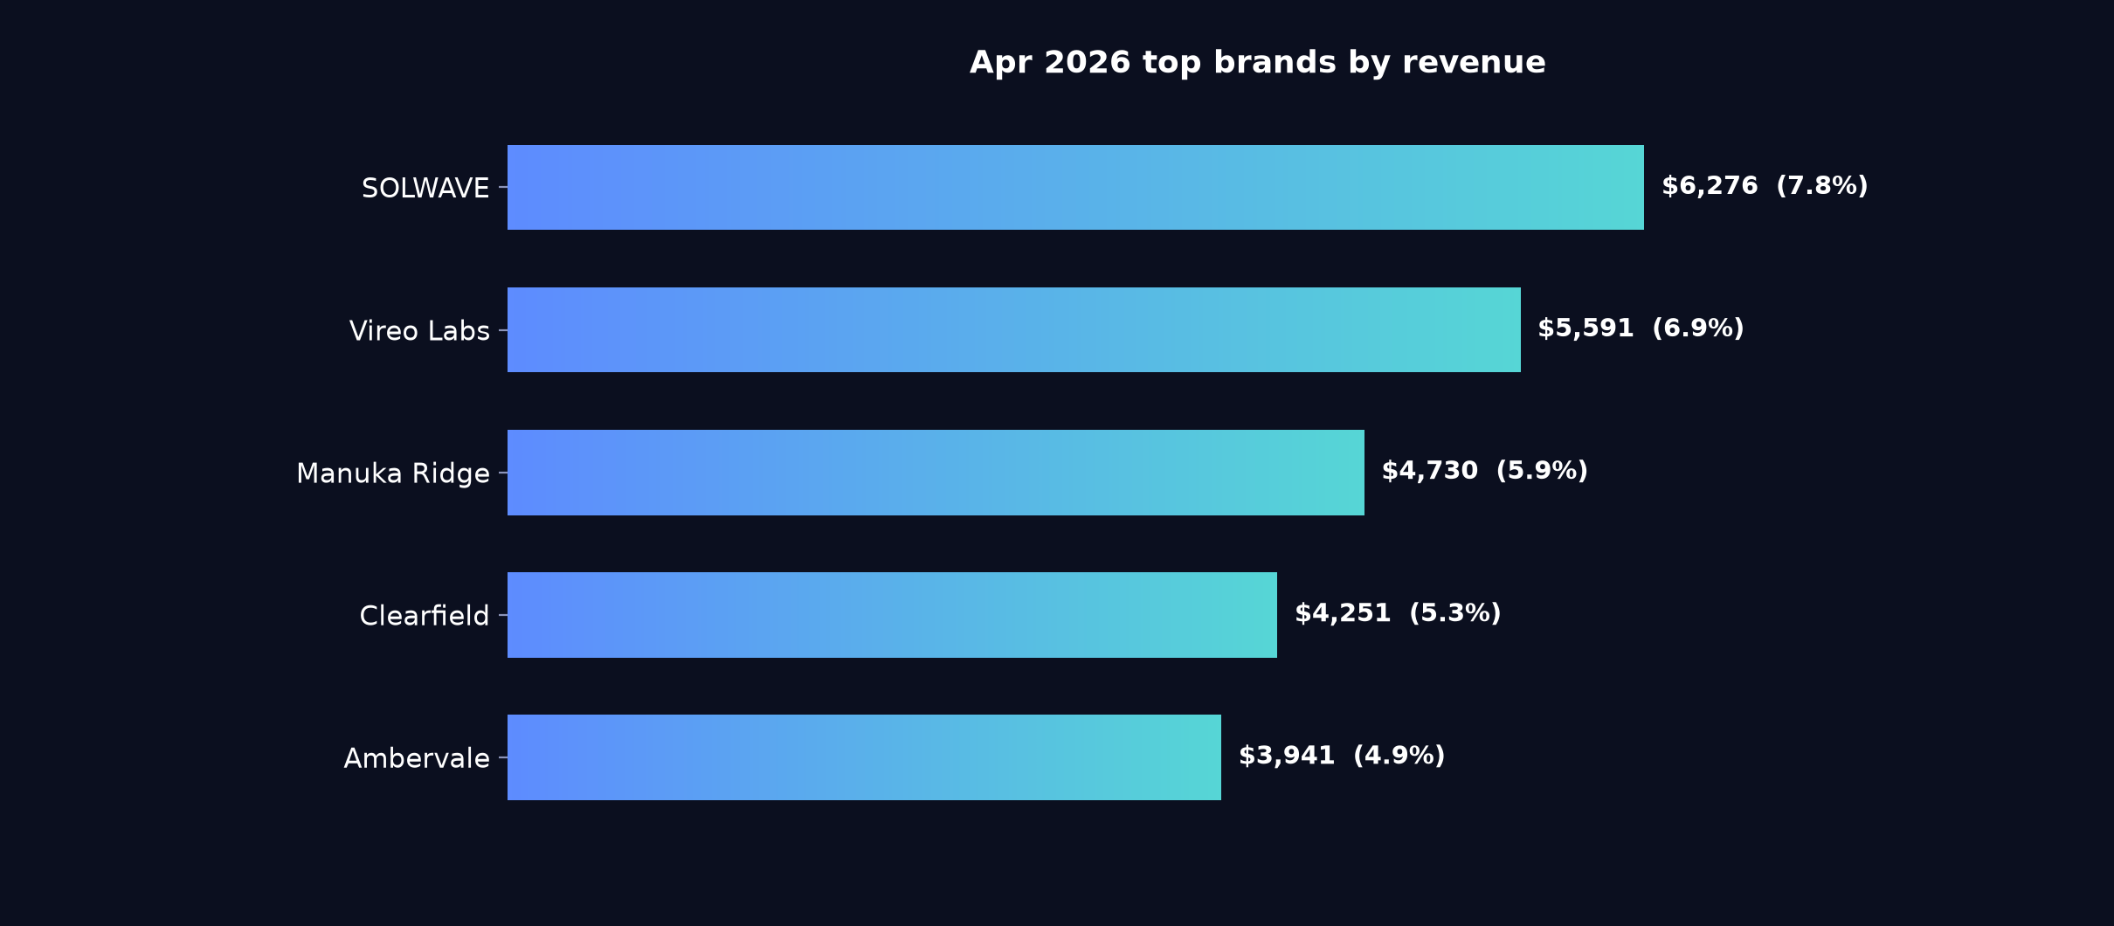
03 · Product structure
Solwave at 7.8% of store revenue heads the supplement brands
Percentages are share of total store revenue

Slide 11
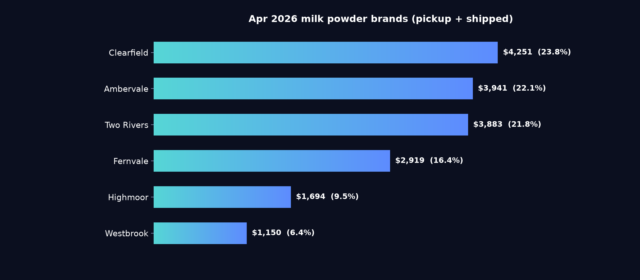
03 · Product structure
Clearfield 23.8% and Ambervale 22.1% split the milk powder category
Pickup and shipped combined · percentages are share of the milk powder category, not of the store
Notes
Clearfield, Ambervale and Two Rivers sit within two points of each other, so no single brand anchors the category; Westbrook at 6.4% is the smallest of the six listed.

Slide 12
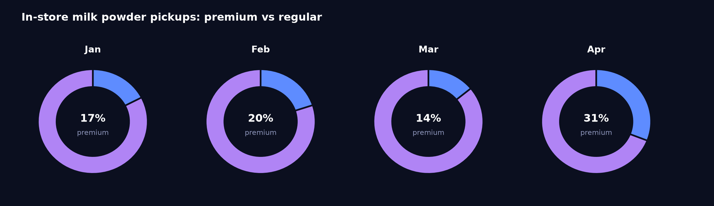
03 · Product structure
Pickup premium rises to NZ$2,238.73 as regular pickup falls to NZ$4,996.31
Premium marks the range the store is putting in front of customers — it is not a price band
Reading
Premium pickup value and units (45) are both the highest of the four months, while regular pickup dropped from NZ$10,231.29 in March. Keep a premium facing at the collection counter so waiting customers see the range.

Slide 13
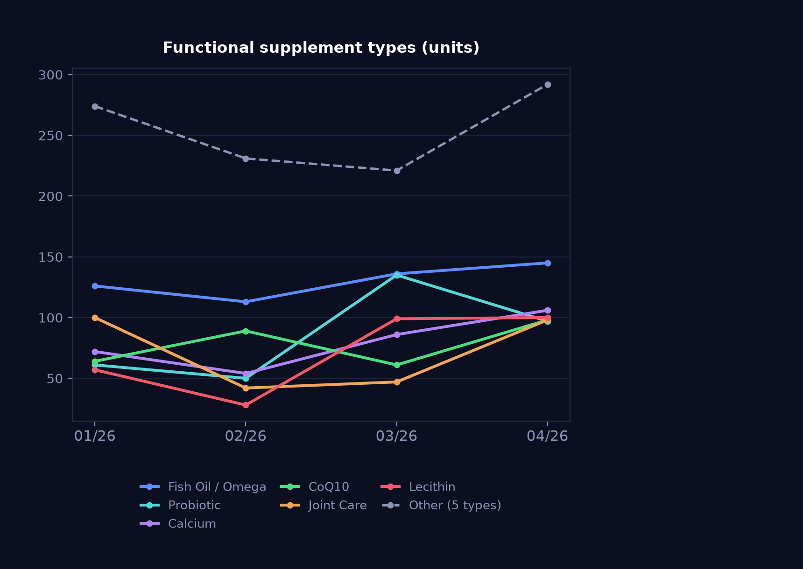
03 · Product structure
Liver support NZ$4,082.87 and fish oil NZ$4,865.41 lead functional lines in April
Units sold · a read on what customers are buying supplements for
Notes
Liver support rose from NZ$862.89 in March to NZ$4,082.87, and joint care from 47 to 98 units; eye care and magnesium both fell back. Group the liver support and fish oil facings together on the supplement bay while demand holds.

Slide 14
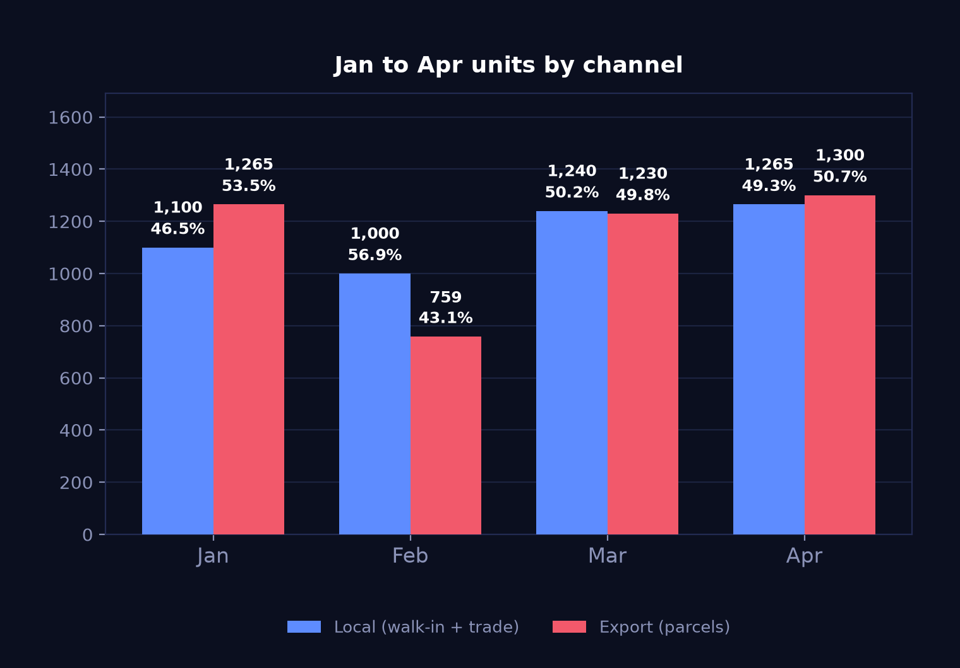
04 · Channels
Export 1,300 units against local 1,265, a 50.7/49.3 split
Units · grouped rather than stacked, because the two channels move independently
+5.7%
Export units
parcels
+2.0%
Local units
walk-in + trade
Reading
Export units rose 5.69% and local 2.02% on March, with export back above the January volume of 1,265 after the February fall that is typically affected by Chinese New Year freight suspension.

Slide 15
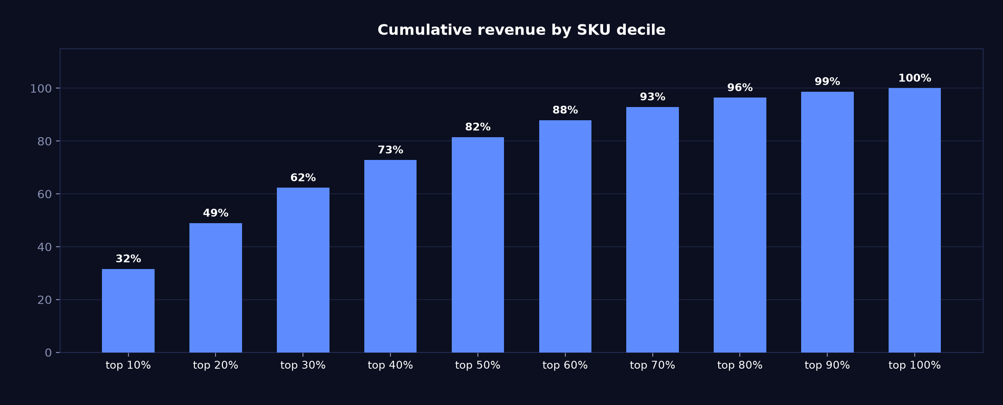
05 · Concentration
Top three deciles of SKUs carry 62.3% of revenue
Cumulative share of revenue as SKUs are added worst-to-best

Slide 16
06 · Operating context
244 visits, 96 mini-programme leads at 63.0% completion, tour group of 30 on 12-14 Apr
Entered by hand each month — these figures are not in the POS
244
96
63%
foot traffic
app enquiries
enquiry completion
Tour groups
12-14 Apr, tour group of 30

Slide 17
06 · Operating context
Autumn health check promo and new honey range launch
Taken from the note entered in monthly_context.csv
Key points
Supplement shoppers: autumn health check promotion
Honey range: new range launch

Slide 18
Questions on any figure trace back to source
DEMO-CENTRAL · Apr 2026
Generated 2026-08-13 from report_data.json — every number on every slide comes from that one file.

