Slide 1
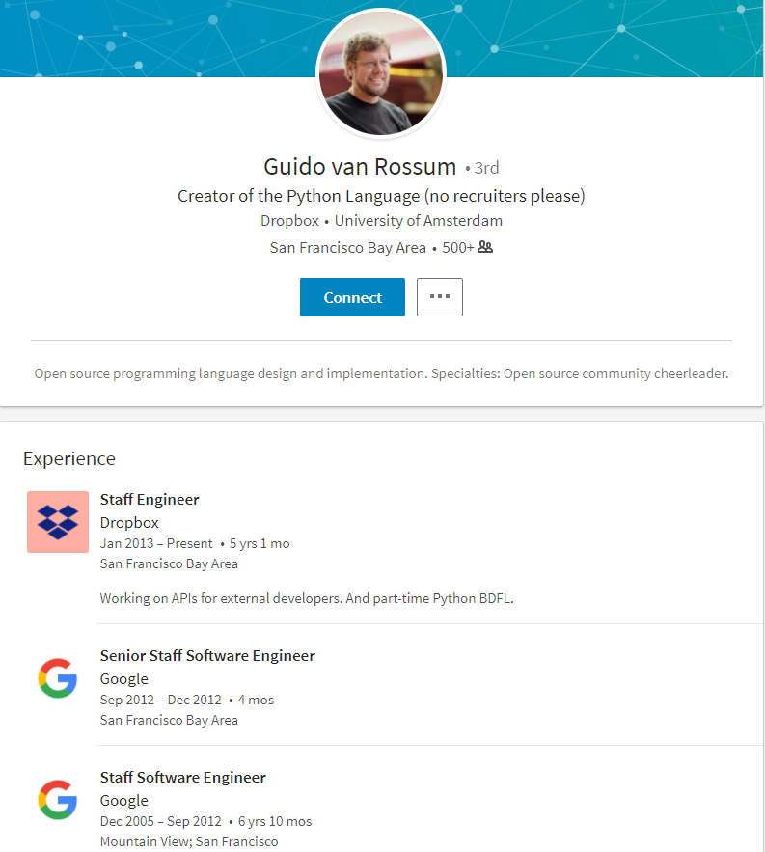
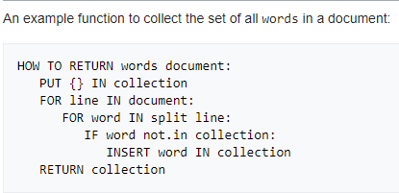
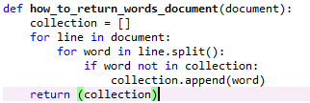
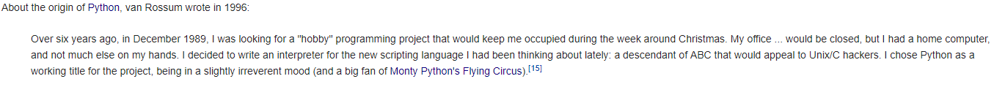
In a nutshell …
High-level programming language for general-purpose programming
Supports multiple programming paradigms
Object-oriented
Functional
Procedural
Imperative
Easy interface with other languages, such as C++/Java
A large and comprehensive standard library
Not so fast though …
ABC
Python

Slide 2
ABC
Python

Slide 3
Python2 or Python3?
Python 2.x is legacy, Python 3.x is the present and future of the language
The final 2.x version 2.7 release came out in mid-2010, with a statement of extended support for this end of life release. There is no new major releases after that.
Python 3.0 was released in 2008. 3.x is under active development and has already seen multiple stable releases. All recent standard library improvements are only available by default in Python 3.x (latest: 3.6.3 released on 2017-10-03).
Python 2.7 will not be maintained past 2020, although official date has not been given.
Differences:
Most obvious one: print function
print ‘abc’ vs. print(‘abc’)
There are still many packages/libraries only support Python2 …

Slide 4
Module management tools
pip (preferred installer program) is a package management system used to install and manage software packages written in Python.
Python 2.7.9 and later (on the python2 series), and Python 3.4 and later include pip (pip3 for Python 3) by default
Example:
pip help
pip search package-name
pip install package-name
pip uninstall package-name
pip list
pip freeze [> requirements.txt]
pip install –r requirements.txt
virtualenv to create isolated Python environments with different python versions or different sets of packages/libraries for different developing purposes.
Anaconda is a distribution of Python data science and machine learning packages/libraries. It also has its own module management tool called conda.

Slide 5



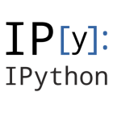


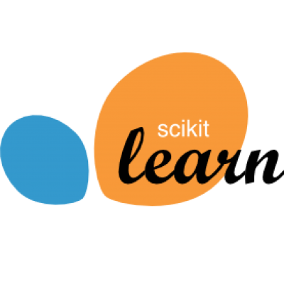
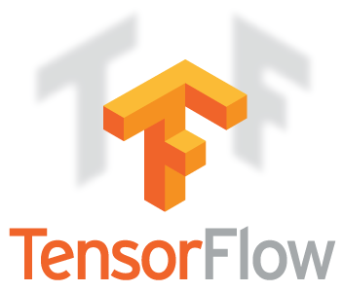

General use cases and libraries
Data analysis
The Scipy eco-system
Numpy
Base N-dimensional array package
Scipy
Fundamental library for scientific computing
Matplotlib
2D plotting library
Example: pyplot (provides a matlab-like interface)
IPython
Interactive shell interface
Jupyter notebook(https://github.com/jupyter/jupyter/wiki/Jupyter-kernels)
Sympy
Symbolic mathematics
Pandas
Dataframe
Sci-kit Learn
TensorFlow
PyTorch

Slide 6




Web and internet development
Django
Instagram, Bitbucket, Firefox, etc.
Pyramid
Dropbox, Quora, etc.
[Micro-framework]
Flask
Pinterest, Lyft backend, Obama 2012 campaign, etc.
Bottle

Slide 7
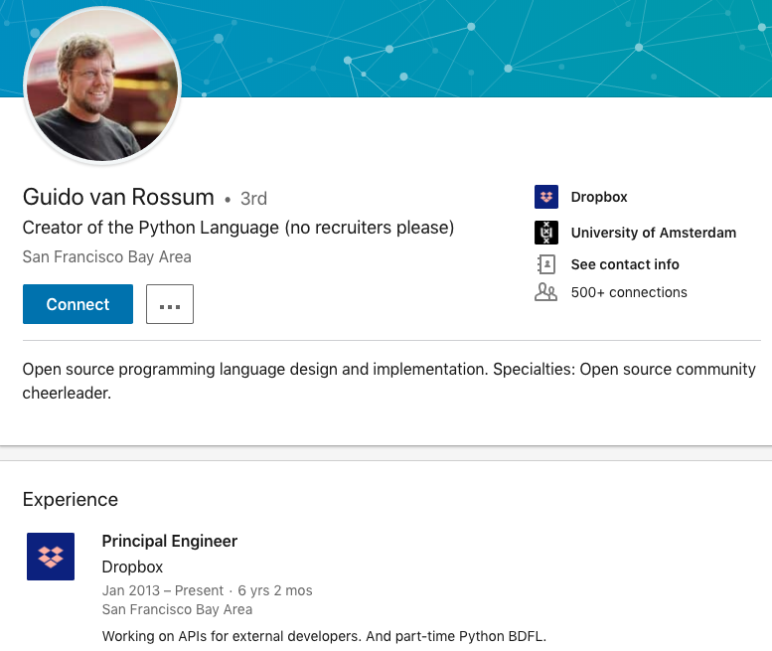
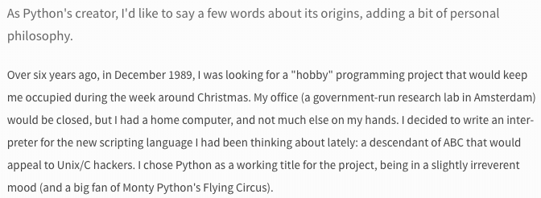
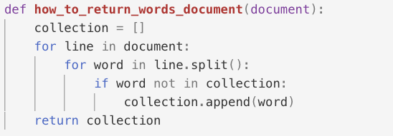
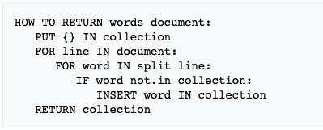

Slide 8

numpy
scipy
statsmodels
matplotlib
Sci-kit learn
ipython
TensorFlow
pandas
pytorch
Analytics
Data Science
Web Development

Slide 9
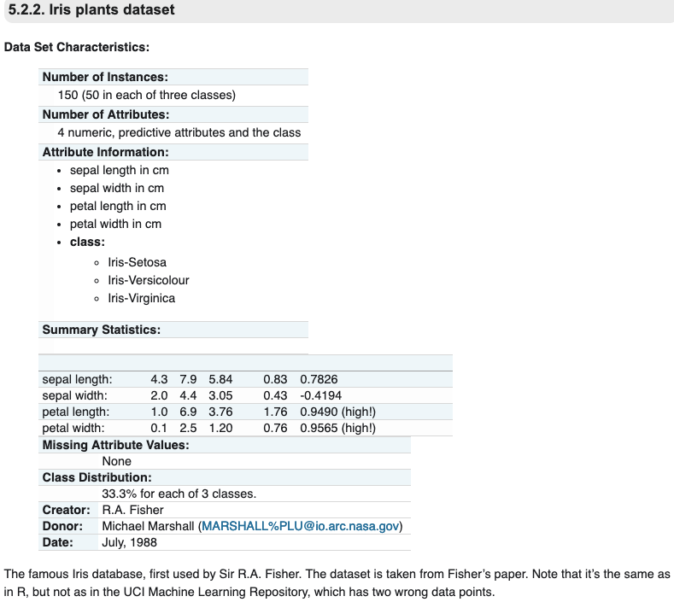
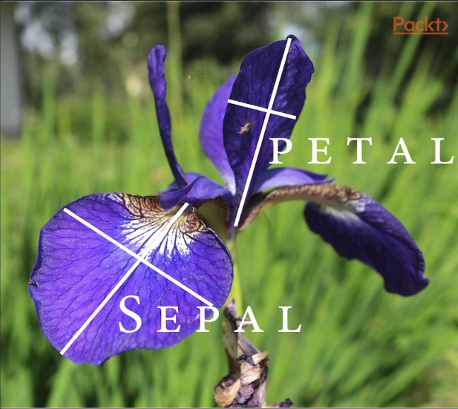

Slide 10
Copyright © 2019 Xiangshi Yin

