Slide 1
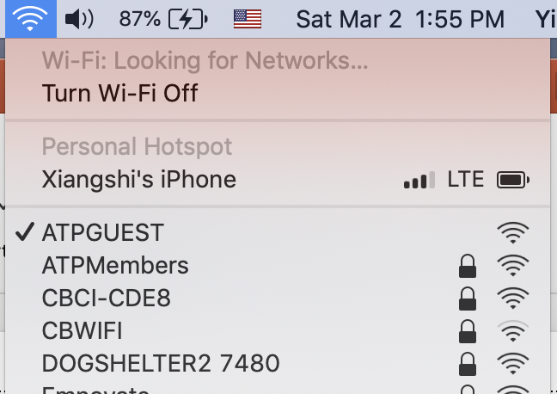
Please choose ATPGUEST in wiki network list, and click link from the pop-up window or browser page to register (free) to enable the connection

