Slide 1
Word2Vec
Xiangshi Yin
5/10/2019

Slide 2
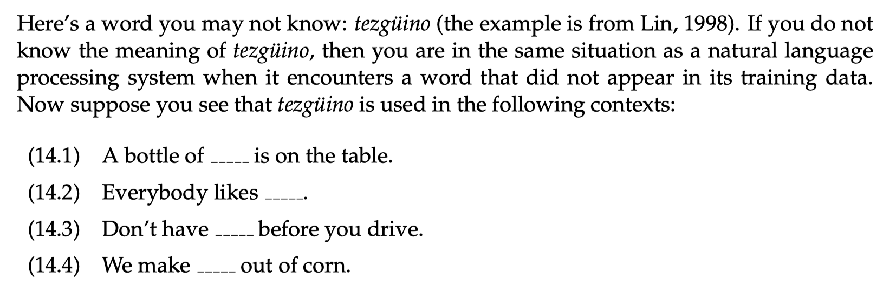

Slide 3
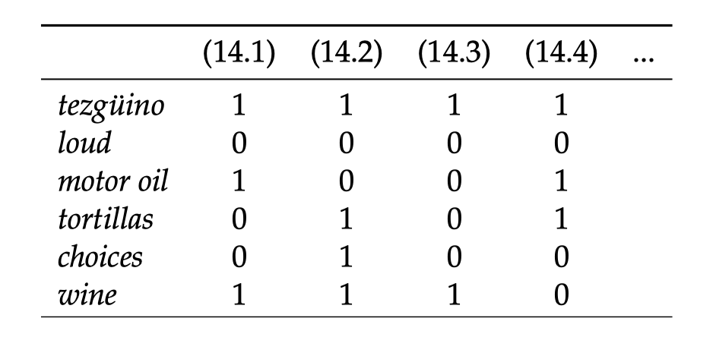
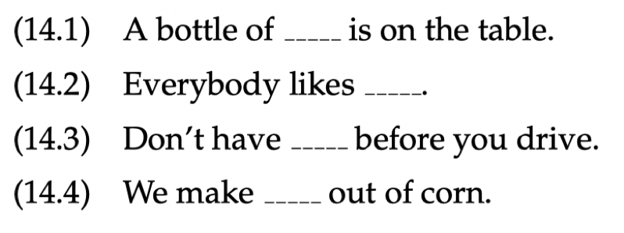

Slide 4
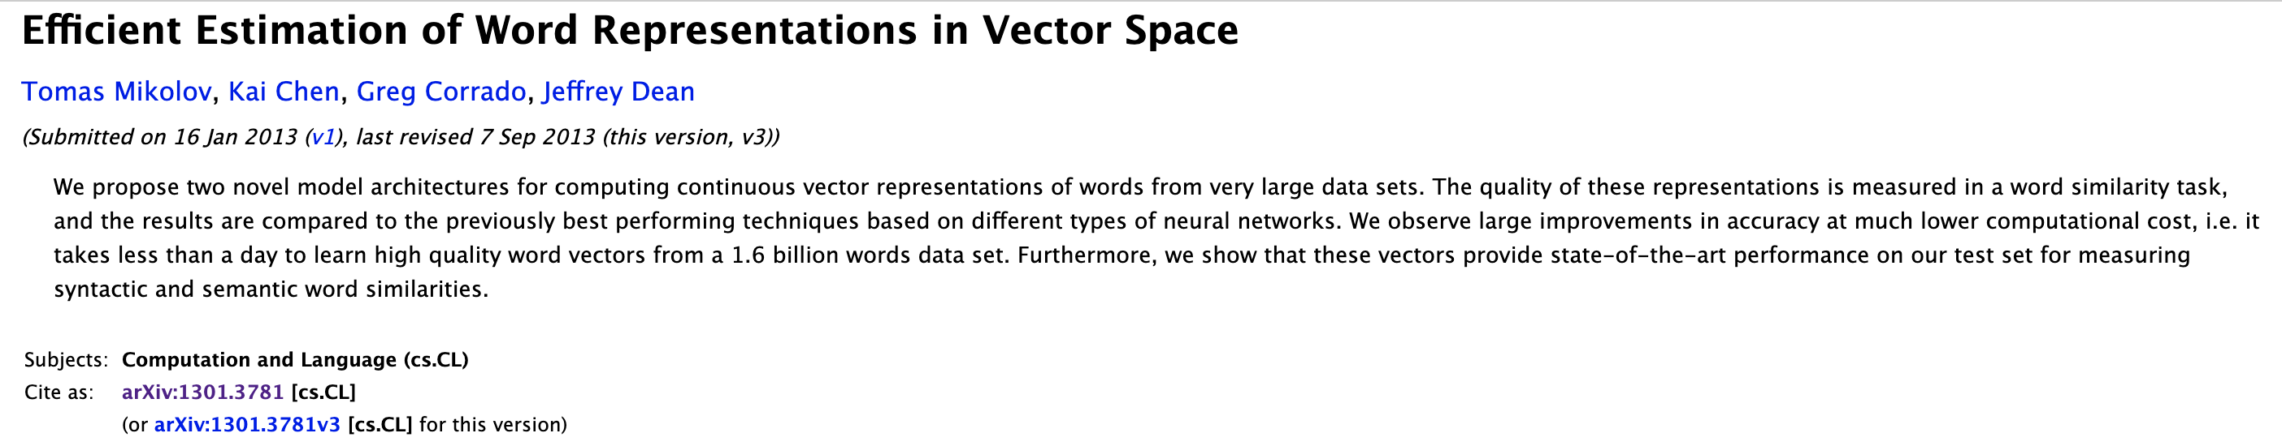
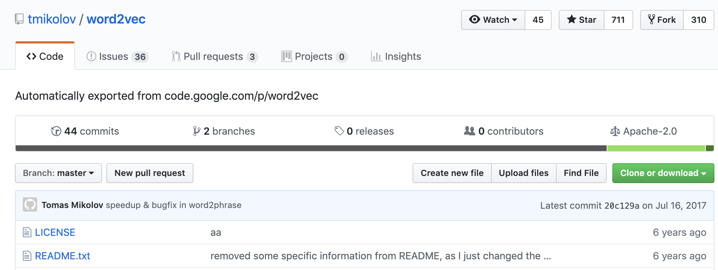

Slide 5
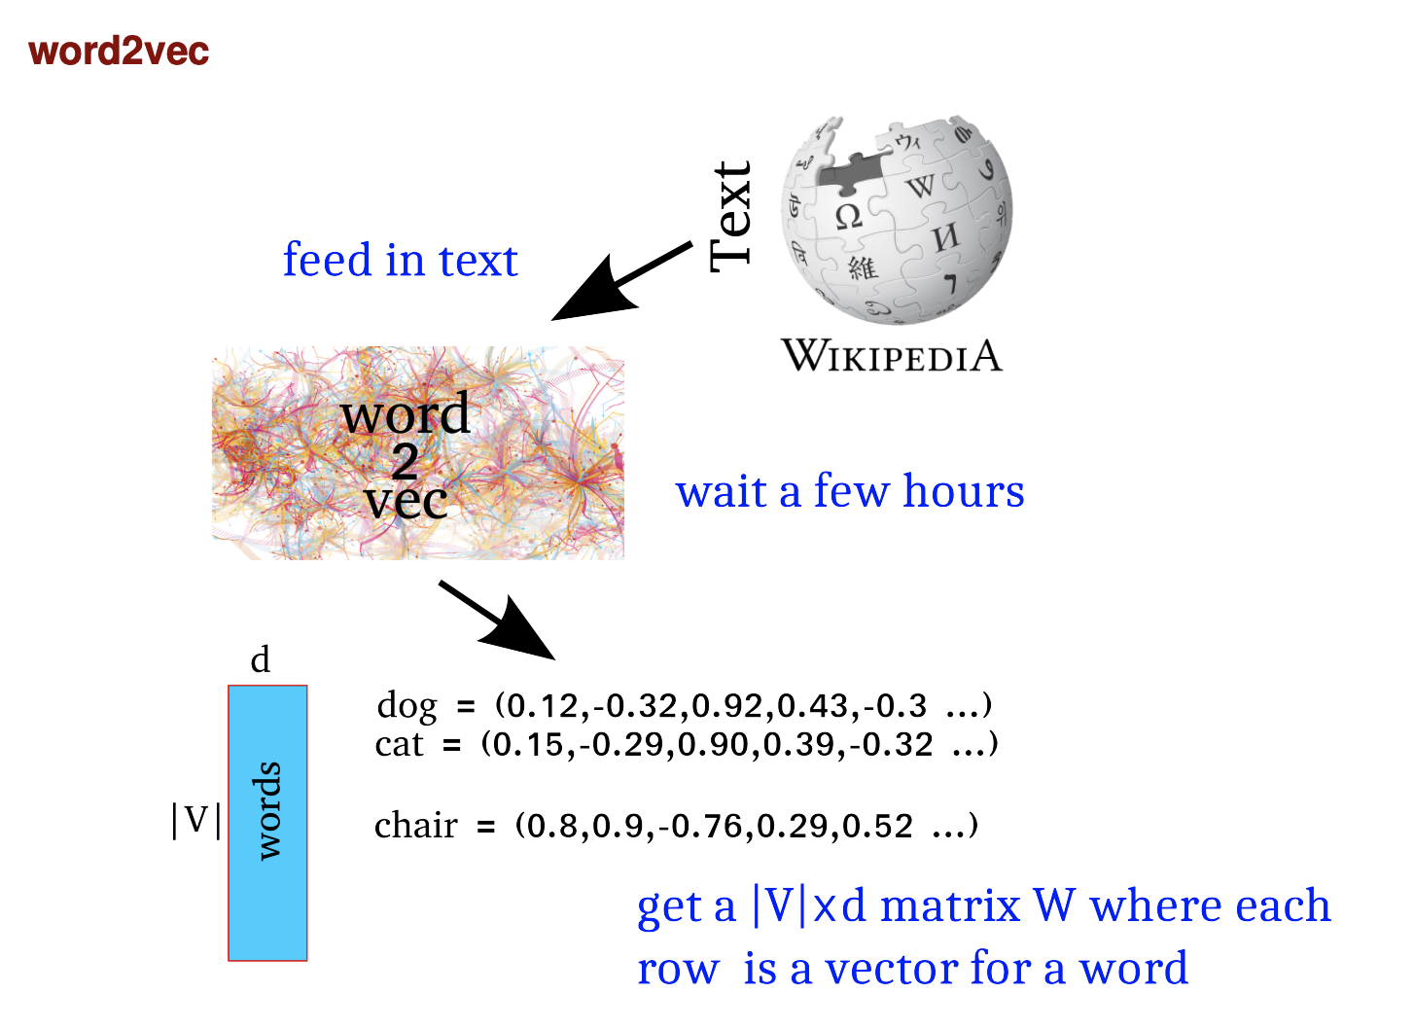

Slide 6
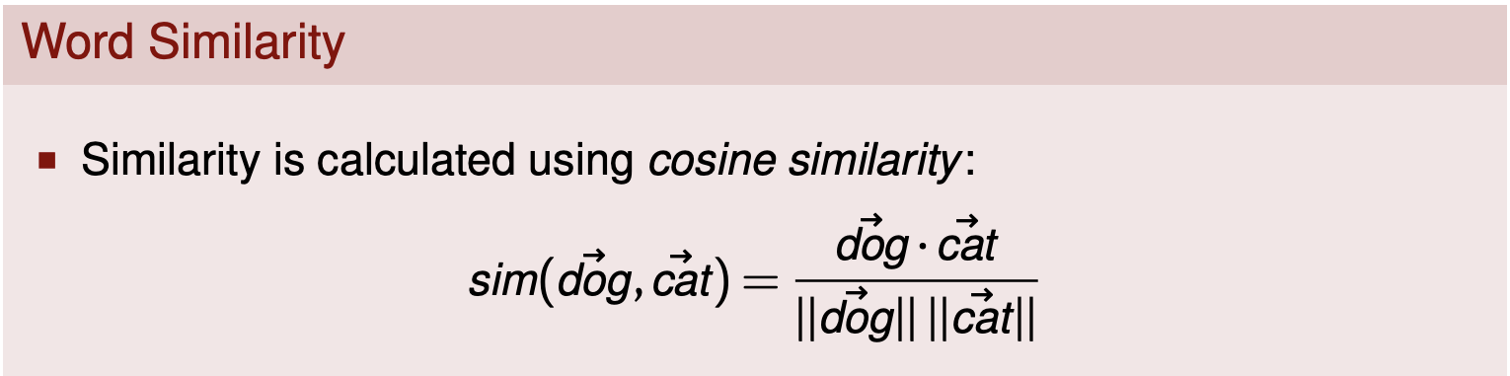
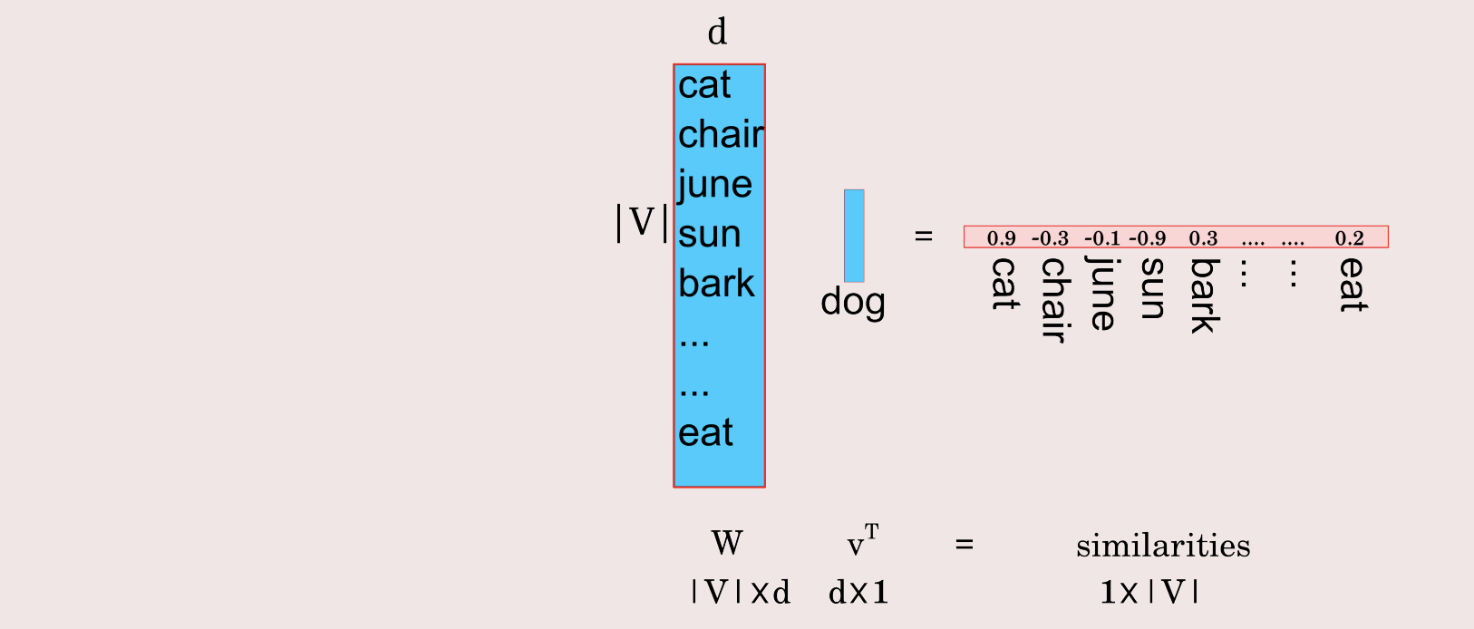

Slide 7
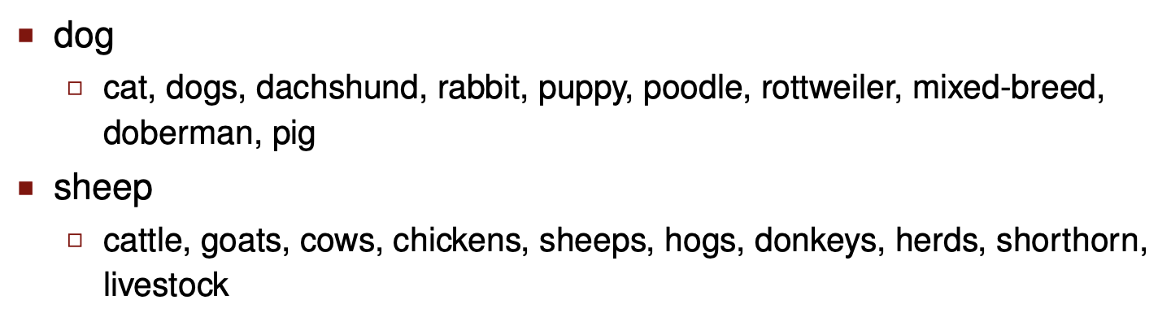

Slide 8
Two flavors of Word2Vec embedding
Skip-Gram Model
Use the current word of to predict its neighbors (its context)
The dog chews the bone
Typically better for larger data sets
CBOW (Continuous Bag of Words)
Use each of these contexts to predict the current word
The dog chews the bone
Typically better for smaller data sets
The limit on the number of words in each context is determined by a parameter called “window size”.

Slide 9
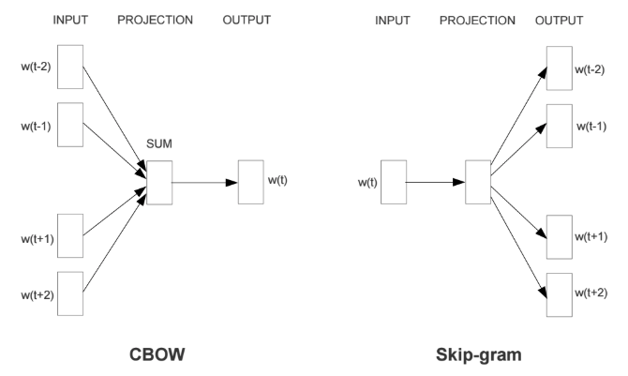

Slide 10
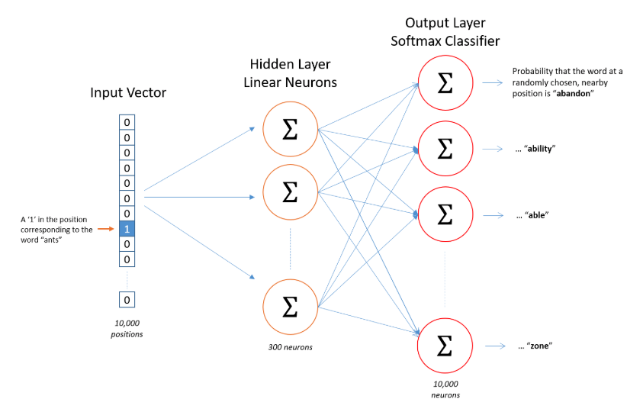

Slide 11
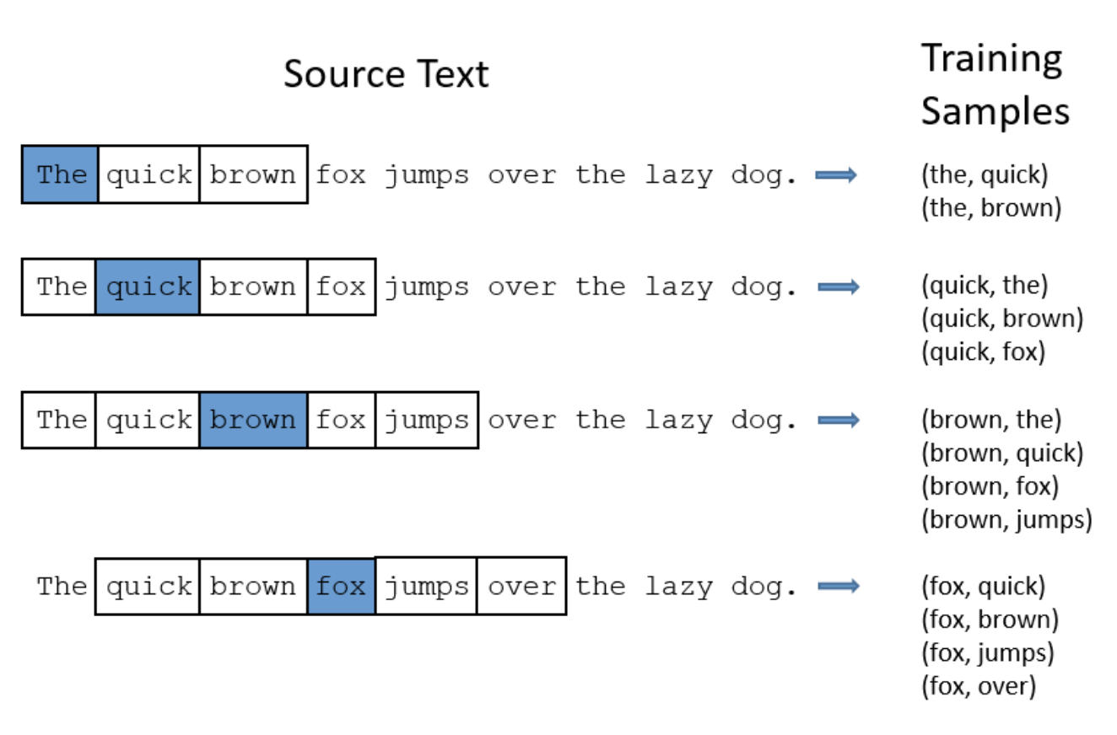
The Skip-Gram Model

Slide 12
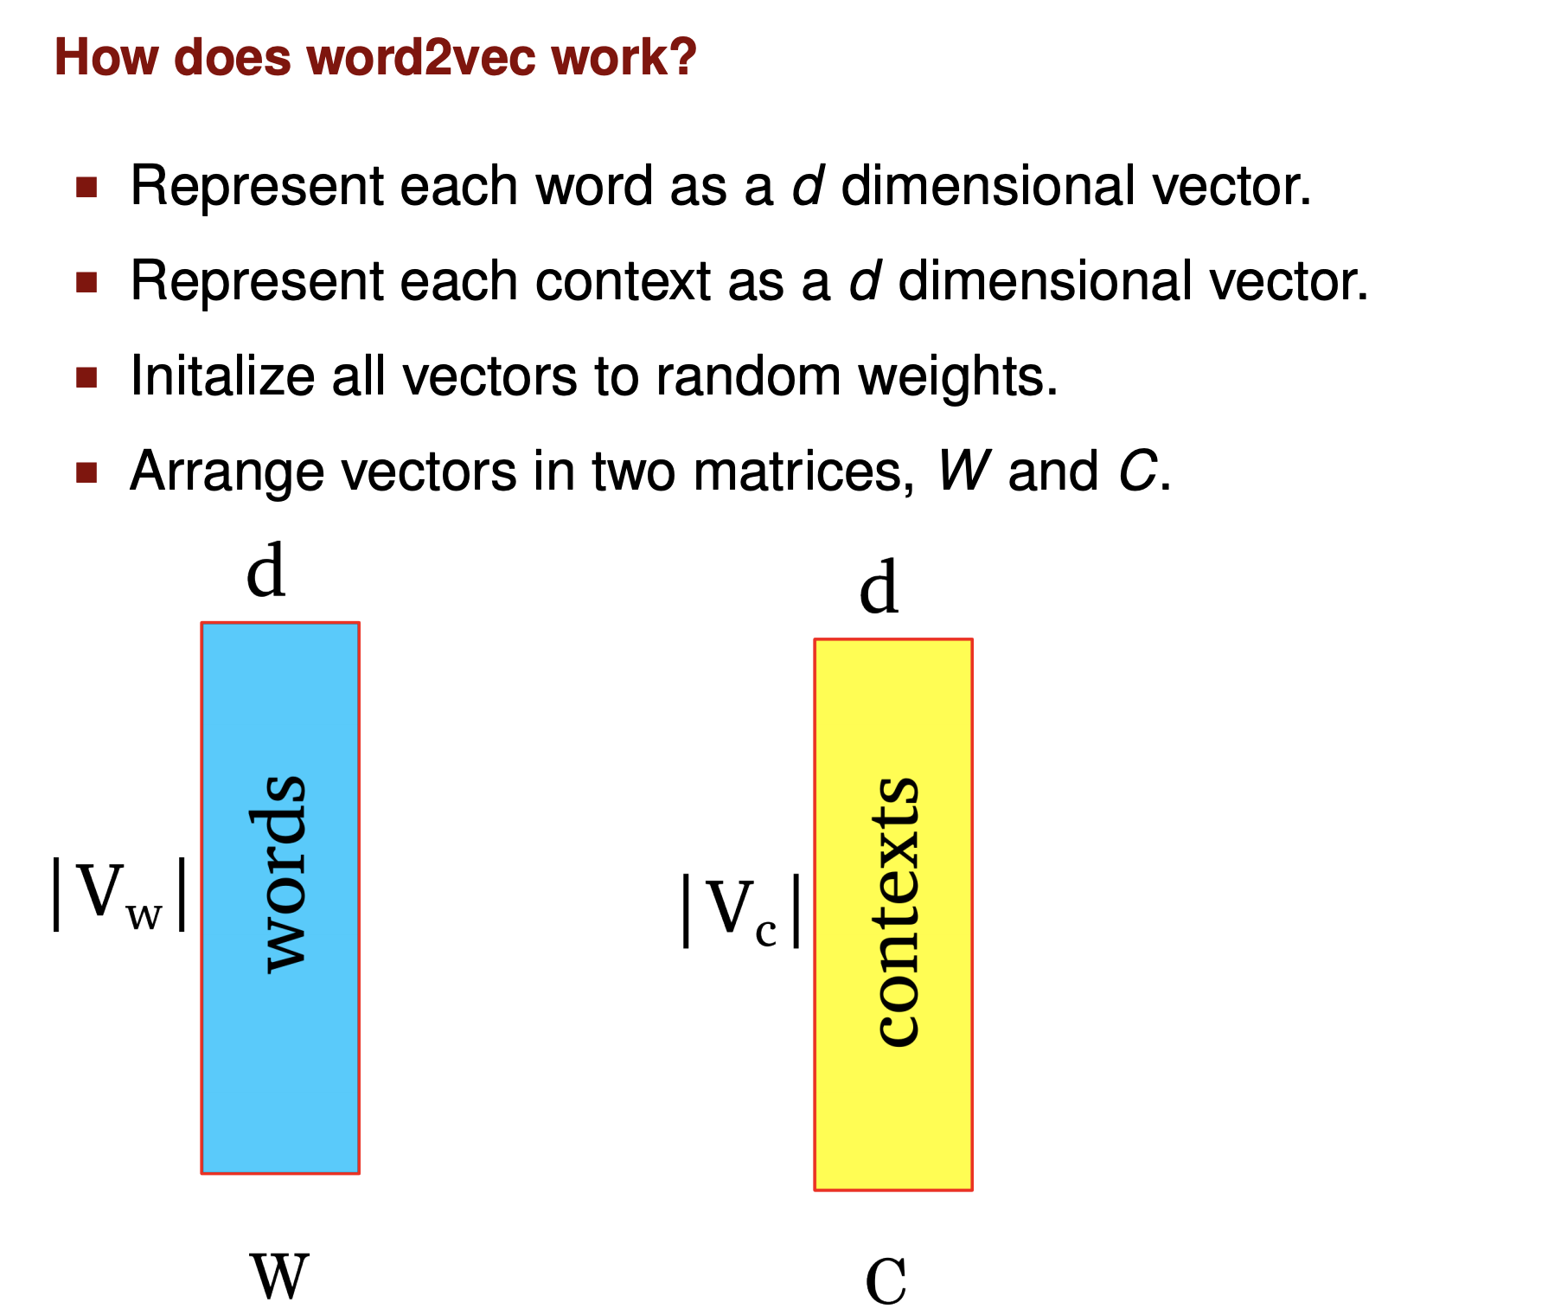

Slide 13
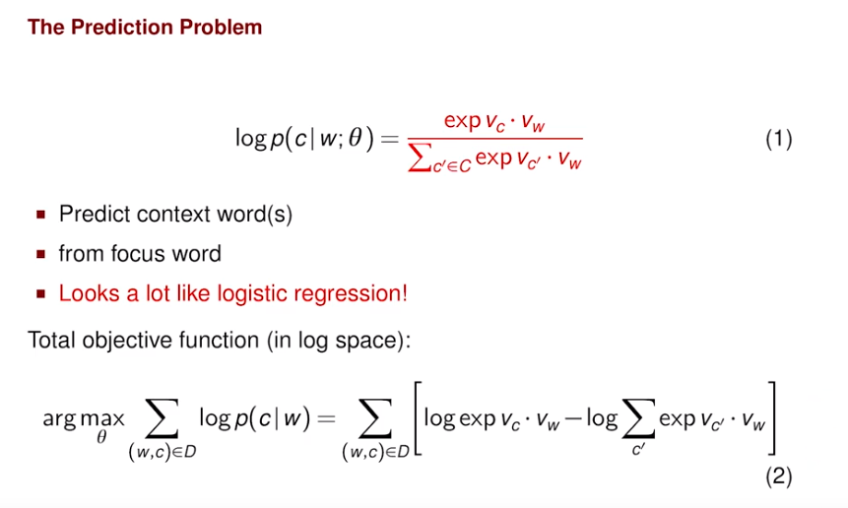

Slide 14
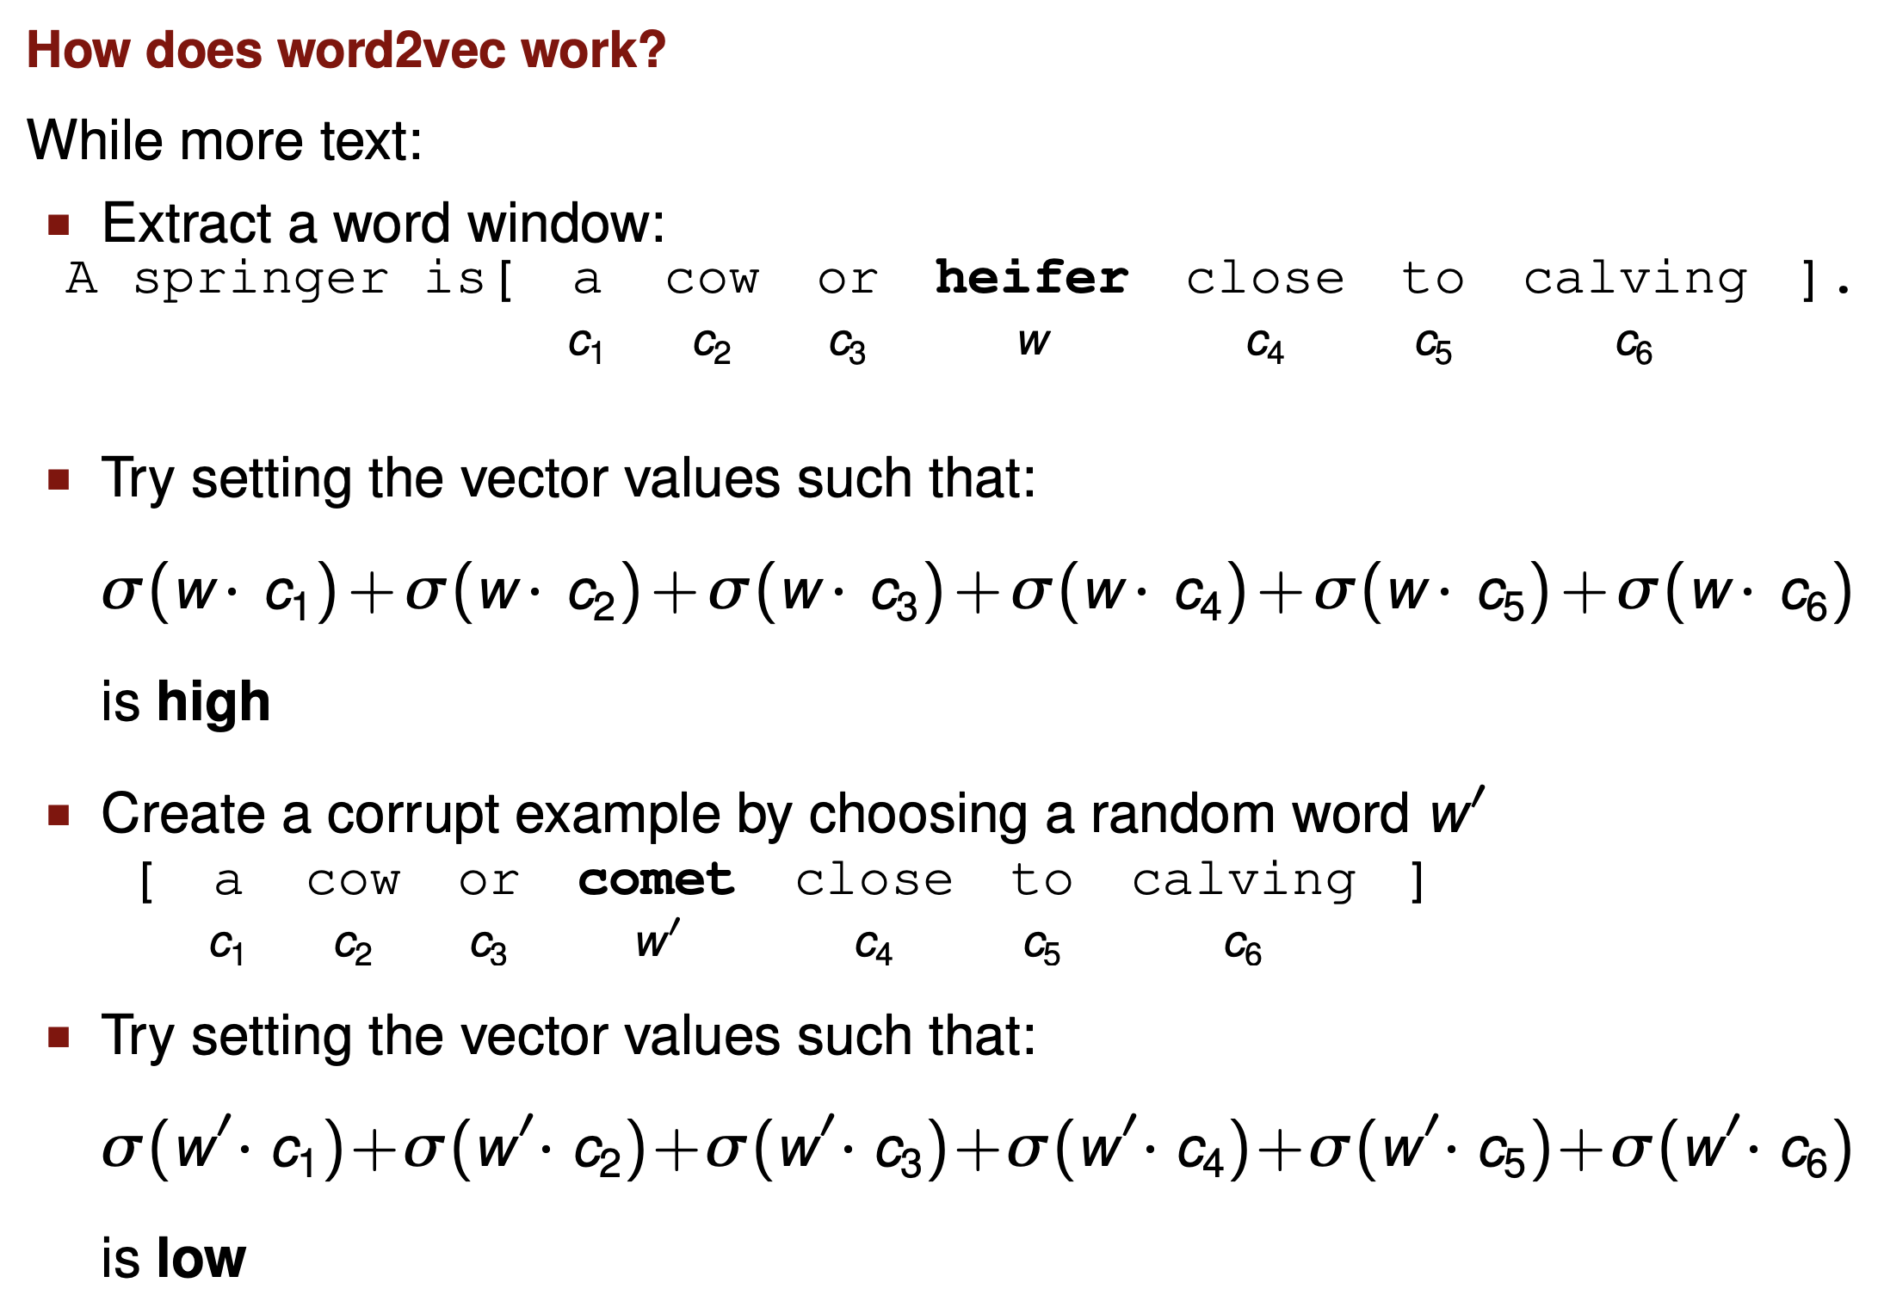

Slide 15
