Slide 1
Report about the experiments on learning parameters of different queueing network
Discriminator choice: LSTM/simple RNN vs Conv1d
System structure and distributions
Experiments:
3.1 settings
3.2 input flow
Homogeneous poisson process
Nonhomogeneous poisson process
A simple case of cox process: mixed poisson process
3.3 a tough task: Situations when we could only get the states of the network sometimes
3.4 learning the routing of the network

Slide 2
1. Discriminator choice: LSTM vs (1d-CNN+Linear)
Data that we have: the time when customers enter or leave nodes in the system, namely
the arrival and exit time sequences of each node(extracted from ciw’s records), without any information about a specific individual.
1d-CNN+Linear:
it requires the length of input data to be constant, so we need to set the length of sequence first.
LSTM+Linear:
can handle sequences of random length

Slide 3
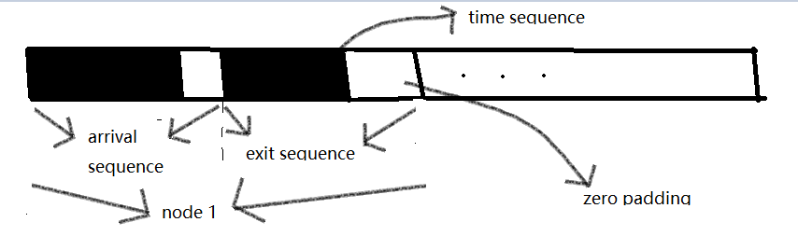
1d-CNN+Linear(Conv layer + Conv layer + Fc layer, activation function:LeakyRELU)
requirements of conv and fc layer: size of the feature tensor must be fixed, therefore, we need to set the length of the feature first.
disadvantages of fixed length feature tensor: the time sequence of a queueing system vary in lengths in different time period or different day, so it is not easy to choose a good fixed length.
advantages of fixed length feature tensor: enable the discriminator to be sensitive to the parameters. To be more precisely, it could easily tell if the feature tensor correspond to a sparse or dense network and provide useful gradients information. This is very important in the good performance on different task.
How I set the fixed length: slightly larger than the longest sequence is OK
Performance: great in very complicated network even with limited data

Slide 4
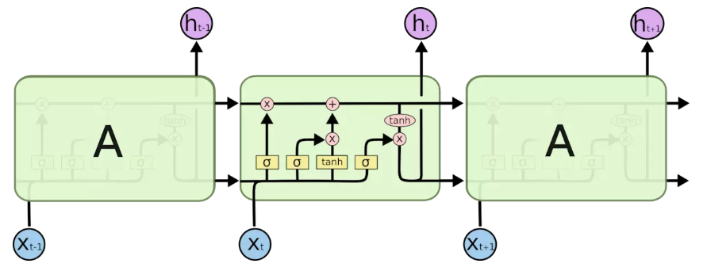
LSTM/RNN:
Advantages:
1.top choice for processing sequences that is related with time
2.do not require the input feature to be a constant number
Disadvantages in our task and settings:
1. hard to train
2. when the time sequence is long, previous information will lost
3.LSTM contains 4 gates in each cell, and the activation function is sigmoid and tanh, these function will cause gradient diminish when input data is large and the sequence is long. So elementary RNN with nonlinearity:relu fits better for our task

Slide 5
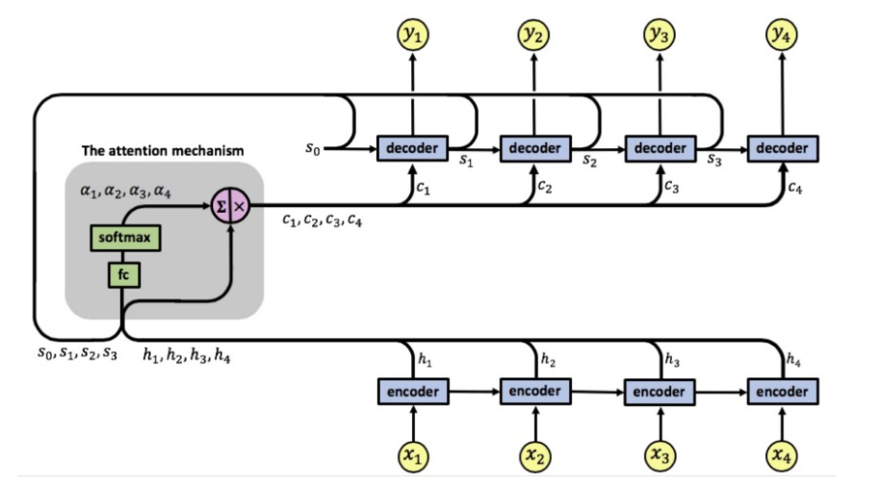
Attention in RNN:

Slide 6
Our dilemma:
attention in traditional nlp and cv tasks have quite distinct meaning and goals: focus on the most relevant part.
In our task, each data is equally important, so whats the difference between attention and fully connected layer and how we design our attention structure?
My way:
attention is in fact a weighting method, and from the pictures in the last ppt(attention in Seq2seq task), we can see that by introducing attention in the process, it actually considers every hidden states in the first unrolled LSTM.
Hence, when I use the LSTM to design discriminator network, I use just one decoder cell, the input of which is calculated using attention mechanism.

Slide 7
2.System structure and distributions
There are many nodes in the network
Custmors might return to a node that he/she have visited before, which means the network may be cyclic.
input flow: various poisson flow(hpp, nhpp, cox ,hawkes)
Service time distribution: exponential, gamma, lognormal, deterministic,…
Capacity: each node posess a capacity which is the maximal customers it can hold
Rejection: when people at the entrance node reach its capacity, new coming customers will be rejected, so the input flow is not stricted poisson
Note: if we add the capacity constrains on the network, it would cause great resistence on the training, this is because we initialize the parameters randomly and the network may be very crowded, in this situation, the capacity will easily be reached, and most customers will be rejected from the entrance.
Ciw guides the transition of customers in the network with a routing matrix

Slide 8
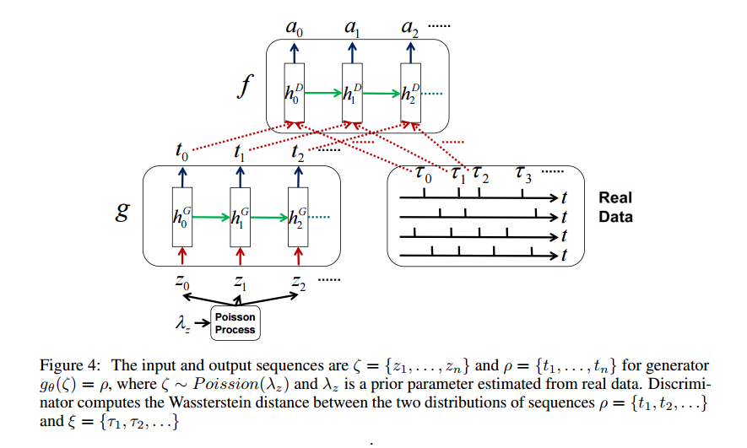
3. Experiments
3.1 settings:
take a look at this paper: Wasserstein Learning of Deep Generative Point Process Models
key point:
Generator and discriminator are both LSTM
Sequential data is complete
focus on intensity
a new norm defined for the EM-distance

Slide 9
Its limitation:
the norm and EM-distance is carefully designed, so it could not(or could be hard) be applied to more sophiscated situations like a queueing system.
One question:
the input data form: T1, T2, …, Tn is a pretty bad input form for LSTM, cause as n becomes larger, the norm of hidden state entries will be relative large(more than 5), and the sigmoid and tanh activation function that take these hidden states will output 1/-1, so the output of LSTM will be extremely small and provides little useful information.
I am a little bit wondering how the authors of the paper solve the problem
Performance of RNN in our task:
could deal with simple network with hpp flow as input, but the training takes a lot of time and the parameters it finally learns is not precise.
Notes: the ordinary performance of RNN is mainly due to the fact that it can deal with sequences of different length but it is not sensitive to the length of the sequence which is very important.

Slide 10
Our focus and settings:
We expect to learn the distribution of the service time and input poisson(to be brief, params that could define the network)
We assume that the data we can observe or we obtain is not complete(no detailed time moments records of individuals, and just the data from a time interval).
Wgan is the tool
4. Lipschitz constraint: weight clipping or gradient penalty(not necessary, what matters most is the learning rate for generator and discriminator)

Slide 11
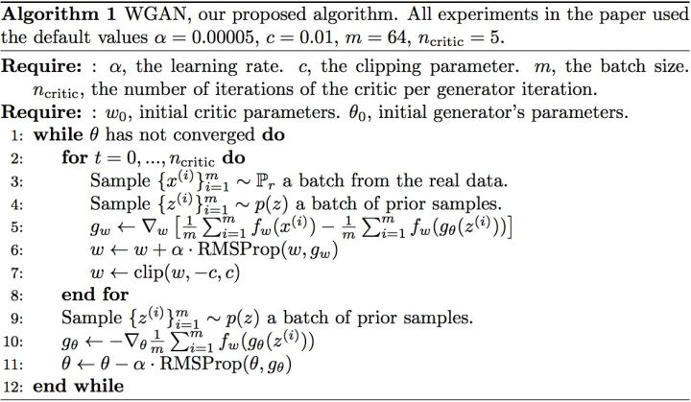
wgan algorithm:
The g in above is the ciw simulator in our project

Slide 12
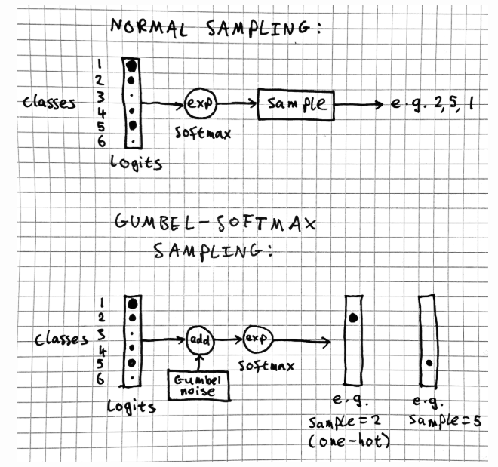
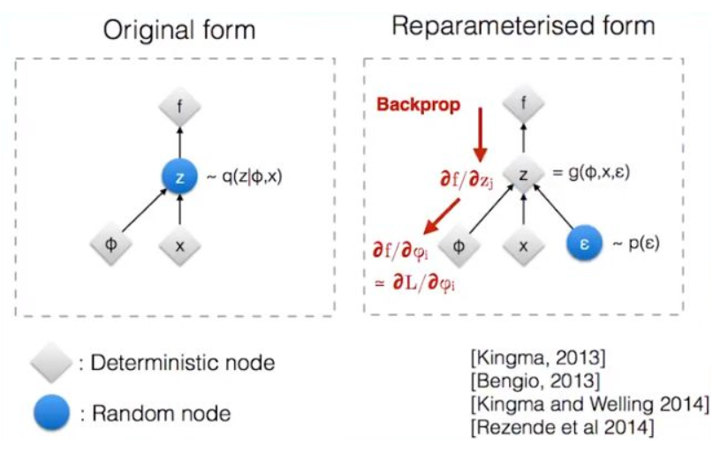
Our method need to promise that the gradients could backpropagate through the generator to the parameters that we care about. Gradients could not pass though the sampling operation in generator(in our task it is the ciw simulator), we use reparameterization trick(continuous variable) and gumbel trick(discrete variable) to solve it

Slide 13
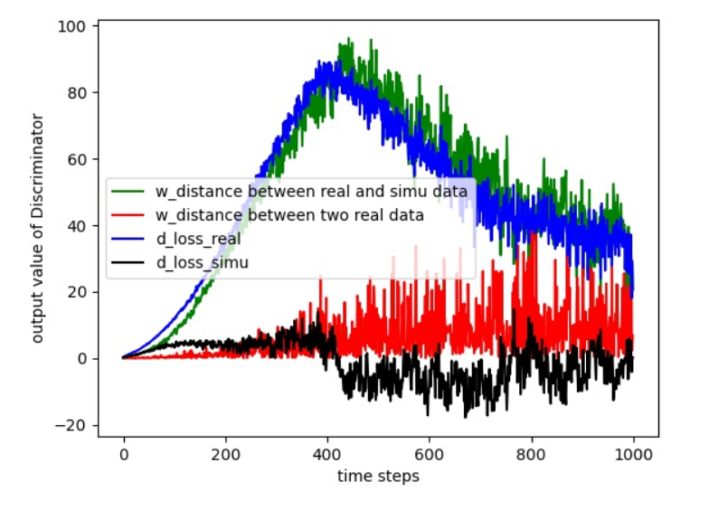
3.2 input flow
Homogeneous poisson process:
The EM distance converges in about 1000 Epoches, and the parameters also converges to the neighbor of real value. Besides, we can see that the discriminator finds it harder and harder to distinguish real data and simu data after 600 epochs
Training trick:
we must control the speed that discriminator updates itself ,
namely avoid discriminator learns how to distinguish real
and fake data too early.
If this is achievable, then the loss will converge.

Slide 14
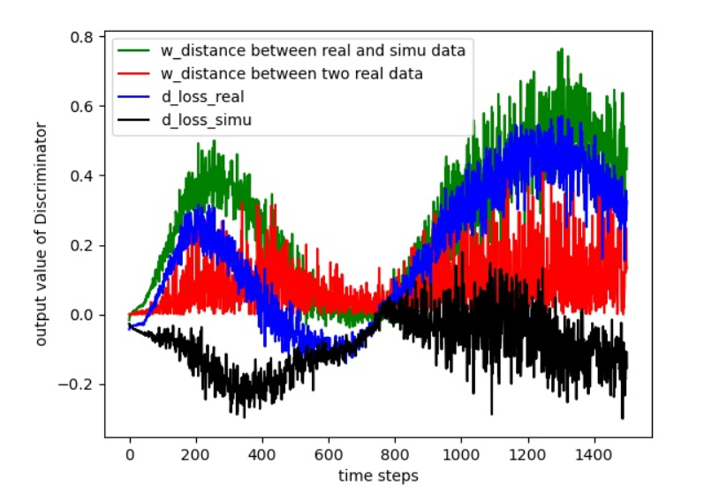
Mixed poisson process: the intensity is a random variate
I test the situation when the rate variate follows gamma distribution.
From the curve and the parameters we can
See that in about 800 epochs, the loss
Converges and we learn a pretty good
Network that is a good approximation of
Real network.
The loss diverges:
Why: 1. initial learning rate is large
2. the convergence point is a shallow
local optimal point, which is easy to
jump out
3. add the capacity constrains on every node
Solution: schedule the learning rate

Slide 15
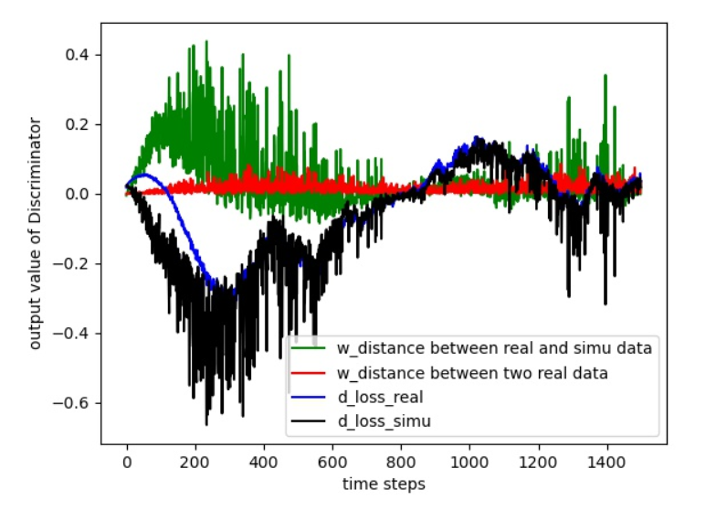
MPP fit the HPP
If the input is a nonhomogeneous process with density that does not change rapidly or is constrained in a small interval like [3,3.5], we could still use the mpp input model to simulate. We can still get a good approximation of the real network by taking the result after 800 epoches .

Slide 16
Nhpp,cox,hawkes
we need to generate the sequence strictly with its parameters utilizing traditional simulating methods.
typically there are three classic simulation methods: thining, integration, conditional theorem.
Only integration methods promise the gradient to pass through the generator, but the integration and the solution of inverse are hard for ordinary situation with random intensity function. So we can simplfy by using piecewise constant rate.

Slide 17
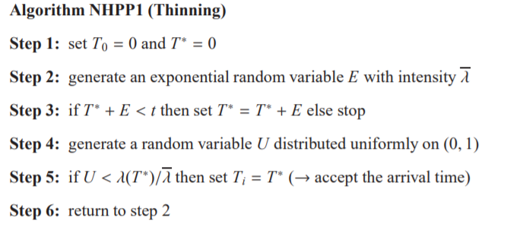
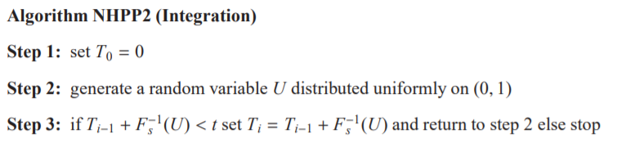
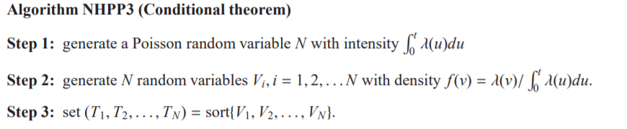

Slide 18
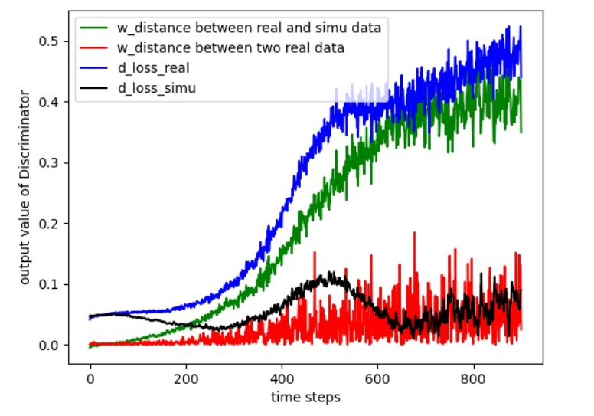
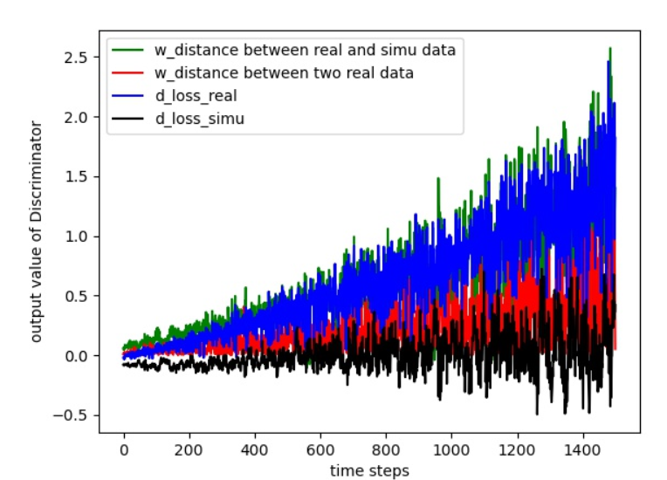
Control the learning speed of discriminator
Reason: I set the capacity(maximal people that is allowed) for each node, it is not reasonable because for generator it will reject quite a lot customers when the initial parametes are bad( cause the network to be crowded) , removing this constrant and we still get perfect converge result

Slide 19
3.3 a tough task: Situations when we could only get the states of the network sometimes
The key focus is that could our method deals with this kind of data, and there are two data forms
data form 1: number of people in each nodes in the system at different time
data form 2: accumulated number of people that have pass the nodes at different time

Slide 20
Difference of these two forms:
data form 1 is incomplete, this is because given only states of the network indifferent time may not be enough to define the network. It is not hard to imagine that there could be two totally different network with almost the same states in different time.
Why I propose data form 2:
from the experiments, I found that the wgan perfoms well when the input data is ascending time moments(T1,T2,…) of each node, and time interval(ΔT1,ΔT2,…) is a bad form or is hard to train.
data form 2 is similar to the first kind of data that wgan likes, and provides relatively complete information about the network.
Performace:
wgan can not learn from data with form 1, wgan could learn a approximate results from data form2, but the result is not satifactary.

Slide 21
3.4 learning the routing of the network
It is a tough task even if all the distribution parameters are known.
In RL, we can learn the policy with policy gradient methods, however, to parameterize the routing matrix and learn the parameters, rewards must be good enough and there is almost no such thing that could play the part of rewards.
if the real routing is [0.1, 0.3, 0.2, 0.4] and we get [0.2,0.1 ,0.4,0.3], or if the real routing is [0.3, 0.7] and we get [0.55, 0.45], is this a good result?
A good thing is that we do not need to care about precise routing matrix, because a rough estimation is enough for the wgan to learn the parameters.

