Slide 1




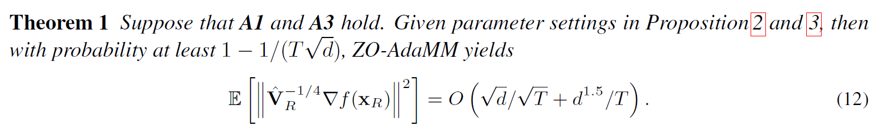
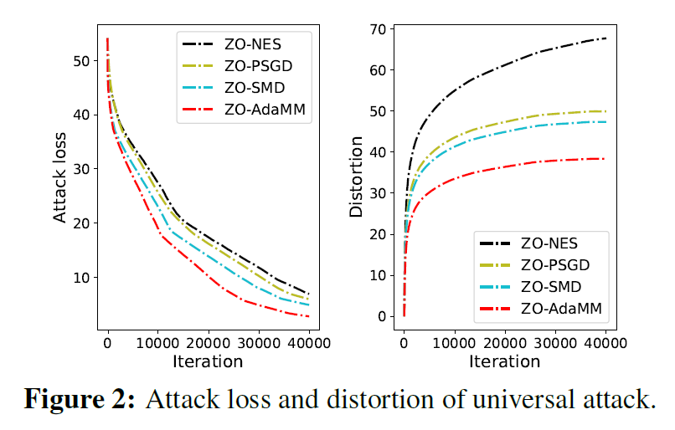
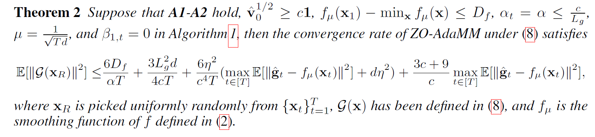
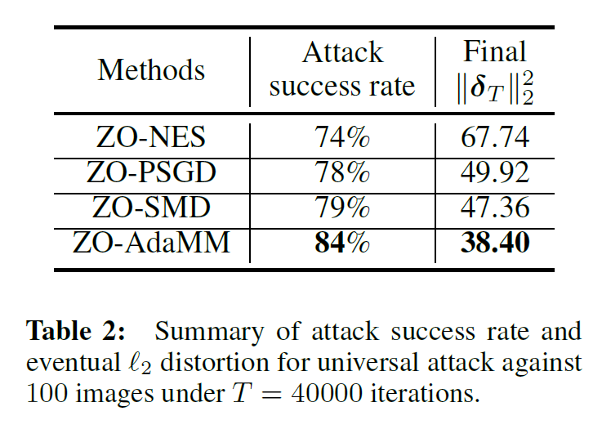
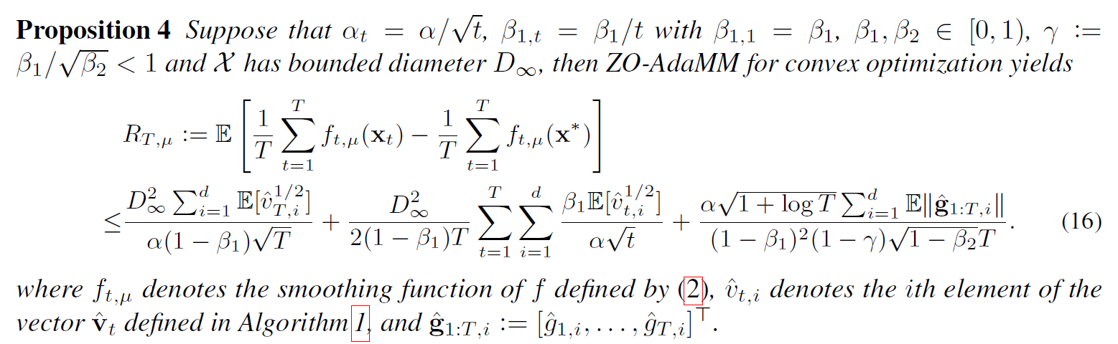
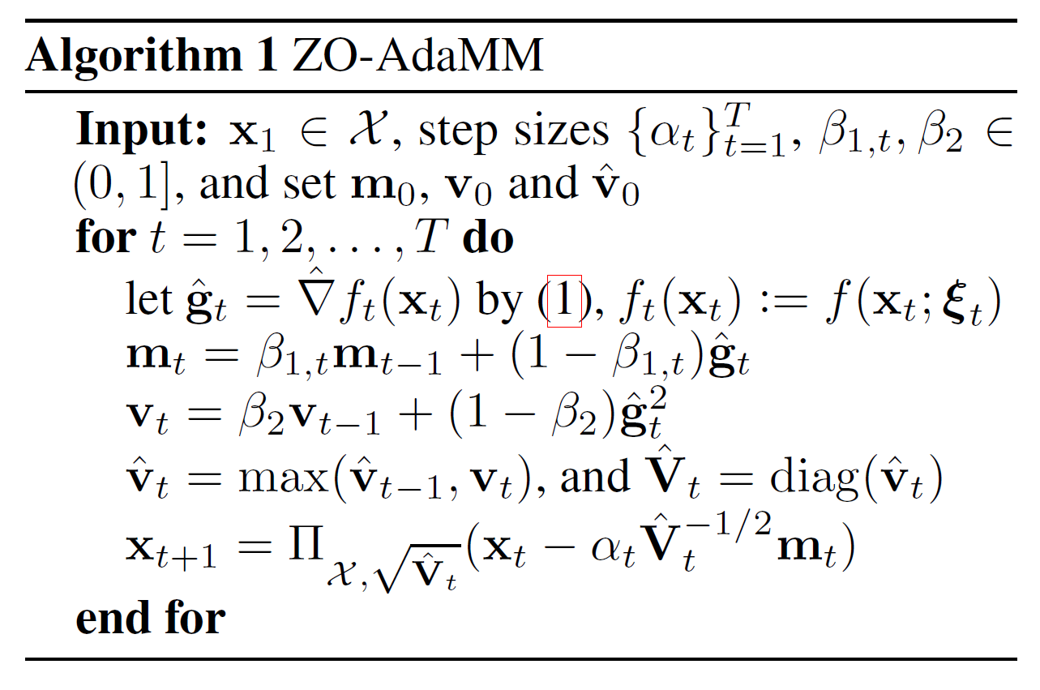
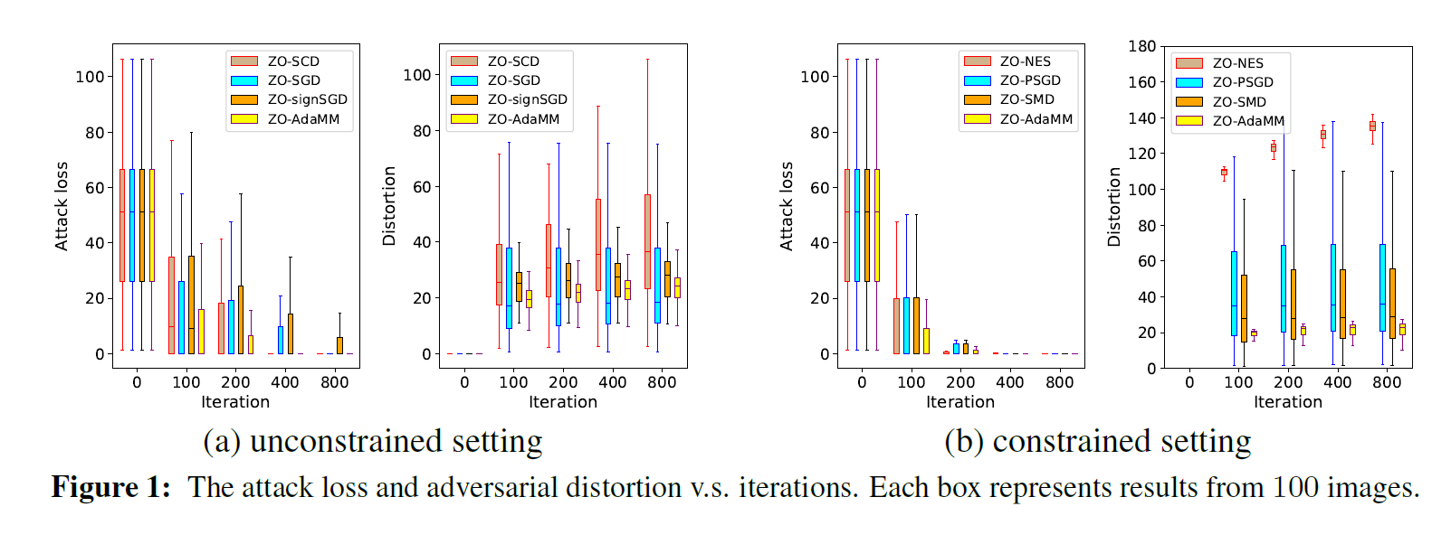

ZO-AdaMM: Zeroth-Order Adaptive Momentum Method for Black-Box Optimization
Xiangyi Chen^{1, *}, Sijia Liu^{2, *}, Kaidi Xu^{3, *}, Xingguo Li^{4, *},
Xue Lin³, Mingyi Hong¹ , David Cox²
¹University of Minnesota - Twin Cities, ²MIT-IBM Watson AI Lab, ³Northeastern University, ⁴Princeton University,
*equal contribution
Contribution
Convergence guarantees
Experiments on universal attack
A new zeroth order adaptive gradient method called ZO-AdaMM
Rigorous convergence analysis of the proposed method
Non-convergence of using Euclidean projection with adaptive gradient methods for constrained optimization
Motivation
Adaptive gradient methods can be faster and easy to tune compared with SGD
Efficient black-box attack is of growing interest in the community
Theoretical understanding of adaptive gradient method in zeroth order optimization is limited
Zeroth order vs first order optimization
The optimizer can only access function values in zeroth order optimization
Zeroth order methods usually converge slower than first order methods
Convergence analysis is more difficult than first order methods (especially for adaptive gradient methods)
ZO-AdaMM algorithm
Application in adversarial attack
Conclusion
Theoretically, ZO-AdaMM have similar convergence rate as existing zeroth order optimization algorithms such as zeroth order stochastic gradient descent
Empirically, ZO-AdaMM succeeded the advantages of its first order counterpart (AMSGrad), the convergence is usually faster than algorithms such as ZO-PSGD.
-- x_{t} : iterates; g_{t} : a stochastic gradient
-- h_{t} ( ): an arbitrary function that returns a vector
-- “/”: element-wise division

