Slide 1
Web Crawler + Form bruteforcer
Groupof4--Xiangying Liu, Hoiyin To, Yu Song, Si Wu

Slide 2
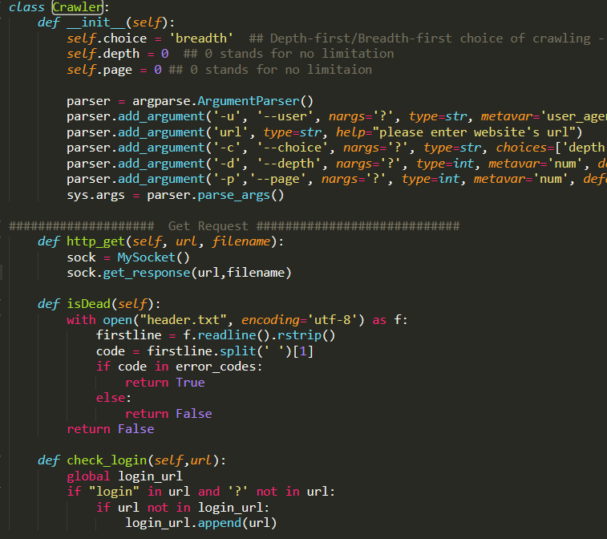
Crawler Class

Slide 3
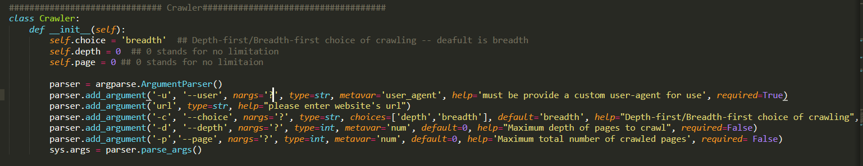
Crawler’s configuration options

Slide 4
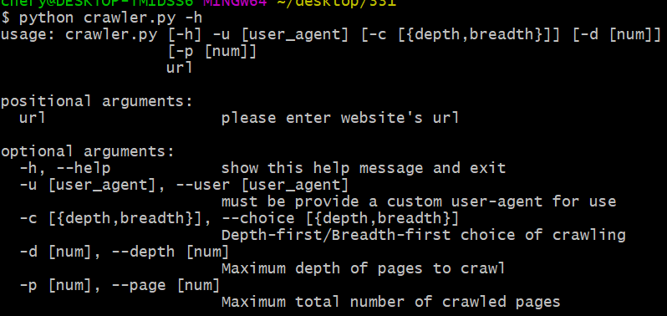
-u user-agent
url the website that user want to crawl
-c Depth-first/Breadth-first choice of crawling
-d Maximum depth of pages to crawl
-p Maximum total number of crawled pages

Slide 5
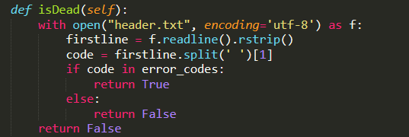
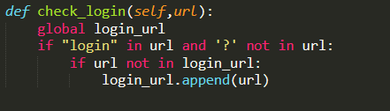
isDead() -- check if the crawled page is dead-end page
check_login()-- check if the crawled page is login page

Slide 6

HTTP GET

Slide 7
MySocket Class

Slide 8
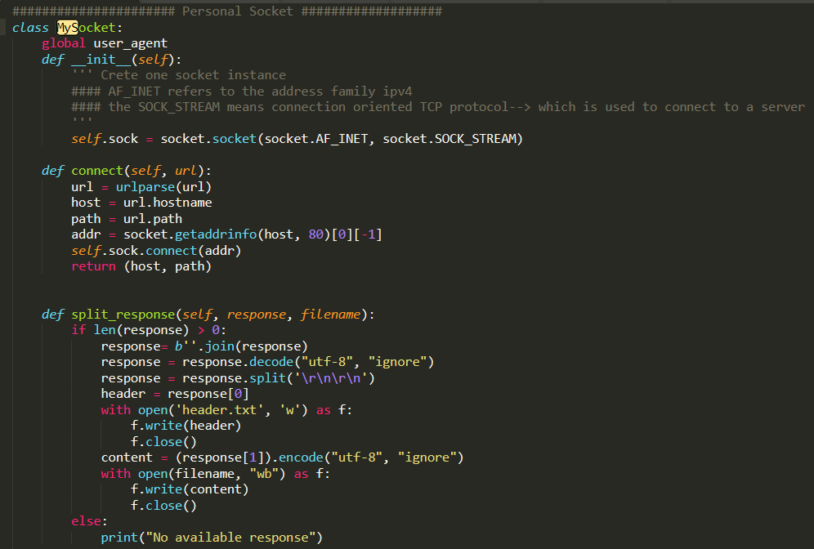

Slide 9
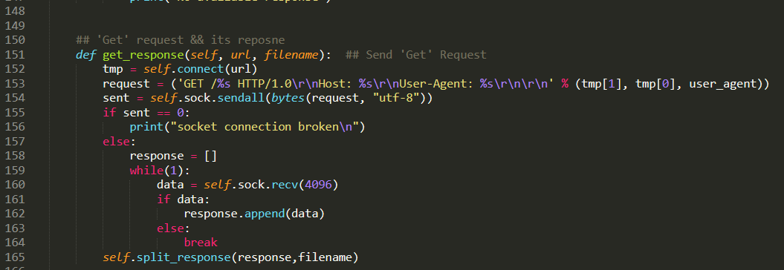
HTTP GET

Slide 10
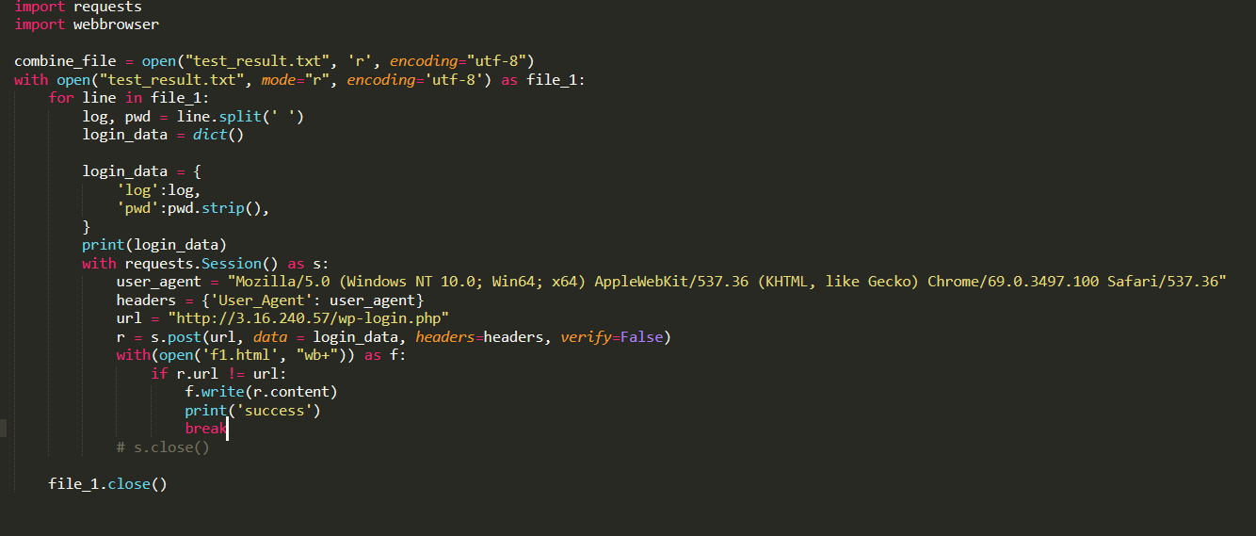
HTTP POST

Slide 11
Beautiful Soup

Slide 12
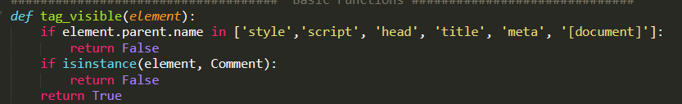
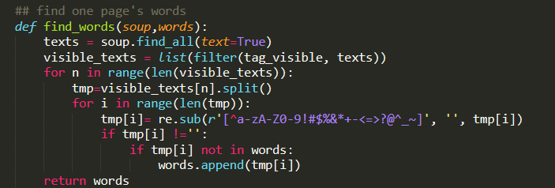

Slide 13
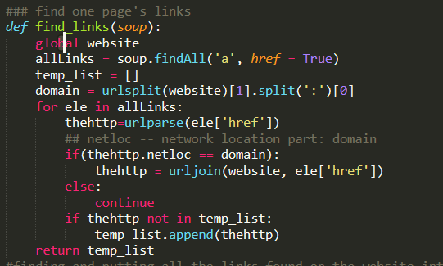

Slide 14
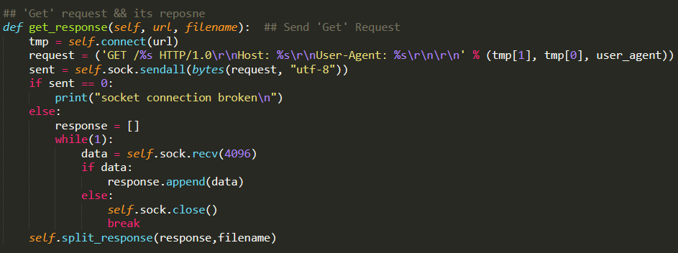

Slide 15
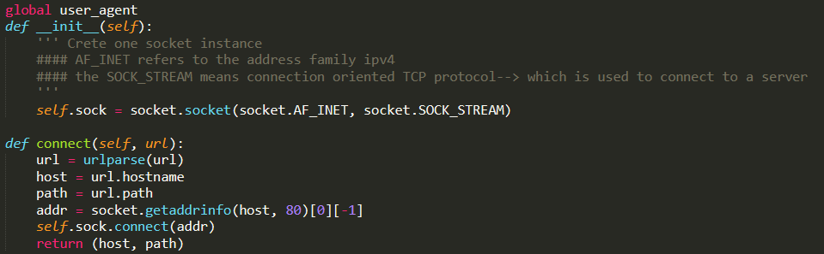
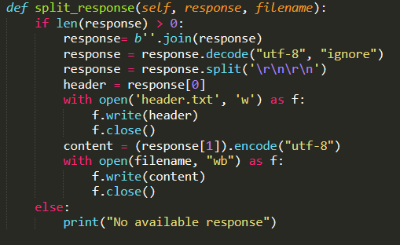

Slide 16
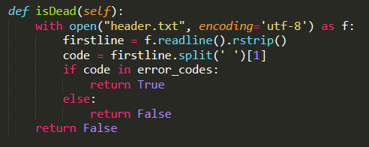
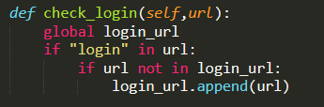

Slide 17
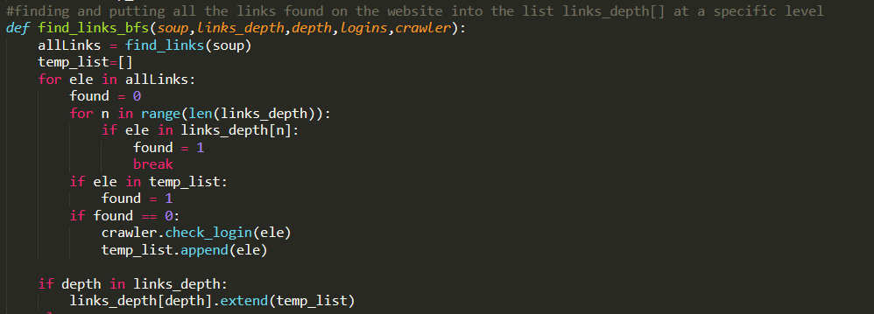
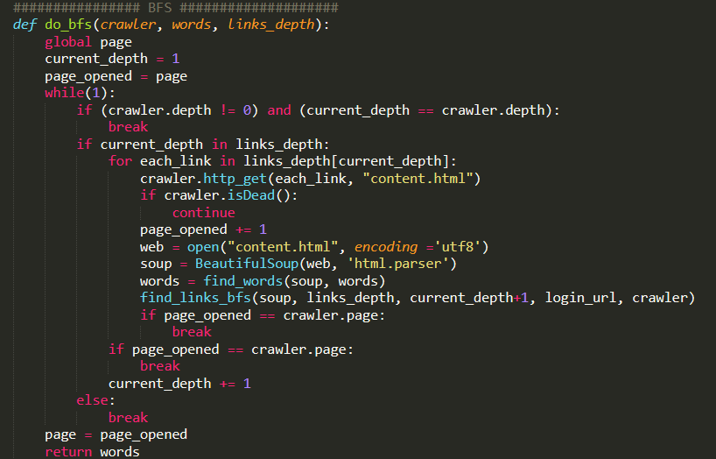
BFS

Slide 18
BFS

Slide 19
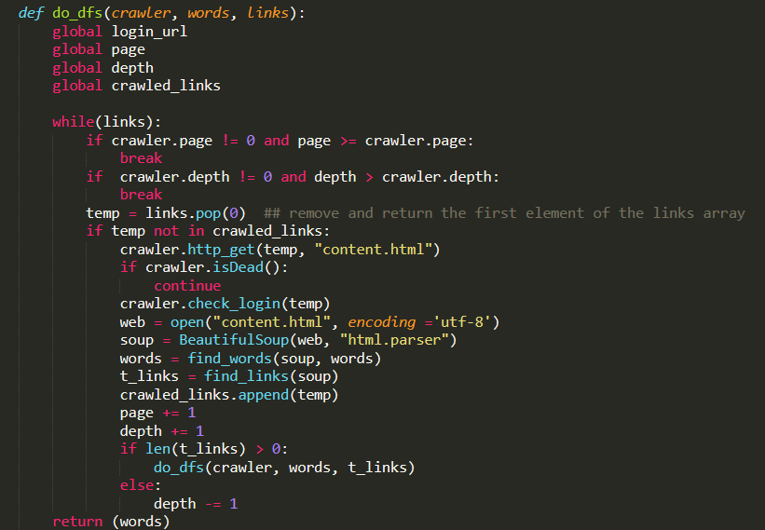
DFS

Slide 20
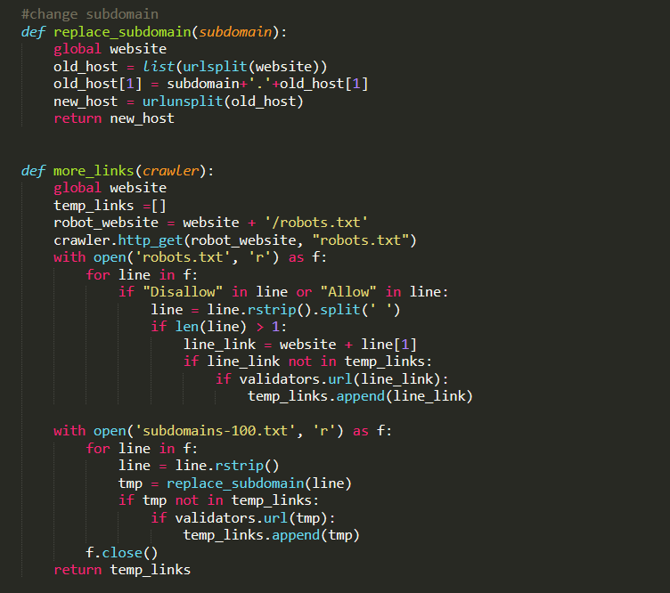
More Pages(robots.txt&subdomain)

Slide 21
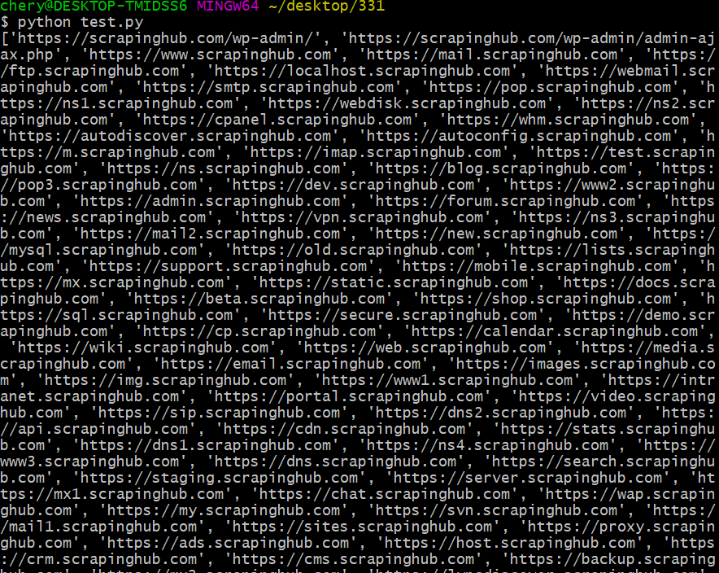
More Pages(robots.txt&subdomain)
--website='https://scrapinghub.com'

Slide 22
Bruteforcer

Slide 23
