Slide 1
Fundamental mode
x
E
First order mode
x
E

Slide 2

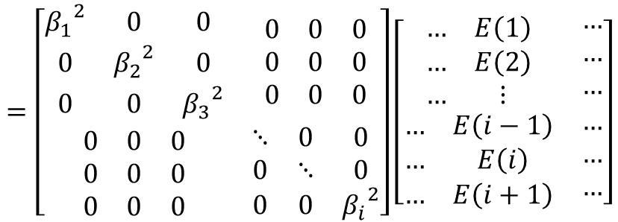









$$∇^{2}\overset{⃑}{E}+k^{2}\overset{⃑}{E}=0⟹\left[\frac{∂^{2}}{∂x^{2}}+\frac{∂^{2}}{∂y^{2}}+n^{2}(x,y){k_{0}}^{2}\right]E\left(x,y\right)=β^{2}E\left(x,y\right)$$
$$\frac{∂E}{∂x}=\frac{E\left(i+1\right)−E\left(i\right)}{∆x}$$
$$\frac{∂^{2}E}{∂x^{2}}=\frac{\frac{E\left(i+1\right)−E\left(i\right)}{∆x}−\frac{E\left(i\right)−E\left(i−1\right)}{∆x}}{∆x}$$
Using the finite difference method, we can introduce and
$$\frac{E\left(i+1\right)−2E\left(i\right)+E\left(i−1\right)}{{\left(∆x\right)}^{2}}+{\left(k_{0}n\left(i\right)\right)}^{2}E\left(i\right)=β^{2}E\left(i\right)$$
$$\left[−\frac{2}{{\left(∆x\right)}^{2}}+{\left(k_{0}n\left(i\right)\right)}^{2}\right]E\left(i\right)+\frac{1}{{\left(∆x\right)}^{2}}E\left(i+1\right)+\frac{1}{{\left(∆x\right)}^{2}}E\left(i−1\right)=β^{2}E\left(i\right)$$
$$a\left(i\right)E\left(i\right)+b\left(i\right)E\left(i+1\right)+c\left(i\right)E\left(i−1\right)=β^{2}E\left(i\right)$$
$$E\left(i+1\right)$$
m^{th} mode
m^{th} mode
$$\left[\begin{matrix}\begin{matrix}a_{1} & b_{1} & 0 \\ c_{1} & a_{2} & b_{2} \\ 0 & c_{2} & a_{3}\end{matrix} & \begin{matrix}0 & 0 & 0 \\ 0 & 0 & 0 \\ b_{3} & 0 & 0\end{matrix} \\ \begin{matrix}0 & 0 & c_{3} \\ 0 & 0 & 0 \\ 0 & 0 & 0\end{matrix} & \begin{matrix}a_{4} & ⋱ & 0 \\ ⋱ & ⋱ & b_{i} \\ 0 & c_{i} & a_{i}\end{matrix}\end{matrix}\right]$$
$$\left[\begin{matrix}\begin{matrix}… & E\left(1\right) \\ … & E\left(2\right) \\ … & ⋮\end{matrix} & \begin{matrix}… \\ … \\ …\end{matrix} \\ \begin{matrix}… & E\left(i−1\right) \\ … & E\left(i\right) \\ … & E\left(i+1\right)\end{matrix} & \begin{matrix}… \\ … \\ …\end{matrix}\end{matrix}\right]$$
$$=\left[\begin{matrix}\begin{matrix}{β_{1}}^{2} & 0 & 0 \\ 0 & {β_{2}}^{2} & 0 \\ 0 & 0 & {β_{3}}^{2}\end{matrix} & \begin{matrix}0 & 0 & 0 \\ 0 & 0 & 0 \\ 0 & 0 & 0\end{matrix} \\ \begin{matrix}0 & 0 & 0 \\ 0 & 0 & 0 \\ 0 & 0 & 0\end{matrix} & \begin{matrix}⋱ & 0 & 0 \\ 0 & ⋱ & 0 \\ 0 & 0 & {β_{i}}^{2}\end{matrix}\end{matrix}\right]\left[\begin{matrix}\begin{matrix}… & E\left(1\right) \\ … & E\left(2\right) \\ … & ⋮\end{matrix} & \begin{matrix}… \\ … \\ …\end{matrix} \\ \begin{matrix}… & E\left(i−1\right) \\ … & E\left(i\right) \\ … & E\left(i+1\right)\end{matrix} & \begin{matrix}… \\ … \\ …\end{matrix}\end{matrix}\right]$$
$$E\left(i−1\right)$$
$$E\left(i\right)$$
$$mode condition: \left\{n_{eff}|n_{0}<n_{eff}=\frac{β}{k_{0}}<n_{1}\right\}$$

