Slide 1
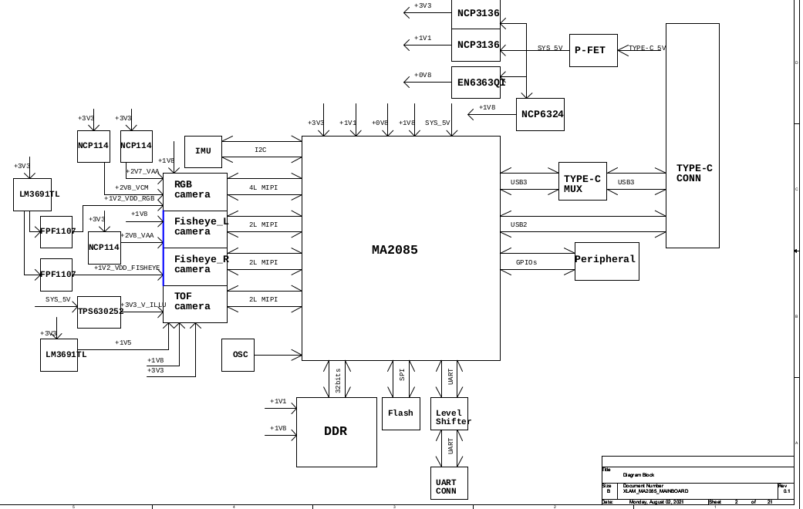

Slide 2
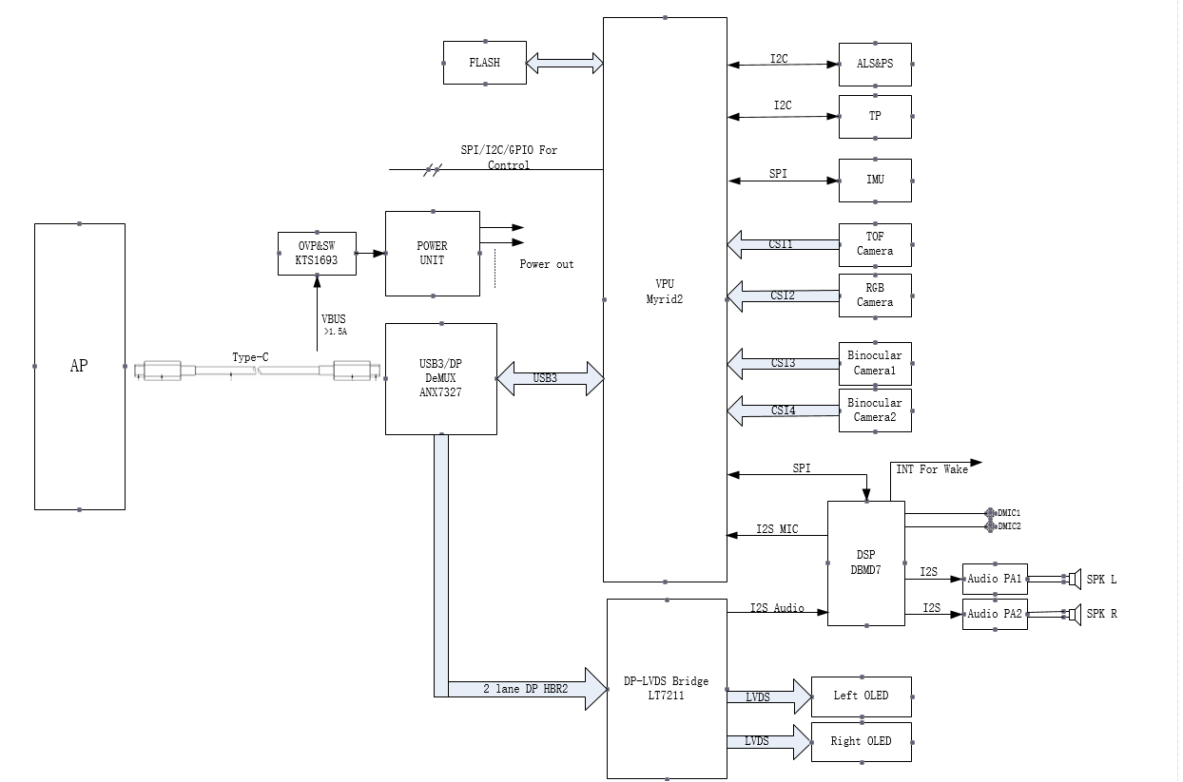

Slide 3
DP
STM
OLED
LingWei
RK3399
LT7911
HOST
usb3.0
cpu modivbus

Slide 4
2line usb3.0 + 2line dp
4line
4linue
TYPEC
4Line+usb2.0
HUP
VAC
usb2.0
Video
UVC
DP 1.4
HBR3 8.1G bps
HBR2 6.4G bps
HBR1 4.8G bps
trasmition : timingxfps = 120HZx3800(H)x1980(v)

Slide 5
DP
STM
OLED
LT7911
usb3.0
cpu modivbus
HOST
Type-C
Redriver
DP/USB3.0
DeMUX
DP
bridge
lvds
Panel
DFP
usb3.0
vpu
UFP

Slide 6
Flash
USB
Board
power on
IMU
SPI device
Board Initialise
IIC device
Flash_descriptor
UART
IMU_descriptor
CAMERA
OLED_descriptor

Slide 7
frameware
usbloader
第四层
USB，Bridge，Panel，Redriver，DeMUX，IMU
第三层
RTEMS
IC Drivers
Soc Drivers
第二层
cpu lib
第一层
CPU Register
第零层

Slide 8
开始
执行make Board=OPPO
加载解析/configs/OPPO_defconfig
执行编译
结束

Slide 9
具体
BoardInit
抽象
DisplayBringupTask_Creat
具体
IC/SOC/Board
firamework
display_controller
component
coogarlite
board specific/board oppo
sub_module : cougar_mdk
IC driver && SOC driver

Slide 10
USB,RT+/RX-3.0 USB D+/D- 2.0
PC
usb3.0
slam
835
835
usb3.0
usb3.0
HUB
slam
PC
usb2.0
usb3.0

Slide 11
FUNCTION
GPIO
DRIVER
SPI
IIC
Bridge
Panel
Redriver
DeMux
Hardware Device
HW_INIT
WATCH DOG
CLOCK
MEMORY
IRQ

Slide 12
Display
POSIX API ictl/open/write/read
redriver
deMux
bridge
panel
ptn3605
others
anx7327
others
lt7911uxc
lt7211d
lt7911d
ecx335
ecx343

Slide 13
应用程序和标准应用组件库
RTEMS 接口
POSIX接口
ITRON接口
管理器
超核
板卡支持包BSP
微处理器
处理器
外设

