Slide 2
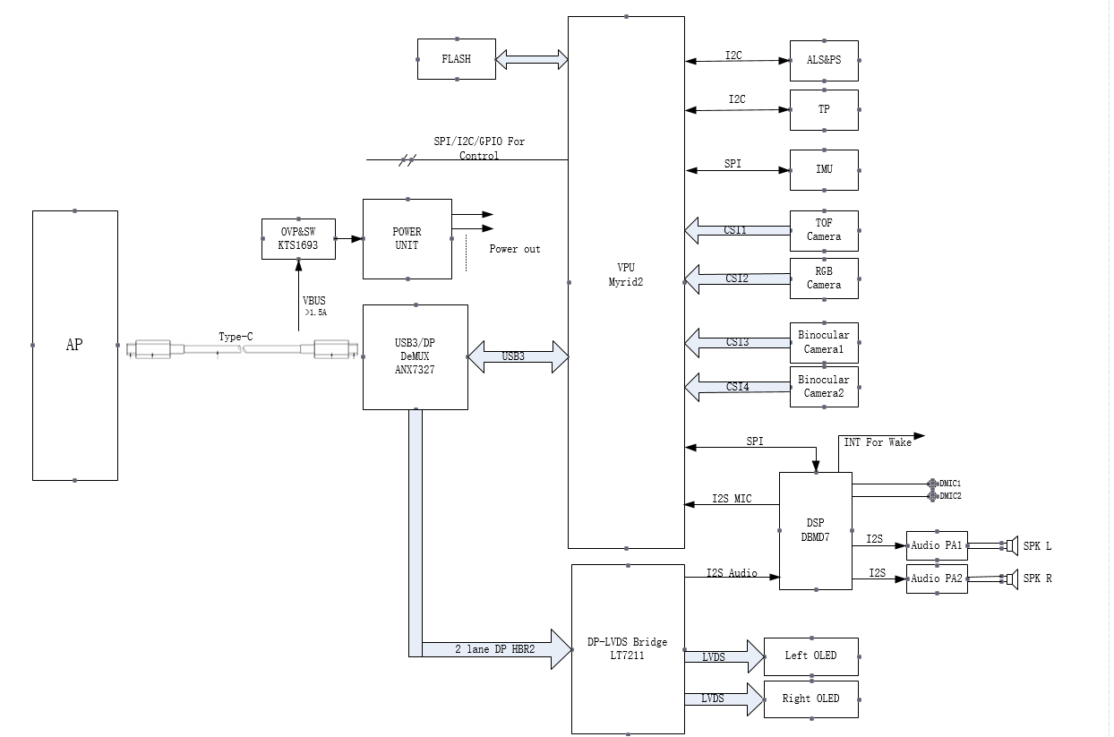

Slide 3
显示模块
HOST
Type-C
Redriver
DP/USB3.0
DeMUX
DP
bridge
lvds
Panel
DFP
usb3.0
vpu
UFP
信号源端
传输端
信号处理
输出端

Slide 4
信号源端
2line usb3.0 + 2line dp
4line
4linue
TYPEC
4Line+usb2.0
HUP
VAC
usb2.0
Video
UVC
DP 1.4
HBR3 8.1G bps
HBR2 6.4G bps
HBR1 4.8G bps
trasmition : timingxfps = 120HZx3800(H)x1980(v)

Slide 5
