Slide 1
QR Code Application
Presented by Andy Liu

Slide 2
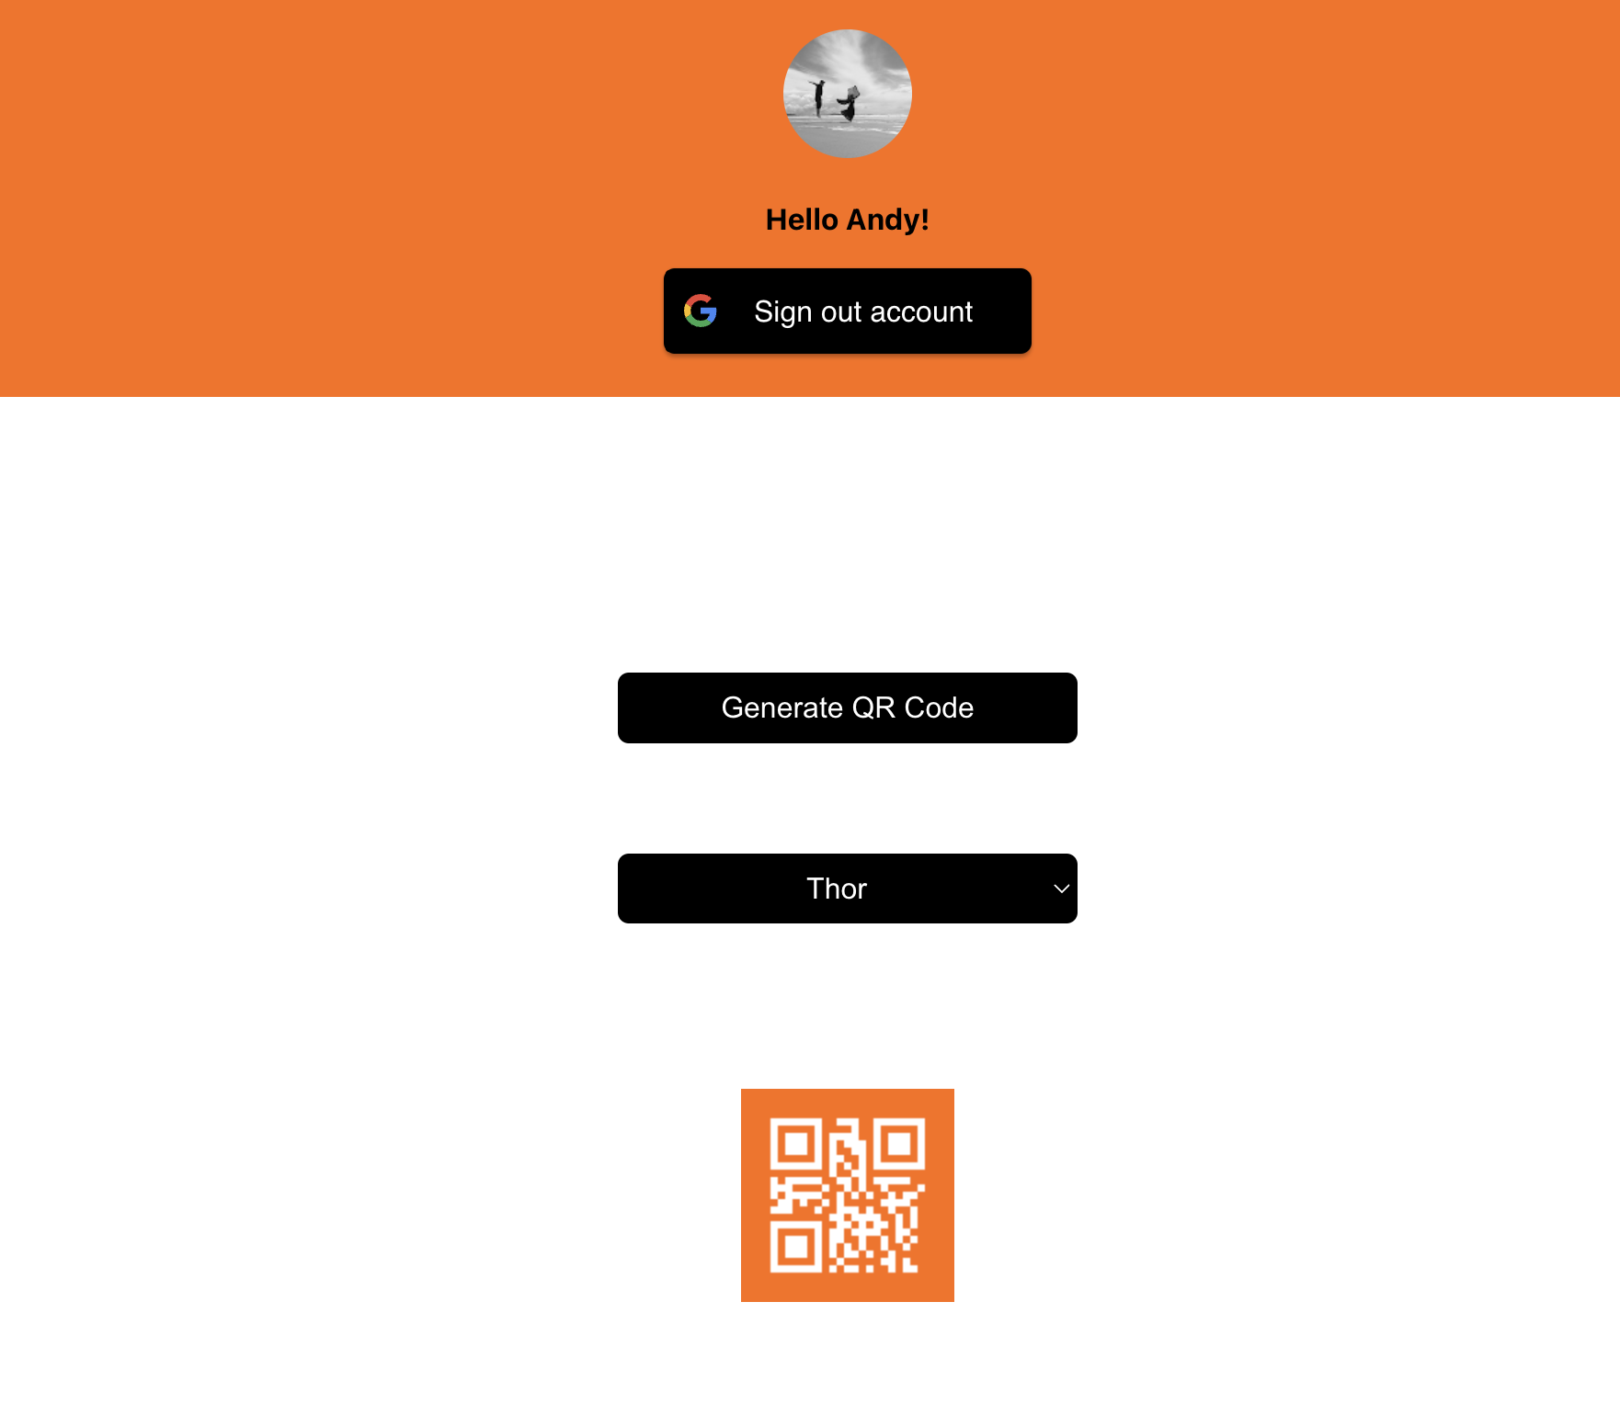
UI & Components
UserProfile
SignIn
Login/out Button
Button
GenerateQRCode
Dropdown
ErrorMessage
QRCode

Slide 3
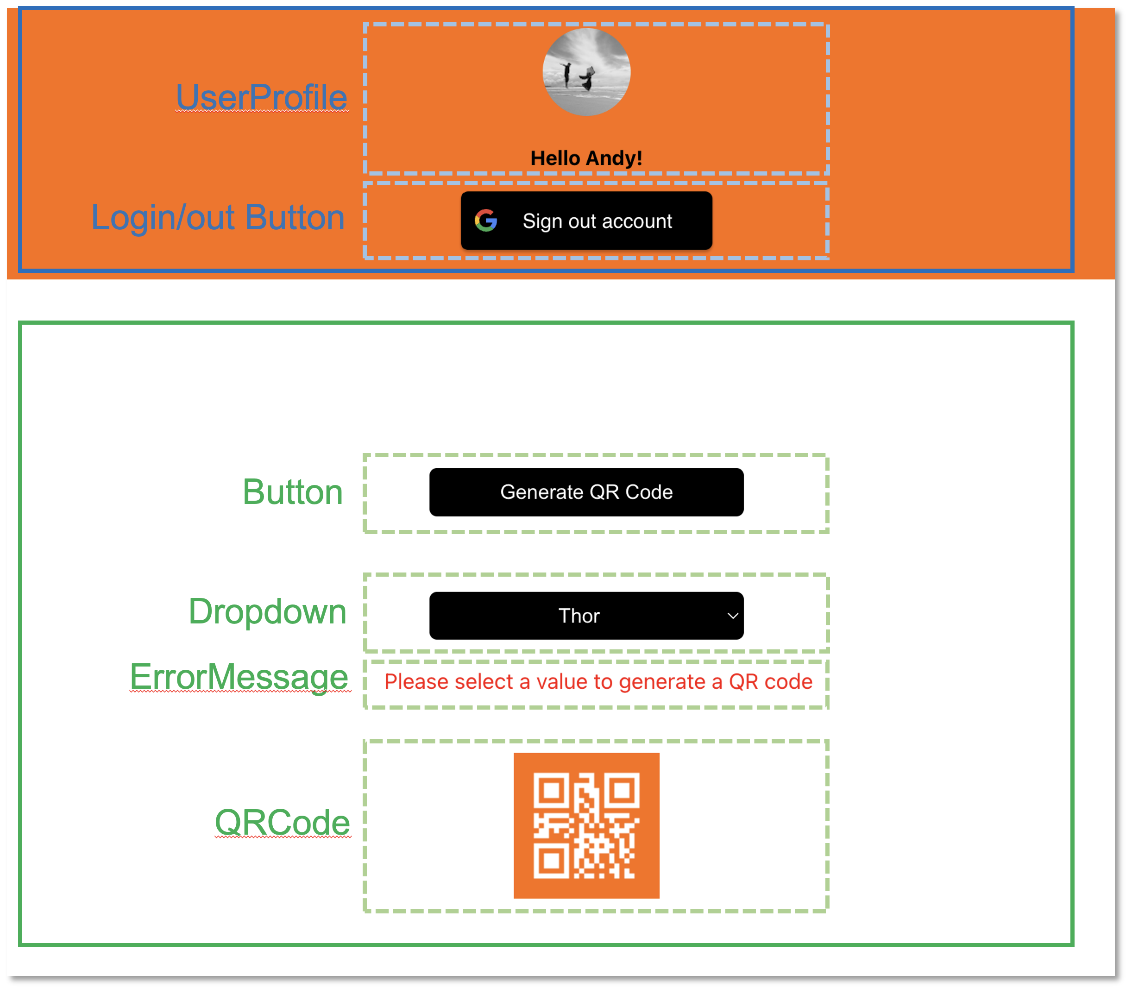
Overview
SignIn
GenerateQRCode
<App/>
<SignIn/>
<Welcome/>
<GenerateQRCode/>
<UserProfile/>
<GoogleLogin/>
<GoogleLogout/>
<Button/>
<Dropdown/>
<ErrorMessage/>
<QRCode/>
<MessageModal/>

Slide 4

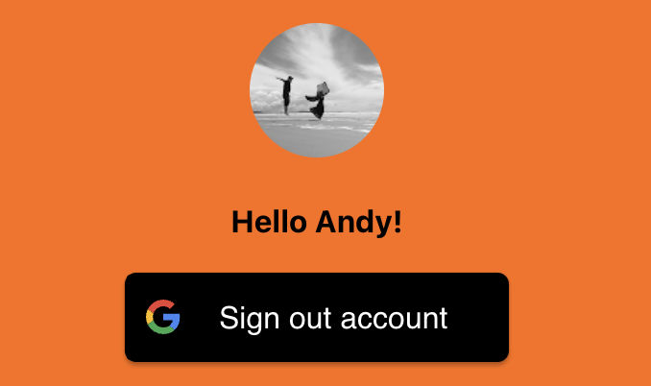
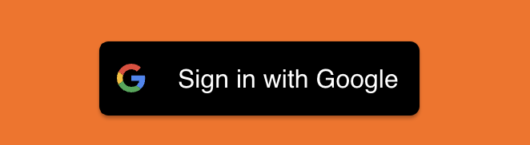
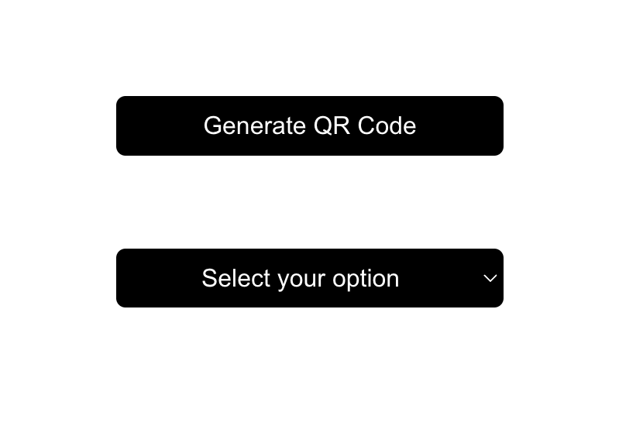
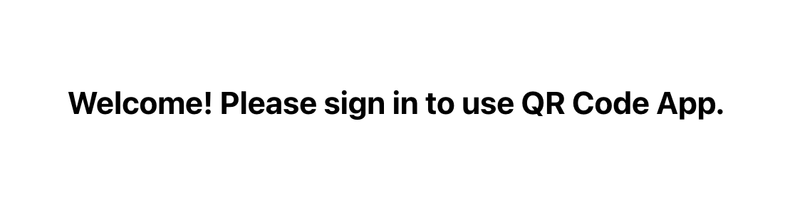
App Flow Chart
START
render App
render SignIn
Is user logged in?
N
Y
render Welcome
render GenerateQRCode
END

Slide 5
SignIn Flow Chart
START
render SignIn
Google api auth
Is user logged in?
N
Y
render Login button
render UserProfile
Logout button
END

Slide 6
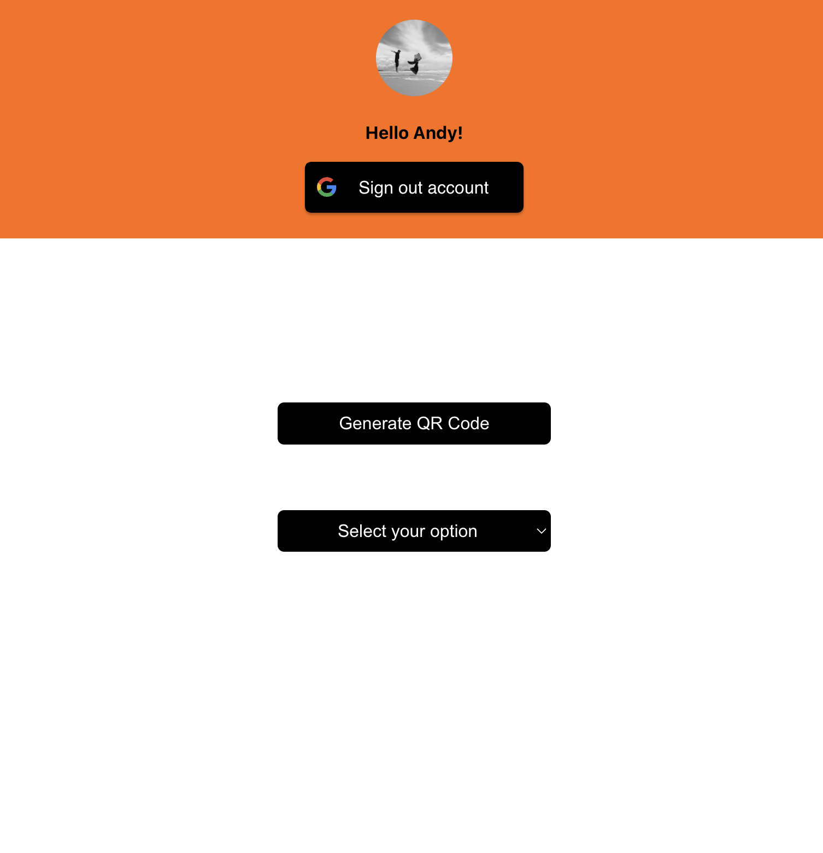

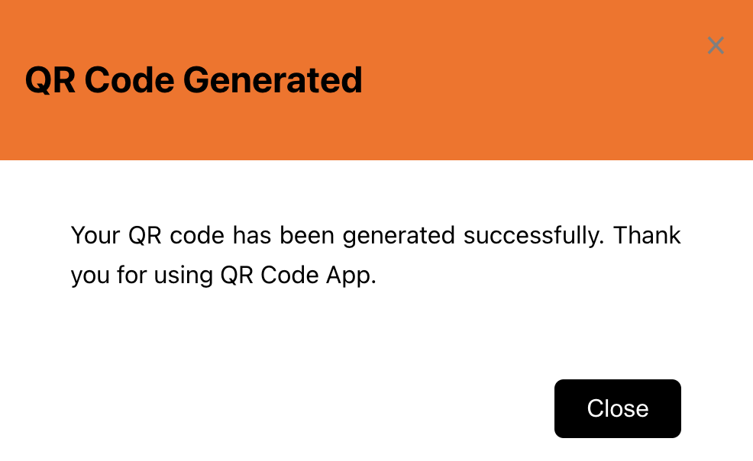
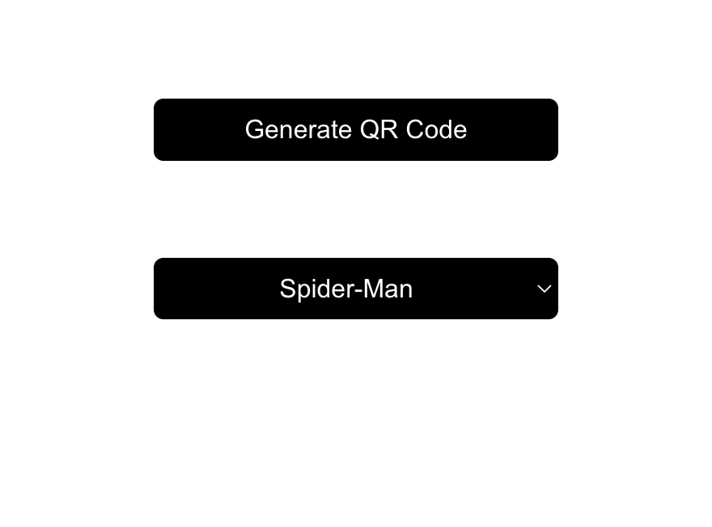
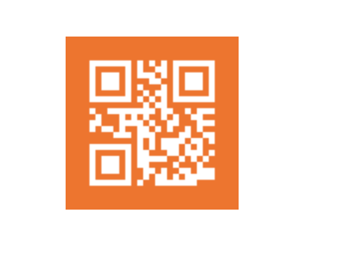
GenerateQRCode Flow Chart
START
render button
and dropdown
button clicked
no option is selected
N
Y
render error msg
selected value changed?
N
Y
render a new QR code
do not re-render QR code
show message
END

Slide 7
What to do next
Use React Redux
React components read data from a Redux store, and dispatch actions to the store to update state
Login status, show the modal
Write Tests
Jest, React Testing Library
Cypress

