Slide 1
QR Code Application
Presented by Andy Liu

Slide 2
Outline
UI & Components
Overview of the Components
Implementation Details
App Component
SignIn Component
GenerateQRCode Component
To Be Improved
Related Information

Slide 3
Outline
UI & Components
Overview of the Components
Implementation Details
App Component
SignIn Component
GenerateQRCode Component
To Be Improved
Related Information

Slide 4
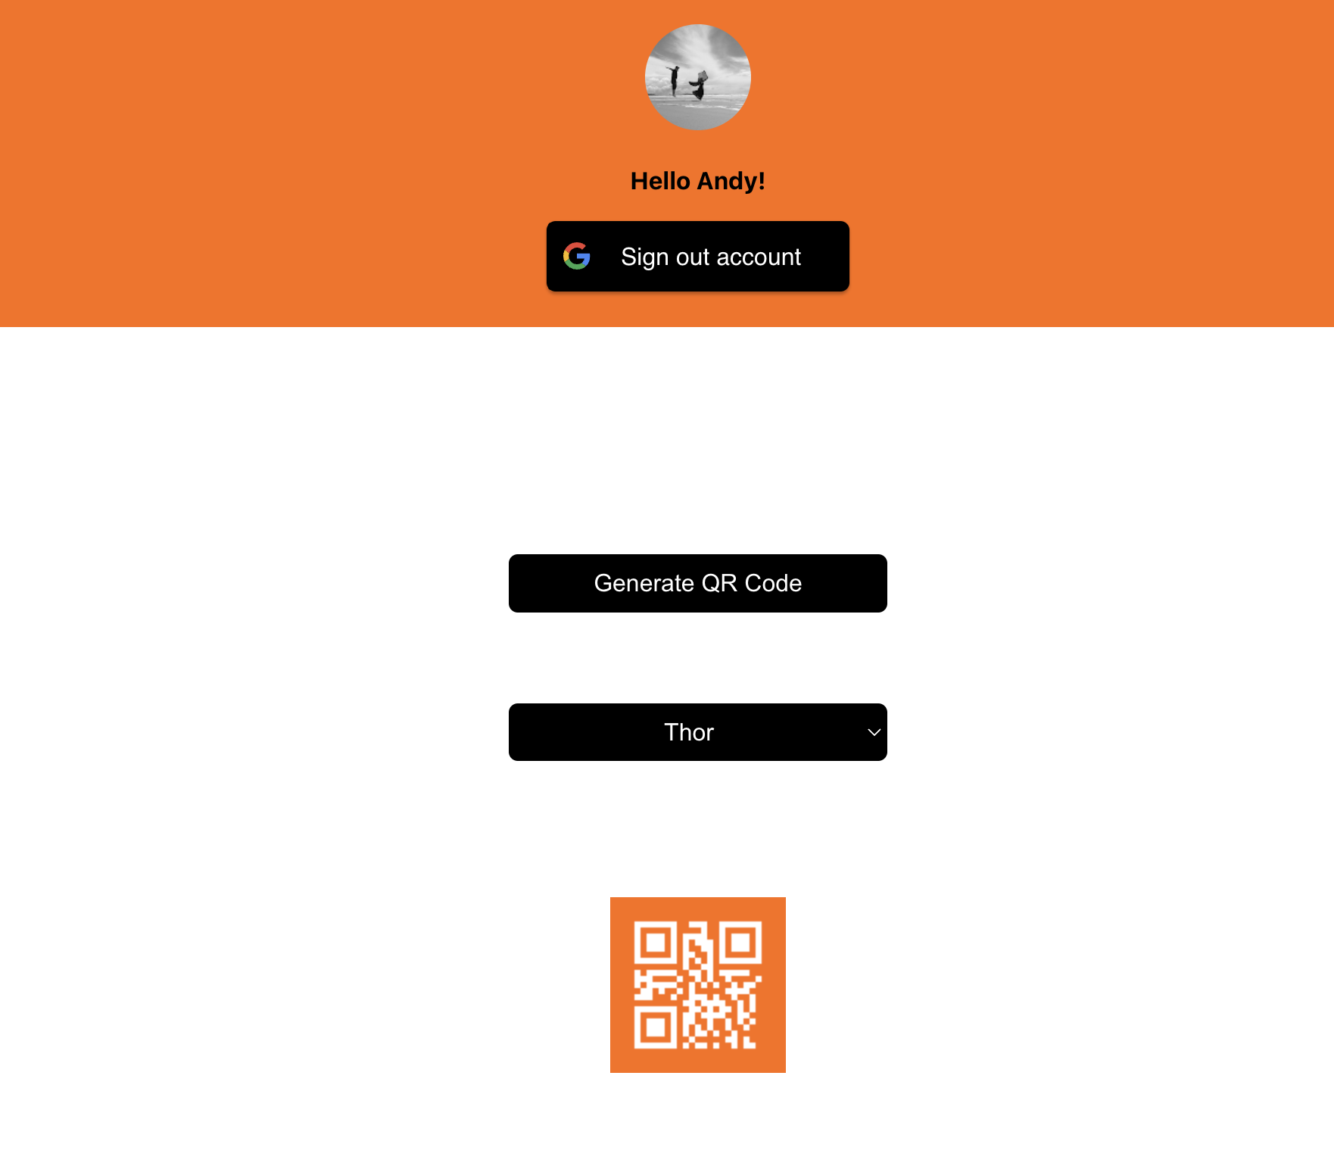
UI & Components
UserProfile
SignIn
Login/out Button
Button
GenerateQRCode
Dropdown
ErrorMessage
QRCode

Slide 5
Outline
UI & Components
Overview of the Components
Implementation Details
App Component
SignIn Component
GenerateQRCode Component
To Be Improved
Related Information

Slide 6
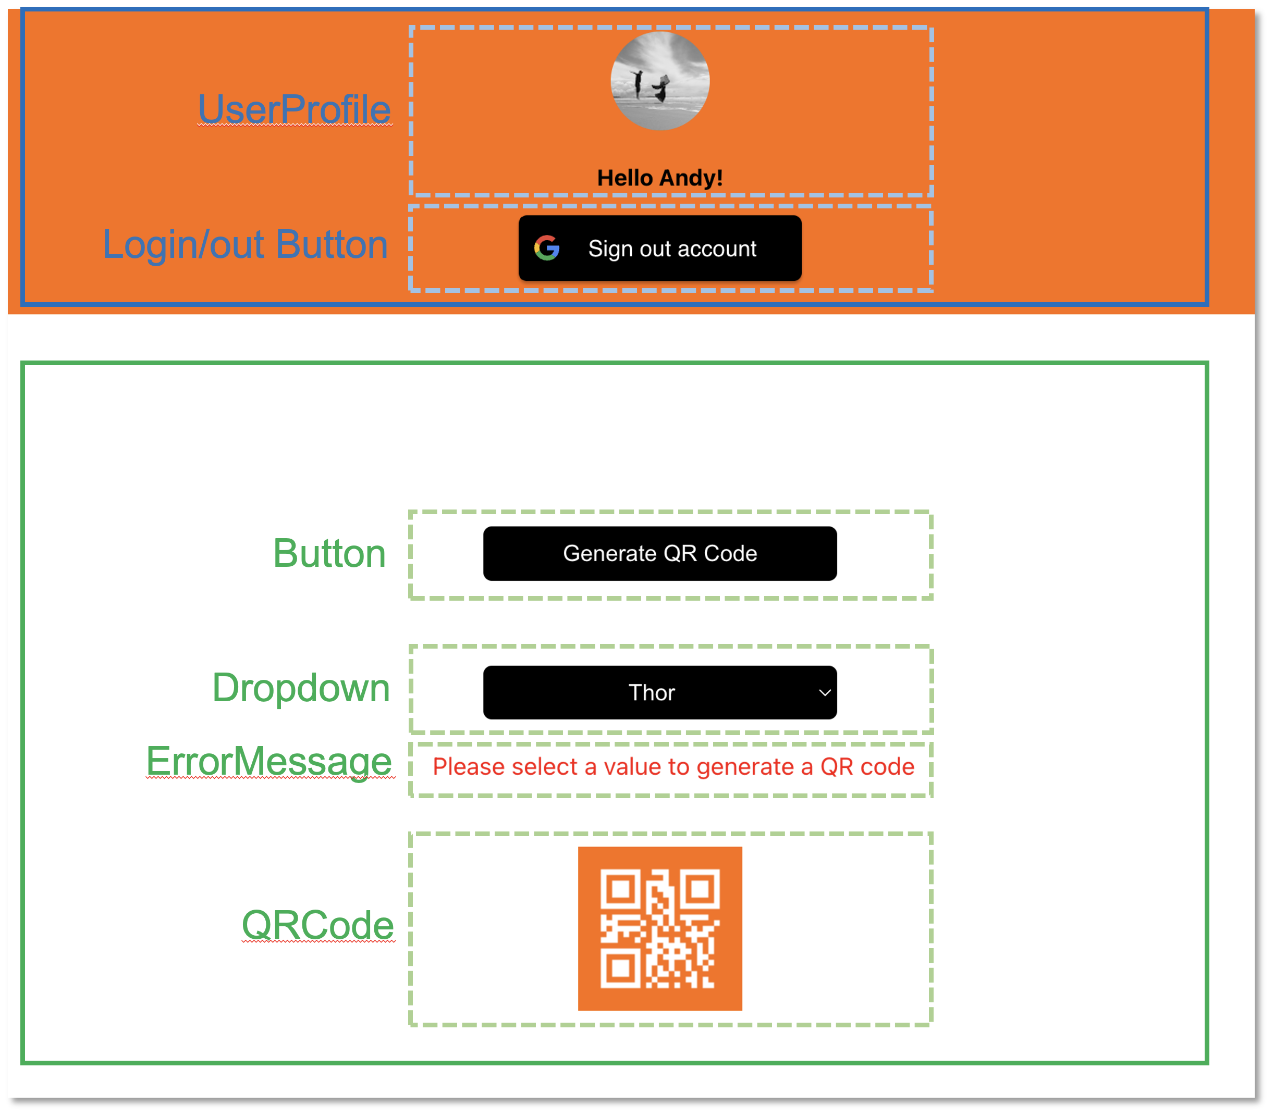
Overview
SignIn
GenerateQRCode
<App/>
<SignIn/>
<Welcome/>
<GenerateQRCode/>
<UserProfile/>
<GoogleLogin/>
<GoogleLogout/>
<Button/>
<Dropdown/>
<ErrorMessage/>
<QRCode/>
<MessageModal/>

Slide 7
Outline
UI & Components
Overview of the Components
Implementation Details
App Component
SignIn Component
GenerateQRCode Component
To Be Improved
Related Information

Slide 8

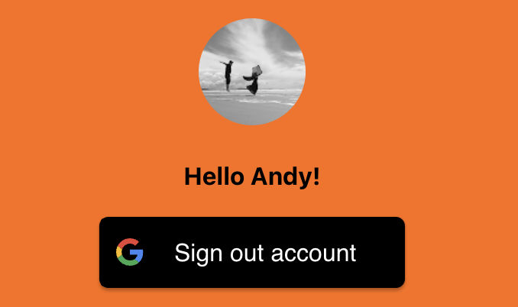

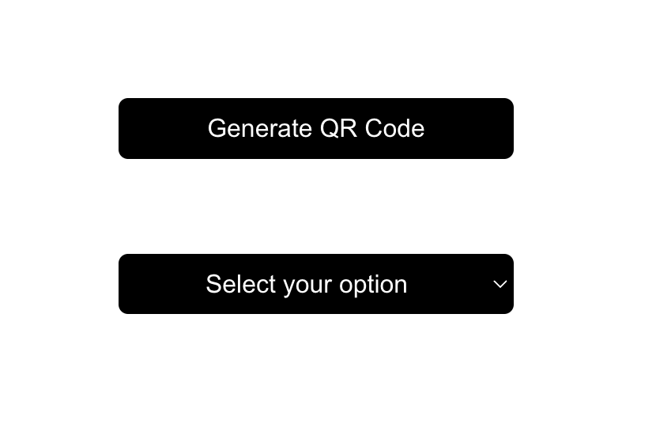

App Component
App Flow Chart
START
render App
render SignIn
Is user logged in?
N
Y
render Welcome
render GenerateQRCode
END

Slide 9
Outline
UI & Components
Overview of the Components
Implementation Details
App Component
SignIn Component
GenerateQRCode Component
To Be Improved
Related Information

Slide 10
SignIn Component
SignIn Flow Chart
START
render SignIn
Google api auth
Is user logged in?
N
Y
render Login button
render UserProfile
Logout button
END

Slide 11
Outline
UI & Components
Overview of the Components
Implementation Details
App Component
SignIn Component
GenerateQRCode Component
To Be Improved
Related Information

Slide 12
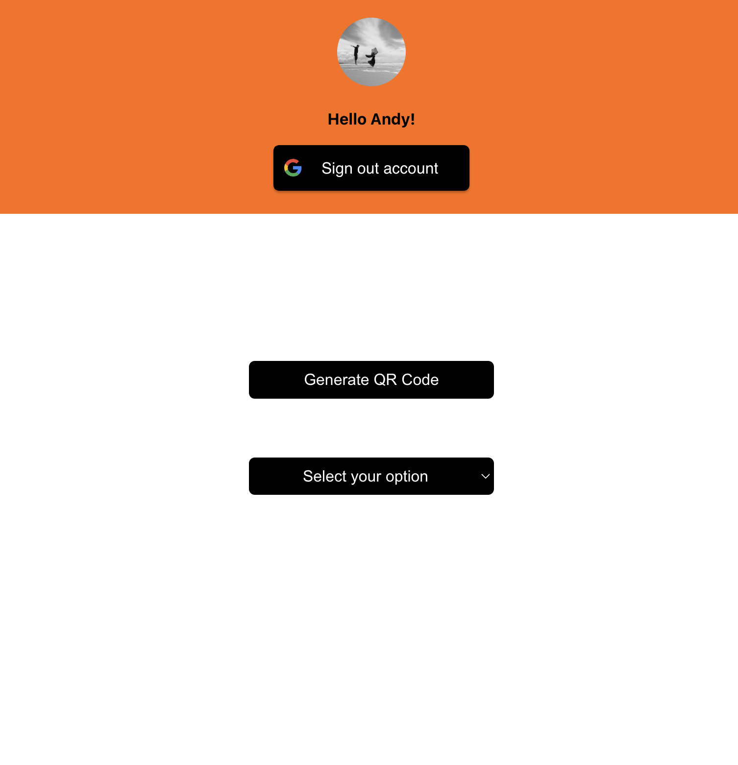

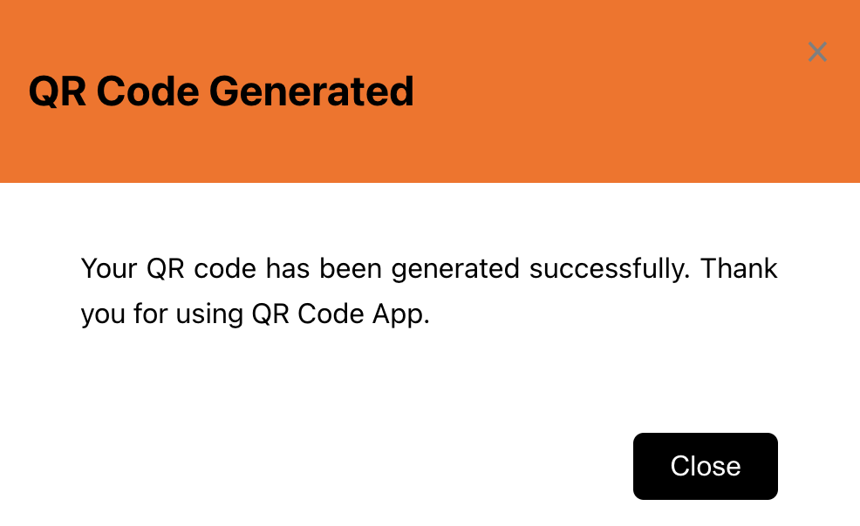
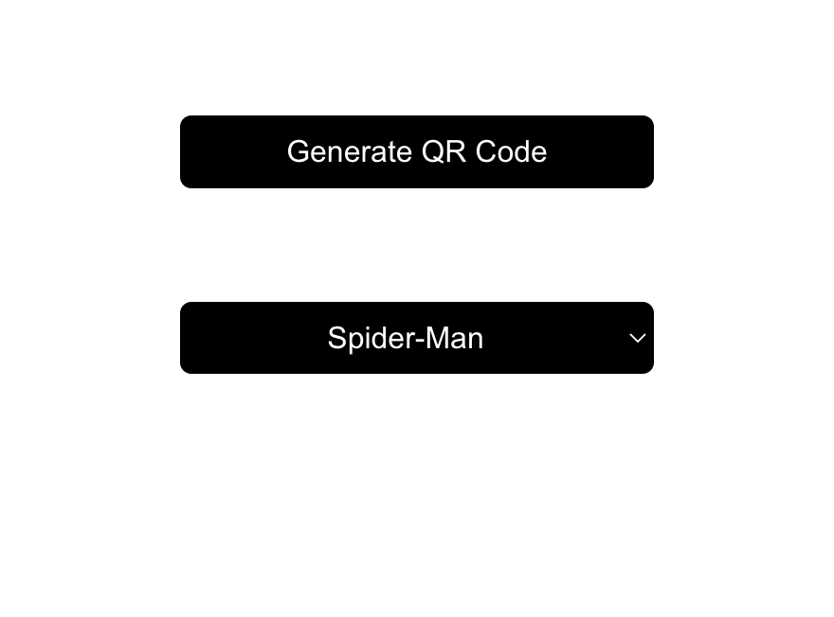

GenerateQRCode Component
GenerateQRCode Flow Chart
START
render button
and dropdown
button clicked
no option is selected
N
Y
render error msg
selected value changed?
N
Y
render a new QR code
do not re-render QR code
show message
END

Slide 13
Outline
UI & Components
Overview of the Components
Implementation Details
App Component
SignIn Component
GenerateQRCode Component
To Be Improved
Related Information

Slide 14
To Be Improved
Use React Redux
React components read data from a Redux store, and dispatch actions to the store to update state
Login status, show the modal
Write Tests
Jest, React Testing Library
Cypress

Slide 15
Outline
UI & Components
Overview of the Components
Implementation Details
App Component
SignIn Component
GenerateQRCode Component
To Be Improved
Related Information

Slide 16
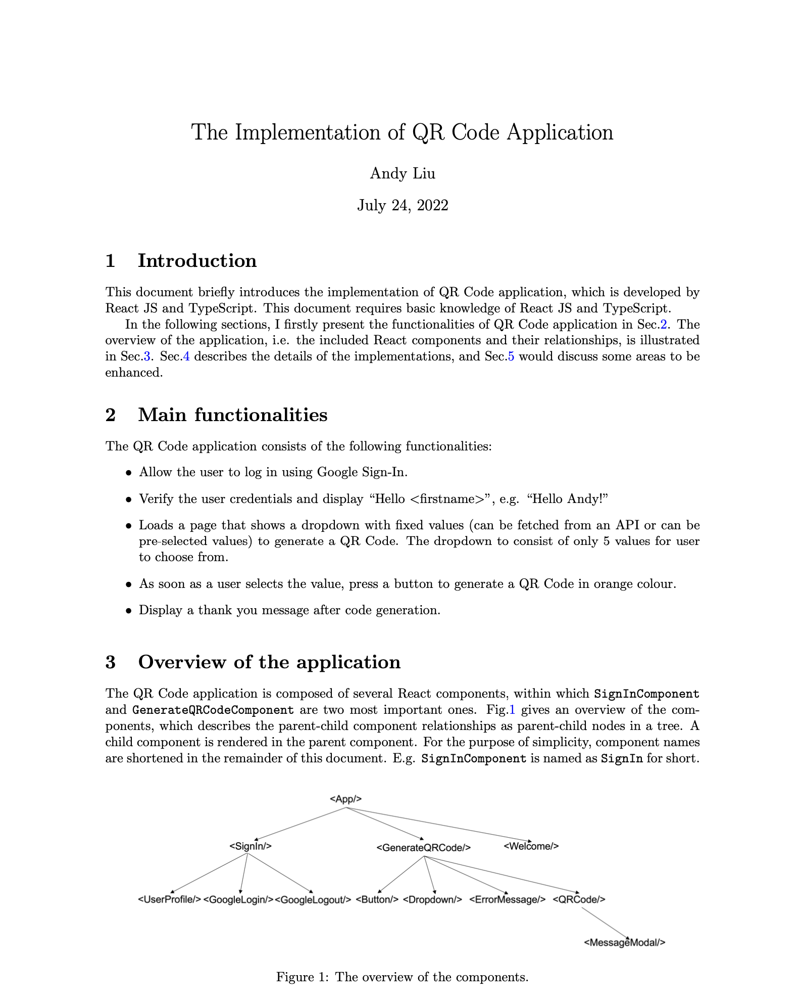
Related Information
Github
https://github.com/xiangyuliu-crs/QRCode.git
Documentation
The implementation of QR Code Application

Slide 17

Thank you

