Slide 1
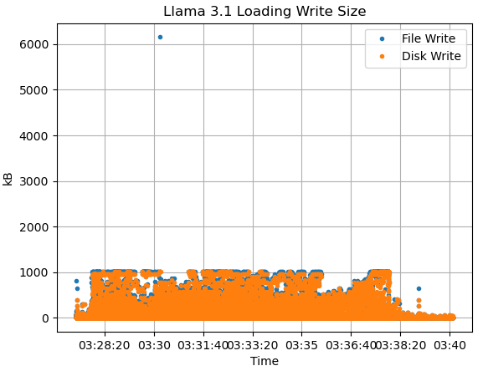
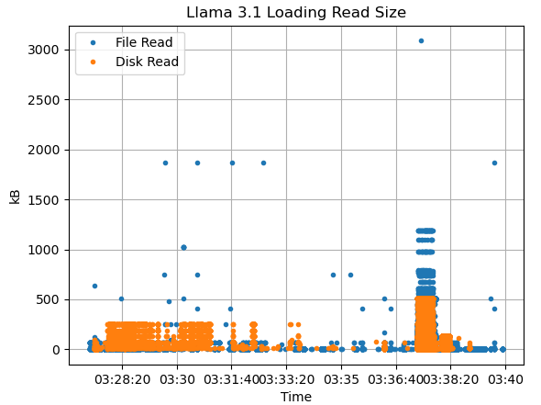
Llama Loading File/Disk Read/Write
File read/write: contain file, size and requesting app information only, no LBA info
Disk read/write: contain LBA and size information only, no file and app info
Note: file read can be directed to memory, not disk; Thus not all file reads are disk reads

Slide 2
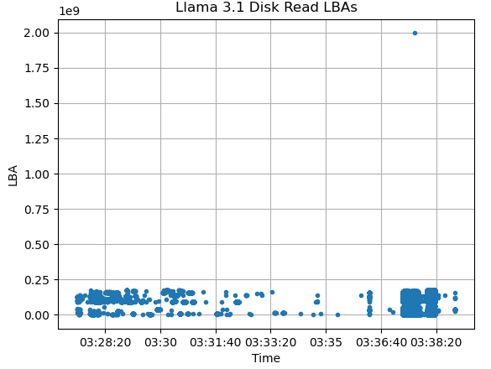
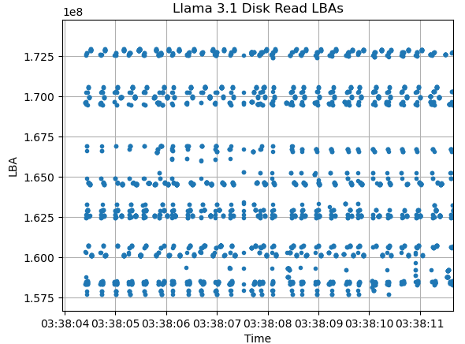
Llama Loading Read LBA Patterns

Slide 3
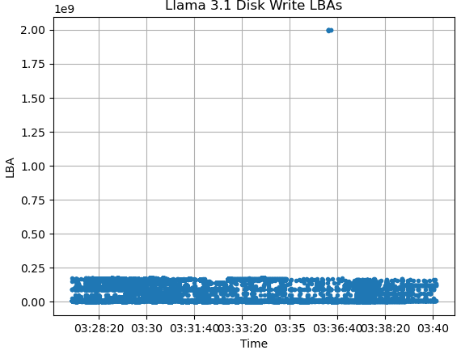
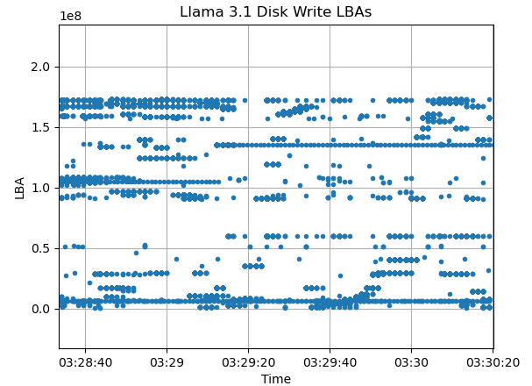
Llama Loading Write LBA Patterns

Slide 4
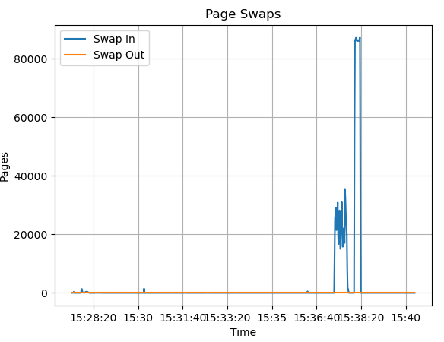
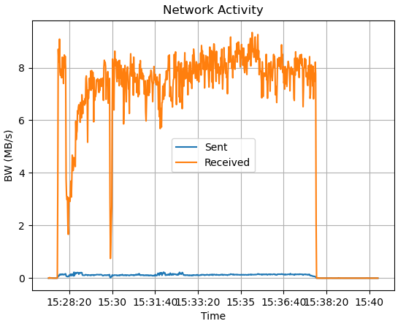
Llama Loading Memory Swaps

Slide 5
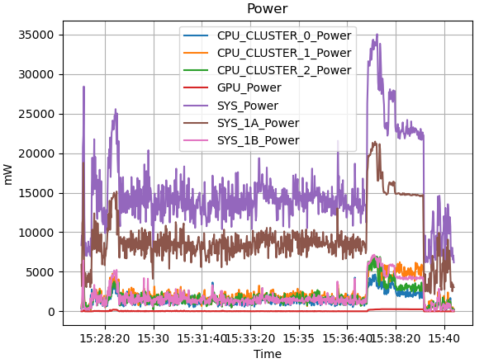
Llama Loading Power Consumption
No counters for SSD power

Slide 6
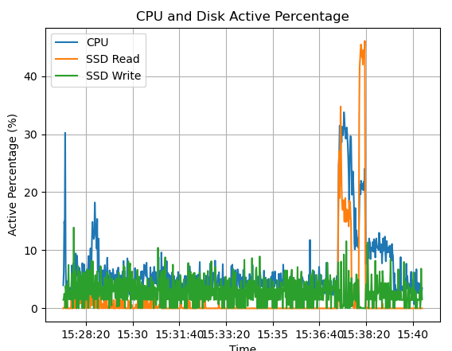
Llama Loading CPU and Disk Activity
Percentage of time CPU and SSD is active

Slide 7
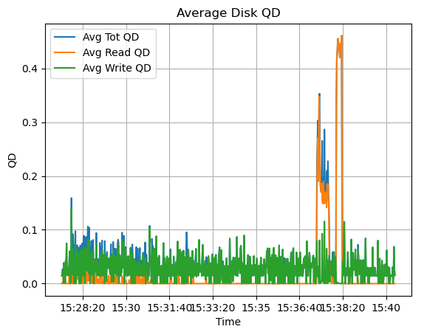
Llama Loading CPU and Disk Activity
Percentage of time CPU and SSD is active

Slide 8
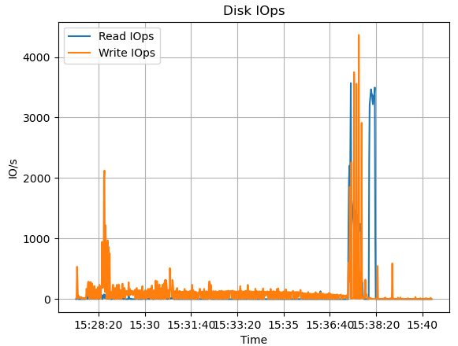
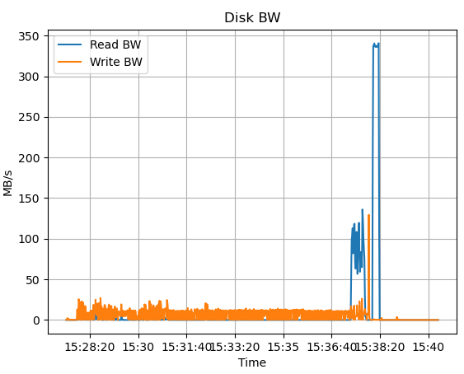
Llama Loading SSD BW/IOps
System performance counter, not processed from traffic trace

Slide 9
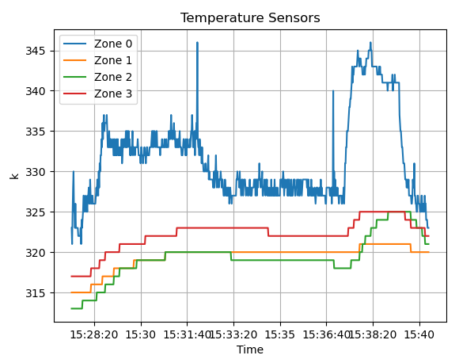
Llama Loading SSD BW/IOps
Not sure what is contained in a zone
Different for each OEM

Slide 10
Llama Loading Network Activity
Loading the Llama model by downloading it first

Slide 11
