Slide 1

Fast Interactive Object Annotation with Curve-GCN
CVPR 2019 Huan Ling, Jun Gao

Slide 2
Introduction
Current approaches are all data hungry.Manually tracing object boundaries is a laborious process.
To speeding up annotation, a number of techniques have been proposed.
Propose a new framework that supports object annotation by either polygons or splines,facilitating labeling efficiency for both line-based and curved objects

Slide 3
1.Related Work
2. Main contributions
3.The architectures of RS-CNN
3.Experience

Slide 4
Related Work
Pixel-wise methods:依赖颜色和纹理特征，求解energy function。最近的DEXTR方法，将用户点击作为图像heatmap的额外特征。需要用户点击4个端点，并在边界上增加点调整预测。
Contour-based methods:早期方法基于水平集，通过求解闭合轮廓线偏微分方程，确定物体边界。近期有基于联合CNN features和active contour parameters的方法,通过优化IoU loss预测轮廓。
Notes:
1用户需要在object周围绘制一个框，还可以在前景或背景上添加额外的涂写。当边界和背景混杂时，需要点击很多次进行修正
2基于水平集的方法标注的很初略，大多数都没有用户交互
1看成回归问题，可以同时预测多个顶点
2可以修正任一个点

Slide 5
Main contributions
1，把object annotation看成一个回归问题，可以同时预测多个顶点
2，模型具有顺序不变性，可以修正任一顶点
3，提出的新的loss function更适合2D annotation task，方案具有human-in-the-loop
4，每次人为修正都会重新预测各个顶点，可以更快的实现交互式标注
Notes:
1用户需要在object周围绘制一个框，还可以在前景或背景上添加额外的涂写。当边界和背景混杂时，需要点击很多次进行修正
2基于水平集的方法标注的很初略，大多数都没有用户交互
1看成回归问题，可以同时预测多个顶点
2可以修正任一个点

Slide 6
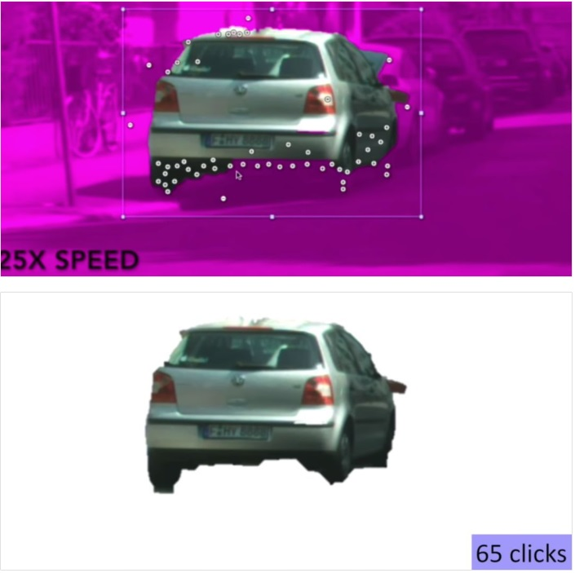
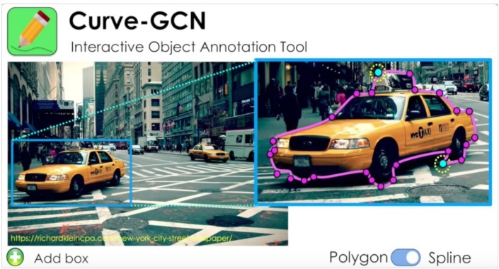

Slide 7
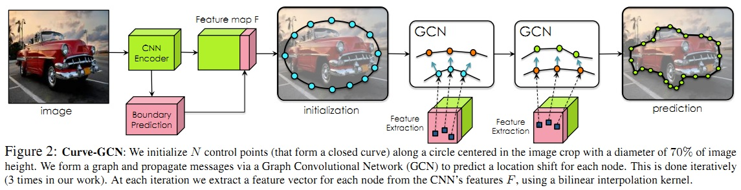
Curve-GCN

Slide 8
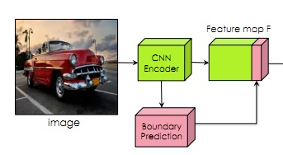
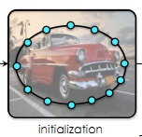
We denote the feature map obtained from the last convolutional layer of the CNN encoder applied on the image crop as Fc.
In order to help the model see image boundaries, we super-vise two additional branches, i.e. an edge branch and a vertex branch, on top of the CNN encoder’s feature map Fc, both of which consist of one 3×3 convolutional layer and one fully-connected layer. These branches are trained to predict the probability of existence of an object edge/vertex on a 28×28 grid.
We initialize N control points (that form a closed curve) along a circle centered in the image crop with a diameter of 70% of image height.

Slide 9
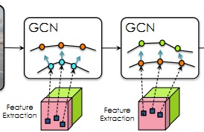
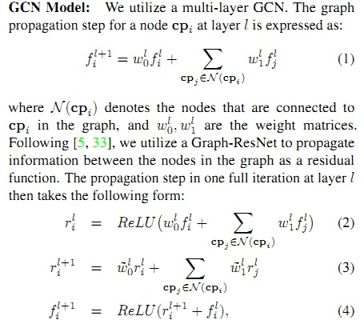

Slide 10
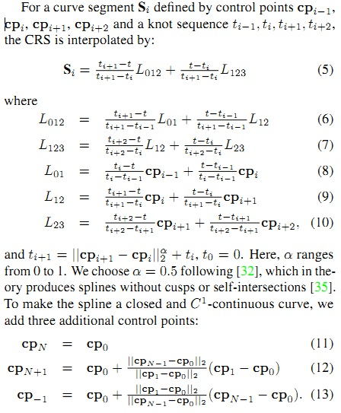
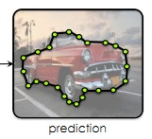

Slide 11

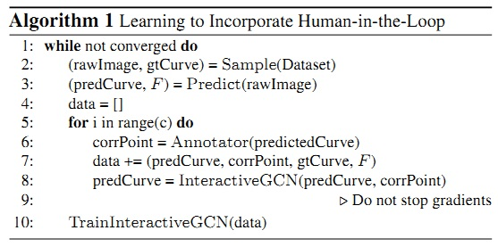


Point Matching Loss:
Differentiable Accuracy Loss:
Annotator in The Loop：

Slide 12
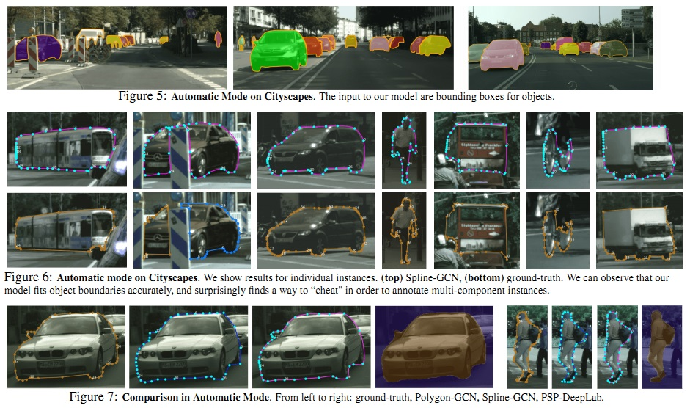

Slide 13
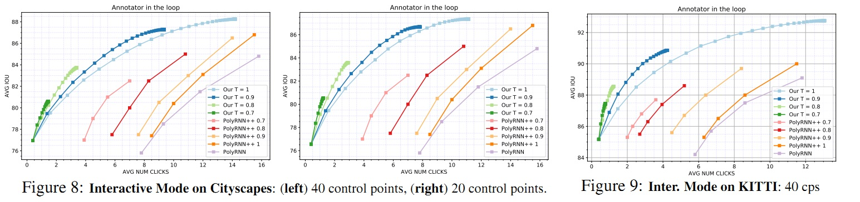
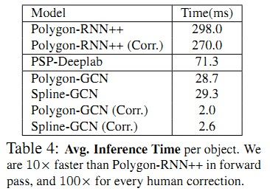

Slide 14
