Slide 1
PVRNet: Point-View Relation Neural Network for 3D Shape Recognition
AAAI 2019 Haoxuan You, Yifan Feng

Slide 2
一、Review existing methods
二、Motivation
三、Main contributions
四、Model
五、Feature Extraction
六、Experiment Result

Slide 3
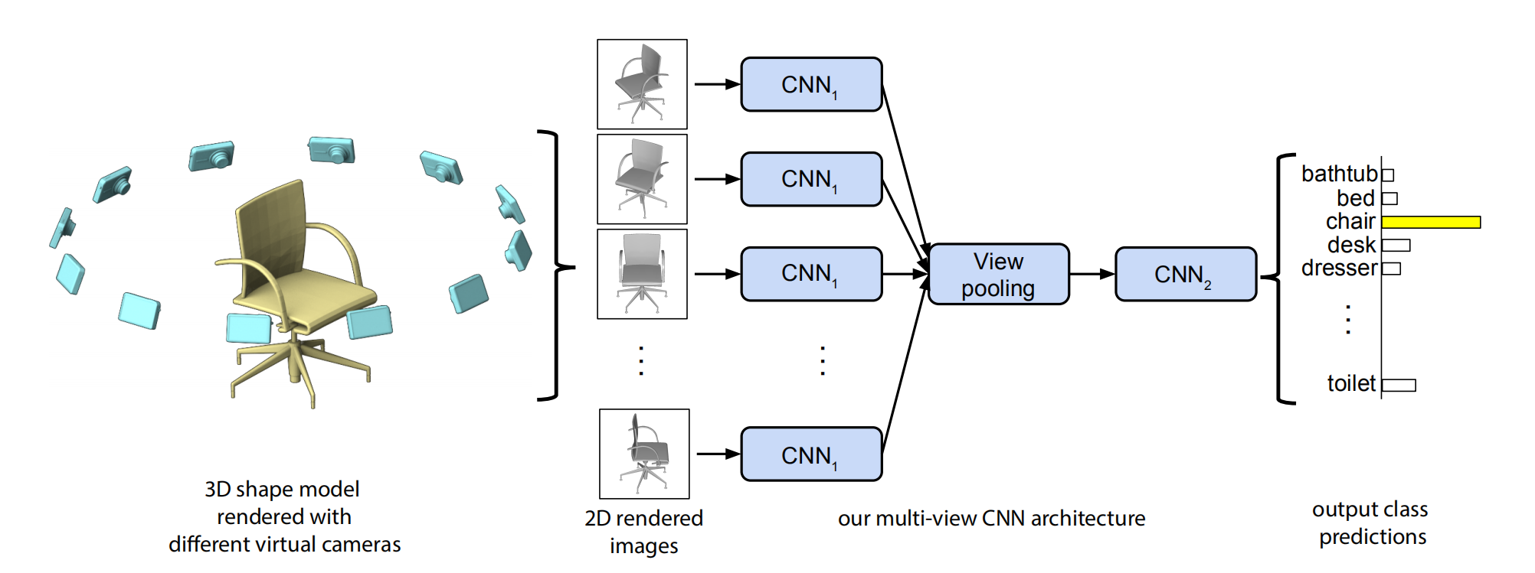
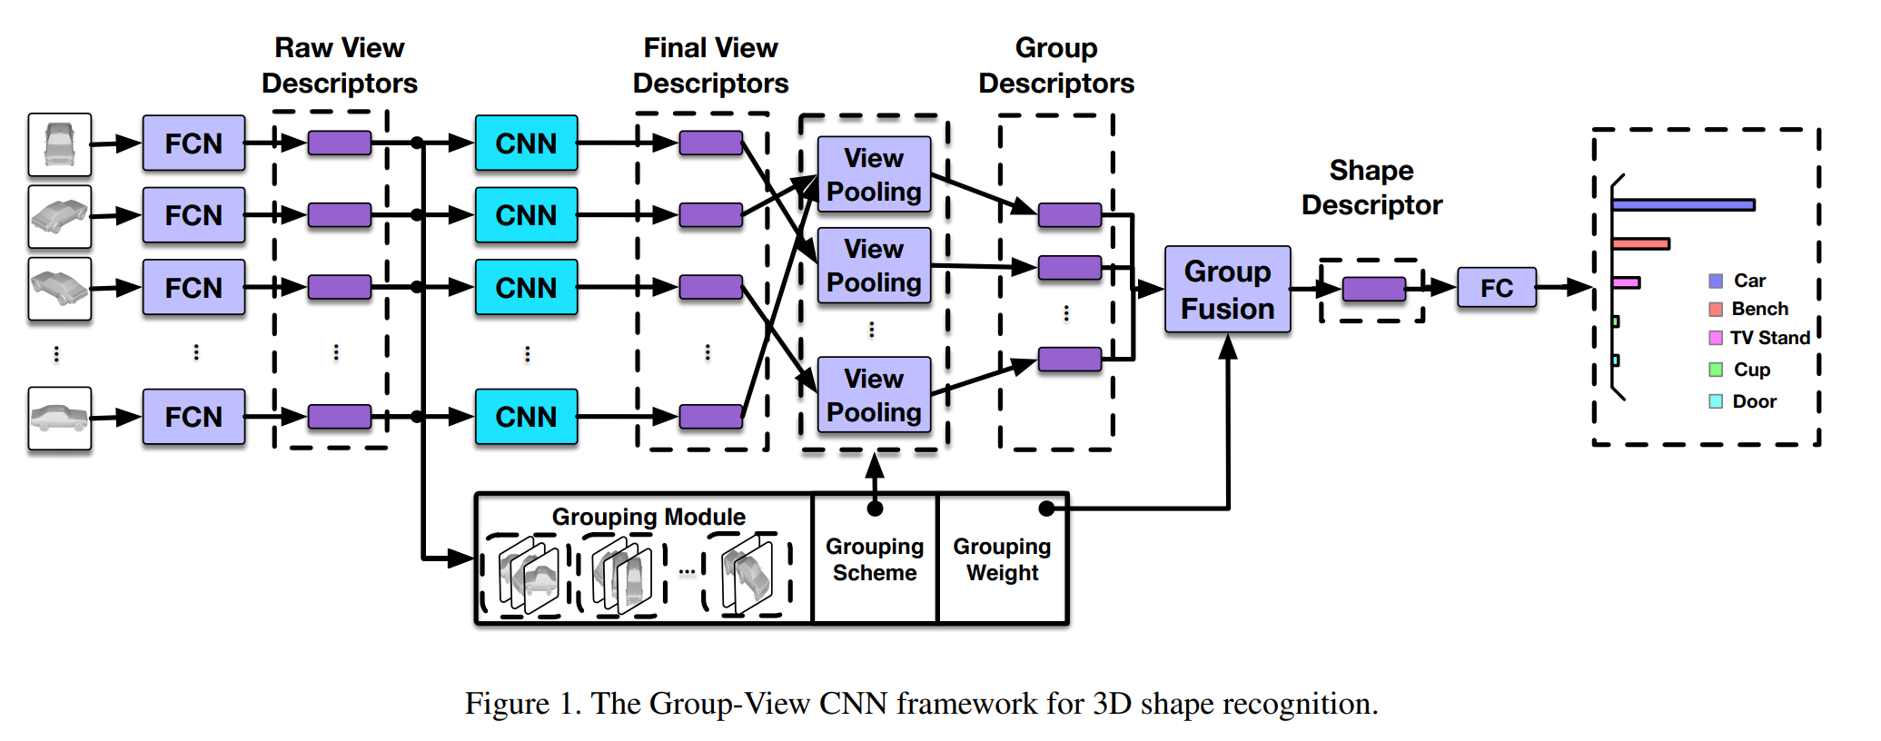
Review existing methods
View Based Methods
使用多视角2D图像来提取3D特征
MVCNN GVCNN
Multi-view Convolutional Neural Networks for 3D Shape Recognition http://vis-www.cs.umass.edu/mvcnn/docs/su15mvcnn.pdf
GVCNN: Group-View Convolutional Neural Networks for 3D Shape Recognition http://openaccess.thecvf.com/content_cvpr_2018/CameraReady/1389.pdf
Notes:
3

Slide 4
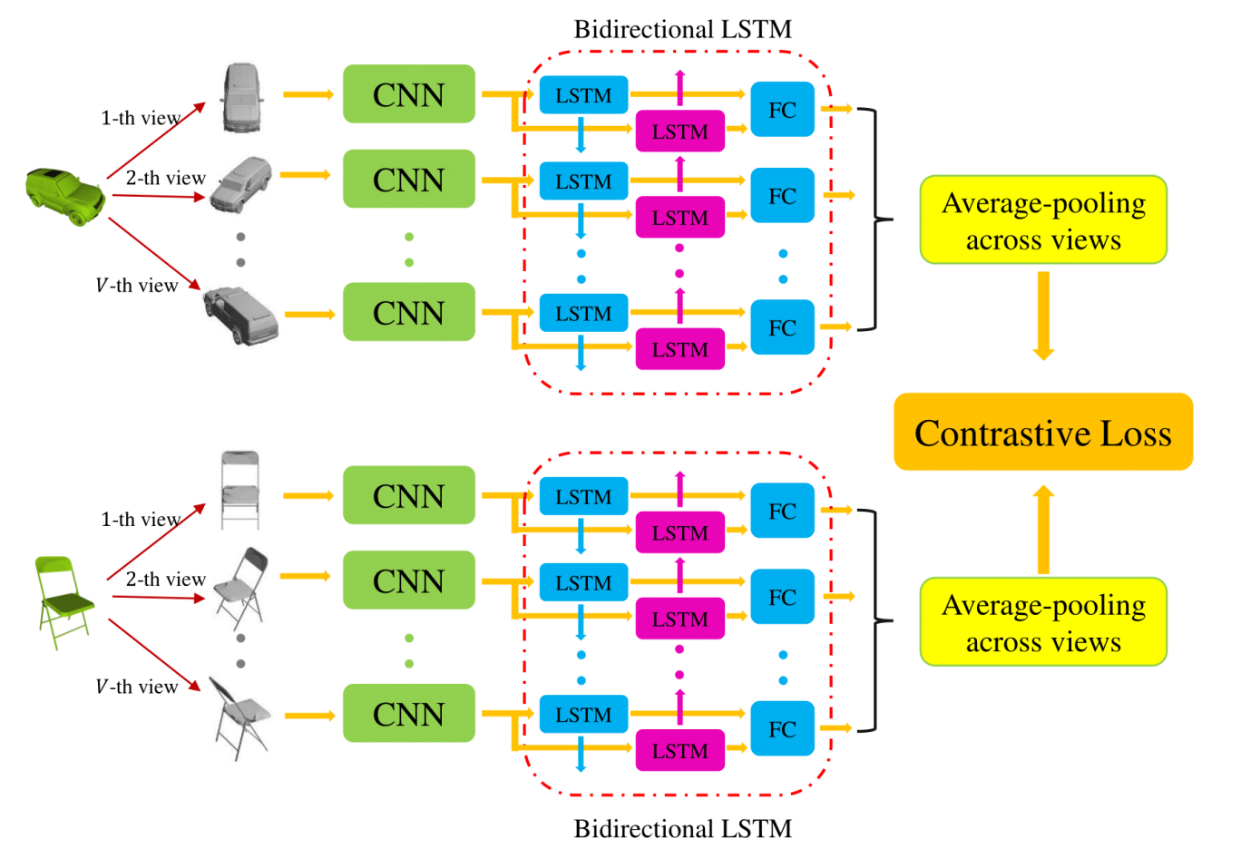
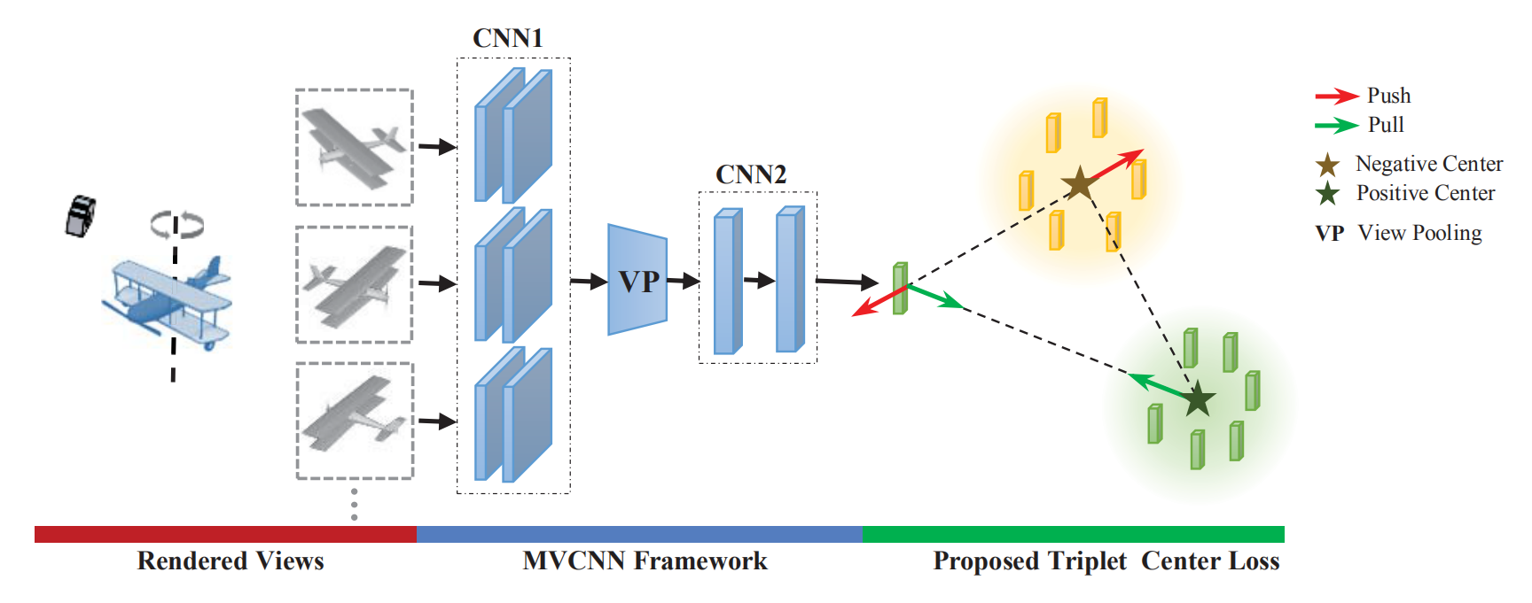
View Based Methods
Siamese CNN-BiLSTM Architecture Triplet-Center Loss
Siamese CNN-BiLSTM Architecture for 3D Shape Representation Learning https://www.ijcai.org/proceedings/2018/0093.pdf
GVCNN: Group-View Convolutional Neural Networks for 3D Shape Recognition https://arxiv.org/pdf/1803.06189.pdf
Notes:
triplet loss:从训练数据集中随机选一个样本，该样本称为Anchor，然后再随机选取一个和Anchor (记为x_a)属于同一类的样本和不同类的样本,这两个样本对应的称为Positive (记为x_p)和Negative (记为x_n)，由此构成一个（Anchor，Positive，Negative）三元组。训练一个参数共享或者不共享的网络，得到三个元素的特征表达 。triplet loss的目的就是通过学习，让x_a和x_p特征表达之间的距离尽可能小，而x_a和x_n的特征表达之间的距离尽可能大，并且要让x_a与x_n之间的距离和x_a与x_p之间的距离之间有一个最小的间隔。
central loss：一个batch中的每个样本的feature离feature 的中心的距离的平方和要越小越好，也就是类内距离要越小越好。这就是center loss。
4

Slide 5
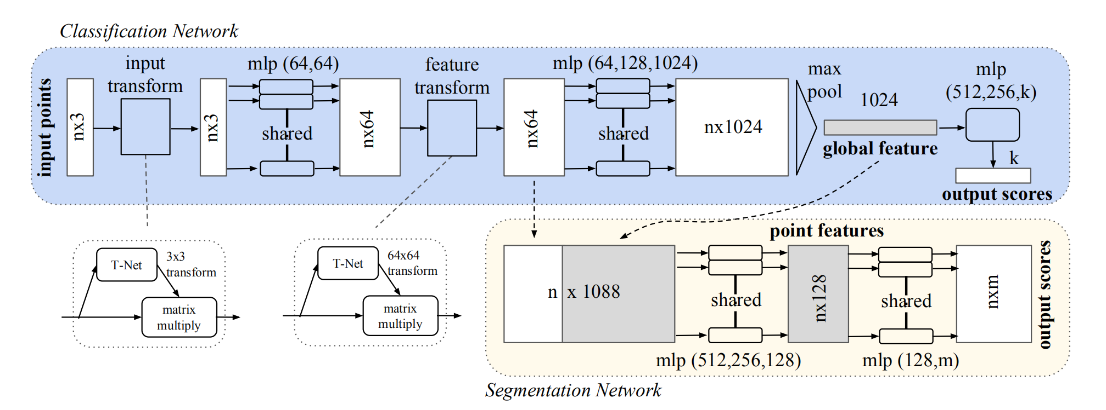
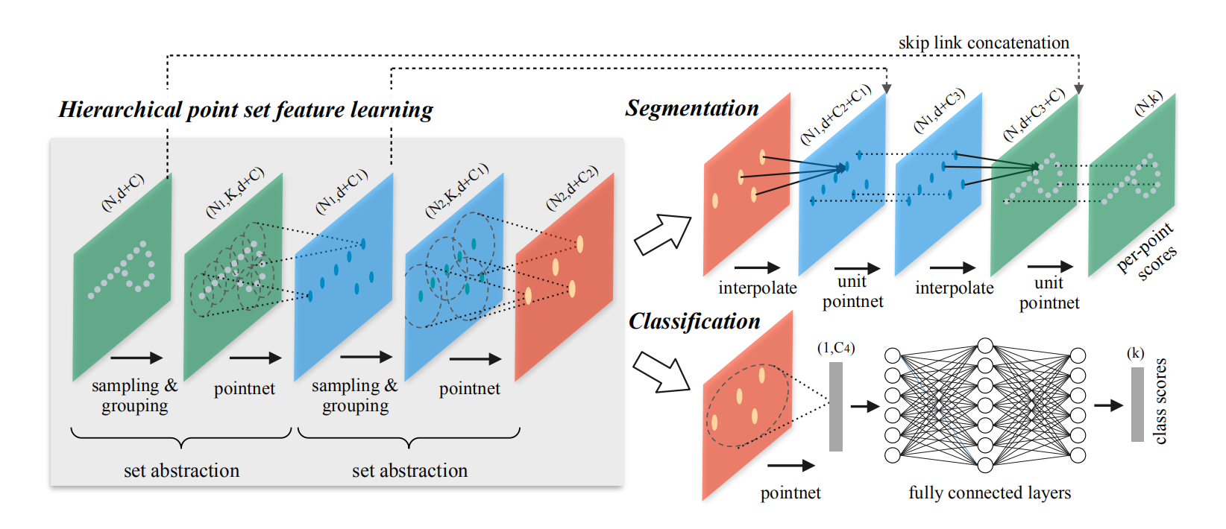
Point Clouds Based Methods
使用点云来提取3D特征
PointNet PointNet++
PointNet: Deep Learning on Point Sets for 3D Classification and Segmentation https://arxiv.org/pdf/1612.00593.pdf
PointNet++: Deep Hierarchical Feature Learning on Point Sets in a Metric Space https://arxiv.org/pdf/1706.02413.pdf
Notes:
5

Slide 6
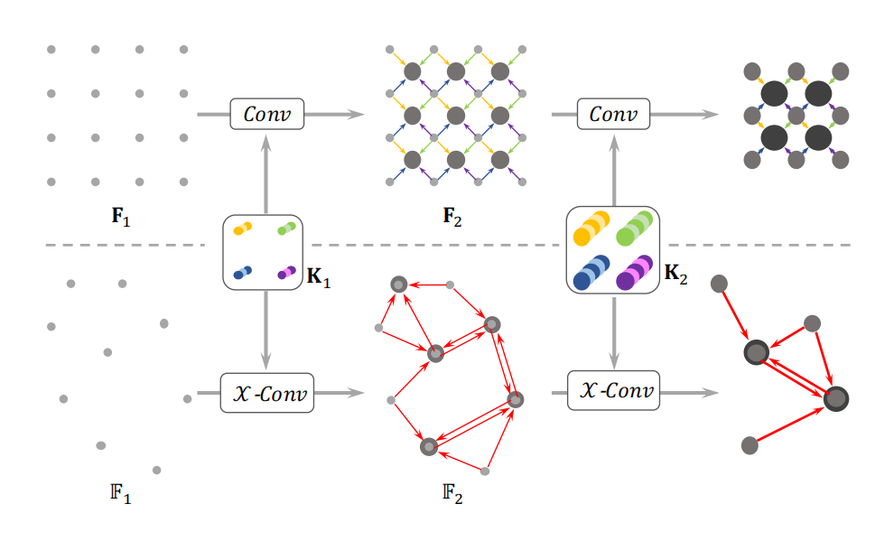
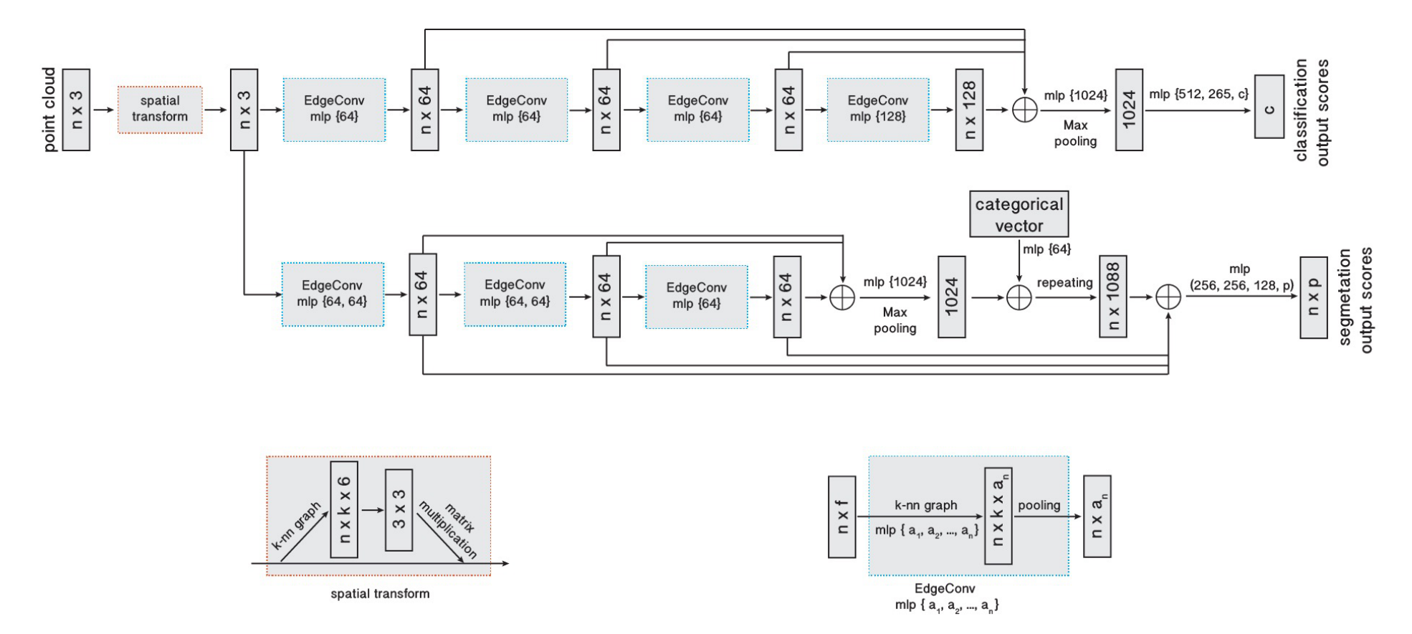
Point Clouds Based Methods
PointCNN DGCNN
PointCNN: Convolution On X-Transformed Points https://arxiv.org/pdf/1801.07791.pdf
Dynamic Graph CNN for Learning on Point Clouds https://arxiv.org/pdf/1612.00593.pdf
Notes:
EdgeConv考虑了点的坐标，与领域点的距离
6

Slide 7
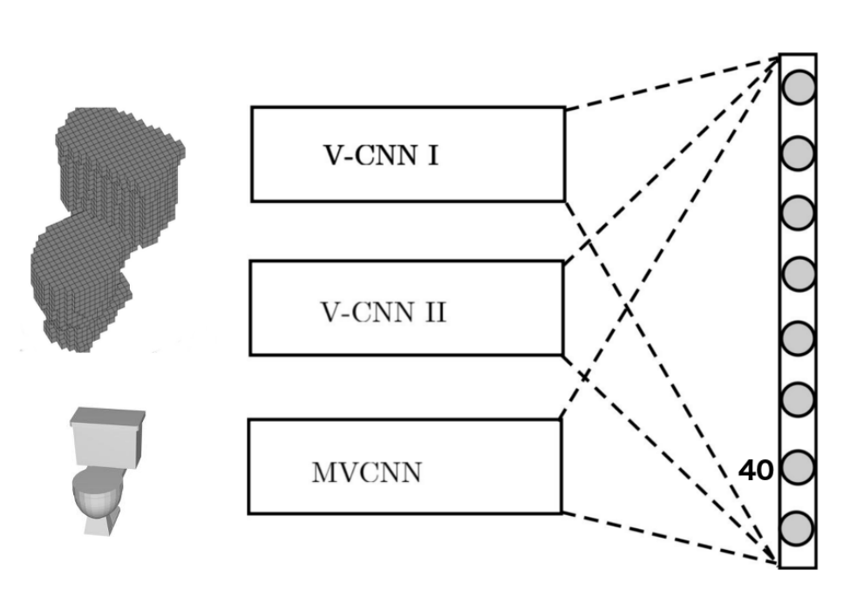
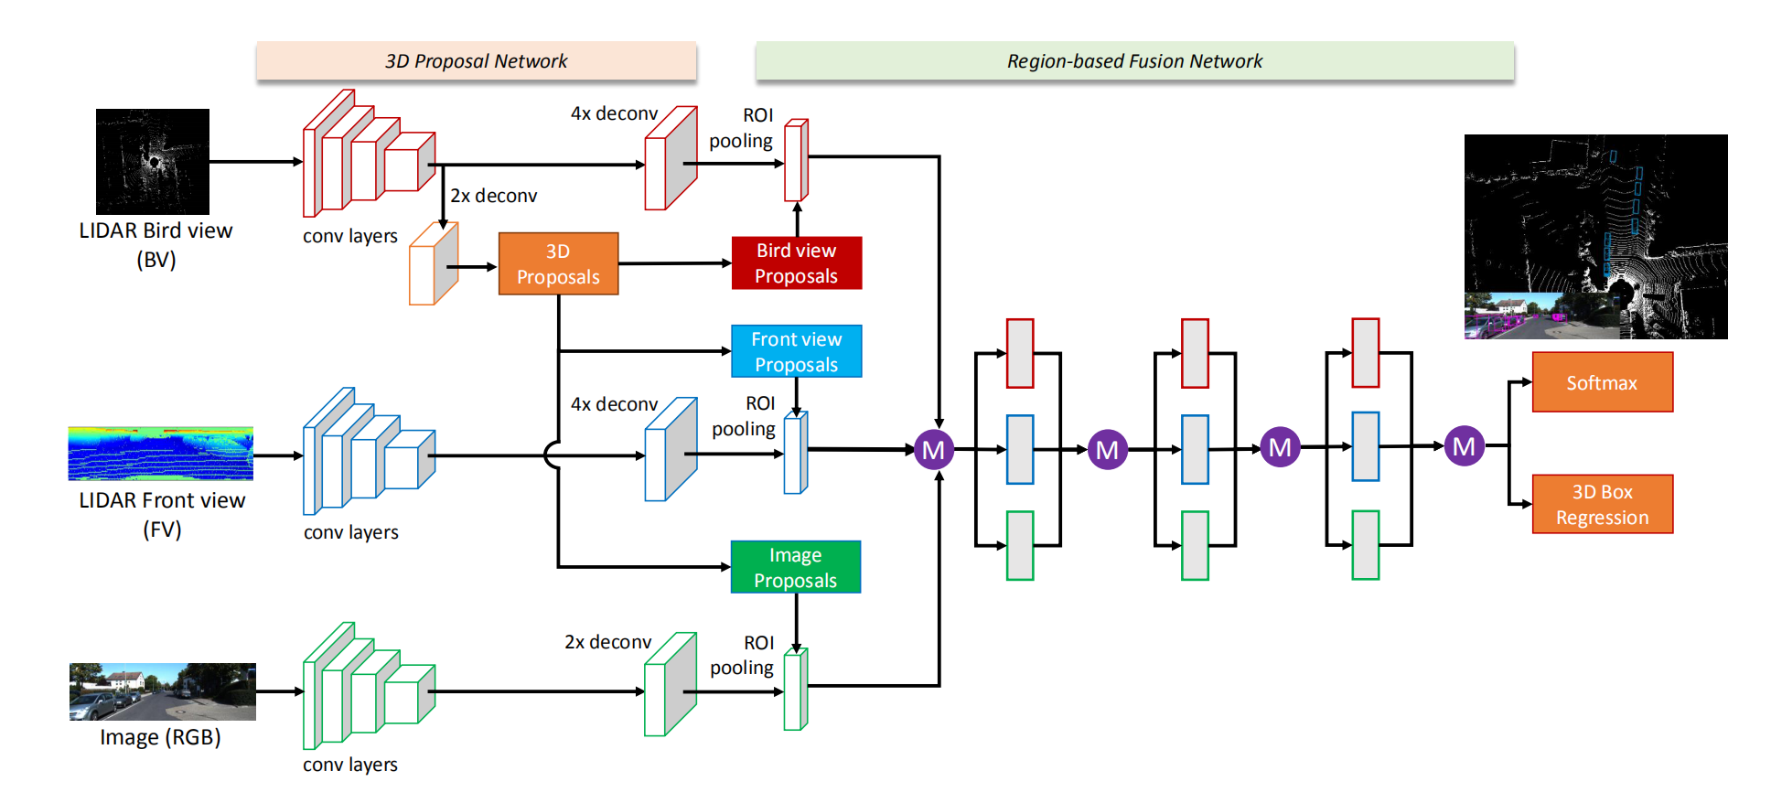
Multimodal Methods
multimodal fusion
FusionNet MV3D Network
FusionNet: 3D Object Classification Using Multiple Data Representations https://arxiv.org/pdf/1607.05695.pdf
Multi-View 3D Object Detection Network for Autonomous Driving https://arxiv.org/pdf/1611.07759v1.pdf
Notes:
FusionNet jointly employs vol_x0002_umetric data and view data together to learn a unified fea_x0002_ture representation
fuses the point cloud data from LiDAR and view data from camera
7

Slide 8
Motivation
Considering the pros and cons of the view based models
and point cloud based models, the fusion of point cloud and multi-view features may obtain a better representation for 3D shape.
Notes:
传统图网络结构的图中，数据的连接是成对出现的，一条边连接两个节点。
在实际应用中，数据连接可能超出成对连接，许多复杂数据关系难以使用简单图进行表示。
超图结构中“超边”能够连接任意多个节点，具有极佳的可扩展性和对复杂关系的建模能力。
当面对多个节点拥有同一属性的时候，普通图只能通过多条边将他们连接在一起，而超图结构仅用一条超边就能实现属性的关联建模，因此具有更好的表征能力
8

Slide 9
Main contributions
introduce the first point-view relation (relevance) based deep neural network to well fuse the multi-view data and point cloud data.
design a new relation fusion scheme for the point cloud feature and the view features.
Notes:
传统图网络结构的图中，数据的连接是成对出现的，一条边连接两个节点。
在实际应用中，数据连接可能超出成对连接，许多复杂数据关系难以使用简单图进行表示。
超图结构中“超边”能够连接任意多个节点，具有极佳的可扩展性和对复杂关系的建模能力。
当面对多个节点拥有同一属性的时候，普通图只能通过多条边将他们连接在一起，而超图结构仅用一条超边就能实现属性的关联建模，因此具有更好的表征能力
9

Slide 10
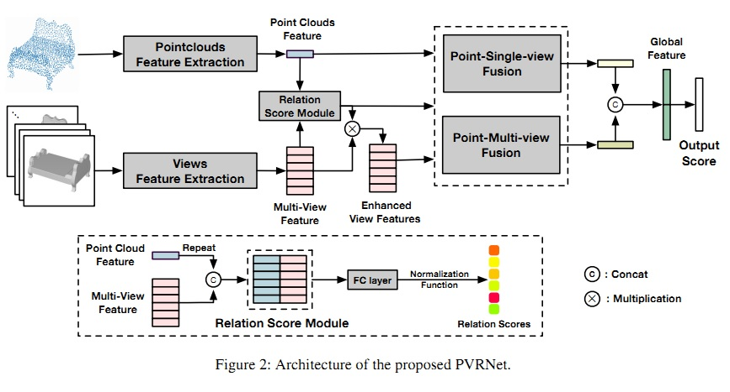
Model

Slide 11

Feature Extraction
Point cloud feature: employ DGCNN to extract the global feature from point cloud
View feature: following MVCNN.The view-pooling is discarded so that the features of each view are preserved.
Relation Score Module:
Notes:
where p is the point cloud feature and V = {v1 ;:::;vn} denotes n extracted view features from a 3D shape. The function g reasons the relations between the point cloud feature and per-view feature and learns an effective fusion. In our network, g uses the simple multilayer perceptrons (MLP) and is the normalization function (sigmoid function is used in our implementation). For each view, the output is a re-lation score ranging from 0 to 1, which represents the sig-niﬁcance of the correlation between different views and the point cloud.

Slide 12
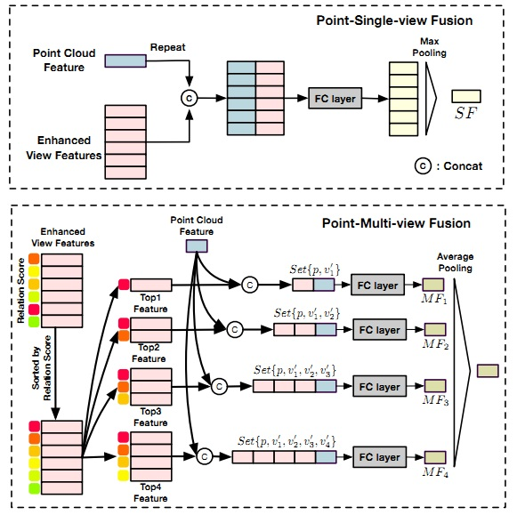

Slide 13



Point-Single-View Fusion
PVSet only includes single view i .
Point-Multi-View Fusion
point cloud is com-bined with several views to form PVSets.
Final feature

Slide 14
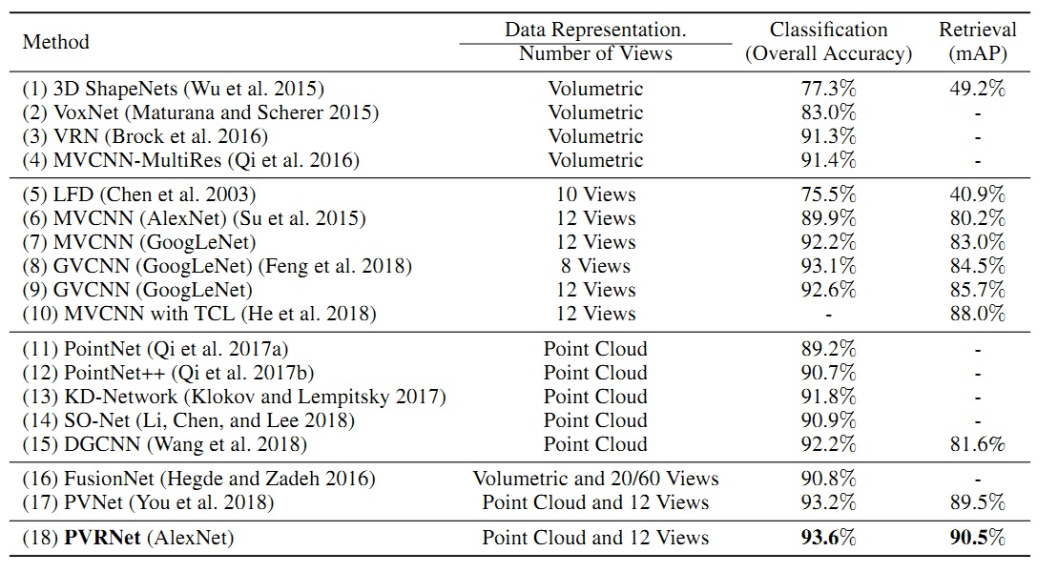
Experiment Result
ModelNet40 dataset

Slide 15
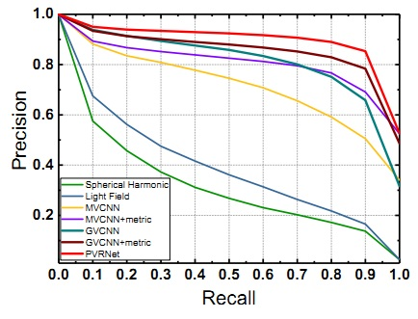
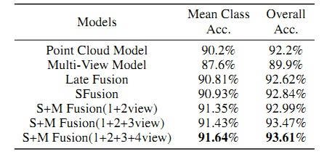
PR曲线
the inﬂuence of different number of PVsets

Slide 16
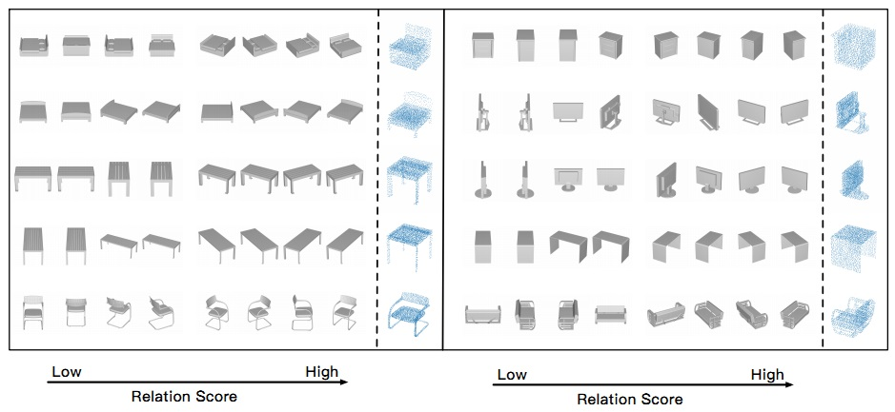

Slide 17
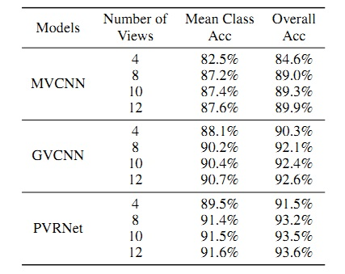
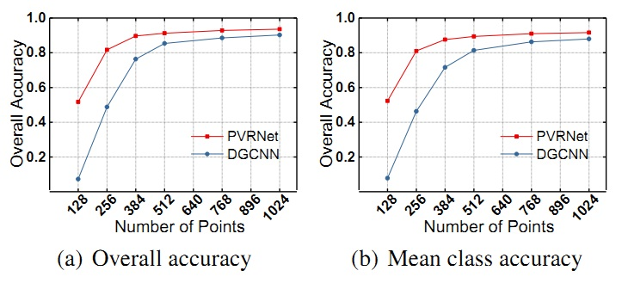
Notes:
鲁棒性好

