Slide 1
Relation-Shape Convolutional Neural Network for Point Cloud Analysis
CVPR 2019 Yongcheng Liu, Bin Fan

Slide 2
Introduction
Mainly three challenges for learning from point set P ⊂ R³
(1)P is unordered(permutaion invariant)
(2)P distributes in 3D geometric space(robust ro rigid translation)
(3)P forms an underlying shape(shape awareness)
The issue (1) has been well resolved by symmtric funtion,such as max,sum,avg.
The issue (2) and (3) still demand for a full exploration.
The RS-CNN can learn from relation,i.e.,the geometric topology constraint among points.
Notes:
(2)rotation and translation
在对称函数中，函数的输出值不随输入变数的排列而改变
RS-CNN 的核心是从几何关系中推理学习 3D 形状

Slide 3
1.Main contribution
2.RS-Conv
3.The architectures of RS-CNN
3.Experience

Slide 4
Main contributions
Key contributions:
(1)提出一个新的Relation-Shape Convolution,可以encode点之间的几何关系，提高形态感知和robustness
(2)提出了RS-CNN结构，将regular grid CNN拓展到不规则结构，用于获取点云的contextual shape-aware learning
(3)实验及理论分析

Slide 5
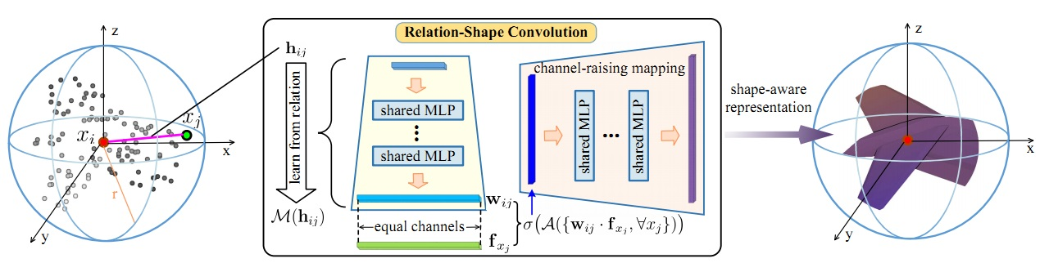
Relation-shape Convolution(RS-Conv)

Slide 6
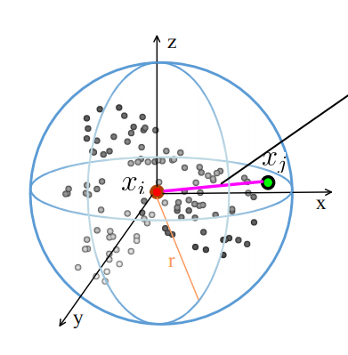

Local-to-global learning, which has gained remarkable success in image CNN.
采用球面邻域获取点云的local point subset—P_{sub}
Learn an inductive represention of this neighborhood
要满足不变性，function A和T在点云中必须共享参数

Slide 7

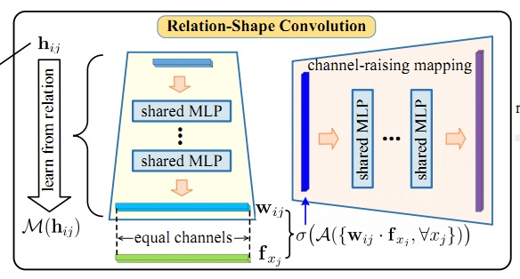

classic CNN
1.参数不共享，对输入点集不具有置换排列不变性
2.反向传播中w_{j}的梯度仅与与孤立点有关，无法捕捉点之间关系
RS-Conv
Learn a mapping M of a relation vector h_{ij} 。h_{ij} 表示点云内部point之间的低维关系，如欧式距离，余弦距离，法线，point在xy，yz，zx上的投影等，通过MLP学习一个映射函数M。M中的数值w_{ij}就包含了点之间的high-level relation。同时M被所有点共享，满足不变性 。
replace w_{j} with w_{ij}
Notes:
Low-level relation hij is deﬁned as a compact vector with 10 channels, i.e., (3D
Euclidean distance, x i − x j, x i, x j). The channel-raising
mapping is achieved by a single-layer shared MLP. Batch
normalization [ 12] is applied in each MLP.

Slide 8
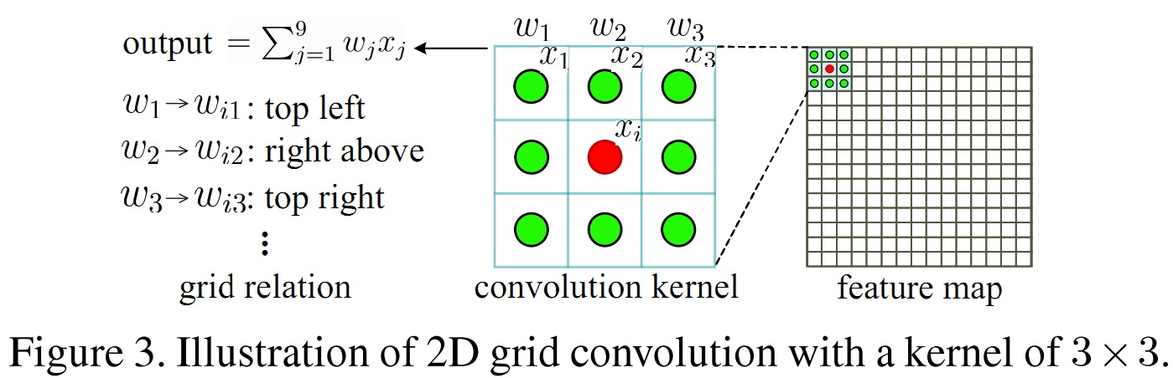

Slide 9
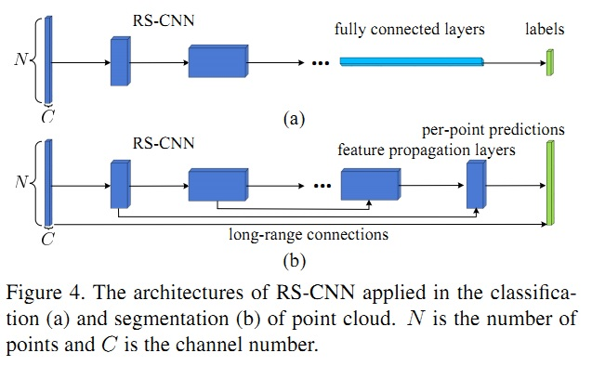

RS-CNN

Slide 10
Experiment
1.Point Cloud Analysis
1.1Shape classification
1.2Shape part segmentation
1.3Normal estimation
2.RS-CNN Design Analysis
2.1Ablation study
2.2Aggregation function A
2.3Mapping function M
2.4Low-level relation h
2.5Robustness to point permutation and rigid transformation
3.Visualization and Complexity Analysis
3.1Visualization
3.2Complexity Analysis

Slide 11
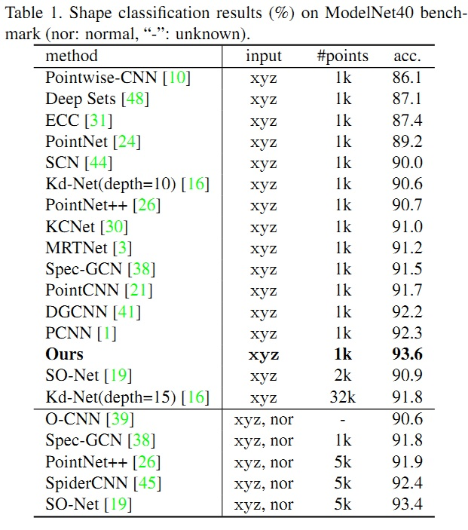
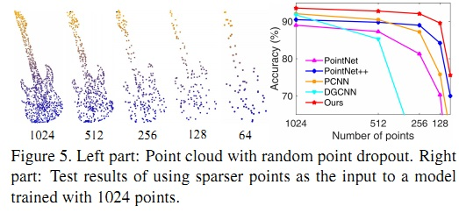
Notes:
PVRNet 93.6

Slide 12
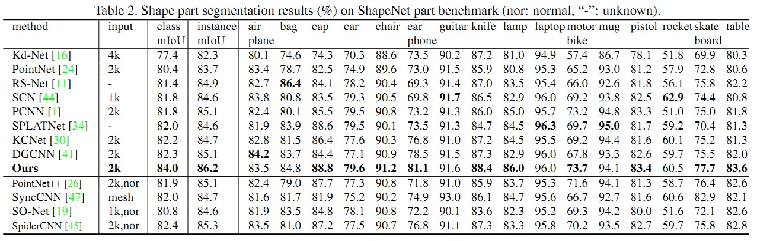
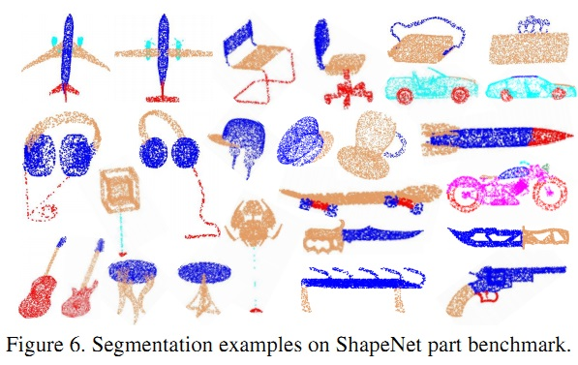
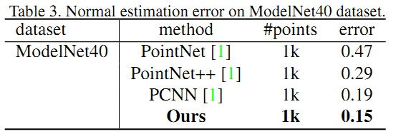

Slide 13
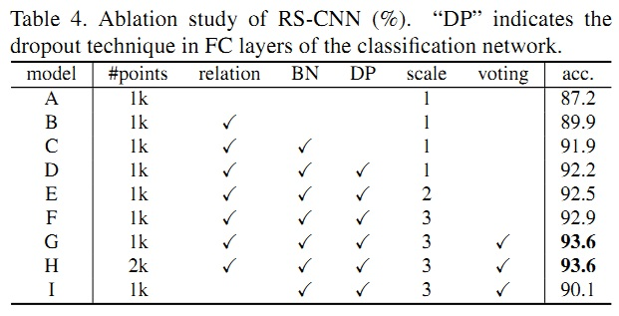
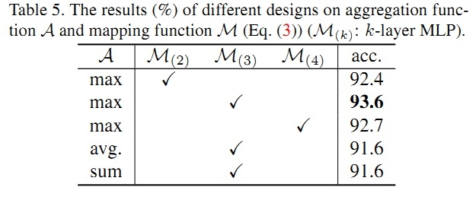
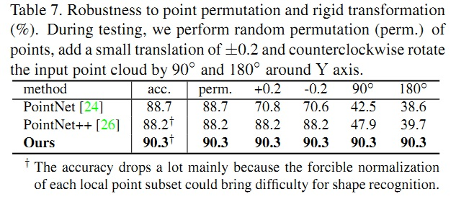
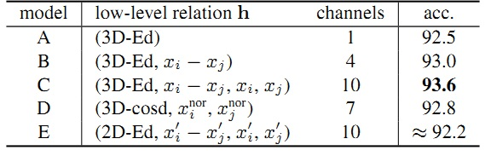

Slide 14
