Slide 1
Smart Checklist Group Meeting Agenda Wednesday November 13, 2013
Status report about Smart Checklist framework development effort
Demonstration of the Smart Checklist framework on a portion of the infusion therapy process model
Possible next goals
Process modeling
Framework development
Possible research directions

Slide 2

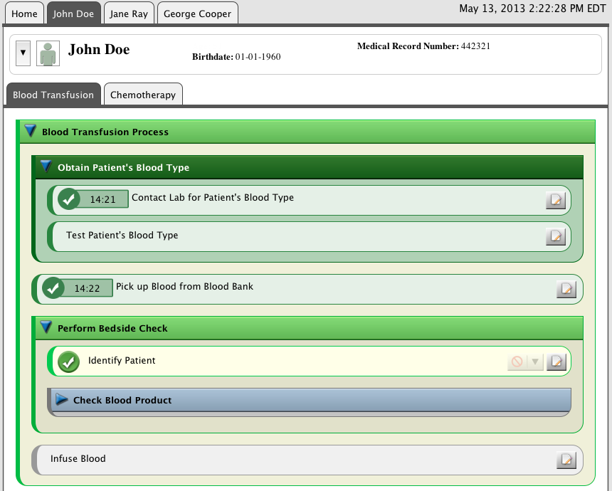


Smart Checklist Framework Architecture
Static Analysis
Dynamic Analysis
Scenarios
Interpreter/Simulator
Retrospector
Prospector
Properties
Model Checker
Process Model
Deviation
Detector
Event Interaction
Manager
Activities
Fault Tree Analyzer
Constraint Evaluator
Artifacts
Resources
Real-Time
Analyzers
FMEA Constructor
FMEA Analyzers
Process Improvement Feedback Loop
Notes:
Title: Framework Architecture, red circles indicate components currently incorporated into the smart checklist as of 13 Novemver 2013.

Slide 3
Smart Checklist Framework Architecture
Static Analysis
Dynamic Analysis
Scenarios
Interpreter/Simulator
Retrospector
Prospector
Properties
Model Checker
Process Model
Deviation
Detector
Event Interaction
Manager
Activities
Fault Tree Analyzer
Constraint Evaluator
Artifacts
Resources
Real-Time
Analyzers
FMEA Constructor
FMEA Analyzers
Process Improvement Feedback Loop
Notes:
Title: Framework Architecture, red circles indicate components currently incorporated into the smart checklist as of 13 Novemver 2013.

Slide 4
Possible Next Goals

Slide 5
Framework development
Changes/additions MDPnP/DocBox/MGH folks would like us to make to the GUI
Changes we can propose to the GUI:
Context
Non-leaf activities show more context
More support for visualization of artifacts/resources, exception handling
Providing more support for customizing the GUI
Color
Amount of hierarchy shown
Timestamps (show/hide)
Leaves shrink/collapse after being finished

Slide 6
Process modeling
Do several more iterations to polish process definition
Followed by validation of models by domain experts
Make a larger part of the Infusion Therapy process executable and hook it up to the Smart Checklist.
Set up meeting/Skype call with DocBox folks to review newest Little-JIL model

Slide 7
Possible research directions
Explore:
Supporting multi-agents, multi-processes
Show communications and waiting time
Recognizing when an automated agent completes an activity
Supporting undo of the last activity performed
Prospection service, so that future process state can be added
Develop an evaluation plan

