Slide 1

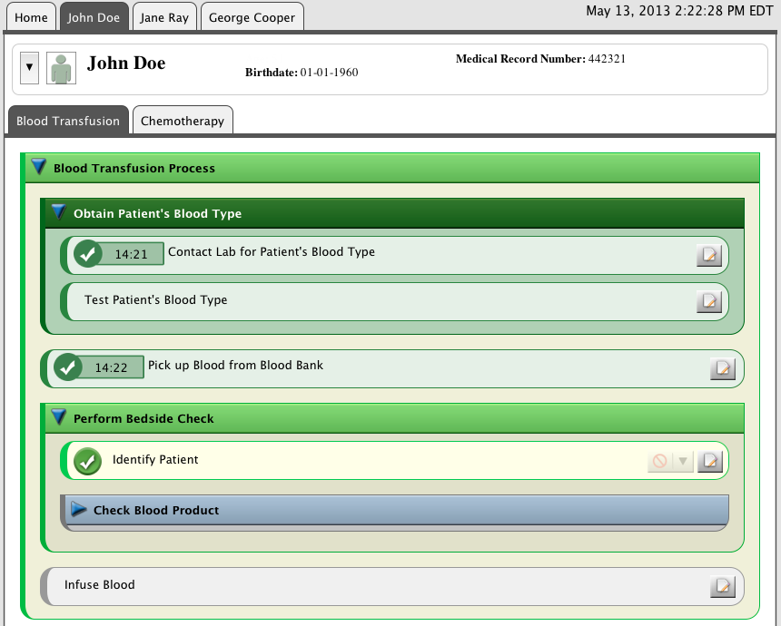


Static Analysis
Dynamic Analysis
Scenarios
Interpreter/Simulator
Retrospector
Prospector
Properties
Model Checker
Process Model
Deviation
Detector
Event Interaction
Manager
Activities
Fault Tree Analyzer
Constraint Evaluator
Artifacts
Resources
Real-Time
Analyzers
FMEA Constructor
FMEA Analyzers
Process Improvement Feedback Loop
Notes:
Title: Framework Architecture

Slide 2
Static Analysis
Dynamic Analysis
Scenarios
Interpreter/Simulator
Retrospector
Prospector
Properties
Model Checker
Process Model
Deviation
Detector
Event Interaction
Manager
Activities
Fault Tree Analyzer
Constraint Evaluator
Artifacts
Resources
Real-Time
Analyzers
FMEA Constructor
FMEA Analyzers
Process Improvement Feedback Loop
Notes:
Title: Framework Architecture, red circles indicate components currently incorporated into the smart checklist as of 13 Novemver 2013.

