Slide 1

Northeastern University - Seattle
CS6650 Building Scalable Distributed Systems
Vishal Rajpal

Slide 2
Week 3 – Distributed Systems Architecture (Whirlwind Tour)
Topics we will cover today:
User Functionality before Scalability
Multi tier Architecture
Scale up and Scale out
Load Balancing
Stateless Services
Distributed Databases
Queuing
Case Study

Slide 3
Software Systems Origins
Very few systems start with scalability as the primary driver.
Agile methods prioritize delivering user facing functionality.
YAGNE principle
Rapid application delivery frameworks dominate
Ruby on Rails, Django etc.
Trade off ease of delivery versus performance, scalability and availability.
Notes:
Most systems start small and grow based on their success

Slide 4
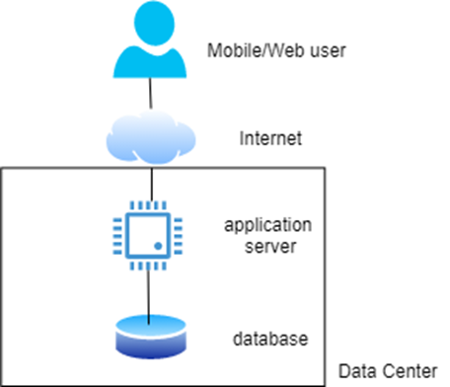
Basic Multi tier distributed systems architecture
Notes:
Some frameworks provide you with a model view controller and a mapperwhich generates queries.

Slide 5
Application Server
Container (execution) environment for application services (APIs)
Accepts client requests and invokes appropriate service functionality
Based on API request endpoint/parameters
Multithreaded execution environment using a thread pool
Connections to database managed through a connection pool
Thread pool size > connection pool size
Notes:
Execution environment such as JEE/Spring for java and flask for python.
Usually results in a monolithic architecture
Which is difficult to modify.

Slide 6
Scale Up
As request loads grow, scale up the system to support high load.
Get a bigger application server and database server.
Server with
More CPUs
More memory
More disks
Additional costs

Slide 7
Scale Up
Advantages
Simple to replace a low end server with high end server.
Disadvantages
Larger machines will incur more costs.
Single Point of Failure (SPoF)
There is still a limited capacity.
No matter how big the server is the capacity is still limited.
SPoF is another bigger problem
Highly reliable hardware is available but expensive.
Historical interest –Tandem/HP Non-stop servers – no longer sold.

Slide 8
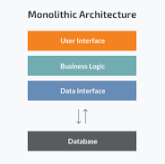
Scale Up
Larger Issue of Monolithic Architecture
Implementations for 10s-100s of APIs all bundled in same code
Hard to make changes and evolve.
Alternative is microservices which is lightweight and popular.

Slide 9
Scale Out
Replicate a service and run multiple copies on multiple server nodes.
Cheap, commodity hardware
Requests from clients are distributed across the replicas
If we have N replicas, each server node processes {#requests/N}.
Adding processing capacity as simple as adding a new server node

Slide 10
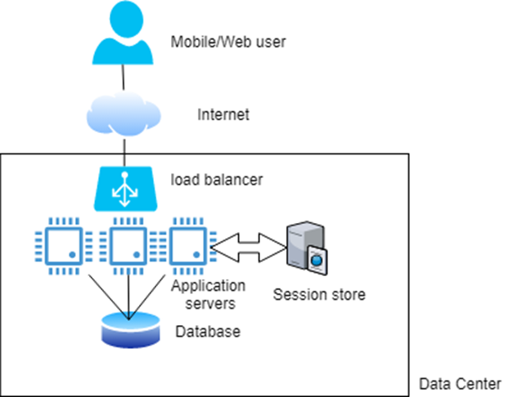
Scale Out

Slide 11
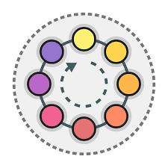
Scale Out
Load Balancer
Distributes requests across available services
Load balancing policy (e.g. round robin)
Stateless services
Each request must be self-contained so load balancer can choose any service
Any session state must be stored external to a service
E.g last page visited, shopping cart

Slide 12
Scale Out
Advantages
Add new (virtual) services to handle increased request loads
As latencies rise, just deploy another server instance.
Requires no code changes
just pay for the hardware deployed
Availability: If a service fails, the requests it is processing will be lost
Failed service manages no session state,
requests can be simply reissued by the client and sent to another service instance for processing

Slide 13
Scale Out
Adding new service instances gives increased capacity
Eventually increased capacity will overload the database
Slow queries will mean longer response times
If overload continues, some system component will fail due to resource exhaustion
clients will see exceptions and request timeouts
Need to remove database bottleneck

Slide 14
Scale Up Database
Simple to scale up but the problem of SPoF still persists.
GCP can provision a SQL database on 96 vCPUs, 624GB of memory, 30TBs of disk and can support 4000 connections.
Cost between $6K and $16K per year.
How can we improve?

Slide 15
Caching
Avoid using the database!!
Employ distributed caching in the service tier
Caches store commonly accessed database results in memory
Can be quickly retrieved without database access
Distributed caches such as a Redis or memcached widely used
Essentially distributed Key-Value stores with very simple APIs.

Slide 16
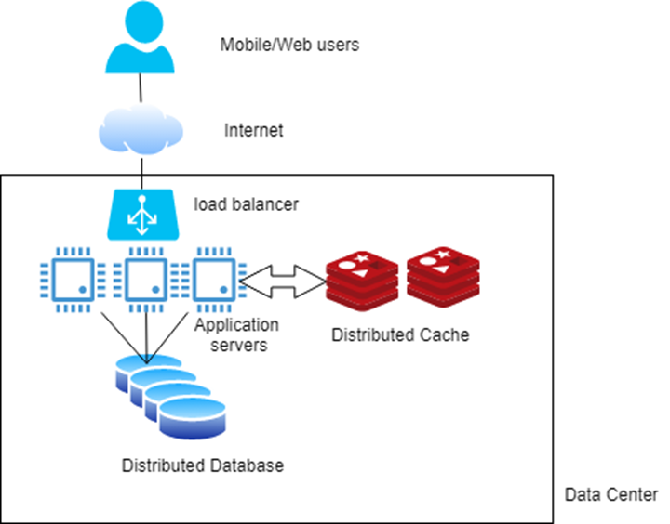
Caching
Notes:
Cache removal strategies include LRU or TTL

Slide 17
Distributed Databases
Two main flavors:
Distributed SQL stores
Store data across multiple disks that are queried by multiple database engine replicas.
Multiple engines logically appear to the application as a single database, hence minimizing code changes
Distributed so-called NoSQL stores
Variety of data models and query languages
Distribute data across multiple nodes running the database engine, each with their own locally attached storage.
Leading products in this category are Cassandra, MongoDB, Neo4j, AWS DynamoDB etc.

Slide 18
Distributed Databases
As data volume grows, the number of database nodes can be increased.
data rebalanced to ensure the processing and storage capacity of each node is equally utilized.
Distributed databases also promote availability through replication
If a node fails or cannot be accessed due to network problems, another copy of the data is available.
Can utilize cloud-hosted databases to simplify administration

Slide 19
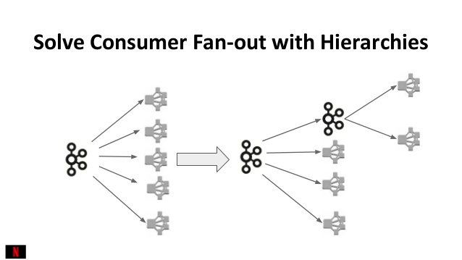
Multiple Processing Tiers
Any scalable system has many services that interact to process a request.
E.g. accessing a Web page on the Amazon.com can require in excess of 100 different services before a response is returned to the user .
With stateless, cached, load-balanced services, we can extend these core design principles and build a multi-tiered application.
In fulfilling a request, a service calls one or more downstream services

Slide 20
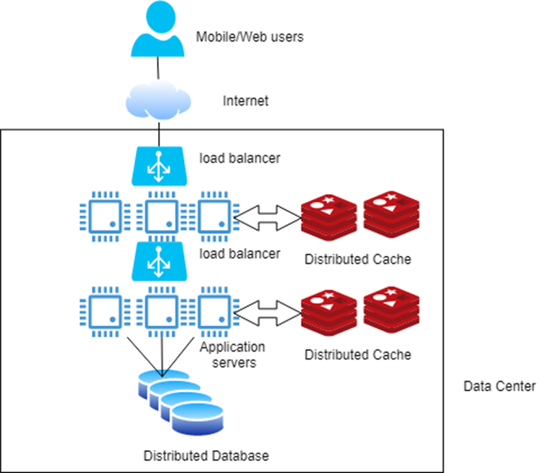
Multiple Processing Tiers
Scaling multiple processing tiers

Slide 21
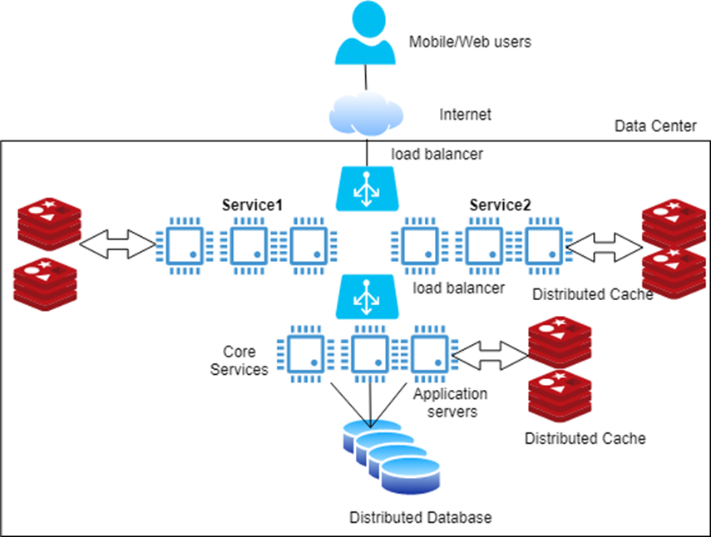
Multiple Processing Tiers
Multiple services in a single tier

Slide 22
Multiple Services
Refactoring the monolith into multiple independent services has advantages:
Easier to build, test, modify
Can be scaled individually based on the service demand.
E.g. Two services:
one for Web users
one for mobile users
Can deploy more mobile services and less Web services to meet demand if only mobile usage grows
Backend for Frontend (BFF) pattern
On the road to microservices

Slide 23
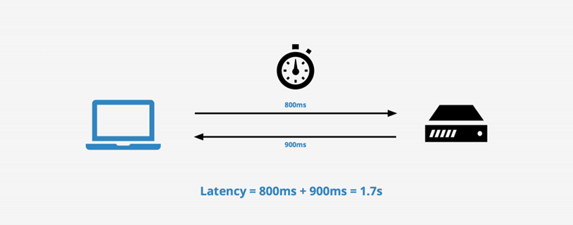
Responsiveness
Most client requests need a response.
List all auction items
View the real estate for sale in a given location.
Client sends a request and waits until a response is received.
Time interval between sending the request and receiving the result is the latency of the request.
Can decrease latencies using caching and precalculated responses,
Many requests will need a (slow) database access.

Slide 24
Responsiveness
Similar story for update requests
user updates their default delivery address
new delivery address must be persisted so that the user can confirm the address before they hit the ‘purchase’ button.
Latency includes the time for the (slow) database write
Some requests don’t need to be persisted immediately, e.g.
User favorites a product in a catalog
User adds a song to playlist
Update GPS location
We can exploit this to improve request responsiveness
Client sends request
Server responds with a ‘promise’ to perform the update (no slow database write)
Server performs the update ‘eventually’

Slide 25
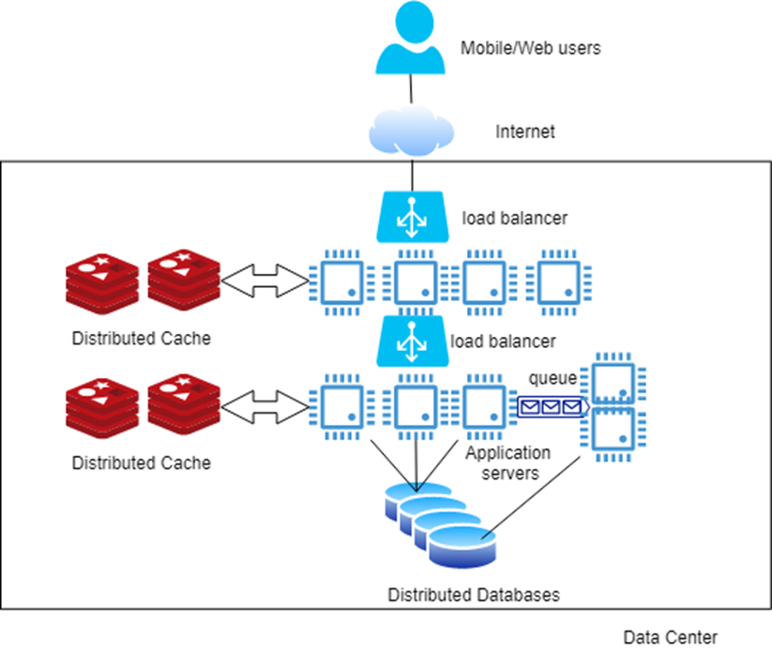
Responsiveness
Increasing Responsiveness with Queueing

Slide 26
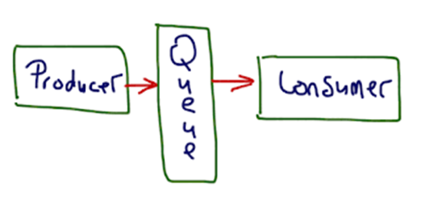
Queueing
Can be utilized when results of a write are not immediately needed
Queuing technologies provide asynchronous communications based on the producer consumer pattern
Producer writes to queue
Consumer reads from queue and updates database
Data is eventually persisted. Eventually means:
A few milliseconds
A second
Longer ….
Use cases that employ this design should be resilient to longer delays without impacting the user experience.

Slide 27
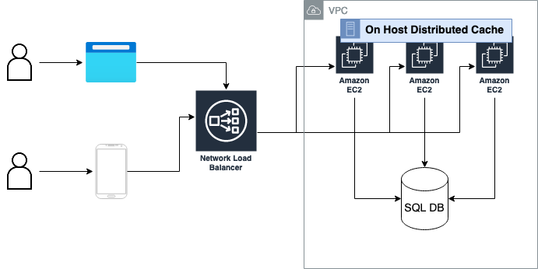
Case Study
A chat application where users can join chatrooms from their browser of mobile apps.

Slide 28
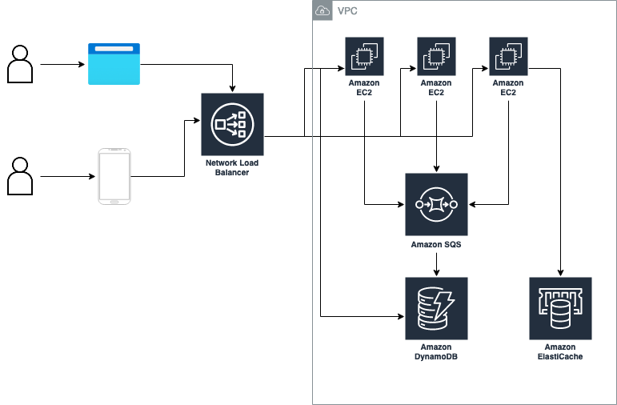
Case Study: After

Slide 29
Summary
Scalability based on a few basic approaches:
Scale up/out
Load balancing
Stateless services
Caching
Distributed databases
Queues
All topics we will revisit throughout the rest of this course

Slide 30
Questions?

