Slide 1

Northeastern University - Seattle
CS6650 Building Scalable Distributed Systems
Vishal Rajpal

Slide 2
Week 1 – Introduction to Scalable Systems
Introductions
Tell us your name
When did you start studying in Seattle?
Where you did your undergraduate studies and what was your major?

Slide 3
Week 1 – Introduction to Scalable Systems
Topics we will cover today:
A brief history of how we got here
Internet Scale Systems
Modern Websites & Scale
What is Scalability?
Course Outline

Slide 4
History
Primitive designs in early 1900s
1821 – Charles Babbage : first mechanical computer called Difference Engine
Jump to 1936 – Alan Turing: Principle of Universal Machine (Turing Machine)
1953 – Grace Hopper: develops the first computer language COBOL
1968-69 – ARPANET is invented
1971 – IBM Engineers develop a floppy disk
1973 - University College of London (England) and Royal Radar Establishment (Norway) connect to ARPANET. Terms birth of “Internet”.
1973-74: The first ISP is born. Telenet
1987: 20000 people on Internet.
Notes:
1936 - Turing Machine: Turing machines are capable of computing anything that is computable.
1971 - Floppy Disk: A team of IBM engineers led by Alan Shugart invent floppy disk enabling data to be shared among different computers.
1973 - Global networking becomes a reality as the University College of London (England) and Royal Radar Establishment (Norway) connect to ARPANET.
1973:-1974: The first Internet Service Provider (ISP) is born with the introduction of a commercial version of ARPANET, known as Telenet.

Slide 5
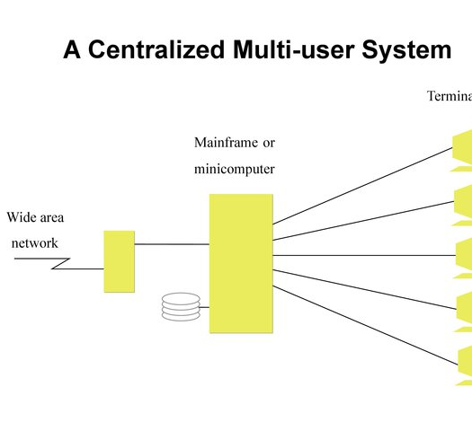
History
Distributed systems were rare until early 1990s.
Slow networks
Slow computers
Communication protocols slow

Slide 6
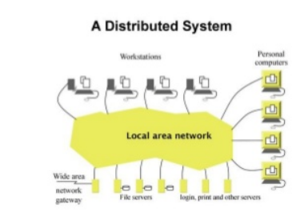
History
Early 1990s Internet becomes mainstream
PCs and workstations become connected.
LANs and WANs
Global Internet Backbone
Corporate networks
Dial up Internet
Programs
Browsers serve static content

Slide 7
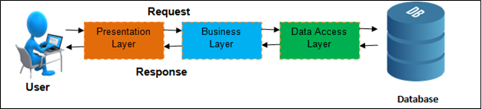
History
Three tier system becomes common

Slide 8
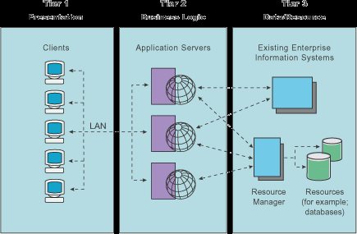
History
Mid 1990s
Businesses open up to Internet.
Internet Banking.
Scalability
Scale out middle tier systems
and database

Slide 9
History
What led to growth?
The advent of the WWW was the backbone for the growth
It allowed for access by an increasing number of users
Potentially every person in the world can see a Web app
It also allowed for a new service model for:
Enterprises
Consumer products
eGovernment
Take a look at the Wayback Machine to see the archived pages of various websites
https://archive.org/web/

Slide 10
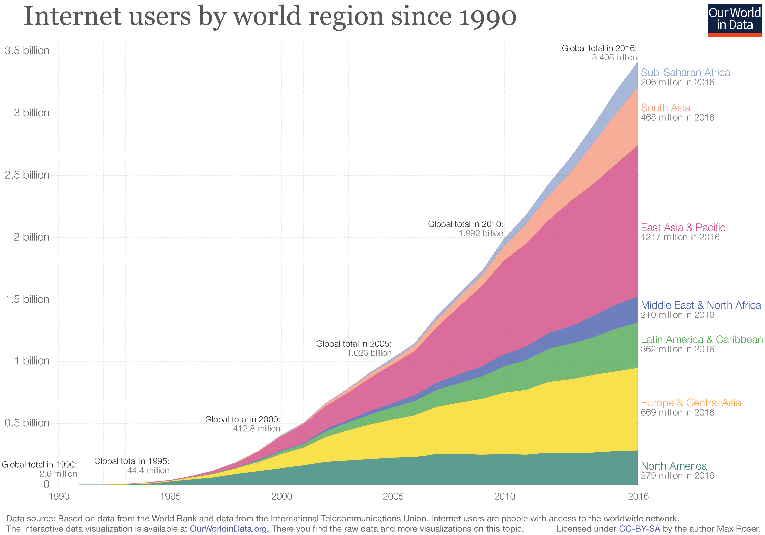
History

Slide 11



History
Technology Companies take advantage

Slide 12
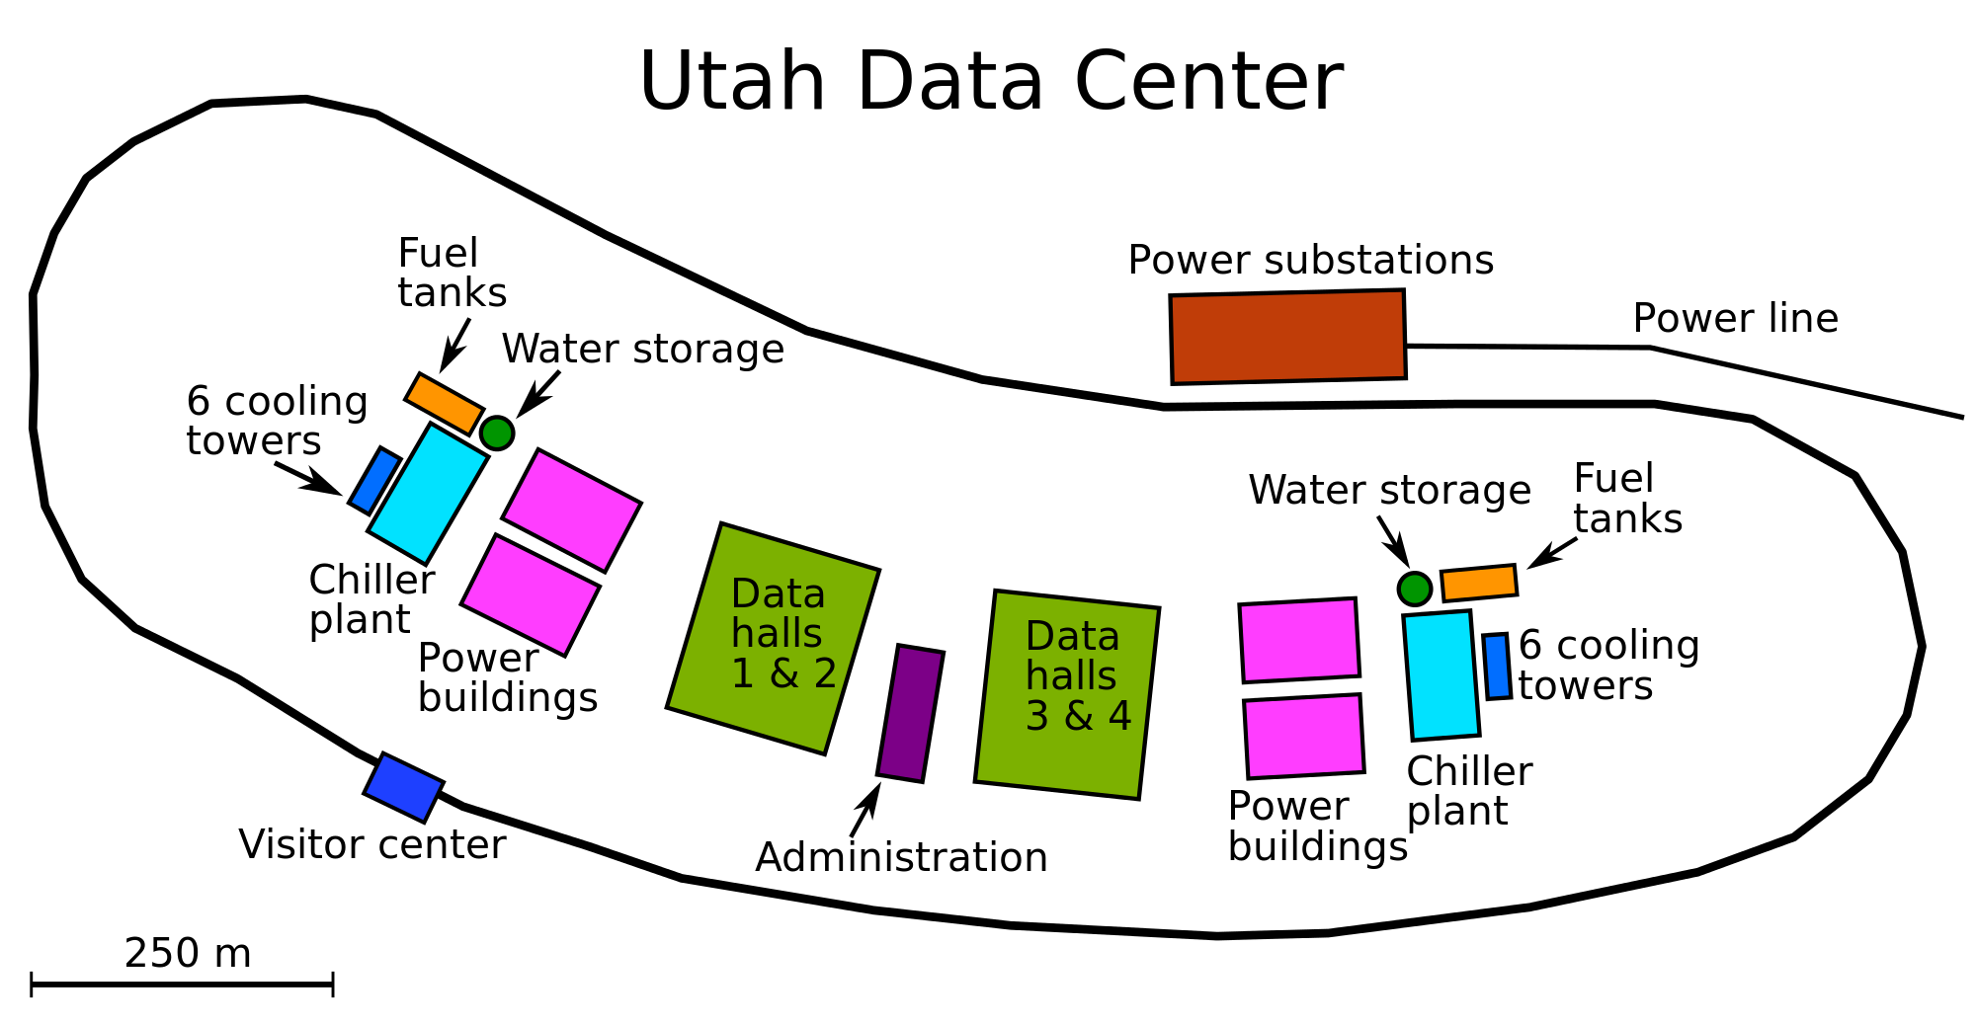
History
New service models allow for collection of data that wasn’t previously available
If managed and analyzed effectively this data can provide a lot of knowledge
Notes:
NSA Utah Data Center

Slide 13
History
Walmart
Walmart knows what will happen when we have inclement weather
What items do you think are impacted by an impending hurricane?
Certainly water and flashlights
The sales of Strawberry Pop Tarts increases seven fold
The largest selling item, however, is beer …
What does knowing this allow Walmart to do?
Predict sales
This allows them to have sufficient stock on hand
It also allows them to minimize the surplus stock that they need

Slide 14
History
Walmart uses this data to it’s advantage
20 years ago Walmart trailed K-Mart
K-Mart had more collective bargaining power and was able to negotiate a lower wholesale price
Walmart used data to streamline operations
They were able to reduce the percentage of the store that was used to stock surplus from the normal 25% to 10%
They are able to better coordinate with suppliers (resulting in more efficient production runs)

Slide 15
History
Distributed Frameworks
Sockets – Berkeley, 1983 (earlier implementations existed), became POSIX implementation
ONC/Sun RPC – 1984-onwards
OSF DCE – 1989-onwards
CORBA – early 1990s-onwards
Java RMI mid 1990-s onwards
XML Web Services – SOAP 2000-ish
Http – REST – Fielding thesis 2000
WebSockets - 2001

Slide 16
Modern Websites & Scale

Slide 17




Modern Websites & Scale
21st Century
Applications

Slide 18
Modern Websites & Scale
Dropbox – exascale storage system, millions of new files per hour, from 2012-16 seen over 12x growth.
Gmail – 1.2 billion users, blocks 10M spam messages every minute
Netflix – runs on AWS, took 7 years to migrate, uses 15% of global downstream internet traffic
Facebook - More than 300 million photos uploaded per day and 510,000 comments posted and 293,000 statuses updated per minute
YouTube - Users watch 4,146,600 YouTube videos every minute

Slide 19
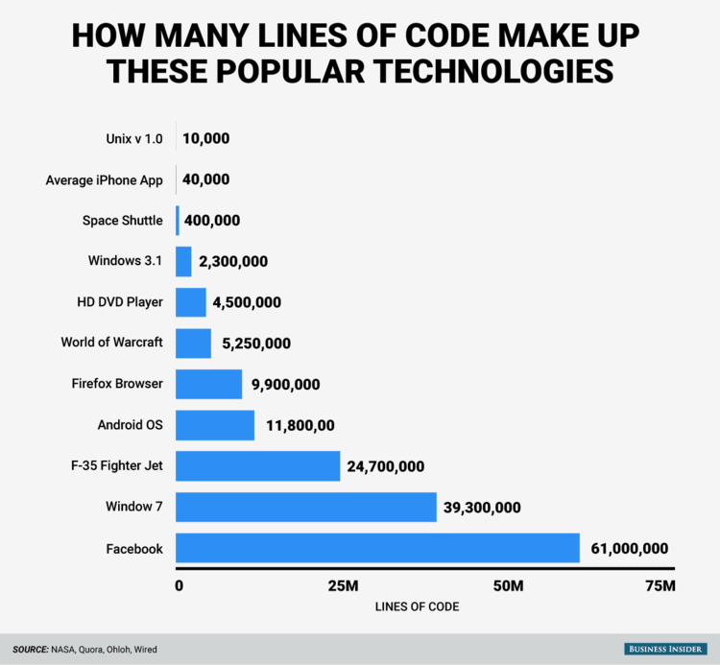
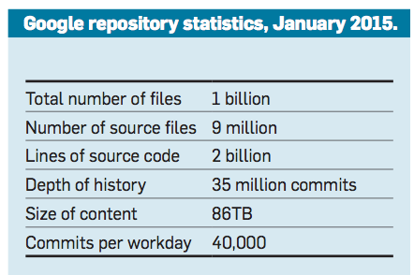
Modern Websites & Scale

Slide 20
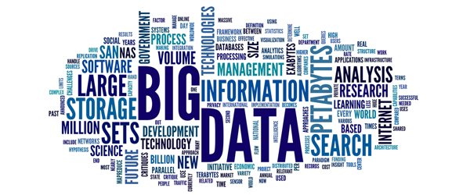
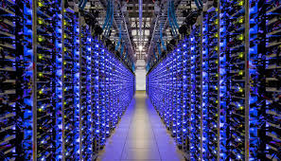
Modern Websites & Scale
Anatomy of a 21st Century Software System
Transactions
User Interactions
Sensors
Internet of Things
Massive cloud scale processing
Globally distributed
Complex big data analytics
Business Insights
System Operations
CAP Theorem

Slide 21
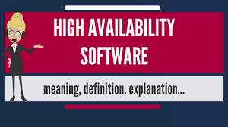


Modern Websites & Scale
Building massive scale systems is difficult
Attributes of such a system
High Availability
High Performance
Software Security

Slide 22
What is Scalability?

Slide 23
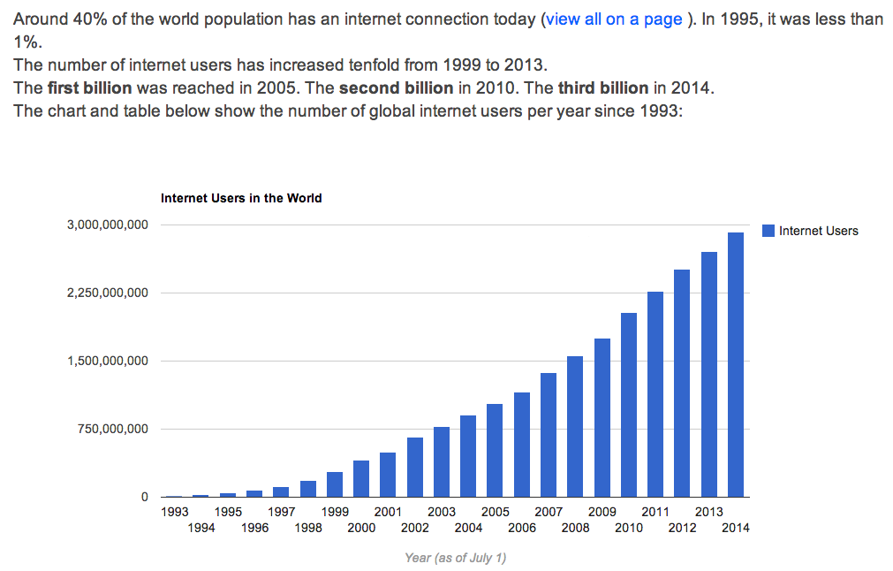
What is Scalability?
Scale is being driven by:

Slide 24
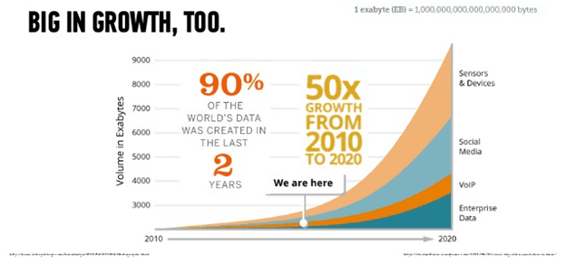
What is Scalability?
Scale is being driven by:
Data Volume & Devices (Internet of Things)

Slide 25
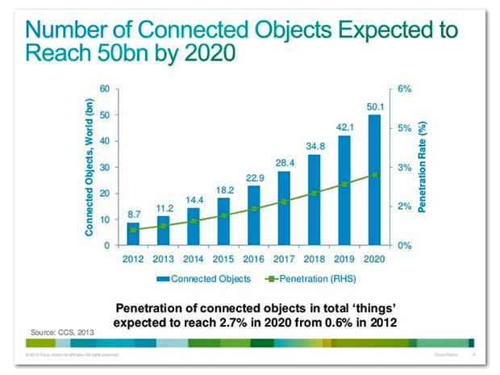
What is Scalability?

Slide 26
Questions?
How are usage statistics derived in a scalable system?
Information must be gathered about every single request
Session length
Session origin
Session behavior
Lots of data
A big data system?

Slide 27

The future is about Big Data Big Problems @Web Scale

Slide 28
What is Scalability
Web Scale
Globally Accessible
Infinite user base
Constant Usage (24 X 7)
Ability to handle surges & spikes in requests
Controllable Costs

Slide 29
What is Scalability
Scalability
The ability of a system to increase or decrease capacity in response to changing demands, while continuing to satisfying service level agreements for latency and availability
Hyperscalability – as above, while supporting exponential growth with linear costs

Slide 30
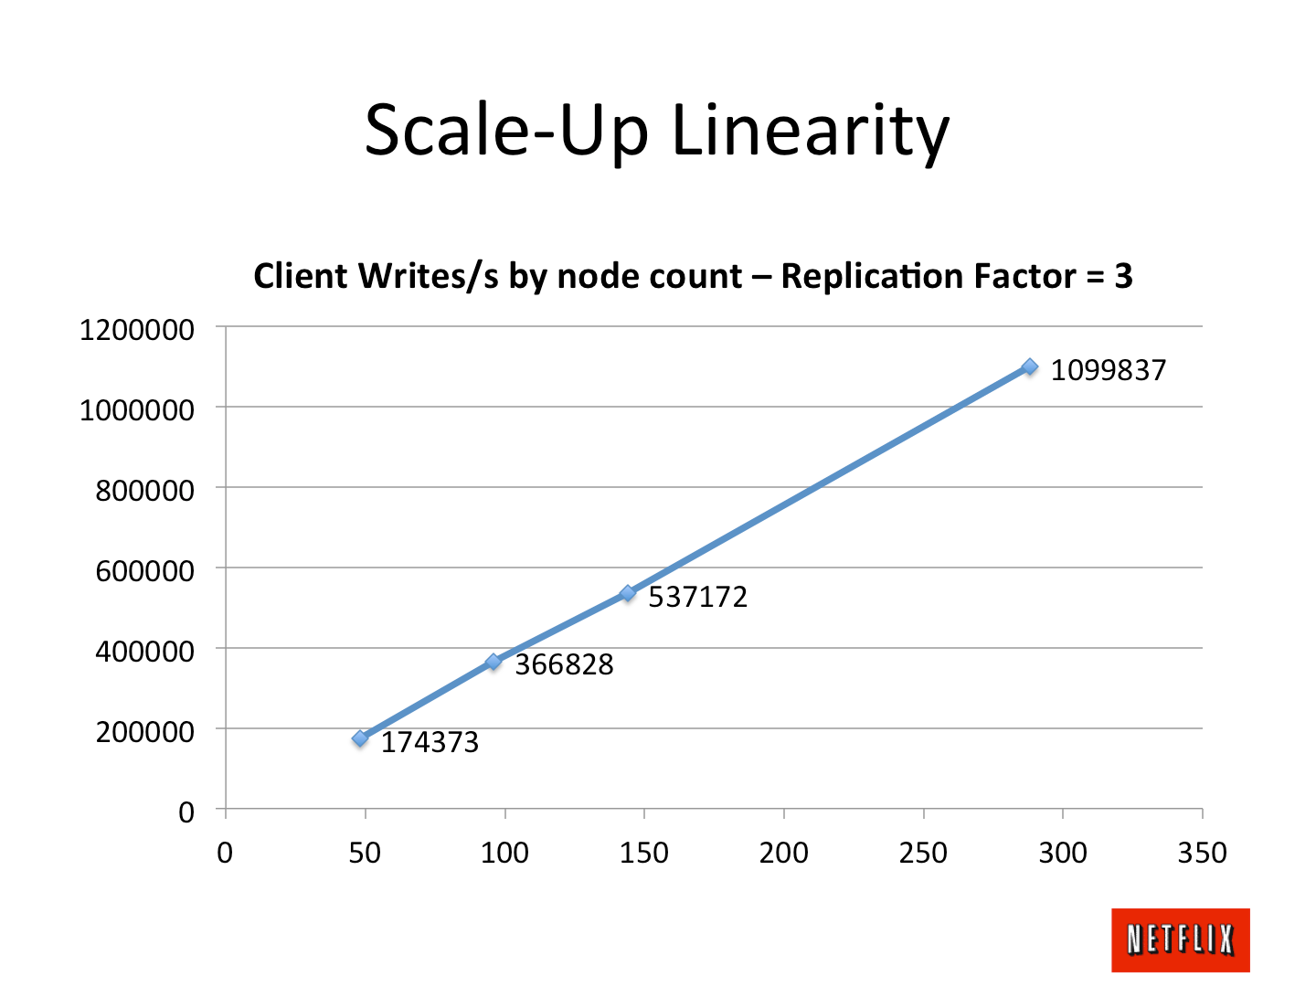
What is Scalability?
Do you just need more machines and disks to achieve Web Scale?
And scale linearly?

Slide 31
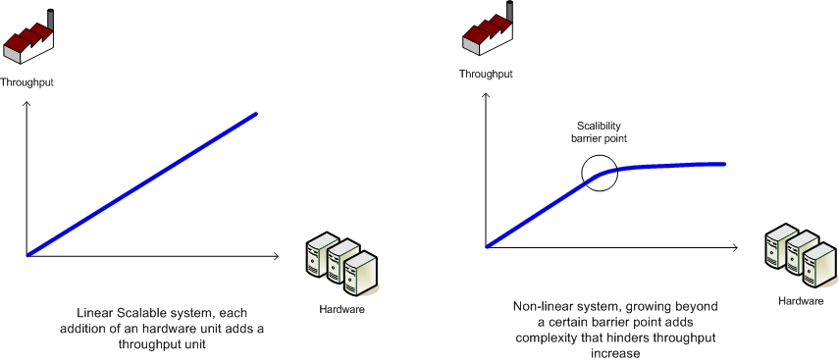
What is Scalability?
Amhdahl’s Law

Slide 32
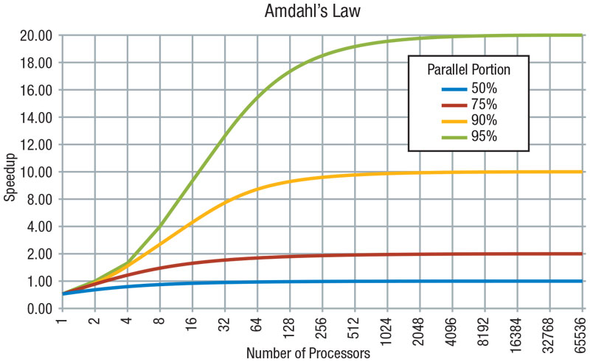
What is Scalability?
Amhdahl’s Law – The law will be the same in 2025 and after.

Slide 33
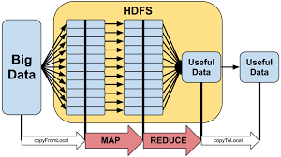
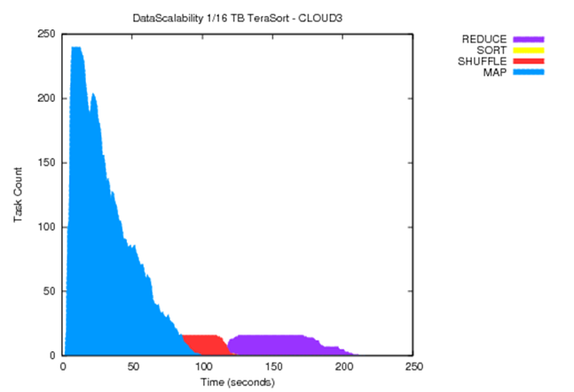
What is Scalability?
Can we parallelize?
Notes:
Data Skew?

Slide 34
What is Scalability?
The future is big problems
That are
Difficult to design.
Difficult to build
Difficult to deploy.
Challenges
High Traffic: Consider ad exchanges that are responding to 1,000,000 requests/second
Huge Volume of Data: Often terabytes or petabytes of data
Strict requirements for systemic properties: Response time, throughput, security, availability, compute cost etc.

Slide 35
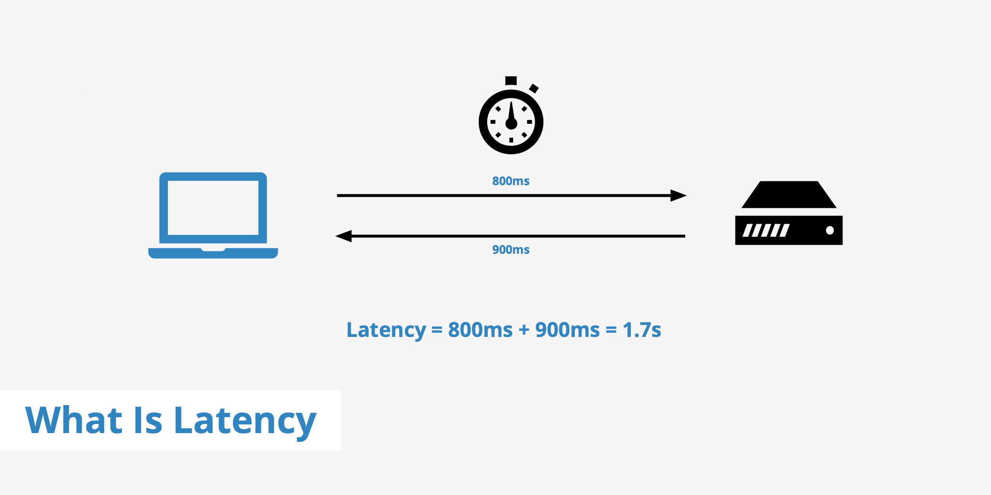
What is Scalability?
Response Time (also known as latency)
Round trip time from when a request sent until a response is received

Slide 36
What is Scalability?
Response Time
Response Time has an impact on user behavior
Many studies show a decrease in sales and customer retention as the response time increases - “Google: increasing page load time from 0.4 seconds to 0.9 seconds decreased traffic and ad revenues by 20%”
In some cases it’s required by contract - Responses to ad-exchanges for example need to be within 40 milliseconds
Website response time impacts google rankings - One factor google uses when determining ad listings

Slide 37
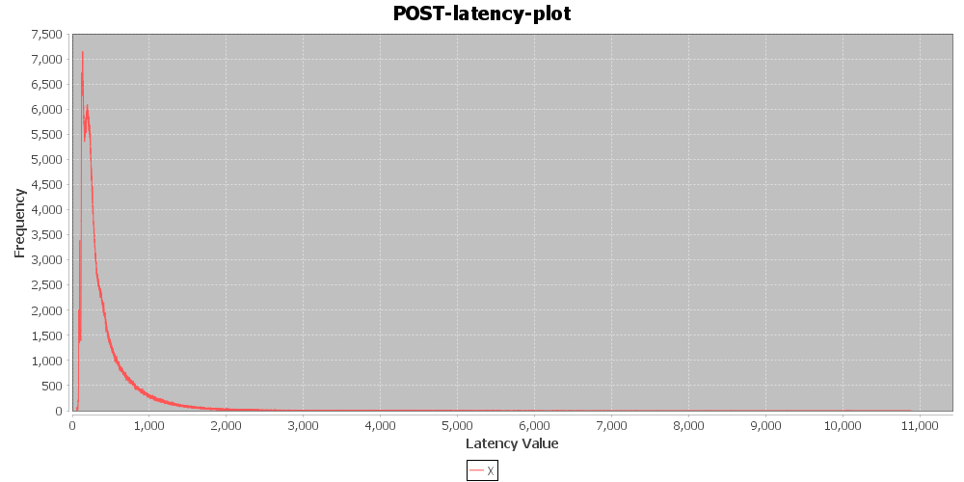
What is Scalability?
Response Time
Typical response time long tail

Slide 38
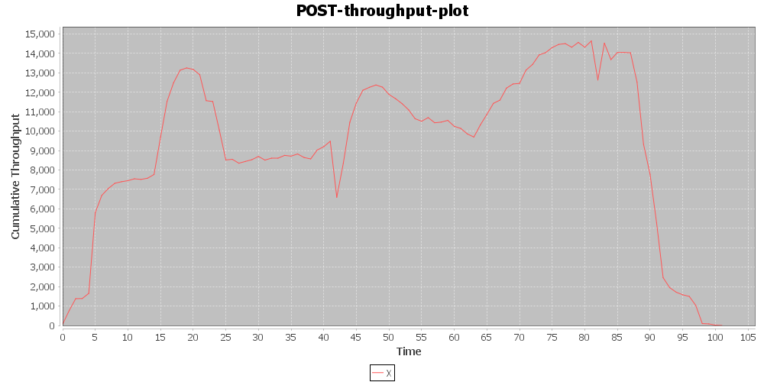
What is Scalability?
Throughput
The capacity of a system to process requests
Typically measured as number of requests/second
Cf latency:
Latency is a measure for a single request
Throughput is a bulk measure of many requests

Slide 39
What is Scalability?
Throughput
Massive throughput is needed at scale i.e. millions of requests/second.
Before web scale systems, we just used bigger more powerful systems
Particularly for database systems
That’s no longer an option at web scale
We need to be able to efficiently scale out i.e. be able to split load across multiple nodes.

Slide 40
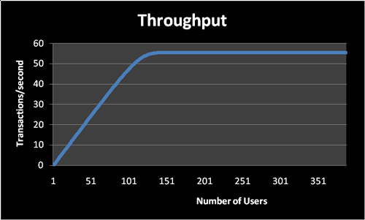
What is Scalability?
Throughput with fixed capacity

Slide 41
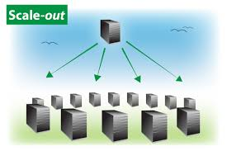
What is Scalability?
Scale out
Scale horizontally (or scale out) means adding more nodes to a system
Increases capacity and hence throughput
100s to 1000s of nodes needed at scale
Scale in/down equally important

Slide 42
What is Scalability?
Availability
The percentage of time a system is accessible to user
At Web Scale
How high?
99%, 99.999%, 99.999999%
https://availability.sre.xyz/
If a system has a single component
System is not available if the component fails
Single Point of Failure (SPoF)
A highly reliable component is needed.
To achieve scalability, we need to scale out to 100s and 1000s of components
Do they all need to be always available? At scale everything breaks …
Systems need to be able to deal with regular component failures
In other words, fault tolerant
Built to handle problems as failure is expected
Notes:
Five-nines or 99.999% availability means 5 minutes, 15 seconds or less of downtime in a year.
Or, if you are really ambitious, shoot for six nines or 99.9999% availability, which allows 32 seconds or less downtime per year.
Otherwise, four nines or 99.99% availability allows 52 minutes, 36 seconds downtime per year.
Three nines or 99.9% availability allows 8 hours, 46 minutes downtime per year.
Two nines or 99% availability allows 3 days, 15 hours and 40 minutes downtime per year.

Slide 43
What is Scalability?
Availability
If my system runs on 10,000 nodes (machines), each with its own disk, how many disk crashes might my system experience every year?
What information do we need to estimate this?
Annualized Failure Rate
AFR (%) = (8760/MTBF)*100
a common drive may have a 300,000 hours MTBF,
gives a theoretical 2.92% annualized failure rate
i.e. a 2.92% chance that a given drive will fail during a year of use.
A CMU 2007 study showed an estimated 3% mean AFR over 1–5 years

Slide 44
What is Scalability?
Availability
Managing Tradeoffs
There is not one way to build such systems
Requirements and context are going to differ from one system to another
Optimizing on one system property is inevitably going to compromise another concern, eg
Throughput versus cost
Performance versus availability
As an engineer you need to be able to understand:
the concerns and context of a given system
the nature of the tradeoff that results from a set of decisions
And use metrics to guide your designs

Slide 45
Course Outline
Web site: https://gortonator.github.io/bsds-6650/
In this course you’ll learn both theory and practical knowledge
To be able to engineer robust, scalable, efficient internet scale systems
The theory will be learned by:
Reading relevant materials/seminar
Lectures
Quizzes
The practical knowledge will be gained by:
In class exercises
Projects

Slide 46
Grading & Course Material
There will be three components to the grades
4 programming assessments (72%)
4 in class Quizzes (24%)
Short paper (4%)
All course material will be available through Canvas
Piazza for discussions
We won’t be taking attendance, but you are expected to attend and actively participate in class

Slide 47
Assignments Overview
Assignment 1 – (Client -> Server) Multithreading, Measurement and Presentation (Using AWS)
Assignment 2 – (Client -> Server) Server thread models, State management, Horizontal Scaling and Data Storage Schemas
Assignment 3 – Queueing, Availability, Scalability, Caching and Monitoring
Assignment 4 – (Yet to decide) May be a Distributed Database depending on what your interests are.
Notes:
Assignment 1 -> A multithreaded client which can send load to a a no-op server .
Assignment 2 -> Introduce business logic in the server and a database. More write dominated system than read oriented which is much harder to scale. Lots of work involved
Assignment 3 -> Server integrated with a lot more services

Slide 48
How to succeed in course?
Do the reading
Study for the quizzes
Start the assignments early
Work consistently
Experiment
Be inquisitive and have fun
Expect to work hard!!!

Slide 49
At the end of course?
You will acquire a set of skills that is in very high demand right now
At Amazon, Google, Facebook, Microsoft and, well, everywhere really!
Projects should be useful in interviews
You will learn a lot about how computer systems really work

Slide 50
Disclaimer
This course is a unique offering and is always evolving.
The technology will be complex and finding help will be a little difficult.
But it will be fun.

Slide 51
Policies
Can we work on assignments together? No
Can I discuss assignments with others in general terms? Yes
Can I use code copied from Web? No
Can I ask questions about the assignment on Piazza? Yes

Slide 52
Questions?

