Slide 1

Northeastern University - Seattle
CS6650 Building Scalable Distributed Systems
Vishal Rajpal

Slide 2
Week 2 – Concurrency
Topics we will cover today:
Why Threads?
Simple threads in Java
Problems with threading
Synchronization primitives
Thread coordination
Thread states
Thread pools
Thread-safe collections

Slide 3
Why Threads?
Concurrency is Fundamental to Many Systems
Distributed systems are inherently concurrent
Events happen on different nodes at the same time
Unpredictable order of events
Concurrency needed on each node to provide:
Responsiveness to requests
Throughput
Ability to handle multiple simultaneous requests

Slide 4
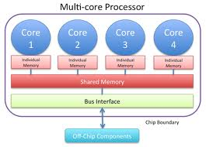
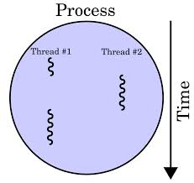
Why Threads?
Why Concurrency?
Concurrent execution is necessary in many systems:
Natural solution to many problems
Increase performance, e.g. do work while waiting for disk accesses
Necessary to exploit multicore

Slide 5
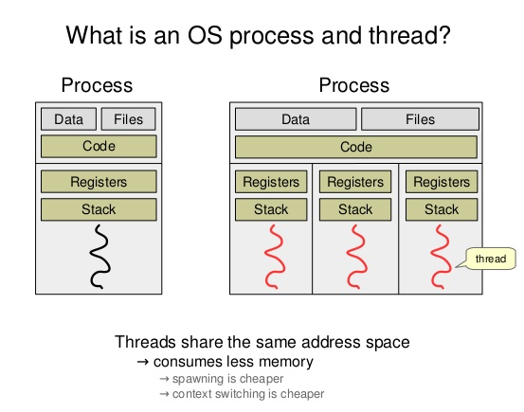
Why Threads?
Address Space

Slide 6
Why Threads?
Units of Concurrency
Processes - different executables - comprise
virtual address space
Code
Security context
Environment variables
Handles to system object (e.g. sockets)
A main thread of execution
A process can create multiple threads

Slide 7
Why Threads?
Threads
Threads are lightweight compared to processes
share the same address space and share data and code
Allocated their own stack space to support independent execution
Context switching between threads is less expensive than between processes
Cost of thread intercommunication is lower than process intercommunication

Slide 8
Simple Threads In Java
Java Threads
public class Thread extends Object implements Runnable
public interface Runnable {
void run();
}
class NamingThread implements Runnable {
private String name;
// default constructor
public NamingThread() {}
public NamingThread(String threadName) {
System.out.println("Constructor called: " + threadName) ;
name = threadName ;
}
public void setName (String threadName) {
name = threadName;
}
public void run() {
//Display info about this thread
System.out.println("Run called : " + name);
System.out.println(name + " : " + Thread.currentThread());
// and terminate silently ....
}
}

Slide 9
Simple Threads in Java
Java Threads
public class SimpleThreadExample {
public static void main(String[] args) {
// create 3 threads and give them names
NamingThread name0 = new NamingThread("thread0");
NamingThread name1 = new NamingThread("thread1");
NamingThread name2 = new NamingThread("thread2");
//Create the threads
Thread t0 = new Thread (name0);
Thread t1 = new Thread (name1);
Thread t2 = new Thread (name2);
// start the threads
t0.start(); t1.start(); t2.start();
try {//delay the main thread for a second
Thread.currentThread().sleep(1000);
} catch (InterruptedException e) {}
//Display info about the main thread and terminate
System.out.println(Thread.currentThread());
}
}
public class MyThread extends Thread {
public void run(){
System.out.println("MyThread running");
}
}
// and to create and start ….
MyThread myThread = new MyThread();
myThread.start();

Slide 10
Simple Threads in Java
Wait for threads to terminate
private static int NUMTHREADS = 10;
NamingThread[] runnables = new NamingThread[NUMTHREADS]; for (int i = 0; i < NUMTHREADS; i++) { runnables[i] = new NamingThread("thread:" + i); }
Thread threads[] = new Thread[NUMTHREADS]; for (int i=0; i < NUMTHREADS ; i++ ) { threads[i] = new Thread (runnables[i]); threads[i].start(); } // wait for each one to finish try { for (int i=0; i < NUMTHREADS ; i++ ) { threads[i].join(); } } catch (InterruptedException e) {} System.out.println(Thread.currentThread());

Slide 11
Simple Threads in Java
Key Points
Create Threads by implementing a Runnable
Start threads with .start() method, which returns immediately
Threads execute independently until completion
Order of thread execution is non-deterministic. Statements overlap.
Objects are basically state machines
State transitions invoked when methods called
Threads define an execution context
Manipulate objects (state) they have reference to
The methods they call execute in the context of the calling thread

Slide 12
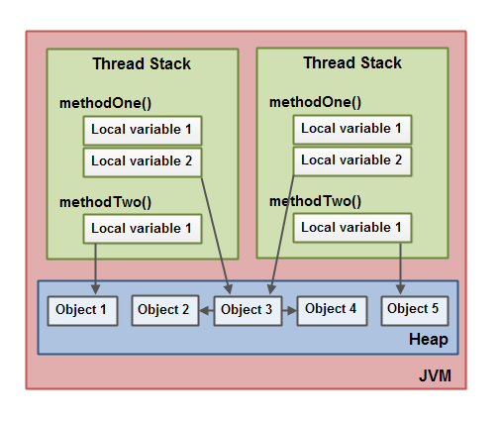
Simple Threads in Java

Slide 13
Problems with Threads
Concurrency makes things challenging
Problems with concurrency
Race conditions
Deadlocks
Source of problems
Non-determinism
Interleavings

Slide 14
Problems with Threads
Problem 1: Shared Variables
Multiple independent threads make changes to same variable at same time
read value from memory to register
change value in register
write register value back to memory
thread 1: x=x+6
thread 2: x=x+1
The result?

Slide 15
Problems with Threads
Race Conditions
Same program, different results
Depends on the manner in which CPU schedules execution
Different interleavings produce different outcomes
Extremely hard to debug
Not reproducible
These are extremely unpleasant when they occur in production systems
Thread 1 | Thread 2
Reads (x) into register
Register value + 6
Writes register value to (x)
 | Reads (x) into register
 | Register value + 1
 | Writes register value to (x)
Thread 1 | Thread 2
Reads (x) into register
Register value + 6
 | Reads (x) into register
 | Register value + 1
 | Writes register value to (x)
Writes register value to (x)

Slide 16
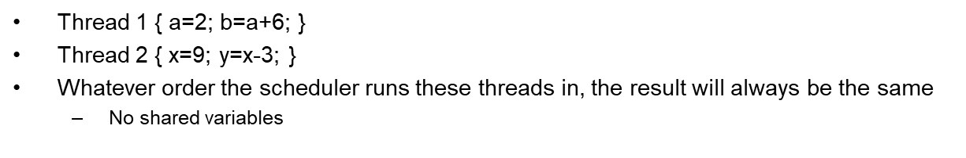
Problems with Threads
Root cause: Non determinism
Sequential programs exhibit deterministic behavior
Race conditions are caused by non-deterministic behavior

Slide 17
Synchronization Primitives
Removing Race Conditions
Use locks to impose ordering constraints
Lock shared variables so they can be accessed only by a single thread at once
Serialized access to shared resources
Each thread wishing to access a variable:
takes the lock
changes the variable
releases the lock
If the lock is set, all other threads wait for it to be released
Which thread proceeds next?
Locks sometimes known as semaphores

Slide 18
Synchronization Primitives
Java synchronization methods
public class SynchronizedCounter {
private int c = 0;
public synchronized void increment() { c++; }
public synchronized void decrement() { c--; }
}
Known as critical section
it is not possible for two invocations of any synchronized methods on the same object to interleave
less error-prone as release is automatic

Slide 19
Synchronization Primitives
Monitor Locks
Synchronization is implemented using monitors. Each object in Java is associated with a monitor, which a thread can lock or unlock.
Only one thread at a time may hold a lock on a monitor.
synchronized (this);
synchronized(Object);
Any other threads attempting to lock that monitor are blocked until they can obtain a lock on that monitor.

Slide 20
Synchronization Primitives
Shared Variable Modification
public class SharedVariableBroken {
final static private int NUMTHREADS = 10000
private int val = 0;
public void inc() {
val++;
}
public int getVal() {
return this.val;
}
public static void main(String[] args) throws InterruptedException {
final SharedVariableBroken rmw = new SharedVariableBroken();
for (int i = 0; i < NUMTHREADS; i++) {
// lambda runnable creation - interface only has a single method so lambda works fine
Runnable thread = () -> { rmw.inc(); };
new Thread(thread).start();
}
Thread.sleep(5000);
System.out.println("Value should be equal to " + NUMTHREADS + " It is: " + rmw.getVal());
}
}
Can you reproduce the error?
Compound operation –
synchronized needed

Slide 21
Synchronization Primitives
Shared variable Modification
Another possible Solution – Atomic Variables
public class SharedVariable {
private final AtomicInteger val= new AtomicInteger();
public void incrementNumber() {
val.getAndIncrement();
}
public int getNumber() { val.get();}
Rest stays the same

Slide 22
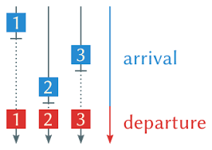
Synchronization Primitives
Barrier Synchronization

Slide 23
Synchronization Primitives
Countdown Latch
Implements a barrier
Initialized with a given count
await() blocks until count is zero
countdown() method decrements value
When count is zero, all threads resume
await() returns
This is a one-shot phenomenon -- the count cannot be reset.
If you need to reset the count, use a CyclicBarrier.

Slide 24
Synchronization Primitives
Barrier Synchronization – Latch
public static void main(String[] args) throws InterruptedException {
final SharedVariable rmw = new SharedVariable();
for (int i = 0; i < NUMTHREADS; i++) {
Runnable thread = () -> {
try {
rmw.startSignal.await();
rmw.inc();
} catch (InterruptedException e) {
} finally {
rmw.endSignal.countDown();
}
};
new Thread(thread).start();
} // end for loop
rmw.startSignal.countDown();
rmw.endSignal.await();
System.out.println("Value should be " + NUMTHREADS + " - It is " + rmw.getVal());
}

Slide 25
Synchronization Primitives
Sharing Structures
Consider a linked list with explicit size variable
read size variable
add new element to the list at end
increment and write back size variable
size variable and list elements must be synchronized
concurrent access of non thread-safe structures is dangerous
none of java.util.* are thread-safe

Slide 26


Lab 2
The Dining Philosophers Problem

Slide 27
Lab 2
Pseudocode
while(true) {
// Initially, thinking about life, universe, and everything
think();
// Take a break from thinking, hungry now
pick_up_left_fork();
pick_up_right_fork();
eat();
put_down_right_fork();
put_down_left_fork();
// Not hungry anymore. Back to thinking!
}

Slide 28
Lab 2
public class Philosopher implements Runnable {
private final Object leftFork;
private final Object rightFork;
Philosopher(Object left, Object right) {
this.leftFork = left;
this.rightFork = right;
}
private void doAction(String action) throws InterruptedException {
System.out.println(Thread.currentThread().getName() + " " + action);
Thread.sleep(((int) (Math.random() * 100)));
}
public void run() {
try {
while (true) {
doAction(System.nanoTime() + ": Thinking"); // thinking
synchronized (leftFork) {
doAction(System.nanoTime() + ": Picked up left fork");
synchronized (rightFork) {
doAction(System.nanoTime() + ": Picked up right fork - eating"); // eating
doAction(System.nanoTime() + ": Put down right fork");
}
doAction(System.nanoTime() + ": Put down left fork. Returning to thinking");
}
}
} catch (InterruptedException e) {
Thread.currentThread().interrupt();
}
}
}
Example Run - Deadlock
Philosopher 4: Thinking
Philosopher 0: Thinking
Philosopher 1: Thinking
Philosopher 2: Thinking
Philosopher 3: Thinking
Philosopher 4: Picked left
Philosopher 1: Picked left
Philosopher 3: Picked left
Philosopher 0: Picked left
Philosopher 2: Picked left

Slide 29
Lab 2
Deadlock
2 threads sharing access to 2 shared variables via locks
thread 1: takes lock a
thread 2: takes lock b
thread 1: blocks on b
thread 2: blocks on lock a
Deadlock!!
Neither thread can proceed
This violates ‘liveness’ – something good eventually happens
Circular wait

Slide 30
Lab 2
Impose total ordering on acquisition of resources.
For our example: chopstick[0] < chopstick[1] < chopstick[2] < chopstick[3] < chopstick[4].
For Philosopher 4 this means it will attempt to acquire chopstick[0] before they acquire chopstick[4].
This breaks the potential circular wait deadlock.
Solution
for (int i = 0; i < philosophers.length; i++) {
Object leftFork = forks[i];
Object rightFork = forks[(i + 1) % forks.length];
if (i == philosophers.length - 1) {
// The last philosopher picks up the right fork first
philosophers[i] = new Philosopher(rightFork, leftFork);
} else {
philosophers[i] = new Philosopher(leftFork, rightFork);
}
Thread t = new Thread(philosophers[i], "Philosopher " + (i + 1));
t.start();
}

Slide 31
Lab 2 – Synchronization is Hard
Too few ordering constraints => race conditions
Too many ordering constraints => deadlocks
Hard/impossible to reason about based on modularity
If an object is shared by multiple threads, need to think about what all threads could do
Thorough testing is impossible
Non-determinism leads to an infinite number of possible interleavings
Controlled by the scheduler and events, not the program

Slide 32
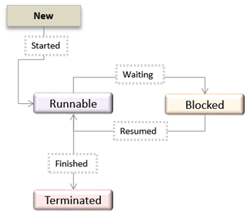
Thread States
New Thread state (Ready-to-run state)
Created but not started
Runnable state (Running state)
Started and either running or waiting to run
Blocked
Dead state
Stop() called or run() terminates
Notes:
Note that Java has its own states to manage its schedulers state machine. These states are general thread states.

Slide 33
Thread States
Not Runnable
A thread is Not Runnable if one of the following occurs:
When sleep() is invoked
Thread.currentThread().sleep(1000);
When suspend() is invoked
When the wait() method is invoked
waits for notification of a free resource
waits for completion of another thread
waits to acquire a lock of an object.
The thread is blocking on an I/O request
Thread Resumption
If a thread is asleep:
the sleep period must elapse or interrupt() method called
If a thread is suspended:
its resume() method must be called
If a thread is waiting on a condition variable,
an object owning the variable must relinquish it by calling either notify() or notifyAll().
If a thread is waiting on I/O, then I/O must complete
Notes:
File I/O or network I/O typically causes the thread to wait.

Slide 34
Thread Priority
In Java every thread has a priority
Higher priority threads get scheduled more frequently than lower priority threads
A Java thread inherits its priority from its parent
MIN_PRIORITY (0) Lowest Priority
NORM_PRIORITY (5) Default Priority
MAX_PRIORITY (10) Highest Priority

Slide 35
Thread Scheduling
The thread scheduler chooses the Runnable thread with the highest priority for execution.
When multiple threads to choose from, scheduler chooses one in a round-robin fashion. The chosen thread will run until:
a higher priority thread becomes Runnable. (Pre-emptive)
it yields, or its run() method exits
its time allotment has expired (time-slicing)

Slide 36
Reentrancy
Every Java object has a lock associated with it
Known as the intrinsic lock
Aka monitor or mutex locks
Synchronized methods exploit this intrinsic lock
Lock acquired by executing thread before entering a synchronized block
Lock released automatically when the thread exits the synchronized block
Is this a deadlock?
public class hipsterBaseClass {
public synchronized void doHipsterStuff() {
// random hipster behaviour
}
}
public class capitolHillBar extends hipsterBaseClass {
public synchronized void orderDrinks() {
// get drinks order
super.doHipsterStuff();
}
}

Slide 37
Reentrancy
Intrinsic locks are reentrant
If a thread tries to acquire a lock it already holds, it succeeds
Each lock has an acquisition count and owning thread
Count can only be incremented above 1 by same owning thread
Reentrancy facilitates encapsulation of locking behavior, and simplifies OO concurrent code

Slide 38
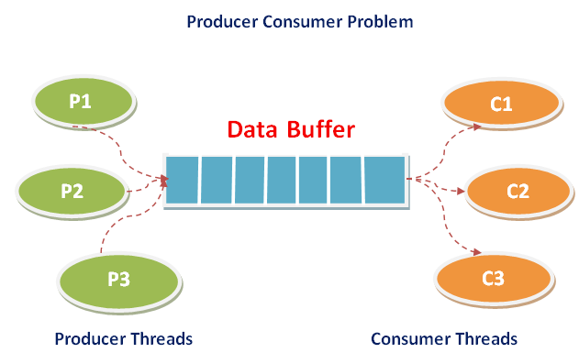
Thread Coordintion
Need to ensure
Consumer waits if buffer empty
Consumer can remove item when buffer not empty
Producer waits if buffer full
Producer can add item if buffer has free space
Guards
Producer-Consumer style examples require ‘guards’
Producer stores message in a shared buffer
Except when full
Consumers retrieve messages from buffer
Wait when empty
Producer
Consumer

Slide 39
Java Guards
Wait() and notify() statements
Wait and notify provide thread inter-communication that synchronizes on the same object.
final void wait(long timeout) throws InterruptedException
final void wait() throws InterruptedException
final void notify()
final void notifyAll()
Let’s work through an example
see ProducerConsumerExample

Slide 40
Producer Consumer Example
public class Buffer {
// Message buffer between producer to consumer.
// private String message;
// True if consumer must wait for producer to send //message,
// false if producer must wait for consumer to retrieve message.
private boolean empty = true;
public synchronized String retrieve() {
// Wait until message is available.
while (empty) {
try {
System.out.println("Waiting for a message");
wait();
} catch (InterruptedException e) {}
}
// Toggle status.
empty = true;
// Notify producer that buffer is empty
notifyAll();
return message;
}
public synchronized void put(String message) {
// Wait until message has been retrieved.
while (!empty) {
try {
wait();
} catch (InterruptedException e) {}
}
// Toggle status.
empty = false;
// Store message.
this.message = message;
// Notify consumer that message is //available
notifyAll();
}
}

Slide 41
Performance and Scalability Issues with Threads
Thread safety requires an internal state of an object protected from concurrent updates.
Updates must be atomic and serialized.
What if an object has no state that persists between calls?
Or the state cannot be modified by a calling thread?
Is this thread safe?

Slide 42
Stateless Servlet
Stateless and Immutable objects are always thread-safe
public class StatelessFactorizer extends GenericServlet implements Servlet {
public void service(ServletRequest req, ServletResponse resp) {
BigInteger i = extractFromRequest(req);
BigInteger[] factors = factor(i);
encodeIntoResponse(resp, factors);
}

Slide 43
Thread Pools
The java.util.concurrent package contains a range of utilities to simplify multithreaded programs
Executor framework
Thread-safe collections

Slide 44
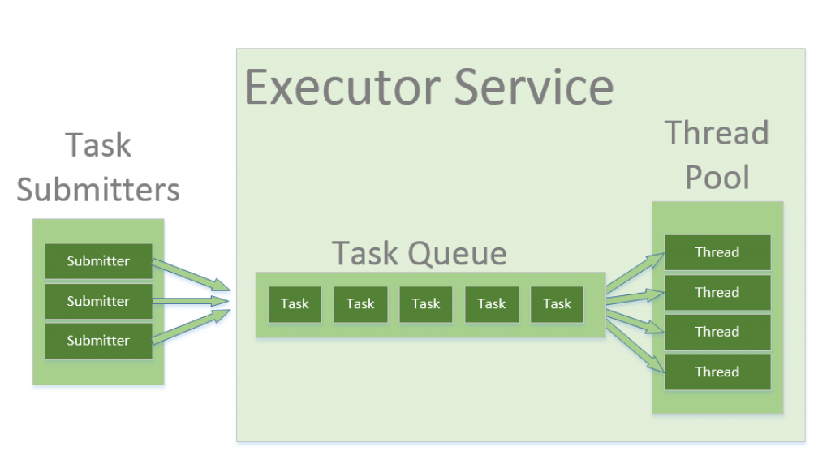
Thread Pools
Threads consume resources
Creation
Context switching
Memory per Thread
Thread pools provide a mechanism for an application to control number of threads.
Reuse threads to minimize creation cost.
Fixed memory size
Support a task-based programming model.
Executor Framework
An object that executes submitted Runnable tasks.
For example, rather than invoking new Thread(new(RunnableTask())).start() for each of a set of tasks,
Executor executor = anExecutor;
executor.execute(new RunnableTask1());
executor.execute(new RunnableTask2());

Slide 45
Thread Pools
Executors
Decouples task submission from task executions
Supports different task execution policies
Executors provide a factory method to create an Executor with desired policies.
Executor executor = Executors.newSingleThreadExecutor()
Executor executor = Executors.newFixedThreadPool(10)
Executor executor = Executors.newCachedThreadPool()
executor.getPoolSize();
executor.getQueueSize();

Slide 46
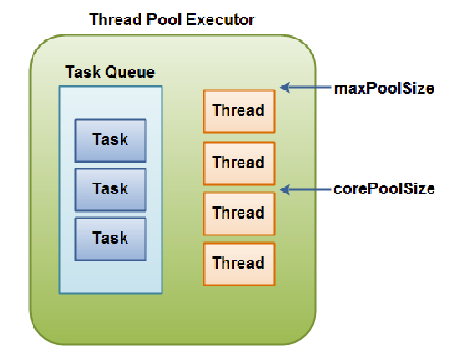
Executor Fixed Size Thread Pool
ExecutorService executorService = Executors.newFixedThreadPool(SIZE);
executorService.execute(new Runnable() {
public void run() {
System.out.println(“new task");
}
});
executorService.shutdown();

Slide 47
Executor Policies
Executors decouple the submission of a request from the execution policy used
Makes it easy to change policies to suit deployment hardware – just choose a different Executors interface
Policies specific things like:
How many concurrent threads?
How many queued requests?
What to do if server overloaded?
Execution priorities/order (LIFO, FIFO), etc …
There is no way to obtain the result of a Runnable
Or find out when threads have completed
You will have to use ExecutorService which is a sub interface of Executor that accepts Runnables and Callables
From Runnable you can return a Future
From Callable you can return a value.

Slide 48
Executor Service methods
Submit(Runnable)
Future future = executorService.submit(new Runnable() {
public void run() {
System.out.println("Asynchronous task");
}
});
future.get();
Submit(Callable)
Future future = executorService.submit(new Callable(){
public Object call() throws Exception {
System.out.println("Asynchronous Callable");
return "Callable Result";
}
});
System.out.println("future.get() = " + future.get());

Slide 49
Executor Service shutdown()
Must shutdown an executor
executorService.shutdown();
Stops accepting new requests but does not shutdown immediately
Must wait for all threads to complete
executorService.awaitTermination();

Slide 50
Thread safe Collections
Sharing Structures
Consider a LinkedList with an explicit size variable.
Read size variable
Add new element to the list at the end
Increment and write back size variable.
Size variable and list elements must be synchronized.
Concurrent access of non thread safe structures is dangerous.

Slide 51
Thread safe Collections
None of the classes in java.util.* package are thread safe except Vector and HashTable
Because synchronized methods are slow.
Either wrap your calls to these collections with a synchronized method or
Use Collections factory method to create thread safe versions for us.
List<String> list = Collections.synchronizedList(new ArrayList<>());
Synchronized wrappers still incur performance penalty.
While collection locked while a single thread makes a modification
Amdahl’s Law – this greatly limits performance
Java 5.0 and above includes java.util.concurrent package specifically designed for efficient multithreaded access.
java.util.concurrent package includes additions to the Java Collections Framework.
BlockingQueue: FIFO that blocks or times out when you attempt to add to a full queue, or retrieve from an empty queue.
ConcurrentMap is a subinterface of java.util.Map that defines useful atomic operations. Also ConcurrentHashMap, which is a concurrent analog of HashMap.
CopyOnWriteArrayList when we want to iterate over a list in a thread-safe way without an explicit synchronization.

Slide 52
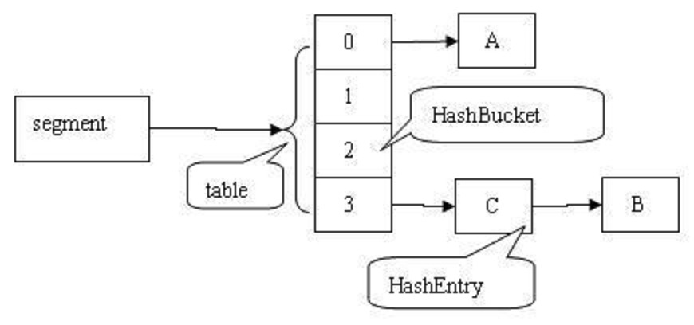
ConcurrentHashMap
HashMap divided into buckets
16 by default
A lock is applied at the bucket level
Allows safe concurrent modification
Atomic operations:
putIfAbsent()
remove()
replace()
Trade-offs - relaxed consistency for
Map.size()
Map.isEmpty()
iterators

Slide 53
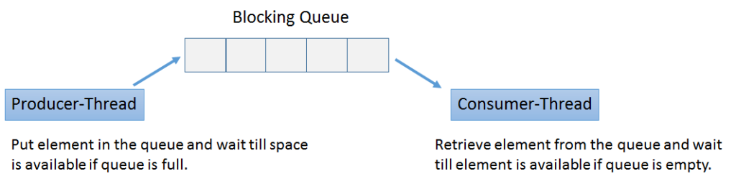
BlockingQueue
class Producer implements Runnable {
private final BlockingQueue queue;
Producer(BlockingQueue q) { queue = q; }
public void run() {
try {
while (true) { queue.put(produce()); }
} catch (InterruptedException ex) { ... handle ...}
}
Object produce() { ... }
}
class Consumer implements Runnable {
private final BlockingQueue queue;
Consumer(BlockingQueue q) { queue = q; }
public void run() {
try {
while (true) { consume(queue.take()); }
} catch (InterruptedException ex) { ... handle ...}
}
void consume(Object x) { ... }
}
class Setup {
void main() {
BlockingQueue q = new LinkedBlockingQueue();
Producer p = new Producer(q);
Consumer c1 = new Consumer(q);
Consumer c2 = new Consumer(q);
new Thread(p).start();
new Thread(c1).start();
new Thread(c2).start();
}
}

Slide 54
CopyOnWriteArrayList
Thread-safe variant of ArrayList
Mutators(add, update and set) create a snapshot of the underlying array.
Each thread using an iterator sees its own version of the snapshot of the array created while initializing the iterator of the list.
Useful in multithreaded code when reads are frequent and updates are rare.
Any mutations to CopyOnWriteArrayList will not reflect during iteration since the iterator was created.

Slide 55
Summary
Concurrency is fundamental to software systems
Introduces problems of race conditions and deadlocks
Synchronization required as a solution
Threads move through various states during their lifetime
Scheduler makes decisions on which thread to run based on their state and priority
Executors and concurrent utility classes simplify threaded programs

Slide 56
Questions?

