Slide 1
AI众包网站原型设计 及微服务构建
陈伟业 张晋 李凯诗 张英杰

Slide 2
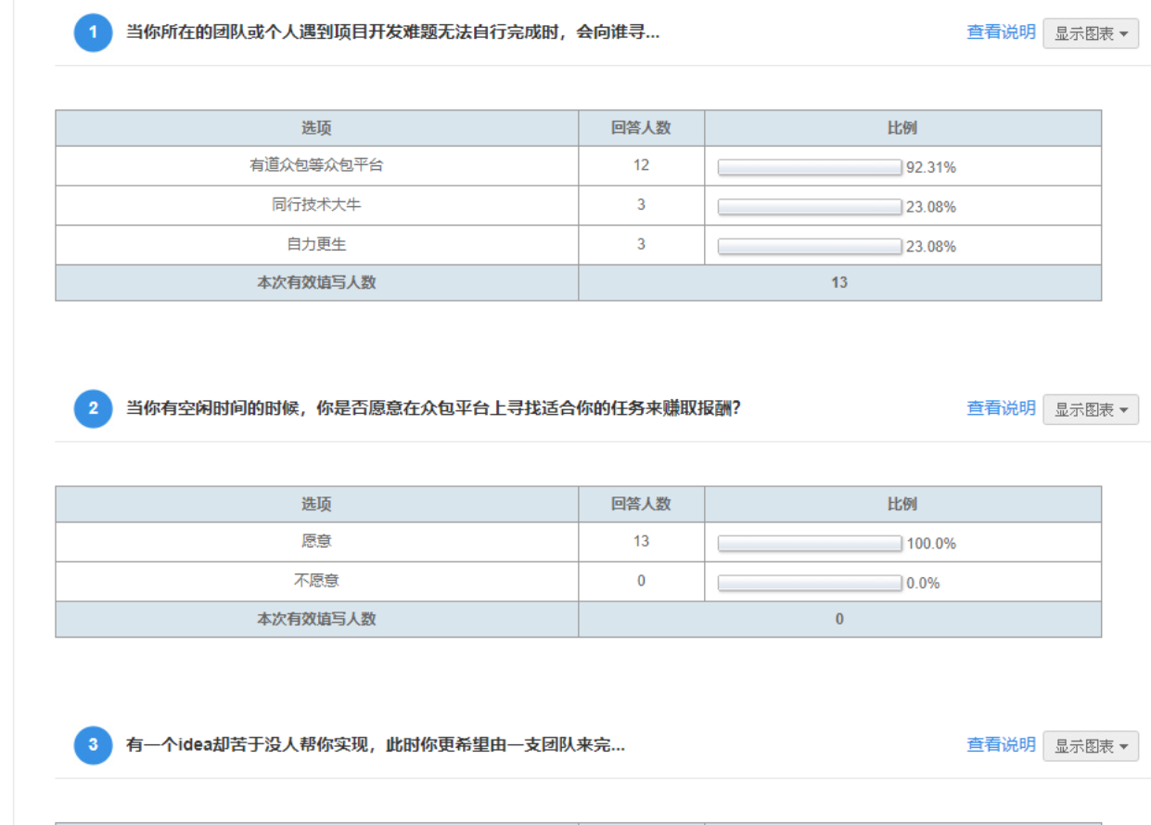
AI众包：用户调研（1）
大部分用户愿意参与一些众包项目
用户更关心的是自己能够完成的任务，所以平台应该要考虑辅助用户找到最合适的任务。

Slide 3
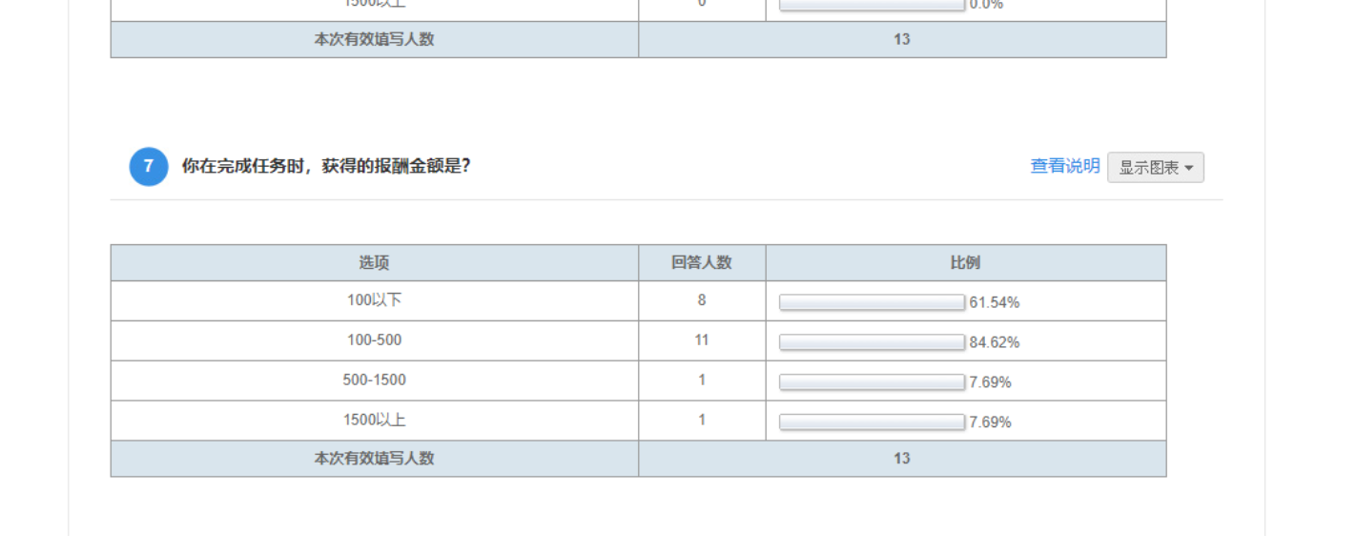
AI众包：用户调研（2）
对于面向学生的众包平台，大部分众包任务的金额不宜过高，应当加大和推荐金额在100-500任务的比例，例如图片标记等。

Slide 4
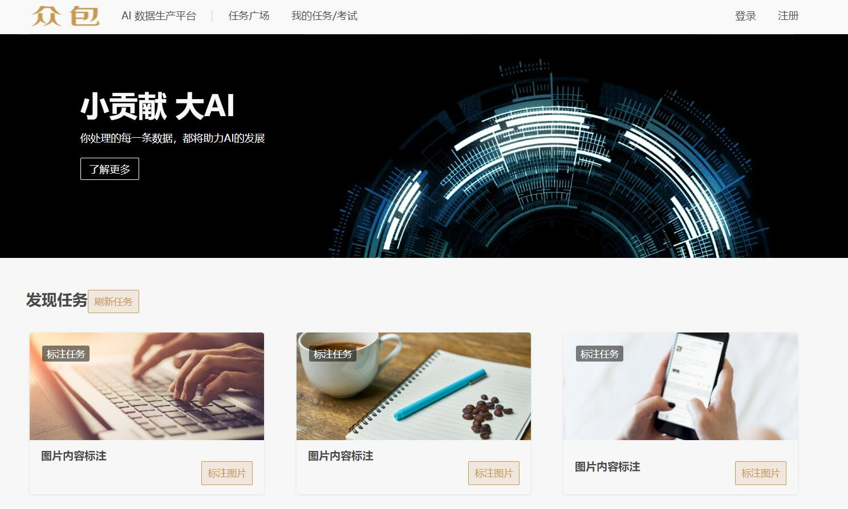
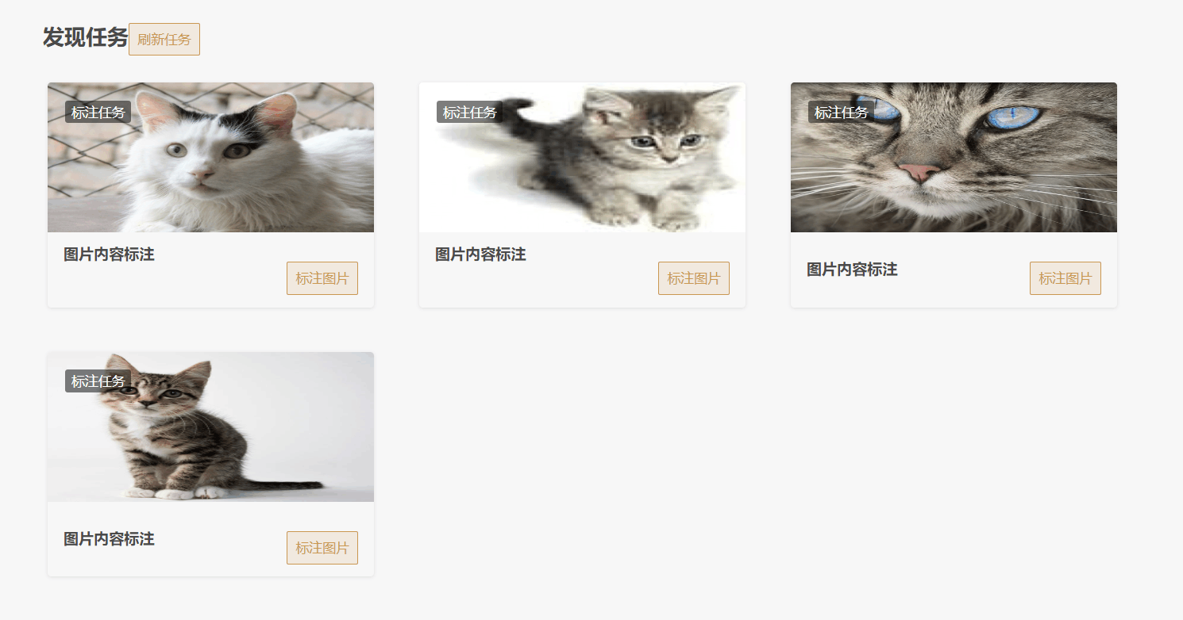
Web Prototype & Microservices
Microservice: 1) Image upload and download
Microservice: 2) CRUD of crowd sourcing tasks

Slide 5
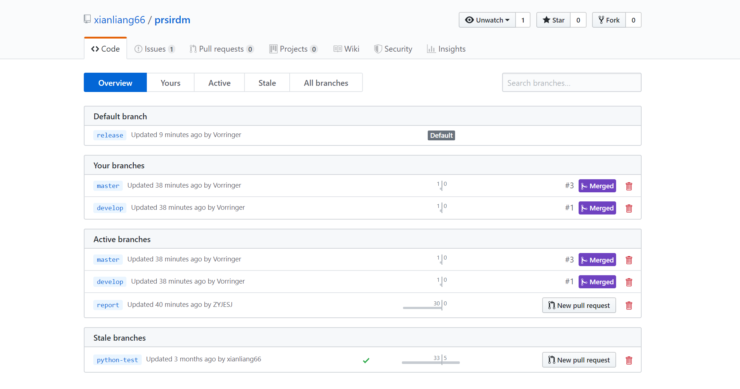
Git workflow

Slide 6
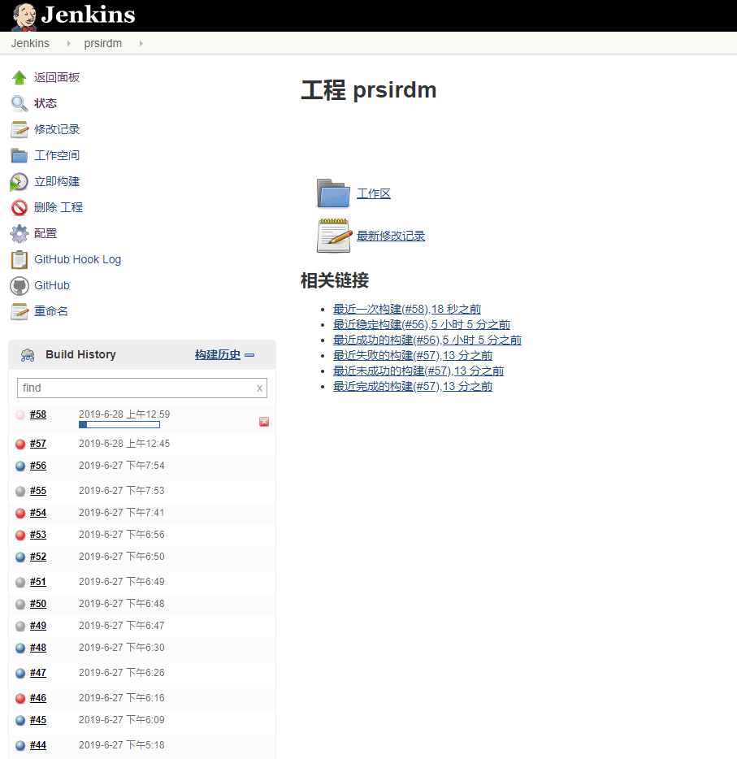
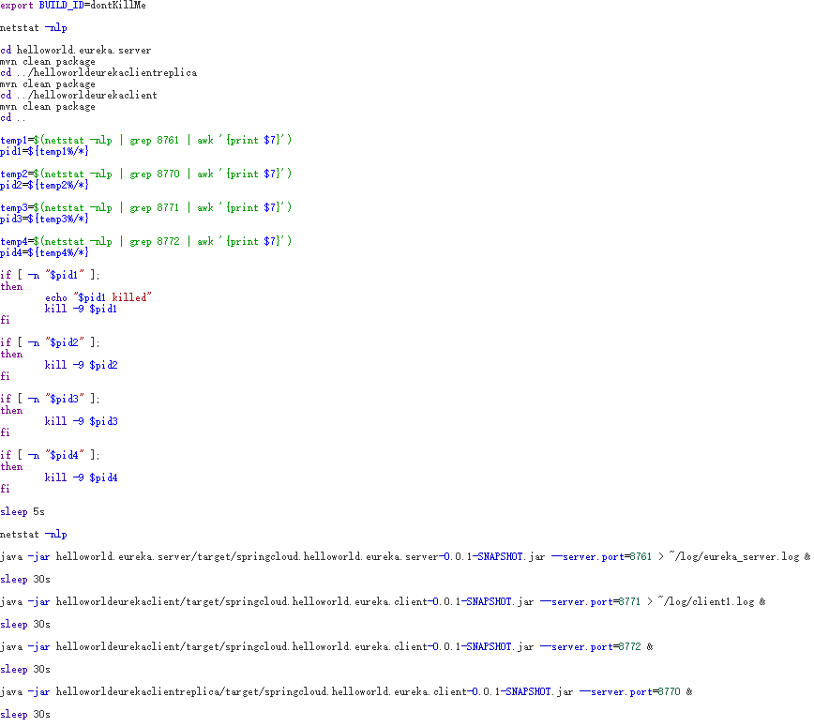
CI/CD: Jenkins

Slide 7
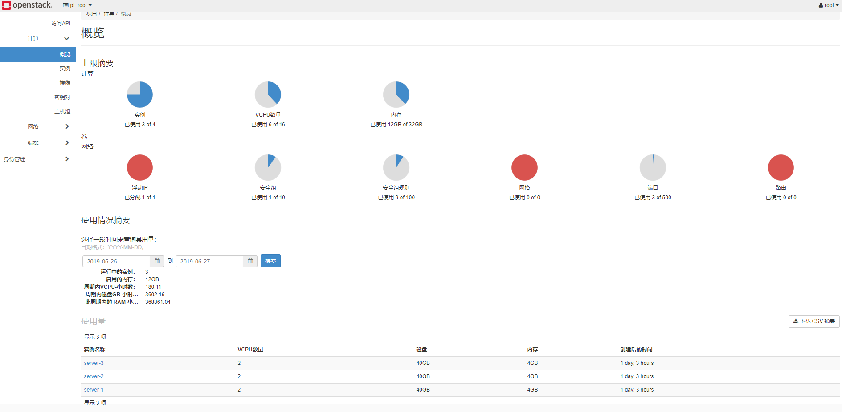
Kubernetes: Cluster Configuration

Slide 8
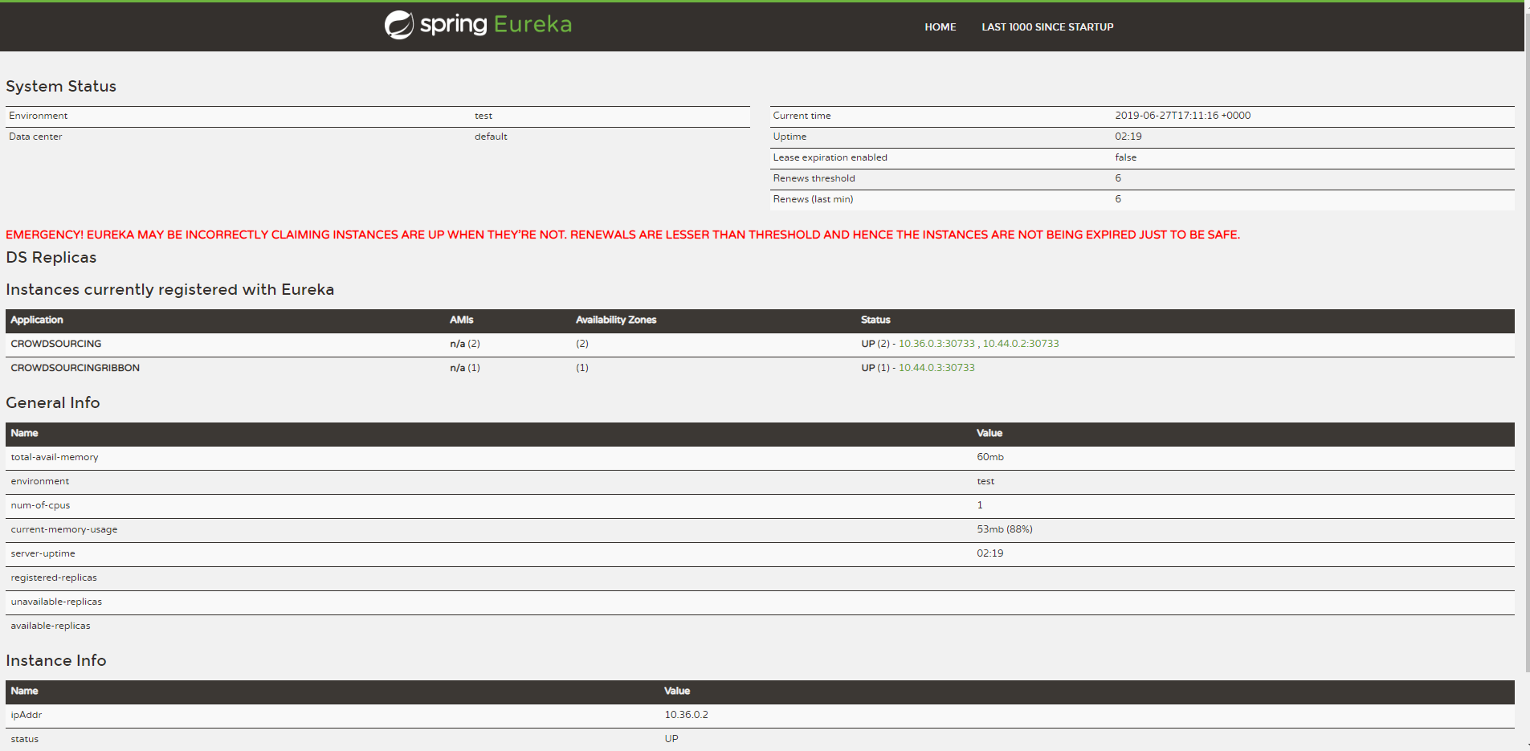
Kubernetes: Eureka Server
Eureka Server: 202.120.40.8:30732
Services register with private IPs

Slide 9
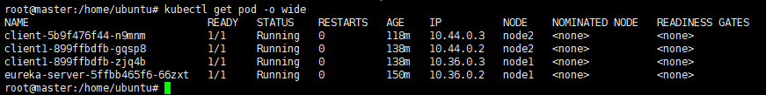
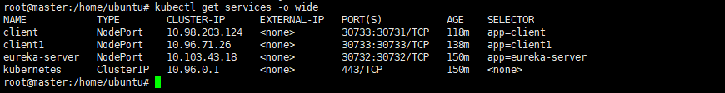
Kubernetes: Microservices
One service entry, two services replicas
Only the service entry is exposed to public

Slide 10

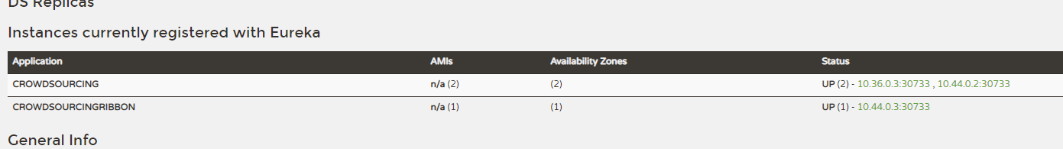
Kubernetes: Load Balancing
Ribbon: forwarding requests to the proper replica
How to find the service replicas ? Eureka Server!

Slide 11
Kubernetes: Auto Scaling
Horizontal-pod-autoscaler
Add service pod when CPU utilization > 80%

Slide 12
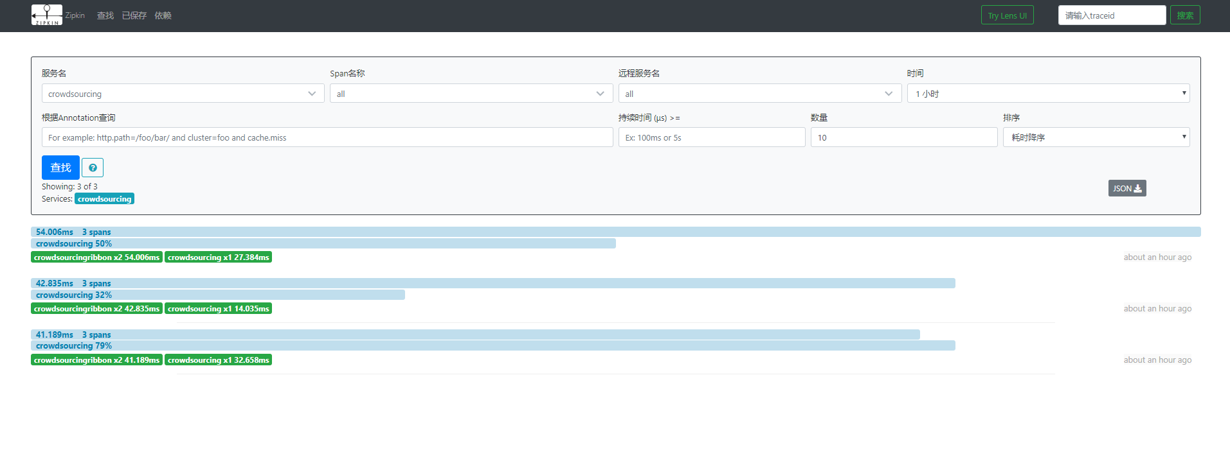
Kubernetes: Distributed Tracing
Zipkin: trace every access to the registered services

Slide 13
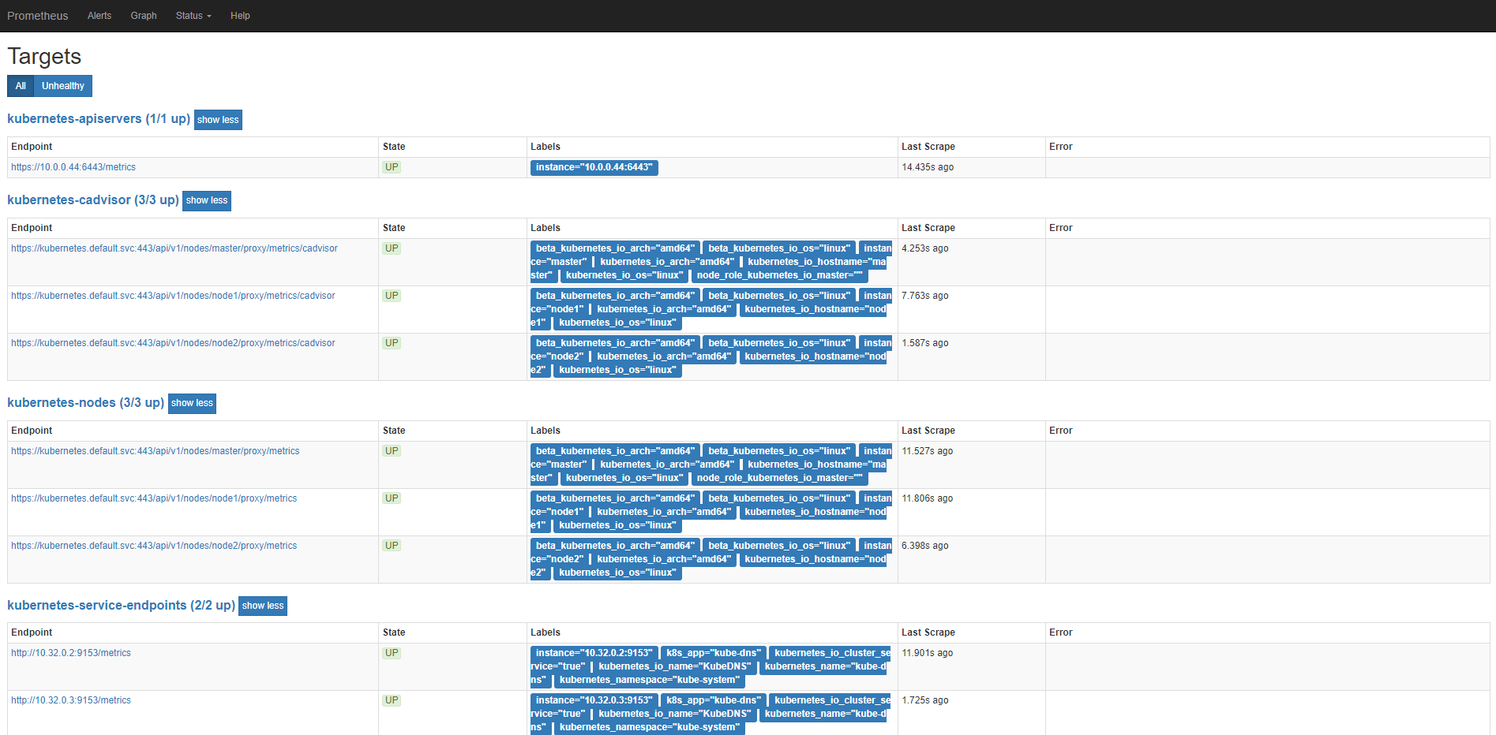
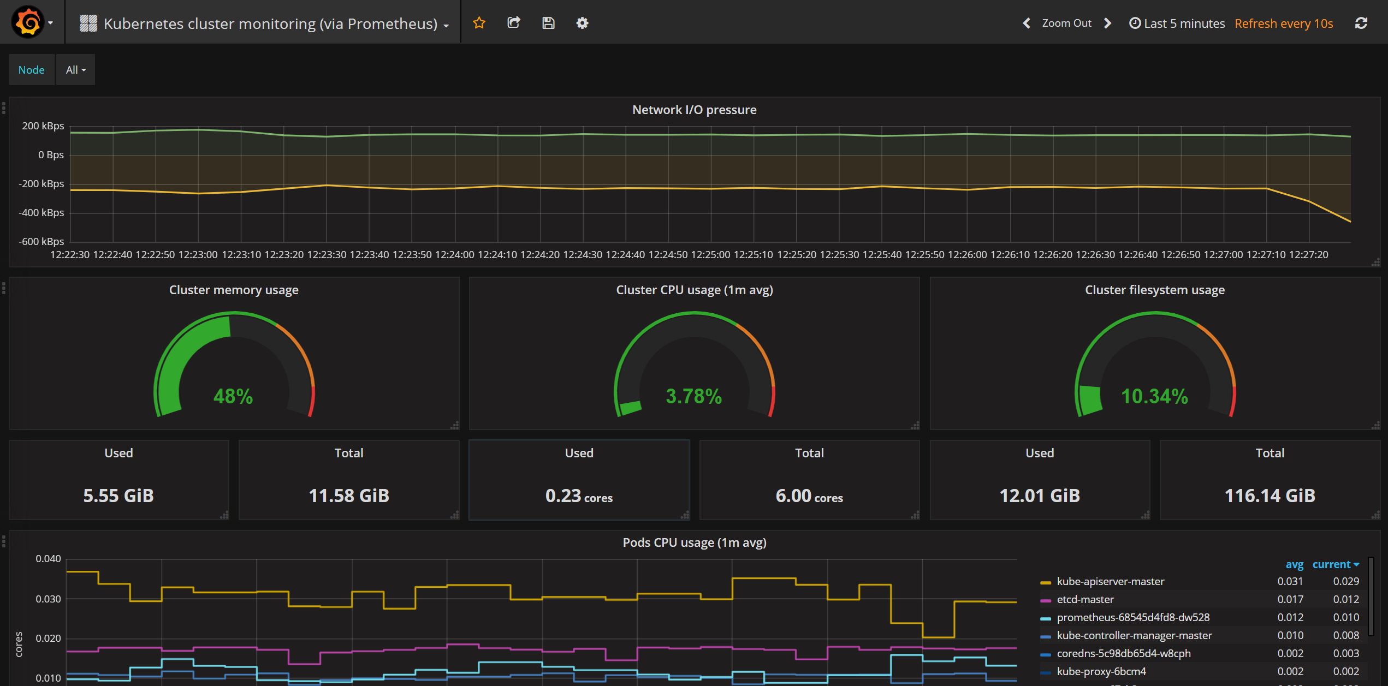
Kubernetes: Service Monitor
Prometheus + Grafana

