Slide 1
Chapter 5: Process Synchronization

Slide 2
Objectives
To present the concept of process synchronization.
To introduce the critical-section problem, whose solutions can be used to ensure the consistency of shared data
To present both software and hardware solutions of the critical-section problem
To examine several classical process-synchronization problems
To explore several tools that are used to solve process synchronization problems

Slide 3
Background
Processes can execute concurrently
  May be interrupted at any time, partially completing execution
Concurrent access to shared data may result in data inconsistency
Maintaining data consistency requires mechanisms to ensure the orderly execution of cooperating processes
Illustration of the problem:
Suppose that we wanted to provide a solution to the consumer-producer problem that fills all the buffers. We can do so by having an integer counter that keeps track of the number of full buffers. Initially, counter is set to 0. It is incremented by the producer after it produces a new buffer and is decremented by the consumer after it consumes a buffer.

Slide 4
Producer-Consumer
while (true) {
/* produce an item in next produced */
while (counter == BUFFER_SIZE) ;
/* do nothing */
buffer[in] = next_produced;
in = (in + 1) % BUFFER_SIZE;
counter++;
}
while (true) {
while (counter == 0)
; /* do nothing */
next_consumed = buffer[out];
out = (out + 1) % BUFFER_SIZE;
counter--;
/* consume the item in next consumed */
}

Slide 5
Race Condition
counter++ could be implemented as
register1 = counter
register1 = register1 + 1
counter = register1
counter-- could be implemented as
register2 = counter
register2 = register2 - 1
counter = register2
Consider this execution interleaving with “count = 5” initially:
  S0: producer execute register1 = counter {register1 = 5}
  S1: producer execute register1 = register1 + 1 {register1 = 6}
  S2: consumer execute register2 = counter {register2 = 5}
  S3: consumer execute register2 = register2 – 1 {register2 = 4}
  S4: producer execute counter = register1 {counter = 6 }
  S5: consumer execute counter = register2 {counter = 4}

Slide 6
Critical Section Problem
Consider system of n processes {p₀, p₁, … p_{n-1}}
Each process has critical section segment of code
  Process may be changing common variables, updating table, writing file, etc
  When one process in critical section, no other may be in its critical section
Critical section problem is to design protocol to solve this
Each process must ask permission to enter critical section in entry section, may follow critical section with exit section, then remainder section

Slide 7

Critical Section
General structure of process P_{i}

Slide 8
Solution to Critical-Section Problem
1. Mutual Exclusion - If process P_{i} is executing in its critical section, then no other processes can be executing in their critical sections
2. Progress - If no process is executing in its critical section and there exist some processes that wish to enter their critical section, then the selection of the processes that will enter the critical section next cannot be postponed indefinitely
3. Bounded Waiting - A bound must exist on the number of times that other processes are allowed to enter their critical sections after a process has made a request to enter its critical section and before that request is granted
  Assume that each process executes at a nonzero speed
  No assumption concerning relative speed of the n processes

Slide 9
Critical-Section Handling in OS
Two approaches depending on if kernel is preemptive or non-preemptive
  Preemptive – allows preemption of process when running in kernel mode
  Non-preemptive – runs until exits kernel mode, blocks, or voluntarily yields CPU
    Essentially free of race conditions in kernel mode

Slide 10
Peterson’s Solution
Good algorithmic description of solving the problem
Two process solution
Assume that the load and store machine-language instructions are atomic; that is, cannot be interrupted
The two processes share two variables:
  int turn;
  Boolean flag[2]
The variable turn indicates whose turn it is to enter the critical section
The flag array is used to indicate if a process is ready to enter the critical section. flag[i] = true implies that process P_{i} is ready!

Slide 11
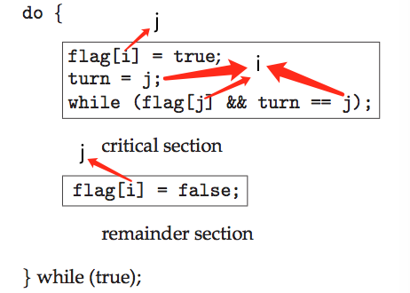
Algorithm for Process P_{i}
Peterson’s solution is restricted to two processes that alternate execution between their critical sections and remainder sections.

Slide 12
Peterson’s Solution (Cont.)
Provable that the three critical section requirement are met:
1. Mutual exclusion is preserved
P_{i} enters critical section only if:
either flag[j] = false or turn = i
2. Progress requirement is satisfied
3. Bounded-waiting requirement is met

Slide 13
Synchronization Hardware
Many systems provide hardware support for implementing the critical section code.
All solutions below based on idea of locking
  Protecting critical regions via locks
Uniprocessors – could disable interrupts
  Currently running code would execute without preemption
  Generally too inefficient on multiprocessor systems
    Operating systems using this not broadly scalable
Modern machines provide special atomic hardware instructions
    Atomic = non-interruptible
  Either test memory word and set value
  Or swap contents of two memory words

Slide 14
Solution to Critical-section Problem Using Locks
do {
acquire lock
critical section
release lock
remainder section
} while (TRUE);

Slide 15
Mutex Locks
Previous solutions are complicated and generally inaccessible to application programmers
OS designers build software tools to solve critical section problem
Simplest is mutex lock
Protect a critical section by first acquire() a lock then release() the lock
  Boolean variable indicating if lock is available or not
Calls to acquire() and release() must be atomic
  Usually implemented via hardware atomic instructions
But this solution requires busy waiting
  This lock therefore called a spinlock

Slide 16
acquire() and release()
acquire() {
while (!available); /* busy wait */
available = false;;
}
release() {
available = true;
}
do {
acquire lock
critical section
release lock
remainder section
} while (true);

Slide 17
Semaphore
Synchronization tool that provides more sophisticated ways (than Mutex locks) for process to synchronize their activities.
Semaphore S – integer variable
Can only be accessed via two indivisible (atomic) operations
  wait() and signal()
    Originally called P() and V()
Definition of the wait() operation
  wait (S) {
  while (S <= 0); // busy wait
  S--;
  }
Definition of the signal() operation
  signal (S) {
  S++;
  }
Watch Animation

Slide 18
Semaphore Usage
Counting semaphore – integer value can range over an unrestricted domain
Binary semaphore – integer value can range only between 0 and 1
  Same as a mutex lock
Can solve various synchronization problems
Consider P₁ and P₂ that require S₁ to happen before S₂
Create a semaphore “synch” initialized to 0
  P1:
  S₁;
  signal(synch);
  P2:
  wait(synch);
  S₂;
Can implement a counting semaphore S as a binary semaphore

Slide 19
Semaphore Implementation
Must guarantee that no two processes can execute the wait() and signal() on the same semaphore at the same time
Thus, the implementation becomes the critical section problem where the wait and signal code are placed in the critical section
  Could now have busy waiting in critical section implementation
    But implementation code is short
    Little busy waiting if critical section rarely occupied
Note that applications may spend lots of time in critical sections and therefore this is not a good solution

Slide 20
Semaphore Implementation with no Busy waiting
With each semaphore there is an associated waiting queue
Each entry in a waiting queue has two data items:
  value (of type integer)
  pointer to next record in the list
Two operations:
  block – place the process invoking the operation on the appropriate waiting queue
  wakeup – remove one of processes in the waiting queue and place it in the ready queue
typedef struct{
int value;
struct process *list;
} semaphore;

Slide 21
Implementation with no Busy waiting (Cont.)
wait(semaphore *S) {
S->value--;
if (S->value < 0) {
add this process to S->list;
block();
}
}
signal(semaphore *S) {
S->value++;
if (S->value <= 0) {
remove a process P from S->list;
wakeup(P);
}
}

Slide 22
Deadlock and Starvation
Deadlock – two or more processes are waiting indefinitely for an event that can be caused by only one of the waiting processes
Let S and Q be two semaphores initialized to 1
P₀ P₁
wait(S); wait(Q);
wait(Q); wait(S);
... ...
signal(S); signal(Q);
signal(Q); signal(S);
Starvation – indefinite blocking
  A process may never be removed from the semaphore queue in which it is suspended
Priority Inversion – Scheduling problem when lower-priority process holds a lock needed by higher-priority process

Slide 23
Classical Problems of Synchronization
Classical problems used to test newly-proposed synchronization schemes
  Bounded-Buffer Problem
  Readers and Writers Problem
  Dining-Philosophers Problem

Slide 24
Bounded-Buffer Problem
n buffers, each can hold one item
Semaphore mutex initialized to the value 1
Semaphore full initialized to the value 0
Semaphore empty initialized to the value n

Slide 25
Bounded Buffer Problem (Cont.)
The structure of the producer process
do {
...
/* produce an item in next_produced */
...
wait(empty);
wait(mutex);
...
/* add next produced to the buffer */
...
signal(mutex);
signal(full);
} while (true);

Slide 26
Bounded Buffer Problem (Cont.)
The structure of the consumer process
Do {
wait(full);
wait(mutex);
...
/* remove an item from buffer to next_consumed */
...
signal(mutex);
signal(empty);
...
/* consume the item in next consumed */
...
} while (true);

Slide 27
Readers-Writers Problem
A data set is shared among a number of concurrent processes
  Readers – only read the data set; they do not perform any updates
  Writers – can both read and write
Problem – allow multiple readers to read at the same time
  Only one single writer can access the shared data at the same time
Several variations of how readers and writers are considered – all involve some form of priorities
Shared Data
  Data set
  Semaphore rw_mutex initialized to 1
  Semaphore mutex initialized to 1
  Integer read_count initialized to 0

Slide 28
Readers-Writers Problem (Cont.)
The structure of a writer process
do {
wait(rw_mutex);
...
/* writing is performed */
...
signal(rw_mutex);
} while (true);

Slide 29
Readers-Writers Problem (Cont.)
The structure of a reader process
do {
wait(mutex);
read_count++;
if (read_count == 1)
wait(rw_mutex);
signal(mutex);
...
/* reading is performed */
...
wait(mutex);
read count--;
if (read_count == 0)
signal(rw_mutex);
signal(mutex);
} while (true);

Slide 30

Dining-Philosophers Problem
Philosophers spend their lives alternating thinking and eating
Don’t interact with their neighbors, occasionally try to pick up 2 chopsticks (one at a time) to eat from bowl
  Need both to eat, then release both when done
In the case of 5 philosophers
  Shared data
    Bowl of rice (data set)
    Semaphore chopstick [5] initialized to 1

Slide 31
Dining-Philosophers Problem Algorithm
The structure of Philosopher i:
    do {
    wait (chopstick[i]);
    wait (chopStick[ (i + 1) % 5]);
    // eat
    signal (chopstick[i] );
    signal (chopstick[ (i + 1) % 5] );
    // think
    } while (TRUE);
What is the problem with this algorithm?

Slide 32
Dining-Philosophers Problem Algorithm (Cont.)
Deadlock handling
  Allow at most 4 philosophers to be sitting simultaneously at the table.
  Allow a philosopher to pick up the forks only if both are available (picking must be done in a critical section.
  Use an asymmetric solution -- an odd-numbered philosopher picks up first the left chopstick and then the right chopstick. Even-numbered philosopher picks up first the right chopstick and then the left chopstick.

Slide 33
Problems with Semaphores
Incorrect use of semaphore operations:
  signal (mutex) …. wait (mutex)
  wait (mutex) … wait (mutex)
  Omitting of wait (mutex) or signal (mutex) (or both)
Deadlock and starvation are possible.

Slide 34
Monitors
A high-level abstraction that provides a convenient and effective mechanism for process synchronization
Abstract data type, internal variables only accessible by code within the procedure
Only one process may be active within the monitor at a time
But not powerful enough to model some synchronization schemes
    monitor monitor-name
    {
    // shared variable declarations
    procedure P1 (…) { …. }
    procedure Pn (…) {……}
    Initialization code (…) { … }
    }
    }

Slide 35

Schematic view of a Monitor

Slide 36
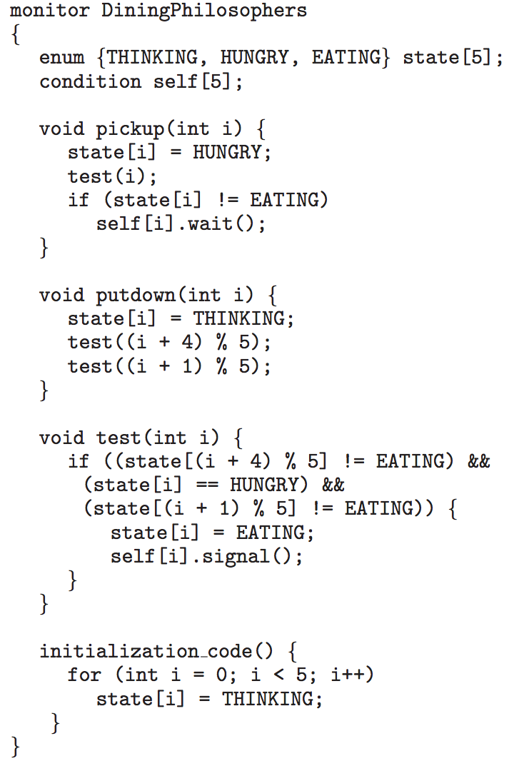
Monitor Solution to Dining Philosophers

Slide 37
Solution to Dining Philosophers (Cont.)
Each philosopher i invokes the operations pickup() and putdown() in the following sequence:
DiningPhilosophers.pickup(i);
EAT
DiningPhilosophers.putdown(i);
No deadlock, but starvation is possible

Slide 38
Single Resource allocation
Allocate a single resource among competing processes using priority numbers that specify the maximum time a process plans to use the resource
R.acquire(t);
...
access the resurce;
...
R.release;
Where R is an instance of type ResourceAllocator

Slide 39
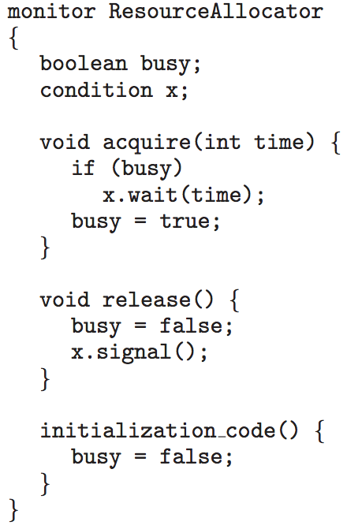
A Monitor to Allocate Single Resource

Slide 40
Synchronization Examples
Solaris
Windows
Linux

Slide 41
Solaris Synchronization
Implements a variety of locks to support multitasking, multithreading (including real-time threads), and multiprocessing
Uses adaptive mutexes for efficiency when protecting data from short code segments
  Starts as a standard semaphore spin-lock
  If lock held, and by a thread running on another CPU, spins
  If lock held by non-run-state thread, block and sleep waiting for signal of lock being released
Uses condition variables
Uses readers-writers locks when longer sections of code need access to data
Uses turnstiles to order the list of threads waiting to acquire either an adaptive mutex or reader-writer lock
  Turnstiles are per-lock-holding-thread, not per-object
Priority-inheritance per-turnstile gives the running thread the highest of the priorities of the threads in its turnstile

Slide 42
Windows Synchronization
Uses interrupt masks to protect access to global resources on uniprocessor systems
Uses spinlocks on multiprocessor systems
  Spinlocking-thread will never be preempted
Also provides dispatcher objects user-land which may act mutexes, semaphores, events, and timers
  Events
    An event acts much like a condition variable
  Timers notify one or more thread when time expired
  Dispatcher objects either signaled-state (object available) or non-signaled state (thread will block)

Slide 43
Linux Synchronization
Linux:
  Prior to kernel Version 2.6, disables interrupts to implement short critical sections
  Version 2.6 and later, fully preemptive
Linux provides:
  Semaphores
  atomic integers
  spinlocks
  reader-writer versions of both
On single-cpu system, spinlocks replaced by enabling and disabling kernel preemption

Slide 44
Deadlocks

Slide 45
System Model
System consists of resources
Resource types R₁, R₂, . . ., R_{m}
    CPU cycles, memory space, I/O devices
Each resource type R_{i} has W_{i} instances.
Each process utilizes a resource as follows:
  request
  use
  release

Slide 46
Deadlock Characterization
Deadlock can arise if four conditions hold simultaneously.
Mutual exclusion: only one process at a time can use a resource
Hold and wait: a process holding at least one resource is waiting to acquire additional resources held by other processes
No preemption: a resource can be released only voluntarily by the process holding it, after that process has completed its task
Circular wait: there exists a set {P₀, P₁, …, P_{n}} of waiting processes such that P₀ is waiting for a resource that is held by P₁, P₁ is waiting for a resource that is held by P₂, …, P_{n–1} is waiting for a resource that is held by P_{n}, and P_{n} is waiting for a resource that is held by P₀.

Slide 47
Resource-Allocation Graph
A set of vertices V and a set of edges E.
V is partitioned into two types:
  P = {P₁, P₂, …, P_{n}}, the set consisting of all the processes in the system
  R = {R₁, R₂, …, R_{m}}, the set consisting of all resource types in the system
request edge – directed edge P_{i} → R_{j}
assignment edge – directed edge R_{j} → P_{i}

Slide 48



Resource-Allocation Graph (Cont.)
Process
Resource Type with 4 instances
P_{i} requests instance of R_{j}
P_{i} is holding an instance of R_{j}
P_{i}
R_{j}
P_{i}
R_{j}

Slide 49

Example of a Resource Allocation Graph
Watch Animation

Slide 50

Resource Allocation Graph With A Deadlock

Slide 51

Graph With A Cycle But No Deadlock

Slide 52
Basic Facts
If graph contains no cycles ⇒ no deadlock
If graph contains a cycle ⇒
  if only one instance per resource type, then deadlock
  if several instances per resource type, possibility of deadlock

Slide 53
Methods for Handling Deadlocks
Ensure that the system will never enter a deadlock state:
  Deadlock prevention
  Deadlock avoidence
Allow the system to enter a deadlock state and then recover
Ignore the problem and pretend that deadlocks never occur in the system; used by most operating systems, including UNIX

Slide 54
Deadlock Prevention
Deadlock prevention provides a et of methods for ensuring that at least one of the necessary cannot hold.
Mutual Exclusion – not required for sharable resources (e.g., read-only files); must hold for non-sharable resources
Hold and Wait – must guarantee that whenever a process requests a resource, it does not hold any other resources
  Require process to request and be allocated all its resources before it begins execution, or allow process to request resources only when the process has none allocated to it.
  Low resource utilization; starvation possible

Slide 55
Deadlock Prevention (Cont.)
No Preemption –
  If a process that is holding some resources requests another resource that cannot be immediately allocated to it, then all resources currently being held are released
  Preempted resources are added to the list of resources for which the process is waiting
  Process will be restarted only when it can regain its old resources, as well as the new ones that it is requesting
Circular Wait – impose a total ordering of all resource types, and require that each process requests resources in an increasing order of enumeration

Slide 56
Deadlock Example
/* thread one runs in this function */
void *do_work_one(void *param)
{
pthread_mutex_lock(&first_mutex);
pthread_mutex_lock(&second_mutex);
/** * Do some work */
pthread_mutex_unlock(&second_mutex);
pthread_mutex_unlock(&first_mutex);
pthread_exit(0);
}
/* thread two runs in this function */
void *do_work_two(void *param)
{
pthread_mutex_lock(&second_mutex);
pthread_mutex_lock(&first_mutex);
/** * Do some work */
pthread_mutex_unlock(&first_mutex);
pthread_mutex_unlock(&second_mutex);
pthread_exit(0);
}

Slide 57
Deadlock Example with Lock Ordering
void transaction(Account from, Account to, double amount)
{
mutex lock1, lock2;
lock1 = get_lock(from);
lock2 = get_lock(to);
acquire(lock1);
acquire(lock2);
withdraw(from, amount);
deposit(to, amount);
release(lock2);
release(lock1);
}
Transactions 1 and 2 execute concurrently. Transaction 1 transfers $25 from account A to account B, and Transaction 2 transfers $50 from account B to account A

Slide 58
Deadlock Avoidance
Requires that the system has some additional a priori information available
Simplest and most useful model requires that each process declare the maximum number of resources of each type that it may need
The deadlock-avoidance algorithm dynamically examines the resource-allocation state to ensure that there can never be a circular-wait condition
Resource-allocation state is defined by the number of available and allocated resources, and the maximum demands of the processes

Slide 59
Safe State
When a process requests an available resource, system must decide if immediate allocation leaves the system in a safe state
System is in safe state if there exists a sequence <P₁, P₂, …, P_{n}> of ALL the processes in the systems such that for each P_{i}, the resources that P_{i} can still request can be satisfied by currently available resources + resources held by all the P_{j}, with j < I
That is:
  If P_{i} resource needs are not immediately available, then P_{i} can wait until all P_{j} have finished
  When P_{j} is finished, P_{i} can obtain needed resources, execute, return allocated resources, and terminate
  When P_{i} terminates, P_{i +1} can obtain its needed resources, and so on

Slide 60
Basic Facts
If a system is in safe state ⇒ no deadlocks
If a system is in unsafe state ⇒ possibility of deadlock
Avoidance ⇒ ensure that a system will never enter an unsafe state.

Slide 61

Safe, Unsafe, Deadlock State

Slide 62
Avoidance Algorithms
Single instance of a resource type
  Use a resource-allocation graph
Multiple instances of a resource type
  Use the banker’s algorithm

Slide 63
Resource-Allocation Graph Scheme
Claim edge P_{i} → R_{j} indicated that process P_{j} may request resource R_{j}; represented by a dashed line
Claim edge converts to request edge when a process requests a resource
Request edge converted to an assignment edge when the resource is allocated to the process
When a resource is released by a process, assignment edge reconverts to a claim edge
Resources must be claimed a priori in the system

Slide 64

Resource-Allocation Graph

Slide 65

Unsafe State In Resource-Allocation Graph

Slide 66
Resource-Allocation Graph Algorithm
Suppose that process P_{i} requests a resource R_{j}
The request can be granted only if converting the request edge to an assignment edge does not result in the formation of a cycle in the resource allocation graph

Slide 67
Banker’s Algorithm
Multiple instances
Each process must a priori claim maximum use
When a process requests a resource it may have to wait
When a process gets all its resources it must return them in a finite amount of time

Slide 68
Data Structures for the Banker’s Algorithm
Let n = number of processes, and m = number of resources types.
Available: Vector of length m. If available [j] = k, there are k instances of resource type R_{j} available
Max: n x m matrix. If Max [i,j] = k, then process P_{i} may request at most k instances of resource type R_{j}
Allocation: n x m matrix. If Allocation[i,j] = k then P_{i} is currently allocated k instances of R_{j}
Need: n x m matrix. If Need[i,j] = k, then P_{i} may need k more instances of R_{j} to complete its task
    Need [i,j] = Max[i,j] – Allocation [i,j]

Slide 69
Safety Algorithm
1. Let Work and Finish be vectors of length m and n, respectively. Initialize:
      Work = Available
      Finish [i] = false for i = 0, 1, …, n- 1
2. Find an i such that both:
  (a) Finish [i] = false
  (b) Need_{i} ≤ Work
  If no such i exists, go to step 4
3. Work = Work + Allocation_{i}
Finish[i] = true
go to step 2
4. If Finish [i] == true for all i, then the system is in a safe state

Slide 70
Resource-Request Algorithm for Process P_{i}
Request_{i} = request vector for process P_{i}. If Request_{i} [j] = k then process P_{i} wants k instances of resource type R_{j}
  1. If Request_{i} ≤ Need_{i} go to step 2. Otherwise, raise error condition, since process has exceeded its maximum claim
  2. If Request_{i} ≤ Available, go to step 3. Otherwise P_{i} must wait, since resources are not available
  3. Pretend to allocate requested resources to P_{i} by modifying the state as follows:
      Available = Available – Request_{i};
      Allocation_{i} = Allocation_{i} + Request_{i};
      Need_{i} = Need_{i} – Request_{i};
    If safe ⇒ the resources are allocated to P_{i}
    If unsafe ⇒ P_{i} must wait, and the old resource-allocation state is restored

Slide 71
Example of Banker’s Algorithm
5 processes P₀ through P₄;
3 resource types:
A (10 instances), B (5 instances), and C (7 instances)
Snapshot at time T₀:
Allocation Max Available
A B C A B C A B C
P₀ 0 1 0 7 5 3 3 3 2
P₁ 2 0 0 3 2 2
P₂ 3 0 2 9 0 2
P₃ 2 1 1 2 2 2
P₄ 0 0 2 4 3 3

Slide 72
Example (Cont.)
The content of the matrix Need is defined to be Max – Allocation
Need
A B C
P₀ 7 4 3
P₁ 1 2 2
P₂ 6 0 0
P₃ 0 1 1
P₄ 4 3 1
The system is in a safe state since the sequence < P₁, P₃, P₄, P₂, P₀> satisfies safety criteria

Slide 73
Example: P₁ Request (1,0,2)
Check that Request ≤ Available (that is, (1,0,2) ≤ (3,3,2) ⇒ true
Allocation Need Available
A B C A B C A B C
P₀ 0 1 0 7 4 3 2 3 0
P₁ 3 0 2 0 2 0
P₂ 3 0 2 6 0 0
P₃ 2 1 1 0 1 1
P₄ 0 0 2 4 3 1
Executing safety algorithm shows that sequence < P₁, P₃, P₄, P₀, P₂> satisfies safety requirement
Can request for (3,3,0) by P₄ be granted?
Can request for (0,2,0) by P₀ be granted?

Slide 74
Deadlock Detection
Allow system to enter deadlock state
Detection algorithm
Recovery scheme

Slide 75
Single Instance of Each Resource Type
Maintain wait-for graph
  Nodes are processes
  P_{i} → P_{j} if P_{i} is waiting for P_{j}
Periodically invoke an algorithm that searches for a cycle in the graph. If there is a cycle, there exists a deadlock
An algorithm to detect a cycle in a graph requires an order of n² operations, where n is the number of vertices in the graph

Slide 76

Resource-Allocation Graph and Wait-for Graph
Resource-Allocation Graph
Corresponding wait-for graph

Slide 77
Several Instances of a Resource Type
Available: A vector of length m indicates the number of available resources of each type
Allocation: An n x m matrix defines the number of resources of each type currently allocated to each process
Request: An n x m matrix indicates the current request of each process. If Request [i][j] = k, then process P_{i} is requesting k more instances of resource type R_{j}.

Slide 78
Detection Algorithm
1. Let Work and Finish be vectors of length m and n, respectively Initialize:
  (a) Work = Available
  (b) For i = 1,2, …, n, if Allocation_{i} ≠ 0, then
  Finish[i] = false; otherwise, Finish[i] = true
2. Find an index i such that both:
  (a) Finish[i] == false
  (b) Request_{i} ≤ Work
  If no such i exists, go to step 4
3. Work = Work + Allocation_{i}
Finish[i] = true
go to step 2
4. If Finish[i] == false, for some i, 1 ≤ i ≤ n, then the system is in deadlock state. Moreover, if Finish[i] == false, then P_{i} is deadlocked

Slide 79
Example of Detection Algorithm
Five processes P₀ through P₄; three resource types
A (7 instances), B (2 instances), and C (6 instances)
Snapshot at time T₀:
Allocation Request Available
A B C A B C A B C
P₀ 0 1 0 0 0 0 0 0 0
P₁ 2 0 0 2 0 2
P₂ 3 0 3 0 0 0
P₃ 2 1 1 1 0 0
P₄ 0 0 2 0 0 2
Sequence <P₀, P₂, P₃, P₁, P₄> will result in Finish[i] = true for all i

Slide 80
Example (Cont.)
P₂ requests an additional instance of type C
Request
A B C
P₀ 0 0 0
P₁ 2 0 2
P₂ 0 0 1
P₃ 1 0 0
P₄ 0 0 2
State of system?
  Can reclaim resources held by process P₀, but insufficient resources to fulfill other processes requests
  Deadlock exists, consisting of processes P₁, P₂, P₃, and P₄

Slide 81
Detection-Algorithm Usage
When, and how often, to invoke depends on:
  How often a deadlock is likely to occur?
  How many processes will need to be rolled back?
    one for each disjoint cycle
If detection algorithm is invoked arbitrarily, there may be many cycles in the resource graph and so we would not be able to tell which of the many deadlocked processes “caused” the deadlock.

Slide 82
Recovery from Deadlock: Process Termination
Abort all deadlocked processes
Abort one process at a time until the deadlock cycle is eliminated
In which order should we choose to abort?
  Priority of the process
  How long process has computed, and how much longer to completion
  Resources the process has used
  Resources process needs to complete
  How many processes will need to be terminated
  Is process interactive or batch?

Slide 83
Recovery from Deadlock: Resource Preemption
Selecting a victim – minimize cost
Rollback – return to some safe state, restart process for that state
Starvation – same process may always be picked as victim, include number of rollback in cost factor

Slide 84
End of Chapter 5

