Slide 1
Reviews

Slide 2
Problems Type
Multiple Choice (1 point for each question)
  Choose one from four options
Fill in the Blanks (1 point for each question)
Short Answer (6 points for each question)
Calculation (10 points for each question)

Slide 3
Process: fork()
The fork syscall returns twice: it returns a zero to the child and the child process ID (pid) to the parent.
int pid;
int status = 0;
pid = fork()
if (pid != 0)
{
/* parent */
…..
pid = wait(&status);
}
else
{
/* child */
…..
exit(status);
}
Parent uses wait to sleep until the child exits; wait returns child pid and status.
Wait variants allow wait on a specific child, or notification of stops and other signals.
Wait has the effect of cleaning up the process out of the system – removes it from the zombie state.

Slide 4
Process: fork()
int pid = fork();
  Create a new process that is a clone of its parent.
exec*(“program” [, argvp, envp]);
  Overlay the calling process virtual memory with a new program, and transfer control to it.
exit(status);
  Exit with status, destroying the process.
int pid = wait*(&status);
  Wait for exit (or other status change) of a child.
parent
fork child
initialize child context
exec
wait
exit

Slide 5
Process: fork()
#include<stdio.h>
#include<stdlib.h>
#include<unistd.h>
#define NUM_CHILD 3
int main(){
int ret_pid;
int ret_val;
int i;
for (i = 0;i < NUM_CHILD;i++) {
ret_pid = fork();
if (ret_pid > 0) {
printf("parent code, pid = %d,parent pid = %d\n",getpid(),getppid());
break;
} else {
printf("child code, pid = %d,parent pid = %d\n",getpid(),getppid());
if (i == NUM_CHILD-1)
exit(EXIT_SUCCESS);
}
}
return 0;
/*ret_pid = wait(&ret_val);
printf("terminated pid = %d,status = %d\n",ret_pid,ret_val);
return EXIT_SUCCESS;*/
}
sample
parent code, pid = 9914,parent pid = 9368
child code, pid = 9915,parent pid = 9914
parent code, pid = 9915,parent pid = 1368
child code, pid = 9916,parent pid = 9915
parent code, pid = 9916,parent pid = 9915
child code, pid = 9917,parent pid = 1368

Slide 6
Critical Section Problem
Consider system of n processes {p₀, p₁, … p_{n-1}}
Each process has critical section segment of code
  Process may be changing common variables, updating table, writing file, etc
  When one process in critical section, no other may be in its critical section
Critical section problem is to design protocol to solve this
Each process must ask permission to enter critical section in entry section, may follow critical section with exit section, then remainder section

Slide 7
Semaphore
Synchronization tool that provides more sophisticated ways (than Mutex locks) for process to synchronize their activities.
Semaphore S – integer variable
Can only be accessed via two indivisible (atomic) operations
  wait() and signal()
    Originally called P() and V()
Definition of the wait() operation
  wait (S) {
  while (S <= 0); // busy wait
  S--;
  }
Definition of the signal() operation
  signal (S) {
  S++;
  }
Binary semaphore – integer value can range only between 0 and 1
Watch Animation

Slide 8
Semaphore Implementation with no Busy waiting
With each semaphore there is an associated waiting queue
Each entry in a waiting queue has two data items:
  value (of type integer)
  pointer to next record in the list
Two operations:
  block – place the process invoking the operation on the appropriate waiting queue
  wakeup – remove one of processes in the waiting queue and place it in the ready queue
typedef struct{
int value;
struct process *list;
} semaphore;

Slide 9
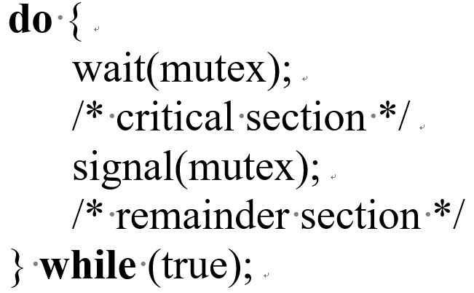
Implementation with no Busy waiting (Cont.)
wait(semaphore *S) {
S->value--;
if (S->value < 0) {
add this process to S->list;
block();
}
}
signal(semaphore *S) {
S->value++;
if (S->value <= 0) {
remove a process P from S->list;
wakeup(P);
}
}
How a binary semaphore can be used to implement mutual exclusion among n processes?

Slide 10
Deadlock and Starvation
Deadlock – two or more processes are waiting indefinitely for an event that can be caused by only one of the waiting processes
Let S and Q be two semaphores initialized to 1
P₀ P₁
wait(S); wait(Q);
wait(Q); wait(S);
... ...
signal(S); signal(Q);
signal(Q); signal(S);
Starvation – indefinite blocking
  A process may never be removed from the semaphore queue in which it is suspended
Priority Inversion – Scheduling problem when lower-priority process holds a lock needed by higher-priority process

Slide 11
Deadlock Avoidance Algorithms
Single instance of a resource type
  Use a resource-allocation graph
Multiple instances of a resource type
  Use the banker’s algorithm

Slide 12
Resource-Allocation Graph
A set of vertices V and a set of edges E.
V is partitioned into two types:
  P = {P₁, P₂, …, P_{n}}, the set consisting of all the processes in the system
  R = {R₁, R₂, …, R_{m}}, the set consisting of all resource types in the system
request edge – directed edge P_{i} → R_{j}
assignment edge – directed edge R_{j} → P_{i}

Slide 13



Resource-Allocation Graph (Cont.)
Process
Resource Type with 4 instances
P_{i} requests instance of R_{j}
P_{i} is holding an instance of R_{j}
P_{i}
R_{j}
P_{i}
R_{j}

Slide 14

Example of a Resource Allocation Graph
Watch Animation

Slide 15

Resource Allocation Graph With A Deadlock

Slide 16

Graph With A Cycle But No Deadlock

Slide 17

Unsafe State In Resource-Allocation Graph

Slide 18
Basic Facts
If graph contains no cycles ⇒ no deadlock
If graph contains a cycle ⇒
  if only one instance per resource type, then deadlock
  if several instances per resource type, possibility of deadlock

Slide 19
Banker’s Algorithm
Multiple instances
Each process must a priori claim maximum use
When a process requests a resource it may have to wait
When a process gets all its resources it must return them in a finite amount of time

Slide 20
Data Structures for the Banker’s Algorithm
Let n = number of processes, and m = number of resources types.
Available: Vector of length m. If available [j] = k, there are k instances of resource type R_{j} available
Max: n x m matrix. If Max [i,j] = k, then process P_{i} may request at most k instances of resource type R_{j}
Allocation: n x m matrix. If Allocation[i,j] = k then P_{i} is currently allocated k instances of R_{j}
Need: n x m matrix. If Need[i,j] = k, then P_{i} may need k more instances of R_{j} to complete its task
    Need [i,j] = Max[i,j] – Allocation [i,j]

Slide 21
Safety Algorithm
1. Let Work and Finish be vectors of length m and n, respectively. Initialize:
      Work = Available
      Finish [i] = false for i = 0, 1, …, n- 1
2. Find an i such that both:
  (a) Finish [i] = false
  (b) Need_{i} ≤ Work
  If no such i exists, go to step 4
3. Work = Work + Allocation_{i}
Finish[i] = true
go to step 2
4. If Finish [i] == true for all i, then the system is in a safe state

Slide 22
Resource-Request Algorithm for Process P_{i}
Request_{i} = request vector for process P_{i}. If Request_{i} [j] = k then process P_{i} wants k instances of resource type R_{j}
  1. If Request_{i} ≤ Need_{i} go to step 2. Otherwise, raise error condition, since process has exceeded its maximum claim
  2. If Request_{i} ≤ Available, go to step 3. Otherwise P_{i} must wait, since resources are not available
  3. Pretend to allocate requested resources to P_{i} by modifying the state as follows:
      Available = Available – Request_{i};
      Allocation_{i} = Allocation_{i} + Request_{i};
      Need_{i} = Need_{i} – Request_{i};
    If safe ⇒ the resources are allocated to P_{i}
    If unsafe ⇒ P_{i} must wait, and the old resource-allocation state is restored

Slide 23
Example of Banker’s Algorithm
5 processes P₀ through P₄;
3 resource types:
A (10 instances), B (5 instances), and C (7 instances)
Snapshot at time T₀:
Allocation Max Available
A B C A B C A B C
P₀ 0 1 0 7 5 3 3 3 2
P₁ 2 0 0 3 2 2
P₂ 3 0 2 9 0 2
P₃ 2 1 1 2 2 2
P₄ 0 0 2 4 3 3

Slide 24
Example (Cont.)
The content of the matrix Need is defined to be Max – Allocation
Need
A B C
P₀ 7 4 3
P₁ 1 2 2
P₂ 6 0 0
P₃ 0 1 1
P₄ 4 3 1
The system is in a safe state since the sequence < P₁, P₃, P₄, P₂, P₀> satisfies safety criteria

Slide 25
Example: P₁ Request (1,0,2)
Check that Request ≤ Available (that is, (1,0,2) ≤ (3,3,2) ⇒ true
Allocation Need Available
A B C A B C A B C
P₀ 0 1 0 7 4 3 2 3 0
P₁ 3 0 2 0 2 0
P₂ 3 0 2 6 0 0
P₃ 2 1 1 0 1 1
P₄ 0 0 2 4 3 1
Executing safety algorithm shows that sequence < P₁, P₃, P₄, P₀, P₂> satisfies safety requirement
Can request for (3,3,0) by P₄ be granted?
Can request for (0,2,0) by P₀ be granted?

Slide 26
CPU Scheduling Algorithms
FCFS
SJF
SRTF (Preemptive SJF)
P₁: 20, P₂: 5, P₃: 3 arrive in the order: P₁ , P₂ , P₃. Please tell me the average waiting time (AWT):
Example
15
P₃, P₂, P₁ ?
3.67
Convoy effect: short process behind long process
P₁: 20, P₂: 5, P₃: 3 arrive at the same time. Please tell me the AWT value:
Example
3.67
P₃: 8, P₂: 11, P₁ : 5 ?
6
ProcessA arri Arrival TimeT Burst Time
P₁ 0 8
P₂ 1 4
P₃ 2 9
P₄ 3 5
Please tell me the AWT value:
5
4
9
3
6.5
4.75

Slide 27
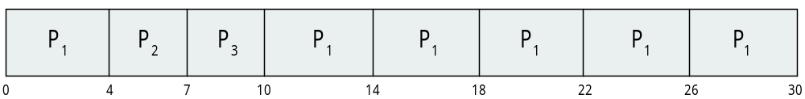
CPU Scheduling Algorithms
Priority
RR
ProcessA arri Burst TimeT Priority
P₁ 10 3
P₂ 1 1
P₃ 2 4
P₄ 1 5
P₅ 5 2
Please tell me the AWT value:
8.2
Process Burst Time
P₁ 24
P₂ 3
P₃ 3
Suppose that the quantum is four.
FCFS,SJF, SRTF, PR, RR
???
How to compute average process completion time (APCT)?

Slide 28
Dynamic Storage-Allocation Problem
How to satisfy a request of size n from a list of free holes?
First-fit: Allocate the first hole that is big enough
Best-fit: Allocate the smallest hole that is big enough; must search entire list, unless ordered by size
  Produces the smallest leftover hole
Worst-fit: Allocate the largest hole; must also search entire list
  Produces the largest leftover hole
First-fit and best-fit better than worst-fit in terms of speed and storage utilization

Slide 29




Dynamic Storage-Allocation Problem
First Fit
Worst Fit
Request:12KB
Best Fit

Slide 30
Page and Frame Replacement Algorithms
Frame-allocation algorithm determines
  How many frames to give each process
  Which frames to replace
Page-replacement algorithm
  Want lowest page-fault rate on both first access and re-access
Evaluate algorithm by running it on a particular string of memory references (reference string) and computing the number of page faults on that string
  String is just page numbers, not full addresses
  Repeated access to the same page does not cause a page fault
  Results depend on number of frames available
In all our examples, the reference string of referenced page numbers is
7,0,1,2,0,3,0,4,2,3,0,3,0,3,2,1,2,0,1,7,0,1

Slide 31

First-In-First-Out (FIFO) Algorithm
Reference string: 7,0,1,2,0,3,0,4,2,3,0,3,0,3,2,1,2,0,1,7,0,1
3 frames (3 pages can be in memory at a time per process)
Can vary by reference string: consider 1,2,3,4,1,2,5,1,2,3,4,5
  Adding more frames can cause more page faults!
    Belady’s Anomaly: for some page-replacement algorithms, the page-fault rate may increase as the number of allocated frames increases.
How to track ages of pages?
  Just use a FIFO queue
Example
15 page faults

Slide 32

Optimal Algorithm
Replace page that will not be used for longest period of time
  9 is optimal for the example
How do you know this?
  Can’t read the future
Used for measuring how well your algorithm performs
Example

Slide 33

Least Recently Used (LRU) Algorithm
Use past knowledge rather than future
Replace page that has not been used in the most amount of time
Associate time of last use with each page
12 faults – better than FIFO but worse than OPT
Generally good algorithm and frequently used
But how to implement?
Example

Slide 34
LRU Algorithm (Cont.)
Counter implementation
  Every page entry has a counter; every time page is referenced through this entry, copy the clock into the counter
  When a page needs to be changed, look at the counters to find smallest value
    Search through table needed
Stack implementation
  Keep a stack of page numbers in a double link form:
  Page referenced:
    move it to the top
    requires 6 pointers to be changed
  But each update more expensive
  No search for replacement
LRU and OPT are cases of stack algorithms that don’t have Belady’s Anomaly

Slide 35
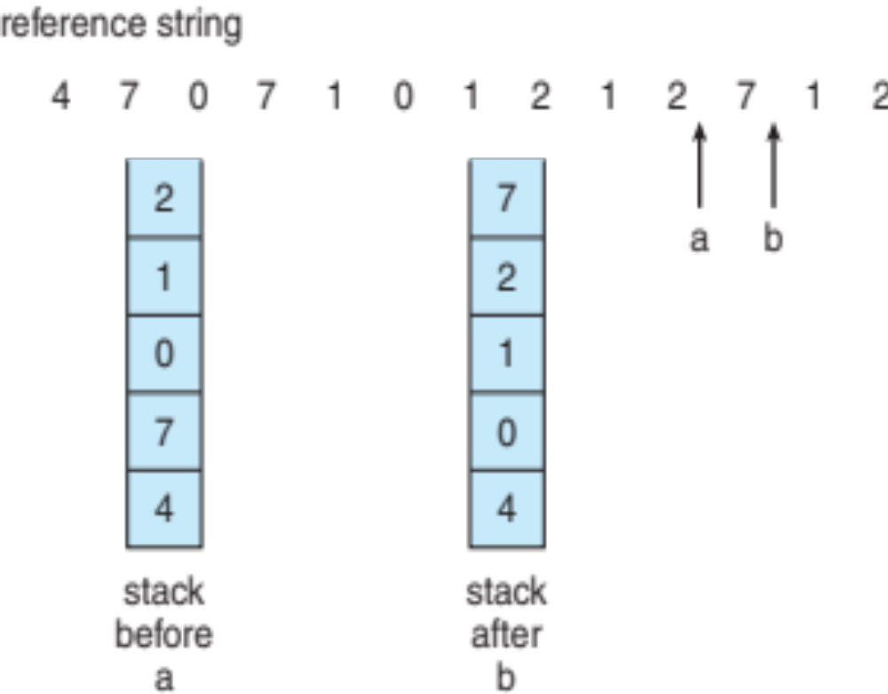
Use Of A Stack to Record Most Recent Page References

Slide 36
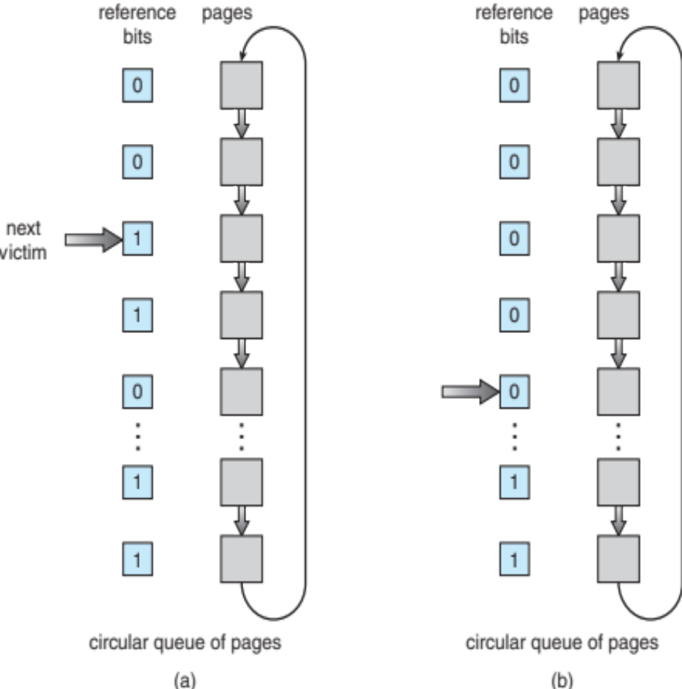
Second-Chance (clock) Page-Replacement Algorithm
LRU needs special hardware and still slow
Second-chance algorithm
  Generally FIFO, plus hardware-provided reference bit
  Clock replacement
  If page to be replaced has
    Reference bit = 0 -> replace it
    reference bit = 1 then:
      set reference bit 0, leave page in memory
      replace next page, subject to same rules
Example

Slide 37
Disk Scheduling
The operating system is responsible for using hardware efficiently — for the disk drives, this means having a fast access time and disk bandwidth
Minimize seek time
Seek time ≈ seek distance
Disk bandwidth is the total number of bytes transferred, divided by the total time between the first request for service and the completion of the last transfer

Slide 38
Disk Scheduling (Cont.)
There are many sources of disk I/O request
  OS
  System processes
  Users processes
I/O request includes input or output mode, disk address, memory address, number of sectors to transfer
OS maintains queue of requests, per disk or device
Idle disk can immediately work on I/O request, busy disk means work must queue
  Optimization algorithms only make sense when a queue exists

Slide 39
Disk Scheduling (Cont.)
Note that drive controllers have small buffers and can manage a queue of I/O requests (of varying “depth”)
Several algorithms exist to schedule the servicing of disk I/O requests
The analysis is true for one or many platters
We illustrate scheduling algorithms with a request queue (0-199)
98, 183, 37, 122, 14, 124, 65, 67
Head pointer 53

Slide 40

FCFS
Illustration shows total head movement of 640 cylinders

Slide 41

SSTF
Shortest Seek Time First selects the request with the minimum seek time from the current head position
SSTF scheduling is a form of SJF scheduling; may cause starvation of some requests
Illustration shows total head movement of 236 cylinders

Slide 42
SCAN
The disk arm starts at one end of the disk, and moves toward the other end, servicing requests until it gets to the other end of the disk, where the head movement is reversed and servicing continues.
SCAN algorithm Sometimes called the elevator algorithm
Illustration shows total head movement of 208 cylinders
But note that if requests are uniformly dense, largest density at other end of disk and those wait the longest

Slide 43

SCAN (Cont.)

Slide 44
C-SCAN
Provides a more uniform wait time than SCAN
The head moves from one end of the disk to the other, servicing requests as it goes
  When it reaches the other end, however, it immediately returns to the beginning of the disk, without servicing any requests on the return trip
Treats the cylinders as a circular list that wraps around from the last cylinder to the first one
Total number of cylinders?

Slide 45

C-SCAN (Cont.)

