Slide 1
MONASH INFORMATION
TECHNOLOGY
FIT5148 - Distributed Databases and Big Data
Week 06 - Document Database (MongoDB)
Notes:
http://nicholasjohnson.com/mongo/course/workbook/
Welcome to FIT5148 Distributed databasesz and bigdata.
For last 3 weeks we worked on handling volume side of big data and learnt how to write parallel algorithms.
This week we move on to the variety side of things.
We will learn about mongodb and how it can handle unstructured data.

Slide 2
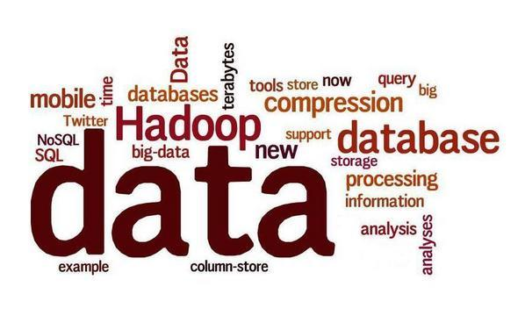
Recall - NoSQL
Definition: “Next generation databases mostly addressing some of the points: being non-relational, distributed, open-source, and horizontal scalable. The original intention has been modern web-scale databases. The movement began early 2009 and is growing rapidly. Often more characteristics apply as: schema-free, easy replication support, simple API, eventually consistent/BASE (not ACID), a huge data amount, and more.”
Notes:
NoSQL = no-SQL or Not Only SQL. Non-relational data storage systems.
NoSQL movement was probably inspired by Google’s Big Table or even Amazon’s S3.
Explosion of social media sites (Facebook, Twitter) with large data needs
NoSQL feature: shared-nothing horizontal scaling – replicating and partitioning data over many servers.
However, NoSQL does not provide ACID properties, but BASE (Basically Available, Soft state, Eventually consistent !!!)
The idea is to give up ACID to achieve much higher performance and scalability.
It is classified as a NoSQL Not Only SQL database program.
MongoDB uses JSON-like documents with schemata which is known as Binary JSON or BSOn for short.
MongoDB is developed by MongoDB Inc., and is published under a combination of the GNU Affero General Public License and the Apache License.
You all must be familiar with the concepts of relations in the databases.
In Relational databases such as oracle or mysql we have a database, database could have one or more tables and each table will have one or many rows. Each table will have a schema, They will have certain number of attributes or columns and the changing the schema is not really an easy task.
In document based database or MongoDB in our case, We have database but tables are replaced by collections and rows are replaced by documents. Schema is at document level, Each document in the collection can have same schema or different schema.

Slide 3
Recall - NoSQL Data Models
Key-value store
Document-oriented database
Column data store
Definition: “Next generation databases mostly addressing some of the points: being non-relational, distributed, open-source, and horizontal scalable. The original intention has been modern web-scale databases. The movement began early 2009 and is growing rapidly. Often more characteristics apply as: schema-free, easy replication support, simple API, eventually consistent/BASE (not ACID), a huge data amount, and more.”
Notes:
NoSQL = no-SQL or Not Only SQL. Non-relational data storage systems.
NoSQL movement was probably inspired by Google’s Big Table or even Amazon’s S3.
Explosion of social media sites (Facebook, Twitter) with large data needs
NoSQL feature: shared-nothing horizontal scaling – replicating and partitioning data over many servers.
However, NoSQL does not provide ACID properties, but BASE (Basically Available, Soft state, Eventually consistent !!!)
The idea is to give up ACID to achieve much higher performance and scalability.
It is classified as a NoSQL Not Only SQL database program.
MongoDB uses JSON-like documents with schemata which is known as Binary JSON or BSOn for short.
MongoDB is developed by MongoDB Inc., and is published under a combination of the GNU Affero General Public License and the Apache License.
You all must be familiar with the concepts of relations in the databases.
In Relational databases such as oracle or mysql we have a database, database could have one or more tables and each table will have one or many rows. Each table will have a schema, They will have certain number of attributes or columns and the changing the schema is not really an easy task.
In document based database or MongoDB in our case, We have database but tables are replaced by collections and rows are replaced by documents. Schema is at document level, Each document in the collection can have same schema or different schema.

Slide 4
Exercise 1 (FLUX Quiz)
MongoDB is an example of a:
A. Column data store
B. Key-value store
C. Document-oriented database
D. Relational DBMS

Slide 5
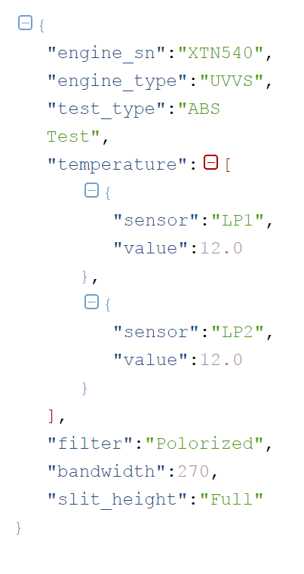
Recall - NoSQL Data Models
JSONObject represented by curly brackets
Document-oriented database
Each item is stored as a document (normally JSON document, but could be XML)
Practically any "document" containing metadata can be managed in this fashion, and common examples include XML, YAML, JSON, and BSON.
JSONArray represented
by square brackets
MongoDB
CouchDB
Notes:
NoSQL = no-SQL or Not Only SQL. Non-relational data storage systems.
NoSQL movement was probably inspired by Google’s Big Table or even Amazon’s S3.
Explosion of social media sites (Facebook, Twitter) with large data needs
NoSQL feature: shared-nothing horizontal scaling – replicating and partitioning data over many servers.
However, NoSQL does not provide ACID properties, but BASE (Basically Available, Soft state, Eventually consistent !!!)
The idea is to give up ACID to achieve much higher performance and scalability.
It is classified as a NoSQL Not Only SQL database program.
MongoDB uses JSON-like documents with schemata which is known as Binary JSON or BSOn for short.
MongoDB is developed by MongoDB Inc., and is published under a combination of the GNU Affero General Public License and the Apache License.
You all must be familiar with the concepts of relations in the databases.
In Relational databases such as oracle or mysql we have a database, database could have one or more tables and each table will have one or many rows. Each table will have a schema, They will have certain number of attributes or columns and the changing the schema is not really an easy task.
In document based database or MongoDB in our case, We have database but tables are replaced by collections and rows are replaced by documents. Schema is at document level, Each document in the collection can have same schema or different schema.

Slide 6
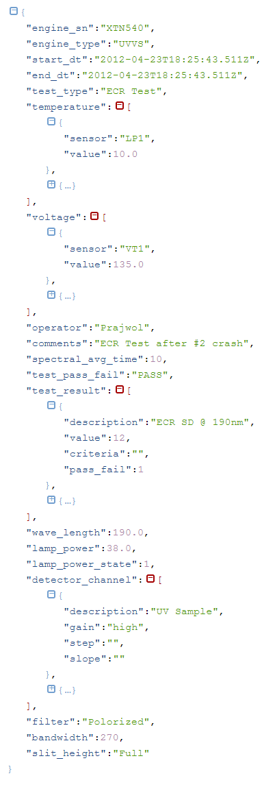
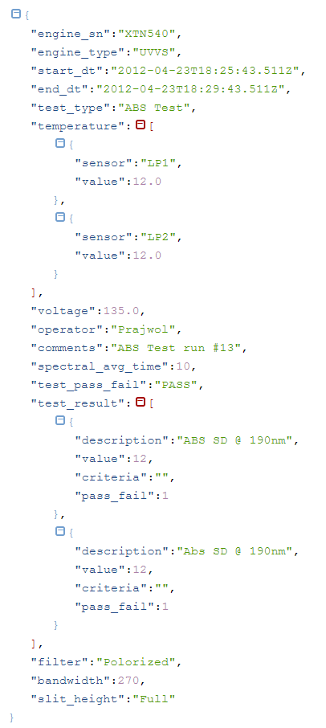
Recall - NoSQL Data Models
Document-oriented database
- MongoDB
Case Study: Manufacturing Scientific Instruments制造科学仪器
- Each instrument can run many different tests
- Based on the type of the test, different sensors in the instrument is triggered. It means that each test will produce different JSON record with different attributes.
Should we have separate table for each experiment (RDBMS approach) or use MongoDB and create only one collection?
ABS Test does not have attributes wavelength, lamp_power, lamp_power_state and detector_channel
Notes:
NoSQL = no-SQL or Not Only SQL. Non-relational data storage systems.
NoSQL movement was probably inspired by Google’s Big Table or even Amazon’s S3.
Explosion of social media sites (Facebook, Twitter) with large data needs
NoSQL feature: shared-nothing horizontal scaling – replicating and partitioning data over many servers.
However, NoSQL does not provide ACID properties, but BASE (Basically Available, Soft state, Eventually consistent !!!)
The idea is to give up ACID to achieve much higher performance and scalability.
It is classified as a NoSQL Not Only SQL database program.
MongoDB uses JSON-like documents with schemata which is known as Binary JSON or BSOn for short.
MongoDB is developed by MongoDB Inc., and is published under a combination of the GNU Affero General Public License and the Apache License.
You all must be familiar with the concepts of relations in the databases.
In Relational databases such as oracle or mysql we have a database, database could have one or more tables and each table will have one or many rows. Each table will have a schema, They will have certain number of attributes or columns and the changing the schema is not really an easy task.
In document based database or MongoDB in our case, We have database but tables are replaced by collections and rows are replaced by documents. Schema is at document level, Each document in the collection can have same schema or different schema.

Slide 7
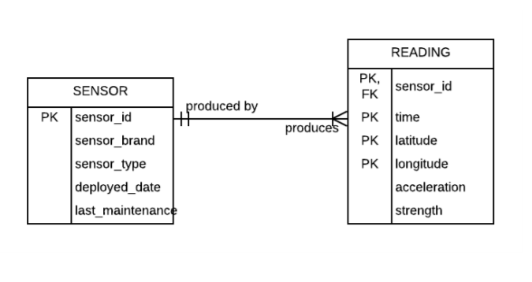
Recall - NoSQL Data Models
Document-oriented database
- MongoDB
Data Operation Characteristics
Append/ Insert only operation, no update or deletion.
Variety- The configuration and what is being read may change overtime i.e. reading information may have different attributes across time.
Large volume.
High velocity of insertion. (e.g. thousands of records per minute)
Potential issues when deployed in relational model
Schema is not stable as sensors readings change. • Need flexibility or support of variety in data model.
To produce reports that combine SENSOR and READING information requires JOIN operation. JOIN is an expensive database operation.
Notes:
NoSQL = no-SQL or Not Only SQL. Non-relational data storage systems.
NoSQL movement was probably inspired by Google’s Big Table or even Amazon’s S3.
Explosion of social media sites (Facebook, Twitter) with large data needs
NoSQL feature: shared-nothing horizontal scaling – replicating and partitioning data over many servers.
However, NoSQL does not provide ACID properties, but BASE (Basically Available, Soft state, Eventually consistent !!!)
The idea is to give up ACID to achieve much higher performance and scalability.
It is classified as a NoSQL Not Only SQL database program.
MongoDB uses JSON-like documents with schemata which is known as Binary JSON or BSOn for short.
MongoDB is developed by MongoDB Inc., and is published under a combination of the GNU Affero General Public License and the Apache License.
You all must be familiar with the concepts of relations in the databases.
In Relational databases such as oracle or mysql we have a database, database could have one or more tables and each table will have one or many rows. Each table will have a schema, They will have certain number of attributes or columns and the changing the schema is not really an easy task.
In document based database or MongoDB in our case, We have database but tables are replaced by collections and rows are replaced by documents. Schema is at document level, Each document in the collection can have same schema or different schema.

Slide 8
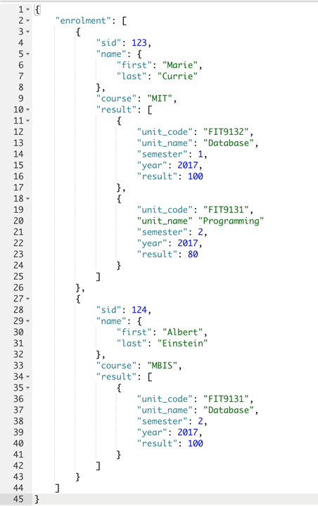
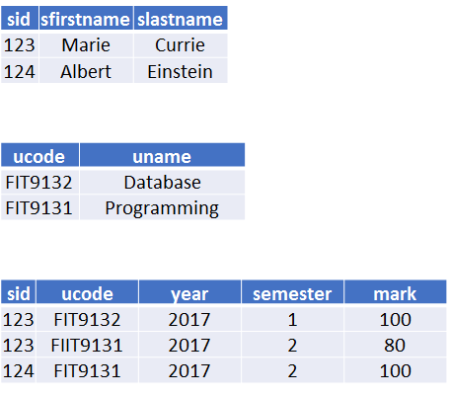
Document Oriented Database
Document Data Model (JSON Data Model)
Notes:
This is a simple example of how relational data model may be pictured in JSON or DOCument data model.
We have three tables here student, unit and enrolment. Obviously, enrolment has information on students and units.
These three tables can be represented in the JSON data modeling the following way.
Enrollment is the root which can consist of 0 or many items so it will be represented as array, [] square brackets.
Enrollment has student id, name is represented as a document {} curly braces as it can have first and last name
course is a string and result is again an array as it can have 0 to many results, [] square brackets.

Slide 9
Document Oriented Database
Document Data Model (JSON Data Model)
Terminologies
Object
Members
Pair
Value
Array
Elements
Notes:
Terminologies that are used in Document data model as objects, members, pair, value, array, elements.
In the example
The object NAME has members (two pairs).
The object ENROLMENT is an ARRAY.
The elements of this ARRAY are STUDENT objects
The object SID is a pair of a string “SID” and a value “123”.
JSON.org

Slide 10
Document Oriented Database
Document Data Model (JSON Data Model)
JSON Object VS Array
Object:
Unordered list. 无序
List 1 {a,b,c,d} = List 2 {b,c,a,d}
Accessed by its name.
Array:
Ordered list 有序
List 1 {a,b,c,d} != List 2 {b,c,a,d}
Can be accessed by its position.
JSON Data Type
String
Number
Object
Array
True
False
NULL
BSON provides more data types, eg date, integer, float.
Notes:
JSON objects are unordered lists, They are accessed by its name. That means, List 1 {a,b,c,d} = List 2 {b,c,a,d}
Array on the other hand is the ordered list. They are accessed by the position and as any other language it starts with position 0. Orders matters in arrays so List 1 {a,b,c,d} != List 2 {b,c,a,d}
Number of different types of data are allowed in JSON, strings, numbers. Objects, arrays. booleans , null but bson provides more data types such as date, float etc.

Slide 11
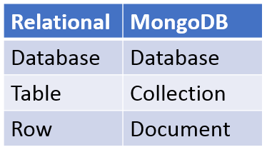
MongoDB
A free and open-source cross-platform document-oriented database.
A NoSQL database
Uses JSON-like documents (BSON - Binary JSON) with schemata.
Developed by MongoDB Inc.
Published under a combination of the GNU Affero General Public License and the Apache License.
Notes:
MongoDB is a free and open-source cross-platform document-oriented database program.
It is classified as a NoSQL Not Only SQL database program.
MongoDB uses JSON-like documents with schemata which is known as Binary JSON or BSOn for short.
MongoDB is developed by MongoDB Inc., and is published under a combination of the GNU Affero General Public License and the Apache License.
You all must be familiar with the concepts of relations in the databases.
In Relational databases such as oracle or mysql we have a database, database could have one or more tables and each table will have one or many rows. Each table will have a schema, They will have certain number of attributes or columns and the changing the schema is not really an easy task.
In document based database or MongoDB in our case, We have database but tables are replaced by collections and rows are replaced by documents. Schema is at document level, Each document in the collection can have same schema or different schema.

Slide 12
Here is why MongoDB is great
Flexible Schema. If your requirements change, you can adapt.
Unstructured data - you can store and retrieve unstructured data easily. It's just JSON. Not every document in a collection needs the same fields.
Denormalized data - Group related content in a single document.
Clean and simple API - Mongo is nice to talk to.
Notes:
So why are we learning mongodb. The first reason is flexible schema. The schema is document level so every single record can have different schema. If the requirements change and you all of a sudden need to have 15 fields added, easy to adapt.
Well, we can store and retrieve unstructured data easily using MongoDB.
Unstructured data is information that either does not have a pre-defined data model or is not organized in a pre-defined manner.
Unstructured information is typically text-heavy, but may contain data such as dates, numbers, and facts as well.
The data strcture is just JSON.
Not every document in a collection needs the same fields. Super flexible.
Denormalized data, we will learn about different modelling techniques later on. So bascically, we can group related content in a single document
Clean and simple API - Mongo is simple and easy to talk to.

Slide 13
Here is why you might not like MongoDB
Denormalized data means no joins.
Flexible schema means no built in data validation.
Bugs - Mongo is new and there are still issues in the tracker.
No transactions
Theoretical data loss
Notes:
Some of the reasons why we might not like MONGODB.
Denormalized data means no joins. If your data is highly relational, Mongo is not your baby. Your data is organised into collections. If you need data from more than collection, you need to hit the database more than once.
Flexible schema means no built in data validation. Your data is validated at the application tier. The database is dumb and will store whatever your application gives it, even junk and typos.
Bugs - Mongo is new and there are still issues in the tracker. Not bad bugs, but occasionally things don't work as you might expect.
No transactions - A SQL database allows you to bundle multiple writes into a transaction. If one write fails the whole transaction is rolled back. Mongo lacks this feature, writes are small and atomic. If you need a transaction you must build it yourself.
Theoretical data loss - Mongo scales using a technique called sharding (We don't learn anything about sharding in this unit. Its advance level mongodb lets say). It creates slaves that mirror data written to the master. If the master goes down before data is mirrored you may lose recent commits depending on your settings.
我们可能不喜欢MONGODB的一些原因。
非规范化数据意味着没有连接。如果您的数据是高度相关的，那么Mongo不是您的宝贝。您的数据被组织成集合。如果您需要来自多个集合的数据，则需要多次访问数据库。
灵活的架构意味着没有内置的数据验证。您的数据在应用程序层验证。数据库是愚蠢的，将存储您的应用程序提供的任何内容，甚至是垃圾和拼写错误。
错误 - Mongo是新的，跟踪器中仍然存在问题。不错的错误，但偶尔事情不会像你期望的那样工作。
无事务 - SQL数据库允许您将多个写入捆绑到事务中。如果一次写入失败，则回滚整个事务。 Mongo缺少这个功能，写入很小且是原子的。如果您需要交易，您必须自己构建。
理论数据丢失 - Mongo使用一种称为分片的技术进行扩展（我们在这个单元中没有学习任何关于分片的知识。它的高级mongodb可以说）。它创建了镜像写入主服务器的数据的从属服务器。如果主数据在镜像数据之前关闭，则可能会丢失最近的提交，具体取决于您的设置。

Slide 14
When should you use MongoDB
Mongo represents data as a tree. If your data is tree shaped, or can be made tree shaped, Mongo is great.
Unstructured data
Semi-structured
If you have big customer data to store, and each customer record contains lists of communications, subscriptions, etc, the data is tree shaped, and Mongo would again be a good choice.
If you have big data and you want to query it in interesting and complex ways, pulling useful aggregated data out the other side in surprisingly short timeframes, Mongo is perfect.
Notes:
Here is when you should use MONGODB.
Mongo represents data as a tree. If your data is tree shaped, or can be made tree shaped, Mongo is great.
If you have big customer data to store, and each customer record contains lists of communications, subscriptions, etc, the data is tree shaped, and Mongo would again be a good choice.
If your data is a web or a network which can't be flattened out, you likely have relational data, and Mongo is perhaps not for you this time.
If you have unstructured data to store which can be represented as a series of nested lists Mongo will make your life more enjoyable.
Say you have a webpage full of widgets, and each of those widgets can contain arbitrary information. This is a semi-structured tree and Mongo might be a very good choice.
If you have big data and you want to query it in interesting and complex ways, pulling useful aggregated data out the other side in surprisingly short timeframes, Mongo is perfect.
On the other hand, if your data looks like a web: comments, purchases, kittens, customers, sharks, exploding hats, etc, all linking to each other in a web, then you have relational data, and you may wish to stick with a relational database like Postgres, MySQL or MS SQL Server.
这是你应该使用MONGODB的时候。
Mongo将数据表示为树。如果您的数据是树形的，或者可以树形，Mongo很棒。
如果您要存储大量客户数据，并且每个客户记录包含通信，订阅等列表，则数据是树形的，Mongo将再次成为一个不错的选择。
如果您的数据是无法展示的网络或网络，您可能拥有关系数据，而Mongo可能不适合您。
如果您有要存储的非结构化数据，可以表示为一系列嵌套列表，Mongo将使您的生活更加愉快。
假设您有一个装满小部件的网页，每个小部件都可以包含任意信息。这是一个半结构化的树，Mongo可能是一个非常好的选择。
如果你有大数据并且想要以有趣和复杂的方式查询它，那么在极短的时间范围内将有用的聚合数据从另一方拉出来，Mongo是完美的。
另一方面，如果你的数据看起来像一个网站：评论，购买，小猫，客户，鲨鱼，爆炸帽等，所有在网络上相互链接，那么你有关系数据，你可能希望坚持一个关系数据库，如Postgres，MySQL或MS SQL Server。

Slide 15
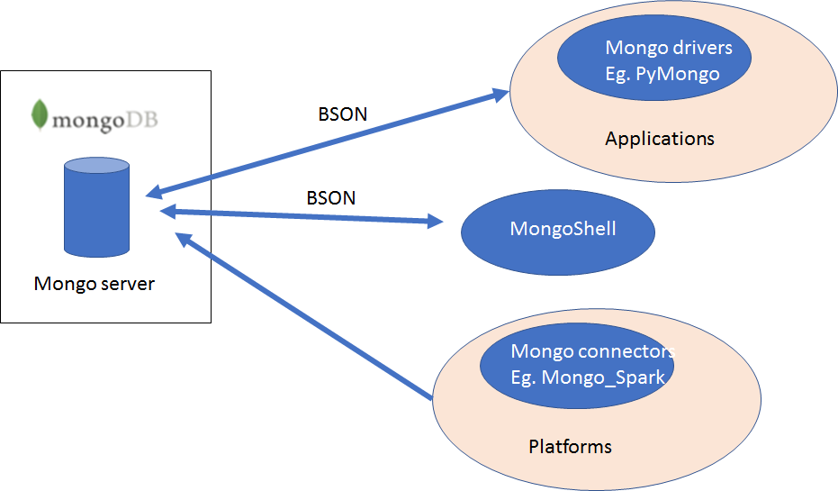
MongoDB Architecture
Notes:
This is the very basic architecture of mongodb.
Basically we have a server that can run in the terminal or run as a service. In our VM, mongdb server runs as a service at the start up.
There are three different ways we can connect to the mongodb database.
The first one is mongo shell. It's a terminal or command line type interface. Basically it is used to write mongo query directly. If you are familiar with SQL developer for Oracle, it can be considered as such from mongo db but will far less features obviously.
The second one is python mongo db connector known as pymongo. PyMongo is a Python distribution containing tools for working with MongoDB, and is the recommended way to work with MongoDB from Python.
Then we have mongo_spark that can help you connect frameworks such as apache spark directly to the mongodb.
We will learn the first two approaches in this unit.

Slide 16
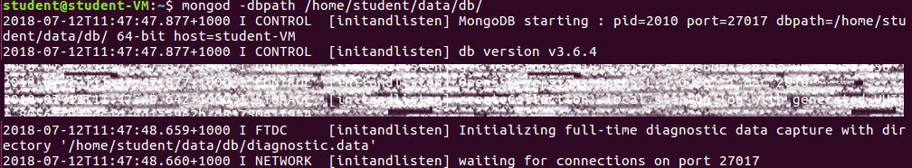
Using Mongo Import
Run the MongoDB server (you don’t need to do this in the VM)
mongod
MongoImport (do this in terminal or command line)
mongoImport
Notes:
Todays lecture is going to be more like do and learn. Hope all of you are in front of the computer and be able to do these with me. If not you can just watch how it is done.
(Open up a VM and start demonstrating the students.)
Mongod: Talk about permission errors.

Slide 17
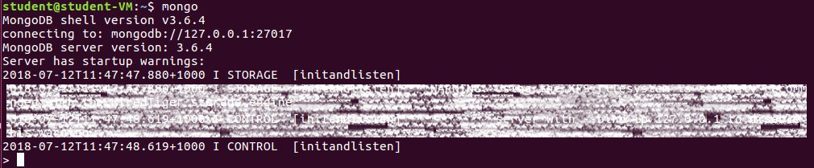
Using MongoDB Shell
Run the MongoDB server (you don’t need to do this in the VM)
mongod
Run the Mongo Shell
mongo
https://docs.mongodb.com/manual/reference/mongo-shell/
Notes:
Todays meetup is going to be more like do and learn. Hope all of you are in front of the computer and be able to do these with me. If not you can just watch how it is done.
(Open up a VM and start demonstrating the students.)
Mongod: Talk about permission errors.

Slide 18
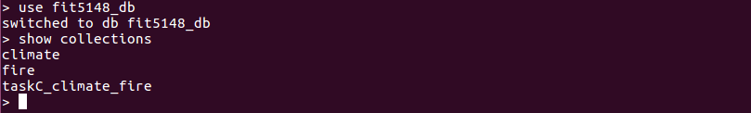
Using MongoDB Shell
List existing databases
show dbs
List existing collections
show collections

Slide 19
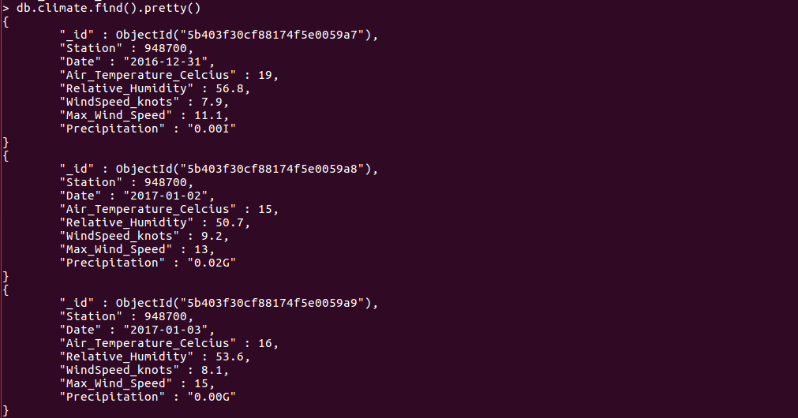
Using MongoDB Shell
List contents of a collection

Slide 20
Using MongoDB Shell
Creating a database
We can switch to a database in Mongo with the use command.
USE petshop
Dropping the database
db.dropDatabase()
Notes:
We can switch to a database in Mongo with the use command.
use petshop
This will switch to writing to the petshop database. It doesn't matter if the database doesn't exist yet. It will be brought into existence when you first write a document to it.
Show dbs
No database yet.
You can find which database you are using simply by typing db.
You can drop the current database and everything in it using db.dropDatabase.

Slide 21
Using MongoDB Shell
Collections
Collections are sets of (usually) related documents.
A database can have many collections.
Create a collection using the createCollection command.
USE petshop
db.createCollection('mammals')
View the database and collections
show dbs
show collections
Notes:
Collections are sets of (usually) related documents. Your database can have as many collections as you like.
Because Mongo has no joins, a Mongo query can pull data from only one collection at a time. You will need to take this into account when deciding how to arrange your data.
You can create a collection using the createCollection command.
USE petshop
db.createCollection('mammals')
Collections will also be created automatically. If you write a document to a collection that doesn't exist that collection will be brought into being for you.
View your databases and collections using the show command, like this:
show dbs
show collections

Slide 22
Using MongoDB Shell
Documents
Documents are JSON objects that live inside a collection.
They can be any valid JSON format, with the caveat that they can't contain functions.
The size limit for a document is 16Mb which is more than ample for most use cases.
Create a document by inserting it into a collection
Notes:
In the beginning we discussed a bit on Documents.
Documents are JSON objects that live inside a collection.
They can be any valid JSON format, with the caveat that they can't contain functions.
The size limit for a document is 16Mb which is more than enough for most use cases.
You can create a document by inserting it into a collection. Now lets see how we can insert a document into a collection.

Slide 23
Using MongoDB Shell
Documents
Insert Document (ONE)
db.mammals.insert({"name": "Polar Bear"})
db.mammals.insert({"name": "Star Nosed Mole"})
Insert Document(MANY)
db.mammals.insertMany([{"name": "Baboon"},{"name":"Opossum"}],{"ordered": false})
Inserted as a collection of array elements.
Each of the element is a document.
Notes:
Id is of type objectidentifier which is automatically inserted or added by mongodb if it is not explicitly provided.
Let's say we didn't create a collection using creatCollection Command. We directly try to insert it into the database. Lets see what happens
db.mammal.insertMany([{"name": "Baboon"},{"name":"Opossum"}],{"ordered": false})
So we didn't create the collect explicitly but it was created when we inserted the document into the collection. That is the beauty of MongoDB.

Slide 24
Using MongoDB Shell
Documents
Finding documents
We can find a document or documents matching a particular pattern using the find function.
db.mammals.find()
db.mammals.find({})
The argument for the function is a JSON document.
The return will be a single or many JSON documents.
Notes:
Finding a document
You can find a document or documents matching a particular pattern using the find function.
If you want to find all the mammals in the mammals collection, you can do this easily.
You can use find with no arguments to list documents in a collection.
db.mammals.find()
This will list all of the codes, 20 at a time.
You can get the same result by passing an empty object, like so:
db.mammals.find({})
The argument for the function is a JSON document.
The return will be a single or many JSON documents.

Slide 25
Using MongoDB Shell
Documents
Finding documents
Find a document by id
db.mammals.find({ObjectId("557afc91c0b20703009f")})
Finding by partial match
db.mammals.find({"name": "Polar Bear"})
db.people.find({"name": "dave","email": "davey@aol.com"})
db.people.find({"name": "dave","age": 69, "email": "davey@aol.com"})
Notes:
Mongo comes with a set of convenience functions for performing common operations. Find is one such function. It allows us to find documents by providing a partial match, or an expression.
Uses
You can use find function to:
Find a document by id:
Assuming you know the object ID of a document. You can pull that document by id like so: db.mammals.find({ObjectId("557afc91c0b20703009f7e")}).
The _id field of any collection is automatically indexed. IDs are 12 byte BSON objects, not Strings which is why we need the ObjectId function.
Finding by partial match
Say you have a list of users and you want to find by name, you might do: db.people.find({name: "dave"})
You can match on more than one field:
db.people.find({
name: "dave", email: "davey@aol.com"})
You can match on numbers:
db.people.find({ name: "dave", age: 69, email: "davey@aol.com" })
Limitations
Well the limitations of find are
You can't use find to chain complex operators. You can do a few simple things like counting, but if you want to real power you need the aggregate pipeline, which is actually not at all scary and is quite easy to use.
The Aggregate pipeline allows us to chain operations together and pipe a set of documents from one operation to the next.

Slide 26
Using MongoDB shell
Documents
Finding Nested documents
Find people with the last name Morgan.
db.people.find({“name.last”: “Morgan”})
Operators - comparison
Find people with age more than 20
db.people.find({“age”: {“$gt”: 20}})
Find people with height less than 175 cms and age more than 20
db.people.find({“height”:{“$lt”:175}, “age”: {“$gt”: 20}})
http://docs.mongodb.org/manual/reference/operator/query/
Notes:
Finding Nested documents
Nested documents can be searched using dot notation.
ind people with the last name Morgan.
We can use operators like this:
$gt - Greater than
$lt - Less than
$exists - The field exists
You can see the full list of operations in the link

Slide 27
Using MongoDB shell
Documents
Querying Missing or NULL fields
Value of null
Find people who have null value as their age
db.people.find({“age”: null})
$exists
Find people without any age.
db.people.find({“age”: {“$exists”:false}})

Slide 28
Using MongoDB shell
Documents
Searching Text
MongoDB uses PCRE(PERL Compatible Regular Expression)
Find people whose surname starts with letter “B”.
db.people.find({“name.last”: {“$regex”: “^B”}})
Limiting Fields in the Query Output
Find people whose age is 25 and display only their last name.
db.people.find({“age”:25},{“name.last”:1, “_id”:0})
Limiting number of documents returned.
Find 10 people whose age is 25.
db.people.find({“age”:25}).limit(10)
Notes:
Find pets whose name starts with H?
db.pets.find({"name": {"$regex": "^H"}})
1 represents display 0 represents no display. In case of id only 0 works.
db.pets.find({"name": {"$regex": "^H"}},{"_id":0})
If you try other fields it wont work
db.pets.find({"name": {"$regex": "^H"}},{"name": 0, "species": 1})
Error: error: {
"ok" : 0,
"errmsg" : "Projection cannot have a mix of inclusion and exclusion.",
"code" : 2,
"codeName" : "BadValue"
}
db.pets.find({"name": {"$regex": "^H"}},{"species": 1})
db.pets.find({"name": {"$regex": "^H"}},{"species": 1,"_id":0})

Slide 29
Using MongoDB shell
Documents
Finding documents
Exercise: Paste the following into your terminal to create a petshop with some pets in it.
use petshop
db.pets.insertMany([{name: "Mikey", species: "Gerbil"},
{name: "Davey Bungooligan", species: "Piranha"},
{name: "Suzy B", species: "Cat"},
{name: "Mikey", species: "Hotdog"},
{name: "Terrence", species: "Sausagedog"},
{name: "Philomena Jones", species: "Cat"}])

Slide 30
Using MongoDB shell
Documents
Finding documents (Flux Exercise)
Tasks:
Add another piranha, and a naked mole rat called Henry.
Use find to list all the pets.
Find the ID of Mikey the Gerbil.
Find all the gerbils.
Find all the creatures named Mikey.
Find all the creatures named Mikey who are gerbils.
Find all the creatures with the string "dog" in their species.
Notes:
db.pets.insertMany([{"name": "Henry", "species": "piranha"}, {"name": "Henry", "species": "Naked Mole Rat"}])
db.pets.find({"name":"Mikey","species":"Gerbil"})
{ "_id" : ObjectId("5ba1dc907d594c3d55ce62bf"), "name" : "Mikey", "species" : "Gerbil" }
db.pets.find({"species":"Gerbil"})
> db.pets.find({"name":"Mikey"})
You can use regular expression to do these kind of searches as follows
db.pets.find({"species": /dog/})

Slide 31
References
http://nicholasjohnson.com/mongo/course/workbook/
https://docs.mongodb.com/manual/crud/#read-operations
https://docs.mongodb.com/manual/reference/operator/query/

