Slide 1
MONASH INFORMATION
TECHNOLOGY
FIT5148 - Distributed Databases and Big Data
Week 07 - Document Database (MongoDB)
Notes:
http://nicholasjohnson.com/mongo/course/workbook/
Welcome to FIT5148 Distributed databasesz and bigdata.
For last 3 weeks we worked on handling volume side of big data and learnt how to write parallel algorithms.
This week we move on to the variety side of things.
We will learn about mongodb and how it can handle unstructured data.

Slide 2
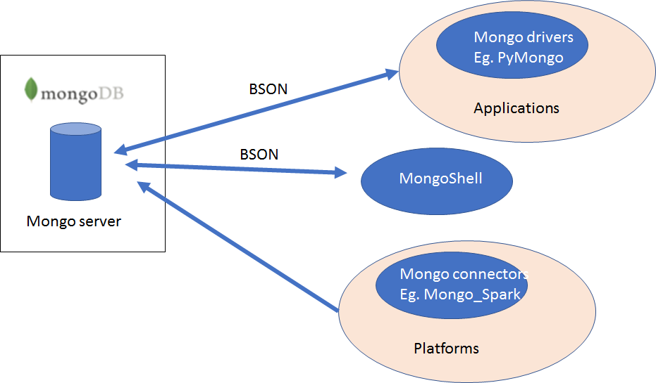
MongoDB Architecture
Notes:
This is the very basic architecture of mongodb.
Basically we have a server that can run in the terminal or run as a service. In our VM, mongdb server runs as a service at the start up.
There are three different ways we can connect to the mongodb database.
The first one is mongo shell. It's a terminal or command line type interface. Basically it is used to write mongo query directly. If you are familiar with SQL developer for Oracle, it can be considered as such from mongo db but will far less features obviously.
The second one is python mongo db connector known as pymongo. PyMongo is a Python distribution containing tools for working with MongoDB, and is the recommended way to work with MongoDB from Python.
Then we have mongo_spark that can help you connect frameworks such as apache spark directly to the mongodb.
We will learn the first two approaches in this unit.

Slide 3
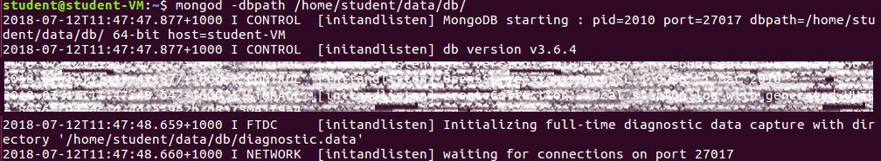
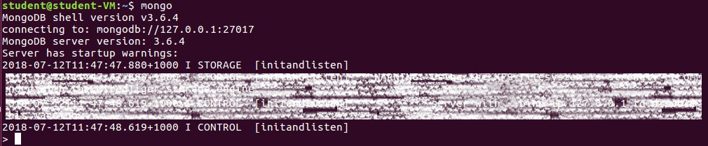
Using MongoDB Shell
Run the MongoDB server (you don’t need to do this in the VM)
mongod
Run the Mongo Shell
mongo
https://docs.mongodb.com/manual/reference/mongo-shell/
Notes:
Todays meetup is going to be more like do and learn. Hope all of you are in front of the computer and be able to do these with me. If not you can just watch how it is done.
(Open up a VM and start demonstrating the students.)
Mongod: Talk about permission errors.

Slide 4
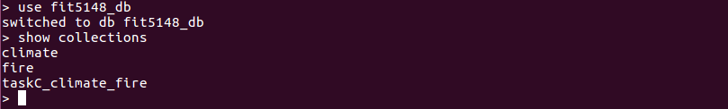
Using MongoDB Shell
List existing databases
show dbs
List existing collections
show collections

Slide 5
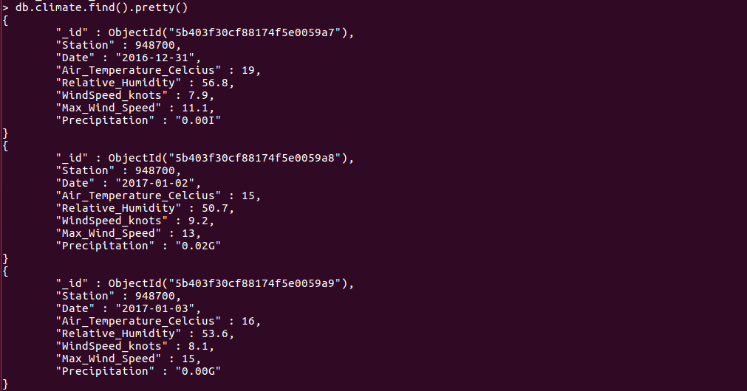
Using MongoDB Shell
List contents of a collection

Slide 6
Using MongoDB shell
Documents
Finding Documents
Querying an array
Exercise 1 (FLUX Quiz)
- How many evaluation gave a score of 9 to the content?
db.evaluation.find({
“results.item”:”content”,
“result.score”:9
}.count()
- A. 1
- B. 2
- C. 3
- D. 4
Notes:
How many evaluation gave a score of 9 to the content?
The answer for the query is 4, According to the collection, the correct answer is 2. Why?

Slide 7
Using MongoDB shell
Documents
Finding Documents
Querying an array
$elemMatch
Forcing query conditions to be evaluated against a single element.
How many evaluation gave a score of 9 to the content?
db.evaluation.find(
{
“results”:{
$elemMatch:{“item”:”content”, “score”:9}
}
}).count()
Notes:
How many evaluation gave a score of 9 to the content?
The answer for the query is 4, According to the collection, the correct answer is 2. Why?

Slide 8
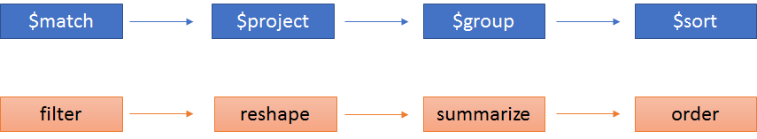
Using MongoDB shell
Documents
Aggregation
Processing a group of documents.
Aggregated values e.g. sum, count, average
Reshaping document during analysis.
Aggregation Pipeline Example
Notes:
Aggregation operations process data records and return computed results.
Aggregation operations group values from multiple documents together, and can perform a variety of operations on the grouped data to return a single result.
MongoDB provides three ways to perform aggregation: the aggregation pipeline, the map-reduce function, and single purpose aggregation methods.
We will be talking about aggregation pipeline more:
MongoDB’s aggregation framework is modeled on the concept of data processing pipelines.
Documents enter a multi-stage pipeline that transforms the documents into an aggregated result.
The most basic pipeline stages provide filters that operate like queries and document transformations that modify the form of the output document.
Other pipeline operations provide tools for grouping and sorting documents by specific field or fields as well as tools for aggregating the contents of arrays, including arrays of documents.
In addition, pipeline stages can use operators for tasks such as calculating the average or concatenating a string.
The pipeline provides efficient data aggregation using native operations within MongoDB, and is the preferred method for data aggregation in MongoDB.

Slide 9
Using MongoDB shell
Documents
Aggregation
Processing a group of documents.
Aggregated values e.g. sum, count, average
Reshaping document during analysis.
Aggregation Pipeline Example
Notes:
Aggregation operations process data records and return computed results.
Aggregation operations group values from multiple documents together, and can perform a variety of operations on the grouped data to return a single result.
MongoDB provides three ways to perform aggregation: the aggregation pipeline, the map-reduce function, and single purpose aggregation methods.
We will be talking about aggregation pipeline more:
MongoDB’s aggregation framework is modeled on the concept of data processing pipelines.
Documents enter a multi-stage pipeline that transforms the documents into an aggregated result.
The most basic pipeline stages provide filters that operate like queries and document transformations that modify the form of the output document.
Other pipeline operations provide tools for grouping and sorting documents by specific field or fields as well as tools for aggregating the contents of arrays, including arrays of documents.
In addition, pipeline stages can use operators for tasks such as calculating the average or concatenating a string.
The pipeline provides efficient data aggregation using native operations within MongoDB, and is the preferred method for data aggregation in MongoDB.

Slide 10
Using MongoDB shell
Documents
Aggregation
Exercise: Try this in the pets collection.
db.pets.aggregate([{"$group":{"_id":"$species", "total": {"$sum":1}}}])
Aggregating Array Elements
Need to change array elements into an object of a document using $unwind.
db.evaluation.aggregate([
{$unwind:"$results"},
{$group:{_id:"$results.item",average:{$avg:"$results.score"}}},
{$sort:{average : 1}}])
Notes:
db.pets.aggregate([{"$group":{"_id":"$species", "total": {"$sum":1}}}])
To count the pets with same name
db.pets.aggregate([{"$group":{"_id":"$name", "total": {"$sum":1}}}])
{ "_id" : "Philomena Jones", "total" : 1 }
{ "_id" : "Mikey", "total" : 2 }
{ "_id" : "Suzy B", "total" : 1 }
{ "_id" : "Terrence", "total" : 1 }
{ "_id" : "Henry", "total" : 2 }
{ "_id" : "Davey Bungooligan", "total" : 1 }
To aggregate an array element, we need to change the array elements into an object of a document using $unwind operator
Unwind operation Deconstructs an array field from the input documents to output a document for each element. Each output document is the input document with the value of the array field replaced by the element.
For the sake of demostration of unwind operation lets say we have follow pet
db.pet.insert({"name":"Timba", "results":[{"score": 10},{"score":11}]})
db.pet.find()
db.pet.aggregate([{"$unwind":"$results"}])

Slide 11
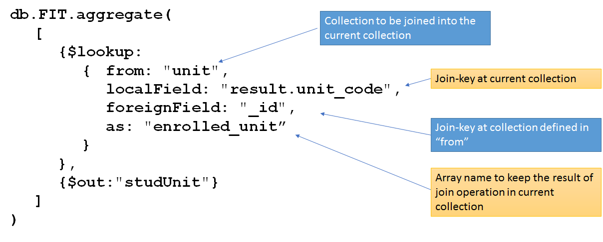
JOIN Using Aggregation
Notes:
Joins using aggregation.
Well if you want to use MongoDB db we should design it so that we do not need join. But in case we need it we can use lookup operator in aggregation pipeline,
Lookup performs a left outer join to a collection in the same database to filter in documents from the “joined” collection for processing.
To each input document, the $lookup stage adds a new array field whose elements are the matching documents from the “joined” collection.
The $lookup stage passes these reshaped documents to the next stage.

Slide 12
JOIN Using Aggregation
Try this:
db.orders.insert([
{ "_id" : 1, "item" : "almonds", "price" : 12, "quantity" : 2 },
{ "_id" : 2, "item" : "pecans", "price" : 20, "quantity" : 1 },
{ "_id" : 3 }])
db.inventory.insert([
{ "_id" : 1, "sku" : "almonds", description: "product 1", "instock" : 120 },
{ "_id" : 2, "sku" : "bread", description: "product 2", "instock" : 80 },
{ "_id" : 3, "sku" : "cashews", description: "product 3", "instock" : 60 },
{ "_id" : 4, "sku" : "pecans", description: "product 4", "instock" : 70 },
{ "_id" : 5, "sku": null, description: "Incomplete" },
{ "_id" : 6 }])

Slide 13
JOIN Using Aggregation
Try this:
db.orders.aggregate([
{
$lookup:
{
from: "inventory",
localField: "item",
foreignField: "sku",
as: "inventory_docs"
}
}
])
https://docs.mongodb.com/manual/reference/operator/aggregation/lookup/
Notes:
The matching items have been embedded as array.

Slide 14
Using MongoDB shell
Exercise 2 (FLUX Quiz)
We have learnt that $lookup operator is used joins two collections in MongoDB. What kind of join is it?
- A. Inner Join
- B. Theta Join
- C. Left outer Join
- D. Right outer Join
Notes:
How many evaluation gave a score of 9 to the content?
The answer for the query is 4, According to the collection, the correct answer is 2. Why?

Slide 15
Using MongoDB shell
Documents
Update
db.collection.updateOne(<filter>, <update>, <options>)
db.collection.updateMany(<filter>, <update>, <options>)
db.collection.replaceOne(<filter>, <replacement>, <options>)
Examples
db.pets.updateOne({“name”: “Mikey”},{“$set”:{“species”: “Cat”}})
db.pets.updateMany({“species”: “Cat”},{“$set”:{“species”: “Dog”}})
db.pets.replaceOne({“name”: “Mikey”},
{“name”: “Mikey”, “species”: “Cat”, “age”: 2})
Notes:
If we want to update the documents we have three different options. Update one, update many and replaceOne.
Update one updates one document, Update many can update multiple documents matching the criteria whereas
Replace one can be used to change the entire document structure.
Please note that we do not have replace many option available.
Do the example

Slide 16
Using MongoDB shell
Documents
Delete
db.collection.deleteMany()
db.collection.deleteOne()
db.collection.drop()
Examples
db.pets.deleteOne({“name”: “Mikey”})
db.pets.deleteMany({“species”: “Dog”})
db.pets.drop()
Notes:
If we want to delete the documents from the collections we can use delete one or delete many. Deleteone deletes only one whereas delete many deletes all documents that matches the criteria.
You can drop the entire colletion using db.<collection name>.drop()

Slide 17
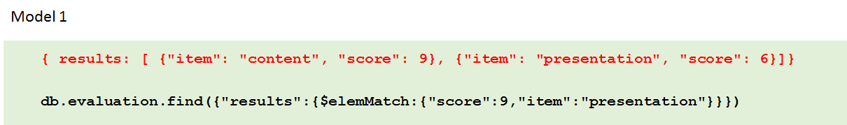
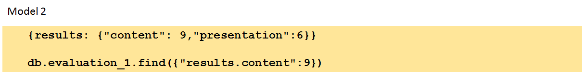
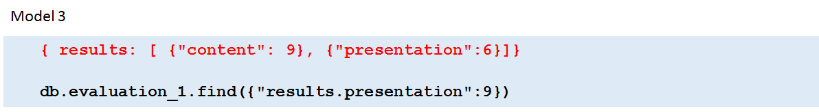
Data Model
Modelling Documents
Notes:
To model the documents we have three different ways in mongoDB.
Let's consider results array for enrollment collection.Result can have particular item and score for that item which can be stored as Model 1.
In this case to search the result you will need to use an operator called element match elemmatch operator.
We are storing key field that is more or less redundant. We can achieve the same functionality using Model 2 or three
So in general, it is more common to omit the field or key.
Think from the perspective of space savings. The size of the document is 16 mb for MongoDB and if we save a lot of redundancies like this Space could be a problem so using model 2 or 3 we Save space for very big data set.
In terms of space savings, Model 2 and 3 are not much different and the choice of model 2 or 3 is completely upon the designers preference.

Slide 18
Data Model
Modelling Relationships
Redundancy may exist, data typically is not normalised.
Connecting two or more documents.
Embedding.
Referencing
There is no JOIN operator.
Join can be performed using:
$lookup in aggregate => outer join
Embedded document structure
Application code
Notes:
For many use cases in MongoDB, the denormalized data model where related data is stored within a single document will be optimal. This is know as embedded data model.
In some cases, it makes sense to store related information in separate documents, typically in different collections or databases.
For those cases we have different document referencing style know as referencing model.
I will give you and example of these in the coming slides.
MongoDB does not have the join operator as SQL databases, however since most of the people coming from SQL background will have hard time to wrap their head around the concepts of no Join, mONGO DB now support left outer join using $lookup operator in aggregation pipeline.

Slide 19
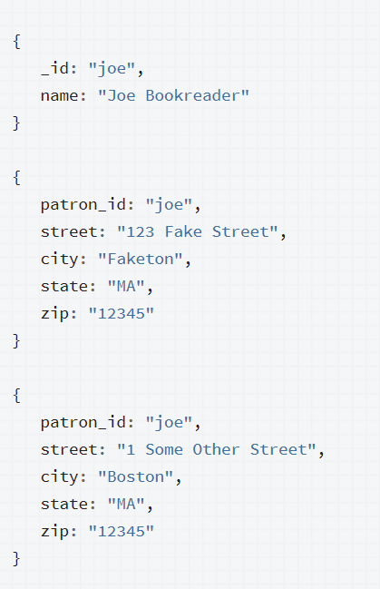
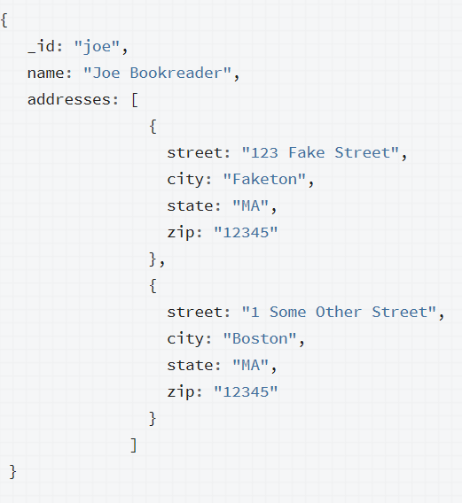
Data Model
Modelling One to Many Relationships
Embedding Documents
Notes:
Now lets have a look at what is embedding model in Mongodb.
Consider the following example that maps patron and multiple address relationships. The example illustrates the advantage of embedding over referencing if you need to view many data entities in context of another. In this one-to-many relationship between patron and address data, the patron has multiple address entities.
In the normalized data model, the address documents contain a reference to the patron document like the one on the left hand side. Id joe is repeated in the two documents.
If your application frequently retrieves the address data with the name information, then your application needs to issue multiple queries to resolve the references.
A more optimal schema would be to embed the address data entities in the patron data, the model on your right hand side where all addresses belonging to joe is kept inside an array.
Advantage:
With the embedded data model, your application can retrieve the complete patron information with one query.
Disadvantage:
If address grows bigger we can exceed the space limitation.
So we need to be very careful while designing the model.

Slide 20
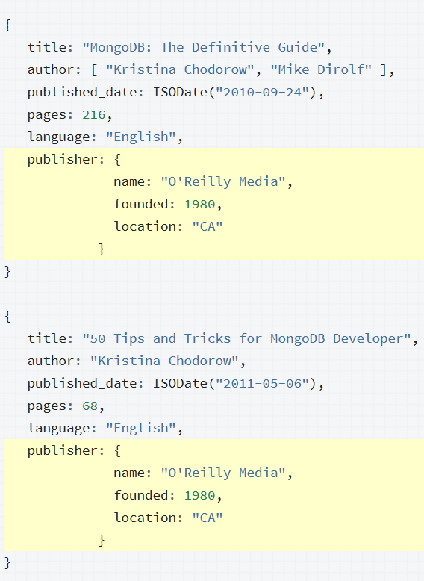
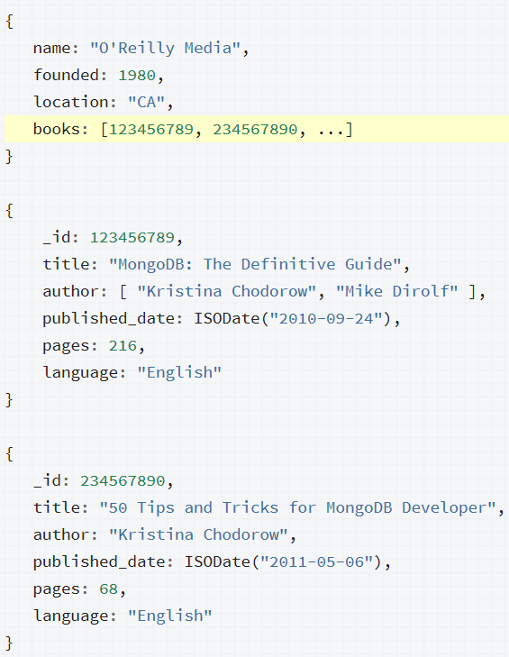
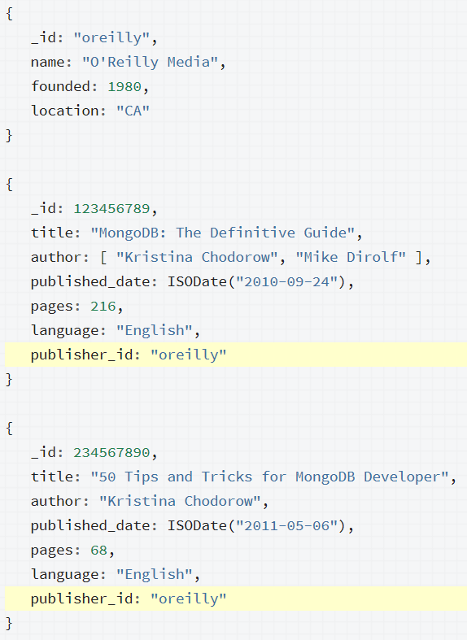
Data Model
Modelling One to Many Relationships
Referencing Documents
Do this
Or this
Notes:
Consider the following example that maps publisher and book relationships.
The example illustrates the advantage of referencing over embedding to avoid repetition of the publisher information.
Embedding the publisher document inside the book document would lead to repetition of the publisher data, as the one in the left hand side (Show in the pic).
To avoid repetition of the publisher data, we can use references and keep the publisher information in a separate collection from the book collection.
When using references, the growth of the relationships determine where to store the reference.
If the number of books per publisher is small with limited growth, storing the book reference inside the publisher document may sometimes be useful.
Otherwise, if the number of books per publisher is unbounded, this data model would lead to mutable, growing arrays, as in example in the middle (show in the pic the growing array):
To avoid mutable, growing arrays, store the publisher reference inside the book document as in the pic on the right hand side (show in the pic):
So kind of general rule:
If One to SOME documents
We can Embed the ”some” documents in the “one” document.
If One to LARGE number of documents (eg thousands)
Use array to keep reference key of the many side. (child referencing)
We need to Make sure array is not too big.
If One to VERY LARGE number of documents (eg millions)
We need to Keep the reference key as a pair of (key,value)
And the reference key of the one side in the many side (parent referencing)

Slide 21
MongoDB Architecture
Notes:
We are more or less done with mongo db shell.
Now we will briefly look into pymongo and applications.
For this we will require mongod service running so that our application can connect to the database.

Slide 22
Connecting MongoDB and Python
Use PyMongo driver from a python application.
Import the library. import pymongo
from pymongo import MongoClient
Make connection to the server
Client = MongoClient() => using default host and port
Client = MongoClient(‘localhost’,27017) => explicitly specify host and port
Client = MongoClient(’mongodb://localhost:27017/’) => using URI to specify host and port
Make a connection to the database.
db = client.FIT5148
Make connection to the collection.
coll = db.FIT
Notes:
We will now write the code in jupyter notebook and connect to the database
#Write this in the first cell
import pymongo
from pymongo import MongoClient
from pprint import pprint
client = MongoClient()
db = client.petshop
coll = db.pets
cursor = coll.find({})
for doc in cursor:
pprint(doc)
#Write this in the second cell
new_pets = [{"name":"Trudi", "species":"cat"},{"name":"John", "species":"Bulldog"}]
coll.insert_many(new_pets)
cursor = coll.find({"name":"John"})
for doc in cursor:
pprint(doc)

Slide 23
Python with MongoDB Code Example
import pymongo
from pymongo import MongoClient
from pprint import pprint
client = MongoClient()
db = client.FIT5148
collEval = db.evaluation
evals = [
{"results":[{"item": "content","score": 9},{"item": "presentation","score": 6}]},
{ "results":[{"item": "content","score": 8},{"item": "presentation","score": 8}]}
]
db.collEval.insert_many(evals) #using insert_many rather than insertMany().
cursor = collEval.find({})
for document in cursor:
pprint(document)

Slide 24
References
http://nicholasjohnson.com/mongo/course/workbook/
https://docs.mongodb.com/manual/aggregation/
https://www.mongodb.com/blog/post/6-rules-of-thumb-for-mongodb-schema-design-part-1
https://www.mongodb.com/blog/post/6-rules-of-thumb-for-mongodb-schema-design-part-2
https://www.mongodb.com/blog/post/6-rules-of-thumb-for-mongodb-schema-design-part-3
https://docs.mongodb.com/manual/crud/#read-operations
https://docs.mongodb.com/manual/reference/operator/query/

