Slide 1
FIT5148 (Volume III - Join)
Week 3b – Parallel Outer Join

Slide 2
Join Queries
Two types of Join Queries
Inner Join
Select R.x, R.a, S.y, S.b
From R, S
Where R.a = S.b;
Outer Join
Select R.x, R.a, S.y, S.b
From R left outer join S on R.a = S.b;

Slide 3
Join Queries
R
S
Results
x | a
0 | 1
1 | 2
2 | 3
y | b
0 | 6
0 | 4
3 | 1
6 | 2
1 | 6
4 | 2
7 | 2
7 | 1
2 | 1
5 | 5
5 | 6
8 | 9
x | a | y | b
0 | 1 | 3 | 1
0 | 1 | 7 | 1
0 | 1 | 2 | 1
1 | 2 | 6 | 2
1 | 2 | 4 | 2
1 | 2 | 7 | 2
Inner Join
Select R.x, R.a, S.y, S.b
From R, S
Where R.a = S.b;

Slide 4
Join Queries
R
S
Results
x | a
0 | 1
1 | 2
2 | 3
y | b
0 | 6
0 | 4
3 | 1
6 | 2
1 | 6
4 | 2
7 | 2
7 | 1
2 | 1
5 | 5
5 | 6
8 | 9
x | a | y | b
0 | 1 | 3 | 1
0 | 1 | 7 | 1
0 | 1 | 2 | 1
1 | 2 | 6 | 2
1 | 2 | 4 | 2
1 | 2 | 7 | 2
2 | 3 | Null | Null
Outer Join
Select R.x, R.a, S.y, S.b
From R left outer join S
On R.a = S.b;

Slide 5
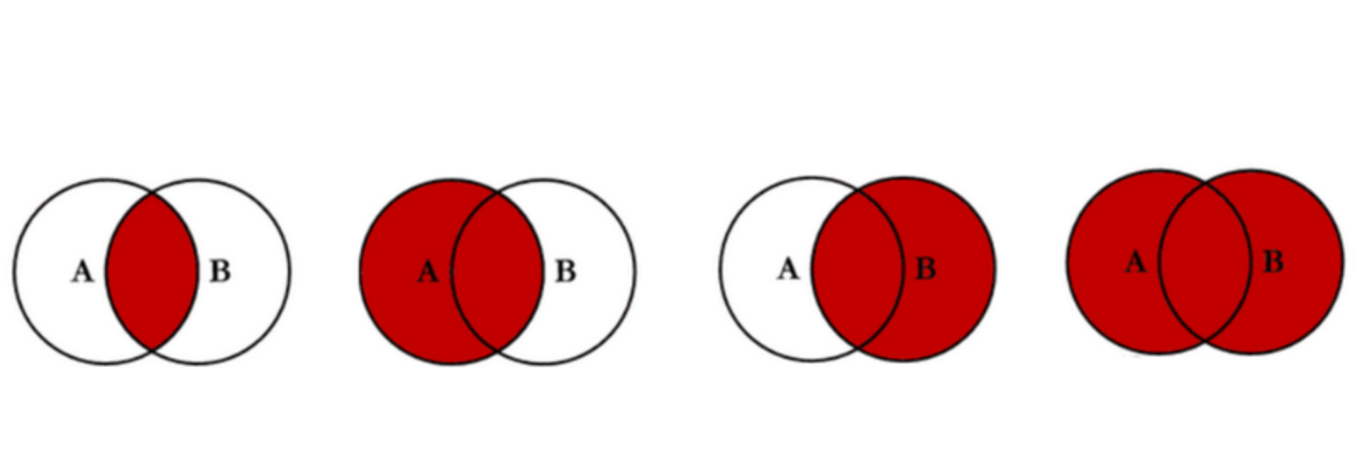
Exercise 1
Identify the LEFT OUTER JOIN?

Slide 6

https://www.codeproject.com/Articles/33052/Visual-Representation-of-SQL-Joins

Slide 7
Parallel Join Query Processing
Parallel Inner Join components
Data Partitioning
Divide and Broadcast
Disjoint Partitioning
Local Join
Nested-Loop Join
Sort-Merge Join
Hash Join
Example of a Parallel Inner Join Algorithm
Divide and Broadcast, plus Hash Join

Slide 8
Parallel Join Query Processing
Parallel Outer Join processing methods
ROJA (Redistribution Outer Join Algorithm)再分配外连接算法
DOJA (Duplication Outer Join Algorithm)复制外连接算法
DER (Duplication & Efficient Redistribution)重复和高效的再分配
Load Balancing
OJSO (Outer Join Skew Optimization)

Slide 9
1. ROJA
SELECT R.x, R.a, S.y, S.b
FROM R left outer join S on R.a = S.b
R |  |  | S
x | a |  | y | b
R |  |  | S
x | a |  | y | b
R |  |  | S
x | a |  | y | b
0
N
6
1
6
2
3
2
1
1
0
N
2
1
0
4
4
2
5
5
3
1
7
2
5
6
6
2
7
1
8
9
Processor 1
Processor 2
Processor 3
Notes:
Step 1 (Distribution): Reshuffled the initial placement based on the join attribute
Step 2 (Local Outer Join): Each processor performs an outer join
Advantage: fast performance; only 2 steps
Drawback: In the Distribution step, there is data skew problem

Slide 10
2. DOJA
SELECT R.x, R.a, S.y, S.b
FROM R left outer join S on R.a = S.b
R |  |  | S
x | a |  | y | b
R |  |  | S
x | a |  | y | b
R |  |  | S
x | a |  | y | b
0
1
0
6
1
2
1
6
2
3
2
1
1
2
0
4
0
1
4
2
1
2
5
5
2
3
3
1
2
3
7
2
0
5
6
1
2
1
6
2
7
1
8
9
Processor 1
Processor 2
Processor 3
Notes:
Step 1 (Replication): Duplicate the small table (table R)
Step 2 (Local Inner Join): Perform inner join in each processor
Step 3 (Distribution): Reshuffle the temp result based on R.x
步骤1（复制）：复制小表（表R）
步骤2（本地内部联接）：在每个处理器中执行内部联接
步骤3（分配）：根据R.x重新洗牌临时结果

Slide 11
2. DOJA
SELECT R.x, R.a, S.y, S.b
FROM R left outer join S on R.a = S.b
R
J
R
J
R
J
x
a
x
a
y
b
x
a
x
a
y
b
x
a
x
a
y
b
0
1
0
1
3
1
1
2
1
2
6
2
2
3
N
N
0
1
7
1
1
2
4
2
0
1
2
1
1
2
7
2
Processor 1
Processor 2
Processor 3
Notes:
Step 4 (Local Outer Join): Perform outer join between the initial table R and the temp join
Drawback:
In the Replication step, if the table is large, the replication cost is expensive.
In the Distribution step, there might be a data skew problem, similar to ROJA
步骤4（本地外部联接）：在初始表R和临时联接之间执行外部联接
缺点：
在“复制”步骤中，如果表很大，则复制成本很高。
在分发步骤中，可能存在数据偏差问题，类似于ROJA

Slide 12
3. DER
SELECT R.x, R.a, S.y, S.b
FROM R left outer join S on R.a = S.b
Row ID
R |  |  | S
x | a |  | y | b
Row ID
R |  |  | S
x | a |  | y | b
Row ID
R |  |  | S
x | a |  | y | b
0
0
1
0
6
0
0
1
1
6
0
0
1
2
1
N
1
1
2
0
4
1
1
2
4
2
1
1
2
5
5
1
2
2
2
3
3
1
2
2
3
7
2
2
2
3
5
6
6
2
7
1
8
9
Processor 1
Processor 2
Processor 3
Notes:
Step 1: Same as DOJA, inner join
Step 2: Select the row ID of table R that DOES NOT match
Step 3: Reshuffle the row ID
Step 4: Store the Row ID that appears as many times as the number of processor in a temporary table
第1步：与DOJA相同，内连接
步骤2：选择不匹配的表R的行ID
第3步：重新洗牌行ID
步骤4：将出现的行ID存储为临时表中处理器数量的多倍

Slide 13
3. DER
SELECT R.x, R.a, S.y, S.b
FROM R left outer join S on R.a = S.b
R
Row ID
R
Row ID
R
Row ID
x
a
x
a
x
a
x
a
y
b
x
a
y
b
x
a
y
b
0
1
1
2
2
3
2
0
1
3
1
0
1
7
1
0
1
2
1
1
2
6
2
1
2
4
2
x
a
y
b
1
2
7
2
2
3
N
N
Processor 1
Processor 2
Processor 3
Notes:
Step 5: Inner Join the row ID and table R
Advantage: It redistributes row ID (the dangling row ID), so it is not costly (compared to redistributing the actual dangling records).
步骤5：内部加入行ID和表R.
优点：它重新分配行ID（悬空行ID），因此成本不高（与重新分配实际的悬空记录相比）。

Slide 14
Parallel Join Query Processing
Parallel Outer Join processing methods
ROJA (Redistribution Outer Join Algorithm)
DOJA (Duplication Outer Join Algorithm)
DER (Duplication & Efficient Redistribution)
Load Balancing
OJSO (Outer Join Skew Optimization)

Slide 15
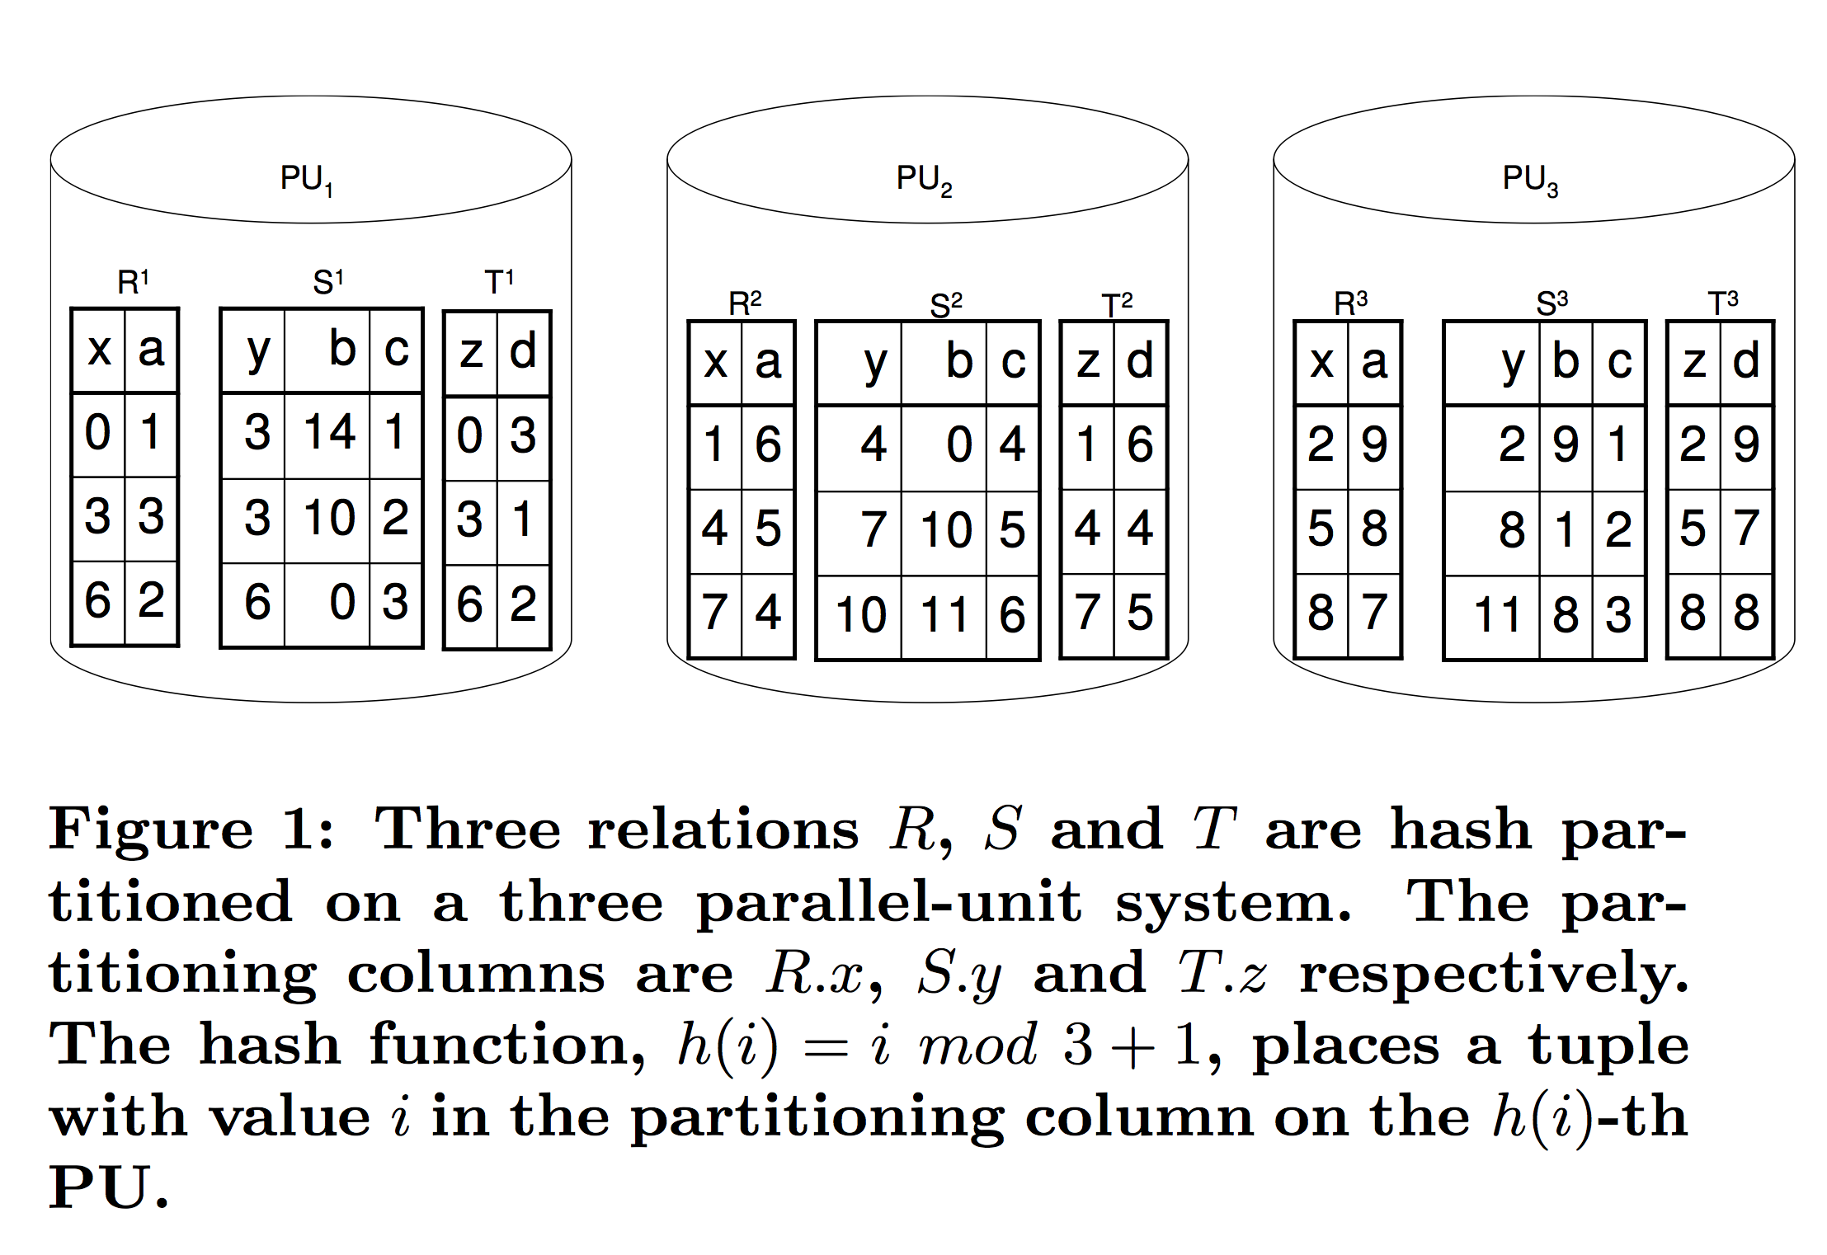
Another example…
Select x, y, z, a, c
From R left outer join S on R.a=S.b
left outer join T on S.c=T.d;
Initial Data Placement

Slide 16
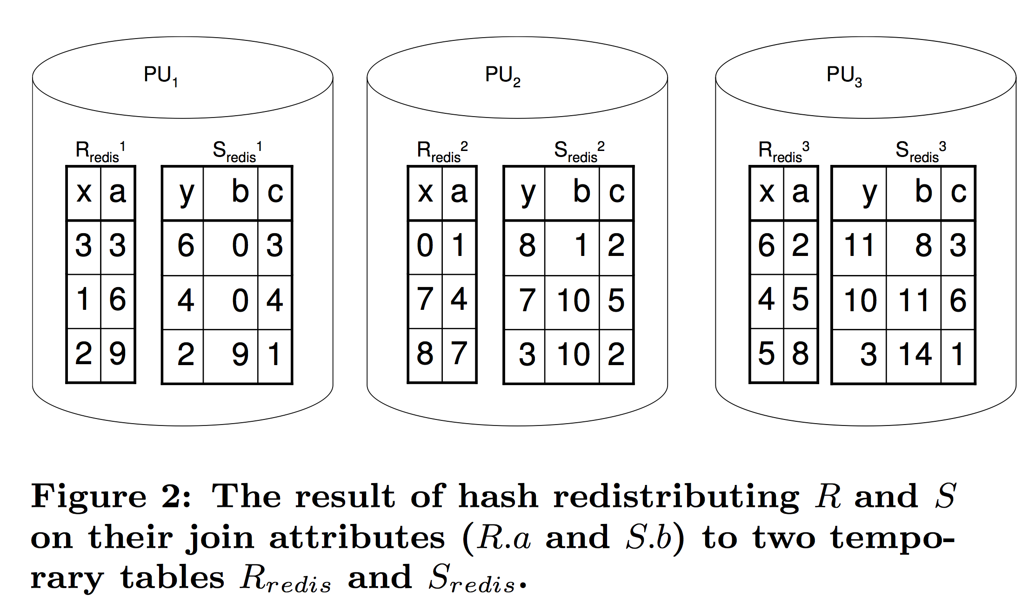
Another example…
Step 1: Redistribution of R and S (why do we need to redistribute?)

Slide 17
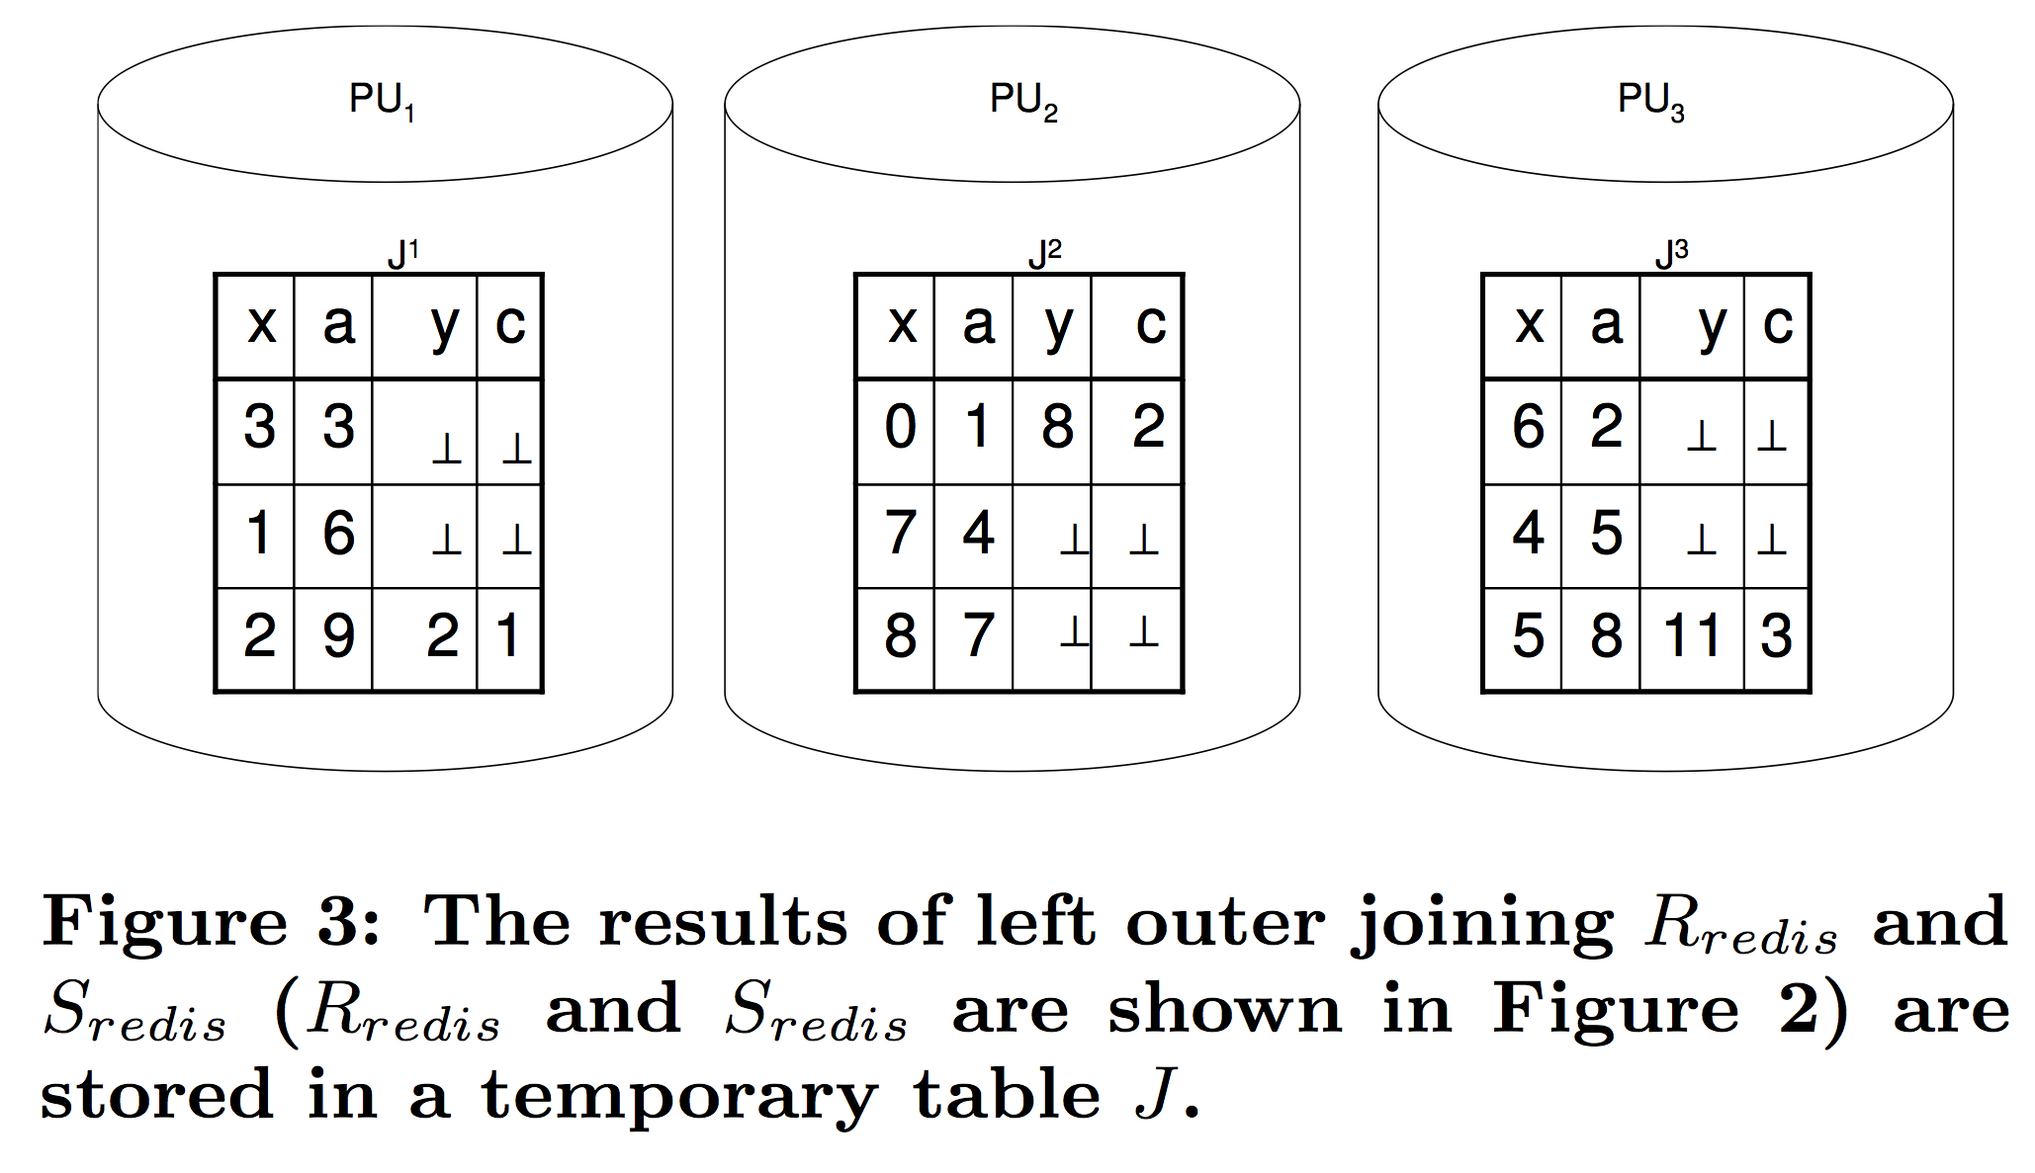
Another example…
Step 2: (a) Outer Join R and S, and store in J

Slide 18
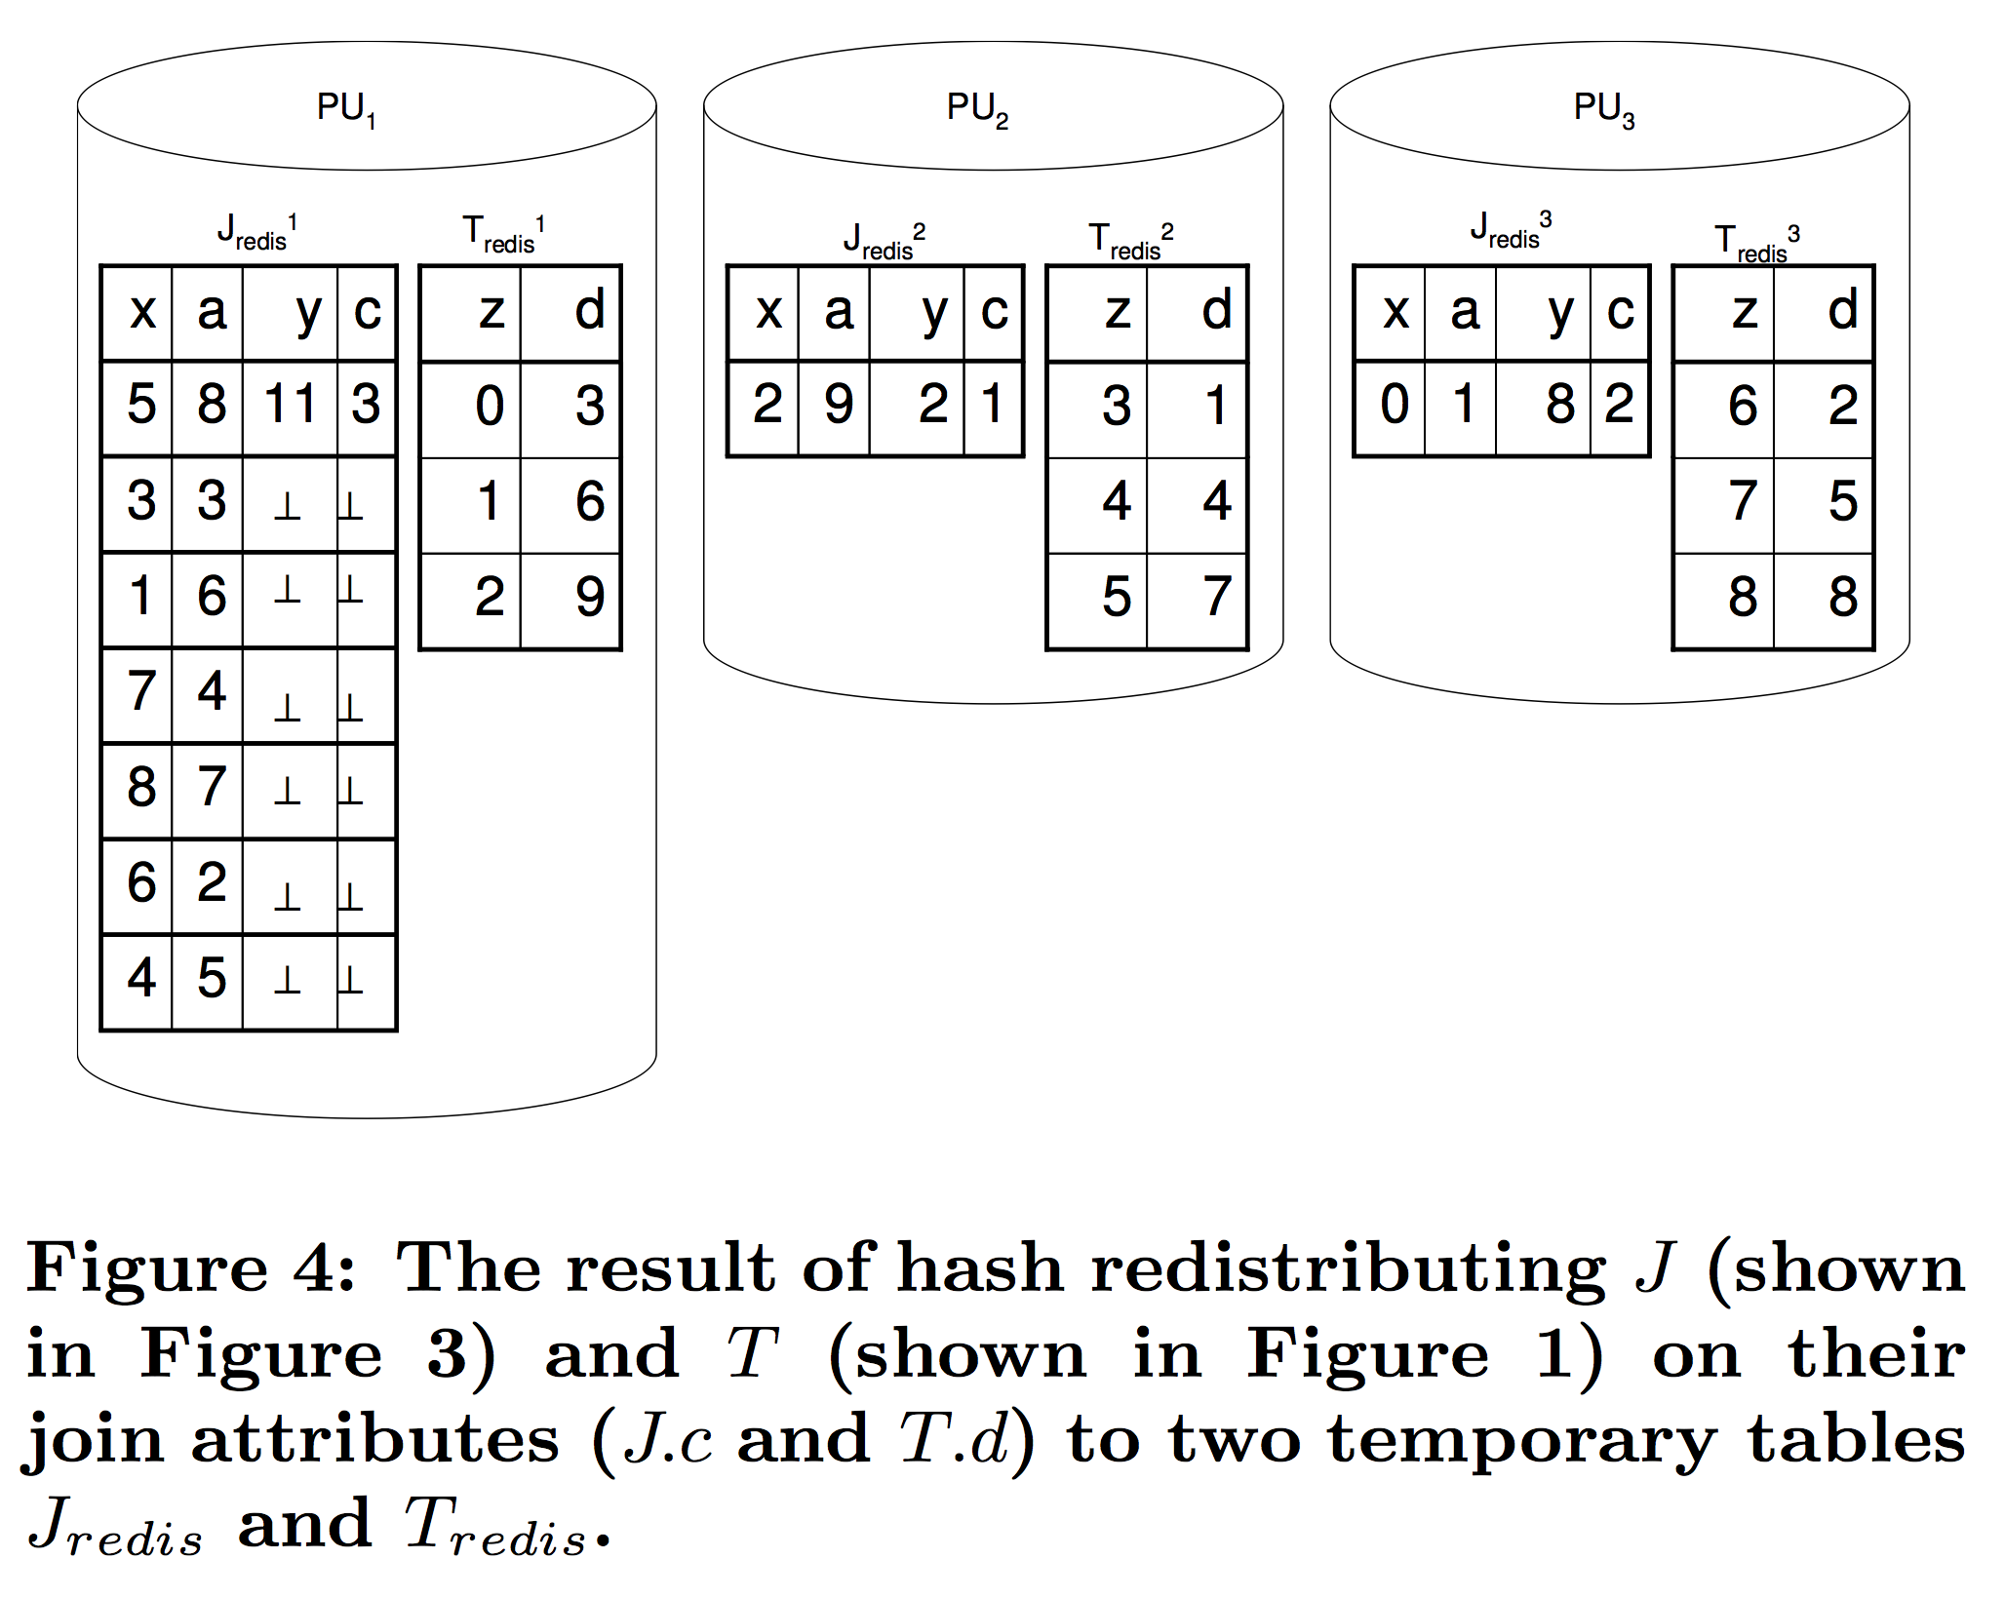
Another example…
Step 2: (b) Redistribute J and T

Slide 19
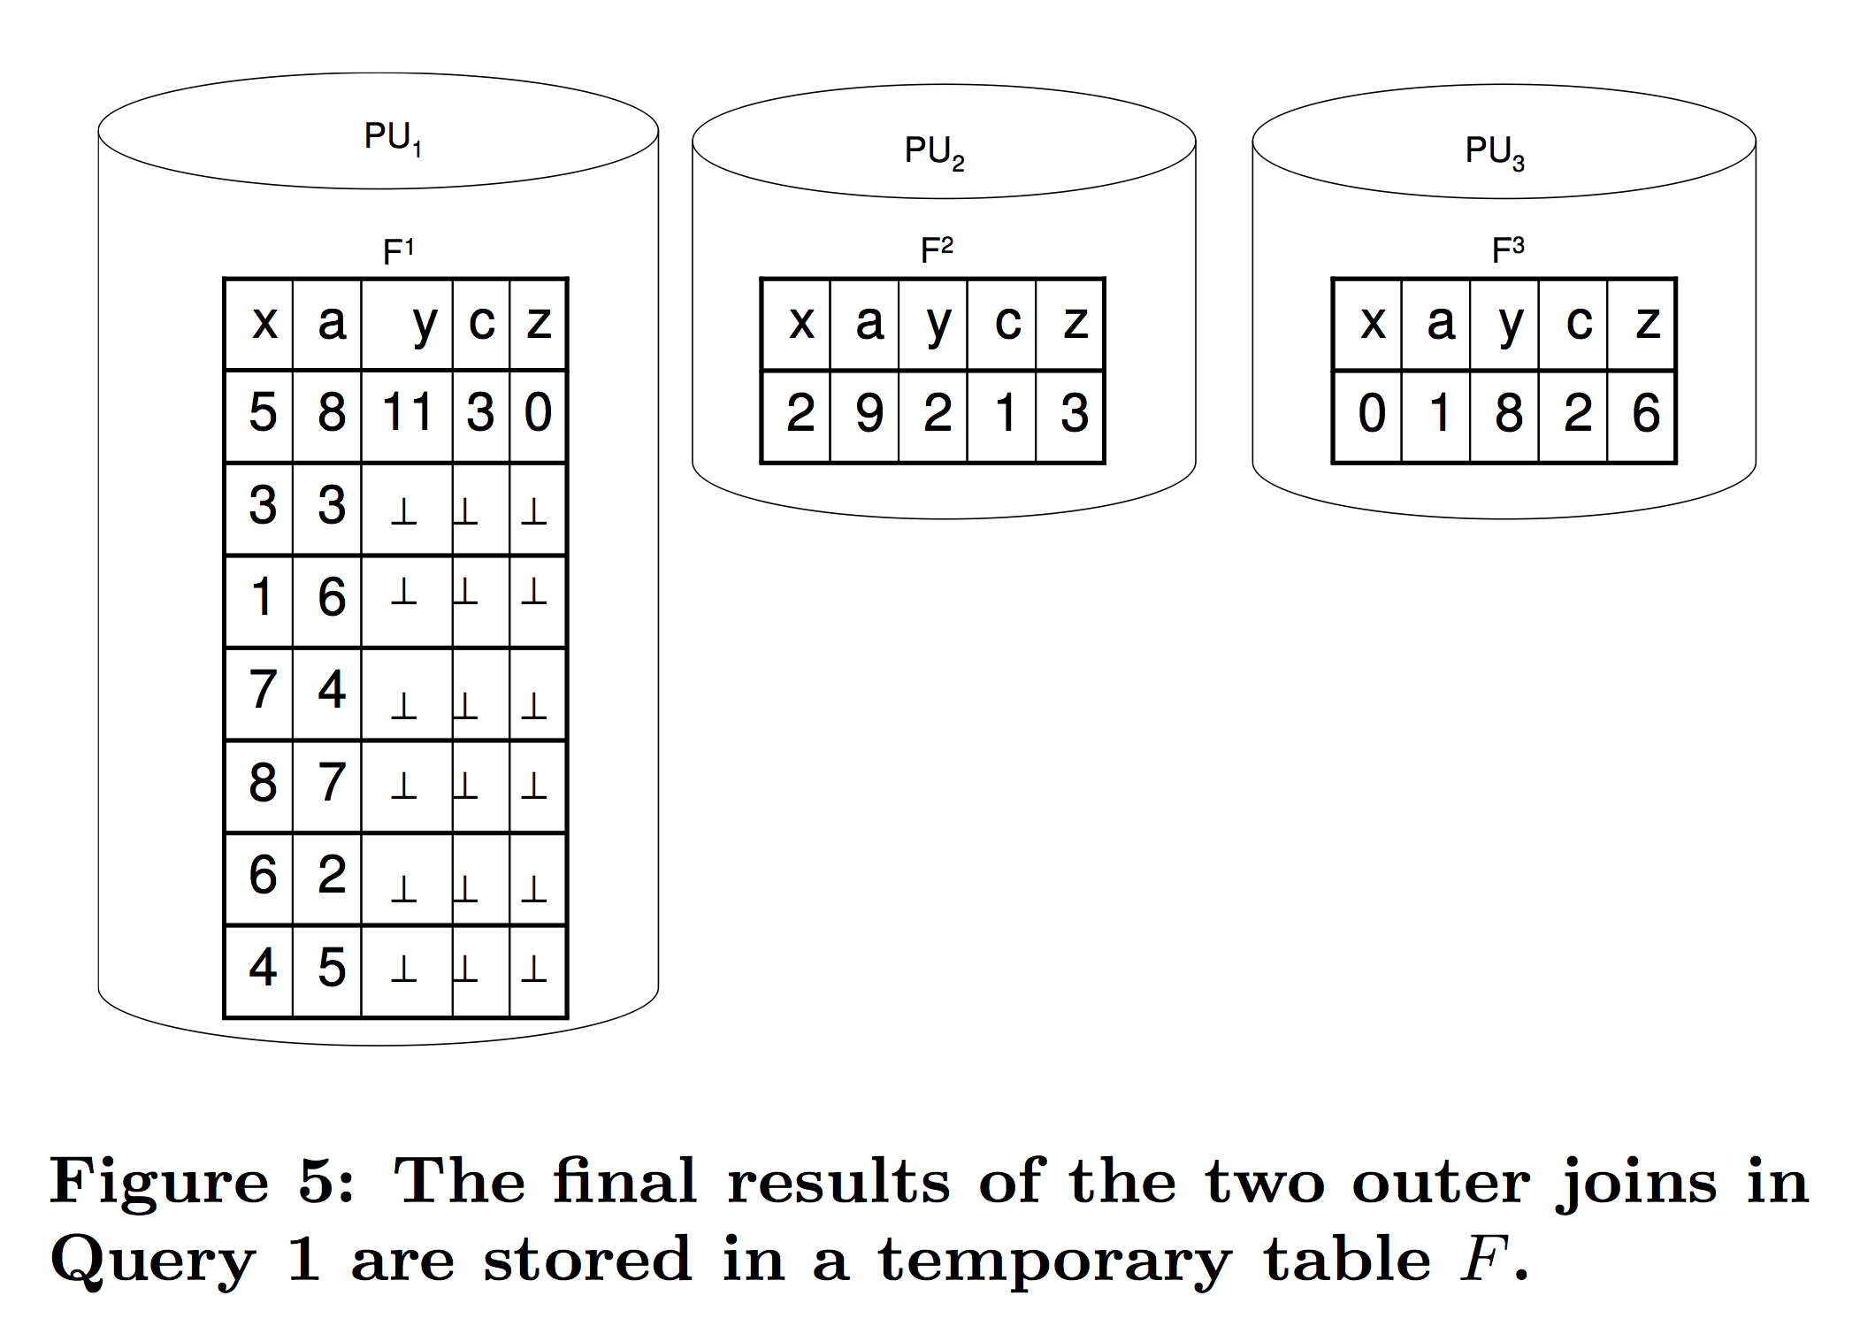
Another example…
Step 3: Outer Join J and T ➔ Final Results

Slide 20
Conclusion…
Skew can easily happen easily in Outer Join queries

Slide 21
Exercise 1 (FLUX Quiz)
In the previous example (R outer join S outer join T), which parallel outer join method was used?
A. ROJA
B. DOJA
C. DER
D. None of the above

Slide 22
A better solution… OJSO
Step 1: Redistribute R and S (same as the previous example)
Notes:
第1步：重新分配R和S（与前一个示例相同）

Slide 23
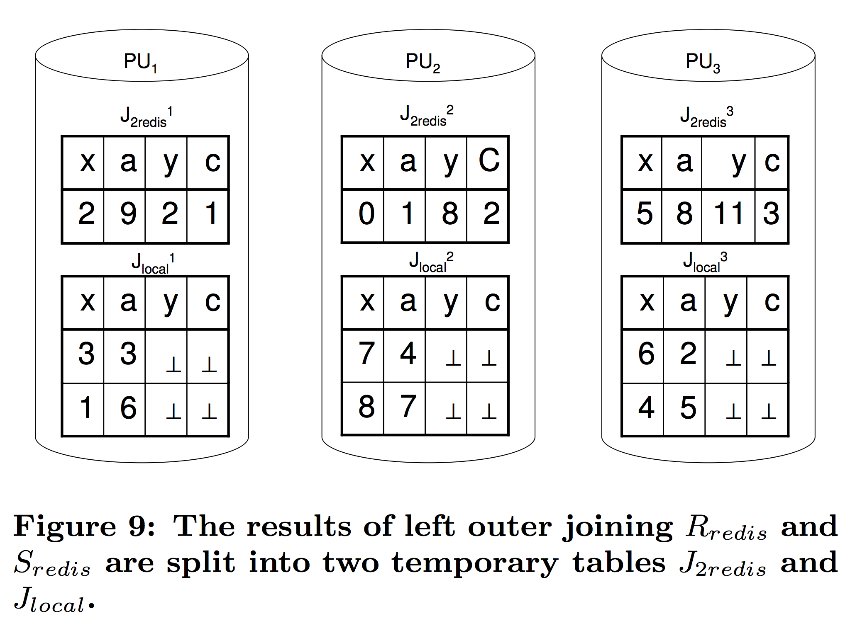
A better solution… OJSO
Step 2: (a) Outer Join R and S, but the results are divided into J_{2redis} and J_{local}
Notes:
步骤2：（a）外连接R和S，但结果分为J2redis和Jlocal

Slide 24
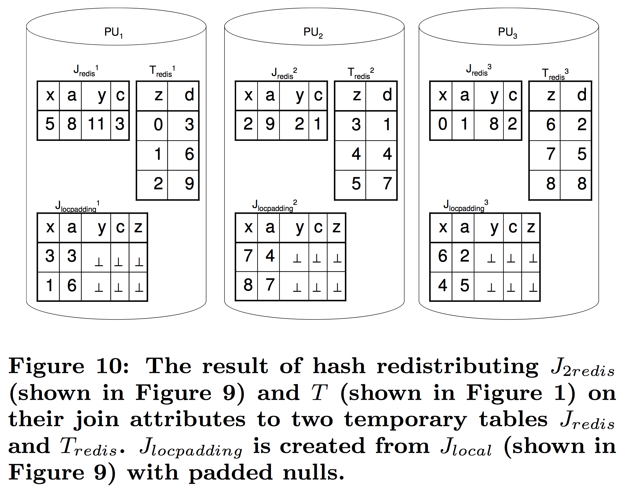
A better solution… OJSO
Step 2: (b) Redistribute J_{2redis} and T; and do an outer join
Notes:
第2步：（b）重新分配J2redis和T; 并进行外连接

Slide 25
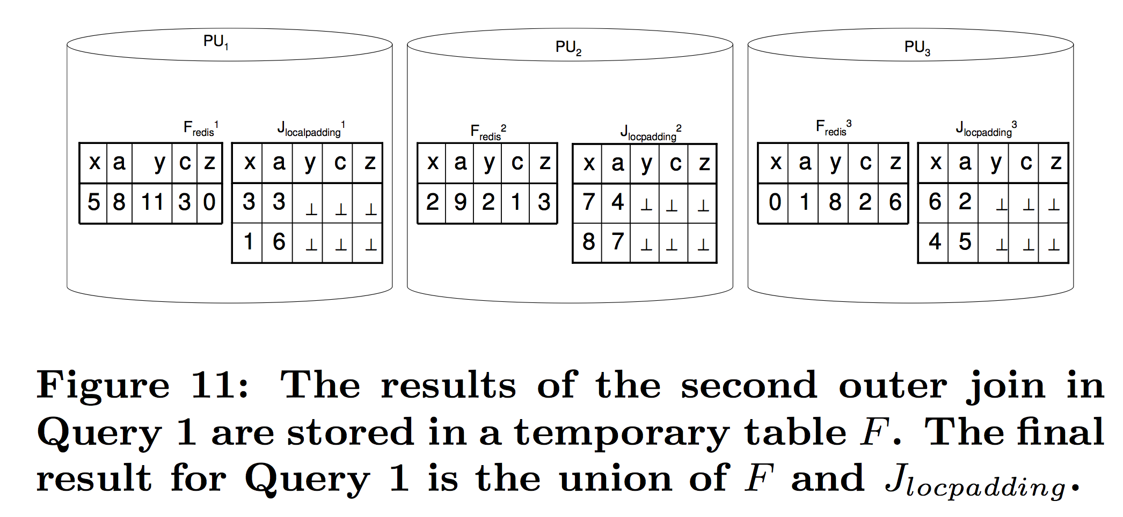
A better solution… OJSO
Step 3: Union the final results in each processor
Notes:
第3步：在每个处理器中合并最终结果

Slide 26
OJSO Conclusion…
Do not redistribute the dangling records from the previous outer join
Notes:
不要从先前的外连接重新分配悬空记录

Slide 27
Summary…
Parallel Outer Join processing methods
ROJA (Redistribution Outer Join Algorithm)
DOJA (Duplication Outer Join Algorithm)
DER (Duplication & Efficient Redistribution)
Load Balancing
OJSO (Outer Join Skew Optimization)

Slide 28
References
Xu, Y. & Kostamaa, P. (2010). A new algorithm for small-large table outer joins in parallel DBMS. In Proceedings of the 26th Intl Conference on Data Engineering (ICDE’2010) (pp. 1018-1024), IEEE Comp Society Press.
Xu,Y. & Kostamaa, P. (2009). Efficient Outer Join Data Skew Handling in Parallel DBMS. In Proceedings of the 35th International Conference on Very Large Data Bases (VLDB’2009) (pp. 1390-1396), VLDB Endowment.

