Slide 1
FIT5148 (Volume IV – Sort and Group By)
Week 4a – Parallel Sort

Slide 2
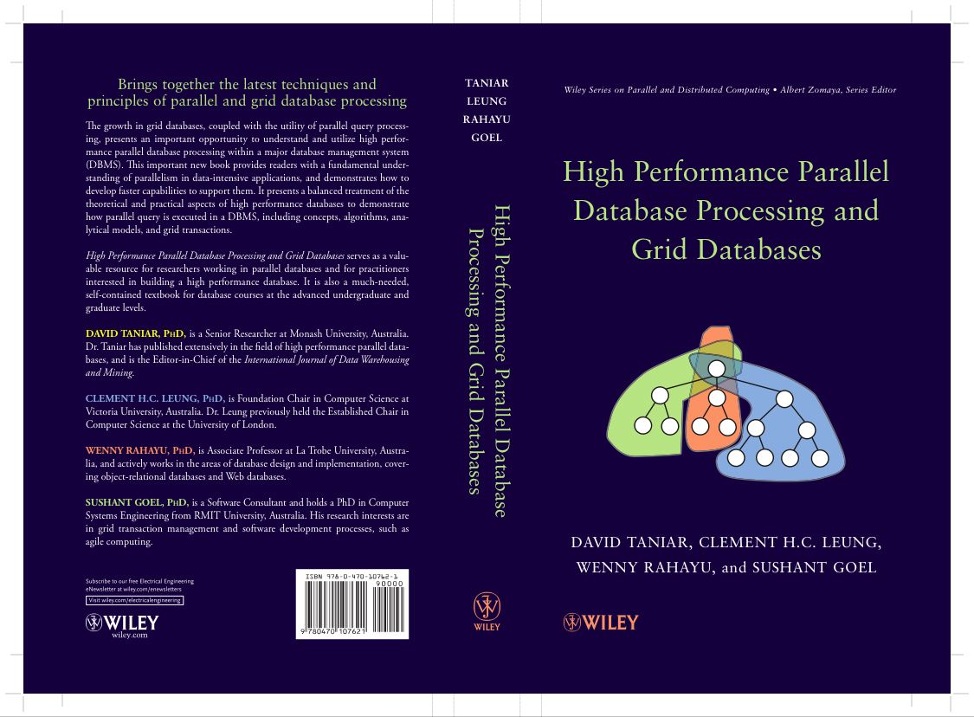
Chapter 5 Parallel Join
Last Week
5.1 Join Operations
5.2 Serial Join Algorithms
5.3 Parallel Join Algorithms
5.4 Cost Models
5.5 Parallel Join Optimization
5.6 Summary
5.7 Bibliographical Notes
5.8 Exercises

Slide 3
Revision
Exercise 1 (FLUX Quiz)
Parallel Join algorithms for Inner Join consists of two major phases: Data Partitioning, and Local Join
A. TRUE
B. FALSE

Slide 4
Revision
Exercise 2 (FLUX Quiz)
Parallel Join algorithms for Outer Join queries are:
A. ROJA and DOJA
B. DER
C. OJSO
E. only A and B
F. A. B and C are correct.

Slide 5
Chapter 4 Parallel Sort and GroupBy
4.1 Sorting, Duplicate Removal and Aggregate
4.2 Serial External Sorting Method
4.3 Algorithms for Parallel External Sort
4.4 Parallel Algorithms for GroupBy Queries
4.5 Cost Models for Parallel Sort
4.6 Cost Models for Parallel GroupBy
4.7 Summary
4.8 Bibliographical Notes
4.9 Exercises

Slide 6
4.1. Sorting, and Serial Sorting
Serial Sorting – INTERNAL
The data to be sorted fits entirely into the main memory
Serial Sorting - EXTERNAL
The data to be sorted DOES NOT fit entirely into the main memory

Slide 7
4.1. Internal Serial Sorting (cont’d)
Bubble Sort冒泡排序
Based on swapping
It compares the first two elements, and if the first is greater than the second, it swaps them.
It continues doing this for each pair of adjacent elements to the end of the data set.
It then starts again with the first two elements, repeating until no swaps have occurred on the last pass.
Example: 6 5 3 1 8 7 2 4

Slide 8
4.1. Internal Serial Sorting (cont’d)
Bubble Sort
6 5 3 1 8 7 2 4
5 6 3 1 8 7 2 4
5 3 6 1 8 7 2 4
5 3 1 6 8 7 2 4
5 3 1 6 8 7 2 4
5 3 1 6 7 8 2 4
5 3 1 6 7 2 8 4
5 3 1 6 7 2 4 8
5 3 1 6 7 2 4 8
3 5 1 6 7 2 4 8
3 1 5 6 7 2 4 8
3 1 5 6 7 2 4 8
3 1 5 6 7 2 4 8
3 1 5 6 2 7 4 8
3 1 5 6 2 4 7 8
3 1 5 6 2 4 7 8
1 3 5 6 2 4 7 8
1 3 5 6 2 4 7 8
1 3 5 6 2 4 7 8
1 3 5 2 6 4 7 8
1 3 5 2 4 6 7 8
1 3 5 2 4 6 7 8
1 3 5 2 4 6 7 8
1 3 5 2 4 6 7 8
1 3 2 5 4 6 7 8
1 3 2 4 5 6 7 8
1 3 2 4 5 6 7 8
1 3 2 4 5 6 7 8
1 2 3 4 5 6 7 8
1 2 3 4 5 6 7 8
1 2 3 4 5 6 7 8
1 2 3 4 5 6 7 8
1 2 3 4 5 6 7 8
1 2 3 4 5 6 7 8
1 2 3 4 5 6 7 8
Finished
Notes:
We will need 6 passes to complete the sorting. The answer is in the learning resources.

Slide 9
4.1. Internal Serial Sorting (cont’d)
Insertion Sort 插入排序
Based on inserting a new value
It works by taking elements from the list one by one and inserting them in their correct position into a new sorted list. In arrays, the new list and the remaining elements can share the array's space, but insertion is expensive, requiring shifting all following elements over by one.要求将所有后续元素移动一个。
Example: 6 5 3 1 8 7 2 4
6 5 3 1 8 7 2 4 Take out 6, and insert it in the previous list 6 5 3 1 8 7 2 4
6 5 3 1 8 7 2 4 Take out 5, and insert it in the previous list 5 6 3 1 8 7 2 4
5 6 3 1 8 7 2 4 Take out 3, and insert it in the previous list 3 5 6 1 8 7 2 4
3 5 6 1 8 7 2 4 Take out 1, and insert it in the previous list 1 3 5 6 8 7 2 4
1 3 5 6 8 7 2 4 Take out 8, and insert it in the previous list 1 3 5 6 8 7 2 4
1 3 5 6 8 7 2 4 Take out 7, and insert it in the previous list 1 3 5 6 7 8 2 4
1 3 5 6 7 8 2 4 Take out 2, and insert it in the previous list 1 2 3 5 6 7 8 4
1 2 3 5 6 7 8 4 Take out 4, and insert it in the previous list 1 2 3 4 5 6 7 8
Finished

Slide 10
4.1. Internal Serial Sorting (cont’d)
Quick Sort
Quick Sort is a divide and conquer algorithm which relies on a partition operation: to partition an array an element called a pivot is selected.
All elements smaller than the pivot are moved before it and all greater elements are moved after it.
The lesser and greater sublists are then recursively sorted.
The most complex issue in Quick Sort is choosing a good pivot element; consistently poor choices of pivots can result in drastically slower performance
Example: 6 5 3 1 8 7 2 4
Notes:
快速排序是一种分而治之的算法，它依赖于分区操作：对数组进行分区时，选择一个名为pivot的元素。
小于pivot的所有元素都在它之前移动，所有更大的元素在它之后移动。
然后递归地对较小和较大的子列表进行排序。
快速排序中最复杂的问题是选择一个好的枢轴元素; 一直选择不好的枢轴会导致性能急剧下降

Slide 11
4.1. Internal Serial Sorting (cont’d)
Quick Sort
Quick Sort is a divide and conquer algorithm which relies on a partition operation: to partition an array an element called a pivot is selected.
All elements smaller than the pivot are moved before it and all greater elements are moved after it.
The lesser and greater sublists are then recursively sorted.
The most complex issue in Quick Sort is choosing a good pivot element; consistently poor choices of pivots can result in drastically slower performance
Example: 6 5 3 1 8 7 2 4
Homework: Work out step-by-step this Quick Sort example

Slide 12
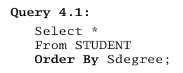

4.2. Serial External Sorting
Sorting is expressed by the ORDER BY clause in SQL
排序由SQL中的ORDER BY子句表示
Duplicate remove is identified by the keyword DISTINCT in SQL

Slide 13
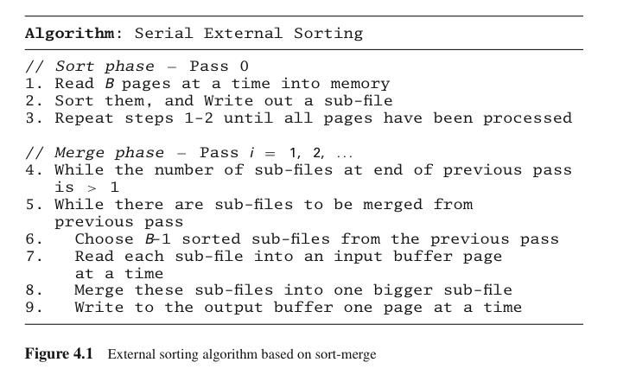
4.2. Serial External Sorting (cont’d)
External sorting assumes that the data does not fit into main memory
Most common external sorting is sort-merge （归并排序）
Break the file up into
unsorted subfiles,
sort the subfiles, and
then merge the subfiles
into larger and larger
sorted subfiles until the
entire file is sorted

Slide 14
4.2. Serial External Sorting (cont’d)
Example
File size to be sorted = 108 pages, number of buffer (or memory size) = 5 pages
Number of subfiles = 108/5 = 22 subfiles (the last subfile is only 3 pages long).
Pass 0 (sorting phase): For each subfile, read from disk, sort in main-memory, and write to disk (Note: sorting the data in main-memory can use any fast in-memory sorting method, like Quick Sort)
Merging phase: We use B-1 buffers (4 buffers) for input and 1 buffer for output
Pass 1: Read 4 sorted subfiles and perform 4-way merging (apply a need k-way algorithm). Repeat the 4-way merging until all subfiles are processed. Result = 6 subfiles with 20 pages each (except the last one which has 8 pages) 每4个subfile 合并为一个subfile。最终得到6个subfile。
Pass 2: Repeat 4-way merging of the 6 subfiles like pass 1 above. Result = 2 subfiles
Pass 3: Merge the last 2 subfiles
Summary: 108 pages and 5 buffer pages require 4 passes

Slide 15
4.2. Serial External Sorting (cont’d)
Exercise 3 (FLUX Quiz)
There are 150 data pages to be sorted. The machine that we have has a limited memory, and can only take 8 pages at a time. How many passes will it take to sort the 150 data pages?
A. 2
B. 3
C. 4
D. 5
pass0--19 subfile
pass1-- 3 subfile
pass2 -- 1subfile.

Slide 16
4.2. Serial External Sorting (cont’d)
Exercise 3
There are 150 data pages to be sorted. The machine that we have has a limited memory, and can only take 8 pages at a time.
How many passes will it take to sort the 150 data pages?
Solution:
File size to be sorted = 150 pages, number of buffer (or memory size) = 8 pages
Number of subfiles = 150/8 = 19 subfiles.
Pass 0 (sorting phase): For each subfile, read from disk, sort in main-memory, and write to disk
Merging phase: We use 7 buffers for input and 1 buffer for output
Pass 1: Read 7 sorted subfiles and perform 7-way merging. Repeat the 7-way merging until all subfiles are processed. Result = 3 subfiles
Pass 2: Merge the 3 subfiles
Summary: 150 pages and 8 buffer pages require 3 passes

Slide 17
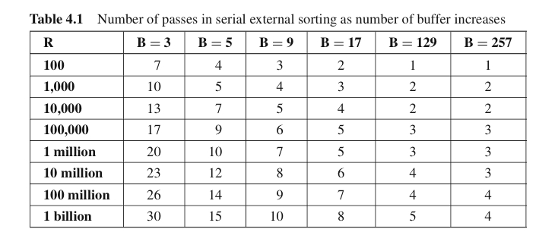
4.2. Serial External Sorting (cont’d)
Example
Buffer size plays an important role in external sort

Slide 18
4.3. Parallel External Sort
Parallel Merge-All Sort
Parallel Binary-Merge Sort
Parallel Redistribution Binary-Merge Sort
Parallel Redistribution Merge-All Sort
Parallel Partitioned Sort

Slide 19
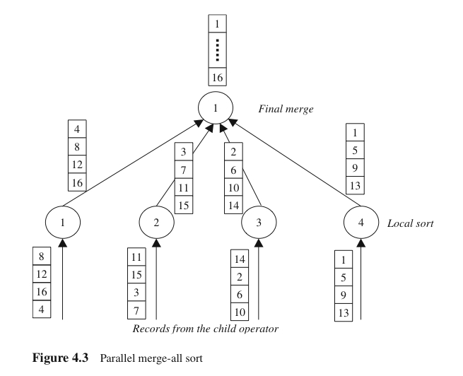
4.3. Parallel External Sort (cont’d)
Parallel Merge-All Sort
A traditional approach
Two phases: local sort and final merge
Load balanced in local sort
Problems with merging:
Heavy load on one processor
Network contention

Slide 20
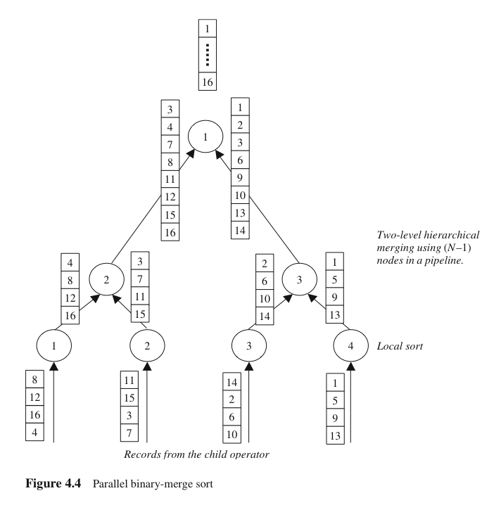
4.3. Parallel External Sort (cont’d)
Parallel Binary-Merge Sort
Local sort similar to traditional method
Merging in pairs only
Merging work is now spread to
pipeline of processors,
but merging is still heavy
合并工作现在已经扩展到所有处理器
，但合并任务仍然很重
5

Slide 21
4.3. Parallel External Sort (cont’d)
Parallel Binary-Merge Sort
Binary merging vs. k-way merging
In k-way merging, the searching for the smallest value among k partitions is done at the same time
In binary merging, it is pairwise, but can be time consuming if the list is long
System requirements: k-way merging requires k files open simultaneously, but the pipeline process in binary merging requires extra overheads、
k-way合并需要同时打开k个文件，但二进制合并中的管道进程需要额外的开销
1
k-way merging:
Searching for the smallest value among the k values
4
8
12
16
3
7
11
15
2
6
11
14
1
5
9
13

Slide 22
4.3. Parallel External Sort (cont’d)
1
2
k-way merging:
4
8
12
16
3
7
11
15
2
6
11
14
1
5
9
13
Searching for the smallest value among the k values
and so on…

Slide 23
4.3. Parallel External Sort (cont’d)
Parallel Binary-Merge Sort
Binary merging vs. k-way merging
In binary merging, it is pairwise, but can be time consuming if the list is long
System requirements: the pipeline process in binary merging requires extra overheads
1
Binary merging:
3
4
7
8
11
12
15
16
1
2
5
6
9
10
13
14
Compare two values only, but lists are longer

Slide 24
4.3. Parallel External Sort (cont’d)
Parallel Binary-Merge Sort
Binary merging vs. k-way merging
In binary merging, it is pairwise, but can be time consuming if the list is long
System requirements: the pipeline process in binary merging requires extra overheads
1
2
Binary merging:
3
4
7
8
11
12
15
16
1
2
5
6
9
10
13
14
Compare two values only, but lists are longer
And so on…

Slide 25
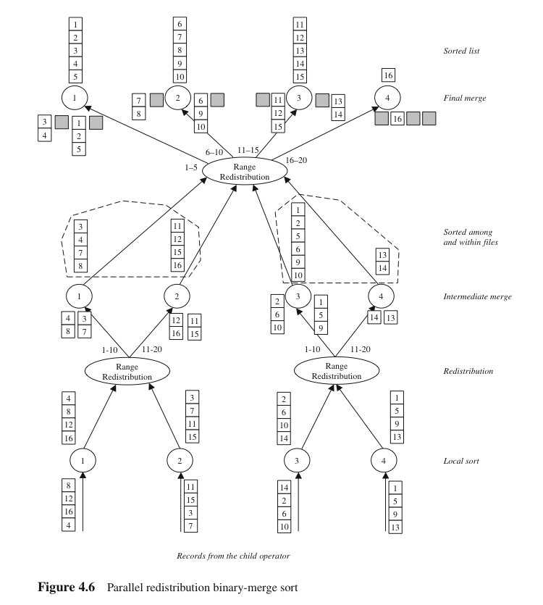
Parallel Redistribution Binary-Merge Sort
Parallelism at all levels in the pipeline hierarchy
Step 1: local sort
Step 2: redistribute the results of local sort
Step 3: merge using the same pool of processors
Benefit: merging becomes lighter than without redistribution
Problem: height of the tree

Slide 26
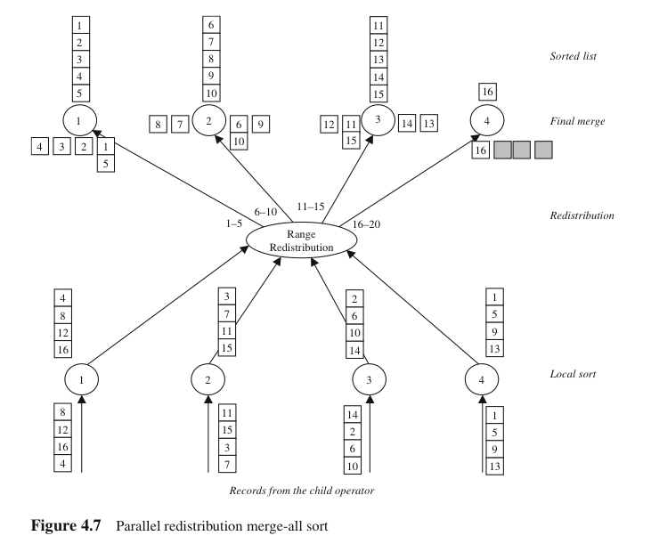
Parallel Redistribution Merge-All Sort
Reduce the height of the tree, and still maintain parallelism
Like parallel merge-all sort, but with redistribution
The advantage is true parallelism in merging
Skew problem in the merging

Slide 27
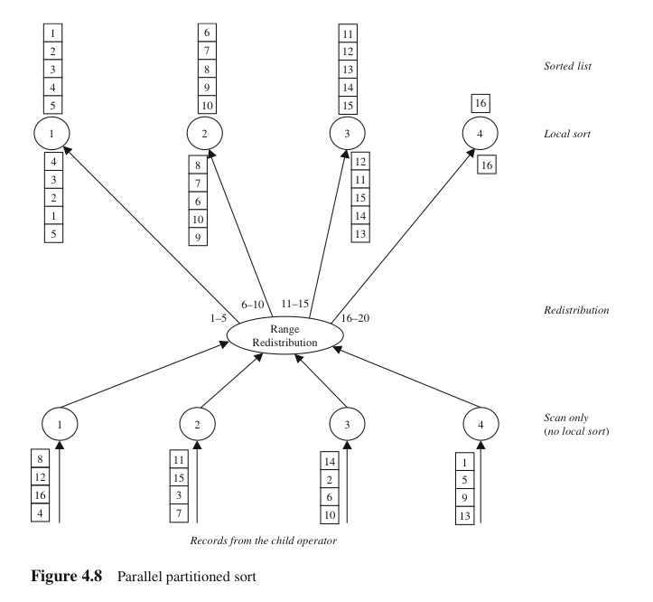
Parallel Partitioned Sort
Two stages: Partitioning stage and Independent local work
Partitioning (or range redistribution) may raise load skew
Local search is done after the partitioning, not before
No merging is necessary
Main problem: Skew produced by the partitioning

Slide 28
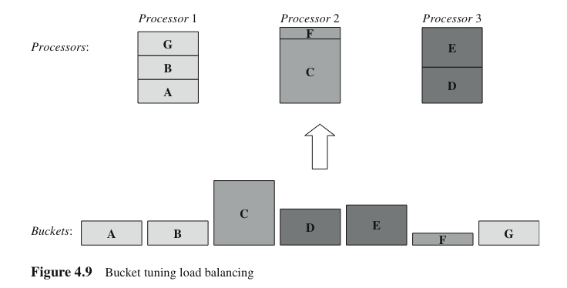
Parallel Partitioned Sort
Bucket tuning: produce more buckets than the available processors
Bucket tuning does not work in parallel sort, because in parallel sort, the order of processor is important
Bucket tuning for load balancing will later be used in parallel join

Slide 29
4.2. Serial External Sorting (cont’d)
Exercise 4 (Home Work)
Given a data set D = {55; 30; 68; 39; 1; 4; 49; 90; 34; 76; 82; 56; 31; 25; 78; 56; 38; 32; 88; 9; 44; 98; 11; 70; 66; 89; 99; 22; 23; 26} and four processors, show step by step how the Parallel Partitioned Sort works.

Slide 30
4.2. Serial External Sorting (cont’d)
Exercise 5 (Difficult)
Given the same dataset as in the previous question, and 4 processors, show how Load Balancing is achieved in the Parallel Partitioned Sort.

