Slide 1
Differential Privacy
Some contents are borrowed from Adam Smith’s slides

Slide 2
Outline
Background
Definition
Applications

Slide 3
Background: Database Privacy
Alice
Users
(government, researchers,
marketers, …)
Collection
and
“sanitization”
Bob

You
“Census problem”
Two conflicting goals
Utility: Users can extract “global” statistics
Privacy: Individual information stays hidden
How can these be formalized?
Notes:
OLD NOTES!
This talk is about database privacy. The term can mean many things but for this talk, the example to keep in mind is a government census. Individuals provide information to a trusted government agency, which processes the information and makes some sanitized version of it available for public use.
- privacy is required by law
- ethical
- pragmatic: people won’t answer unless they trust you
There are two goals: we want users to be able to extract global statistics about the population being studied. However, for legal, ethical and pragmatic reasons, we also want to protect the privacy of the individuals who participate.
And so we have a fundamental tradeoff between privacy on one hadn and utility on the other. The extremes are easy: publishing nothing at all provides complet eprivacy, but no utility, and publishing the raw data exactly provides the most utility but no privacy.
Thus the first-order goal of this paper is to plot some middle course between the extremes; that is, to find a compromise which allows users to obtain useful information while also providing a meaningful guarantee of privacy.
This problem is not new: it is often called the "statistical database" problem. I would say a second-order goal of this paper is to change the way the problem is approached and treated in the literature…
Graphically, this is what is going on. As I said, there are two goals, utility and privacy.
Utility is easy to understand, and to explain to a user. To prove that your scheme provides a particular utility, just give an algoriithm and an analysis.
Privacy is much harder to get a handle on…

Slide 4
Database Privacy
Alice
Users
(government, researchers,
marketers, …)
Collection
and
“sanitization”
Bob

You
Variations on model studied in
Statistics
Data mining
Theoretical CS
Cryptography
Different traditions for what “privacy” means
Notes:
OLD NOTES!
This talk is about database privacy. The term can mean many things but for this talk, the example to keep in mind is a government census. Individuals provide information to a trusted government agency, which processes the information and makes some sanitized version of it available for public use.
- privacy is required by law
- ethical
- pragmatic: people won’t answer unless they trust you
There are two goals: we want users to be able to extract global statistics about the population being studied. However, for legal, ethical and pragmatic reasons, we also want to protect the privacy of the individuals who participate.
And so we have a fundamental tradeoff between privacy on one hadn and utility on the other. The extremes are easy: publishing nothing at all provides complet eprivacy, but no utility, and publishing the raw data exactly provides the most utility but no privacy.
Thus the first-order goal of this paper is to plot some middle course between the extremes; that is, to find a compromise which allows users to obtain useful information while also providing a meaningful guarantee of privacy.
This problem is not new: it is often called the "statistical database" problem. I would say a second-order goal of this paper is to change the way the problem is approached and treated in the literature…
Graphically, this is what is going on. As I said, there are two goals, utility and privacy.
Utility is easy to understand, and to explain to a user. To prove that your scheme provides a particular utility, just give an algoriithm and an analysis.
Privacy is much harder to get a handle on…

Slide 5
Background
Interactive database query
  A classical research problem for statistical databases
  Prevent query inferences – malicious users submit multiple queries to infer private information about some person
  Has been studied since decades ago
Non-interactive: publishing statistics then destroy data
micro-data publishing?

Slide 6
Basic Setting
x₁
query 1
Users
(government, researchers,
marketers, …)
x₂
San
answer 1
DB=
x₃


query T
x_{n-1}
answer T
x_{n}
¢
¢
¢
random coins
Database DB = table of n rows, each in domain D
  D can be numbers, categories, tax forms, etc
  This talk: D = {0,1}^{d}
  E.g.: Married?, Employed?, Over 18?, …
Notes:
- Maybe say a few words about individuals’ data
- Note that this also captures noninteractive schemes

Slide 7
Examples of sanitization methods
Input perturbation
  Change data before processing
  E.g. Randomized response
Summary statistics
  Means, variances
  Marginal totals (# people with blue eyes and brown hair)
  Regression coefficients
Output perturbation
  Summary statistics with noise
Interactive versions of above:
  Auditor decides which queries are OK
Notes:
This should be 4 separate slides

Slide 8
Two Intuitions for Privacy
“If the release of statistics S makes it possible to determine the value [of private information] more accurately than is possible without access to S, a disclosure has taken place.” [Dalenius]
Learning more about me should be hard
Privacy is “protection from being brought to the attention of others.” [Gavison]
Safety is blending into a crowd
Remove Gavison def?

Slide 9
Why not use crypto definitions?
Attempt #1:
  Def’n: For every entry i, no information about x_{i} is leaked (as if encrypted)
  Problem: no information at all is revealed!
  Tradeoff privacy vs utility
Attempt #2:
  Agree on summary statistics f(DB) that are safe
  Def’n: No information about DB except f(DB)
  Problem: how to decide that f is safe?
  (Also: how do you figure out what f is?)

Slide 10
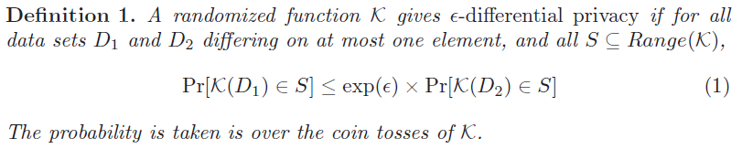
Differential Privacy
The risk to my privacy should not substantially increase as a result of participating in a statistical database:

Slide 11
Differential Privacy
No perceptible risk is incurred by joining DB.
Any info adversary can obtain, it could obtain without Me (my data).
Pr [t]

Slide 12
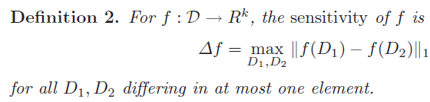
Sensitivity of functions

Slide 13

Design of randomization K
Laplace distribution
K adds noise to the function output f(x)
  Add noise to each of the k dimensions
Can be other distributions. Laplace distribution is easier to manipulate

Slide 14


For d functions, f1,…,fd
  Need noise:
  the quality of each answer deteriorates with the sum of the sensitivities of the queries

Slide 15
Typical application
Histogram query
  Partition the multidimensional database into cells, find the count of records in each cell

Slide 16
Application: contingency table
Contingency table
  For K dimensional boolean data
  Contains the count for each of the 2^k cases
Can be treated as a histogram, each entry add an e-noise
Drawback, noise can be large for maginals

Slide 17
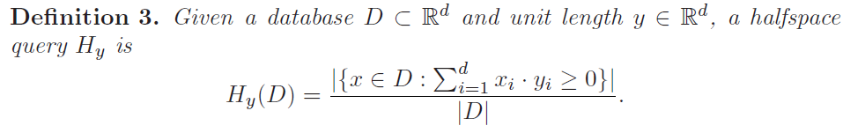
Halfspace queries
We try to publish some canonical halfspace queries,
any non-canonical ones can be mapped to the canonical ones and find approximate answers

Slide 18
applications
Privacy integrated queries (PINQ)
  PINQ provides analysts with a programming interface to unscrubbed data through a SQL-like language
Airavat
  a MapReduce-based system which provides strong security and privacy guarantees for distributed computations on sensitive data.

