Slide 1

Differential Privacy
CS 380S
Vitaly Shmatikov
most slides from Adam Smith (Penn State)
slide <number>

Slide 2
Reading Assignment
Dwork. “Differential Privacy” (invited talk at ICALP 2006).
slide <number>

Slide 3
Basic Setting
x₁
query 1
x₂
San
answer 1
Users
(government, researchers, marketers, …)
DB=
x₃


query T
x_{n-1}
answer T
x_{n}
¢
¢
¢
random coins
slide <number>

Slide 4
Examples of Sanitization Methods
Input perturbation
  Add random noise to database, release
Summary statistics
  Means, variances
  Marginal totals
  Regression coefficients
Output perturbation
  Summary statistics with noise
Interactive versions of the above methods
  Auditor decides which queries are OK, type of noise
slide <number>

Slide 5
Strawman Definition
Assume x₁,…,x_{n} are drawn i.i.d. from unknown distribution
Candidate definition: sanitization is safe if it only reveals the distribution
Implied approach:
  Learn the distribution
  Release description of distribution or re-sample points
This definition is tautological!
  Estimate of distribution depends on data… why is it safe?
slide <number>

Slide 6
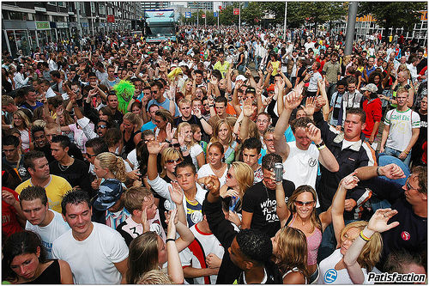
Blending into a Crowd
Frequency in DB or frequency in underlying population?
Intuition: “I am safe in a group of k or more”
  k varies (3… 6… 100… 10,000?)
Many variations on theme
  Adversary wants predicate g
  such that 0 < #{i | g(x_{i})=true} < k
Why?
  Privacy is “protection from being brought to the attention of others” [Gavison]
  Rare property helps re-identify someone
  Implicit: information about a large group is public
    E.g., liver problems more prevalent among diabetics
slide <number>

Slide 7
Clustering-Based Definitions
Given sanitization S, look at all databases consistent with S
Safe if no predicate is true for
all consistent databases
k-anonymity
  Partition D into bins
  Safe if each bin is either empty, or
  contains at least k elements
Cell bound methods
  Release marginal sums
 | brown | blue | Σ
blond | 2 | 10 | 12
brown | 12 | 6 | 18
Σ | 14 | 16
 | brown | blue | Σ
blond | [0,12] | [0,12] | 12
brown | [0,14] | [0,16] | 18
Σ | 14 | 16
slide <number>

Slide 8
Issues with Clustering
Purely syntactic definition of privacy
What adversary does this apply to?
  Does not consider adversaries with side information
  Does not consider probability
  Does not consider adversarial algorithm for making decisions (inference)
slide <number>

Slide 9
“Bayesian” Adversaries
Adversary outputs point z ∈ D
Score = 1/f_{z} if f_{z} > 0, 0 otherwise
  f_{z} is the number of matching points in D
Sanitization is safe if E(score) ≤ ε
Procedure:
  Assume you know adversary’s prior distribution over databases
  Given a candidate output, update prior conditioned on output (via Bayes’ rule)
  If max_{z} E( score | output ) < ε, then safe to release
slide <number>

Slide 10
Issues with “Bayesian” Privacy
Restricts the type of predicates adversary can choose
Must know prior distribution
  Can one scheme work for many distributions?
  Sanitizer works harder than adversary
Conditional probabilities don’t consider previous iterations
  Remember simulatable auditing?
slide <number>

Slide 11
Classical Intution for Privacy
“If the release of statistics S makes it possible to determine the value [of private information] more accurately than is possible without access to S, a disclosure has taken place.” [Dalenius 1977]
  Privacy means that anything that can be learned about a respondent from the statistical database can be learned without access to the database
Similar to semantic security of encryption
  Anything about the plaintext that can be learned from a ciphertext can be learned without the ciphertext
slide <number>

Slide 12
Problems with Classic Intuition
Popular interpretation: prior and posterior views about an individual shouldn’t change “too much”
  What if my (incorrect) prior is that every UTCS graduate student has three arms?
How much is “too much?”
  Can’t achieve cryptographically small levels of disclosure and keep the data useful
  Adversarial user is supposed to learn unpredictable things about the database
slide <number>

Slide 13
Impossibility Result
[Dwork]
Privacy: for some definition of “privacy breach,”
∀ distribution on databases, ∀ adversaries A, ∃ A’
such that Pr(A(San)=breach) – Pr(A’()=breach) ≤ ε
  For reasonable “breach”, if San(DB) contains information about DB, then some adversary breaks this definition
Example
  Vitaly knows that Alex Benn is 2 inches taller than the average Russian
  DB allows computing average height of a Russian
  This DB breaks Alex’s privacy according to this definition… even if his record is not in the database!
slide <number>

Slide 14
(Very Informal) Proof Sketch
Suppose DB is uniformly random
  Entropy I( DB ; San(DB) ) > 0
“Breach” is predicting a predicate g(DB)
Adversary knows r, H(r ; San(DB)) ⊕ g(DB)
  H is a suitable hash function, r=H(DB)
By itself, does not leak anything about DB (why?)
Together with San(DB), reveals g(DB) (why?)
slide <number>

Slide 15
Differential Privacy (1)
x₁
query 1
x₂
San
answer 1
DB=
x₃


query T
x_{n-1}
x_{n}
¢
¢
¢
answer T
Adversary A
random coins
Example with Russians and Alex Benn
  Adversary learns Alex’s height even if he is not in the database
Intuition: “Whatever is learned would be learned regardless of whether or not Alex participates”
  Dual: Whatever is already known, situation won’t get worse
slide <number>

Slide 16
Differential Privacy (2)
x₁
query 1
x₂
San
answer 1
DB=
0


query T
x_{n-1}
x_{n}
¢
¢
¢
answer T
Adversary A
random coins
Define n+1 games
  Game 0: Adv. interacts with San(DB)
  Game i: Adv. interacts with San(DB_{-i}); DB_{-i} = (x₁,…,x_{i-1},0,x_{i+1},…,x_{n})
Given S and prior p() on DB, define n+1 posterior distrib’s
slide <number>

Slide 17
Differential Privacy (3)
x₁
query 1
x₂
San
answer 1
DB=
0


query T
x_{n-1}
x_{n}
¢
¢
¢
answer T
Adversary A
random coins
Definition: San is safe if
∀ prior distributions p(¢) on DB,
∀ transcripts S, ∀ i =1,…,n
StatDiff( p₀(¢|S) , p_{i}(¢|S) ) ≤ ε
slide <number>

Slide 18
Indistinguishability
x₁
query 1
transcript
S
x₂
San
answer 1
DB=
x₃


query T
x_{n-1}
x_{n}
¢
¢
¢
answer T
Distance
between
distributions
is at most ε
random coins
Differ in 1 row
x₁
query 1
transcript
S’
x₂
San
answer 1
DB’=
y₃


query T
x_{n-1}
x_{n}
¢
¢
¢
answer T
random coins
slide <number>

Slide 19
Which Distance to Use?
Problem: ε must be large
  Any two databases induce transcripts at distance ≤ nε
  To get utility, need ε > 1/n
Statistical difference 1/n is not meaningful!
Example: release random point in database
  San(x₁,…,x_{n}) = ( j, x_{j} ) for random j
For every i , changing x_{i} induces statistical difference 1/n
But some x_{i} is revealed with probability 1
slide <number>

Slide 20
Formalizing Indistinguishability
?
transcript
S
query 1
transcript
S’
query 1
answer 1
answer 1
Adversary A
Definition: San is ε-indistinguishable if
∀ A, ∀ DB, DB’ which differ in 1 row, ∀ sets of transcripts S
p( San(DB) ∈ S ) ∈
(1 ± ε) p( San(DB’) ∈ S )
Equivalently, ∀ S:
p( San(DB) = S )
p( San(DB’)= S )
∈ 1 ± ε
slide <number>

Slide 21
Indistinguishability ⇒ Diff. Privacy
Definition: San is safe if
∀ prior distributions p(¢) on DB,
∀ transcripts S, ∀ i =1,…,n
StatDiff( p₀(¢|S) , p_{i}(¢|S) ) ≤ ε
For every S and DB, indistinguishability implies
This implies StatDiff( p₀(¢|S) , p_{i}(¢| S) ) ≤ ε
slide <number>

Slide 22

Diff. Privacy in Output Perturbation
User
Database
Tell me f(x)
x₁
…
x_{n}
f(x)+noise
Intuition: f(x) can be released accurately when f is insensitive to individual entries x₁, … x_{n}
Global sensitivity GS_{f} = max_{neighbors x,x’} ||f(x) – f(x’)||₁
  Example: GS_{average} = 1/n for sets of bits
Theorem: f(x) + Lap(GS_{f} / ε) is ε-indistinguishable
  Noise generated from Laplace distribution
Lipschitz
constant of f
slide <number>

Slide 23
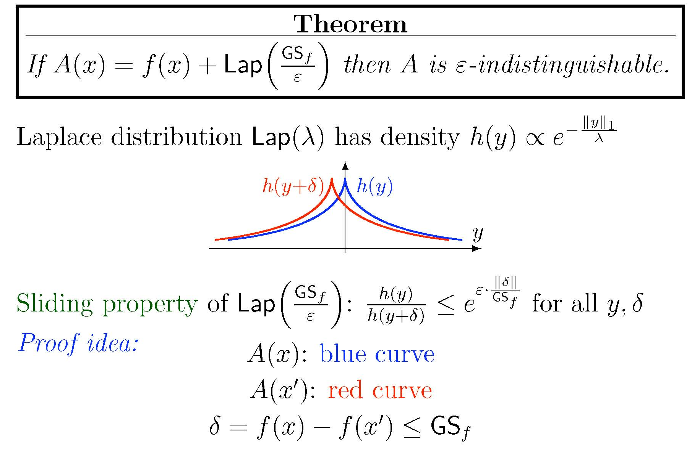
Sensitivity with Laplace Noise
slide <number>

Slide 24
Differential Privacy: Summary
San gives ε-differential privacy if for all values of DB and Me and all transcripts t:
Pr[ San (DB - Me) = t]
≤ e^{ε} ≈ 1±ε
Pr[ San (DB + Me) = t]
Pr [t]
slide <number>

Slide 25
Intuition
No perceptible risk is incurred by joining DB
Anything adversary can do to me, it could do without me (my data)
Pr [response]
Bad Responses:
X
X
X
slide <number>

