Slide 1
Computational Fuzzy Extractors
Benjamin Fuller, Xianrui Meng, and Leonid Reyzin
Notes:
1
1

Slide 2
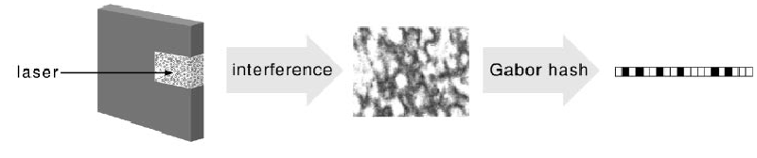
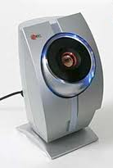

Noisy Distributions
High entropy sources suitable for key derivation are often noisy
Want to derive stable and cryptographically strong key from noisy data (called a source)
Source value changes over time, w₀≠ w₁
Want this key to map to same key
Gen( w₀ ) = Gen( w₁ )
Different samples from source must map to different and independent keys
Gen( w₀ ) ≠ Gen( w₀’ )
Physically Unclonable Functions
Biometric Data

Slide 3
Security from Noisy Data
Key Derivation
Authentication
Collect Reading w₁ and compare to initial reading w₀ accept if d( w₀, w₁ )<d_{max}
Similar application for PUFs where w₀, w₁ are the output of some challenge function
Privacy Amplification [BennettBrassardRobert88]
Use a shared w₀, w₁ (that are close) to create a shared key
Considered in information theoretic terms
(Fuzzy) Password Authentication Key Exchange
[BoyenDodisKatzOstrovskySmith05]
Use a shared w₀, w₁ (that are close) to create a shared key independent key with high entropy
Requires Computational Assumptions

Slide 4
Fuzzy Extractors
Assume our source is high entropy
Fuzzy Extractors derive reliable keys from noisy data
[DodisOstrovskyReyzinSmith08]
Derive a key using a randomness extractor
Error-correct the source using a Secure Sketch
Gen
Rep

Slide 5
Fuzzy Extractors
Assume our source is high entropy
Fuzzy Extractors derive reliable keys from noisy data
[DodisOstrovskyReyzinSmith08]
Derive a key using a randomness extractor
Error-correct the source using a Secure Sketch
Converts high entropy sources to uniform H∞(W₀)≥ k Ext (W ) ≈ U
Gen
Ext
Rep
Ext

Slide 6
Fuzzy Extractors
Assume our source is high entropy
Fuzzy Extractors derive reliable keys from noisy data
[DodisOstrovskyReyzinSmith08]
Derive a key using a randomness extractor
Error-correct the source using a Secure Sketch
Converts high entropy sources to uniform H∞(W₀)≥ k Ext (W ) ≈ U
Gen
Ext
Rep
Sketch
Rec
Ext

Slide 7
Secure Sketches
Gen
Ext
Rep
Sketch
Rec
Ext
ec = Encode(x)
Code Offset Sketch
p=Encode(x) ⊕ w₀

Slide 8
Secure Sketches
Gen
Ext
Rep
Sketch
Rec
Ext
ec’=Dec(p ⊕ w₁)
ec = Encode(x)
Code Offset Sketch
If w₀ and w₁ are close then w₀ = ec’ ⊕ p.
p ⊕ w₁
p=Encode(x) ⊕ w₀

Slide 9
Secure Sketches
Gen
Ext must be able to extract from distributions where
Ext
Rep
Sketch
Rec
Ext
Code Offset Sketch
w₀ is unknown (knowing p):
(k-k’)– entropy loss
p ⊕ w₁
p=Encode(x) ⊕ w₀
p ⊕ w₀’

Slide 10
Entropy Loss From Fuzzy Extractors
Most biometrics have 100-200 bits of entropy [RathaConnellBolle2001]
Entropy loss is considered in information-theoretic setting (all powerful adversary)
Fuzzy extractors have two losses:
Secure sketches lose at least the error correcting capability of the code (k-k’)
For error rates of 10-20%, equates to 10-40 bits.
Randomness extractors lose 2log (1/ε) or between 60-100 bits
After these losses the key may be too short to be useful: 30-60 bits
Can we eliminate either of these entropy losses?
[DodisOstrovskyReyzinSmith]
Secure Sketch Code (corrects random errors)
Implies k-k’ ≥ |B_{dmax}| (Ball of radius d_{max})
Fuzzy Extractors and Secure Sketches consider unbounded adversaries. Can we do better in the computational setting?

Slide 11
Can we do better in computational setting?
For secure sketches: NO
Show that defining a secure sketch in computational setting does not improve entropy loss
For fuzzy extractors: YES
Construct a lossless computational Fuzzy Extractor based on the Learning with Errors (LWE) problem
Extend hardness of LWE to case when some dimensions have known error

Slide 12
Computational Secure Sketches
Can we construct a secure sketch that provides little information about w₀ to computational adversaries?
Goal:
H^{comp}( W₀ | p) > H∞( W₀ | p)

Slide 13
HILL Secure Sketch
Most natural requirement: W₀ | p looks like it has high entropy. That is
(W₀ | p) ≈ (Y | p) and H∞(Y | p) ≥ k’
Known as HILL entropy [HastadImpagliazzoLevinLuby99], denoted as H^{HILL}(W₀ | p) ≥ k’
Applying a randomness extractor to HILL entropy produces a pseudorandom key

Slide 14
HILL Secure Sketches Secure Sketches
Theorem:
If H^{HILL}(W₀ | p) ≥ k’, then
there exists an error-correcting code C with 2^{k’-2} points and Rec corrects d_{max} random errors on C
Corollary: (Sketch of [DodisSmith05]) If the HILL entropy of a sketch drops by k bits, there exists a sketch whose information theoretic entropy drops by no more than k+2 bits.
We can fix an p value where Rec functions as a good a decoding algorithm. For a distribution, Y, to be indistinguishable, Rec must also decode on Y.

Slide 15
Can sketches be unpredictable?
HILL entropy (indistinguishability) may be asking too much
Maybe another notion of entropy is achievable
Definitely need that W₀ | ss is unpredictable
Applying a randomness extractor (with reconstruction procedure) produces a pseudorandom key [HsiaoLuReyzin07]

Slide 16
Maximum unpredictability conditioned on ss
Theorem:
For W₀=U and the Hamming metric,
W₀’s unpredictability conditioned on any secure sketch
decreases by at least |B_{dmax}|
Theorem 2 also holds for Y that are indistinguishable from W₀
Note: Nonconstructively, there are sketches whose entropy decreases by |B_{dmax}| [Varshamov1957]
These results also hold for any algorithm 1) that is error-tolerant, and 2) that outputs a value v and w₀ can be efficiently computed from w₀
Give up on building a secure sketch, focus on fuzzy extractor

Slide 17
Can we do better in computational setting?
For secure sketches: NO
A sketch that retains HILL entropy implies an information theoretic sketch
The unpredictability of W₀ must drop by |B_{dmax}|
For fuzzy extractors: YES
Look for computational assumption with “errors”
Seems natural to use random linear codes
(decoding is NP-hard [BerlekampMcElieseVanTilborg1978])

Slide 18
Our construction
What happens if we replace the code in our previous sketch with a random linear code?
Issues:
Creating/finding a pseudorandom key? (can’t use bits of w₀)
Finding efficient decoding algorithm
Proving security for different source distributions W₀
Secure Sketch Offset
ec = Encode(x)
p ⊕ w₁
p=Ax ⊕ w₀
p=Encode(x) ⊕ w₀
We’ll spend the rest of the talk addressing these issues. For now, assume W₀ is the uniform distribution.

Slide 19
Solving Random Linear Equations
n
A
A
x
b
m
=
,
Gaussian Elimination!
What happens if we add small errors?
Small errors seem to make the problem difficult
Syndrome decoding of random linear code is NP-hard
Recovering x known as Learning with Errors (LWE)

Slide 20
Solving Random Linear Equations
n
A
A
x
e
b
m
+
=
,
Gaussian Elimination!
What happens if we add small errors?
Decoding random linear code is NP-hard
Small errors seem to make the problem difficult
Recovering x known as Learning with Errors (LWE)

Slide 21
Learning with Errors
n
A
A
x
e
b
m
+
=
,
Gaussian Elimination!
What happens if we add small errors?
Decoding random linear code is NP-hard
Small errors seem to make the problem difficult
Recovering x known as Learning with Errors (LWE)

Slide 22
Learning with Errors
n
A
A
x
e
b
m
+
=
,
[Regev05] reduces solving LWE to approximating lattice problems of dimension O(n) (within polynomial factors)
Error is drawn from Gaussian distribution

Slide 23
Computational Fuzzy Extractor
Source
Public (p)
n
A
A
A
A
x
w₀
e
b
b
m
+
=
,
First idea: Use w₀ as the randomness for Gaussian distribution
Pro: Would inherent security proof of Regev
Con: Gaussian sampling takes a variable number of bits

Slide 24
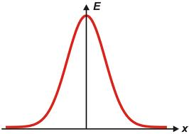
Randomness w/ Variable Sampling Length
Assume the Gaussian algorithm requires 4 or 5 bits to sample (determined by 1st bit)
w₀
10101 11111 00100 11010 10101 11010 10101
1010
1111
1100
1001
1010
1010
1110
e₀

Slide 25
Randomness w/ Variable Sampling Length
Assume the Gaussian algorithm requires 4 or 5 bits to sample (determined by 1st bit)
w₀
10101 11111 00100 11010 10101 11010 10101
d(w₀ , w₁)=1
w₁
00101 11111 00100 11010 10101 11010 10101
00101
1111
1001
00110
1010
1011
1010
e₁
d(e₀ , e₁)=6
1010
1111
1100
1001
1010
1010
1110
e₀

Slide 26
LWE w/ Uniform Error
Source
Public (p)
n
A
A
A
x
w₀
e
b
A
b
m
+
=
,
Recent Results of [DöttlingMüller-Quade13, MicciancioPeikert13] show security of LWE with error drawn uniformly from an interval
Our construction:
Preserves distance: if d(w₀, w₁) < d_{max} then d(Ax+w₀, Ax+w₁) < d_{max}

Slide 27
Finding a key
Source
Public (p)
n
A
b
A
A
A
x
w₀
b
m
+
=
,
We use hardcore bits of x as our key:
[AkaviaGoldwasserKalai09] show if LWE is secure on n dimensions, any additional dimensions are hardcore
Our construction:
Preserves distance: if d(w₀, w₁) < d_{max} then d(Ax+w₀, Ax+w₁) < d_{max}

Slide 28
Finding a key
Source
Public (p)
n
n/2
n/2
A₁
A₂
A₁
A₂
x₁
w₀
e
b
x₂
m
+
=
,
We use hardcore bits of x as our key:
[AkaviaGoldwasserKalai09] show if LWE is secure on n dimensions, any additional dimensions are hardcore
Our construction:
Preserves distance: if d(w₀, w₁) < d_{max} then d(Ax+w₀, Ax+w₁) < d_{max}

Slide 29
Finding a key
Source
Public (p)
n/2
n/2
A₁
A₂
A₁
A₂
x₁
w₀
e
b
x₂
m
+
=
,
We use hardcore bits of x as our key:
[AkaviaGoldwasserKalai09] show if LWE is secure on
f
Our construction:
Preserves distance: if d(w₀, w₁) < d_{max} then d(Ax+w₀, Ax+w₁) < d_{max}

Slide 30
Finding a key
Source
Public (p)
n/2
n/2
key
A₁
A₂
A₁
A₂
x₁
w₀
e
b
x₂
x₂
m
+
=
,
We use hardcore bits of x as our key:
[AkaviaGoldwasserKalai09] show if LWE is secure on A₁, A₁x₁+w₀ then x₂ | A, b is pseudorandom
x₂
Our construction:
Preserves distance: if d(w₀, w₁) < d_{max} then d(Ax+w₀, Ax+w₁) < d_{max}

Slide 31
Finding a key
Source
Public (p)
n/2
n/2
key
A₁
A₂
A₁
A₂
x₁
w₀
e
b
x₂
m
+
=
,
We use hardcore bits of x as our key:
[AkaviaGoldwasserKalai09] show if LWE is secure on A₁, A₁x₁+w₀ then x₂ | A, b is pseudorandom
Our construction:
Preserves distance: if d(w₀, w₁) < d_{max} then d(Ax+w₀, Ax+w₁) < d_{max}
Has a key: if LWE is secure for n/2 variables, then x₂ | A, b is pseudorandom

Slide 32
Our construction
Gen ( w₀ ):
What happens if we replace the code in our previous sketch with a random linear code?
Issues:
Creating/finding a pseudorandom key?
Use hardcore bits of codeword.
Finding efficient decoding algorithm for small d_{max}.
Proving security for different types of distributions W₀
A₁
A₂
A₁
A₂
x₁
w₀
b
x₂
+
=
,
Rep ( w₁ , (A, b)):
b
w₁
A₁
A₂
x₁
w₀
w₁
-
=
x₂
+
-
To recover key, we need to decode Ax + (w₀ – w₁), this is a random code with d(w₀, w₁)<d_{max} errors

Slide 33
Inversion algorithm for small d_{max}
n
A₁
A₂
A₁
A₂
x₁
w₀
w₁
x₂
,
m
+
-
,
Can’t decode for arbitrary d_{max}
Select n random dimensions
(hopefully, they have no errors)
Compute x using Gaussian elimination on these dimensions
Verify correctness x using other samples
Repeat until successful
This algorithm runs in expected polynomial time if d_{max} = O( log n (m/n ))

Slide 34
Our construction
Gen ( w₀ ):
What happens if we replace the code in our previous sketch with a random linear code?
Issues:
Creating/finding a pseudorandom key?
Use hardcore bits of codeword.
Finding efficient decoding algorithm for small d_{max}.
Trial and error inversion
Proving security for different types of distributions W₀
A₁
A₂
A₁
A₂
x₁
w₀
b
x₂
+
=
,
Rep ( w₁ , (A, b)):
b
w₁
A₁
A₂
x₁
w₀
w₁
-
=
x₂
+
-

Slide 35
Lossless Fuzzy Extractor
Using [DottlingMullerQuade13], we sample dimensions of w with a constant fraction of the bits in each dimension of x
This means we can protect bits of x using fewer bits
We can extract half the bits of x as a key
These two conditions make us lossless when m = O(n)
Our inversion algorithm works if
Theorem 3: If d_{max} = O(log n) and W is uniform, our construction
1) Is lossless
2) Decoding runs in expected polynomial time
3) Yields pseudorandom key assuming GAPSVP and SIVP are hard to approximate within polynomial factors

Slide 36
Our construction
Gen ( w₀ ):
What happens if we replace the code in our previous sketch with a random linear code?
Issues:
Creating/finding a pseudorandom key?
Use hardcore bits of codeword.
Finding efficient decoding algorithm for small d_{max}.
Trial and error inversion
Proving security for different types of distributions W₀
Extend LWE when some dimensions have known error
A₁
A₂
A₁
A₂
x₁
w₀
b
x₂
+
=
,
Rep ( w₁ , (A, b)):
b
w₁
A₁
A₂
x₁
w₀
w₁
-
=
x₂
+
-

Slide 37
LWE w/ known errors
Source
Public (p)
key
n/2
Fixed
n/2
A₁
A₂
A₁
A₂
x₁
w₀
e
b
x₂
m
+
=
,

Slide 38
LWE w/ known errors
Source
Public (p)
key
n/2
Fixed
n/2
A₁
A₂
A₁
A₂
x₁
w₀
e
b
x₂
m
+
=
,

Slide 39
LWE w/ known errors
Source
Public (p)
key
n/3
Fixed
n/3
n/3
A₁
A₂
A₃
A₁
A₂
A₃
x₁
w₀
e
b
x₂
m
x₃
+
=
,
Theorem: If there are fewer than n/3 dimensions with known error
and LWE is secure on A₁, A₁x₁+w₀ with the known samples removed,
then x₂ | A, b is pseudorandom

Slide 40
Open Problems
Find an inverter supporting larger d_{max}
Show security of LWE for other high entropy distributions
Base a lossless fuzzy extractor on other computational assumptions
Questions?

Slide 41
LWE w/ block fixing sources
Theorem 4:
Let
If
Then for

Slide 42
Backups

Slide 43
Outline
Authentication with Noisy Data
Fuzzy Extractors
Impossibility of Computational Secure Sketches
Computational Fuzzy Extractor from Learning with Errors (based on hard lattice problems)

Slide 44
Fuzzy Extractors
Transform the noisy features to a key
Provide error correction
Derive a key
Fuzzy Extractors derive keys from noisy data
[DodisOstrovskyReyzinSmith08]
Error-correct the source using a Secure Sketch
Secure Sketch
ec = Encode(x)
ec’=Decode(ss ⊕ w₁)
ss ⊕ w₁
ss=Encode(x) ⊕ w₀
ss ⊕ w₀’
If w₀ and w₁ are close then w₀ = ec’ ⊕ ss,
and
w₀ is information theoretically unknown (knowing ss):

Slide 45
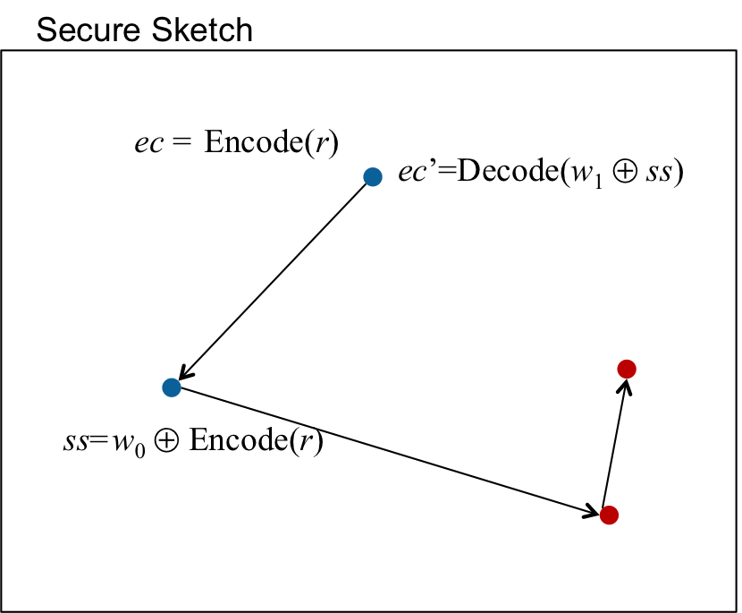
Fuzzy Extractors
Transform the noisy features to a key
Provide error correction
Derive a key
Error correction material should hide the source value
Fuzzy Extractors derive keys from noisy data
[DodisOstrovskyReyzinSmith08]
Error-correct the source using a Secure Sketch
Derive a key using a randomness extractor
If w₀ and w₁ are close then w₀ = ec’ ⊕ ss, and
Converts high entropy sources to uniform H∞(W₀)≥ k Ext (W ) ≈ U
Ext
Notes:
Need to update picture

Slide 46
Fuzzy Extractors
Transform the noisy features to a key
Provide error correction
Derive a key
Error correction material should hide information should not reveal the source value
Fuzzy Extractors derive keys from noisy data
[DodisOstrovskyReyzinSmith08]
Error-correct the source using a Secure Sketch
Derive a key using a randomness extractor
Secure Sketch
ec = Encode(r)
ec’=Decode(w₁ ⊕ ss)
ss=w₀ ⊕ Encode(r)
Converts high entropy sources to the uniform distribution H∞(W₀)≥ k then Ext (W ) ≈ U
If w₀ and w₁ are close then w₀ = ec’ ⊕ ss, and w₀ is information theoretically unknown (knowing ss):

Slide 47
Another View of Secure Sketches
Secure Sketch
Secure Sketches Transform a code C into a code C’ where the original biometric reading is a codeword
Secure Sketches reveals the shift between C and C’
This is the number of redundant bits in the code
Equal to radius of each ball (in a perfect code)
This drops the information theoretic entropy of the biometric by the radius of each ball
C
C’
p
p’

Slide 48
Randomness w/ Variable Sampling Length
Assume the Gaussian algorithm requires 4 or 5 bits (determined by 1st bit)
w₀
10101 11111 00100 11010 10101 11010 10101
e₀
1010 1111 1100 1001 1010 1010 1110
w₁
00101 11101 00100 11010 10101 11010 10101
e₁
00101 1110 1001 00110 1010 1011 1010
d(w₀ , w₁)=1
d(e₀ , e₁)=7

Slide 49
Solving random linear equations
Gaussian Elimination!
What happens if we add small errors?
Small errors seem to make the problem difficult
Syndrome decoding of random linear code is NP-hard
Recovering x known as Learning with Errors (LWE)

Slide 50
Learning with Errors
Gaussian Elimination!
What happens if we add small errors?
Small errors seem to make the problem difficult
Syndrome decoding of random linear code is NP-hard
Recovering x known as Learning with Errors (LWE)

Slide 51
Learning with Errors
Gaussian Elimination!
What happens if we add small errors?
Small errors seem to make the problem difficult
Syndrome decoding of random linear code is NP-hard
Recovering x known as Learning with Errors (LWE)

Slide 52
Learning with Errors
n
A
A
x
e
b
m
+
=
,
Gaussian Elimination!
What happens if we add small errors?
Small errors seem to make the problem difficult
Syndrome decoding of random linear code is NP-hard
Recovering x known as Learning with Errors (LWE)

Slide 53
Our construction
What happens if we replace the code in our previous sketch with a random linear code?
Issues:
Creating/finding a pseudorandom key?
Use hardcore bits of codeword.
Finding efficient decoding algorithm for small d_{max}.
Trial and error inversion
Proving security for different types of distributions W₀
Gen ( w₀ ):
Sample uniformly
Compute
Output (key, p)
Rep ( w₁ , p):
Parse p as:
Compute
3. Invert C-w₁, output key

Slide 54
Our construction
What happens if we replace the code in our previous sketch with a random linear code?
Issues:
Creating/finding a pseudorandom key?
Use hardcore bits of codeword.
Finding efficient decoding algorithm for small d_{max}.
Trial and error inversion
Proving security for different types of distributions W₀
Extend LWE when some dimensions have known error
Gen ( w₀ ):
Sample uniformly
Compute
Output (key, p)
Rep ( w₁ , p):
Parse p as:
Compute
3. Invert C-w₁, output key
W=W_{1,…,n} is a block fixing source if

Slide 55
Finding a key
Source
Public (p)
n/2
n/2
key
A₁
A₂
A₁
A₂
x₁
w₀
e
b
x₂
m
+
=
,
We use hardcore bits of x as our key:
[AkaviaGoldwasserKalai09] show if LWE is secure on A₁, A₁x₁+w₀ then x₂ | A, b is pseudorandom
Our construction:
Preserves distance: if d(w₀, w₁) < d_{max} then d(Ax+w₀, Ax+w₁) < d_{max}
fff

Slide 56
Our construction
What happens if we replace the code in our previous sketch with a random linear code?
Issues:
Creating/finding a pseudorandom key?
Use hardcore bits of codeword.
Finding efficient decoding algorithm for small d_{max}.
Trial and error inversion
Proving security for different types of distributions W₀
Extend security for block-fixing sources
Gen ( w₀ ):
Sample uniformly
Compute
Output (key, p)
Rep ( w₁ , p):
Parse p as:
Compute
3. Invert C-w₁, output key
W=W_{1,…,m} is a block fixing source if
Theorem 4 implies our construction is secure if W = W_{1,…, m} is a block fixing source (assuming enough blocks are uniform)

