Slide 1

Key Derivation from Noisy Sources with More Errors than Entropy
Ran Canetti, Benjamin Fuller, Omer Paneth, Leonid Reyzin, and Adam Smith
(also Penn State, Tel Aviv University, MIT Lincoln Labs)
Oct 1, 2014
Notes:
1
1

Slide 2
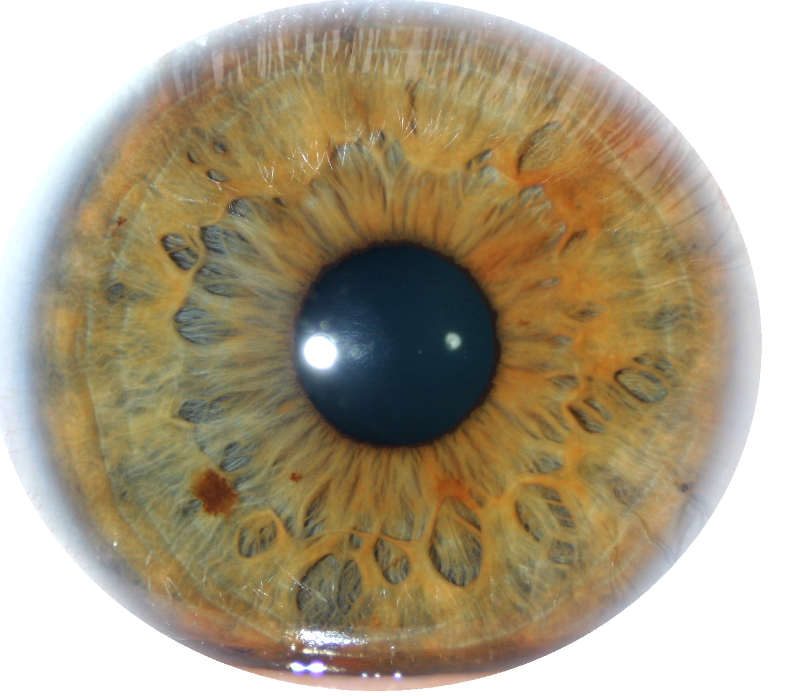
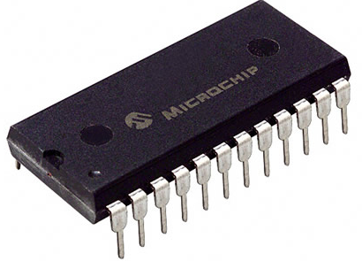
Key Derivation from Noisy Sources
Physically Unclonable Functions (PUFs)
Biometric Data
High-entropy sources are often noisy
Initial reading w₀ ≠ later reading reading w₁
Assume a bound on distance: d(w₀, w₁) ≤ t
Goal: derive a stable cryptographically strong output
Want w₀, w₁ to map to same output
The output should look uniform to the adversary
Goal of this talk: produce good outputs in scenarios we couldn’t handle before
Notes:
http://sigma.octopart.com/14152599/image/Microchip-TC14433EPG.jpg
http://www.drgaelriverz.com/images/Round_Eye.JPG

Slide 3
Fuzzy Extractors: Functionality [Wyner75] … [BennettBrassardRobert85] …lots of work… [DodisOstrovskyReyzinSmith04] …
Enrollment algorithm Gen: Take a measurement w₀ from the source. Use it to “lock up” a random output in a nonsecret value p.
Subsequent algorithm Rep: give same output if d(w₀, w₁) < t
Security: r looks uniform even given p, whenever the source is good enough
Gen
r
w₀
Rep
p
r
< t
w₁

Slide 4
Fuzzy Extractors: Goals
Goal 1: handle as many sources as possible (typically, any source in which w₀ is 2^{k} hard to guess)
Goal 2: handle as much error as possible (typically, any w₁ within distance t)
Most previous approaches are analyzed in terms of t and k
This work: handle t > k
Gen
r
entropy k
w₀
Rep
p
r
< t
w₁

Slide 5
Fuzzy Extractors: Typical Construction
- derive r using a randomness extractor
(converts high-entropy sources to uniform, e.g., via universal hashing)
- correct errors using a secure sketch
(gives recovery of the original from a noisy signal e.g., via the “checksum” bits of an error-correcting code)
Gen
r
entropy k
w₀
Ext
Rep
p
r
< t
Ext
w₁

Slide 6
Fuzzy Extractors: Typical Construction
- derive r using a randomness extractor
(converts high-entropy sources to uniform, e.g., via universal hashing)
- correct errors using a secure sketch
(gives recovery of the original from a noisy signal e.g., via the “checksum” bits of an error-correcting code)
Gen
r
entropy k
w₀
Ext
Rep
p
r
w₀
< t
Sketch
Ext
Rec
w₁

Slide 7
Problem with Secure Sketches
p must store enough information to let you recover w₀
How much information is that?
Gen
r
entropy k
w₀
Ext
Rep
p
r
w₀
< t
Sketch
Ext
Rec
w₁

Slide 8
Problem with Secure Sketches
p must store enough information to let you recover w₀
How much information is that?
w₀ could be anywhere within distance t, so log|B_{t} | > t bits
No security left if t > k (can be made rigorous for large classes of sources)
Our approach: give up on trying to recover w₀
stores t bits about w₀
has k < t bits of entropy
Rep
w₀
p
r
B_{t}
w₀
< t
Ext
Rec
w₁
Notes:
ADS: Is giving up on reconstruction really the contribution here?

Slide 9
Is it possible to handle “more errors than entropy” (t > k)?
Consider some distribution for w₀ with entropy k
Suppose t > k
Then B_{t} > 2^{k}
Possibly |B_{t}| > # of possibilities for w₀
Possibly all w₀ lie in a single ball
No matter what we do, adversary can get the output by running Rep on w₁ = center of that ball
No construction that is analyzed only in terms of t and k can be secure!
E.g., irises: log |B_{t}| ≈ 900 but k ≈ 250
t
r
w₁
Rep
Notes:
ADS: Bullet structure too simple here: these items don’t all belong in one list

Slide 10
Is it possible to handle “more errors than entropy” (t > k)?
Consider some distribution for w₀ with entropy k
Suppose t > k
Then B_{t} > 2^{k}
Possibly |B_{t}| > # of possibilities for w₀
Possibly all w₀ lie in a single ball
No matter what we do, adversary can get the output by running Rep on w₁ = center of that ball
No construction that is analyzed only in terms of t and k can be secure!
E.g., irises: log |B_{t}| ≈ 900 but k ≈ 250
But not all in a single ball!
t
r
w₁
Rep
Moral: our constructions will exploit structure in the source (not “any source of a given k” like prior work)

Slide 11
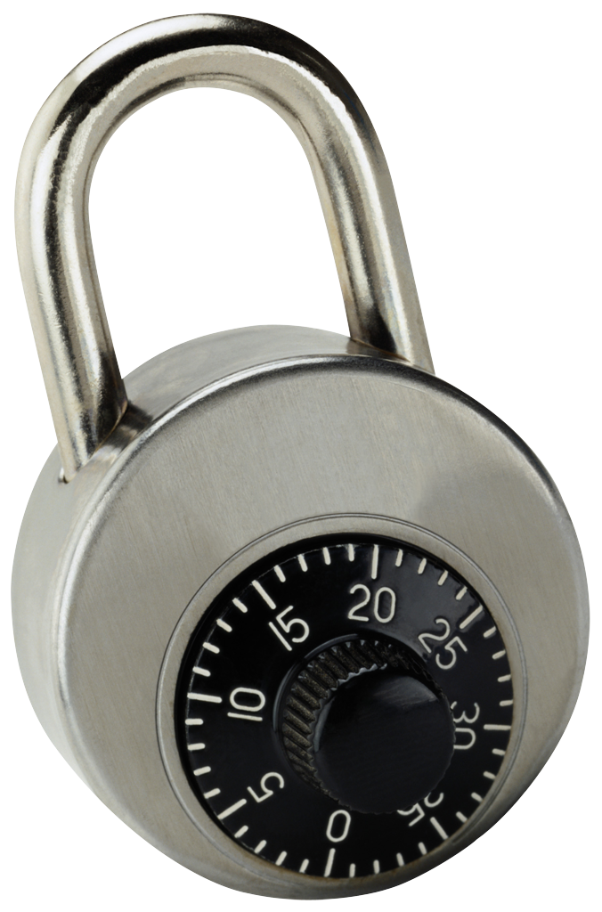
Idea: “encrypt” r using parts of w₀
Source: a string of symbols, arbitrary alphabet
Errors: Hamming
Gen: - get random combinations of symbols in w₀
r
- “lock” r using these combinations
r
w₀ = a₁ a₂ a₃ a₄ a₅ a₆ a₇ a₈ a₉
Gen
p
r
r
r
r
r
r
r
r
r
r
r
r
a₁ a₉ a₂
a₃ a₉ a₅
a₃ a₄ a₅
a₇ a₅ a₆
a₂ a₈ a₇
a₃ a₅ a₂

Slide 12
Idea: “encrypt” r using parts of w₀
Source: a string of symbols, arbitrary alphabet
Errors: Hamming
Gen: - get random combinations of symbols in w₀
r
- “lock” r using these combinations
r
w₀ = a₁ a₂ a₃ a₄ a₅ a₆ a₇ a₈ a₉
Gen
p
r
r
r
r
r
r
r
r
r
r
r
r
a₁ a₉ a₂
a₃ a₉ a₅
a₃ a₄ a₅
a₇ a₅ a₆
a₂ a₈ a₇
a₃ a₅ a₂

Slide 13
Idea: “encrypt” r using parts of w₀
Source: a string of symbols, arbitrary alphabet
Errors: Hamming
Gen: - get random combinations of symbols in w₀
r
- “lock” r using these combinations
r
w₀ = a₁ a₂ a₃ a₄ a₅ a₆ a₇ a₈ a₉
Gen
p
r
r
r
r
r
r
r
r
r
r
r
r
a₁ a₉ a₂
a₃ a₉ a₅
a₃ a₄ a₅
a₇ a₅ a₆
a₂ a₈ a₇
a₃ a₅ a₂

Slide 14
Idea: “encrypt” r using parts of w₀
Source: a string of symbols, arbitrary alphabet
Errors: Hamming
Gen: - get random combinations of symbols in w₀
r
- “lock” r using these combinations
- = locks + positions of symbols needed to unlock
p
r
w₀ = a₁ a₂ a₃ a₄ a₅ a₆ a₇ a₈ a₉
Gen
p
r
r
r
r
r
r
a₁ a₉ a₂
a₃ a₉ a₅
a₃ a₄ a₅
a₇ a₅ a₆
a₂ a₈ a₇
a₃ a₅ a₂

Slide 15
Idea: “encrypt” r using parts of w₀
Source: a string of symbols, arbitrary alphabet
Errors: Hamming
Gen: - get random combinations of symbols in w₀
r
- “lock” r using these combinations
- = locks + positions of symbols needed to unlock
p
r
w₀ = a₁ a₂ a₃ a₄ a₅ a₆ a₇ a₈ a₉
Gen
p
r
r
r
r
r
r
a₁ a₉ a₂
a₃ a₉ a₅
a₃ a₄ a₅
a₇ a₅ a₆
a₂ a₈ a₇
a₃ a₅ a₂

Slide 16
Idea: “encrypt” r using parts of w₀
Source: a string of symbols, arbitrary alphabet
Errors: Hamming
Gen: - get random combinations of symbols in w₀
r
- “lock” r using these combinations
- = locks + positions of symbols needed to unlock
p
p
r
r
r
r
r
r
a₁ a₉ a₂
a₃ a₉ a₅
a₃ a₄ a₅
a₇ a₅ a₆
a₂ a₈ a₇
a₃ a₅ a₂

Slide 17
Idea: “encrypt” r using parts of w₀
Source: a string of symbols, arbitrary alphabet
Errors: Hamming
Gen: - get random combinations of symbols in w₀
r
- “lock” r using these combinations
- = locks + positions of symbols needed to unlock
p
Rep:
w₁ = a₁ a₂ a₃ a₄ a₅ a₆ a₇ a₈ a₉
r
Rep
p
r
r
r
r
r
r
a₁ a₉ a₂
a₃ a₉ a₅
a₃ a₄ a₅
a₇ a₅ a₆
a₂ a₈ a₇
a₃ a₅ a₂

Slide 18
Idea: “encrypt” r using parts of w₀
Source: a string of symbols, arbitrary alphabet
Errors: Hamming
Gen: - get random combinations of symbols in w₀
r
- “lock” r using these combinations
- = locks + positions of symbols needed to unlock
p
Rep:
w₁ = a₁ a₂ a₃ a₄ a₅ a₆ a₇ a₈ a₉
r
Rep
p
r
r
r
r
r
r
a₁ a₉ a₂
a₃ a₉ a₅
a₃ a₄ a₅
a₇ a₅ a₆
a₂ a₈ a₇
a₃ a₅ a₂

Slide 19
Idea: “encrypt” r using parts of w₀
Source: a string of symbols, arbitrary alphabet
Errors: Hamming
Gen: - get random combinations of symbols in w₀
r
- “lock” r using these combinations
- = locks + positions of symbols needed to unlock
p
Rep: Use the symbols of w₁ to open at least one lock
w₁ = a₁ a₂ a₃ a₄ a₅ a₆ a₇ a₈ a₉
r
Rep
p
r
r
r
r
r
r
a₁ a₉ a₂
a₃ a₉ a₅
a₃ a₄ a₅
a₇ a₅ a₆
a₂ a₈ a₇
a₃ a₅ a₂

Slide 20
Idea: “encrypt” r using parts of w₀
Source: a string of symbols, arbitrary alphabet
Errors: Hamming
Gen: - get random combinations of symbols in w₀
r
- “lock” r using these combinations
- = locks + positions of symbols needed to unlock
p
Rep: Use the symbols of w₁ to open at least one lock
w₁ = a₁ a₂ a₃ a₄ a₅ a₆ a₇ a₈ a₉
r
Rep
p
r
r
r
r
r
r
r
a₁ a₉ a₂
a₃ a₉ a₅
a₃ a₄ a₅
a₇ a₅ a₆
a₂ a₈ a₇
a₃ a₅ a₂

Slide 21
Idea: “encrypt” r using parts of w₀
Source: a string of symbols, arbitrary alphabet
Errors: Hamming
Gen: - get random combinations of symbols in w₀
r
- “lock” r using these combinations
- = locks + positions of symbols needed to unlock
p
Rep: Use the symbols of w₁ to open at least one lock
Error-tolerance: as long as at least one combination is ok
Security: each combination must have enough entropy
(sampling of symbols must preserve sufficient entropy)
r
r
r
r
r
r
r
a₁ a₉ a₂
a₃ a₉ a₅
a₃ a₄ a₅
a₇ a₅ a₆
a₂ a₈ a₇
a₃ a₅ a₂

Slide 22
How to implement locks?
A lock is the following program:
If input = a₁ a₉ a₂, output r
Else output ⊥
r
a₁ a₉ a₂
Obfuscate this program!
Obfuscation: preserve functionality, hide the program
Obfuscating this specific program gives a “digital locker”: encryption of r that is secure even multiple times with correlated and weak keys [Canetti Kalai Varia Wichs 10]
For this specific program: obfuscation is practical (R.O. or DL-based) [Canetti Dakdouk 08], [Bitansky Canetti 10]
For example (R.O. model): lock = r ⊕ H(a₁ a₉ a₂)
Hiding r as long as the input can’t be exhaustively searched (superlogarithmic entropy)
Notes:
ADS: Say RO construction first? Then say point obfuscation?

Slide 23
How to implement locks?
A lock is the following program:
If input = a₁ a₉ a₂, output r
Else output ⊥
r
a₁ a₉ a₂
Q: if you are going to use obfuscation, why bother? Why not just obfuscate the following program for p
If distance between w₀ and the input is less than t, output r
Else output ⊥
A: you can do that [Bitansky Canetti Kalai Paneth 14], except it’s very impractical + has a very strong assumption

Slide 24
How good is this construction?
We can correct more errors than entropy!
For correctness: t < constant fraction of symbols
Quality of construction depends on on what constitutes a single symbol (explored in paper)
Another construction for t = constant fraction for really large alphabets (in the paper)
w₀ =
OR
r
r
r
r
r
r
a₁ a₉ a₂
a₃ a₉ a₅
a₃ a₄ a₅
a₇ a₅ a₆
a₂ a₈ a₇
a₃ a₅ a₂

Slide 25
How good is this construction?
We can correct more errors than entropy!
For correctness: t < constant fraction of symbols
Quality of construction depends on on what constitutes a single symbol (explored in paper)
Another construction for t = constant fraction for really large alphabets (in the paper)
Note: computational, not information-theoretic, security (a different info-theoretic construction in the paper)
r
r
r
r
r
r
a₁ a₉ a₂
a₃ a₉ a₅
a₃ a₄ a₅
a₇ a₅ a₆
a₂ a₈ a₇
a₃ a₅ a₂
Notes:
ADS: too much text (break it up somehow?)

Slide 26
How good is this construction?
It is reusable!
Same source can be enrolled multiple times with multiple independent services
r
w₀
Gen
p
Secret even given
p, p’,p’’, r, r’'
r'
w₀'
Gen
p'
r''
w₀''
Gen
p''

Slide 27
How good is this construction?
It is reusable!
Same source can be enrolled multiple times with multiple independent services
Follows from composability of obfuscation
In the past: difficult to achieve, because typically new enrollments leak fresh information
Only previous construction [Boyen 2004]: all reading must differ by fixed constants (unrealistic)
Our construction: each reading individually must satisfy our conditions

Slide 28
Conclusion
It is possible to cover sources with more errors than entropy!
Exploit the source
Don’t aim for secure sketches (i.e., full error correction)
It is also possible to get reusability!
Use computational security
t

Slide 29
Follow-up
Minimum necessary condition for fuzzy extraction: weight inside any B_{t} must be small
Let H_{fuzz}(W) = log (1/max wt(B_{t}))
Big H_{fuzz}(W) is necessary
Q: Is big H_{fuzz}(W) sufficient for fuzzy extractors?
A1: Yes if security is computational (obfuscation)
A2: No if security is information-theoretic
A3: No if you try to build a secure sketch
t
r
w₁
Rep
if the adversary knows more about the source than you do
Notes:
ADS: Emphasize “Yes, if FE designer knows a description of the distribution”

