Slide 1
Strong Key Derivation from Biometrics
Benjamin Fuller Privacy Enhancing Technologies for Biometrics
University of Haifa
January 15, 2015
Based on three works:
Computational Fuzzy Extractors [FullerMengReyzin13]
When are Fuzzy Extractors Possible? [FullerSmithReyzin14]
Key Derivation from Noisy Sources with More Errors than Entropy [CanettiFullerPanethSmithReyzin14]
Notes:
1
1

Slide 2
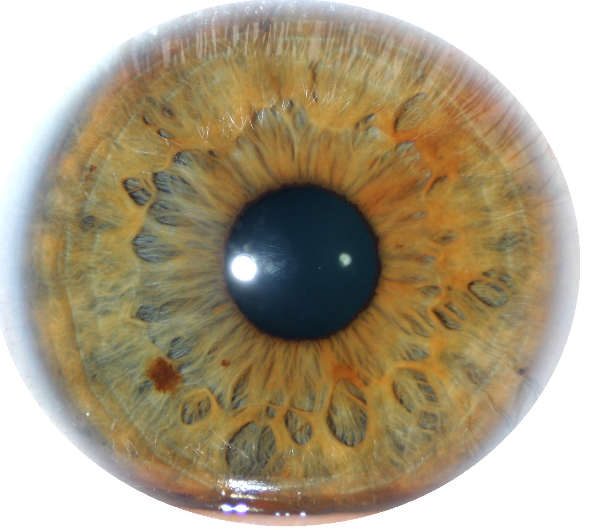
Key Derivation from Noisy Sources
High-entropy sources are often noisy
Initial reading w₀ ≠ later reading reading w₁
Consider sources w₀ = a₁,…, a_{k}, each symbol a_{i} over alphabet Z
Assume a bound distance: d(w₀, w₁) ≤ t
d(w₀, w₁)=# of symbols in that differ
Biometric Data
d(w₀, w₁)=4
w₀
A | B | C | A | D | B | E | F | A | A
A | G | C | A | B | B | E | F | C | B
w₁
Notes:
http://sigma.octopart.com/14152599/image/Microchip-TC14433EPG.jpg
http://www.drgaelriverz.com/images/Round_Eye.JPG

Slide 3
Key Derivation from Noisy Sources
High-entropy sources are often noisy
Initial reading w₀ ≠ later reading reading w₁
Consider sources w₀ = a₁,…, a_{k}, each symbol a_{i} over alphabet Z
Assume a bound distance: d(w₀, w₁) ≤ t
Goal: derive a stable cryptographically strong output
Want w₀, w₁ to map to same output
The output should look uniform to the adversary
Biometric Data
Goal of this talk: produce good outputs for sources we couldn’t handle before
Notes:
http://sigma.octopart.com/14152599/image/Microchip-TC14433EPG.jpg
http://www.drgaelriverz.com/images/Round_Eye.JPG

Slide 4
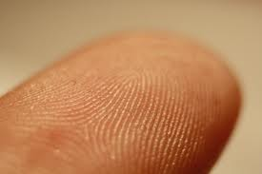
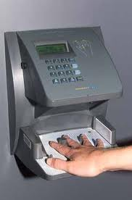
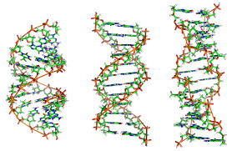
Biometrics
Measure unique physical phenomenon
Unique, collectable, permanent, universal
Repeated readings exhibit significant noise
Uniqueness/Noise vary widely
Human iris believed to be “best” [Daugman04], [PrabhakarPankantiJain03]
Theoretic work, with iris in mind

Slide 5

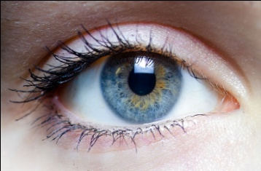

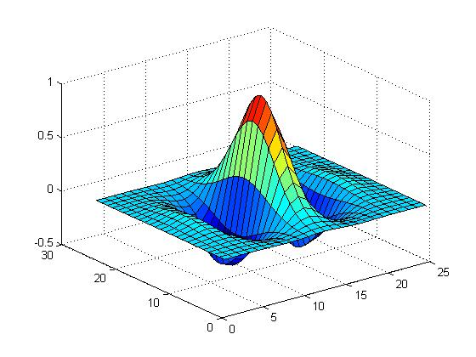


Iris Codes [Daugman04]
Locating the iris
Iris unwrapping
Iris code
Fuzzy Extractor
*
Filtering and 2-bit phase quantization
Iris code: sequence of quantized wavelets (computed at different positions)
Daugman’s transform is 2048 bits long
Entropy estimate 249 bits
Error rate depends on conditions, user applications 10%
Notes:
We explored human iris.
This is how it is typically used today: the iris image is captured and transformed into an iris code.
Then today, typically, this iris code is matched against a template to provide authentication.
We want to change this – (1) instead of one bit output of the matching we would like to extract a cryptographically strong key, every time the same for the same iris on the input.
We use a cryptographic construct called Fuzzy Extractors and it is closely related to Error-Correcting Codes.

Slide 6


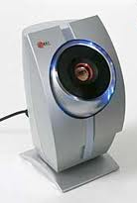
Two Physical Processes
w₀
Uncertainty
w₀ – create a new biometric, take initial reading
w₁
Errors
w₁ – take new reading from a fixed person
Two readings may not be subject to same noise. Often less error in original reading

Slide 7
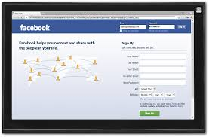
Key Derivation from Noisy Sources
Interactive Protocols [Wyner75] … [BennettBrassardRobert85,88] …lots of work…
User must store initial reading w₀ at server
w₀
w₁
Not appropriate for user authenticating to device
Parties agree on cryptographic key

Slide 8
Fuzzy Extractors: Functionality [JuelsWattenberg99], …, [DodisOstrovskyReyzinSmith04] …
Enrollment algorithm Gen: Take a measurement w₀ from the source. Use it to “lock up” random r in a nonsecret value p.
Subsequent algorithm Rep: give same output if d(w₀, w₁) < t
Security: r looks uniform even given p, when the source is good enough
Traditionally, security def. is information theoretic
Gen
r
w₀
Rep
p
r
< t
w₁

Slide 9
Fuzzy Extractors: Goals
Goal 1: handle as many sources as possible (typically, any source in which w₀ is 2^{k}-hard to guess)
Goal 2: handle as much error as possible (typically, any w₁ within distance t)
Most previous approaches are analyzed in terms of t and k
Traditional approaches do not support sources with t > k
t > k for the iris
Say: more errors than entropy
Gen
r
entropy k
w₀
Rep
p
r
< t
w₁

Slide 10
Contribution
Lessons on how to construct fuzzy extractors when t > k [FMR13,FRS14]
First fuzzy extractors for large classes of distributions where t > k [CFPRS14]
First Reusable fuzzy extractor for arbitrary correlation between repeated readings [CFPRS14]
Preliminary results on the iris

Slide 11
Fuzzy Extractors: Typical Construction
- derive r using a randomness extractor
(converts high-entropy sources to uniform, e.g., via universal hashing [CarterWegman77])
- correct errors using a secure sketch
[DodisOstrovskyReyzinSmith08]
(gives recovery of the original from a noisy signal)
Gen
r
entropy k
w₀
Ext
Rep
p
r
< t
Ext
w₁

Slide 12
Fuzzy Extractors: Typical Construction
- derive r using a randomness extractor
(converts high-entropy sources to uniform, e.g., via universal hashing [CarterWegman77])
- correct errors using a secure sketch
[DodisOstrovskyReyzinSmith08]
(gives recovery of the original from a noisy signal)
Gen
r
entropy k
w₀
Ext
Rep
p
r
w₀
< t
Sketch
Ext
Rec
w₁

Slide 13
Secure Sketches
Generate
r
w₀
Ext
Reproduce
r
p
< t
Sketch
Rec
Ext
w₁
Code Offset Sketch
[JuelsWattenberg99]
c
p =c ⊕ w₀
C – Error correcting code correcting t errors
Notes:
I’ll start by describing the sketch algorithm.
<click, click>
The sketch I am going to describe is called the “code-offset sketch” in the literature. Assume we have an error correcting code that can correct dmax errors.
<click>
We will start by selecting a random codeword. So we select a random value x and encode x using the error correcting code. We will use this ec value as a mask for our value w_0.
<click>
Our public value p will be the exclusive or of the value ec and our original reading. Remember, we want two properties from p: it should allow recovery from a close value w_1 and it shouldn’t give much information about w_0.

Slide 14
Secure Sketches
Generate
r
w₀
Ext
Reproduce
r
p
< t
Sketch
Rec
Ext
w₁
Code Offset Sketch
[JuelsWattenberg99]
c
c’=Decode(c*)
If decoding succeeds, w₀ = c’ ⊕ p.
p ⊕ w₁ = c*
p =c ⊕ w₀
C – Error correcting code correcting t errors
Notes:
I’ll now show have the first property is fulfilled.
<click>
This is done in the Recovery function.
<click>
So the recovery function has just the public value p and the new reading w_1.
<click>
It adds these two values together.
<click>
We then run the decoding procedure of the error correcting code on this value p\oplus w_1. This gives us a value ec’.
<click>
If w_0 and w_1 are within the decoding radius for the error correcting code then ec’ = ec. This means we can recover the value w_0 from a close w_1.

Slide 15
Secure Sketches
Generate
r
w₀
Ext
Reproduce
r
p
> t
Sketch
Rec
Ext
w’₁
Code Offset Sketch
[JuelsWattenberg99]
Goal: minimize how much p informs on w₀.
p ⊕ w₁ = c*
p =c ⊕ w₀
C – Error correcting code correcting t errors
p ⊕ w’₁
Notes:
We will now work on the second property. We need the value p not to give much information about w_0.
<click>
Consider the case where we collect a reading from a different source, say w_0’.
<click, click>
This means that p \oplus w_0’ will not be close to the original codeword and decoding will give an unrelated value.
<click> Formally, we can say that W_0 retains high entropy even conditioned on the public value p. This is the main novel contribution of a secure sketch (otherwise we could just provide error correcting information.
<click>
Recall the starting entropy was k. We will call k-k’ the entropy loss of a secure sketch. This value is important as it determines the strength of our key.
<click>
In particular, the extractor must be able to produce a good key with only k’ bits of entropy.

Slide 16
Outline
Key Derivation from Noisy Sources
Fuzzy Extractors
Limitations of Traditional Approaches/Lessons
New Constructions

Slide 17
Is it possible to handle “more errors than entropy” (t > k)?
This distribution has 2^{k} points
Why might we hope to extract from this distribution?
Points are far apart
No need to deconflict original reading
Support of w₀
w₁
Notes:
ADS: Bullet structure too simple here: these items don’t all belong in one list

Slide 18
Is it possible to handle “more errors than entropy” (t > k)?
Support of w₀
Support of v₀
r
Since t > k there is a distribution v₀ where all points lie in a single ball
Left and right have same number of points and error tolerance
Notes:
ADS: Bullet structure too simple here: these items don’t all belong in one list

Slide 19
Is it possible to handle “more errors than entropy” (t > k)?
Support of w₀
Support of v₀
t
?
r
r
Rep
t
r
r
w₁
Rep
v₁
r
The likelihood of adversary picking a point w₁ close enough to recover r is low
For any construction adversary learns r by running with v₁
Recall: adversary can run Rep on any point
Notes:
ADS: Bullet structure too simple here: these items don’t all belong in one list

Slide 20
Is it possible to handle “more errors than entropy” (t > k)?
To distinguish between w₀ and v₀ must consider more than just t and k
Support of w₀
Support of v₀
t
?
r
Rep
t
r
r
w₁
Rep
v₁
r
The likelihood of adversary picking a point w₁ close enough to recover r is low
For any construction adversary learns r by running with v₁
Key derivation may be possible for w₀, impossible for v₀

Slide 21
Lessons
Exploit structure of source beyond entropy
Need to understand what structure is helpful

Slide 22
Understand the structure of source
Minimum necessary condition for fuzzy extraction: weight inside any B_{t} must be small
Let H_{fuzz}(W₀) = log (1/max wt(B_{t}))
Big H_{fuzz}(W₀) is necessary
Models security in ideal world
Q: Is big H_{fuzz}(W₀) sufficient for fuzzy extractors?
t
r
w₁
Rep

Slide 23
Is big H_{fuzz}(W₀) sufficient?
Thm [FRS]: Yes, if algorithms know exact distribution of W₀
Imprudent to assume construction and adversary have same view of W₀
Should assume adversary knows more about W₀
Deal with adversary knowledge by providing security for family V of W₀, security should hold for whole family
Thm [FRS]: No if W₀ is only known to come from a family V
A3: Yes if security is computational (using obfuscation) [Bitansky Canetti Kalai Paneth 14]
A4: No if security is information-theoretic
A5: No if you try to build (computational) secure sketch
Will show negative result for secure sketches (negative result for fuzzy extractors more complicated)

Slide 24
Thm [FRS]: No if W₀ comes from a family V
Describe a family of distributions V
For any fuzzy extractor Gen, Rep for most W₀ in V, few w* in W₀ could produce p
Implies W₀ has little entropy conditioned on p
Rep
w₀
p
B_{t}
w₀
< t
Rec
w₁

Slide 25
Now we’ll consider family V, Adv. goal: most W in V, impossible to have many augmented fixed points
Adversary specifies V
Goal: build Sketch, Rec maximizing H(W | p), for all W in V
First consider one dist. W
For w₀, Rec(w₀, p) =w₀
For nearby w₁, Rec(w₁, p) = w₀
Call augmented fixed point
To maximize H(W | p) make as many points of W augmented fixed points
Augmented fixed points at least distance t apart (exponentially small fraction of space)
W
w₀ = Rec(w₀, p)
w₁

Slide 26
Adversary specifies V
Goal: build Sketch, Rec maximizing H(W | p), for all W in V
Sketch must create augmented fixed points based only on w₀
Build family with many possible distributions for each w₀
Sketch can’t tell W from w₀
W
w₀

Slide 27
Adversary specifies V
Goal: build Sketch, Rec maximizing H(W | p), for all W in V
Sketch must create augmented fixed points based only on w₀
Build family with many possible distributions for each w₀
Sketch can’t tell W from w₀
W
w₀

Slide 28
Adversary specifies V
Goal: build Sketch, Rec maximizing H(W | p), for all W in V
Sketch must create augmented fixed points based only on w₀
Build family with many possible distributions for each w₀
Sketch can’t tell W from w₀
W
w₀

Slide 29
Adversary specifies V
Goal: build Sketch, Rec maximizing H(W | p), for all W in V
Sketch must create augmented fixed points based only on w₀
Build family with many possible distributions for each w₀
Sketch can’t tell W from w₀
Distributions only share w₀
Sketch must include augmented fixed points from all distributions with w₀
Adversary knows color of w₀
Viable points set by Gen
w₀

Slide 30
Adversary specifies V
Goal: build Sketch, Rec maximizing H(W | p), for all W in V
Sketch must create augmented fixed points based only on w₀
Build family with many possible distributions for each w₀
Sketch can’t tell W from w₀
Distributions only share w₀
Sketch must include augmented fixed points from all distributions with w₀
Adversary knows color of w₀
Viable points set by Gen
Maybe this was a bad choice of viable points?
w₀
Adversary’s search space

Slide 31
Adversary specifies V
Goal: build Sketch, Rec maximizing H(W | p), for all W in V
Sketch must create augmented fixed points based only on w₀
Build family with many possible distributions for each w₀
Sketch can’t tell W from w₀
Distributions only share w₀
Sketch must include augmented fixed points from all distributions with w₀
Adversary knows color of w₀
Alternative Points
w₀

Slide 32
Thm: Sketch, Rec can include at most 4 augmented fixed points from members of V on average
Adversary specifies V
Goal: build Sketch, Rec maximizing H(W | p), for all W in V
Sketch must create augmented fixed points based only on w₀
Build family with many possible distributions for each w₀
Sketch can’t tell W from w₀
Distributions only share w₀
Sketch must include augmented fixed points from all distributions with w₀
Adversary knows color of w₀
Alternative Points
w₀
Adversary’s search space

Slide 33
Is big H_{fuzz}(W₀) sufficient?
Thm [FRS]: Yes, if algorithms know exact distribution of W₀
Imprudent to assume construction and adversary have same view of W₀
Deal with adversary knowledge by providing security for family V of W₀, security should hold for whole family
Thm [FRS]: No if adversary knows more about W₀ than fuzzy extractor creator
A3: Yes if security is computational (using obfuscation) [Bitansky Canetti Kalai Paneth 14]
A4: No if security is information-theoretic
A5: No if you try to build (computational) secure sketch
Fuzzy extractors defined information-theoretically (used info-theory tools),
No compelling need for info-theory security

Slide 34
Lessons
Stop using secure sketches
Define objects computationally
Thm [FMR13]: Natural definition of computational secure sketches (pseudo entropy) limited:
Stop using secure sketches
Can build sketches with info-theoretic security from sketches that provide computational security

Slide 35
Outline
Key Derivation from Noisy Sources
Traditional Fuzzy Extractors
Lessons
Exploit structure of source beyond entropy
Define objects computationally
Stop using secure sketches
New Constructions

Slide 36

Idea [CFPRS14]: “encrypt” r using parts of w₀
Gen: - get random combinations of symbols in w₀
r
- “lock” r using these combinations
r
w₀ = a₁ a₂ a₃ a₄ a₅ a₆ a₇ a₈ a₉
Gen
p
r
r
r
r
r
r
r
r
r
r
r
r
a₁ a₉ a₂
a₃ a₉ a₅
a₃ a₄ a₅
a₇ a₅ a₆
a₂ a₈ a₇
a₃ a₅ a₂

Slide 37
Idea [CFPRS14]: “encrypt” r using parts of w₀
Gen: - get random combinations of symbols in w₀
r
- “lock” r using these combinations
r
w₀ = a₁ a₂ a₃ a₄ a₅ a₆ a₇ a₈ a₉
Gen
p
r
r
r
r
r
r
r
r
r
r
r
r
a₁ a₉ a₂
a₃ a₉ a₅
a₃ a₄ a₅
a₇ a₅ a₆
a₂ a₈ a₇
a₃ a₅ a₂

Slide 38
Idea [CFPRS14]: “encrypt” r using parts of w₀
Gen: - get random combinations of symbols in w₀
r
- “lock” r using these combinations
r
w₀ = a₁ a₂ a₃ a₄ a₅ a₆ a₇ a₈ a₉
Gen
p
r
r
r
r
r
r
r
r
r
r
r
r
a₁ a₉ a₂
a₃ a₉ a₅
a₃ a₄ a₅
a₇ a₅ a₆
a₂ a₈ a₇
a₃ a₅ a₂

Slide 39
Idea [CFPRS14]: “encrypt” r using parts of w₀
Gen: - get random combinations of symbols in w₀
r
- “lock” r using these combinations
- = locks + positions of symbols needed to unlock
p
r
w₀ = a₁ a₂ a₃ a₄ a₅ a₆ a₇ a₈ a₉
Gen
p
r
r
r
r
r
r
a₁ a₉ a₂
a₃ a₉ a₅
a₃ a₄ a₅
a₇ a₅ a₆
a₂ a₈ a₇
a₃ a₅ a₂

Slide 40
Idea [CFPRS14]: “encrypt” r using parts of w₀
Gen: - get random combinations of symbols in w₀
r
- “lock” r using these combinations
- = locks + positions of symbols needed to unlock
p
r
w₀ = a₁ a₂ a₃ a₄ a₅ a₆ a₇ a₈ a₉
Gen
p
r
r
r
r
r
r
a₁ a₉ a₂
a₃ a₉ a₅
a₃ a₄ a₅
a₇ a₅ a₆
a₂ a₈ a₇
a₃ a₅ a₂

Slide 41
Idea [CFPRS14]: “encrypt” r using parts of w₀
Gen: - get random combinations of symbols in w₀
r
- “lock” r using these combinations
- = locks + positions of symbols needed to unlock
p
p
r
r
r
r
r
r
a₁ a₉ a₂
a₃ a₉ a₅
a₃ a₄ a₅
a₇ a₅ a₆
a₂ a₈ a₇
a₃ a₅ a₂

Slide 42
Idea [CFPRS14]: “encrypt” r using parts of w₀
Gen: - get random combinations of symbols in w₀
r
- “lock” r using these combinations
- = locks + positions of symbols needed to unlock
p
Rep:
w₁ = a₁ a₂ a₃ a₄ a₅ a₆ a₇ a₈ a₉
r
Rep
p
r
r
r
r
r
r
a₁ a₉ a₂
a₃ a₉ a₅
a₃ a₄ a₅
a₇ a₅ a₆
a₂ a₈ a₇
a₃ a₅ a₂

Slide 43
Idea [CFPRS14]: “encrypt” r using parts of w₀
Gen: - get random combinations of symbols in w₀
r
- “lock” r using these combinations
- = locks + positions of symbols needed to unlock
p
Rep:
w₁ = a₁ a₂ a₃ a₄ a₅ a₆ a₇ a₈ a₉
r
Rep
p
r
r
r
r
r
r
a₁ a₉ a₂
a₃ a₉ a₅
a₃ a₄ a₅
a₇ a₅ a₆
a₂ a₈ a₇
a₃ a₅ a₂

Slide 44
Idea [CFPRS14]: “encrypt” r using parts of w₀
Gen: - get random combinations of symbols in w₀
r
- “lock” r using these combinations
- = locks + positions of symbols needed to unlock
p
Rep: Use the symbols of w₁ to open at least one lock
w₁ = a₁ a₂ a₃ a₄ a₅ a₆ a₇ a₈ a₉
r
Rep
p
r
r
r
r
r
r
a₁ a₉ a₂
a₃ a₉ a₅
a₃ a₄ a₅
a₇ a₅ a₆
a₂ a₈ a₇
a₃ a₅ a₂

Slide 45
Idea [CFPRS14]: “encrypt” r using parts of w₀
Gen: - get random combinations of symbols in w₀
r
- “lock” r using these combinations
- = locks + positions of symbols needed to unlock
p
Rep: Use the symbols of w₁ to open at least one lock
w₁ = a₁ a₂ a₃ a₄ a₅ a₆ a₇ a₈ a₉
r
Rep
p
r
r
r
r
r
r
r
a₁ a₉ a₂
a₃ a₉ a₅
a₃ a₄ a₅
a₇ a₅ a₆
a₂ a₈ a₇
a₃ a₅ a₂

Slide 46
Idea [CFPRS14]: “encrypt” r using parts of w₀
Gen: - get random combinations of symbols in w₀
r
- “lock” r using these combinations
- = locks + positions of symbols needed to unlock
p
Rep: Use the symbols of w₁ to open at least one lock
Error-tolerance: one combination must unlock with high probability
Security: each combination must have enough entropy
(sampling of symbols must preserve sufficient entropy)
r
r
r
r
r
r
r
a₁ a₉ a₂
a₃ a₉ a₅
a₃ a₄ a₅
a₇ a₅ a₆
a₂ a₈ a₇
a₃ a₅ a₂

Slide 47
How to implement locks?
A lock is the following program:
If input = a₁ a₉ a₂, output r
Else output ⊥
One implementation (R.O. model): lock = r ⊕ H(a₁ a₉ a₂)
r
a₁ a₉ a₂
Ideally: Obfuscate this program
Obfuscation: preserve functionality, hide the program
Obfuscating this specific program called “digital locker”
Notes:
ADS: Say RO construction first? Then say point obfuscation?

Slide 48
Digital Lockers
r
Digital Locker is obfuscation of
If input = a₁ a₉ a₂, output r
Else output ⊥
Equivalent to encryption of r that is secure even multiple times with correlated, weak keys [CanettiKalaiVariaWichs10]
Digital lockers are practical (R.O. or DL-based) [CanettiDakdouk08], [BitanskyCanetti10]
Hides r if input can’t be exhaustively searched (superlogarithmic entropy)
a₁ a₉ a₂

Slide 49
Digital Lockers
r
Digital Locker is obfuscation of
If input = a₁ a₉ a₂, output r
Else output ⊥
Equivalent to encryption of r that is secure even multiple times with correlated and weak keys [CanettiKalaiVariaWichs10]
Digital lockers are practical (R.O. or DL-based) [CanettiDakdouk08], [BitanskyCanetti10]
Hides r if input can’t be exhaustively searched (superlogarithmic entropy)
a₁ a₉ a₂
Q: if you are going to use obfuscation, why bother? Why not just obfuscate the following program for p
If distance between w₀ and the input is less than t, output r
Else output ⊥
A: you can do that [BitanskyCanettiKalaiPaneth14], except it’s very impractical + has a very strong assumption

Slide 50
How good is this construction?
Handles sources with t > k
For correctness: t < constant fraction of symbols
r
r
r
r
r
r
a₁ a₉ a₂
a₃ a₉ a₅
a₃ a₄ a₅
a₇ a₅ a₆
a₂ a₈ a₇
a₃ a₅ a₂

Slide 51
How good is this construction?
Handles sources with t > k
For correctness: t < constant fraction of symbols
Construction 2:
Supports t = constant fraction but only for really large alphabets
Construction 3:
Similar parameters but info-theoretic security
Why did I tell you about computation constructional?
r
r
r
r
r
r
a₁ a₉ a₂
a₃ a₉ a₅
a₃ a₄ a₅
a₇ a₅ a₆
a₂ a₈ a₇
a₃ a₅ a₂
Notes:
ADS: too much text (break it up somehow?)

Slide 52
How good is this construction?
It is reusable!
Same source can be enrolled multiple times with multiple independent services
r
w₀
Gen
p
Secret even given
p, p', p'', r, r''
r'
w₀'
Gen
p'
r''
w₀''
Gen
p''

Slide 53
How good is this construction?
It is reusable!
Same source can be enrolled multiple times with multiple independent services
Follows from composability of obfuscation
In the past: difficult to achieve, because typically new enrollments leak fresh information
Only previous construction [Boyen2004]: all reading must differ by fixed constants (unrealistic)
Our construction: each reading individually must satisfy our conditions

Slide 54
How good is this construction?
It is reusable!
Looks promising for the iris
Security: need samples of iris code bits are high entropy
First look: 100 bit sample of iris code has 60 bits of entropy
Correctness: unlock at one lock with high probability
Fuzzy extractors for iris codes should support 10% errors for high probability of recovering key
Takes 170,000 combination locks on 100 bit input (impractical for client server, feasible for personal devices)
Next step: verify irises satisfy properties needed for security of construction

Slide 55
Conclusion
Lessons:
Exploit structure in source
Provide computational security
Don’t use secure sketches (i.e., full error correction)
It is possible to cover sources with more errors than entropy!
Also get reusability!
Preliminary iris results promising
t
Questions?

Slide 56
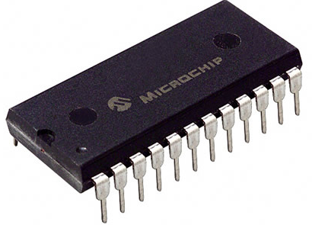
Key Derivation from Noisy Sources
Physically Unclonable Functions (PUFs)
Biometric Data
High-entropy sources are often noisy
Initial reading w₀ ≠ later reading reading w₁
Source w₀ = a₁,…, a_{k}, each symbol a_{i} over alphabet Z
Assume a bound on distance: d(w₀, w₁) ≤ t
Goal: derive a stable cryptographically strong output
Want w₀, w₁ to map to same output
The output should look uniform to the adversary
Goal of this talk: produce good outputs in scenarios we couldn’t handle before
Notes:
http://sigma.octopart.com/14152599/image/Microchip-TC14433EPG.jpg
http://www.drgaelriverz.com/images/Round_Eye.JPG

Slide 57
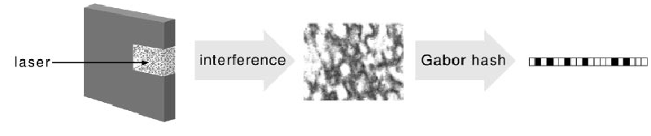
Physical Unclonable Functions (PUFs) [PappuRechtTaylorGershenfeld02]
Hardware that implements random function
Impossible to copy precisely
Large challenge/response space
On fixed challenge, responses close together
interference
Gabor Hash
Laser

Slide 58
Outline
Strong Authentication through Key Derivation
Key Derivation from Biometrics
Limitations of Traditional Approaches/Lessons
New Constructions

Slide 59
Problem with Secure Sketches
p must store enough information to recover w₀
How much information is that?
Gen
r
entropy k
w₀
Ext
Rep
p
r
w₀
< t
Sketch
Ext
Rec
w₁

Slide 60
Problem with Secure Sketches
p must store enough information to recover w₀
How much information is that?
If all Rep knows about source is entropy, w₀ can be anywhere within distance t, so log |B_{t} | > t bits
Current approaches provide no security if t > k
stores t bits about w₀
has k < t bits of entropy
Rep
r
w₀
p
r
B_{t}
w₀
< t
Ext
Rec
w₁

Slide 61
Problem with Secure Sketches
Fuzzy extractors and secure sketches have upper bounds on key length based on error tolerance
Secure sketches subject to stronger bounds
Thm [FMR13]: Secure sketches with computational security limited:
Can build sketches with info-theoretic security from sketches that provide computational security
stores t bits about w₀
has k < t bits of entropy
Rep
r
w₀
p
r
B_{t}
w₀
< t
Ext
Rec
w₁

Slide 62
Lessons
Stop using secure sketches
Subject to strong bounds
Bounds apply with computational security

