Slide 1

Key Derivation from Noisy Sources with More Errors than Entropy
Ran Canetti, Benjamin Fuller, Omer Paneth, Leonid Reyzin, and Adam Smith
(also Penn State, Tel Aviv University, MIT Lincoln Lab)
Oct 22, 2014
Notes:
1
1

Slide 2
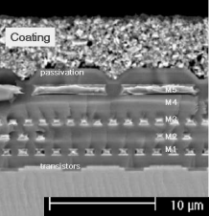
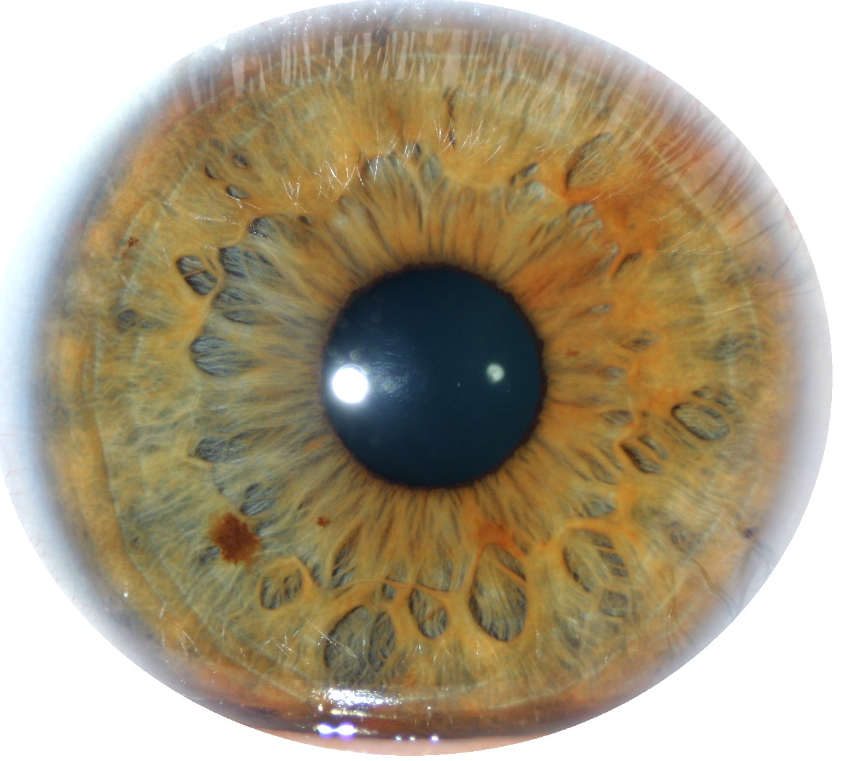
Key Derivation from Noisy Sources
Physically Unclonable Functions (PUFs)
Biometric Data
High-entropy sources are often noisy
Initial reading w₀ ≠ later reading reading w₁
Assume a bound on distance: d(w₀, w₁) ≤ t
Goal: derive a stable cryptographically strong output
Want w₀, w₁ to map to same output
The output should look uniform to the adversary
Goal of this talk: produce good outputs in scenarios we couldn’t handle before
Notes:
http://sigma.octopart.com/14152599/image/Microchip-TC14433EPG.jpg
http://www.drgaelriverz.com/images/Round_Eye.JPG

Slide 3
Fuzzy Extractors: Functionality [Wyner75] … [BennettBrassardRobert85] …lots of work… [DodisOstrovskyReyzinSmith04] …
Enrollment algorithm Gen: Take a measurement w₀ from the source. Use it to “lock up” a random output in a nonsecret value p.
Subsequent algorithm Rep: give same output if d(w₀, w₁) < t
Security: r looks uniform even given p, whenever the source is good enough
Gen
r
w₀
Rep
p
r
< t
w₁

Slide 4
Fuzzy Extractors: Goals
Goal 1: handle as many sources as possible (typically, any source in which w₀ is 2^{k} hard to guess)
Goal 2: handle as much error as possible (typically, any w₁ within distance t)
Most previous approaches are analyzed in terms of t and k
This work: handle t > k
Gen
r
entropy k
w₀
Rep
p
r
< t
w₁

Slide 5
Fuzzy Extractors: Typical Construction
- derive r using a randomness extractor
(converts high-entropy sources to uniform, e.g., via universal hashing)
- correct errors using a secure sketch
(gives recovery of the original from a noisy signal)
Gen
r
entropy k
w₀
Ext
Rep
p
r
< t
Ext
w₁

Slide 6
Fuzzy Extractors: Typical Construction
- derive r using a randomness extractor
(converts high-entropy sources to uniform, e.g., via universal hashing)
- correct errors using a secure sketch
(gives recovery of the original from a noisy signal)
Gen
r
entropy k
w₀
Ext
Rep
p
r
w₀
< t
Sketch
Ext
Rec
w₁

Slide 7
Secure Sketches
Generate
r
w₀
Ext
Reproduce
r
p
< t
Sketch
Rec
Ext
w₁
ec = Gc
Code Offset Sketch
p =ec ⊕ w₀
G – Generating matrix for code that corrects t errors
Notes:
I’ll start by describing the sketch algorithm.
<click, click>
The sketch I am going to describe is called the “code-offset sketch” in the literature. Assume we have an error correcting code that can correct dmax errors.
<click>
We will start by selecting a random codeword. So we select a random value x and encode x using the error correcting code. We will use this ec value as a mask for our value w_0.
<click>
Our public value p will be the exclusive or of the value ec and our original reading. Remember, we want two properties from p: it should allow recovery from a close value w_1 and it shouldn’t give much information about w_0.

Slide 8
Secure Sketches
Generate
r
w₀
Ext
Reproduce
r
p
< t
Sketch
Rec
Ext
w₁
ec = Gc
ec’=Dec(p ⊕ w₁)
Code Offset Sketch
If w₀ and w₁ are close then w₀ = ec’ ⊕ p.
p ⊕ w₁
p =ec ⊕ w₀
G – Generating matrix for code that corrects t errors
Notes:
I’ll now show have the first property is fulfilled.
<click>
This is done in the Recovery function.
<click>
So the recovery function has just the public value p and the new reading w_1.
<click>
It adds these two values together.
<click>
We then run the decoding procedure of the error correcting code on this value p\oplus w_1. This gives us a value ec’.
<click>
If w_0 and w_1 are within the decoding radius for the error correcting code then ec’ = ec. This means we can recover the value w_0 from a close w_1.

Slide 9
Secure Sketches
Generate
r
w₀
Ext
Reproduce
r
p
> t
Sketch
Rec
Ext
w’₁
Code Offset Sketch
p ⊕ w₀
p =ec ⊕ w₀
G – Generating matrix for code that corrects d_{max} errors
p ⊕ w’₁
Notes:
We will now work on the second property. We need the value p not to give much information about w_0.
<click>
Consider the case where we collect a reading from a different source, say w_0’.
<click, click>
This means that p \oplus w_0’ will not be close to the original codeword and decoding will give an unrelated value.
<click> Formally, we can say that W_0 retains high entropy even conditioned on the public value p. This is the main novel contribution of a secure sketch (otherwise we could just provide error correcting information.
<click>
Recall the starting entropy was k. We will call k-k’ the entropy loss of a secure sketch. This value is important as it determines the strength of our key.
<click>
In particular, the extractor must be able to produce a good key with only k’ bits of entropy.

Slide 10
Problem with Secure Sketches
p must store enough information to recover w₀
How much information is that?
Gen
r
entropy k
w₀
Ext
Rep
p
r
w₀
< t
Sketch
Ext
Rec
w₁

Slide 11
Problem with Secure Sketches
p must store enough information to recover w₀
How much information is that?
w₀ could be anywhere within distance t, so log|B_{t} | > t bits
No security left if t > k (can be made rigorous for large classes of sources)
Observation: unnecessary to recover w₀
stores t bits about w₀
has k < t bits of entropy
Rep
w₀
p
r
B_{t}
w₀
< t
Ext
Rec
w₁

Slide 12
Is it possible to handle “more errors than entropy” (t > k)?
This distribution has 2^{k} points
Why might we hope to extract from this distribution?
Points are far apart
No need to deconflict original reading
Extractor can find the nearest point of w₀ in Rep and hash
Support of w₀
w₁
Notes:
ADS: Bullet structure too simple here: these items don’t all belong in one list

Slide 13
Is it possible to handle “more errors than entropy” (t > k)?
Support of w₀
The likelihood of adversary picking a point w₁ close enough to recover r is low
t
?
r
Rep
w₁
Recall: adversary gets access to Rep can provide arbitrary point w₁
Notes:
ADS: Bullet structure too simple here: these items don’t all belong in one list

Slide 14
Is it possible to handle “more errors than entropy” (t > k)?
Support of w₀
Support of v₀
t
?
r
Rep
w₁
Left and right have same number of points and error tolerance
Notes:
ADS: Bullet structure too simple here: these items don’t all belong in one list

Slide 15
Is it possible to handle “more errors than entropy” (t > k)?
Support of w₀
Support of v₀
t
?
r
Rep
t
r
r
w₁
Rep
v₁
r
For any construction adversary learns r by running with v₁
Recall: adversary gets access to Rep can provide arbitrary point w₁
Notes:
ADS: Bullet structure too simple here: these items don’t all belong in one list

Slide 16
Is it possible to handle “more errors than entropy” (t > k)?
To distinguish between v₀ and w₀ must consider more than just t and k
Support of w₀
Support of v₀
t
?
r
Rep
t
r
r
w₁
Rep
v₁
r
For any construction adversary learns r by running with v₁
Key derivation may be possible for w₀, impossible for v₀

Slide 17
Is it possible to handle “more errors than entropy” (t > k)?
To distinguish between v₀ and w₀ must consider more than just t and k
Support of w₀
Support of v₀
t
?
r
Rep
t
r
r
w₁
Rep
w₁
r
For any construction adversary learns r by running with v₁
Moral: our constructions will exploit structure in the source (not “any source of a given k” like prior work)

Slide 18
Hamming Metric
Sources w = a₁,…, a_{k} symbols a_{i} over alphabet Z
d(w₀, w₁)=# of symbols in that differ
w₀
100 | 011 | 101 | 001 | 000 | 110 | 101 | 010 | 111 | 101
100 | 110 | 101 | 001 | 001 | 110 | 101 | 010 | 000 | 100
w₁
d(w₀, w₁)=4

Slide 19
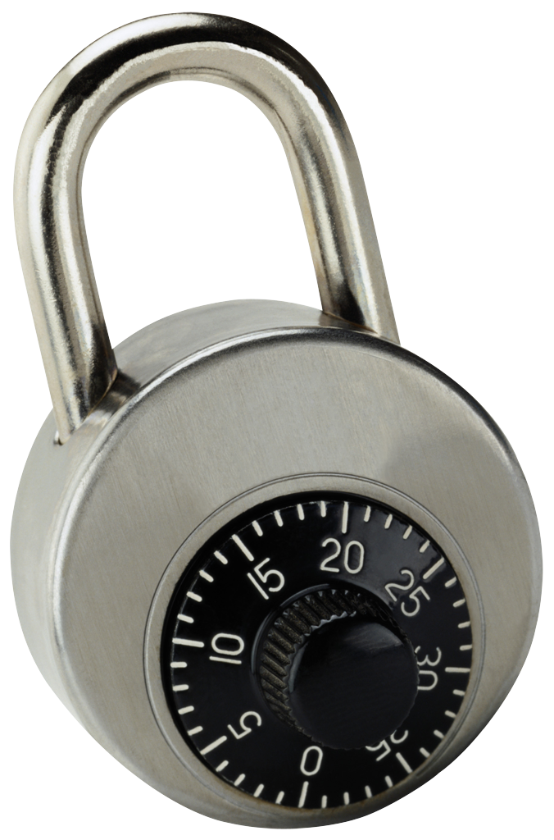
Idea: “encrypt” r using parts of w₀
Source: a string of symbols, arbitrary alphabet
Errors: Hamming
Gen: - get random combinations of symbols in w₀
r
- “lock” r using these combinations
r
w₀ = a₁ a₂ a₃ a₄ a₅ a₆ a₇ a₈ a₉
Gen
p
r
r
r
r
r
r
r
r
r
r
r
r
a₁ a₉ a₂
a₃ a₉ a₅
a₃ a₄ a₅
a₇ a₅ a₆
a₂ a₈ a₇
a₃ a₅ a₂

Slide 20
Idea: “encrypt” r using parts of w₀
Source: a string of symbols, arbitrary alphabet
Errors: Hamming
Gen: - get random combinations of symbols in w₀
r
- “lock” r using these combinations
r
w₀ = a₁ a₂ a₃ a₄ a₅ a₆ a₇ a₈ a₉
Gen
p
r
r
r
r
r
r
r
r
r
r
r
r
a₁ a₉ a₂
a₃ a₉ a₅
a₃ a₄ a₅
a₇ a₅ a₆
a₂ a₈ a₇
a₃ a₅ a₂

Slide 21
Idea: “encrypt” r using parts of w₀
Source: a string of symbols, arbitrary alphabet
Errors: Hamming
Gen: - get random combinations of symbols in w₀
r
- “lock” r using these combinations
r
w₀ = a₁ a₂ a₃ a₄ a₅ a₆ a₇ a₈ a₉
Gen
p
r
r
r
r
r
r
r
r
r
r
r
r
a₁ a₉ a₂
a₃ a₉ a₅
a₃ a₄ a₅
a₇ a₅ a₆
a₂ a₈ a₇
a₃ a₅ a₂

Slide 22
Idea: “encrypt” r using parts of w₀
Source: a string of symbols, arbitrary alphabet
Errors: Hamming
Gen: - get random combinations of symbols in w₀
r
- “lock” r using these combinations
- = locks + positions of symbols needed to unlock
p
r
w₀ = a₁ a₂ a₃ a₄ a₅ a₆ a₇ a₈ a₉
Gen
p
r
r
r
r
r
r
a₁ a₉ a₂
a₃ a₉ a₅
a₃ a₄ a₅
a₇ a₅ a₆
a₂ a₈ a₇
a₃ a₅ a₂

Slide 23
Idea: “encrypt” r using parts of w₀
Source: a string of symbols, arbitrary alphabet
Errors: Hamming
Gen: - get random combinations of symbols in w₀
r
- “lock” r using these combinations
- = locks + positions of symbols needed to unlock
p
r
w₀ = a₁ a₂ a₃ a₄ a₅ a₆ a₇ a₈ a₉
Gen
p
r
r
r
r
r
r
a₁ a₉ a₂
a₃ a₉ a₅
a₃ a₄ a₅
a₇ a₅ a₆
a₂ a₈ a₇
a₃ a₅ a₂

Slide 24
Idea: “encrypt” r using parts of w₀
Source: a string of symbols, arbitrary alphabet
Errors: Hamming
Gen: - get random combinations of symbols in w₀
r
- “lock” r using these combinations
- = locks + positions of symbols needed to unlock
p
p
r
r
r
r
r
r
a₁ a₉ a₂
a₃ a₉ a₅
a₃ a₄ a₅
a₇ a₅ a₆
a₂ a₈ a₇
a₃ a₅ a₂

Slide 25
Idea: “encrypt” r using parts of w₀
Source: a string of symbols, arbitrary alphabet
Errors: Hamming
Gen: - get random combinations of symbols in w₀
r
- “lock” r using these combinations
- = locks + positions of symbols needed to unlock
p
Rep:
w₁ = a₁ a₂ a₃ a₄ a₅ a₆ a₇ a₈ a₉
r
Rep
p
r
r
r
r
r
r
a₁ a₉ a₂
a₃ a₉ a₅
a₃ a₄ a₅
a₇ a₅ a₆
a₂ a₈ a₇
a₃ a₅ a₂

Slide 26
Idea: “encrypt” r using parts of w₀
Source: a string of symbols, arbitrary alphabet
Errors: Hamming
Gen: - get random combinations of symbols in w₀
r
- “lock” r using these combinations
- = locks + positions of symbols needed to unlock
p
Rep:
w₁ = a₁ a₂ a₃ a₄ a₅ a₆ a₇ a₈ a₉
r
Rep
p
r
r
r
r
r
r
a₁ a₉ a₂
a₃ a₉ a₅
a₃ a₄ a₅
a₇ a₅ a₆
a₂ a₈ a₇
a₃ a₅ a₂

Slide 27
Idea: “encrypt” r using parts of w₀
Source: a string of symbols, arbitrary alphabet
Errors: Hamming
Gen: - get random combinations of symbols in w₀
r
- “lock” r using these combinations
- = locks + positions of symbols needed to unlock
p
Rep: Use the symbols of w₁ to open at least one lock
w₁ = a₁ a₂ a₃ a₄ a₅ a₆ a₇ a₈ a₉
r
Rep
p
r
r
r
r
r
r
a₁ a₉ a₂
a₃ a₉ a₅
a₃ a₄ a₅
a₇ a₅ a₆
a₂ a₈ a₇
a₃ a₅ a₂

Slide 28
Idea: “encrypt” r using parts of w₀
Source: a string of symbols, arbitrary alphabet
Errors: Hamming
Gen: - get random combinations of symbols in w₀
r
- “lock” r using these combinations
- = locks + positions of symbols needed to unlock
p
Rep: Use the symbols of w₁ to open at least one lock
w₁ = a₁ a₂ a₃ a₄ a₅ a₆ a₇ a₈ a₉
r
Rep
p
r
r
r
r
r
r
r
a₁ a₉ a₂
a₃ a₉ a₅
a₃ a₄ a₅
a₇ a₅ a₆
a₂ a₈ a₇
a₃ a₅ a₂

Slide 29
Idea: “encrypt” r using parts of w₀
Source: a string of symbols, arbitrary alphabet
Errors: Hamming
Gen: - get random combinations of symbols in w₀
r
- “lock” r using these combinations
- = locks + positions of symbols needed to unlock
p
Rep: Use the symbols of w₁ to open at least one lock
Error-tolerance: as long as at least one combination is ok
Security: each combination must have enough entropy
(sampling of symbols must preserve sufficient entropy)
r
r
r
r
r
r
r
a₁ a₉ a₂
a₃ a₉ a₅
a₃ a₄ a₅
a₇ a₅ a₆
a₂ a₈ a₇
a₃ a₅ a₂

Slide 30
How to implement locks?
A lock is the following program:
If input = a₁ a₉ a₂, output r
Else output ⊥
One implementation (R.O. model): lock = r ⊕ H(a₁ a₉ a₂)
r
a₁ a₉ a₂
Obfuscation this program!
Obfuscation: preserve functionality, hide the program
Obfuscating this specific program called “digital locker”: encryption of r that is secure even multiple times with correlated and weak keys [Canetti Kalai Varia Wichs 10]
For this specific program: obfuscation is practical (R.O. or DL-based) [Canetti Dakdouk 08], [Bitansky Canetti 10]
Hides r if input can’t be exhaustively searched (superlogarithmic entropy)
Notes:
ADS: Say RO construction first? Then say point obfuscation?

Slide 31
How to implement locks?
A lock is the following program:
If input = a₁ a₉ a₂, output r
Else output ⊥
One implementation (R.O. model): lock = r ⊕ H(a₁ a₉ a₂)
r
a₁ a₉ a₂
Q: if you are going to use obfuscation, why bother? Why not just obfuscate the following program for p
If distance between w₀ and the input is less than t, output r
Else output ⊥
A: you can do that [Bitansky Canetti Kalai Paneth 14], except it’s very impractical + has a very strong assumption

Slide 32
How good is this construction?
We can correct more errors than entropy!
For correctness: t < constant fraction of symbols
r
r
r
r
r
r
a₁ a₉ a₂
a₃ a₉ a₅
a₃ a₄ a₅
a₇ a₅ a₆
a₂ a₈ a₇
a₃ a₅ a₂

Slide 33
How good is this construction?
We can correct more errors than entropy!
For correctness: t < constant fraction of symbols
Construction 2:
Supports t= constant fraction but only for really large alphabets
Construction 3:
Similar parameters but info-theoretic security
Why did I tell you about computation constructional?
r
r
r
r
r
r
a₁ a₉ a₂
a₃ a₉ a₅
a₃ a₄ a₅
a₇ a₅ a₆
a₂ a₈ a₇
a₃ a₅ a₂
Notes:
ADS: too much text (break it up somehow?)

Slide 34
How good is this construction?
It is reusable!
Same source can be enrolled multiple times with multiple independent services
r
w₀
Gen
p
Secret even given
p, p', p'', r, r''
r'
w₀'
Gen
p'
r''
w₀''
Gen
p''

Slide 35
How good is this construction?
It is reusable!
Same source can be enrolled multiple times with multiple independent services
Follows from composability of obfuscation
In the past: difficult to achieve, because typically new enrollments leak fresh information
Only previous construction [Boyen 2004]: all reading must differ by fixed constants (unrealistic)
Our construction: each reading individually must satisfy our conditions

Slide 36
Conclusion
It is possible to cover sources with more errors than entropy!
Exploit the source
Don’t aim for secure sketches (i.e., full error correction)
It is also possible to get reusability!
Use computational security
t

Slide 37
Follow-up
Minimum necessary condition for fuzzy extraction: weight inside any B_{t} must be small
Let H_{fuzz}(W) = log (1/max wt(B_{t}))
Big H_{fuzz}(W) is necessary
Q: Is big H_{fuzz}(W) sufficient for fuzzy extractors?
t
r
w₁
Rep

Slide 38
Is big H_{fuzz}(W) sufficient?
A1: Yes info-theoretic, if algorithms know precise distribution of W
Imprudent to assume construction and adversary have same view of W
Deal with adversary knowledge by providing security for family of W, security should hold for whole family
A2: No if security is info-theoretic
A3: Yes if security is computational (using obfuscation) [Bitansky Canetti Kalai Paneth 14]
A4: No if security is information-theoretic
A5: No if you try to build (computational) secure sketch

Slide 39
Adversary knows what color be provided
Constraints imposed by Gen
Gen supports a family V
Gen does not know what distribution it is being asked to correct (only receives sample from distribution)
Gen imposes constraints on W
Constraints only depend on received sample and are independent of rest of W
When W has little entropy Gen constraints remove all entropy

Slide 40
Adversary knows what color be provided
Constraints imposed by Gen
Gen supports a family V
Gen does not know what distribution it is being asked to correct (only receives sample from distribution)
Gen imposes constraints on W
Constraints only depend on received sample and are independent of rest of W
When W has little entropy Gen constraints remove all entropy
M
Adversary’s search space
Maybe those were “bad” constraints?

Slide 41
Adversary knows what color be provided
Alternative Constraints
Gen supports a family V
Gen does not know what distribution it is being asked to correct (only receives sample from distribution)
Gen imposes constraints on W
Constraints only depend on received sample and are independent of rest of W
When W has little entropy Gen constraints remove all entropy

Slide 42
Adversary knows what color be provided
Alternative Constraints
Gen supports a family V
Gen does not know what distribution it is being asked to correct (only receives sample from distribution)
Gen imposes constraints on W
Constraints only depend on received sample and are independent of rest of W
When W has little entropy Gen constraints remove all entropy
M
Adversary’s search space
Every Gen must create constraints that are independent of the color, Leaves few points of each color

Slide 43
Is big H_{fuzz}(W) sufficient?
A1: Yes info-theoretic, if algorithms know precise distribution of W
Imprudent to assume construction and adversary have same view of W
Deal with adversary knowledge by providing security for family of W
A2: No if info-theoretic and Adv knows more about W
A3: Yes if security is computational (using obfuscation) [Bitansky Canetti Kalai Paneth 14]
A4: No if you try to build (computational) secure sketch and Adv knows more

Slide 44
Questions?

