Slide 1
Computational Fuzzy Extractors
Benjamin Fuller, Xianrui Meng, and Leonid Reyzin
Notes:
1
1

Slide 2
Outline
Authentication with Noisy Data
Fuzzy Extractors
Impossibility of Computational Secure Sketches
Computational Fuzzy Extractor from Learning with Errors (based on hard lattice problems)

Slide 3
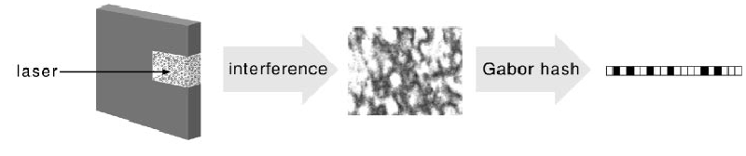
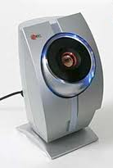

Noisy Distributions
High entropy sources suitable for key derivation are often noisy
Want to derive stable and cryptographically strong key from noisy data (called a source)
Source value changes over time, w₀≠ w₁
Want this key to map to same key
Gen( w₀ ) = Gen( w₁ )
Different samples from source must map to different and independent keys
Gen( w₀ ) ≠ Gen( w₀’ )
Physically Unclonable Functions
Biometric Data

Slide 4
Security from Noisy Data
Key Derivation
Authentication
Collect Reading w₁ and compare to initial reading w₀ accept if d( w₀, w₁ )<d_{max}
Similar application for PUFs where w₀, w₁ are the output of some challenge function
Privacy Amplification [ChandranKanukurthiOstrovskyReyzin]
Use a shared w₀, w₁ (that are close) to create a shared key
Considered in information theoretic terms
(Fuzzy) Password Authentication Key Exchange
[BoyenDodisKatzOstrovsky05]
Use a shared w₀, w₁ (that are close) to create a shared key independent key with high entropy
Requires Computational Assumptions

Slide 5
Fuzzy Extractors
Assume our source is high entropy
Fuzzy Extractors derive reliable keys from noisy data
[DodisOstrovskyReyzinSmith08]
Derive a key using a randomness extractor
Error-correct the source using a Secure Sketch
Gen
Rep

Slide 6
Fuzzy Extractors
Assume our source is high entropy
Fuzzy Extractors derive reliable keys from noisy data
[DodisOstrovskyReyzinSmith08]
Derive a key using a randomness extractor
Error-correct the source using a Secure Sketch
Converts high entropy sources to uniform H∞(W₀)≥ k Ext (W ) ≈ U
Gen
Ext
Rep
Ext

Slide 7
Fuzzy Extractors
Assume our source is high entropy
Fuzzy Extractors derive reliable keys from noisy data
[DodisOstrovskyReyzinSmith08]
Derive a key using a randomness extractor
Error-correct the source using a Secure Sketch
Converts high entropy sources to uniform H∞(W₀)≥ k Ext (W ) ≈ U
Gen
Ext
Rep
Sketch
Rec
Ext

Slide 8
Secure Sketches
Gen
Ext
Rep
Sketch
Rec
Ext
ec = Encode(x)
Code Offset Sketch
p=Encode(x) ⊕ w₀

Slide 9
Secure Sketches
Gen
Ext
Rep
Sketch
Rec
Ext
ec’=Dec (p ⊕ w₁)
ec = Encode(x)
Code Offset Sketch
If w₀ and w₁ are close then w₀ = ec’ ⊕ p.
p ⊕ w₁
p=Encode(x) ⊕ w₀

Slide 10
Secure Sketches
Gen
Ext must be able to extract from distributions where
Ext
Rep
Sketch
Rec
Ext
Code Offset Sketch
w₀ is unknown (knowing ss):
p ⊕ w₁
p=Encode(x) ⊕ w₀
p ⊕ w₀’

Slide 11
Fuzzy Extractors
Transform the noisy features to a key
Provide error correction
Derive a key
Fuzzy Extractors derive keys from noisy data
[DodisOstrovskyReyzinSmith08]
Error-correct the source using a Secure Sketch
Secure Sketch
ec = Encode(x)
ec’=Decode(ss ⊕ w₁)
ss ⊕ w₁
ss=Encode(x) ⊕ w₀
ss ⊕ w₀’
If w₀ and w₁ are close then w₀ = ec’ ⊕ ss,
and
w₀ is information theoretically unknown (knowing ss):

Slide 12
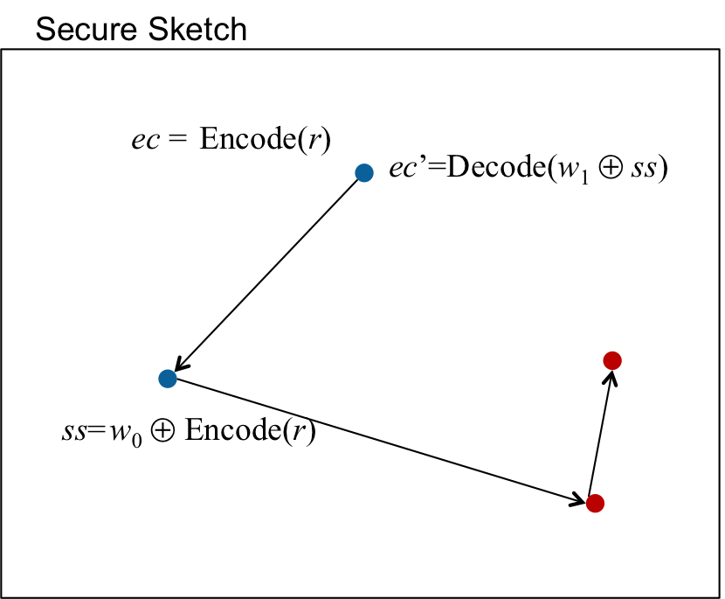
Fuzzy Extractors
Transform the noisy features to a key
Provide error correction
Derive a key
Error correction material should hide the source value
Fuzzy Extractors derive keys from noisy data
[DodisOstrovskyReyzinSmith08]
Error-correct the source using a Secure Sketch
Derive a key using a randomness extractor
If w₀ and w₁ are close then w₀ = ec’ ⊕ ss, and
Converts high entropy sources to uniform H∞(W₀)≥ k Ext (W ) ≈ U
Ext
Notes:
Need to update picture

Slide 13
Fuzzy Extractors
Transform the noisy features to a key
Provide error correction
Derive a key
Error correction material should hide information should not reveal the source value
Fuzzy Extractors derive keys from noisy data
[DodisOstrovskyReyzinSmith08]
Error-correct the source using a Secure Sketch
Derive a key using a randomness extractor
Secure Sketch
ec = Encode(r)
ec’=Decode(w₁ ⊕ ss)
ss=w₀ ⊕ Encode(r)
Converts high entropy sources to the uniform distribution H∞(W₀)≥ k then Ext (W ) ≈ U
If w₀ and w₁ are close then w₀ = ec’ ⊕ ss, and w₀ is information theoretically unknown (knowing ss):

Slide 14
Another View of Secure Sketches
Secure Sketch
Secure Sketches Transform a code C into a code C’ where the original biometric reading is a codeword
Secure Sketches reveals the shift between C and C’
This is the number of redundant bits in the code
Equal to radius of each ball (in a perfect code)
This drops the information theoretic entropy of the biometric by the radius of each ball
C
C’
p
p’

Slide 15
Entropy Loss From Fuzzy Extractors
Most biometrics have 100-200 bits of entropy
Entropy loss is considered in information-theoretic setting (all powerful adversary)
Fuzzy extractors have two losses:
Secure sketches lose at least the error correcting capability of the code
For error rates of 10-20%, equates to 10-20 bits.
Randomness extractors lose 2log (1/ε) or between 60-100 bits
After these losses the key may be too short to be useful: 30-60 bits
Can we eliminate either of these entropy losses?
[DodisOstrovskyReyzinSmith] The entropy retained by a secure sketch is bounded by the best error-correcting code that can correct d_{max} random errors with high probability
Fuzzy Extractors and Secure Sketches consider unbounded adversaries. Can we do better in the computational setting?

Slide 16
Results
Show that defining a secure sketch in computational setting does not improve entropy loss
Construct a lossless computational Fuzzy Extractor based on the Learning with Errors (LWE) problem
Extend hardness of LWE to case when some dimensions have known error
Construct lossless computational Fuzzy Extractor for block-fixing sources [KampZuckerman07]

Slide 17
Outline
Authentication with Noisy Data
Fuzzy Extractors
Impossibility of Computational Secure Sketches
Computational Fuzzy Extractor from Learning with Errors

Slide 18
Computational Secure Sketch
Can we construct a secure sketch such that ss does not provide information about w₀, but w₀ can be recovered from a close w₁?
Do there exist algorithms:
ss = sketch(w₀)
w₀ = rec(ss, w₁) if d(w₀ , w₁)<d_{max}
and H^{comp}( W₀ | ss) = H∞( W₀ )

Slide 19
HILL Secure Sketch
Most natural requirement: W₀ | ss looks like it has high entropy. That is
(W₀ | ss) ≈ (Y | ss) and H∞(Y | ss) ≥ k
Known as HILL entropy [HastadImpagliazzoLevinLuby99], denoted as H^{HILL}(W₀ | ss) ≥ k
Applying a randomness extractor to HILL entropy produces a pseudorandom key

Slide 20
HILL Secure Sketches Secure Sketches
Theorem 1:
If H^{HILL}(W₀ | ss) ≥ k, then
there exists set C, |C|≥2^{k-2} the points of C form an error-correcting code
and rec corrects d_{max} random errors on C
Corollary 1: (Sketch of [DodisSmith05]) If the HILL entropy of a sketch drops by k bits, there exists a sketch whose information theoretic entropy drops by no more than k+2 bits.
We can fix an ss value where rec functions as a good a decoding algorithm. For a distribution, Y, to be indistinguishable, rec must also decode on Y.

Slide 21
Can sketches be unpredictable?
Indistinguishability may the wrong definition
Definitely need that W₀ | ss is unpredictable
Applying a randomness extractor (with reconstruction procedure) produces a pseudorandom key [HsiaoLuReyzin07]
Main concern: rec acts like a decoder of an error-correcting code

Slide 22
Maximum unpredictability conditioned on ss
Let |B_{dmax}| be the # of points in balls of radius d_{max}
Theorem 2:
For W₀=U and the Hamming metric,
W₀’s unpredictability conditioned on any secure sketch
decreases by |B_{dmax}|
Theorem 2 also holds if we consider unpredictability of distributions that are indistinguishable from W₀
These results also hold for any algorithm 1) that is error-tolerant, and 2) the source can be recovered from the output.
Give up on building a secure sketch, focus on fuzzy extractor

Slide 23
Outline
Authentication with Noisy Data
Fuzzy Extractors
Impossibility of Computational Secure Sketches
Lossless Computational Fuzzy Extractor
Need computational assumption that is error-tolerant
Seems natural to use random linear codes (syndrome decoding is NP-hard)

Slide 24
Our construction
What happens if we replace the code in our previous sketch with a random linear code?
Issues:
Creating/finding a pseudorandom key? (can’t use bits of w₀)
Finding efficient decoding algorithm for small d_{max}.
Proving security for different types of distributions W₀
Secure Sketch Offset
ec = Encode(x)
ec’=Decode(ss ⊕ w₁)
ss ⊕ w₁
ss=Encode(x) ⊕ w₀
ss=Ax ⊕ w₀
We’ll spend the rest of the talk addressing these issues. For now, assume W₀ is the uniform distribution.

Slide 25
Solving random linear equations
Gaussian Elimination!
What happens if we add small errors?
Small errors seem to make the problem difficult
Syndrome decoding of random linear code is NP-hard
Recovering x known as Learning with Errors (LWE)

Slide 26
Learning with Errors
Gaussian Elimination!
What happens if we add small errors?
Small errors seem to make the problem difficult
Syndrome decoding of random linear code is NP-hard
Recovering x known as Learning with Errors (LWE)

Slide 27
Learning with Errors
Gaussian Elimination!
What happens if we add small errors?
Small errors seem to make the problem difficult
Syndrome decoding of random linear code is NP-hard
Recovering x known as Learning with Errors (LWE)

Slide 28
Learning with Errors
n
A
A
x
e
b
m
+
=
,
Gaussian Elimination!
What happens if we add small errors?
Small errors seem to make the problem difficult
Syndrome decoding of random linear code is NP-hard
Recovering x known as Learning with Errors (LWE)

Slide 29
Learning with Errors
n
A
A
x
e
b
m
+
=
,
[Regev05] reduces solving LWE to approximating lattice problems of dimension O(n) (within polynomial factors) in P
Error is drawn from Gaussian distribution

Slide 30
Computational Fuzzy Extractor
A
A
x
w₀
e
b
+
=
,
First idea: Use w₀ as the randomness for Gaussian distribution
Pro: Would inherent security proof of Regev
Con: Gaussian sampling takes a variable number of bits

Slide 31
Randomness w/ Variable Sampling Length
Assume the Gaussian algorithm requires 4 or 5 bits (determined by 1st bit)
w₀
10101 11111 00100 11010 10101 11010 10101
e₀
1010 1111 1100 1001 1010 1010 1110
w₁
00101 11101 00100 11010 10101 11010 10101
e₁
00101 1110 1001 00110 1010 1011 1010
d(w₀ , w₁)=1
d(e₀ , e₁)=7

Slide 32
LWE w/ Uniform Error
A
A
x
w₀
e
b
+
=
,
Recent Results of [DöttlingMüller-Quade13, MicciancioPeikert13] show security of LWE with error drawn uniformly from an interval
Our construction now:
Preserves distance: if d(w₀, w₁) < d_{max} then d(Ax+w₀, Ax+w₁) < d_{max}
Hard to invert: Assuming LWE, no poly-time algorithm can find x

Slide 33
Finding a key
A
A
x
w₀
e
b
+
=
,
We use hardcore bits of x as our key:
[AkaviaGoldwasserKalai09] show if LWE is secure on n dimensions, any additional dimensions are hardcore
Our construction now:
Preserves distance: if d(w₀, w₁) < d_{max} then d(Ax+w₀, Ax+w₁) < d_{max}
Hard to invert: Assuming LWE, no poly-time algorithm can find x

Slide 34
Finding a key
A₁
A₂
A₁
A₂
x₁
w₀
e
b
x₂
+
=
,
We use hardcore bits of x as our key:
[AkaviaGoldwasserKalai09] show if LWE is secure on n dimensions, any additional dimensions are hardcore
Our construction now:
Preserves distance: if d(w₀, w₁) < d_{max} then d(Ax+w₀, Ax+w₁) < d_{max}
Hard to invert: Assuming LWE, no poly-time algorithm can find x

Slide 35
Finding a key
A₁
A₂
A₁
A₂
x₁
w₀
e
b
x₂
+
=
,
We use hardcore bits of x as our key:
[AkaviaGoldwasserKalai09] show if LWE is secure on
f
Our construction now:
Preserves distance: if d(w₀, w₁) < d_{max} then d(Ax+w₀, Ax+w₁) < d_{max}
Hard to invert: Assuming LWE, no poly-time algorithm can find x

Slide 36
Finding a key
A₁
A₂
A₁
A₂
x₁
w₀
e
b
x₂
+
=
,
We use hardcore bits of x as our key:
[AkaviaGoldwasserKalai09] show if LWE is secure on A₁,A₁x₁+w₀ then x₂ is hardcore
Our construction now:
Preserves distance: if d(w₀, w₁) < d_{max} then d(Ax+w₀, Ax+w₁) < d_{max}
Hard to invert: Assuming LWE, no poly-time algorithm can find x

Slide 37
Finding a key
A₁
A₂
A₁
A₂
x₁
w₀
e
b
x₂
+
=
,
We use hardcore bits of x as our key:
[AkaviaGoldwasserKalai09] show if LWE is secure on A₁,A₁x₁+w₀ then x₂ is hardcore
Our construction now:
Preserves distance: if d(w₀, w₁) < d_{max} then d(Ax+w₀, Ax+w₁) < d_{max}
fff

Slide 38
Finding a key
A₁
A₂
A₁
A₂
x₁
w₀
e
b
x₂
+
=
,
We use hardcore bits of x as our key:
[AkaviaGoldwasserKalai09] show if LWE is secure on A₁,A₁x₁+w₀ then x₂ is hardcore
Our construction now:
Preserves distance: if d(w₀, w₁) < d_{max} then d(Ax+w₀, Ax+w₁) < d_{max}
Has a key: if LWE is secure for n/2 variables, then x₂ | Ax+w₀ is pseudorandom

Slide 39
Our construction
What happens if we replace the code in our previous sketch with a random linear code?
Issues:
Creating/finding a pseudorandom key?
Use hardcore bits of codeword.
Finding efficient decoding algorithm for small d_{max}.
Proving security for different types of distributions W₀
Gen ( w₀ ):
Sample uniformly
Compute
Output (key, p)
Rep ( w₁ , p):
Parse p as:
Compute
3. ???
To recover key, we need to decode Ax + (w₀ – w₁), this is a random code with d(w₀, w₁)<d_{max} errors

Slide 40
Inversion algorithm for small d_{max}
Select n random dimensions
(hopefully, no errors in these dimensions)
Try to compute x using Gaussian elimination on these dimensions
Verify correctness of x using other samples
A
C-w₁
This algorithm runs in expected polynomial time if d_{max} = O( log n (m/n ))

Slide 41
Our construction
What happens if we replace the code in our previous sketch with a random linear code?
Issues:
Creating/finding a pseudorandom key?
Use hardcore bits of codeword.
Finding efficient decoding algorithm for small d_{max}.
Trial and error inversion
Proving security for different types of distributions W₀
Gen ( w₀ ):
Sample uniformly
Compute
Output (key, p)
Rep ( w₁ , p):
Parse p as:
Compute
3. Invert C-w₁, output key

Slide 42
Lossless Fuzzy Extractor
Using [DottlingMullerQuade13], dimensions of x have linearly more bits than dimensions of w
We can extract half the bits of x as a key
Allows us to be lossless when m = O(n)
Our inversion algorithm works if
Theorem 3: If d_{max} = O(log n) and W is uniform, our construction
1) Is lossless
2) Decoding runs in expected polynomial time
3) Yields pseudorandom key assuming GAPSVP and SIVP are hard to approximate within polynomial factors

Slide 43
Our construction
What happens if we replace the code in our previous sketch with a random linear code?
Issues:
Creating/finding a pseudorandom key?
Use hardcore bits of codeword.
Finding efficient decoding algorithm for small d_{max}.
Trial and error inversion
Proving security for different types of distributions W₀
Extend security for block-fixing sources
Gen ( w₀ ):
Sample uniformly
Compute
Output (key, p)
Rep ( w₁ , p):
Parse p as:
Compute
3. Invert C-w₁, output key
W=W_{1,…,n} is a block fixing source if

Slide 44
LWE w/ block fixing sources
Theorem 4:
Let
If
Then for

Slide 45
Our construction
What happens if we replace the code in our previous sketch with a random linear code?
Issues:
Creating/finding a pseudorandom key?
Use hardcore bits of codeword.
Finding efficient decoding algorithm for small d_{max}.
Trial and error inversion
Proving security for different types of distributions W₀
Extend security for block-fixing sources
Gen ( w₀ ):
Sample uniformly
Compute
Output (key, p)
Rep ( w₁ , p):
Parse p as:
Compute
3. Invert C-w₁, output key
W=W_{1,…,m} is a block fixing source if
Theorem 4 implies our construction is secure if W = W_{1,…, m} is a block fixing source (assuming enough blocks are uniform)

Slide 46
Open Problems
Find an inverter supporting larger d_{max}
Show security of LWE for other high entropy distributions
Base a lossless fuzzy extractor on other computational assumptions
Questions?

