Slide 1
Introduction to Java NYU Tandon CS9053
Dr. Constantine (Dean) Christakos
Email: dean@christakos.com
TAs:
TBD

Slide 2
Class Format
Weekly Problem Sets
Covers the week’s material
40% of your grade
Will drop the lowest problem set
Take Home Midterm
Cumulative evaluation of what you’ve learned so far
30% of your grade
Final Project
Project of your design, with proposal reviewed by us
30% of your grade

Slide 3
Class Format
Slides will generally be drawn from the Liang Introduction to Java Programming and Data Structures text, with some variation
I will be going through code which will be available on Brightspace in each week’s section.

Slide 4
What You’re Going to Learn
Java Syntax
What Object Oriented Programming is all about
Java’s libraries and datatypes
Learning Java’s strengths – GUI development and Multithreaded Programming

Slide 5
What You Won’t Learn
The basics of computer programming (I assume you know this already)
Software Engineering of Large Projects
Computer Science Algorithms
E.g., the sort of thing you’d get quizzed on if you were interviewing at Google
Though some problem sets will be exercises in algorithmic implementation

Slide 6
Chapter 1 Introduction to Computers, Programs, and Java

Slide 7
Objectives
To understand computer basics, programs, and operating systems (§§1.2–1.4).
To describe the relationship between Java and the World Wide Web (§1.5).
To understand the meaning of Java language specification, API, JDK, and IDE (§1.6).
To write a simple Java program (§1.7).
To display output on the console (§1.7).
To explain the basic syntax of a Java program (§1.7).
To create, compile, and run Java programs (§1.8).
To use sound Java programming style and document programs properly (§1.9).
To explain the differences between syntax errors, runtime errors, and logic errors (§1.10).
To develop Java programs using NetBeans (§1.11).
To develop Java programs using Eclipse (§1.12).

Slide 8
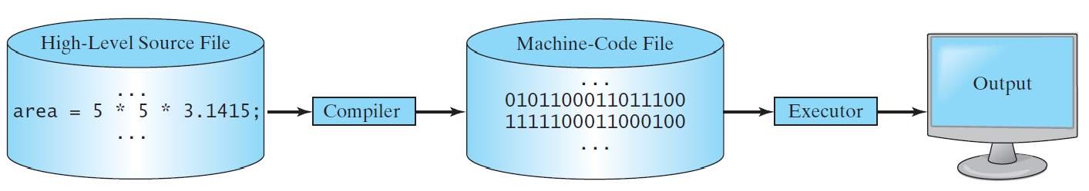
Compiling Source Code
A compiler translates the entire source code into a machine-code file, and the machine-code file is then executed, as shown in the following figure.

Slide 9
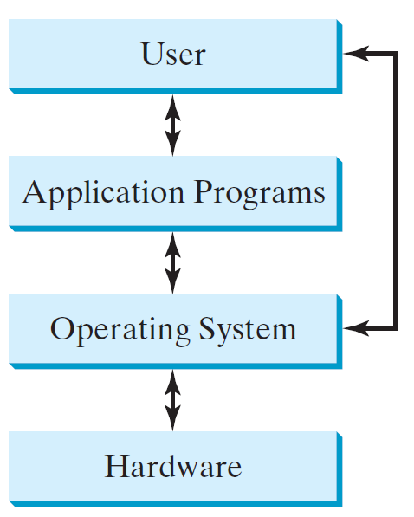
Operating Systems
The operating system (OS) is a program that manages and controls a computer’s activities. The popular operating systems for general-purpose computers are Microsoft Windows, Mac OS, and Linux. Application programs, such as a Web browser or a word processor, cannot run unless an operating system is installed and running on the computer.

Slide 10
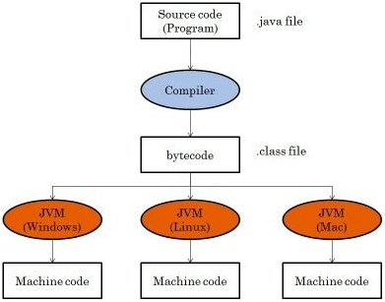
Where Java Fits In
Java programs aren’t compiled into Machine Code, they’re compiled into Bytecode, and the Java Virtual Machine for each platform translates Bytecode into Machine Code when it loads a class
That means (ideally) you can write Java code once, compile the bytecode and run the bytecode anywhere

Slide 11
Why Java?
The answer is that Java enables users to develop and deploy applications on the Internet for servers, desktop computers, and small hand-held devices. The future of computing is being profoundly influenced by the Internet, and Java promises to remain a big part of that future. Java is the Internet programming language.
Java is a general purpose programming language.
Java is the Internet programming language.

Slide 12
Java, Web, and Beyond
Java was originally used to develop applications running from a browser.
Java can be used to develop standalone applications.
Java can also be used to develop applications for hand-held devices.
Java can be used to develop applications for Web servers.

Slide 13
Java’s History
James Gosling and Sun Microsystems
Oak
Java, May 20, 1995, Sun World
HotJava
The first Java-enabled Web browser
Early History Summary:
https://codegym.cc/groups/posts/594-history-of-java-a-full-story-of-java-development-from-1991-to-2021

Slide 14
Characteristics of Java
Companion Website
Java Is Simple
Java Is Object-Oriented
Java Is Distributed
Java Is Interpreted
Java Is Robust
Java Is Secure
Java Is Architecture-Neutral
Java Is Portable
Java's Performance
Java Is Multithreaded
Java Is Dynamic
https://liveexample.pearsoncmg.com/etc/JavaCharacteristics.pdf

Slide 15
Characteristics of Java
Companion Website
Java Is Simple
Java Is Object-Oriented
Java Is Distributed
Java Is Interpreted
Java Is Robust
Java Is Secure
Java Is Architecture-Neutral
Java Is Portable
Java's Performance
Java Is Multithreaded
Java Is Dynamic
Java is partially modeled on C++, but greatly simplified and improved. Some people refer to Java as "C++--" because it is like C++ but with more functionality and fewer negative aspects.

Slide 16
Characteristics of Java
Companion Website
Java Is Simple
Java Is Object-Oriented
Java Is Distributed
Java Is Interpreted
Java Is Robust
Java Is Secure
Java Is Architecture-Neutral
Java Is Portable
Java's Performance
Java Is Multithreaded
Java Is Dynamic
Java is inherently object-oriented. Although many object-oriented languages began strictly as procedural languages, Java was designed from the start to be object-oriented. Object-oriented programming (OOP) is a popular programming approach that is replacing traditional procedural programming techniques.
One of the central issues in software development is how to reuse code. Object-oriented programming provides great flexibility, modularity, clarity, and reusability through encapsulation, inheritance, and polymorphism.

Slide 17
Characteristics of Java
Companion Website
Java Is Simple
Java Is Object-Oriented
Java Is Distributed
Java Is Interpreted
Java Is Robust
Java Is Secure
Java Is Architecture-Neutral
Java Is Portable
Java's Performance
Java Is Multithreaded
Java Is Dynamic
Distributed computing involves several computers working together on a network. Java is designed to make distributed computing easy. Since networking capability is inherently integrated into Java, writing network programs is like sending and receiving data to and from a file.

Slide 18
Characteristics of Java
Companion Website
Java Is Simple
Java Is Object-Oriented
Java Is Distributed
Java Is Interpreted
Java Is Robust
Java Is Secure
Java Is Architecture-Neutral
Java Is Portable
Java's Performance
Java Is Multithreaded
Java Is Dynamic
You need an interpreter to run Java programs. The programs are compiled into the Java Virtual Machine code called bytecode. The bytecode is machine-independent and can run on any machine that has a Java interpreter, which is part of the Java Virtual Machine (JVM).

Slide 19
Characteristics of Java
Companion Website
Java Is Simple
Java Is Object-Oriented
Java Is Distributed
Java Is Interpreted
Java Is Robust
Java Is Secure
Java Is Architecture-Neutral
Java Is Portable
Java's Performance
Java Is Multithreaded
Java Is Dynamic
Java compilers can detect many problems that would first show up at execution time in other languages.
Java has eliminated certain types of error-prone programming constructs found in other languages.
Java has a runtime exception-handling feature to provide programming support for robustness.

Slide 20
Characteristics of Java
Companion Website
Java Is Simple
Java Is Object-Oriented
Java Is Distributed
Java Is Interpreted
Java Is Robust
Java Is Secure
Java Is Architecture-Neutral
Java Is Portable
Java's Performance
Java Is Multithreaded
Java Is Dynamic
Java implements several security mechanisms to protect your system against harm caused by stray programs.

Slide 21
Characteristics of Java
Companion Website
Java Is Simple
Java Is Object-Oriented
Java Is Distributed
Java Is Interpreted
Java Is Robust
Java Is Secure
Java Is Architecture-Neutral
Java Is Portable
Java's Performance
Java Is Multithreaded
Java Is Dynamic
Write once, run anywhere
With a Java Virtual Machine (JVM), you can write one program that will run on any platform.

Slide 22
Characteristics of Java
Companion Website
Java Is Simple
Java Is Object-Oriented
Java Is Distributed
Java Is Interpreted
Java Is Robust
Java Is Secure
Java Is Architecture-Neutral
Java Is Portable
Java's Performance
Java Is Multithreaded
Java Is Dynamic
Because Java is architecture neutral, Java programs are portable. They can be run on any platform without being recompiled.

Slide 23
Characteristics of Java
Companion Website
Java Is Simple
Java Is Object-Oriented
Java Is Distributed
Java Is Interpreted
Java Is Robust
Java Is Secure
Java Is Architecture-Neutral
Java Is Portable
Java's Performance
Java Is Multithreaded
Java Is Dynamic
Java’s performance has been improved impressively over the years with every new version.

Slide 24
Characteristics of Java
Companion Website
Java Is Simple
Java Is Object-Oriented
Java Is Distributed
Java Is Interpreted
Java Is Robust
Java Is Secure
Java Is Architecture-Neutral
Java Is Portable
Java's Performance
Java Is Multithreaded
Java Is Dynamic
Multithread programming is smoothly integrated in Java, whereas in other languages you have to call procedures specific to the operating system to enable multithreading.

Slide 25
Characteristics of Java
Companion Website
Java Is Simple
Java Is Object-Oriented
Java Is Distributed
Java Is Interpreted
Java Is Robust
Java Is Secure
Java Is Architecture-Neutral
Java Is Portable
Java's Performance
Java Is Multithreaded
Java Is Dynamic
Java was designed to adapt to an evolving environment. New code can be loaded on the fly without recompilation. There is no need for developers to create, and for users to install, major new software versions. New features can be incorporated transparently as needed.

Slide 26
JDK Versions
JDK 1.02 (1995)
JDK 1.1 (1996)
JDK 1.2 (1998)
JDK 1.3 (2000)
JDK 1.4 (2002)
JDK 1.5 (2004) a. k. a. JDK 5 or Java 5
JDK 1.6 (2006) a. k. a. JDK 6 or Java 6
JDK 1.7 (2011) a. k. a. JDK 7 or Java 7
JDK 1.8 (2014) a. k. a. JDK 8 or Java 8
Java 9, 10, 11, 12, 13, 14, 15, 16, 17, 18, 19, 20, 21

Slide 27
Why Java 8?
The latest version of Java is Java 17 as of Sept. 2021
Java 8 was a significant release with many important syntactical features that were not available in Java 1.6 and 1.7.
forEach loops
Lambda expressions
The Stream API
Java 8 is a “LTS” (Long Term Support) version, and commercial use of Java starting with Java 11 requires that organizations pay for Java, so organizations stick with Java 8 rather than paying for subsequent LTS versions like Java 11 and Java 17

Slide 28
JDK Editions
Java Standard Edition (J2SE)
J2SE can be used to develop client-side standalone applications
Java Enterprise Edition (J2EE)
J2EE can be used to develop server-side applications such as Java servlets, Java ServerPages, and Java ServerFaces.
Java Micro Edition (J2ME).
J2ME can be used to develop applications for mobile devices such as cell phones.
This book uses J2SE to introduce Java programming.

Slide 29
Popular Java IDEs
NetBeans
Eclipse
I will use Eclipse for most in-class demonstrations, and Eclipse makes submission easiest for the TAs. However, there is no required IDE for this class, and you are free to use the IDE of your choice.

Slide 30
A Simple Java Program
Listing 1.1
// This program prints Welcome to Java!
public class Welcome {
public static void main(String[] args) {
System.out.println("Welcome to Java!");
}
}
Note: Clicking the green button displays the source code with interactive animation. You can also run the code in a browser. Internet connection is needed for this button.
Welcome

Slide 31
Trace a Program Execution
animation
Enter main method
// This program prints Welcome to Java!
public class Welcome {
public static void main(String[] args) {
System.out.println("Welcome to Java!");
}
}

Slide 32
Trace a Program Execution
animation
Execute statement
// This program prints Welcome to Java!
public class Welcome {
public static void main(String[] args) {
System.out.println("Welcome to Java!");
}
}

Slide 33
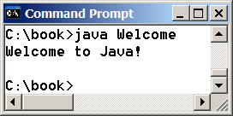
Trace a Program Execution
animation
// This program prints Welcome to Java!
public class Welcome {
public static void main(String[] args) {
System.out.println("Welcome to Java!");
}
}
print a message to the console

Slide 34
Two More Simple Examples
WelcomeWithThreeMessages
ComputeExpression

Slide 35

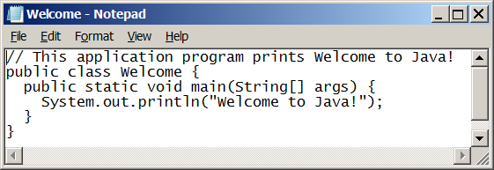
Creating and Editing Using NotePad
To use NotePad, type
notepad Welcome.java
from the DOS prompt.

Slide 36

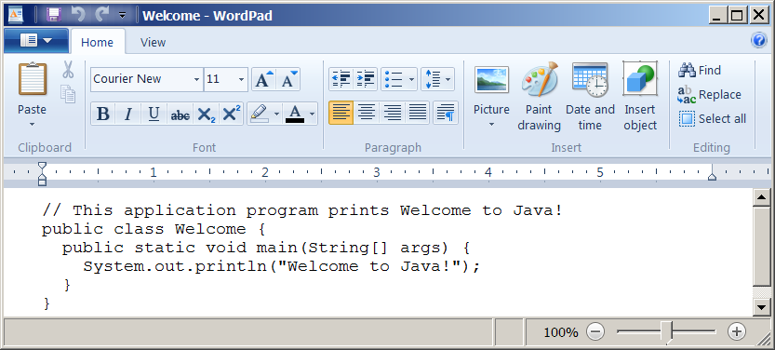
Creating and Editing Using WordPad
To use WordPad, type
write Welcome.java
from the DOS prompt.

Slide 37
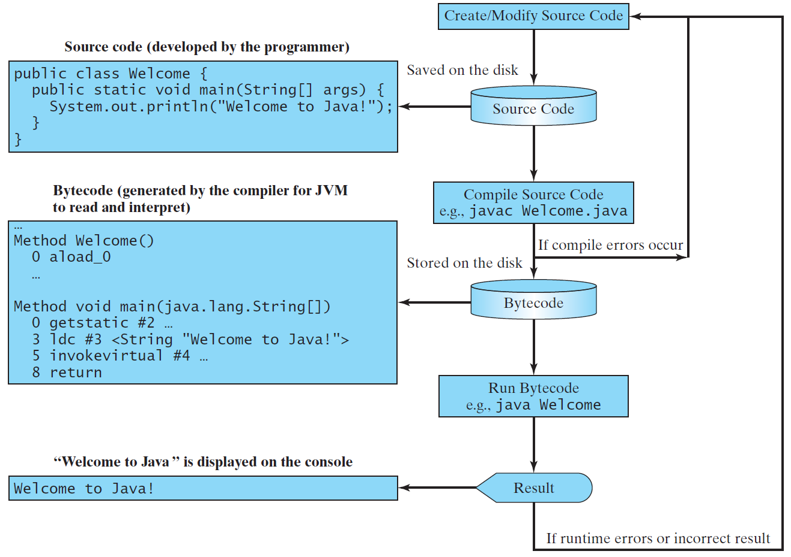
Creating, Compiling, and Running Programs

Slide 38
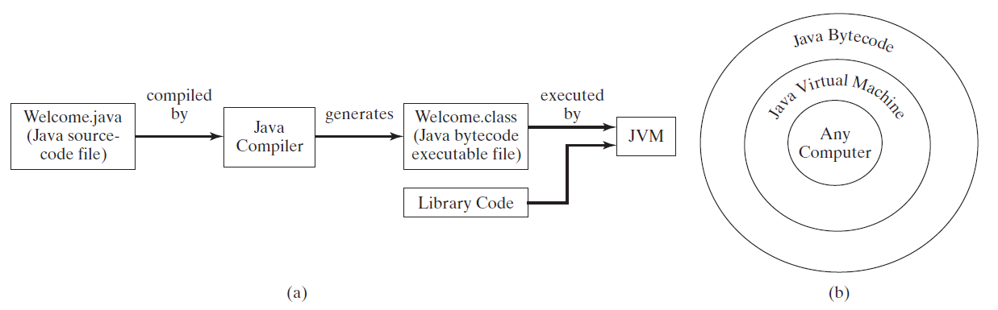
Compiling Java Source Code
You can port a source program to any machine with appropriate compilers. The source program must be recompiled, however, because the object program can only run on a specific machine. Nowadays computers are networked to work together. Java was designed to run object programs on any platform. With Java, you write the program once, and compile the source program into a special type of object code, known as bytecode. The bytecode can then run on any computer with a Java Virtual Machine, as shown below. Java Virtual Machine is a software that interprets Java bytecode.

Slide 39
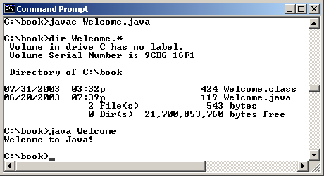
Compiling and Running Java from the Command Window
Companion Website
Set path to JDK bin directory
set path=c:\Program Files\java\jdk1.8.0\bin
Set classpath to include the current directory
set classpath=.
Compile
javac Welcome.java
Run
java Welcome

Slide 40
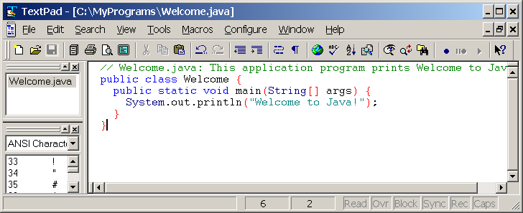
Compiling and Running Java from TextPad
Companion Website
See Supplement II.A on the Website for details

Slide 41
Anatomy of a Java Program
Class name
Main method
Statements
Statement terminator
Reserved words
Comments
Blocks

Slide 42
Class Name
Every Java program must have at least one class. Each class has a name. By convention, class names start with an uppercase letter. In this example, the class name is Welcome.
// This program prints Welcome to Java!
public class Welcome {
public static void main(String[] args) {
System.out.println("Welcome to Java!");
}
}

Slide 43
Main Method
Line 2 defines the main method. In order to run a class, the class must contain a method named main. The program is executed from the main method.
// This program prints Welcome to Java!
public class Welcome {
public static void main(String[] args) {
System.out.println("Welcome to Java!");
}
}

Slide 44
Statement
A statement represents an action or a sequence of actions. The statement System.out.println("Welcome to Java!") in the program in Listing 1.1 is a statement to display the greeting "Welcome to Java!“.
// This program prints Welcome to Java!
public class Welcome {
public static void main(String[] args) {
System.out.println("Welcome to Java!");
}
}

Slide 45
Statement Terminator
Every statement in Java ends with a semicolon (;).
// This program prints Welcome to Java!
public class Welcome {
public static void main(String[] args) {
System.out.println("Welcome to Java!");
}
}

Slide 46
Keywords
Keywords are words that have a specific meaning to the compiler and cannot be used for other purposes in the program. For example, when the compiler sees the word class, it understands that the word after class is the name for the class.
// This program prints Welcome to Java!
public class Welcome {
public static void main(String[] args) {
System.out.println("Welcome to Java!");
}
}

Slide 47
Blocks
A pair of braces in a program forms a block that groups components of a program.

Slide 48
Special Symbols

Slide 49
{ … }
// This program prints Welcome to Java!
public class Welcome {
public static void main(String[] args) {
System.out.println("Welcome to Java!");
}
}

Slide 50
( … )
// This program prints Welcome to Java!
public class Welcome {
public static void main(String[] args) {
System.out.println("Welcome to Java!");
}
}

Slide 51
;
// This program prints Welcome to Java!
public class Welcome {
public static void main(String[] args) {
System.out.println("Welcome to Java!");
}
}

Slide 52
// …
// This program prints Welcome to Java!
public class Welcome {
public static void main(String[] args) {
System.out.println("Welcome to Java!");
}
}

Slide 53
" … "
// This program prints Welcome to Java!
public class Welcome {
public static void main(String[] args) {
System.out.println("Welcome to Java!");
}
}

Slide 54
Programming Style and Documentation
Appropriate Comments
Naming Conventions
Proper Indentation and Spacing Lines
Block Styles

Slide 55
Appropriate Comments
Include a summary at the beginning of the program to explain what the program does, its key features, its supporting data structures, and any unique techniques it uses.
Include your name, class section, instructor, date, and a brief description at the beginning of the program.

Slide 56
Naming Conventions
Choose meaningful and descriptive names.
Class names:
Capitalize the first letter of each word in the name. For example, the class name ComputeExpression.

Slide 57
Proper Indentation and Spacing
Indentation
Indent two spaces.
Spacing
Use blank line to separate segments of the code.

Slide 58
Block Styles
Use end-of-line style for braces.

Slide 59
Programming Errors
Syntax Errors
Detected by the compiler
Runtime Errors
Causes the program to abort
Logic Errors
Produces incorrect result

Slide 60
Syntax Errors
public class ShowSyntaxErrors {
public static main(String[] args) {
System.out.println("Welcome to Java);
}
}
ShowSyntaxErrors

Slide 61
Runtime Errors
public class ShowRuntimeErrors {
public static void main(String[] args) {
System.out.println(1 / 0);
}
}
ShowRuntimeErrors

Slide 62
Logic Errors
public class ShowLogicErrors {
public static void main(String[] args) {
System.out.println("Celsius 35 is Fahrenheit degree ");
System.out.println((9 / 5) * 35 + 32);
}
}
ShowLogicErrors

Slide 63
Trace a Program Execution
animation
allocate memory for radius
public class ComputeArea {
/** Main method */
public static void main(String[] args) {
double radius;
double area;
// Assign a radius
radius = 20;
// Compute area
area = radius * radius * 3.14159;
// Display results
System.out.println("The area for the circle of radius " +
radius + " is " + area);
}
}
radius
no value

Slide 64
Trace a Program Execution
animation
public class ComputeArea {
/** Main method */
public static void main(String[] args) {
double radius;
double area;
// Assign a radius
radius = 20;
// Compute area
area = radius * radius * 3.14159;
// Display results
System.out.println("The area for the circle of radius " +
radius + " is " + area);
}
}
memory
radius
no value
area
no value
allocate memory for area

Slide 65
Trace a Program Execution
animation
public class ComputeArea {
/** Main method */
public static void main(String[] args) {
double radius;
double area;
// Assign a radius
radius = 20;
// Compute area
area = radius * radius * 3.14159;
// Display results
System.out.println("The area for the circle of radius " +
radius + " is " + area);
}
}
assign 20 to radius
radius
20
area
no value

Slide 66
Trace a Program Execution
animation
public class ComputeArea {
/** Main method */
public static void main(String[] args) {
double radius;
double area;
// Assign a radius
radius = 20;
// Compute area
area = radius * radius * 3.14159;
// Display results
System.out.println("The area for the circle of radius " +
radius + " is " + area);
}
}
memory
radius
20
area
1256.636
compute area and assign it to variable area

Slide 67

Trace a Program Execution
animation
public class ComputeArea {
/** Main method */
public static void main(String[] args) {
double radius;
double area;
// Assign a radius
radius = 20;
// Compute area
area = radius * radius * 3.14159;
// Display results
System.out.println("The area for the circle of radius " +
radius + " is " + area);
}
}
memory
radius
20
area
1256.636
print a message to the console

Slide 68
Reading Input from the Console
1. Create a Scanner object
Scanner input = new Scanner(System.in);
2. Use the method nextDouble() to obtain to a double value. For example,
System.out.print("Enter a double value: ");
Scanner input = new Scanner(System.in);
double d = input.nextDouble();
ComputeAreaWithConsoleInput
ComputeAverage

Slide 69
Implicit Import and Explicit Import
java.util.* ; // Implicit import
java.util.Scanner; // Explicit Import
No performance difference

Slide 70
For next week, Assignment 1
Intro assignment
Most of your time will probably be spent getting Eclipse working correctly and familiarizing yourself with it
But that part is not graded!
I promise most assignments won’t be several pages long, as this one is
Due 11:59pm, Sept. 14th

