Slide 1
Week 3: Objects and Classes

Slide 2
The String Pool
Remember if you create two Strings with the name value, they won’t be the same string:
But if you declare strings as literals, the compiler implicitly instantiates that String, and every other time it encounters that String literal, it retrieves it from the same place:
String a = new String(“Hello!”);
String b = new String(“Hello!”);
System.out.println(a == b); // prints “false”
String c = Hello!”;
String d = Hello!”;
System.out.println(c == d); // prints “true” (!)

Slide 3
The String Pool
What Java does is store all these String literals in a place called the “String pool”, so it does not duplicate and recreate String literals when they’re encountered. c and d here will point to the same String literal
String c = “Hello!”;
String d = “Hello!”;
String e = “Goodbye!”;
String f = new String(“Goodbye!”);
String g = new String(“Goodbye!”);
c d
e f
Goodbye!!
“Hello!”
“Goodbye!”
g
Goodbye!!

Slide 4

Objects: Motivations
After learning the preceding chapters, you are capable of solving many programming problems using selections, loops, methods, and arrays. However, these Java features are not sufficient for developing graphical user interfaces and large scale software systems. Suppose you want to develop a graphical user interface as shown below. How do you program it?

Slide 5
Objectives
To describe objects and classes, and use classes to model objects (§9.2).
To use UML graphical notation to describe classes and objects (§9.2).
To demonstrate how to define classes and create objects (§9.3).
To create objects using constructors (§9.4).
To access objects via object reference variables (§9.5).
To define a reference variable using a reference type (§9.5.1).
To access an object’s data and methods using the object member access operator (.) (§9.5.2).
To define data fields of reference types and assign default values for an object’s data fields (§9.5.3).
To distinguish between object reference variables and primitive data type variables (§9.5.4).
To use the Java library classes Date, Random, and Point2D (§9.6).
To distinguish between instance and static variables and methods (§9.7).
To define private data fields with appropriate get and set methods (§9.8).
To encapsulate data fields to make classes easy to maintain (§9.9).
To develop methods with object arguments and differentiate between primitive-type arguments and object-type arguments (§9.10).
To store and process objects in arrays (§9.11).
To create immutable objects from immutable classes to protect the contents of objects (§9.12).
To determine the scope of variables in the context of a class (§9.13).
To use the keyword this to refer to the calling object itself (§9.14).

Slide 6
OO Programming Concepts
Object-oriented programming (OOP) involves programming using objects. An object represents an entity in the real world that can be distinctly identified. For example, a student, a desk, a circle, a button, and even a loan can all be viewed as objects. An object has a unique identity, state, and behaviors. The state of an object consists of a set of data fields (also known as properties) with their current values. The behavior of an object is defined by a set of methods.

Slide 7

Objects
An object has both a state and behavior. The state defines the object, and the behavior defines what the object does.

Slide 8
Classes
Classes are constructs that define objects of the same type. A Java class uses variables to define data fields and methods to define behaviors. Additionally, a class provides a special type of methods, known as constructors, which are invoked to construct objects from the class.

Slide 9
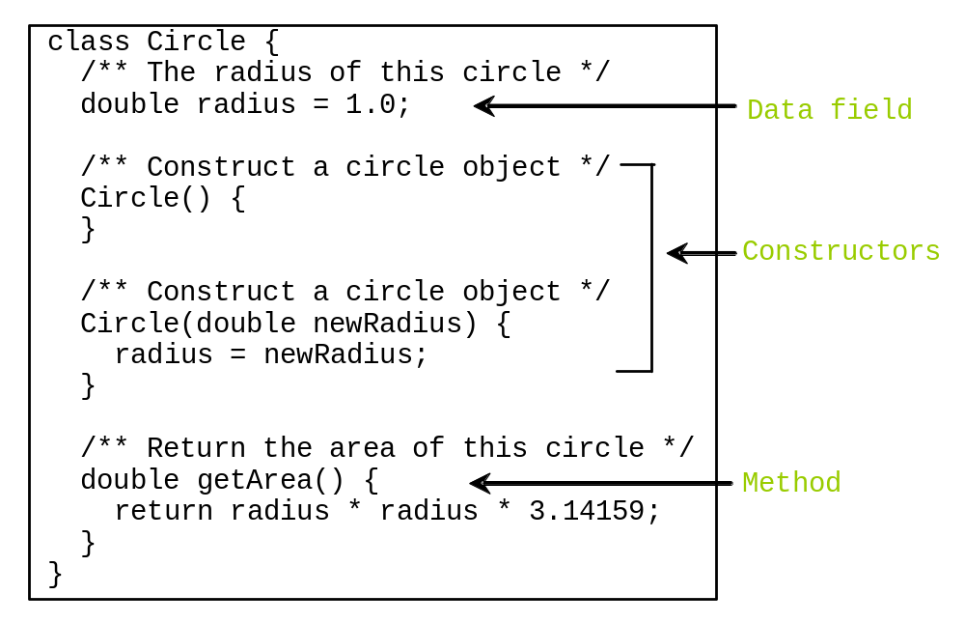
Classes

Slide 10
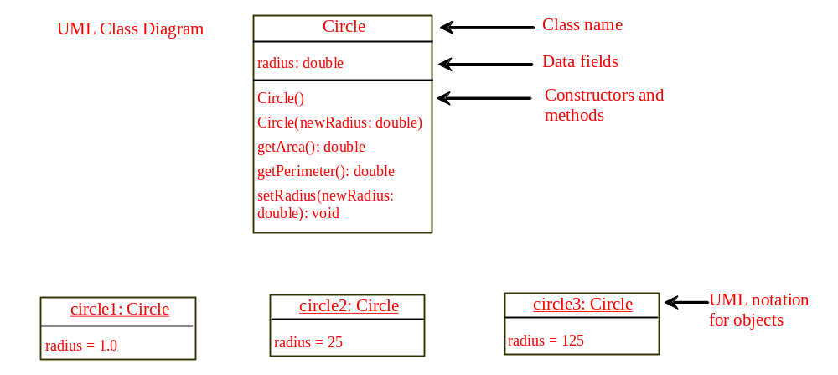
Unified Modelling Language (UML) Class Diagram

Slide 11
Example: Defining Classes and Creating Objects
Objective: Demonstrate creating objects, accessing data, and using methods.
TestSimpleCircle

Slide 12
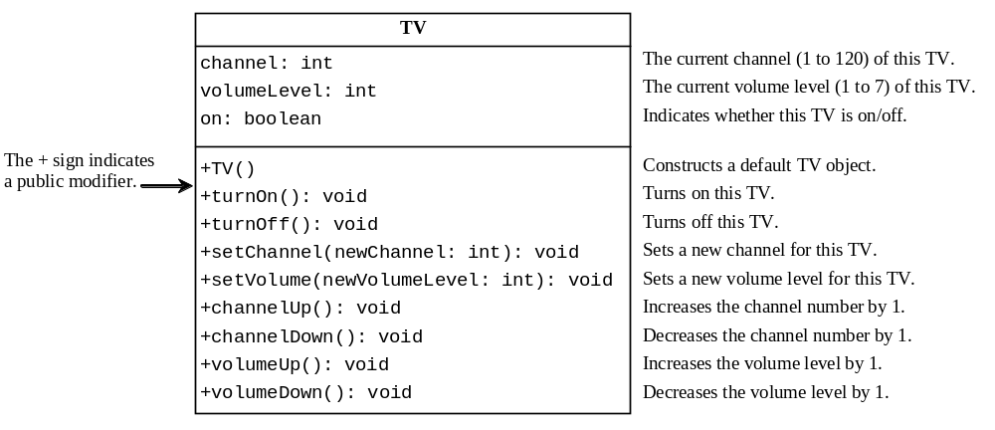
Example: Defining Classes and Creating Objects
TV
TestTV

Slide 13
Constructors
Constructors are a special kind of methods that are invoked to construct objects.
Circle() {
}
Circle(double newRadius) {
radius = newRadius;
}

Slide 14
Constructors, cont.
A constructor with no parameters is referred to as a no-arg constructor.
· Constructors must have the same name as the class itself.
· Constructors do not have a return type—not even void.
· Constructors are invoked using the new operator when an object is created. Constructors play the role of initializing objects.

Slide 15
Creating Objects Using Constructors
new ClassName();
Example:
new Circle();
new Circle(5.0);

Slide 16
Default Constructor
A class may be defined without constructors. In this case, a no-arg constructor with an empty body is implicitly defined in the class. This constructor, called a default constructor, is provided automatically only if no constructors are explicitly defined in the class.

Slide 17
Declaring Object Reference Variables
To reference an object, assign the object to a reference variable.
To declare a reference variable, use the syntax:
ClassName objectRefVar;
Example:
Circle myCircle;

Slide 18
Declaring/Creating Objects in a Single Step
ClassName objectRefVar = new ClassName();
Example:
Circle myCircle = new Circle();
Assign object reference
Create an object

Slide 19
Accessing Object’s Members
Referencing the object’s data:
objectRefVar.data
e.g., myCircle.radius
Invoking the object’s method:
objectRefVar.methodName(arguments)
e.g., myCircle.getArea()

Slide 20
Trace Code
animation
Declare myCircle
Circle myCircle = new Circle(5.0);
Circle yourCircle = new Circle();
yourCircle.radius = 100;
myCircle
no value

Slide 21

Trace Code, cont.
animation
Circle myCircle = new Circle(5.0);
Circle yourCircle = new Circle();
yourCircle.radius = 100;
myCircle
no value
Create a circle

Slide 22
Trace Code, cont.
animation
Circle myCircle = new Circle(5.0);
Circle yourCircle = new Circle();
yourCircle.radius = 100;
myCircle
reference value
Assign object reference to myCircle

Slide 23
Trace Code, cont.
animation
Circle myCircle = new Circle(5.0);
Circle yourCircle = new Circle();
yourCircle.radius = 100;
myCircle
reference value
yourCircle
no value
Declare yourCircle

Slide 24
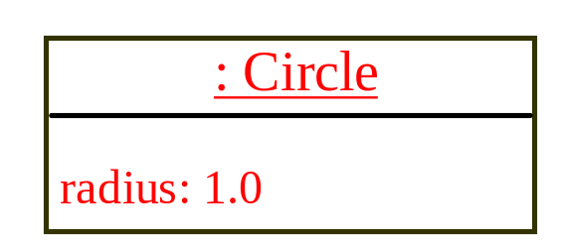
Trace Code, cont.
animation
Circle myCircle = new Circle(5.0);
Circle yourCircle = new Circle();
yourCircle.radius = 100;
myCircle
reference value
yourCircle
no value
Create a new Circle object

Slide 25

Trace Code, cont.
animation
Circle myCircle = new Circle(5.0);
Circle yourCircle = new Circle();
yourCircle.radius = 100;
myCircle
reference value
yourCircle
reference value
Assign object reference to yourCircle

Slide 26

Trace Code, cont.
animation
Circle myCircle = new Circle(5.0);
Circle yourCircle = new Circle();
yourCircle.radius = 100;
myCircle
reference value
yourCircle
reference value
Change radius in yourCircle

Slide 27
Caution
Recall that you use
  Math.methodName(arguments) (e.g., Math.pow(3, 2.5))
to invoke a method in the Math class. Can you invoke getArea() using SimpleCircle.getArea()? The answer is no. All the methods used before this chapter are static methods, which are defined using the static keyword. However, getArea() is non-static. It must be invoked from an object using
  objectRefVar.methodName(arguments) (e.g., myCircle.getArea()).
More explanations will be given in the section on “Static Variables, Constants, and Methods.”

Slide 28
Reference Data Fields
The data fields can be of reference types. For example, the following Student class contains a data field name of the String type.
public class Student {
String name; // name has default value null
int age; // age has default value 0
boolean isScienceMajor; // isScienceMajor has default value false
char gender; // c has default value '\u0000'
}

Slide 29
The null Value
If a data field of a reference type does not reference any object, the data field holds a special literal value, null.

Slide 30
Default Value for a Data Field
The default value of a data field is null for a reference type, 0 for a numeric type, false for a boolean type, and '\u0000' for a char type. However, Java assigns no default value to a local variable inside a method.
public class Test {
public static void main(String[] args) {
Student student = new Student();
System.out.println("name? " + student.name);
System.out.println("age? " + student.age);
System.out.println("isScienceMajor? " + student.isScienceMajor);
System.out.println("gender? " + student.gender);
}
}

Slide 31
Example
Java assigns no default value to a local variable inside a method.
public class Test {
public static void main(String[] args) {
int x; // x has no default value
String y; // y has no default value
System.out.println("x is " + x);
System.out.println("y is " + y);
}
}
Compile error: variable not initialized

Slide 32

Differences between Variables of
Primitive Data Types and Object Types

Slide 33

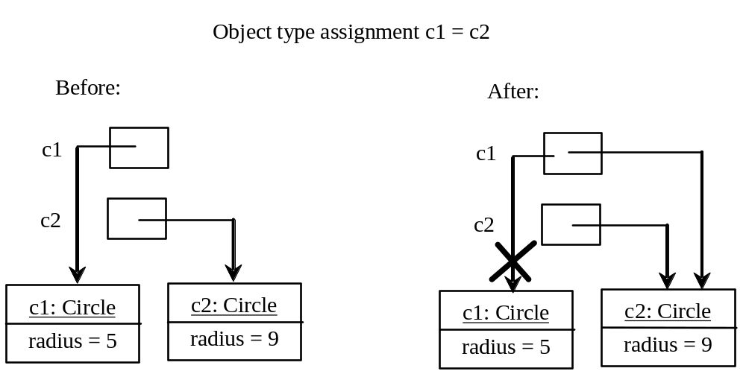
Copying Variables of Primitive Data Types and Object Types

Slide 34
Garbage Collection
As shown in the previous figure, after the assignment statement c1 = c2, c1 points to the same object referenced by c2. The object previously referenced by c1 is no longer referenced. This object is known as garbage. Garbage is automatically collected by JVM.

Slide 35
Garbage Collection, cont
TIP: If you know that an object is no longer needed, you can explicitly assign null to a reference variable for the object. The JVM will automatically collect the space if the object is not referenced by any variable.

Slide 36

The Date Class
Java provides a system-independent encapsulation of date and time in the java.util.Date class. You can use the Date class to create an instance for the current date and time and use its toString method to return the date and time as a string.

Slide 37
The Date Class Example
For example, the following code
  java.util.Date date = new java.util.Date();
  System.out.println(date.toString());
displays a string like Sun Mar 09 13:50:19 EST 2003.

Slide 38

The Random Class
You have used Math.random() to obtain a random double value between 0.0 and 1.0 (excluding 1.0). A more useful random number generator is provided in the java.util.Random class.

Slide 39
The Random Class Example
If two Random objects have the same seed, they will generate identical sequences of numbers. For example, the following code creates two Random objects with the same seed 3.
Random random1 = new Random(3);
System.out.print("From random1: ");
for (int i = 0; i < 10; i++)
System.out.print(random1.nextInt(1000) + " ");
Random random2 = new Random(3);
System.out.print("\nFrom random2: ");
for (int i = 0; i < 10; i++)
System.out.print(random2.nextInt(1000) + " ");
From random1: 734 660 210 581 128 202 549 564 459 961
From random2: 734 660 210 581 128 202 549 564 459 961

Slide 40
Instance
Variables, and Methods
Instance variables belong to a specific instance.
Instance methods are invoked by an instance of the class.

Slide 41
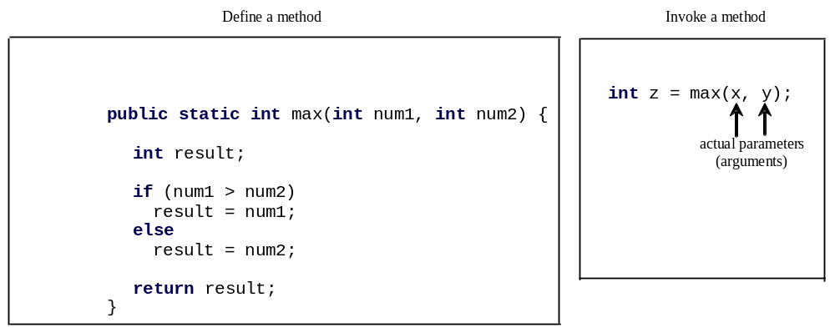
Defining Methods
A method is a collection of statements that are grouped together to perform an operation.

Slide 42

Defining Methods
A method is a collection of statements that are grouped together to perform an operation.

Slide 43
Method Signature
Method signature is the combination of the method name and the parameter list.

Slide 44
Formal Parameters
The variables defined in the method header are known as formal parameters.

Slide 45
Actual Parameters
When a method is invoked, you pass a value to the parameter. This value is referred to as actual parameter or argument.

Slide 46
Return Value Type
A method may return a value. The returnValueType is the data type of the value the method returns. If the method does not return a value, the returnValueType is the keyword void. For example, the returnValueType in the main method is void.

Slide 47
Calling Methods
Testing the max method
This program demonstrates calling a method max to return the largest of the int values
TestMax

Slide 48
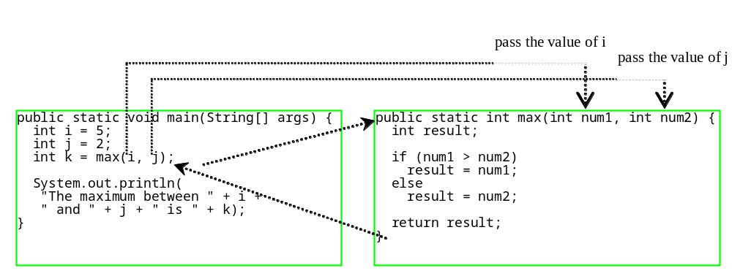
Calling Methods, cont.
animation

Slide 49

Trace Method Invocation
animation
i is now 5

Slide 50
Trace Method Invocation
animation
j is now 2

Slide 51
Trace Method Invocation
animation
invoke max(i, j)

Slide 52
Trace Method Invocation
animation
invoke max(i, j)
Pass the value of i to num1
Pass the value of j to num2

Slide 53
Trace Method Invocation
animation
declare variable result

Slide 54
Trace Method Invocation
animation
(num1 > num2) is true since num1 is 5 and num2 is 2

Slide 55
Trace Method Invocation
animation
result is now 5

Slide 56
Trace Method Invocation
animation
return result, which is 5

Slide 57
Trace Method Invocation
animation
return max(i, j) and assign the return value to k

Slide 58
Trace Method Invocation
animation
Execute the print statement

Slide 59

CAUTION
A return statement is required for a value-returning method. The method shown below in (a) is logically correct, but it has a compilation error because the Java compiler thinks it possible that this method does not return any value.
To fix this problem, delete if (n < 0) in (a), so that the compiler will see a return statement to be reached regardless of how the if statement is evaluated.

Slide 60
Reuse Methods from Other Classes
NOTE: One of the benefits of methods is for reuse. The max method can be invoked from any class besides TestMax. If you create a new class Test, you can invoke the max method using ClassName.methodName (e.g., TestMax.max).

Slide 61
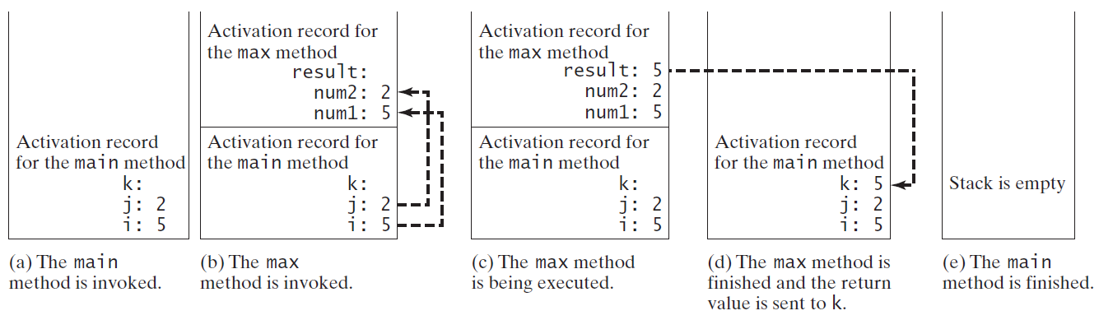
Call Stacks

Slide 62


Trace Call Stack
animation
i is declared and initialized

Slide 63
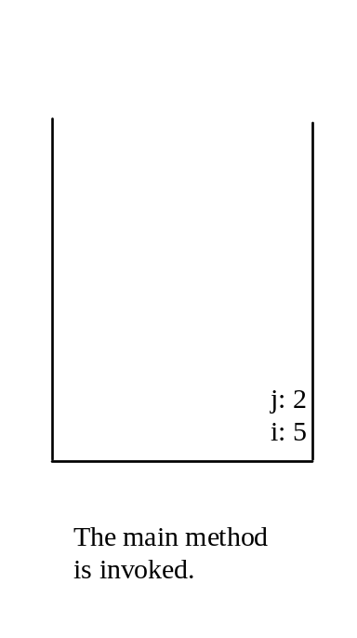
Trace Call Stack
animation
j is declared and initialized

Slide 64

Trace Call Stack
animation
Declare k

Slide 65
Trace Call Stack
animation
Invoke max(i, j)

Slide 66

Trace Call Stack
animation
pass the values of i and j to num1 and num2

Slide 67

Trace Call Stack
animation
Declare result

Slide 68
Trace Call Stack
animation
(num1 > num2) is true

Slide 69

Trace Call Stack
animation
Assign num1 to result

Slide 70

Trace Call Stack
animation
Return result and assign it to k

Slide 71

Trace Call Stack
animation
Execute print statement

Slide 72
void Method Example
This type of method does not return a value. The method performs some actions.
TestVoidMethod
TestReturnGradeMethod

Slide 73
Passing Parameters
public static void nPrintln(String message, int n) {
for (int i = 0; i < n; i++)
System.out.println(message);
}
Suppose you invoke the method using
  nPrintln(“Welcome to Java”, 5);
What is the output?
Suppose you invoke the method using
  nPrintln(“Computer Science”, 15);
What is the output?
Can you invoke the method using
  nPrintln(15, “Computer Science”);

Slide 74
Pass by Value
This program demonstrates passing values to the methods.
Increment

Slide 75
Pass by Value
Testing Pass by value
This program demonstrates passing values to the methods.
TestPassByValue

Slide 76
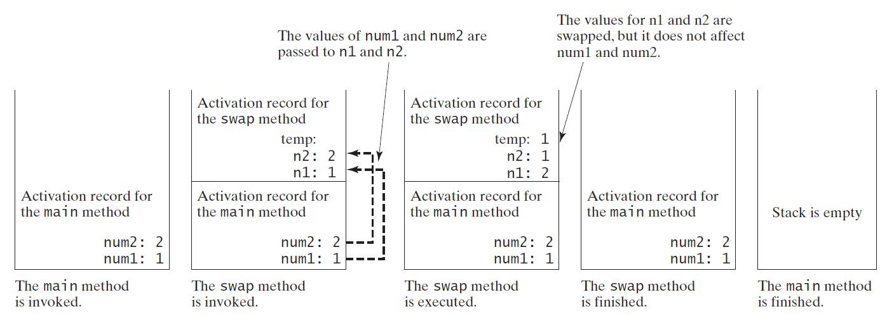
Pass by Value, cont.

Slide 77
Modularizing Code
Methods can be used to reduce redundant coding and enable code reuse. Methods can also be used to modularize code and improve the quality of the program.

Slide 78
Case Study: Converting Hexadecimals to Decimals
Write a method that converts a hexadecimal number into a decimal number.
ABCD =>
A*16^3 + B*16^2 + C*16^1+ D*16^0
= ((A*16 + B)*16 + C)*16+D
= ((10*16 + 11)*16 + 12)*16+13 = ?
Hex2Dec

Slide 79
Overloading Methods
Overloading the max Method
public static double max(double num1, double num2) {
if (num1 > num2)
return num1;
else
return num2;
}
TestMethodOverloading

Slide 80
Ambiguous Invocation
Sometimes there may be two or more possible matches for an invocation of a method, but the compiler cannot determine the most specific match. This is referred to as ambiguous invocation. Ambiguous invocation is a compile error.

Slide 81
Ambiguous Invocation
public class AmbiguousOverloading {
public static void main(String[] args) {
System.out.println(max(1, 2));
}
public static double max(int num1, double num2) {
if (num1 > num2)
return num1;
else
return num2;
}
public static double max(double num1, int num2) {
if (num1 > num2)
return num1;
else
return num2;
}
}

Slide 82
Scope of Local Variables
A local variable: a variable defined inside a method.
Scope: the part of the program where the variable can be referenced.
The scope of a local variable starts from its declaration and continues to the end of the block that contains the variable. A local variable must be declared before it can be used.

Slide 83
Scope of Local Variables, cont.
You can declare a local variable with the same name multiple times in different non-nesting blocks in a method, but you cannot declare a local variable twice in nested blocks.

Slide 84

Scope of Local Variables, cont.
A variable declared in the initial action part of a for loop header has its scope in the entire loop. But a variable declared inside a for loop body has its scope limited in the loop body from its declaration and to the end of the block that contains the variable.

Slide 85

Scope of Local Variables, cont.

Slide 86
Scope of Local Variables, cont.
// Fine with no errors
public static void correctMethod() {
int x = 1;
int y = 1;
// i is declared
for (int i = 1; i < 10; i++) {
x += i;
}
// i is declared again
for (int i = 1; i < 10; i++) {
y += i;
}
}

Slide 87
Scope of Local Variables, cont.
// With errors
public static void incorrectMethod() {
int x = 1;
int y = 1;
for (int i = 1; i < 10; i++) {
int x = 0;
x += i;
}
}

Slide 88

Method Abstraction
You can think of the method body as a black box that contains the detailed implementation for the method.

Slide 89
Static Variables, Constants, and Methods
Static variables are shared by all the instances of the class.
Static methods are not tied to a specific object.
Static constants are final variables shared by all the instances of the class.

Slide 90
Static Variables, Constants, and Methods, cont.
To declare static variables, constants, and methods, use the static modifier.

Slide 91
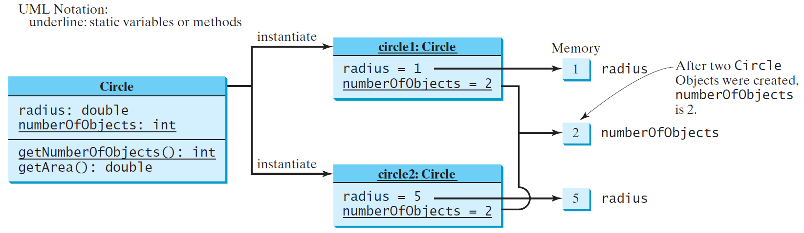
Static Variables, Constants, and Methods, cont.

Slide 92
Example of
Using Instance and Class Variables and Method
Objective: Demonstrate the roles of instance and class variables and their uses. This example adds a class variable numberOfObjects to track the number of Circle objects created.
CircleWithStaticMembers
TestCircleWithStaticMembers

Slide 93
Visibility Modifiers and
Accessor/Mutator Methods
By default, the class, variable, or method can be
accessed by any class in the same package.
public
The class, data, or method is visible to any class in any package.
private
The data or methods can be accessed only by the declaring class.
The get and set methods are used to read and modify private properties.

Slide 94

The private modifier restricts access to within a class, the default modifier restricts access to within a package, and the public modifier enables unrestricted access.

Slide 95

The default modifier on a class restricts access to within a package, and the public modifier enables unrestricted access.

Slide 96
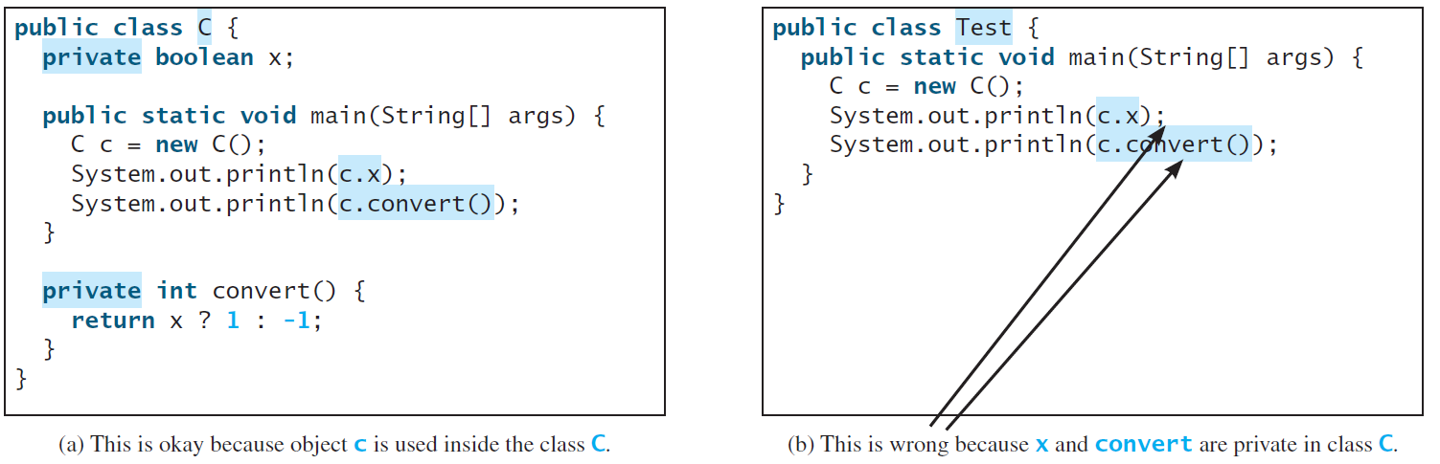
NOTE
An object cannot access its private members, as shown in (b). It is OK, however, if the object is declared in its own class, as shown in (a).

Slide 97
Why Data Fields Should Be private?
To protect data.
To make code easy to maintain.

Slide 98

Example of
Data Field Encapsulation
CircleWithPrivateDataFields
TestCircleWithPrivateDataFields

Slide 99
Passing Objects to Methods
Passing by value for primitive type value (the value is passed to the parameter)
Passing by value for reference type value (the value is the reference to the object)
TestPassObject

Slide 100
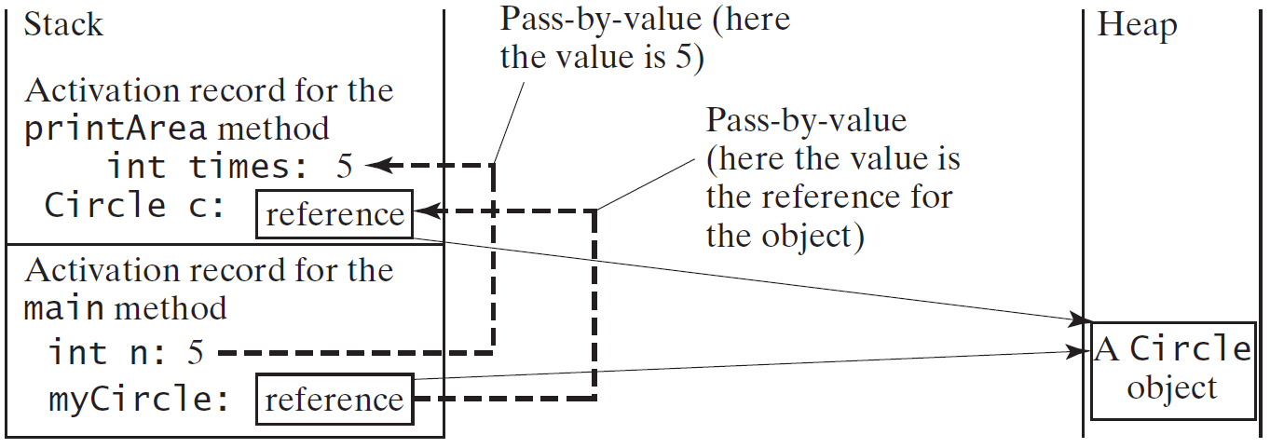
Passing Objects to Methods, cont.

Slide 101
Array of Objects
Circle[] circleArray = new Circle[10];
An array of objects is actually an array of reference variables. So invoking circleArray[1].getArea() involves two levels of referencing as shown in the next figure. circleArray references to the entire array. circleArray[1] references to a Circle object.

Slide 102

Array of Objects, cont.
Circle[] circleArray = new Circle[10];

Slide 103
Array of Objects, cont.
Summarizing the areas of the circles
TotalArea

Slide 104
Immutable Objects and Classes
If the contents of an object cannot be changed once the object is created, the object is called an immutable object and its class is called an immutable class. If you delete the set method in the Circle class in Listing 8.10, the class would be immutable because radius is private and cannot be changed without a set method.
A class with all private data fields and without mutators is not necessarily immutable. For example, the following class Student has all private data fields and no mutators, but it is mutable.

Slide 105
Example
public class BirthDate {
private int year;
private int month;
private int day;
public BirthDate(int newYear,
int newMonth, int newDay) {
year = newYear;
month = newMonth;
day = newDay;
}
public void setYear(int newYear) {
year = newYear;
}
}
public class Student {
private int id;
private BirthDate birthDate;
public Student(int ssn,
int year, int month, int day) {
id = ssn;
birthDate = new BirthDate(year, month, day);
}
public int getId() {
return id;
}
public BirthDate getBirthDate() {
return birthDate;
}
}
public class Test {
public static void main(String[] args) {
Student student = new Student(111223333, 1970, 5, 3);
BirthDate date = student.getBirthDate();
date.setYear(2010); // Now the student birth year is changed!
}
}

Slide 106
What Class is Immutable?
For a class to be immutable, it must mark all data fields private and provide no mutator methods and no accessor methods that would return a reference to a mutable data field object.

Slide 107
Scope of Variables
The scope of instance and static variables is the entire class. They can be declared anywhere inside a class.
The scope of a local variable starts from its declaration and continues to the end of the block that contains the variable. A local variable must be initialized explicitly before it can be used.

Slide 108
The this Keyword
The this keyword is the name of a reference that refers to an object itself. One common use of the this keyword is reference a class’s hidden data fields.
Another common use of the this keyword to enable a constructor to invoke another constructor of the same class.

Slide 109

Reference the Hidden Data Fields

Slide 110

Calling Overloaded Constructor

Slide 111
End

Slide 112
Wrapper Classes
Boolean
Character
Short
Byte
Integer
Long
Float
Double
NOTE: (1) The wrapper classes do not have no-arg constructors. (2) The instances of all wrapper classes are immutable, i.e., their internal values cannot be changed once the objects are created.

Slide 113
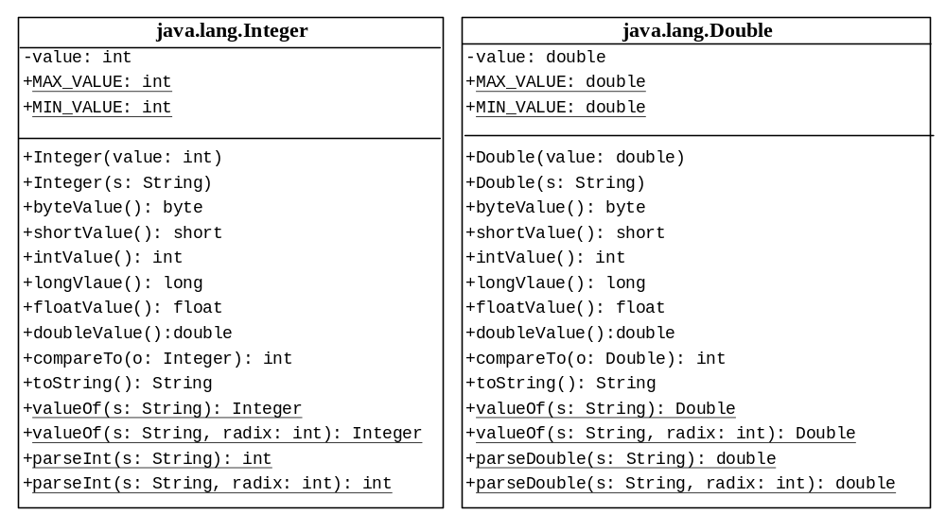
The Integer and Double Classes

Slide 114
The Integer Class and the Double Class
Constructors
Class Constants MAX_VALUE, MIN_VALUE
Conversion Methods

Slide 115
Numeric Wrapper Class Constructors
You can construct a wrapper object either from a primitive data type value or from a string representing the numeric value. The constructors for Integer and Double are:
  public Integer(int value)
  public Integer(String s)
  public Double(double value)
  public Double(String s)

Slide 116
Numeric Wrapper Class Constants
Each numerical wrapper class has the constants MAX_VALUE and MIN_VALUE.
MAX_VALUE represents the maximum value of the corresponding primitive data type.
For Byte, Short, Integer, and Long, MIN_VALUE represents the minimum byte, short, int, and long values.
For Float and Double, MIN_VALUE represents the minimum positive float and double values.
The following statements display the maximum integer (2,147,483,647), the minimum positive float (1.4E-45), and the maximum double floating-point number (1.79769313486231570e+308d).

Slide 117
Conversion Methods
Each numeric wrapper class implements the abstract methods doubleValue, floatValue, intValue, longValue, and shortValue, which are defined in the Number class. These methods “convert” objects into primitive type values.

Slide 118
The Static valueOf Methods
The numeric wrapper classes have a useful class method, valueOf(String s). This method creates a new object initialized to the value represented by the specified string. For example:
  Double doubleObject = Double.valueOf("12.4");
  Integer integerObject = Integer.valueOf("12");

Slide 119
The Methods for Parsing Strings into Numbers
You have used the parseInt method in the Integer class to parse a numeric string into an int value and the parseDouble method in the Double class to parse a numeric string into a double value. Each numeric wrapper class has two overloaded parsing methods to parse a numeric string into an appropriate numeric value.

Slide 120
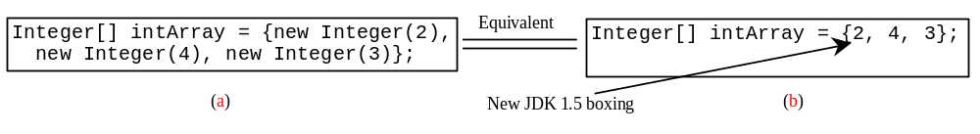
Automatic Conversion Between Primitive Types and Wrapper Class Types
JDK 1.5 allows primitive type and wrapper classes to be converted automatically. For example, the following statement in (a) can be simplified as in (b):
Integer[] intArray = {1, 2, 3};
System.out.println(intArray[0] + intArray[1] + intArray[2]);
Unboxing

Slide 121
BigInteger and BigDecimal
If you need to compute with very large integers or high precision floating-point values, you can use the BigInteger and BigDecimal classes in the java.math package. Both are immutable. Both extend the Number class and implement the Comparable interface.

Slide 122
BigInteger and BigDecimal
BigInteger a = new BigInteger("9223372036854775807");
BigInteger b = new BigInteger("2");
BigInteger c = a.multiply(b); // 9223372036854775807 * 2
System.out.println(c);
LargeFactorial
BigDecimal a = new BigDecimal(1.0);
BigDecimal b = new BigDecimal(3);
BigDecimal c = a.divide(b, 20, BigDecimal.ROUND_UP);
System.out.println(c);

Slide 123
The String Pool and the Integer Pool
Remember if you create two Strings with the name value, they won’t be the same string:
String a = new String(“Hello!”);
String b = new String(“Hello!”);
System.out.println(a == b); // prints “false”
But if you declare strings as literals, the compiler implicitly instantiates that String, and every other time it encounters that String literal, it retrieves it from the same place:
String c = Hello!”;
String d = Hello!”;
System.out.println(c == d); // prints “true” (!)

Slide 124
The String Pool
What Java does is store all these String literals in a place called the “String pool”, so it does not duplicate and recreate String literals when they’re encountered. c and d here will point to the same String literal
String c = “Hello!”;
String d = “Hello!”;
String e = “Goodbye!”;
String f = new String(“Goodbye!”);
String g = new String(“Goodbye!”);
c d
e f
Goodbye!!
“Hello!”
“Goodbye!”
g
Goodbye!!

Slide 125
The Integer Pool
Works like the String Pool, except that explicitly creating new Integer objects are all drawn from the Integer pool for all Integers from -128 to 127
Integer i = new Integer(12);
Integer j = new Integer(12);
System.out.println(i == j); // prints “true”
Integer m = new Integer(999);
Integer n = new Integer(999);
System.out.println(m == n); // prints “false”

