Slide 1
A Measurement Study of RDMA Performance In Multi-Tenant Environment - VMs and Containers
Student: Zhuangdi Zhu Supervisor: Alex Liu
Mentors: Salman A Baset Michael R Hines
Dec 9th, 2014

Slide 2
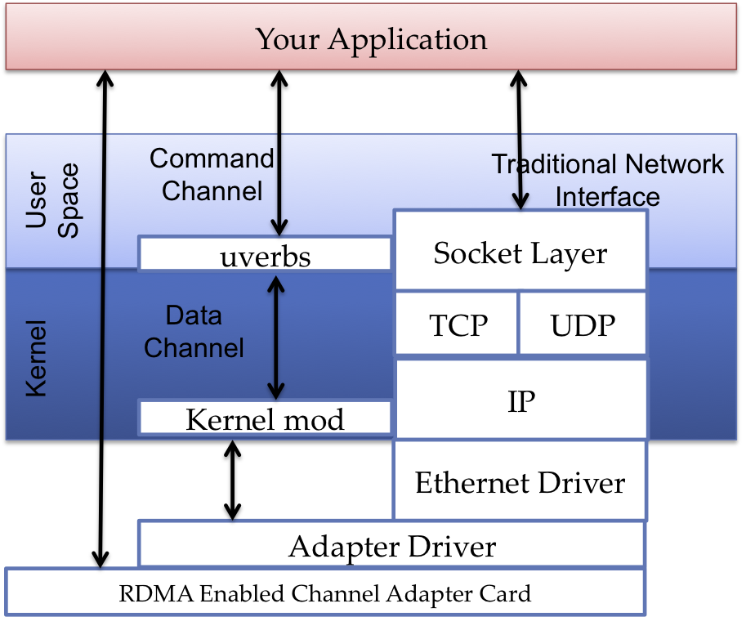
RDMA
RDMA provides high-throughput, low-latency networking:
Reduce consumption of CPU cycles
Reduce communication latency
Notes:
RDMA is the ability of accessing( i.e. reading from or writing to) on a remote machine without interrupting the processing of CPU(s) on that system.

Slide 3
RDMA
Three protocols support RDMA:
InfiniBand (IB)
RDMA Over Converged Ethernet (RoCE)
Internet Wide Area RDMA Protocol (iWARP)
Application
Application
Application
TCP
OFA software
OFA software
IB transport
IB transport
IP
Ethernet Link
Ethernet Link
IB link
TCP
RoCE
InfiniBand

Slide 4
InfiniBand (IB)
a new generation network protocol which supports RDMA natively from the beginning. it requires NICs and switches which supports this technology.
⬥ High throughput
⬥ Low latency
⬥ Quality of service
⬥ Fail over
⬥ Scalability
⬥ Reliable transport

Slide 5
RDMA over Converged Ethernet (RoCE)
a network protocol which allows performing RDMA over Ethernet network.
Its lower network headers are Ethernet headers and its upper network headers (including the data) are InfiniBand headers. This allows using RDMA over standard Ethernet infrastructure (switches). Only the NICs should be special and support RoCE.

Slide 6
Internet Wide Area RDMA Protocol (iWARP)
a network protocol which allows performing RDMA over TCP.
There are features that exist in IB and RoCE and aren't supported in iWARP. This allows using RDMA over standard Ethernet infrastructure (switches).
Only the NICs should be special and support iWARP (if CPU offloads are used) otherwise, all iWARP stacks can be implemented in SW and loosing most of the RDMA performance advantages

Slide 7
Proposed Experiment Paths
scenario | sender | receiver | protocol | test
1 | host | host | TCP | 1 and 4 transfers
2 | host | host | RDMA | 1 and 4 transfers
3 | VM | VM | TCP | 1 and 4 transfers
4 | VM | VM | RDMA | 1 and 4 transfers
5 | LXC | LXC | TCP | 1 and 4 transfers
6 | LXC | LXC | RDMA | 1 and 4 transfers
7 | 4 VMs | 4 VMs | TCP | 1 transfer
8 | 4 VMs | 4 VMs | RDMA | 1 transfer
9 | 4 LXCs | 4 LXCs | TCP | 1 transfer
10 | 4 LXCs | 4 LXCs | RDMA | 1 transfer

Slide 8
Reading List
Papers/Slides/Websites
List No. | Title | Status
1 | Accelerating Spark with RDMA for Big Data Processing: Early Experiences | read
2 | IBM Zurich – RDMA
3 | Hadoop RDMA
4 | Accelerating Big Data with RDMA solutions | read
5 | Features/RDMALiveMigration - QEMU
6 | RDMA Consortium

Slide 9
Reading List
RFC Documents
List No. | Title | Status
7 | RFC5532 - Network File System (NFS) Remote Direct Memory Access (RDMA) Problem Statement
8 | RFC5041 - Direct Data Placement over Reliable Transports
9 | RFC5042 - Direct Data Placement Protocol (DDP) / Remote Direct Memory Access Protocol (RDMAP) Security | read 2 pages
10 | RFC5040 - A Remote Direct Memory Access Protocol Specification
11 | RFC7146 - Securing Block Storage Protocols over IP: RFC 3723 Requirements Update for IPsec v3

Slide 10
Reading List
Resources from Google Search
List No. | Title | Status
12 | Z-Copy Education and Sample Code for RDMA Programminghttp://zcopy.wordpress.com/2010/10/08/quick-concepts-part-1-%E2%80%93-introduction-to-rdma/ | read
13 | Introduction to Remote Direct Memory Access (RDMA)http://www.rdmamojo.com/2014/03/31/remote-direct-memory-access-rdma | read
14 | Working with RDMA in RedHat/CentOS 6.* http://www.rdmamojo.com/2014/09/20/working-rdma-redhatcentos-6/ | read
15 | RDMA Performance in Virtual Machines using QDR InfiniBand on Vmware http://www.mellanox.com/related-docs/whitepapers/RDMA_Performance_in_Virtual_Machines_using_QDR_InfiniBand_on_VMware_vSphere5.pdf | read
16 | Access to InfiniBand* from Linux* https://software.intel.com/en-us/articles/access-to-infiniband-from-linux/ | read

Slide 11




Test Environment
Host Hardware | MacBook Air
Host OS | OS X 10.9.5 (13F34)
Processor | 1.4 GHz Intel Core i5 Dual Core
Memory | 4 GB 1600 MHz DDR3
VM Software | VirtualBox 4.3.20
Guest OS | Linux CentOS 6.5
Linux Kernel Version | 2.6.32-431.el6.x86_64
OFA OFED | Open Fabrics Alliance OFED(3.12/3.5) (failed)
Guest Memory | 1 GB

Slide 12
Proposed Methodology
Set up a pair of nodes for each protocol: RDMA(RoCE or iWARP) and TCP.
Install, configure & run minimal services on test nodes to maximize machine performance.
Directly connect nodes to maximize network performance.
Write program / use existing benchmark to test data transfer using TCP and RDMA.
Install single guest VM on each node, repeat the above steps.
Install four guest VMs on each node, repeat the above steps.

Slide 13
Work I have done
Read Documents/Web resources about RDMA
Installed VirtualBox on Macbook
Installed CentOS 6.5 as Guest OS and basic utilities
Read materials about RoCE
Experiments:
tried to install Open Fabrics Alliance OFED(3.12 and 3.5) but it seems in-compatible with Linux version(CentOS 6.6 and 6.5).

Slide 14
Difficulties
I Don’t Have Hardware Resource for Experiments
Only one MacBook without Ethernet Card
RDMA required RDMA-enabled Network Adapter
Seems only SoftRoCE or SoftiWARP can be used at this moment
Finding the right versions of OS, OFED, drivers that work together
E.g., OFA OFED doesn’t support CentOS 6.6
How to fix the errors or problems during installation and compilation (OFED, RoCE ..)
Work with Linux kernel, modules and drivers

Slide 15
TODO
Install SoftRoCE in Virtualbox

Slide 16
Backup slides

Slide 17
Your Application
User Space
Command Channel
Traditional Network Interface
Socket Layer
uverbs
Kernel
Data Channel
TCP
UDP
IP
Verbs API
Kernel mod
Ethernet Driver
Adapter Driver
RDMA Enabled Channel Adapter Card

Slide 18
A Measurement Study of RDMA Performance In Multi-Tenant Environment - VMs and Containers
Student: Zhuangdi Zhu Supervisor: Alex Liu
Mentors: Salman A Baset Michael R Hines
Dec 15th, 2014

Slide 19
Work I have done
Installed CentOS-6.5-x86_64 as Operating System on two real hosts.
Installed the right kernel-devel (2.6.32-431.el6.x86_64).
Installed openmpi and finished the first experiment (host to host , 1 transfer, using tcp).
Equipped the two hosts with InfiniBand Adapter cards(CX353A).
Installed OFED-3.12 successfully.
Tried to connect the two hosts directly using one InfiniBand cable but failed.

Slide 20
Steps
#ssh 192.168.1.104 (ssh 192.168.1.103)
# yum install rpm-build libtool zlib-devel libstdc++-devel gcc-c++ bison flex tcl tk glib2-devel tcl-devel git
#uname –r
2.6.32-431.el6.x86_64
#wgethttp://vault.centos.org/6.5/os/x86_64/Packages/kernel-devel-2.6.32-431.el6.x86_64.rpm
#useradd test
#passwd test
#su test
#cd
#yum –y install openmpi-devel
#cd openmpi-1.8.3
#./configure --prefix=/home/test/openmpi
#make
#make install

Slide 21

Steps
# wget http://downloads.openfabrics.org/downloads/OFED/ofed-3.12/OFED-3.12.tgz
#cd OFED-3.12
#./install.pl
#vim transfer1.c
#mpicc transfer1.c –o transfer1
#mpirun -np 2 hostname
#mpirun -np 2 -host zhuangdizhu1,zhuangdizhu2 hostname
#mpirun -np 2 -host zhuangdizhu1 ./transfer1

Slide 22
Steps
#mpirun -np 2 -host zhuangdizhu1,zhuangdizhu2 ./transfer1
#ifconfig ib0
ib0 Link encap:InfiniBand HWaddr 80:00:00:48:FE:80:00:00:00:00:00:00:00:00:00:00:00:00:00:00
BROADCAST MULTICAST MTU:4092 Metric:1
RX packets:0 errors:0 dropped:0 overruns:0 frame:0
TX packets:0 errors:0 dropped:0 overruns:0 carrier:0
collisions:0 txqueuelen:256
RX bytes:0 (0.0 b) TX bytes:0 (0.0 b)

Slide 23
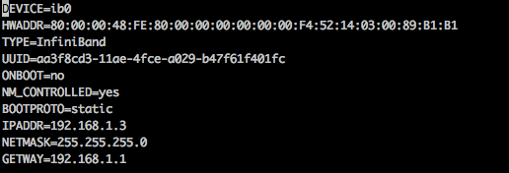
Steps
#vim /etc/sysconfig/network-scripts/ifcfg-ib0
Add the following:
#ONBOOT=yes
BOOTPROTO=static
IPADDR=192.168.1.2(192.168.1.3 for the other host)
NETMASK=255.255.255.255
GATEWAY=192.168.1.1

Slide 24
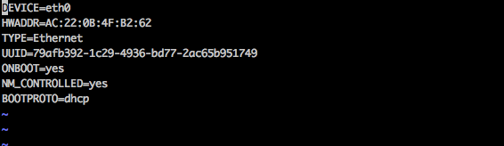
Steps
#vim /etc/sysconfig/network-scripts/ifcfg-eth0
#service network restart
#route
#route add 192.168.1.1 dev ib0
#route add default gw 192.168.1.1
#route
#ping 192.168.1.2

Slide 25
Backup slides

Slide 26
A Measurement Study of RDMA Performance In Multi-Tenant Environment - VMs and Containers
Student: Zhuangdi Zhu Supervisor: Alex Liu
Mentors: Salman A Baset Michael R Hines
Dec 20th, 2014

Slide 27
Sequence diagram for RDMA client-server file transfer:
Post receive Start listening
Initiate connection
Accept connection Post receive
Send memory region details
Re-post receive
RDMA-write file name
Open file descriptor
Re-post receive
Send ready-to-receive
Re-post-receive
Read chunk from file RDMA-write chunk
Write chunk to file
Re-post receive
Send ready-to-receive
Re-post-receive
RDMA-write zero bytes
Send done
Close connection
Chose file secriptor
Client
Server

Slide 28
Reading List
List No. | Title | Status
1 | Intro_to_IB_for_End_Users | Read chapter 1, 4 and most part of chapter 5
2 | building-an-rdma-capable-application-with-ib-verbs | Read part 1( Basics), and roughly read part 2(source code for server side) and 3(source code for client side)
3 | rdma-read-and-write-with-ib-verbs | Same as above
4 | basic-flow-control-for-rdma-transfers | Adjusted the sample code it provided and used it to finish a single rdma transfer
5 | Introduction to Sockets Programming in C using TCP/IP | Read the first 30 pages

Slide 29
Work I Have Done
Test rdma/tcp bandwidth and latency using qperf to obtain a basic understanding of the performance difference between TCP and RDMA
Qperf：
qperf measures bandwidth and latency between two nodes. It can work over TCP/IP as well as the RDMA transports. On one of the nodes, qperf is typically run with no arguments designating it the server node. One may then run qperf on a client node to obtain measurements such as bandwidth, latency and cpu utilization.

Slide 30
Work I Have Done
Test rdma/tcp bandwidth and latency using qperf
[root@zhuangdizhu1 ~]# qperf
[root@zhuangdizhu2 ~]# for i in {1..10}; do qperf zhuangdizhu1 rc_rdma_read_lat; done
[root@zhuangdizhu2 ~]# for i in {1..10}; do qperf zhuangdizhu1 rc_rdma_read_bw; done
[root@zhuangdizhu2 ~]# for i in {1..10}; do qperf zhuangdizhu1 rc_rdma_write_bw; done
[root@zhuangdizhu2 ~]# for i in {1..10}; do qperf zhuangdizhu1 rc_rdma_write_lat; done
[root@zhuangdizhu2 ~]# for i in {1..10}; do qperf zhuangdizhu1 tcp_bw; done
[root@zhuangdizhu2 ~]# for i in {1..10}; do qperf zhuangdizhu1 tcp_lat; done

Slide 31
Work I Have Done
Table 1. Comparison of RDMA and TCP using qperf
Results | 1 | 2 | 3 | 4 | 5 | 6 | 7 | 8 | 9 | 10 | Avg
Rdma_read-lantency(us) | 3.98 | 4.08 | 4.03 | 4.04 | 4.05 | 4.06 | 3.91 | 4.07 | 4.04 | 4.04 | 4.03
Rdma_read-bandwidth (GB/sec) | 3.82 | 3.81 | 3.82 | 3.82 | 3.82 | 3.82 | 3.82 | 3.82 | 3.82 | 3.82 | 3.819
Rdma_write-lantency(us) | 10.7 | 10.8 | 10.8 | 10.8 | 10.7 | 10.6 | 10.8 | 10.8 | 10.8 | 10.8 | 10.76
Rdma_write-bandwidth (GB/sec) | 3.74 | 3.75 | 3.74 | 3.75 | 3.75 | 3.76 | 3.75 | 3.75 | 3.75 | 3.75 | 3.749
Tcp_bandwidth(MB/sec) | 11.9 | 11.9 | 11.9 | 11.9 | 11.9 | 11.9 | 11.9 | 11.9 | 11.9 | 11.9 | 11.90
Tcp_latency (us) | 36.8 | 36.8 | 36.8 | 36.8 | 36.9 | 36.8 | 36.8 | 36.8 | 36.8 | 36.8 | 36.81

Slide 32
Comparisons

Slide 33
Work I Have Done
Finished the experiment of RDMA single transfer using lower-level-programming rather than MPI.
Table 2. Time for client transferring 1GB file to server
results | No.1 | No.2 | No.3 | No.4 | No.5 | No.6 | No.7 | No.8 | No.9 | N.10 | Avg
Rdma single transfer (sec) | 1.154 | 1.157 | 1.155 | 1.142 | 1.151 | 1.154 | 1.157 | 1.155 | 1.159 | 1.216 | 1.160

Slide 34
Work I Have Done
Precise Timing (nano secs)
#vim Makefile
LDFLAGS := ${LDFLAGS} -lrdmacm -libverbs –lrt
#vim client.c
#include <time.h>
…………
…………
int main(int argc, char **argv)
{
…………
…………
clock_gettime(CLOCK_REALTIME,&t1);
rc_client_loop(argv[1], DEFAULT_PORT, &ctx);
clock_gettime(CLOCK_REALTIME, &t2);
diff = (double) (t2.tv_sec-t1.tv_sec) + (double) (t2.tv_nsec-t1.tv_nsec) / 1e9;
printf("%lf\n", diff);
close(ctx.fd);
return 0;
}

Slide 35
Work I Have Done
[test@zhuangdizhu1 rdma-file-transfer]$ ./server
waiting for connections. interrupt (^C) to exit.
opening file test-file
received 10485760 bytes.
received 10485760 bytes.
……
received 10485760 bytes.
received 10485760 bytes.
received 4194304 bytes.
finished transferring test-file
[root@zhuangdizhu2 rdma-file-transfer]# dd if=/dev/zero of=test-file bs=1M count=1024
[root@zhuangdizhu2 rdma-file-transfer]# ./client 172.16.1.2 test-file
received MR, sending file name
received READY, sending chunk
received READY, sending chunk
……
received READY, sending chunk
received READY, sending chunk
received DONE, disconnecting
1.155221

Slide 36
Work I Have Done
Read documents, try to understand and tune the /proc/sys/net/ipv4/tcp_** parameters (rmem, wmem, etc)
Try to find a sample code for tcp socket programming but have not found one yet

Slide 37
Difficulties
I want to use a higher-level program to make it easier to code, e.g. MPI, but there is something wrong with my openmpi version .
It works when the program runs on one host , and works as well on two hosts when it runs hostname
[test@zhuangdizhu2 ~]$ mpirun -np 2 -host zhuangdizhu2 --report-bindings --mca btl self,sm,openib ./transfer1
[zhuangdizhu2:13201] MCW rank 1 bound to socket 0[core 1[hwt 0-1]]: [../BB/../..]
[zhuangdizhu2:13201] MCW rank 0 bound to socket 0[core 0[hwt 0-1]]: [BB/../../..]
time per 1GB: 0.614994 secs
[test@zhuangdizhu2 ~]$
[test@zhuangdizhu2 ~]$ mpirun -np 2 -host zhuangdizhu2,zhuangdizhu1 --report-bindings --mca btl self,sm,openib hostname
[zhuangdizhu2:13186] MCW rank 0 bound to socket 0[core 0[hwt 0-1]]: [BB/../../..]
zhuangdizhu2
[zhuangdizhu1:04666] MCW rank 1 bound to socket 0[core 0[hwt 0-1]]: [BB/../../..]
zhuangdizhu1
However, openmpi cannot identify openib as a component:

Slide 38
Difficulties
And It will not show any results when using tcp network:
[test@zhuangdizhu2 ~]$ mpirun -np 2 -host zhuangdizhu2,zhuangdizhu1 --report-bindings --mca btl self,sm,tcp ./transfer1
[zhuangdizhu2:13218] MCW rank 0 bound to socket 0[core 0[hwt 0-1]]: [BB/../../..]
[zhuangdizhu1:04699] MCW rank 1 bound to socket 0[core 0[hwt 0-1]]: [BB/../../..]
^CKilled by signal 2.
[zhuangdizhu1][[29789,1],1][btl_tcp_frag.c:215:mca_btl_tcp_frag_recv] mca_btl_tcp_frag_recv: readv failed: Connection reset by peer (104)

Slide 39
A Measurement Study of RDMA Performance In Multi-Tenant Environment - VMs and Containers
Student: Zhuangdi Zhu Supervisor: Alex Liu
Mentors: Salman A Baset Michael R Hines
Dec 22th, 2014

Slide 40
Virtio
An abstraction layer over devices in a paravirtualized hypervisor

Slide 41
Virtio
virtio is an abstraction for a set of common emulated devices in a paravirtualized hypervisor.
export a common set of emulated devices and make them available through a common application programming interface (API).

Slide 42
Device emulation
(full virtualization) (paravirtualization)
Guest Operating System
Guest Operating System
Para-drivers
Hypervisor
(Full virtualization)
Hypervisor
(Full virtualization)
Traps
Traps
Device
Emulation
Device
Emulation
Hardware
Hardware

Slide 43
Driver abstractions with virtio
virtio
Linux guest
Front-end drivers
KVM
(Linux ypervisor)
Back-end drivers
Back-end drivers
Lguest
(Linux ypervisor)
Device emulation
Device emulation
Hardware

Slide 44
Virtio architecture
(High-level architecture of the virtio framework)
virtio-blk
virtio-net
virtio-pcl
virtio-balloom
virtio-console
virtio
Transport
Virtio back-end
drivers

Slide 45
Cgroups
Rule 1
A single hierarchy can have one or more subsystems attached to it
Rule 2
Any single subsystem (such as cpu) cannot be attached to more than one hierarchy if one of those hierarchies has a different subsystem attached to it already.

