Slide 1
Majority Voting Ensemble Classification System for Human Activity Recognition with Multimodal Sensor Dataset Done by: Team Sensorithm (Theme 2) Wong Xianyang (A0178532Y) Goh See Ting (A0111650X) Goh Yu Chen (A0178437R)

Slide 2
Agenda
Introduction
Data Preparation
Feature Engineering
Modelling Results
Future Improvements

Slide 3
Introduction
Dataset
Multimodal sensor data from University of Texas at Dallas (UTD-MHAD)
Used Inertial and Skeletal dataset
Trained 5 different machine learning (ML) models
Explore if a non-deep learning approach can provide a reasonable benchmark for other researchers to compare against
Created final model on fusion of inertial and skeletal data through majority voting ensemble

Slide 4
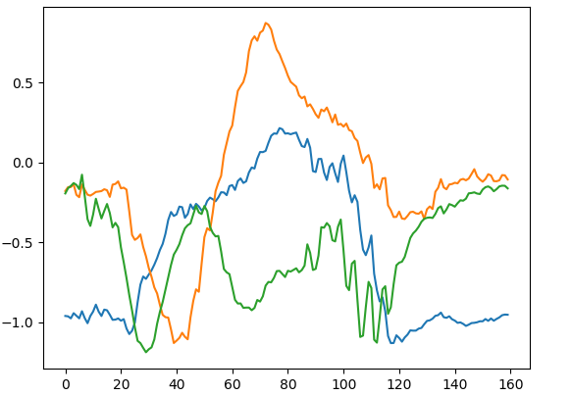
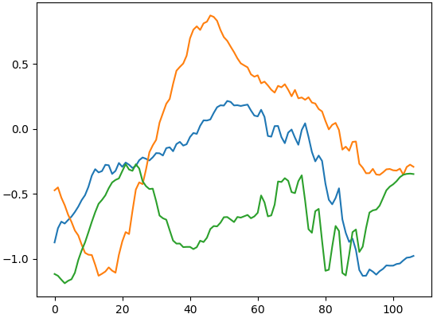
Data Preparation - Rescaling
Inertial Sensor Signal Dataset (50hz, which is 50 frames per second)
Skeleton Joint Position Dataset (30 frames per second)
Different subjects had varying frames per trial thus we standardized to minimum frames per trial by rescaling and dropping off excess frames at the beginning and end of each sequence
Summary of Number of Frames per Trial
Measure | Inertial | Skeletal
Count | 861 | 861
Mean | 180.8 | 67.7
Std | 35.4 | 12.8
Min | 107 | 41
25% | 156 | 58
50% | 177 | 67
75% | 200 | 75
Max | 326 | 125

Slide 5
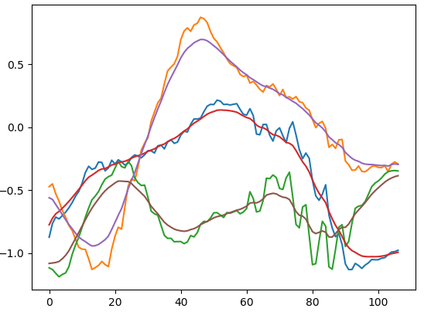
Data Preparation - Smoothening
Removed noise through the use of backwards and forwards EWMA smoothing
Inertial data: Span of 10
Skeletal data: Span of 4

Slide 6
Feature Engineering Overview
Inertial Sensor Signal Dataset
Skeleton Joint Position Dataset
Feature Engineering
Time-based features
Flattening Data
Split each trial into 6 equal non-overlapping temporal frames
Aggregation of time, velocity and jerk features: mean, std, min, max, rms
Velocity/Jerk features
Frequency-based features: FFT
Feature Engineering
Flattening Data
Distance between joints
2D anti-clockwise joint angles (xy & yz plane)
Velocity Features
Split each trial into 6 equal non-overlapping temporal frames
Aggregation of: mean, std, min, max
Merge
Train & Test
Using the following preprocess data to train and test with any ML models

Slide 7
Inertial Features
Time-based
16 created features: x_acc, y_acc, z_acc, x_gyro, y_gyro, z_gyro, x_acc_diff, y_acc_diff, z_acc_diff, x_gyro_diff, y_gyro_diff, z_gyro_diff, acc_mag, gyro_mag, acc_diff_mag, gyro_diff_mag
6 temporal frames
5 statistical features: Minimum, Maximum, Mean, Standard Deviation, Root Mean Square
16 * 6 * 5 = 480 features per trial
Frequency-based
Fast Fourier Transform of: x_acc, y_acc, z_acc, x_gyro, y_gyro, z_gyro, acc_mag, gyro_mag
8 * floor(107 / 2) = 8 * 53 = 434 features per trial

Slide 8
Skeletal Features
24 key joint position (x,y,z) features
24 anticlockwise angles between three joints in XY and YZ planes
18 joint velocity features
10 key joint distance features
6 temporal frames
4 statistical features: Minimum, Maximum, Mean, Standard Deviation
(24 + 24 + 18 + 10) * 6 * 4 = 1824 features per trial

Slide 9
Modelling Outline
Classifiers Used | Dealing with High Dimensionality | Splitting Data
Logistic Regression KNN Support Vector Machine Random Forests Extremely Randomized Trees | PCA Feature Selection using Variable Importance Plots Model Regularization | Train: Subjects 1, 3, 5 & 7 4-fold CV using subjects on Train Test: Subjects 2, 4, 6, 8

Slide 10
Modelling Results on Test data
Model | Accuracy |  |  |  |  | F1 Measure
 | Inertial_F | Inertial_T | Inertial_F_T | Skeletal | Inertial_T & Skeletal | Inertial_F | Inertial_T | Inertial_F_T | Skeletal | Inertial_T & Skeletal
Logistic Regression | 40.9% | 77.9% | 78.8% | 84.0% | 88.6% | 40.1% | 76.7% | 77.1% | 83.8% | 88.6%
KNN | 61.4% | 76.3% | 76.7% | 76.7% | 86.7% | 61.9% | 76.2% | 76.4% | 76.4% | 86.4%
SVM | 56.0% | 79.5% | 80.2% | 86.5% | 92.3% | 55.8% | 79.0% | 79.9% | 86.4% | 92.3%
Random Forest | 62.6% | 78.6% | 78.6% | 84.9% | 89.5% | 61.7% | 77.5% | 76.9% | 84.5% | 88.9%
Extra Trees | 61.2% | 79.5% | 80.5% | 86.0% | 90.7% | 59.9% | 78.2% | 78.8% | 85.4% | 90.3%
Model | Precision |  |  |  |  | Recall
 | Inertial_F | Inertial_T | Inertial_F_T | Skeletal | Inertial_T & Skeletal | Inertial_F | Inertial_T | Inertial_F_T | Skeletal | Inertial_T & Skeletal
Logistic Regression | 44.6% | 79.9% | 80.9% | 85.3% | 89.9% | 50.3% | 77.9% | 78.8% | 84.0% | 88.6%
KNN | 64.6% | 80.5% | 81.2% | 80.0% | 88.3% | 63.8% | 76.3% | 76.7% | 76.7% | 86.7%
SVM | 67.0% | 81.7% | 83.5% | 87.7% | 93.5% | 58.2% | 79.5% | 80.2% | 86.5% | 92.3%
Random Forest | 69.6% | 80.4% | 79.5% | 86.0% | 91.5% | 62.6% | 78.6% | 78.6% | 84.9% | 89.5%
Extra Trees | 68.7% | 81.3% | 82.1% | 87.5% | 92.4% | 61.2% | 79.5% | 80.5% | 86.0% | 90.7%

Slide 11
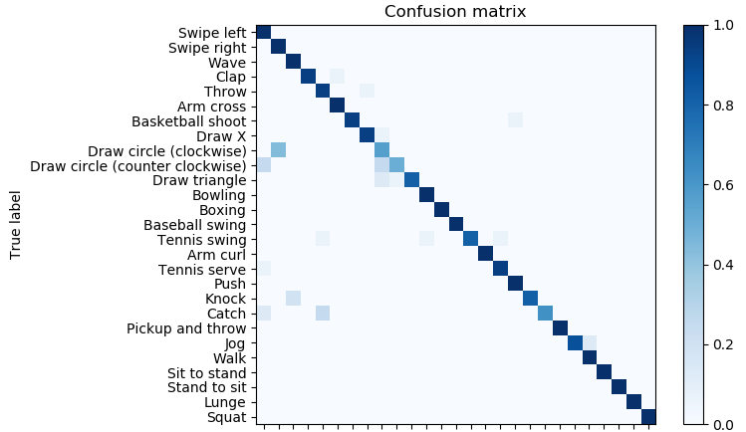
Final Model on Inertial + Skeletal
Majority Voting Ensemble
KNN + Logistic Regression + SVM + RF + ET
Accuracy | Precision | Recall | F1 Measure
91.4% | 0.9% | 91.4% | 0.9%

Slide 12
Future Improvements
Explore other signal processing methods for feature extraction
Try out other statistical or aggregation features during the flattening phase: Signal Magnitude Area, Interquartile range, Entropy, Correlation between signals, Index of frequency component with largest magnitude, Weighted average of frequency components, Skewness, Kurtosis, Energy etc…
Experiment with different number of temporal frames
Try out other dimensionality reduction methodologies: High Correlation filters, Low Variance filters, t-SNE, UMAP
Better tune machine learning models
Apply more complex ensembling methods like stacking
Incorporate Depth or Video data

Slide 13
Thank you! Questions?

