Slide 1

Automatic Performance Tuning of SpMV on GPGPU
Xianyi Zhang
Lab of Parallel Computing
Institute of Software Chinese Academy of Sciences
zxy@mail.rdcps.ac.cn

Slide 2

Outline
Motivation
SpMV Introduction
AMD Stream Computing
GOSpMV Overview
GOSpMV Performance Evaluation
Conclusion & Future Work

Slide 3
Motivation
Sparse Matrix-Vector Multiplication (SpMV) y=y+Ax
  The important kernel in scientific applications
    PDE solver, simulation, etc.
  Low performance
    Irregular memory access pattern

Slide 4
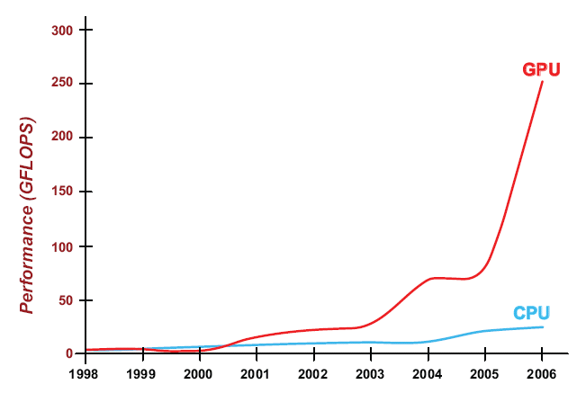
Motivation
GPU
  Huge computation power
Jason Yang, James Goodman. Symmetric Key Cryptography on Modern Graphics Hardware. http://ati.amd.com/technology/streamcomputing/asiacrypt2007.pdf
Notes:
So, we need to leverage GPU to accelerate SpMV.

Slide 5
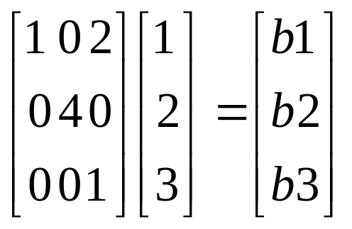
SpMV Introduction
CSR (Compressed Sparse Row)
A_val=[1,2,4,1]
A_col=[0,2,1,2] A_ptr=[0,2,3,4]
for(i = 0; i < n ; i++)
{ value = 0;
for(j = A_ptr[i]; j < A_ptr[i+1] ; j++)
value = value + A_val[j]*x[A_col[j]];
y[i] += value;
}
x is accessed irregularly
x is accessed indirectly

Slide 6
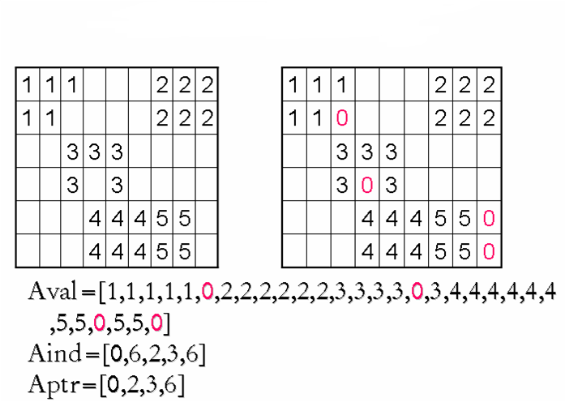
SpMV Introduction
BCSR (Block Compressed Sparse Row)
  BCSR 2 × 3

Slide 7
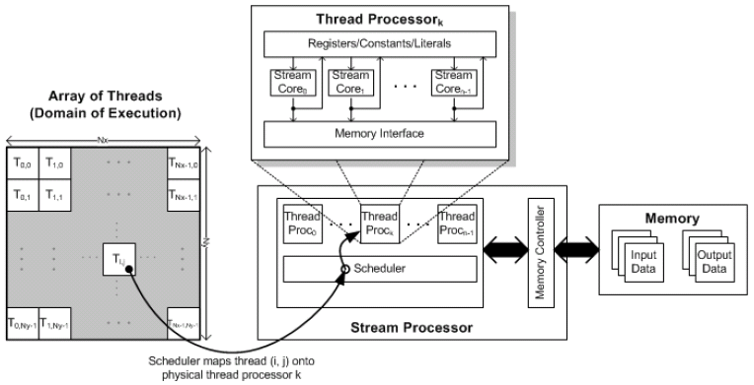
AMD Stream Computing
Programming Model
AMD Stream Computing User Guide

Slide 8
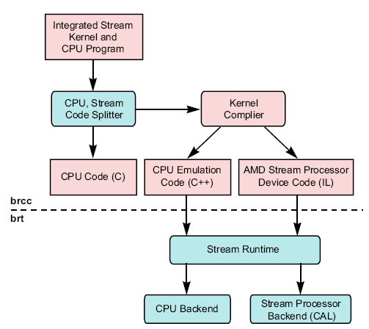
AMD Stream Computing
AMD Brook+
AMD Stream Computing User Guide

Slide 9
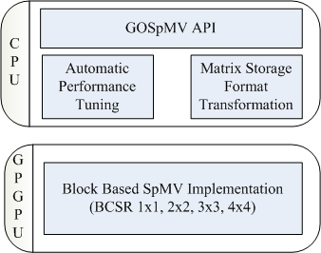
GOSpMV Overview
GOSpMV Software Architecture

Slide 10
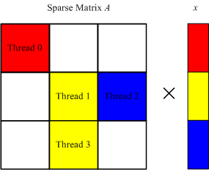
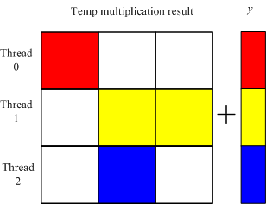
GOSpMV Overview
BCSR SpMV implementation on GPGPU
Notes:
This implementation can utilize the many processing units in GPU.

Slide 11
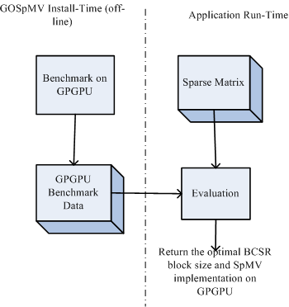
GOSpMV Overview
Automatic Performance Tuning

Slide 12
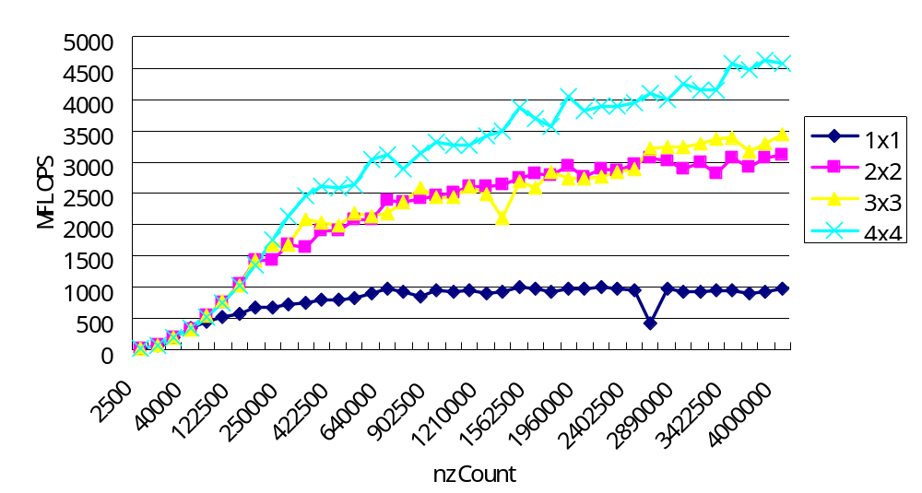
GOSpMV Overview
  Off-line GPGPU Benchmark
    Dense matrix (different size)
    Every BCSR block size
Notes:
In this part, we used dense matrix to test the performance of every BCRS block size implementation on different matrix size.

Slide 13
GOSpMV Overview
  Run-Time Evaluation(search optimal BCSR block size)
  Input: Sparse Matrix A, GPGPU Benchmark data P_{dense}(block-format, nz_{d})
  Output: the maximum P (A, block-format, σ), optimal BCSR block size
  For each BCSR r × c block,
  do
  calculate fill ratio f_{Erc}(A, σ) with sample rate σ
    P_{sp}(block-format, nz_{EBCSR})= P_{dense}(block-format, nz_{d}), nz_{d} is nearest to nz_{EBCSR}
    P (A, block-format, σ) = P (block-format, nz_{EBCSR})/ f_{Erc}(A, σ)
  done

Slide 14
GOSpMV Performance Evaluation
Test box
  Intel Pentium Dual Core E2160/1.8GHz, 2.0GB memory
  GPU
    AMD Radeon HD 3690 (RV670), theoretical peak:428.8 GigaFlOPS (single precision)
  AMD Stream SDK v1.1-beta
  Ubuntu 8.04, Linux 2.6.24, gcc 4.2.3
Test matrices
  8 sparse matrices, different size (small, medium, large)
    Small (nonzeros < 100,000)
    Medium (100,000 < nonzeros < 1,000,000)
    Large (nonzeros >= 1,000,000)
  Matrix Market and UF Sparse Matrix Collection .

Slide 15
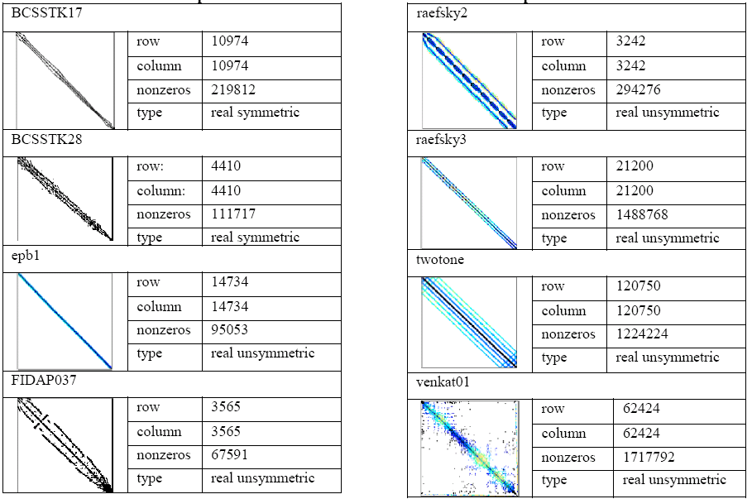
GOSpMV Performance Evaluation
Test matrices

Slide 16
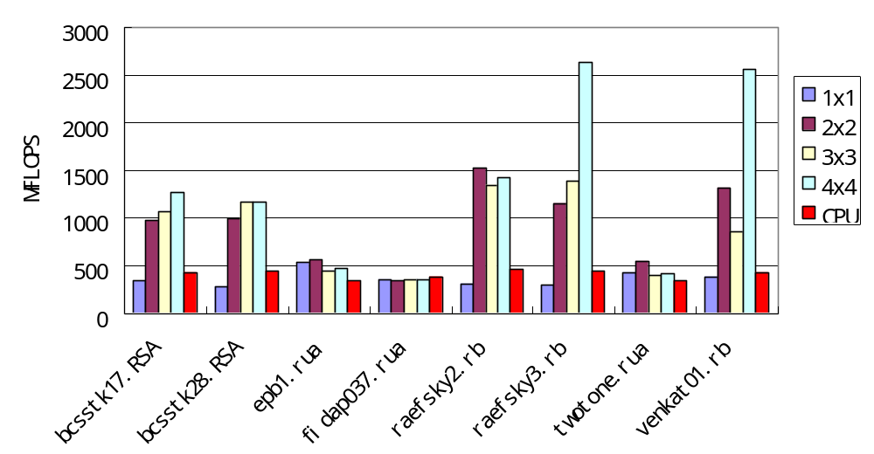
GOSpMV Performance Evaluation
AMD Radeon HD 3690 Result
  SpMV BCSR on GPGPU (1500 iterations)
Notes:
It’s suitable for large and regular sparse matrices.

Slide 17
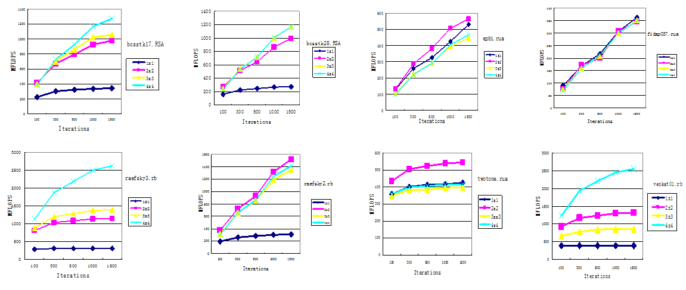
GOSpMV Performance Evaluation
  Different iterations (100,300,500,1000,1500)
Notes:
The reason is the cost used in kernel initialization and schedule on GPGPU can be amortized by more iteration number.

Slide 18
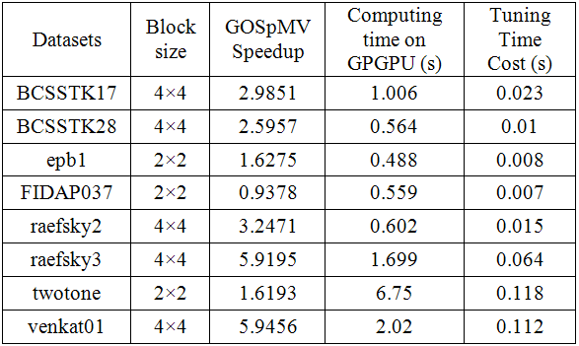
GOSpMV Performance Evaluation
  The automatic performance tuning (1500 iterations)
The average speedup: 3.11
Notes:
In general, it selects the optimal BCRS block size except rasfsky2.

Slide 19
Conclusion
GOSpMV Performance Speedup
  AMD Radeon HD 3690
    average: 3.11, max: 5.96, 1500 iterations
GOSpMV is suited for
  Medium matrices, Large matrices
  Iteration number>= 300
  Regular matrices (low fill ratio)
In general, GOSpMV selects the better BCSR block size by automatic performance tuning technology.

Slide 20
Future Work
Double precision
Support other BCSR block size (e.g. 8x8)
New HW (AMD RV770)
Automatic performance tuning strategy
  Re-ordering matrix

Slide 21
Thank you！
Ｑ＆Ａ

