Slide 1
EarthOnline
15302010002 胡弋舟
15302010022 麻俊特
14307110274 文进

Slide 2
CONTENTS
1
2
3
4
PART ONE
PART TWO
PART THREE
PART FOUR
Main Functions
What’s new?
Services
Framework

Slide 3
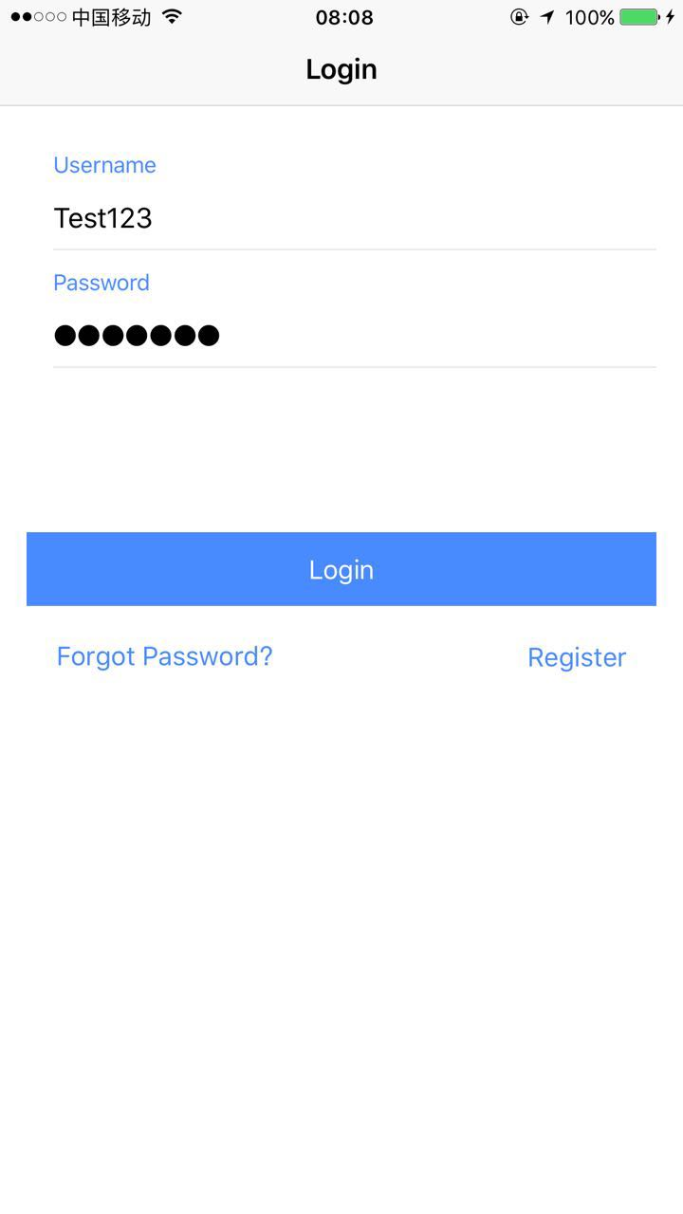
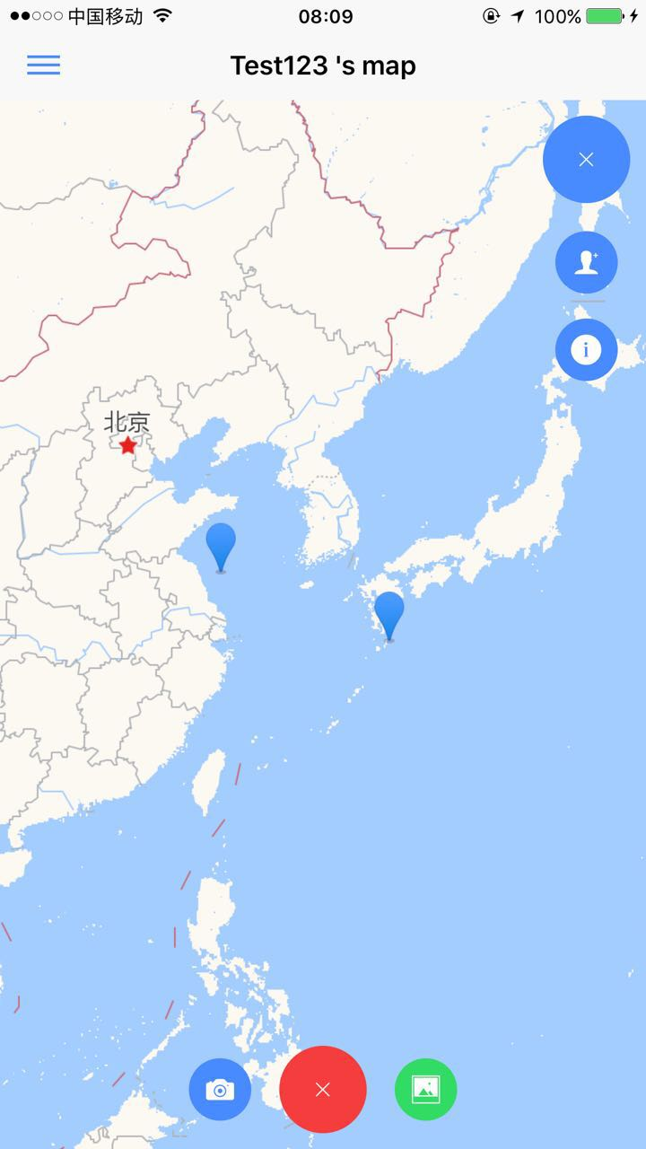
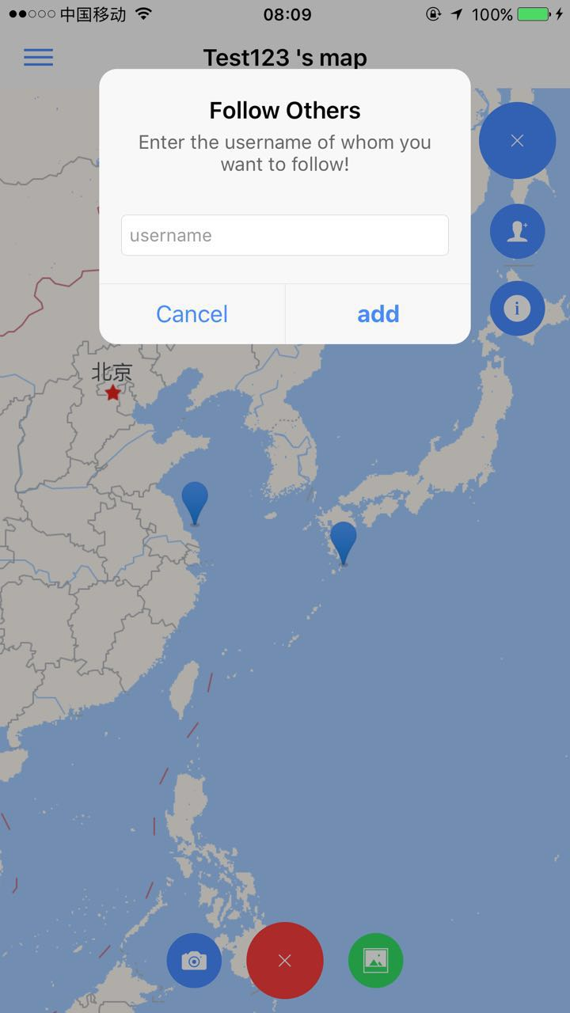
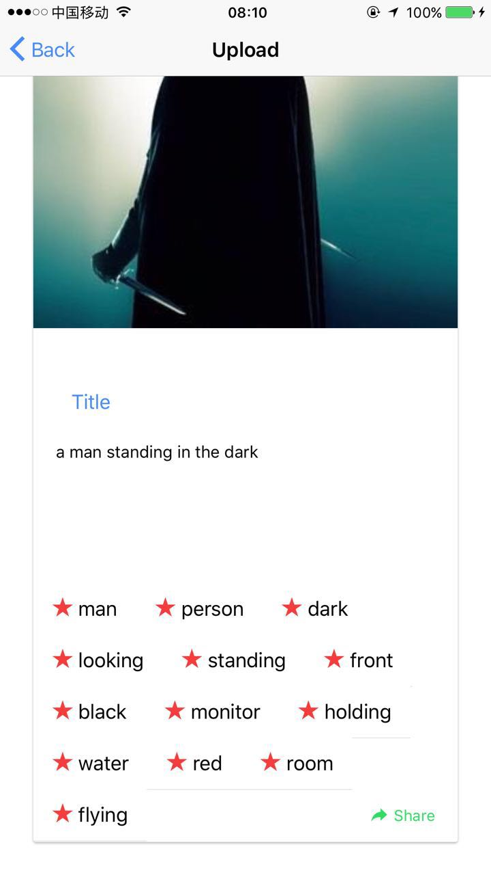
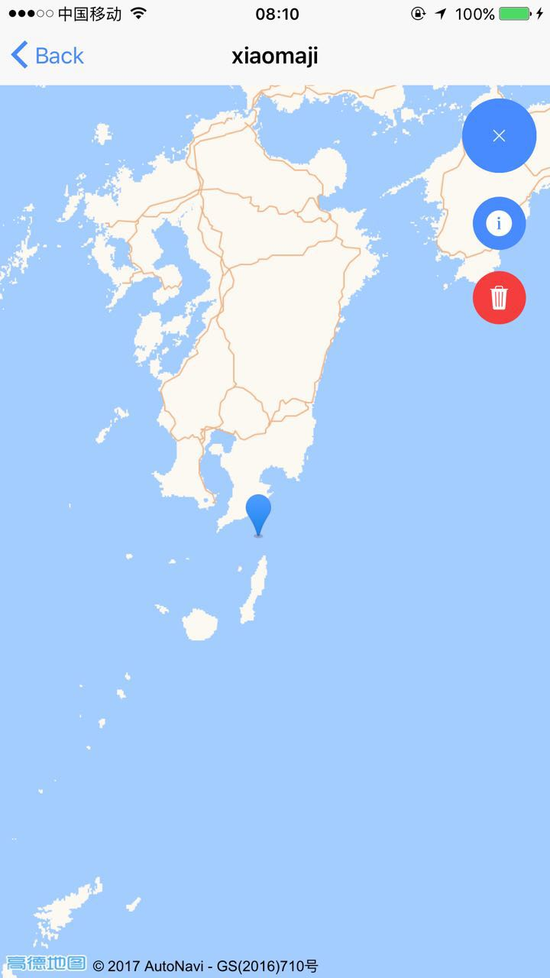
PART ONE
Target Users and Main Functions

Slide 4
PART TWO
What’s new?
lighter
Location-based
Automatic

Slide 5
Image Censor
Weather
PART THREE
Services
Image Recognition

Slide 6



PART Four
Framework

Slide 7
THANK YOU
FOR WATCHING

