Slide 1


TEAM O Reading Hub
Asuquo Effiong Glory (2361383E)
Xianyu Zhang (2237786Z)
Wu Haotian (2371139W)
Xu Cheng (2415791X)

Slide 2
REQUIREMENT MoSCoW
User must be able to create account.
User must be able to log in and out of their account.
User should be able to recommend books
User should be able to review books, comments and likes
User must be able to join events
User could be able to view the location of the event on google map
User chould be able to see list of recommended book by categories
User should be able to view details of book (name, likes, description, ratings etc.)
Users should be able to like books

Slide 3
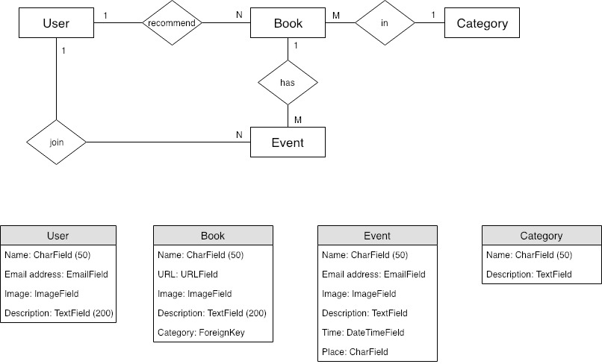
ER DIGRAM

Slide 4
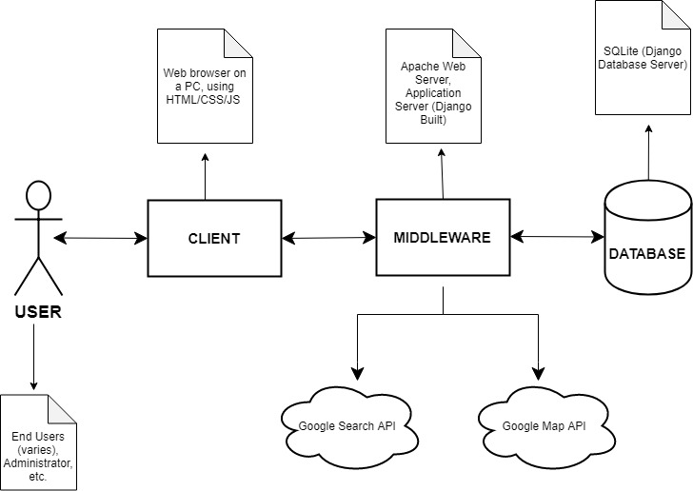
SYSTEM ARCHITECTURE DIAGRAM

Slide 5
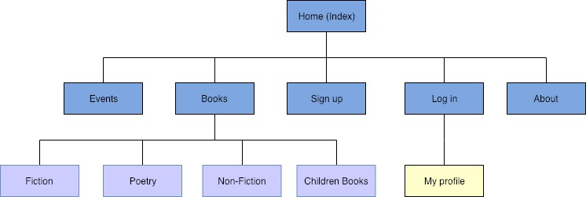
SITE URLs
/home
/about
/books
- /books/fiction
- /books/non-fiction
- /books/poetry
- /Books/ChildrenBook
/events
/signUp
/login
- /login/Profile

Slide 6
Technologies
Django
CSS
JS
AJAX
PYTHON
BOOTSTRAP
HTML

Slide 7
Development Challenges
Understanding and Working with bootstrap 4 elements
Creating dynamic pages with CSS.
Pulling and Pushing from origin master

Slide 8
FUTURE DEVELOPMENT
Display the comments and reviews of users on a book
Search engine to search for books and events
Share events by adding social icons and links to their association.
Display list of suggested books by users in their profiles.

Slide 9
Acknowledgement
As a team we have worked together tirelessly and relentlessly to accomplish this project and are therefore grateful to our lecturer Dr Gerardo Aragon-Camara for the journey through Django!
THANK YOU!!!!

