Slide 1
Simulation-Based Cryptographic Security in a Quantum Era
--- with the example of quantum zero-knowledge
Xiao Liang (梁宵)
Department of Computer Science and Engineering
The Chinese University of Hong Kong
July 21, 2025

Slide 2



Quantum Threats to Cryptography
Modern Cryptography follows a “reduction paradigm”
In threat of Quantum Computing
Cryptography Reduction
(cryptographers’ daily work)
Encryption algorithm
Hard Math Problems:
Factoring
Discrete log
RSA
Diffie-Hellman
Built into
break
solve
Replace them with Quantum-hard problems (e.g., LWE, Isogeny)
Warning: not the end of the story!
the reduction step itself!!!
Typical examples: zero-knowledge, secure multiparty computation, etc

Slide 3


Definition of Zero-Knowledge Proofs (1/2)
Definition for ZK proofs
Interactive Proof system
complexity class IP (=PSPACE)
- NP language L
- x ∈ L and w is the witness for x
Completeness:
if x is true, V accepts.
Soundness:
if x is false, V must reject, regardless of P’s behavior.
question
answer
…
Prover (P)
question
Verifier (V)
(x, w)
answer
x
Zero-Knowledge:
V learns nothing from P’s proof (except for x is true).
accept or reject
How to formalize it???

Slide 4


Definition of ZK (2/2)
Simulation Paradigm
Real:
question
answer
…
P(x,w)
V*(x)
V*’s outputs in both worlds are “the same.”
Simulated:
…
…
…
Real-world execution is ZK
State cloning through a quantum lens
???
???
…
S’s advantage over P?
rewind V*(x)
(倒帶、回溯、“悔棋”)
V*(x)
Simulator S(x)

Slide 5

Classical ZK for Graph 3-Coloring (G3C)
L: the Graph 3-Coloring (G3C) problems (NP-Complete)
x: a graph
w: how to 3-color the graph x
Prover (P)
Verifier (V)
(x, w)
x
I want to check the picked edge
Pick an edge at random
Sure! Open it for you.
accept

Slide 6
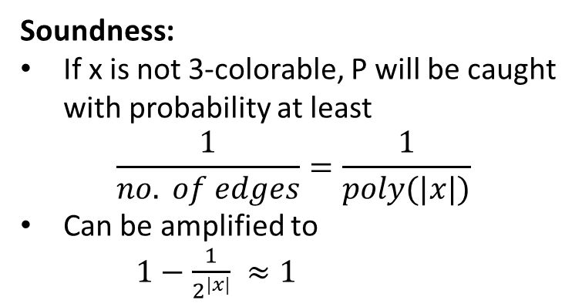
Classical ZK for G3C
L: the Graph 3-Coloring (G3C) problems (NP-Complete)
x: a graph
w: how to 3-color the graph x
Completeness:
obvious
Soundness:
If x is not 3-colorable, P will be caught with probability at least
$$\frac{1}{no. of edges}=\frac{1}{poly(|x|)}$$
Can be amplified to
$1−\frac{1}{2^{|x|}} ≈1$
Prover (P)
Verifier (V)
(x, w)
x
Pick an edge at random
Zero-Knowledge (Intuition):
V doesn’t see unopened vertices
The opened ones are just of random color
So, no new knowledge to learn

Slide 7
Classical ZK Simulator for G3C
L: the Graph 3-Coloring (G3C) problems (NP-Complete)
x: a graph
w: how to 3-color the graph x
*
*
x
*
x
Guess an edge that V will pick later.
Check this one
… …
If V picked the * : Open
Running time of Sim:
Will terminate in poly(|x|) times (in expectation)
Thus, the simulation is efficient.
Otherwise: Rewind!

Slide 8

Quantum Rewinding?
…
Does not work in the quantum setting due to the no-cloning theorem.
New quantum tools are required to address this issue
…
???
???
Watrous Quantum Rewinding Lemma [Wat06]:
The panacea in simulation-based quantum cryptography!
Then,
good
bad

Slide 9
Simulation using Watrous’ Lemma
good
bad
*
*
matches
Some garbage state
Sim succeeds
x
x
Guess an edge that V will pick later.
Check this one
If V picked the * : Open
Otherwise: Rewind!

Slide 10
Limits of Watrous (or general) Quantum Rewinding
Can we do parallel repetition?
Sealed graph
Sealed graph
Sealed graph
… …
open
open
open
Without repetition:
With n repetition:
Doesn’t prove ZK
But could there be a better lemma than Watrous?

Slide 11
Major Results on Quantum Rewinding
But could there be a better lemma than Watrous?
No!
[CCLY21] at FOCS, and [CCLL24]:
the previous parallel repetition is impossible, unless BQP = QMA
Major Possibility Results:
[CCY21] at CRYPTO:
constant-round PQ-ZK with epsilon-simulation
Concurrent work
[CCLY22] at CRYPTO:
constant-round PQ-ZK argument of knowledge with epsilon-simulation
Minimal assumption
Black-box construction (more efficient)
[LMS22] at FOCS:
constant-round PQ-ZK argument of knowledge with epsilon-simulation
Minimal assumption
But not black-box
1. This talk focuses only on ZK with “black-box” simulation. If non-black-box simulation is utilized, then the landscape of quantum ZK is different from what we described here.

Slide 12
Closing Remarks
Many interesting questions remain open:
Minimal exact round number?
Resettable soundness?
Concurrency?
…
Main take-away:
Quantum security for simulation-based cryptography is highly non-trivial
Significant progress on quantum ZK (as well as secure multi-party computation) in recent years
Still, enough open questions to investigate
One of the most important open question: concurrent QZK
Any non-trivial results (possibility/impossibility) are highly appreciated

Slide 13
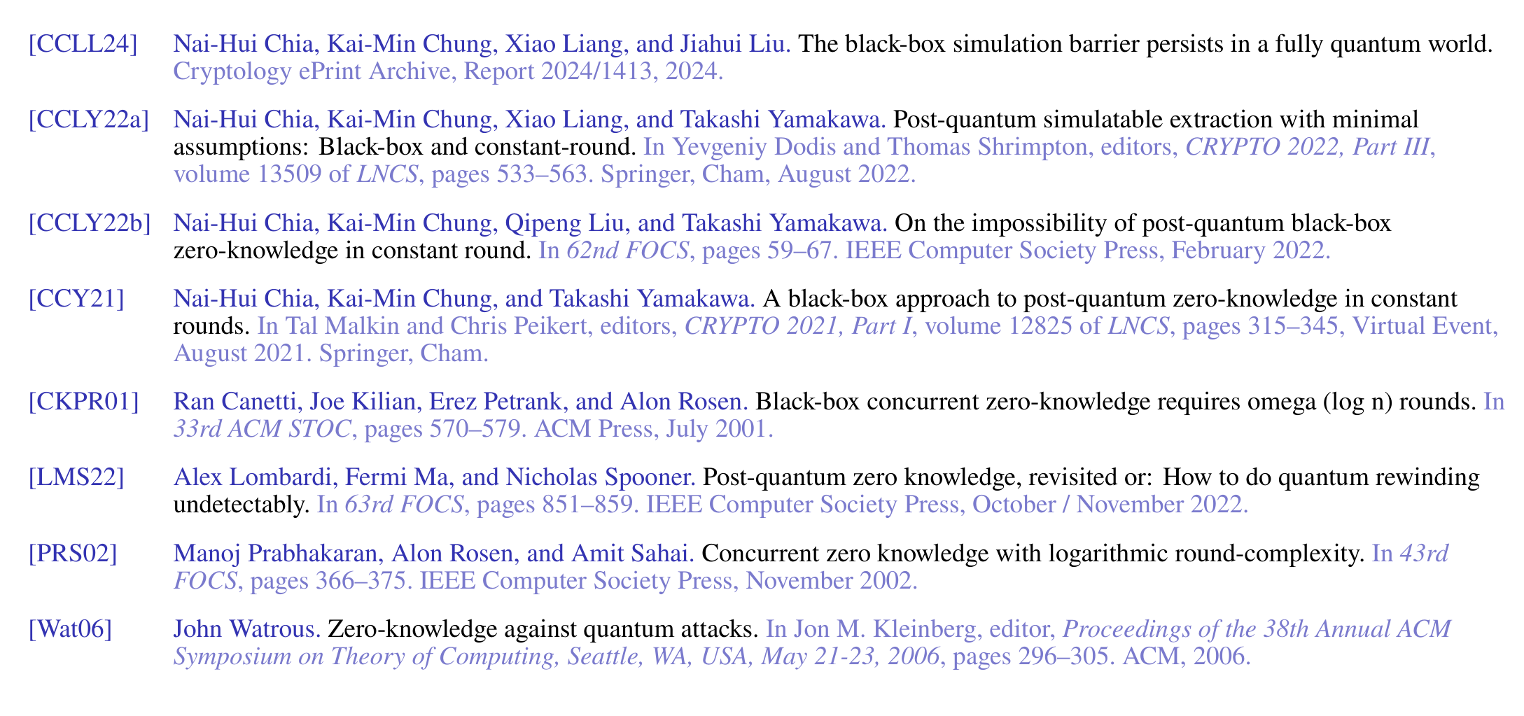
Reference

Slide 14
Sequential Repetition to Reduce Soundness Error
Sealed graph
Soundness Amplification:
Repeat n times
Accept if all repetition accepts
a random edge
open
Sealed graph
a random edge
Does not affect ZK:
Perform Watrous rewinding session by session, top to bottom
open
Sealed graph
a random edge
However, large number of rounds!
open
Can we do parallel repetition?
NO. ZK does not hold!
… …
Sealed graph
Sealed graph
Sealed graph
Sealed graph
a random edge
… …
open
open
open
open

Slide 15
Limits of Watrous (or General) Quantum Rewinding
But could there be a better lemma than Watrous?
No!
[CCLY21] at FOCS:
Constant-round post-quantum ZK is impossible unless
Post-Quantum:
Honest parties are classical
Adversaries could be quantum
[CCLL24]:
Constant-round fully-quantum ZK is impossible unless BQP ≠ QMA
Fully-Quantum:
All parties can be quantum
Stronger lower bound
(if established)
1. This talk focuses only on ZK with “black-box” simulation. If non-black-box simulation is utilized, then the landscape of quantum ZK is different from what we described here.

Slide 16
Major Results of QZK
[Wat06] at STOC:
initial feasibility, polynomial rounds
[CCLY21] at FOCS:
impossibility of constant rounds (post-quantum)
[CCLL24]:
impossibility of constant rounds (fully quantum)
[CCY21] at CRYPTO:
constant-round PQ-ZK with epsilon-simulation
Concurrent work
[CCLY22] at CRYPTO:
constant-round PQ-ZK argument of knowledge with epsilon-simulation
Minimal assumption
Black-box construction (more efficient)
[LMS22] at FOCS:
constant-round PQ-ZK argument of knowledge with epsilon-simulation
Minimal assumption

Slide 17
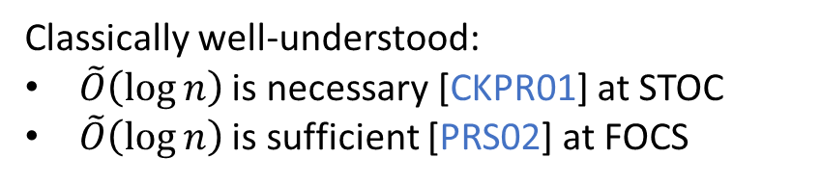
Major Open Questions
Many interesting questions to ask:
Minimal exact round number?
Resettable soundness?
Concurrency?
…
…
…
…
…
Round Complexity of concurrent epsilon-QZK?
Significant practical and theoretical value
…
Classically well-understood:
$\tilde{O}\left(\log{n}\right)$ is necessary [CKPR01] at STOC
$\tilde{O}\left(\log{n}\right)$ is sufficient [PRS02] at FOCS
Nothing is known in the quantum setting!
Can we replicate the classical results?
Can we obtain better impossibility?

