Slide 1
On the Quantum (Im)possibility of MPC
Xiao Liang
Department of Computer Science and Engineering
The Chinese University of Hong Kong

Slide 2
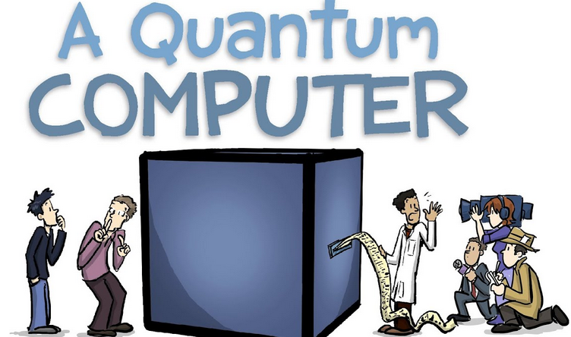
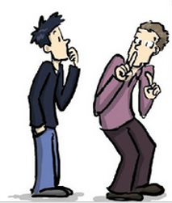


Quantum Is Coming!
OMG! Quantum hackers?!!!
Great news! Quantum algorithms, machine learning, programming languages…
Cryptographers
normal people

Slide 3
Main Theme:
The interaction between QC and MPC

Slide 4


Source of Change: No-Cloning (1/2)
universal* quantum algorithm
*Universal: it could “clone” any input quantum state.
Not an issue for simply primitives, e.g.:
One-way functions,
IND-CPA PKE
Exceptions: ROM-ish tools (PRFs, CRHFs, Fiat-Shamir, block-ciphers, …)
Problematic for interactive, simulation-based protocols, e.g.:
Zero-Knowledge
MPC

Slide 5



Source of Change: No-Cloning (2/2)
Real:
…
Sim’s advantage over P:
rewinding V*
called “black-box” simulation
P(x,w)
V*(x)
Simulated:
…
Non-black-box bypass?
Some hope
But no success yet
More discussion later
Against No-cloning!
???
???
…
V*(x)
Simulator S(x)

Slide 6
Agenda
Part I: Traditional MPC vs QC
Changes
Challenges
Opportunities
Landscape of MPC has been greatly changed by Quantum!
Part II: “Non-Traditional” MPC via QC
Spatiotemporal MPC
Intrusion-Detectable MPC (skipped due to time constraints)

Slide 7
Part I: Traditional MPC vs Quantum Computing

Slide 8
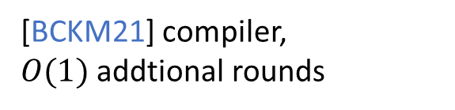
Proposal and Definition
Proposal of MPC [Yao82, Yao86, GMW87]
Post-Quantum MPC (~[VDG97])
Classical honest parties and their channels
Security against quantum adversaries
Classical functionalities only
[BCKM21] compiler,
$O(1)$ addtional rounds
Quantum
Classical
Fully-Quantum MPC (~[CGS02])
Quantum parties and channels
Quantum adversaries
Quantum functionalities
Notes:
[Yao82] proposed the Millionaire problem and solve it using a customized solution.
[Yao86] proposed the idea of garbled circuits and solved the general-purpose 2PC problem.
[CGS02] is IT MPQC with < 1/6 fraction of malicious parties.

Slide 9
Initial Feasibility Results
Semi-honest 2PC [Yao86]
Security proof appeared in [LinPin09]
Maliciously-secure 2PC [GMW87]
Maliciously-secure MPC [GMW87]
Semi-honest 2PQC [DNS10]
Maliciously-secure 2PQC [DNS12]
Maliciously-secure MPQC [DGJMS20]
Maliciously-secure PQ-MPC [ABGKM21]
Quantum
Classical
Notes:
Didn’t include IT MPC results. They need to satisfy certain conditions like honest majority etc.
[ABGKM21] is the first work to study PQ-MPC without trusted setup. No previous results for PQ-2PC (even with poly rounds) in the plain model. Despite the progress of MPQC.

Slide 10
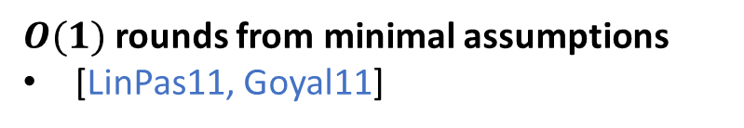
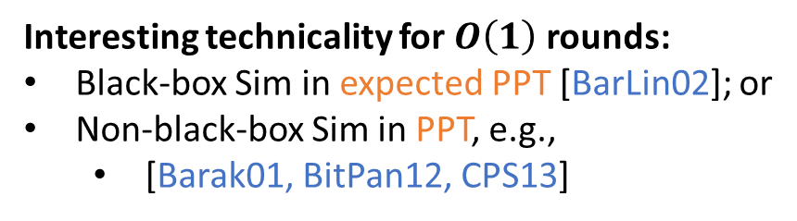
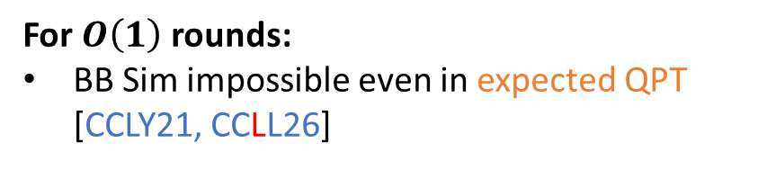
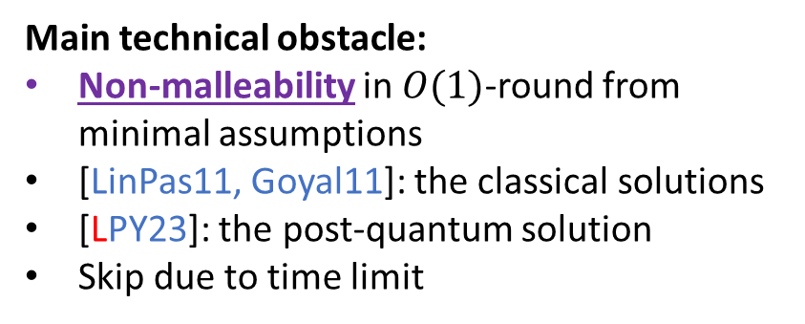
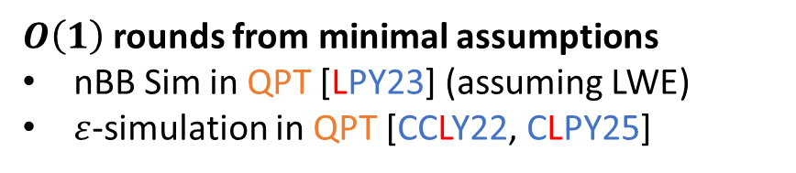
Asymptotic Optimality
$O(1)$ rounds from minimal assumptions
[LinPas11, Goyal11]
For $O\left(1\right)$ rounds:
BB Sim impossible even in expected QPT [CCLY21, CCLL26]
$O\left(1\right)$ rounds from minimal assumptions
nBB Sim in QPT [LPY23] (assuming LWE)
$ε$-simulation in QPT [CCLY22, CLPY25]
Interesting technicality for $O\left(1\right)$ rounds:
Black-box Sim in expected PPT [BarLin02]; or
Non-black-box Sim in PPT, e.g.,
[Barak01, BitPan12, CPS13]
Quantum
Classical
Main technical obstacle:
Non-malleability in $O(1)$-round from minimal assumptions
[LinPas11, Goyal11]: the classical solutions
[LPY23]: the post-quantum solution
Skip due to time limit

Slide 11
Rich Research Opportunities
Desirable properties and further optimizations for Quantum MPC:
Black-box constructions from minimal assumptions:
[CLPY25] for PQ-MPC
[open problems] for MPQC
Concrete efficiency [open problems]
Exact round complexity [open problems]
Composable security in the plain model:
Partial results [GLM23, GLPTY25]
[open problems]
…
…
Quantum
take a closer look
Why this one?
It touches upon the difficulty core of quantum rewinding techniques.

Slide 12

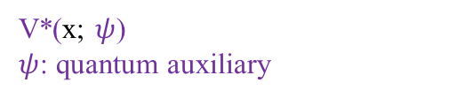
Peeking into Technical Challenges (1/4)
Watrous Lemma [Wat06]
If:
A Sigma Protocol:
Com
Then:
resp.
V*(x; $ψ$)
$ψ$: quantum auxiliary
Application to Simulating the Sigma protocol:
: guess V*’s challenge and simulate
Prove ZK against quantum V*?
Remark: HVZK is easy
: the guess is correct
: the guess is wrong
: the prob. of correct guess
Notes:
[Wat06]: the most important technique in quantum ZK/MPC

Slide 13
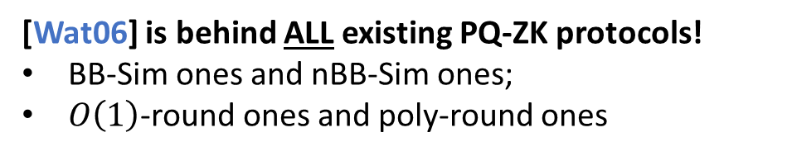
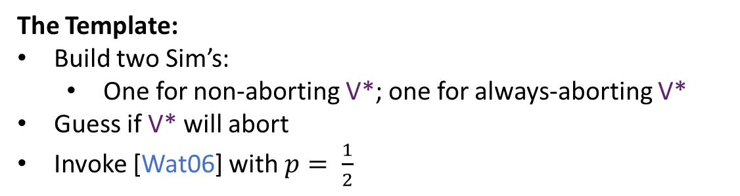

Peeking into Technical Challenges (2/4)
Watrous Lemma [Wat06]
If:
Then:
[Wat06] is behind ALL existing PQ-ZK protocols!
BB-Sim ones and nBB-Sim ones;
$O\left(1\right)$-round ones and poly-round ones
…
The Template:
Build two Sim’s:
One for non-aborting V*; one for always-aborting V*
Guess if V* will abort
Invoke [Wat06] with $p= \frac{1}{2}$
V*(x; $ψ$)
Most difficult

Slide 14


Peeking into Technical Challenges (3/4)
Watrous Lemma [Wat06]
If:
Then:
k parallel sessions
…
…
…
…
V*(x; $ψ$)
$2^{k}$ ways of aborting
: guessing V*’s aborting pattern correctly
(exponential simulation time)

Slide 15
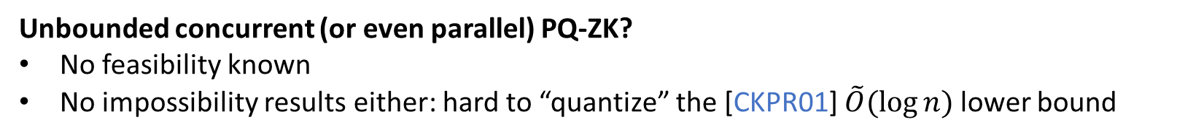

Peeking into Technical Challenges (4/4)
k parallel sessions
…
…
…
…
V*(x; $ψ$)
(exponential simulation time)
Partial results:
Known: Bounded-concurrent quantum ZK [ACL21] and quantum MPC [GLM23]
Impossibility: (unbounded) concurrent quantum MPC is impossible assuming PQ-OWFs [GLM23]
Open problem: bounded-concurrency in constant rounds? (I.e., quantum analogue of [Pas04])
Unbounded concurrent (or even parallel) PQ-ZK?
No feasibility known
No impossibility results either: hard to “quantize” the [CKPR01] $\tilde{O}(\log{n})$ lower bound

Slide 16
Part II: “Non-Traditional” MPC via Quantum Computing

Slide 17

Spatiotemporal MPC
User 1
Users at different locations
Different subscription prices
Different user statistics
…
New York
User 2
Aarhus
User 3
Hong Kong

Slide 18
Spatiotemporal MPC
User 1
Users at different locations
Different subscription price
Different user statistics
…
New York
Spatiotemporal MPC
Compute spacetime-dependent functionalities
ClosedAI is against “VPN” attack.
Users want data and location privacy!
User 2
Aarhus
Scenarios with similar difficulty:
Anonymous voting with different regional weights
Location-based AR multiplayer systems
VPN: Japan
In augmented reality games or collaborative AR, devices in the near-by physical area compute:
shared object placement
occlusion maps
local scene understanding
interaction synchronization
User 3
Hong Kong

Slide 19
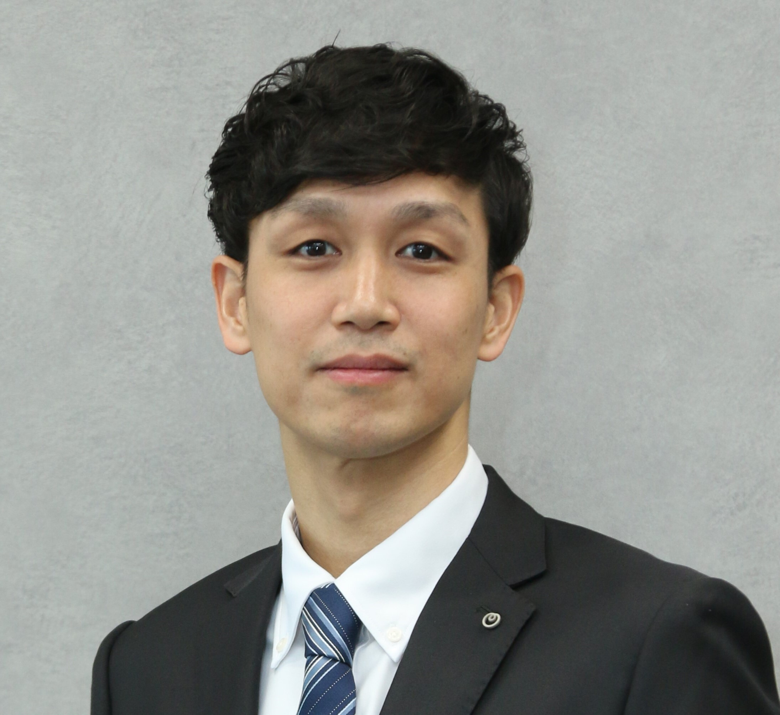
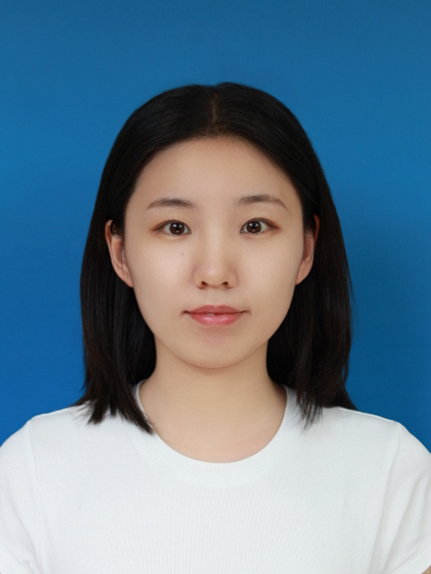
Spatiotemporal MPC
Two Immediate Questions:
How to define it?
How to build it?
Based on an on-going work with
Fuyuki Kitagawa
Distinguished Researcher
NTT Social Informatics Laboratories
Ziqing Guo
PhD Student
The Chinese University of Hong Kong

Slide 20

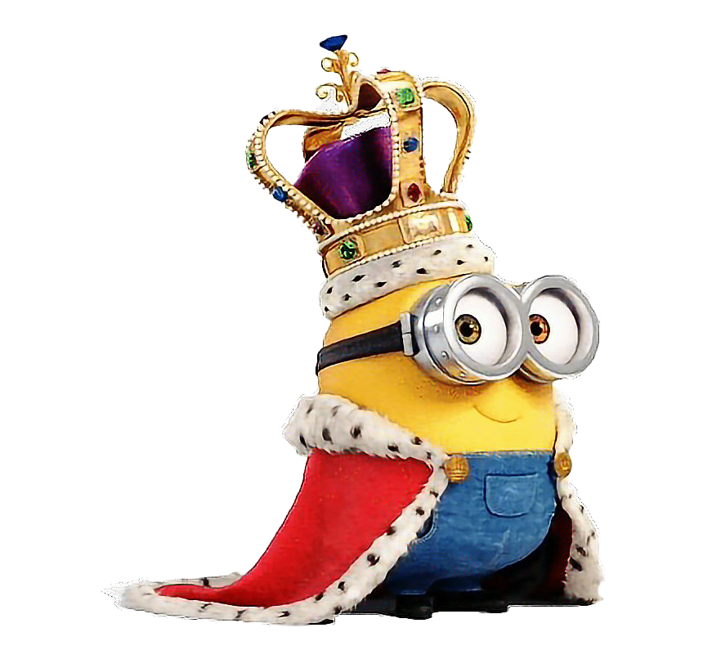
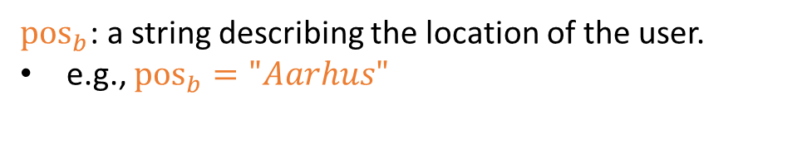
Spatiotemporal MPC: Definition (1/2)
Real world
Ideal world
${pos}_{b}$: a string describing the location of the user.
e.g., ${pos}_{b}="Aarhus"$
…

Slide 21


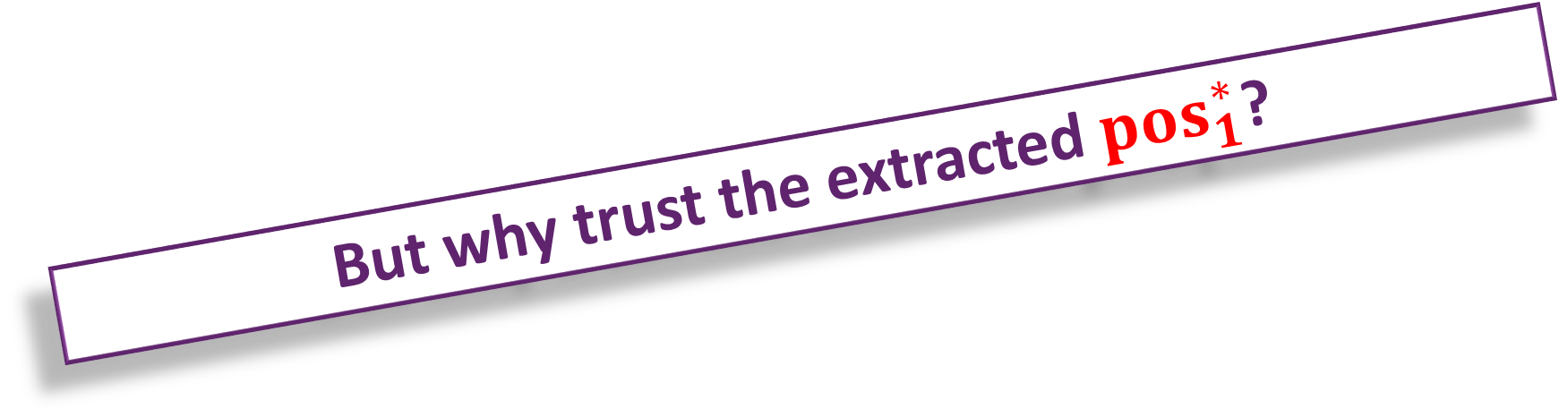
Spatiotemporal MPC: Definition (1/2)
Real world
Ideal world
${pos}_{b}$: a string describing the location of the user.
e.g., ${pos}_{b}="Aarhus"$
But why trust the extracted ${pos}_{1}^{∗}$?
…
…

Slide 22

Spatiotemporal MPC: Definition (2/2)
Solution:
I prove, therefore I am!
…
is in position ${pos}_{1}^{∗}$ iff it can prove that!
…
Use Quantum Position Verification for that!

Slide 23

Position Verification Protocols
Completeness:
V accepts if P is really in Aarhus
I’m in Aarhus
Soundness:
V rejects any P* who isn’t in Aarhus
…
Impossible unless we use quantum computing!
Prover (P)
Verifier (V)
Accept / reject

Slide 24
2D Position-Verification
Preprocessing:
: Computational encoding
: Hadamard encoding
On-line:
P
V
V
0
0.5
1
Aarhus

Slide 25
2D Position-Verification
V
V
0
0.3
0.5
1
Aarhus
Let c denote the speed of light
RHS Verifier waiting time:
Inconsistent!
In the honest case:

Slide 26
2D Position-Verification
V
V
0
0.5
1
Aarhus
Reduces to the previous single Adv case
There is no way to make both verifiers receive the k after exactly:

Slide 27
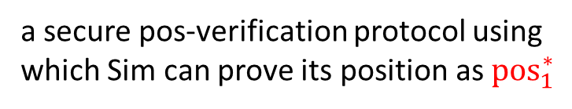
Spatiotemporal MPC: Definition (3/3)
Ideal world:
…
satisfies the following properties:
1.
2.
a secure pos-verification protocol using which Sim can prove its position as ${pos}_{1}^{∗}$
…
Notes:
Remark:
1 & 2 are related by the same Sim, and the extracted ${pos}_{1}^{∗}$ during simulation

Slide 28
Spatiotemporal MPC: Feasibilities
Theorem 1 (on-going work with Kitagawa and Guo):
LWE
MPC for spatiotemporal quantum functionalities
Theorem 2 (on-going work with Kitagawa and Guo):
MPC for spatiotemporal classical functionalities
two rounds
CRS model:
LWE
Conjecture (still working on that):
CRS model:
Sub-exponential LWE
MPC for spatiotemporal quantum functionalities
four rounds in total
two on-line rounds

Slide 29
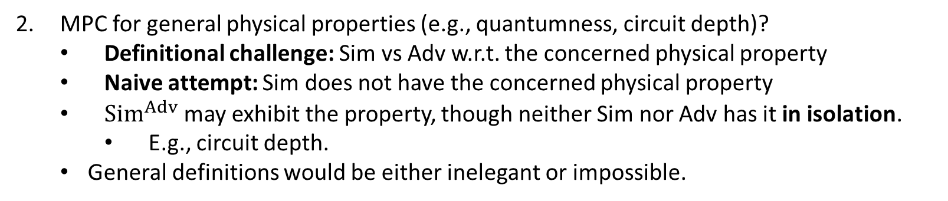
Spatiotemporal MPC: Future Directions
Standard MPC optimization questions:
Succinctness,
minimal assumptions (e.g., OT)
Black-box constructions
Composable security
…
MPC for general physical properties (e.g., quantumness, circuit depth)?
Definitional challenge: Sim vs Adv w.r.t. the concerned physical property
Naive attempt: Sim does not have the concerned physical property
${Sim}^{Adv}$ may exhibit the property, though neither Sim nor Adv has it in isolation.
E.g., circuit depth.
General definitions would be either inelegant or impossible.

Slide 30

Conclusion
It has been 40 years since the proposal of MPC [Yao86]
Interesting to see how Quantum Computing and MPC evolve together for the next 40 years!
Let’s work together to figure it out!
Notes:
Hope:
Sparked your interests; attracted you to this direction
suggested some interesting directions or topics for you

Slide 31
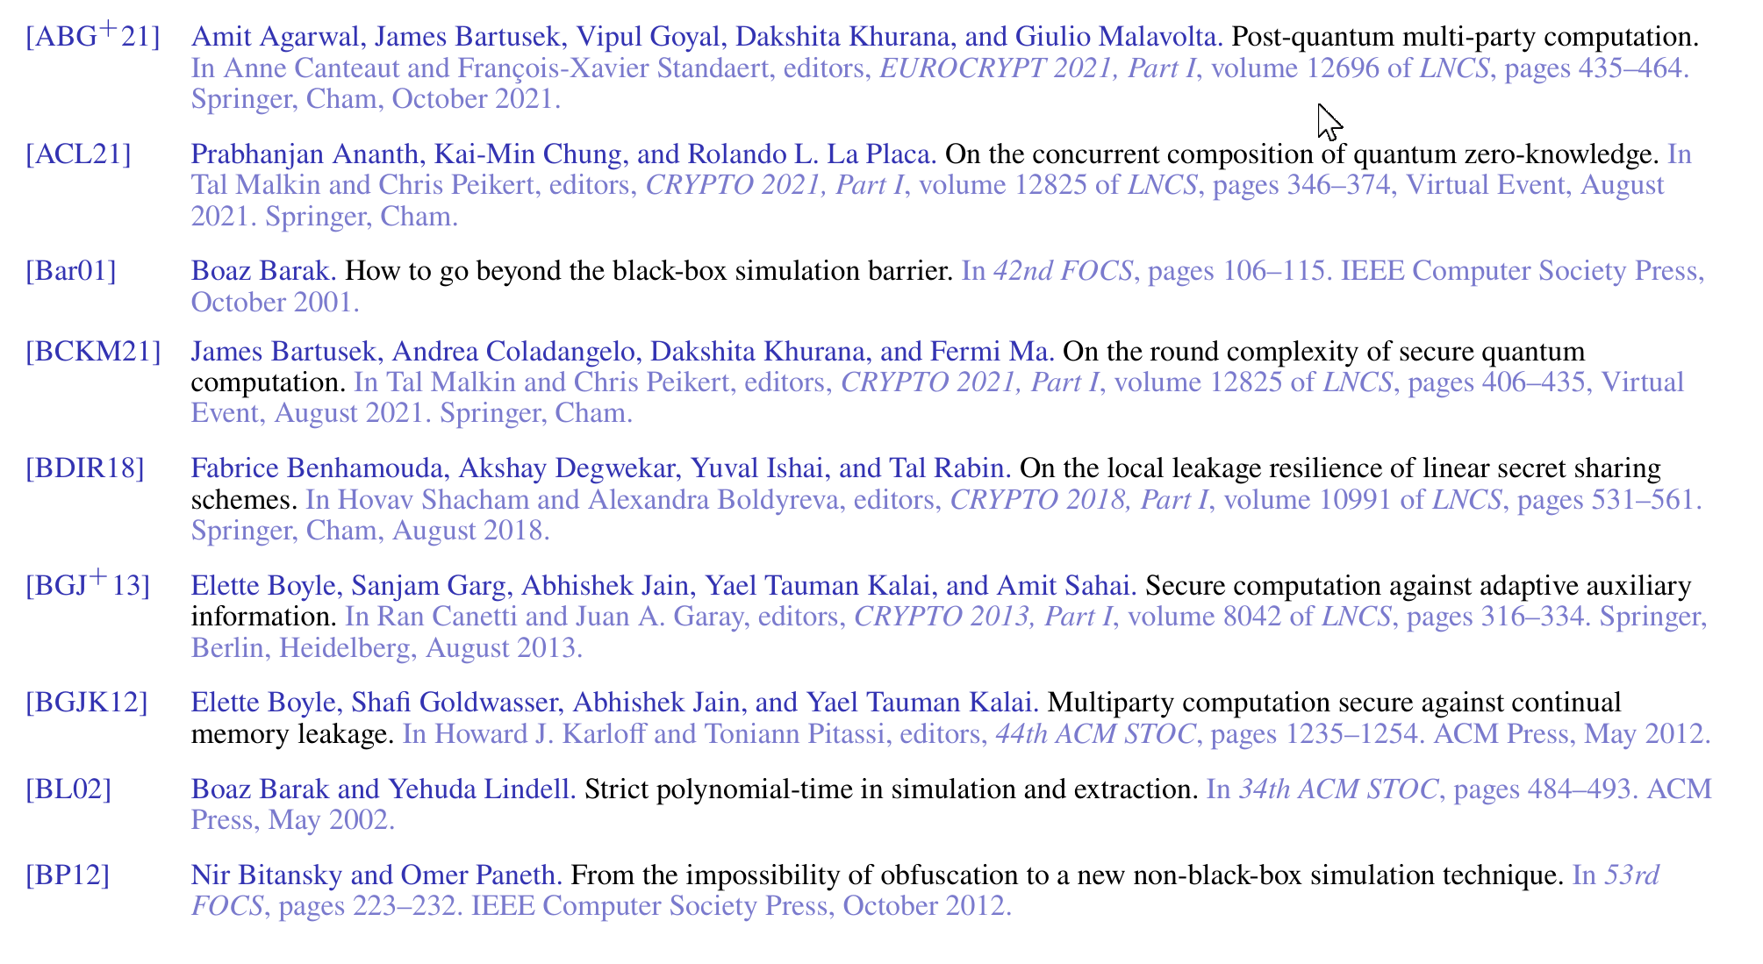
References (1/4)

Slide 32
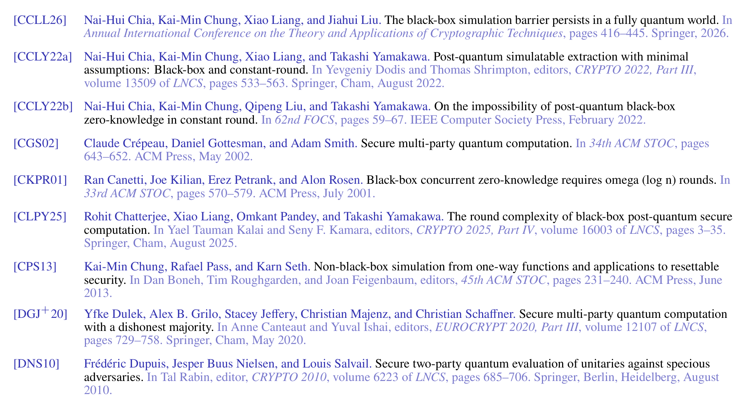
References (2/4)

Slide 33
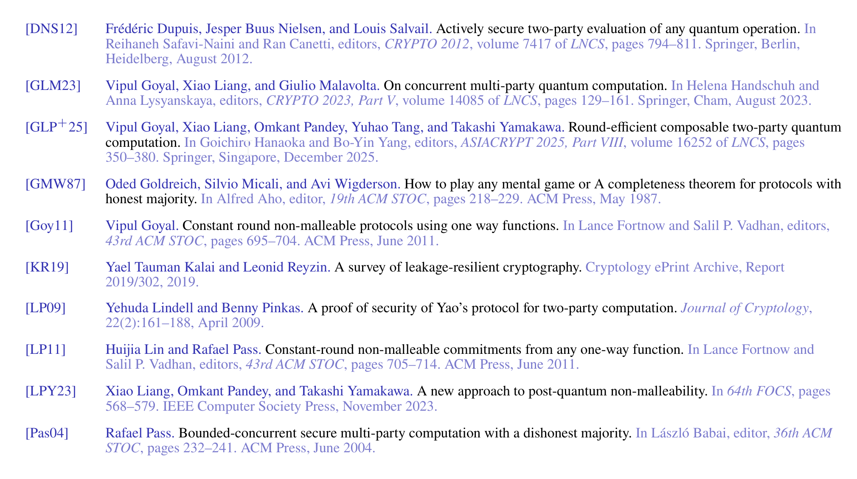
References (3/4)

Slide 34
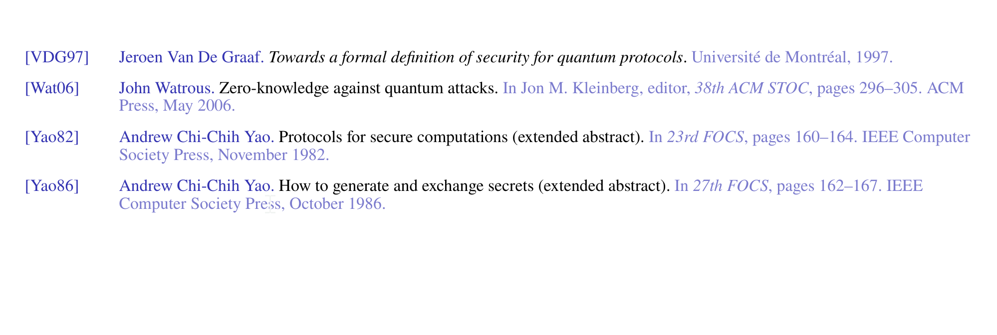
References (4/4)

Slide 35

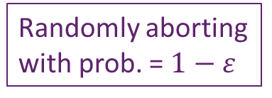
Quantum-Exclusive Lower Bounds (1/3)
[BarLin02] vs [CCLY21]: the main take-away
Example: Goldreich-Kahan Graph-3-Coloring ZK
Com to c
faked
simulated
Com to colored graph
Simulator S(x)
decom to c
decom to c
V*(x)
decom to c
Resp.
Resp. to c
Randomly aborting with prob. = $1−ε$
Running time of Expected PPT Sim:
Sim’s exact running time must depend on $ε$
Notes:
Warn: intuition and technical proof are very different.

Slide 36

Quantum-Exclusive Lower Bounds (2/3)
[BarLin02] vs [CCLY21]: the main idea
Sim’s exact running time must depend on $ε$
Quantum impossibility for expected QPT simulation
Real execution
Simulation
Contradiction!
The first two registers (V’s) are “pure”
V’s registers (S’s traced out) are “mixed”
Notes:
Warn: intuition and technical proof are very different.

Slide 37
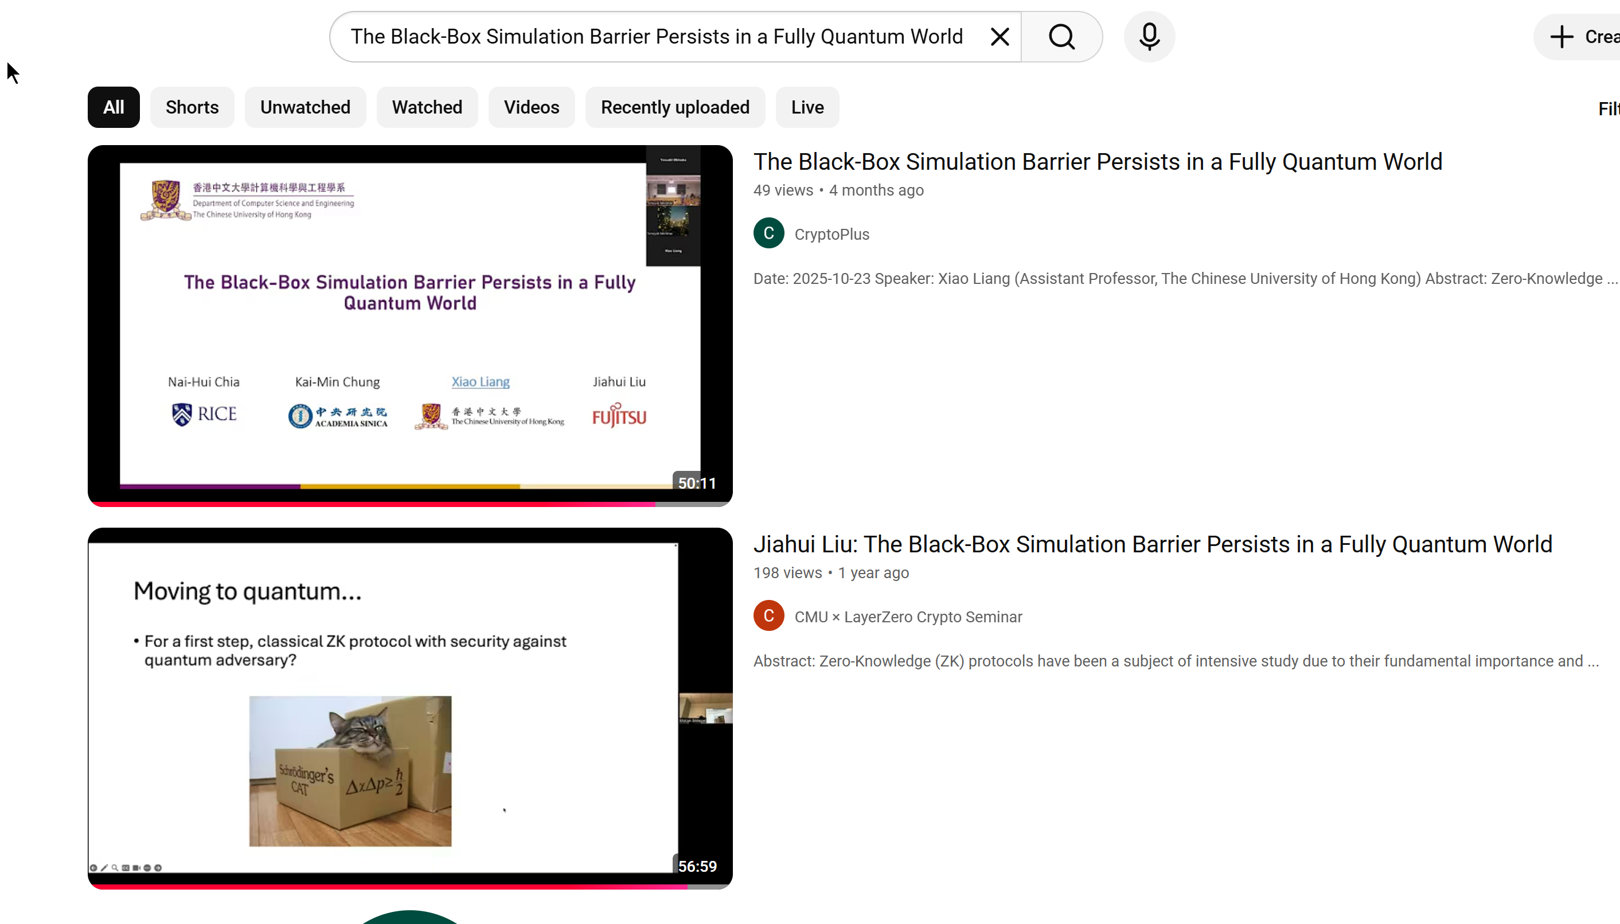

Quantum-Exclusive Lower Bounds (3/3)
Major Lower Bounds for ZK with BB Simulation
Paper | Setting | Num. of rounds | Assumptions
[BarLin02] | classical | O(1) rounds | NP ≠ BPP
[CCLY21] | post-quantum | O(1) rounds
[CCLL26] | fully-quantum | O(1) rounds | QMA ≠ BQP
More on techniques
More on background
Implications of [CCLL26]:
Explains why existing QZK (and MPQC) require either super-constant rounds or non-black-box simulation.
Clarify the non-existence of quantum advantage in QZK round complexity:
contrasting to QKD, OT, non-interactive commitments, interactive arguments.
Connect QZK to the “BQP vs QMA” problem
Quantum toolkit to handle the inherent random nature of quantum V* (deviating from [BarLin02, CCLY21]);
Notes:
[BarLin02] vs [CCLY21]: ruling out expected QPT
[CCLY21] vs [CCLL26]: a native quantum language dealing with the randomized nature of V*

