Slide 1




The Round Complexity of Black-Box Post-Quantum Secure Computation
Slides prepared by this guy, whose U.S. visa got rejected (again).
Rohit Chatterjee
National University of Singapore
Xiao Liang
The Chinese University of Hong Kong
Omkant Pandey
Stony Brook University
Takashi Yamakawa
NTT Social Informatic Laboratories

Slide 2
Secure (Quantum) Multi-Party Computation
MPC is important and ubiquitous:
A formal definition is redundant for Crypto audience
Only need to emphasize:
MPC security is simulation-based; security proofs typically involve rewinding.
Quantum computing puts new threats:
Rewinding-based techniques requires re-investigation due to the no-cloning theorem
Post-quantum (PQ) model (our main focus):
Honest parties (and their communication) are entirely classical
Adversaries can be quantum locally (i.e., still classical communication)
Challenging due to the asymmetric power favoring stronger (quantum) adversaries
PQ feasibilities typically extend to “fully-quantum” setting (e.g., [BCKM21])

Slide 3
Post-Quantum MPC: Desirable Features
Fundamental Aspects of MPC Constructions:
Round complexity
Minimal assumptions (semi-honest OT)
Black-box constructions
Communication complexity
Parties’ computational cost
…
Our focus
What are black-box Constructions?
Making I/O access to building blocks (e.g., OT, PRG, …)
Similar to the concept of API (application programming interface)
Why black-box Constructions?
Modular design
Often lead to better efficiency
Valid even if building blocks are physical objects (e.g., temper-proof hardware)
Traditionally, an important research them: [IKLP06, IKOS07, Hai08, IPS08, PW09, CDMW09, Wee10, Goy11, … ]

Slide 4
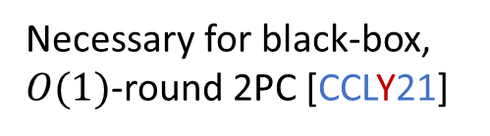
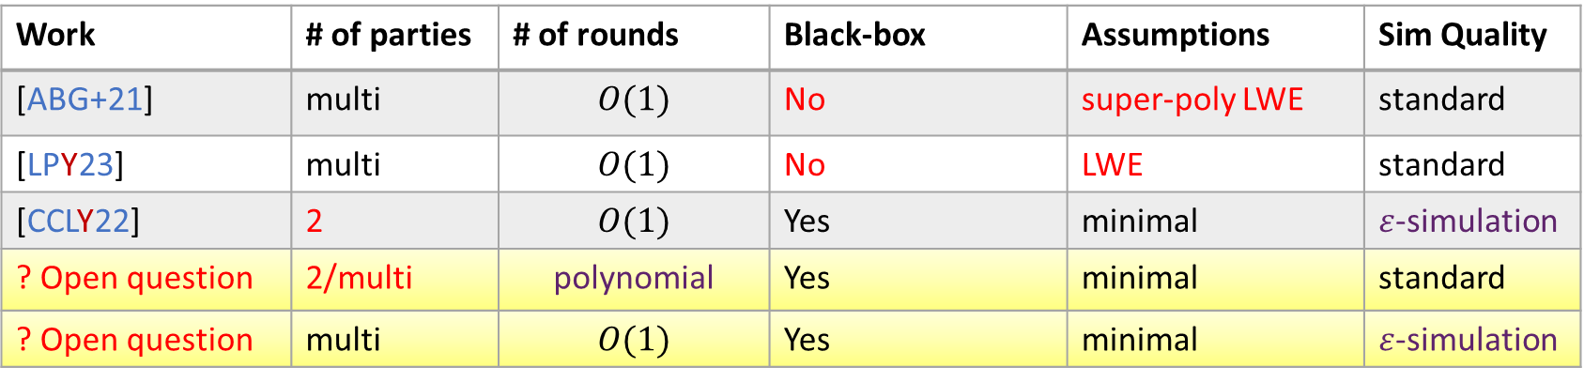
Post-Quantum MPC: State of the Art
Work | # of parties | # of rounds | Black-box | Assumptions | Sim Quality
[ABG+21] | multi | $$O(1)$$ | No | super-poly LWE | standard
[LPY23] | multi | $$O(1)$$ | No | LWE | standard
[CCLY22] | 2 | $$O(1)$$ | Yes | minimal | $ε$-simulation
? Open question | 2/multi | polynomial | Yes | minimal | standard
? Open question | multi | $$O(1)$$ | Yes | minimal | $ε$-simulation
Necessary for black-box, $O(1)$-round 2PC [CCLY21]

Slide 5
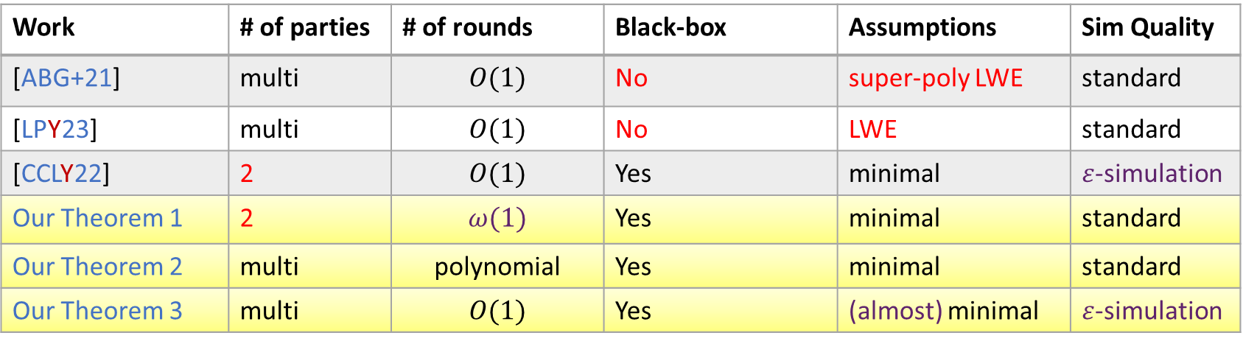
Our Results
Work | # of parties | # of rounds | Black-box | Assumptions | Sim Quality
[ABG+21] | multi | $$O(1)$$ | No | super-poly LWE | standard
[LPY23] | multi | $$O(1)$$ | No | LWE | standard
[CCLY22] | 2 | $$O(1)$$ | Yes | minimal | $ε$-simulation
Our Theorem 1 | 2 | $$ω(1)$$ | Yes | minimal | standard
Our Theorem 2 | multi | polynomial | Yes | minimal | standard
Our Theorem 3 | multi | $$O(1)$$ | Yes | (almost) minimal | $ε$-simulation
Necessary for black-box, $O(1)$-round 2PC [CCLY21]
(Post-quantum) lossy PKE, linearly homomorphic PKE, or dense cryptosystem
Matches the best in the classical setting
Full picture for the round complexity of black-box PQ-MPC!

Slide 6
Black-Box PQ-2PC from Minimal Assumptions
Classical
Post-Quantum
Semi-honest OT
Semi-honest PQ-OT
Option 1 (non-black-box):
ZKAoK (e.g., [GMW86])
Can we “quantize” it?
Option 2 (black-box):
Cut-and-choose based techniques (e.g., [HIK+11, CDMW09])
Malicious OT
Malicious PQ-OT
Black-box,
information-theoretic
(e.g., [Kilian88])
straightforward
MPC
PQ-MPC

Slide 7

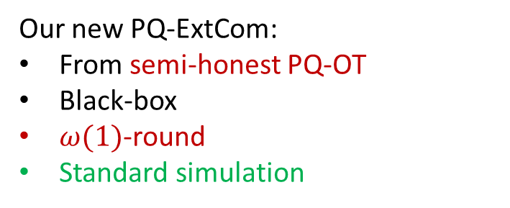
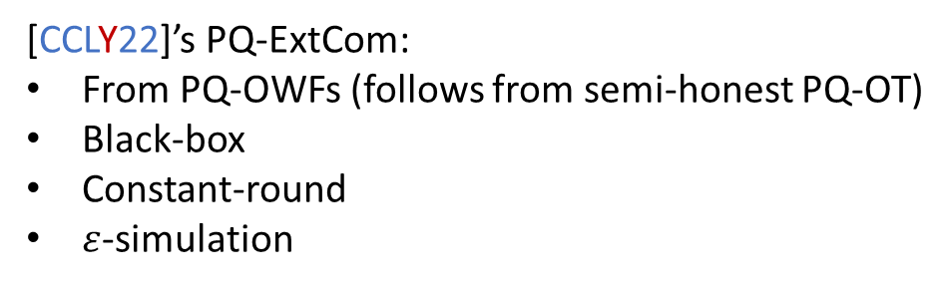
Final Step: Quantizing Black-Box OT Compiler
Semi-honest OT
Key component:
Post-quantum extractable commitment (PQ-ExtCom) in black-box
Option 2 (black-box):
Cut-and-choose based techniques (e.g., [HIK+11, CDMW09])
PQ-ExtCom: there exists a QPT Simulation-Extractor that can extract the committed message from a malicious committer, while simultaneously simulating the post-extraction state
Malicious OT
[CCLY22]’s PQ-ExtCom:
From PQ-OWFs (follows from semi-honest PQ-OT)
Black-box
Constant-round
$ε$-simulation
Our new PQ-ExtCom:
From semi-honest PQ-OT
Black-box
$ω(1)$-round
Standard simulation
Malicious PQ-OT with $ε$-simulation
Standard malicious PQ-OT

Slide 8
Further Application of Our Black-Box MPC
Recently active research topic “MicroCrypt”:
Roughly, cryptography when P=NP (i.e., even without OWFs)
Made possible by quantum computing
[KQT25]:
Relative to a classical oracle, it holds that P = NP, yet BQP-computable trapdoor functions exist!
Our fully-black-box MPC from semi-honest OT (thus trapdoor functions)
Corollary 1:
Relative to a classical oracle, it holds that P = NP, yet LOCC MPC exists!
Parties can perform quantum local computation, but communicate via classical channels only.

Slide 9
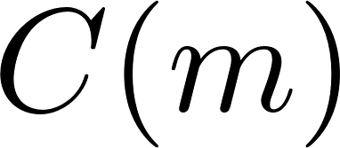


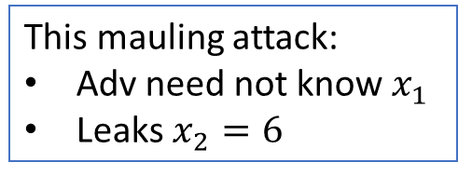

Black-Box PQ-MPC in Constant Rounds
Recall [CCLY22]:
Const.-round
Black-box
PQ-2PC
What we want:
Const.-round
Black-box
PQ-MPC
Shouldn’t this be easy?
NO!
Missing tool:
1-many non-malleability in const.-round
(Informal) Def. of Non-Malleable Com
Why necessary for MPC?
This mauling attack:
Adv need not know $x_{1}$
Leaks $x_{2}=6$
Session 0
Session 1
Adv
…
…
3PC for Sum
(effectively)
Learns:
Requirement: $m$ and $\tilde{m}$ are “independent”

Slide 10
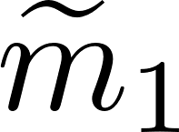
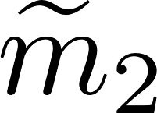
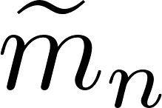
What We Really Need
1-Many Parallel Non-Malleable Com
Session 0
Session 1
Session 2
…
Session poly(n)
Adv
…
…
…
…
…
Requirement: $m$ and $({\tilde{m}}_{1},{\tilde{m}}_{2}, …,{\tilde{m}}_{n})$ are “independent”
(i.e., none of the right session can depend on the left session)
Why 1-Many Parallel NMCom for MPC?
There are multiple parties (and thus multiple sessions)
“1-many” implies “many-many”
No need for fully concurrency: channels are synchronous in typical MPC setting

Slide 11
Our Contribution
Main technical lemma:
Post-quantum 1-Many (weak) Parallel NMCom can be constructed in constant rounds, making black-box use of post-quantum OWFs.
Recall [CCLY22]:
Const.-round
Black-box
PQ-2PC
The first
Const.-round
Black-box
PQ-MPC
Our new PQ 1-many (weak) parallel NMCom

Slide 12
Further Application of Our 1-Many NMCom
[BQSY24]:
Assuming const.-round many-many (weak) parallel PQ-NMCom, parallel repetition does not always reduce the soundness error of PQ interactive arguments.
Our construction from PQ-OWFs
Corollary 2:
Assuming PQ-OWFs, parallel repetition does not always reduce the soundness error of PQ interactive arguments.
Matches the classical analog from [BIN97]
Assuming OWFs, parallel repetition does not always reduce the soundness error of (classical) interactive arguments.

Slide 13
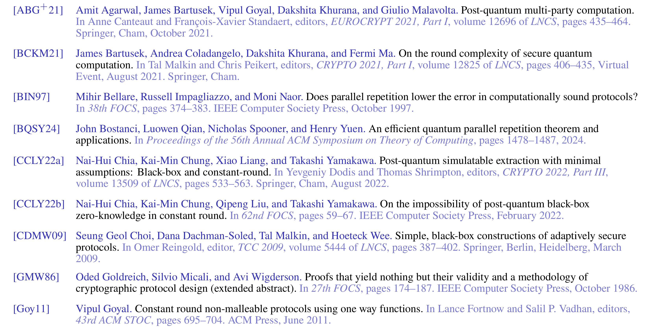
Reference (1/2)

Slide 14
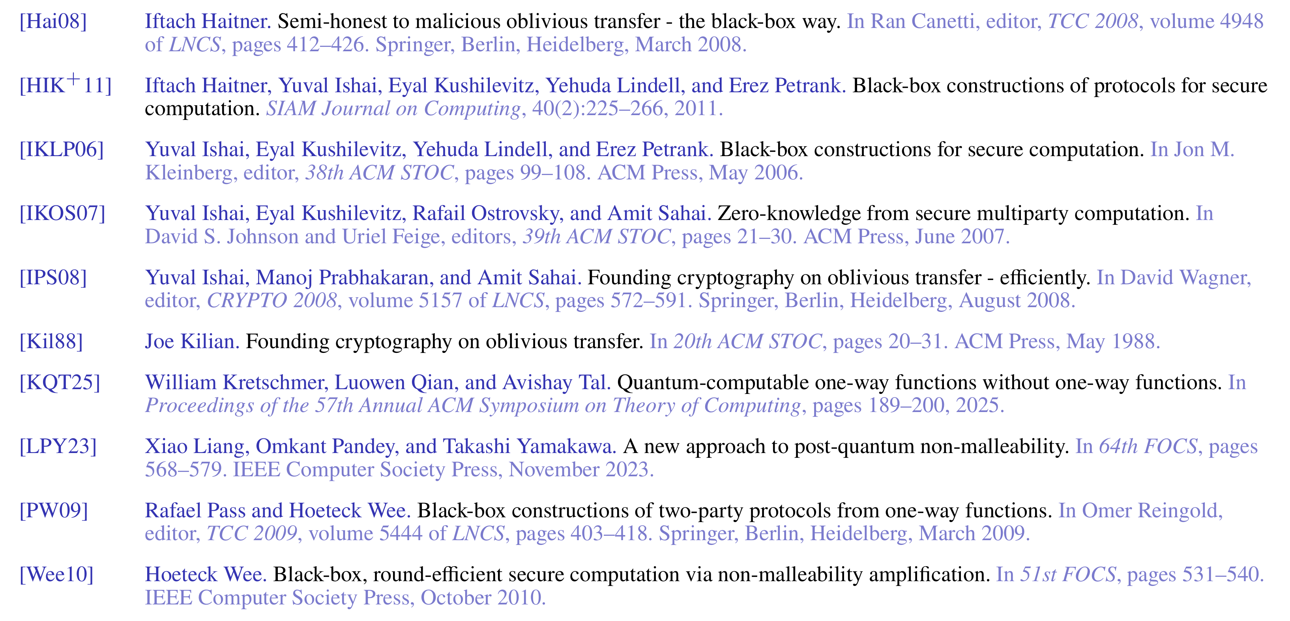
Reference (2/2)

